Slide 1
Video Games Rating vs. Platforms
Lien Ly – Final Project winter 2016

Slide 2
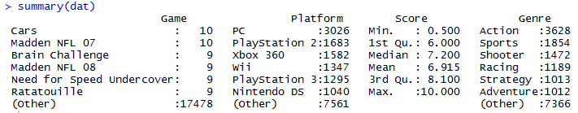
Data Source and Definitions explained
Source: IGN (Imagine Games Network)
Scrapping tool: http://schoolofdata.org/handbook/recipes/scraping-multiple-pages-with-refine-and-scraper/
Observations: 17,534

Slide 3
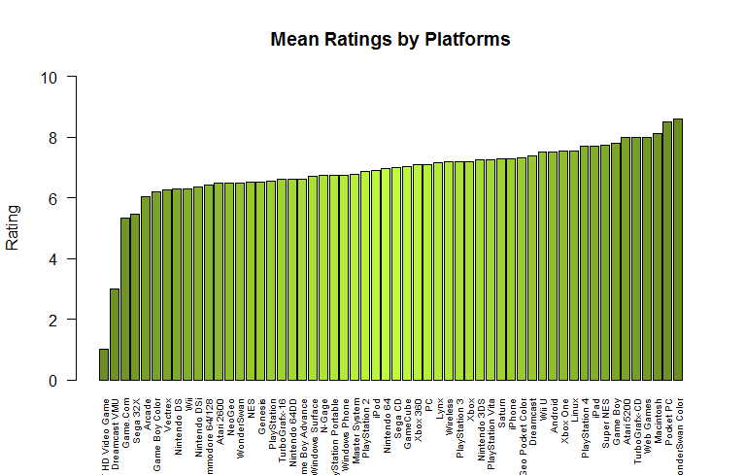
Data Source and Definitions explained

Slide 4
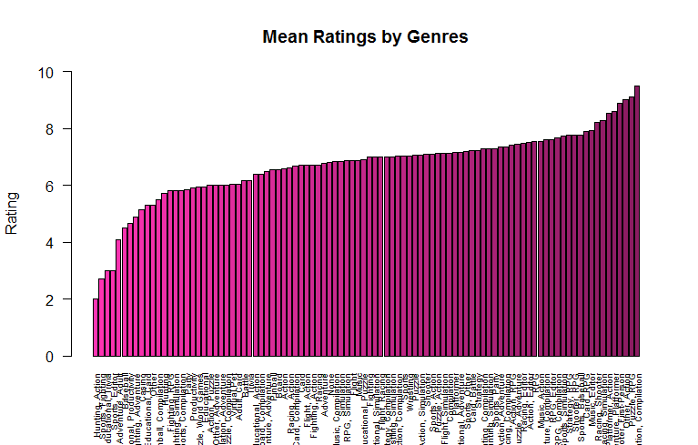
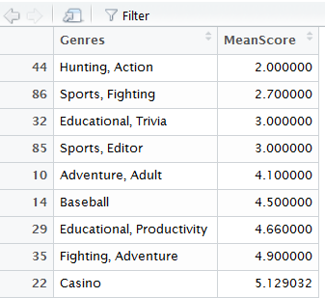
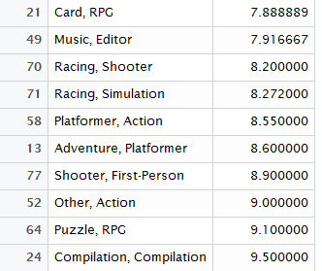
Data Source and Definitions explained

Slide 5
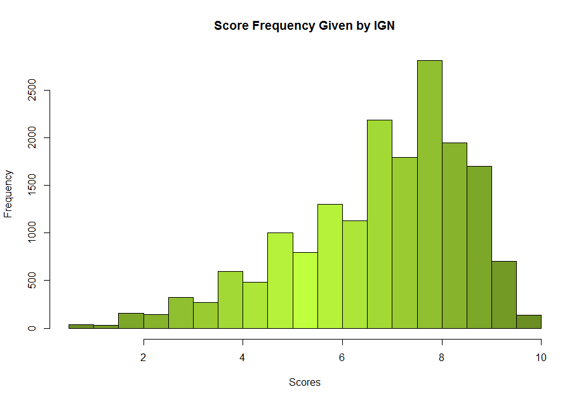
Data Source and Definitions explained

Slide 6
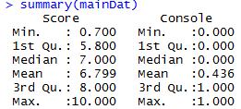
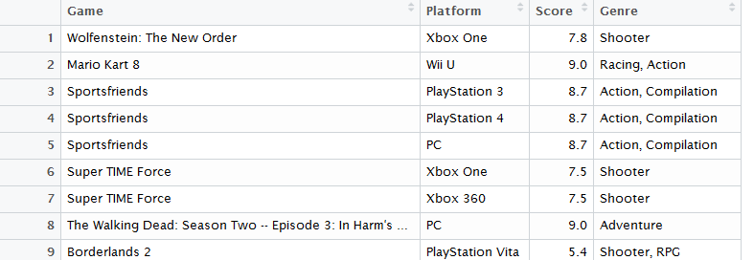
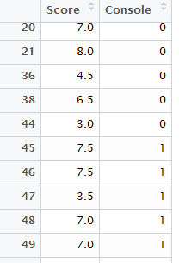
Main features of dataset and visualization
Goal
Original data

Slide 7
Main features of dataset
To get goal data:
- 56 different platforms, divide those platforms into two categories: “console” and “non-console”, where “console” is represented by 1, and “non-console” is represented by 0.
- Types of platforms:
Arcade
Audio
Console (home video games console)
Handheld (mobile, handheld console)
Online
PC
Ambiguous: “DVD/HD Video Game”, “Wireless”
Extract out cross platform games, remains exclusivity

Slide 8
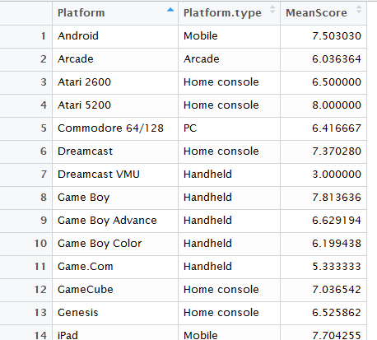
Main features of dataset
Manually categorize platforms:
Apply all procedures mentioned in previous slide
Observations: 8,646

Slide 9
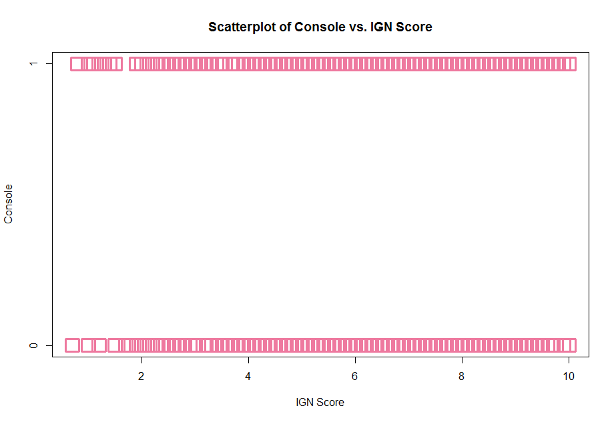
Main features visualization

Slide 10
Research questions
Develop a model that will provide the probability and odds of a game being a console game for any given IGN rating?
Approximately what rating is associated with a probability of 50% (the odds are even) for a game to be a console game?
Input rating of games whose platforms are unknown into the model to determine the probability and odds of the game being a console game. The game was also not included in the original dataset. Chosen game: Superhot (Rating: 7.5)
Determine how decreasing the rating from 7.5 to 6.5 would affect the probability and odds of the game being console game.

Slide 11
Method for addressing research question
Doesn’t make sense to have a fitted line
Use logistic regression to address research questions, because logistic regression allows us to:
Model the probability of an event occurring depending on the values of the independent variables (in this case IGN game ratings), which can be categorical or numerical (in our case it is numerical).
Estimate the probability that an event occurs for a randomly selected observation (that we want to predict) versus the probability that the event does not occur.
Predict the effect of a series of variables on a binary response variable. In our case, if we only have one independent variable IGN score, or more than one independent variables, and the one dependent variable that is binary (0 or 1).
Classify observations by estimating the probability that an observation is in a particular category (such as a game being console game, or non-console game).

Slide 12
Method for addressing research question
Reasons for not choosing other regression methods:
Simple linear regression is one quantitative variable predicting another (our Console variable is binary, not quantitative)
Multiple regression is simple linear regression with more independent variables
Non-linear regression is still two quantitative variables, but the data is curvilinear.
Problems if we run linear regression for these research questions:
Binary data does not have a normal distribution, which is a condition needed for most other types of regression (we can observe this through scatterplot above)
Predicted values of the dependent variables can be beyond 0 and 1 which violates the definition of probability

Slide 13
Data satisfaction of requirements of method demonstrated
Binary logistic regression requires the dependent variable to be binary. In our main dataset, the “console” data is binary. The game is either a console game (1), or non-console game (0).
Logistic regression assumes that P(Y=I) is the probability of the event occurring, our dependent variables are coded accordingly.
Logistic regression requires each observation to be independent. Our “Score” variables are scores of individual games, they are not related to one another, completely independent from one another.
Logistic regression assumes linearity of independent variables and log odds.
Logistic regression requires large sample size, our number of observations is 8,646.

Slide 14
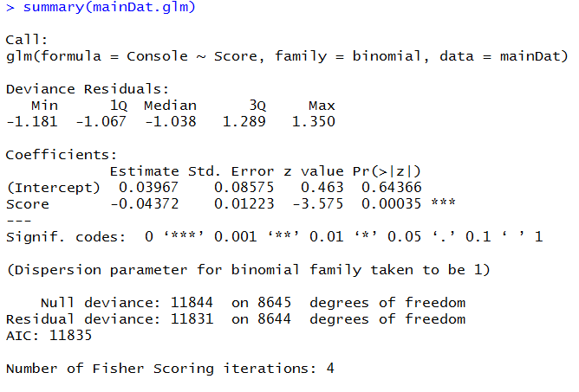
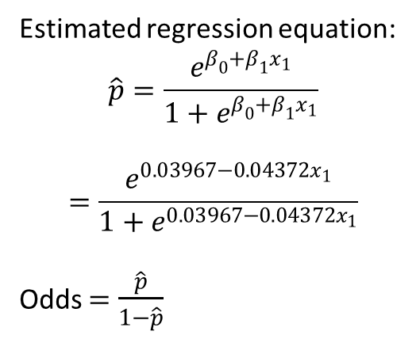
Method applied and interpretation: Logistic Regression
P-value is small -> Score does have an influence, or does help predict Console
Estimated regression equation:
$$\hat{p}=\frac{e^{β_{0}+β_{1}x_{1}}}{1+e^{β_{0}+β_{1}x_{1}}}$$
$$=\frac{e^{0.03967−0.04372x_{1}}}{1+e^{0.03967−0.04372x_{1}}}$$
Odds $=$ $\frac{\hat{p}}{1−\hat{p}}$

Slide 15
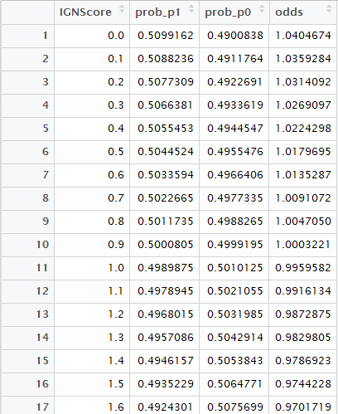

Method applied and interpretation: Logistic Regression
“Superhot” game with IGN rating of 7.5, based on the regression equation above we got the probability of Superhot being a console game is
$\hat{p}=\frac{e^{0.03967−0.04372(7.5)}}{1+e^{0.03967−0.04372(7.5)}}=0.4284$ or 42.84%. Turns out, this game is
Scores are at around 0.9 to 1.0, the odds of a score being a console game or non-console game is even, in other words, the probability of a score being a console game or non-console game is roughly 50%.

Slide 16
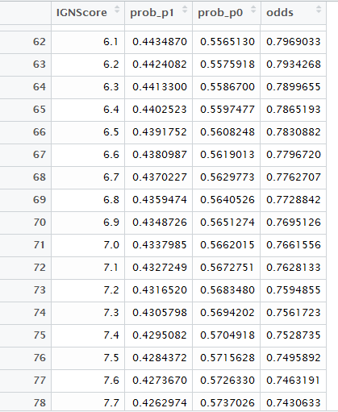
Method applied and interpretation: Logistic Regression
The odds of getting 7.5 is 0.7496, odds of getting 6.5 is 0.7831. Hence, decreasing the rating from 7.5 to 6.5 will increase the odds of being a console game by (0.7831 – 0.7496)*100 = 3.35%.

Slide 17
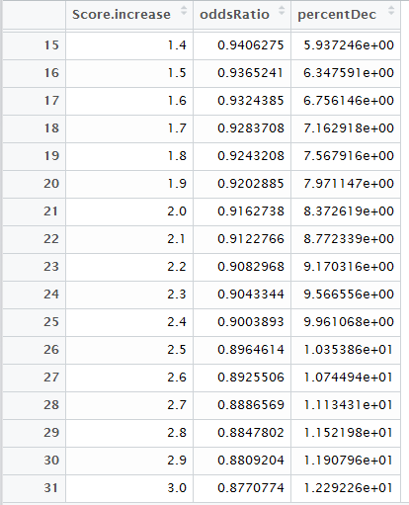
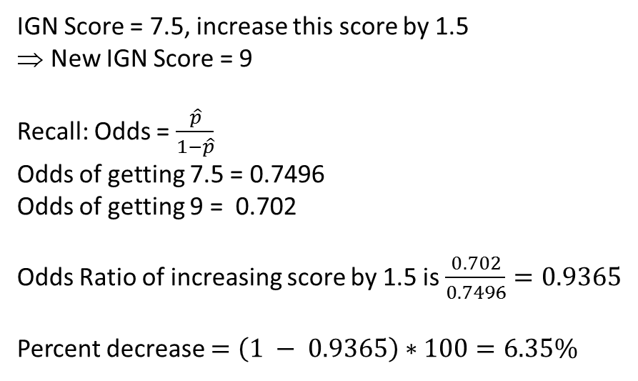
Method applied and interpretation: Logistic Regression
Interval Score
IGN Score = 7.5, increase this score by 1.5
New IGN Score = 9
Recall: Odds = $\frac{\hat{p}}{1−\hat{p}}$
Odds of getting 7.5 = 0.7496
Odds of getting 9 = 0.702
Odds Ratio of increasing score by 1.5 is $\frac{0.702}{0.7496}=0.9365$
Percent decrease $=\left(1 − 0.9365\right)∗100=6.35\%$

Slide 18
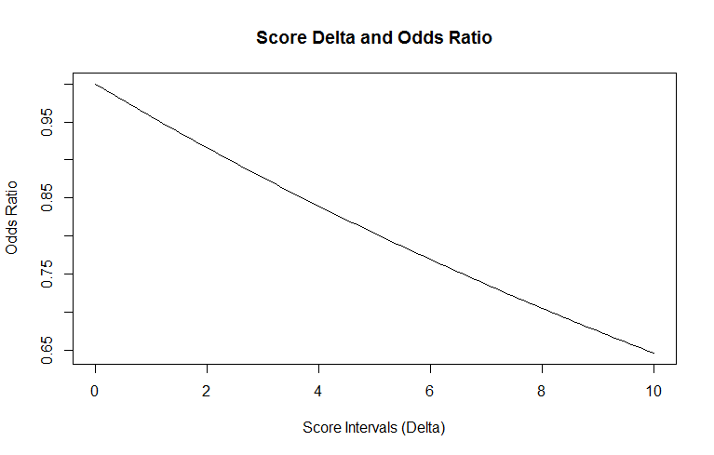
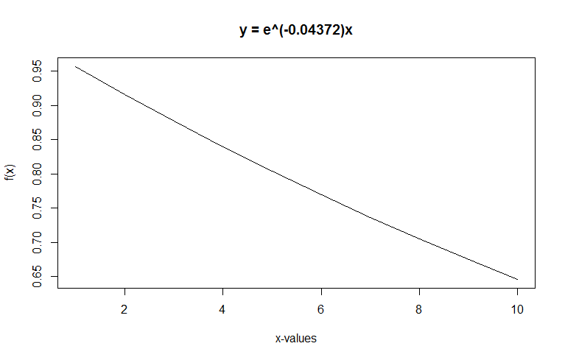

Method applied and interpretation: Logistic Regression
$$y=e^{β_{1}×δ}$$
Interval Score

