Slide 1
The perf_event subsystem
Tomson Li, Yifan Wang, Lien Zhu

Slide 2
Revisiting HPCs
Hardware Performance Counters measure micro-architectural events
Special purpose registers used for performance analysis
ARM Cortex-A53
CPU Core
PMU
CPU Core
PMU
CPU Core
PMU
CPU Core
PMU
L2 Cache
CSE 522S – Operating Systems Organization. Marion Sudvarg, David Ferry, Chris Gill, Brian Kocoloski

Slide 3
ARM PMU
PMU
PMCR
Performance Monitors Control Register
32-bits
Each bit is an individual control
Enable, reset, 32/64-bit mode, report number of counters, etc.
PMCNTR
Performance Monitors Cycle Count Register
32-63
0-31
Performance Monitor Event Counters
and Performance Monitor Event Types
Event type register controls corresponding counter
Reset by setting counter to 0
Enable 64-bit mode by chaining subsequent counters
PMEVCNTR0
PMEVCNTR1
PMEVCNTR2
PMEVCNTR3
PMEVCNTR4
PMEVCNTR5
PMEVTYPER0
PMEVTYPER1
PMEVTYPER2
PMEVTYPER3
PMEVTYPER4
PMEVTYPER5
CSE 522S – Operating Systems Organization. Marion Sudvarg, David Ferry, Chris Gill, Brian Kocoloski

Slide 4
Linux perf_event subsystem abstracts the PMU
The perf_event_open() syscall
The perf user space tool

Slide 5
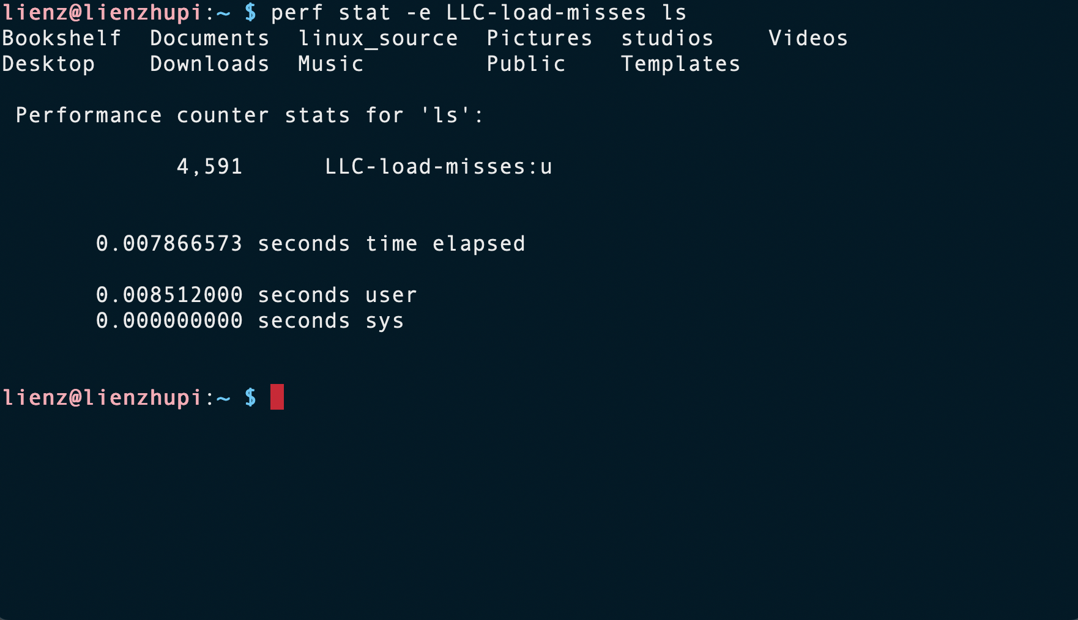
The perf user space tool provides a command line interface for interacting with the kernel
Notes:
Still, the subsystem is riddled with error

Slide 6
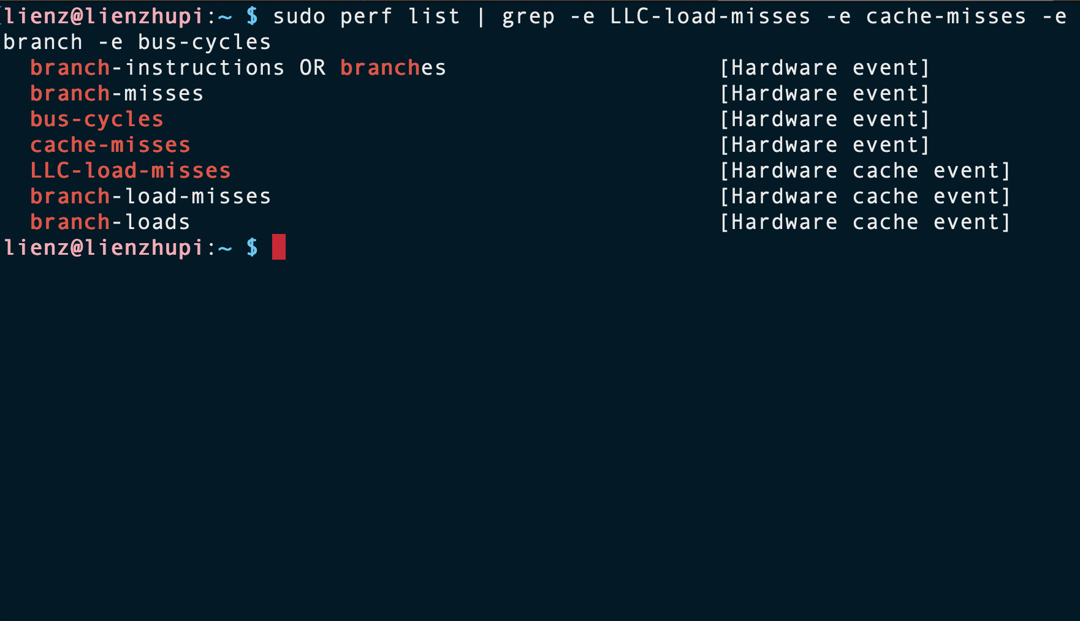
Supported events are architecture dependent
Notes:
Draw attention to LLC-load-misses

Slide 7
Multiplexing introduces extrapolation error into the subsystem
Events must be time-shared on to counters then extrapolated
Motivates event scheduling
[1] https://developer.arm.com/documentation/ddi0500/j/Performance-Monitor-Unit/About-the-PMU?lang=en
Notes:
A significant source of error is due to multiplexing
Raspberry Pi has 6 general purpose counters [1]
Ran 1-6, 12, and 24 events in perf stat –e <events> on stress-ng
LLC-load-misses was the pre-selected event

Slide 8
The Event Scheduler Algorithm
Linked list of event groups is traversed
TODO: explain group attributes, event constraints
Failed group results in activation of counters, rest of groups wait for next iteration

Slide 9
Observations
Linux hrtimer sends multiplexing interrupt for interval
Inefficient!!
Counters are activated as soon as a group fails, which does not consider schedulability of later event groups
Reducing need for multiplexing would improve accuracy of event counts
Notes:
Once a hardware event group fails to be scheduled, software events are scheduled onto the remaining counters.
This reduces time on PMU for hardware events which exacerbates error from extrapolation

