Slide 1
The perf_event subsystem
Tomson Li, Yifan Wang, Lien Zhu

Slide 2
From Process Scheduler to Event Scheduler
Original Goal: Investigate Process Scheduler (i.e., CFS)
CFS was introduced to Linux Kernel 2.6.23 (October 2007). Since then, it is the default event/process scheduler for Linux. (Not much improvements for more than a decade)
New Goal: Event Scheduler and perf_event subsystem
Still many ongoing issues with event monitoring.

Slide 3
Revisiting HPCs
Hardware Performance Counters measure micro-architectural events
Special purpose registers used for performance analysis
ARM Cortex-A53
CPU Core
PMU
CPU Core
PMU
CPU Core
PMU
CPU Core
PMU
L2 Cache
CSE 522S – Operating Systems Organization. Marion Sudvarg, David Ferry, Chris Gill, Brian Kocoloski
Notes:
HPC special registers in cpu
Monitor and measure events, cache miss, cpu cycles, and bus access.

Slide 4
ARM PMU
PMU
PMCR
Performance Monitors Control Register
32-bits
Each bit is an individual control
Enable, reset, 32/64-bit mode, report number of counters, etc.
PMCNTR
Performance Monitors Cycle Count Register
32-63
0-31
Performance Monitor Event Counters
and Performance Monitor Event Types
Event type register controls corresponding counter
Reset by setting counter to 0
Enable 64-bit mode by chaining subsequent counters
PMEVCNTR0
PMEVCNTR1
PMEVCNTR2
PMEVCNTR3
PMEVCNTR4
PMEVCNTR5
PMEVTYPER0
PMEVTYPER1
PMEVTYPER2
PMEVTYPER3
PMEVTYPER4
PMEVTYPER5
CSE 522S – Operating Systems Organization. Marion Sudvarg, David Ferry, Chris Gill, Brian Kocoloski
Notes:
Overview of PMU from slides.
This is the HPC used in our project to help analyze the performance of event scheduler.
Point out 6 counters

Slide 5
Linux perf_event subsystem abstracts the PMU
The perf_event_open() syscall
The perf user space tool

Slide 6
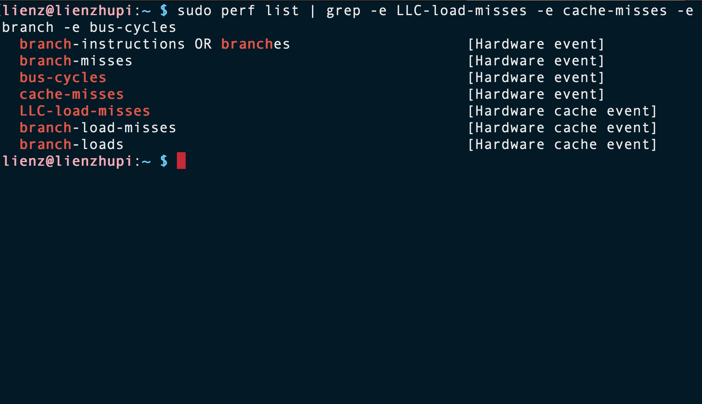
The perf user space tool provides a command line interface for interacting with the kernel
Notes:
Draw attention to LLC-load-misses

Slide 7
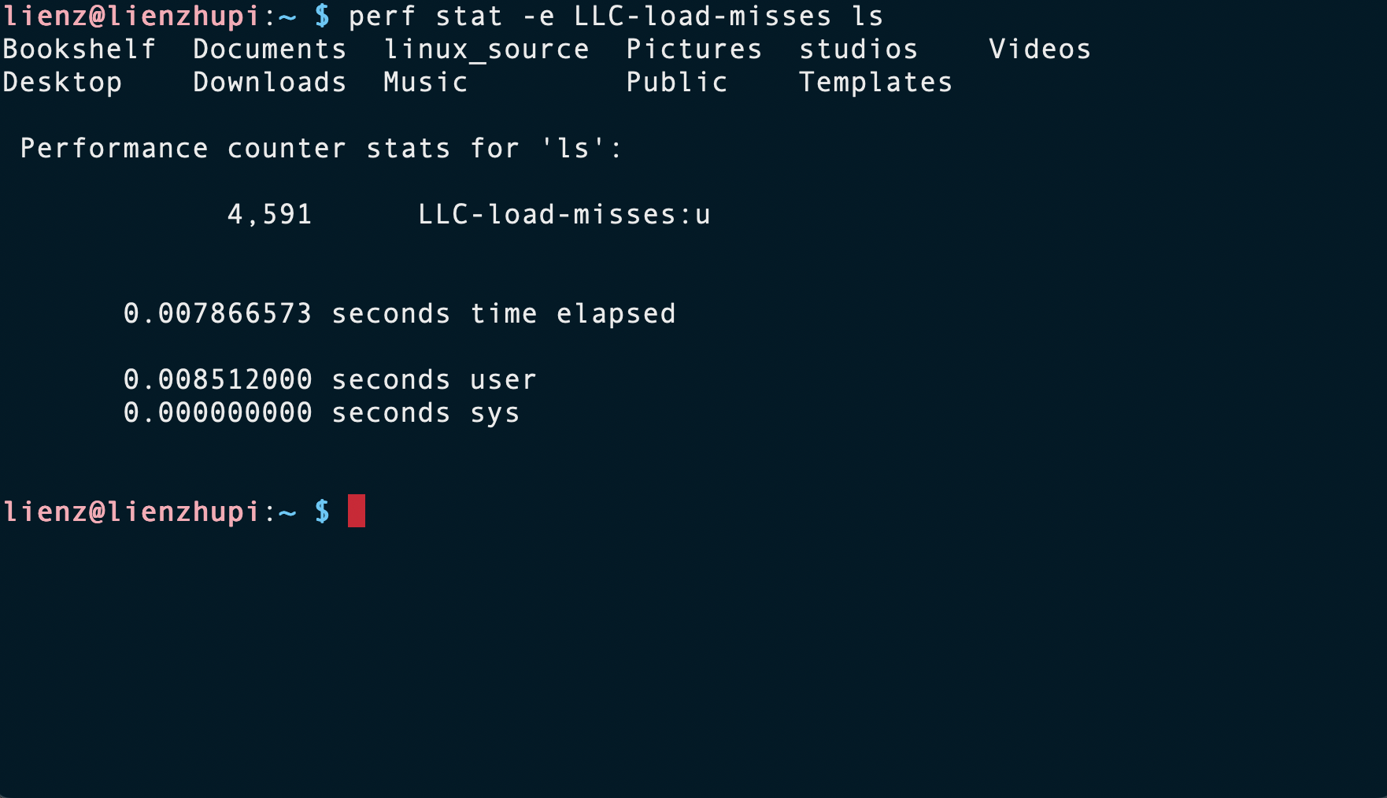
The perf user space tool provides a command line interface for interacting with the kernel
Notes:
But, this subsystem is prone to error

Slide 8
Multiplexing introduces extrapolation error into the subsystem
Events must be time-shared on to counters then extrapolated
Motivates event scheduling
[1] https://developer.arm.com/documentation/ddi0500/j/Performance-Monitor-Unit/About-the-PMU?lang=en
Notes:
A significant source of error is due to multiplexing
Raspberry Pi has 6 general purpose counters [1]
Ran 1-6, 12, and 24 events in perf stat –e <events> on stress-ng
LLC-load-misses was the pre-selected event
So multiplexing is quite impactful
How events are assigned to counters is solved by event scheduling algorithms

Slide 9
The vanilla Event Scheduler algorithm Background
Primitive unit of scheduling is event group
All events in a group must have certain attributes in common
Pinned vs Flexible
All or None in an event group
Event groups are added into a linked list
E1, E2, E3
E4, E5, E6, E7
E8, E9, E10
E11, 12
G1
G2
G3
G4
M. Dimakopoulou, S. Eranian, N. Koziris and N. Bambos, "Reliable and Efficient Performance Monitoring in Linux,”. SC 2016
Linux kernel source code

Slide 10


The vanilla Event Scheduler algorithm Example
E1, E2, E3
E4, E5, E6, E7
E8, E9, E10
E11, E12
G1
G2
G3
G4
C1 | C2 | C3 | C4 | C5 | C6
E1 | E2 | E3 | x | x | x
Notes:
List is traversed head to tail
G2 fails to schedule
Upon failure, the algorithm activates counters for counting and iteration proceeds
Software events fill the rest of counters, but error in hardware event counts is exacerbated
- Linux hrtimer sends multiplexing interrupt for interval

Slide 11
The Event Scheduler algorithm Example, second iteration
E11, E12
E4, E5, E6, E7
E8, E9, E10
E1, E2, E3
G4
G2
G3
G1
C1 | C2 | C3 | C4 | C5 | C6
E11 | E12 | E4 | E5 | E6 | E7
Notes:
- Tail rotates to head
- This time all counters are utilized

Slide 12

Observations
The algorithm is significantly Inefficient
Counters are activated as soon as a group fails, which does not consider schedulability of later event groups
E1, E2, E3
E4, E5, E6, E7
E8, E9, E10
E11, E12
G1
G2
G3
G4
C1 | C2 | C3 | C4 | C5 | C6
E1 | E2 | E3 | E8 | E9 | E10
Notes:
Once a hardware event group fails to be scheduled, software events are scheduled onto the remaining counters.
This reduces time on PMU for hardware events which exacerbates error from extrapolation
Modifying the event scheduler is difficult, but may not be necessary to see significant improvements

Slide 13
Key Insight: Not every event is significant
Reducing need for multiplexing would improve accuracy of event counts
Sensitivity analysis can
inform users of perf user space tool
reduce extrapolation error
Notes:
We can reduce the need to multiplex in the first place by reducing the events that are traced
Transition to Tomson

Slide 14
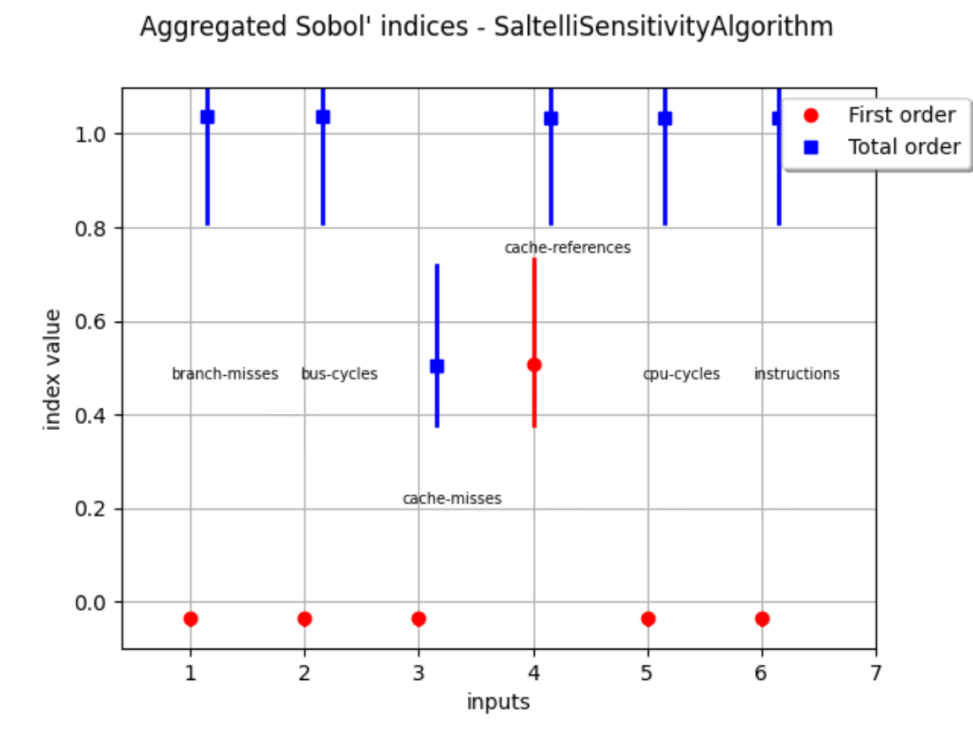
Sensitivity Analysis (Preliminary)
Variance-based Sensitivity Analysis: Sobol Indices
Giving perf_events an importance ranker (First-order)
How events interact/relate to each other (Total-order)

Slide 15
Sensitivity Analysis based Framework
With Sensitivity Index we can reduce the number of events that need to be multiplexed.
Use Trusted Execution Environment (TEE) runtime as ground truth, Sensitivity Index that has large difference in an untrusted execution environment may imply possible security issues.
?

