Slide 1
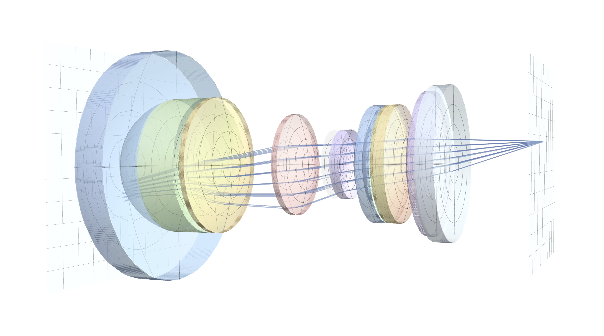
SIGGRAPH ASIA 2026 • TECHNICAL PAPERS
LieOptics
z
A Ray-Free Framework for Optical Modeling and Analysis
Haosheng Shi · Praneeth Chakravarthula
University of North Carolina at Chapel Hill
Notes:
Title page, pure visual

Slide 2
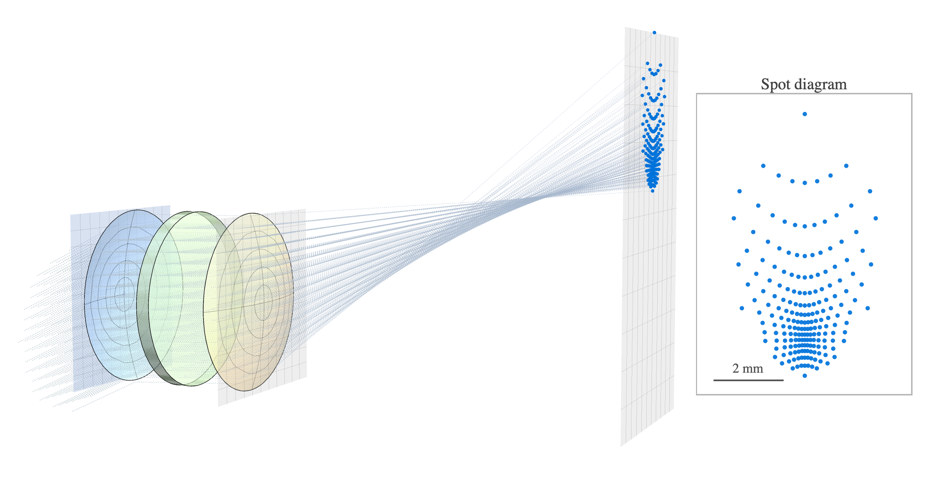
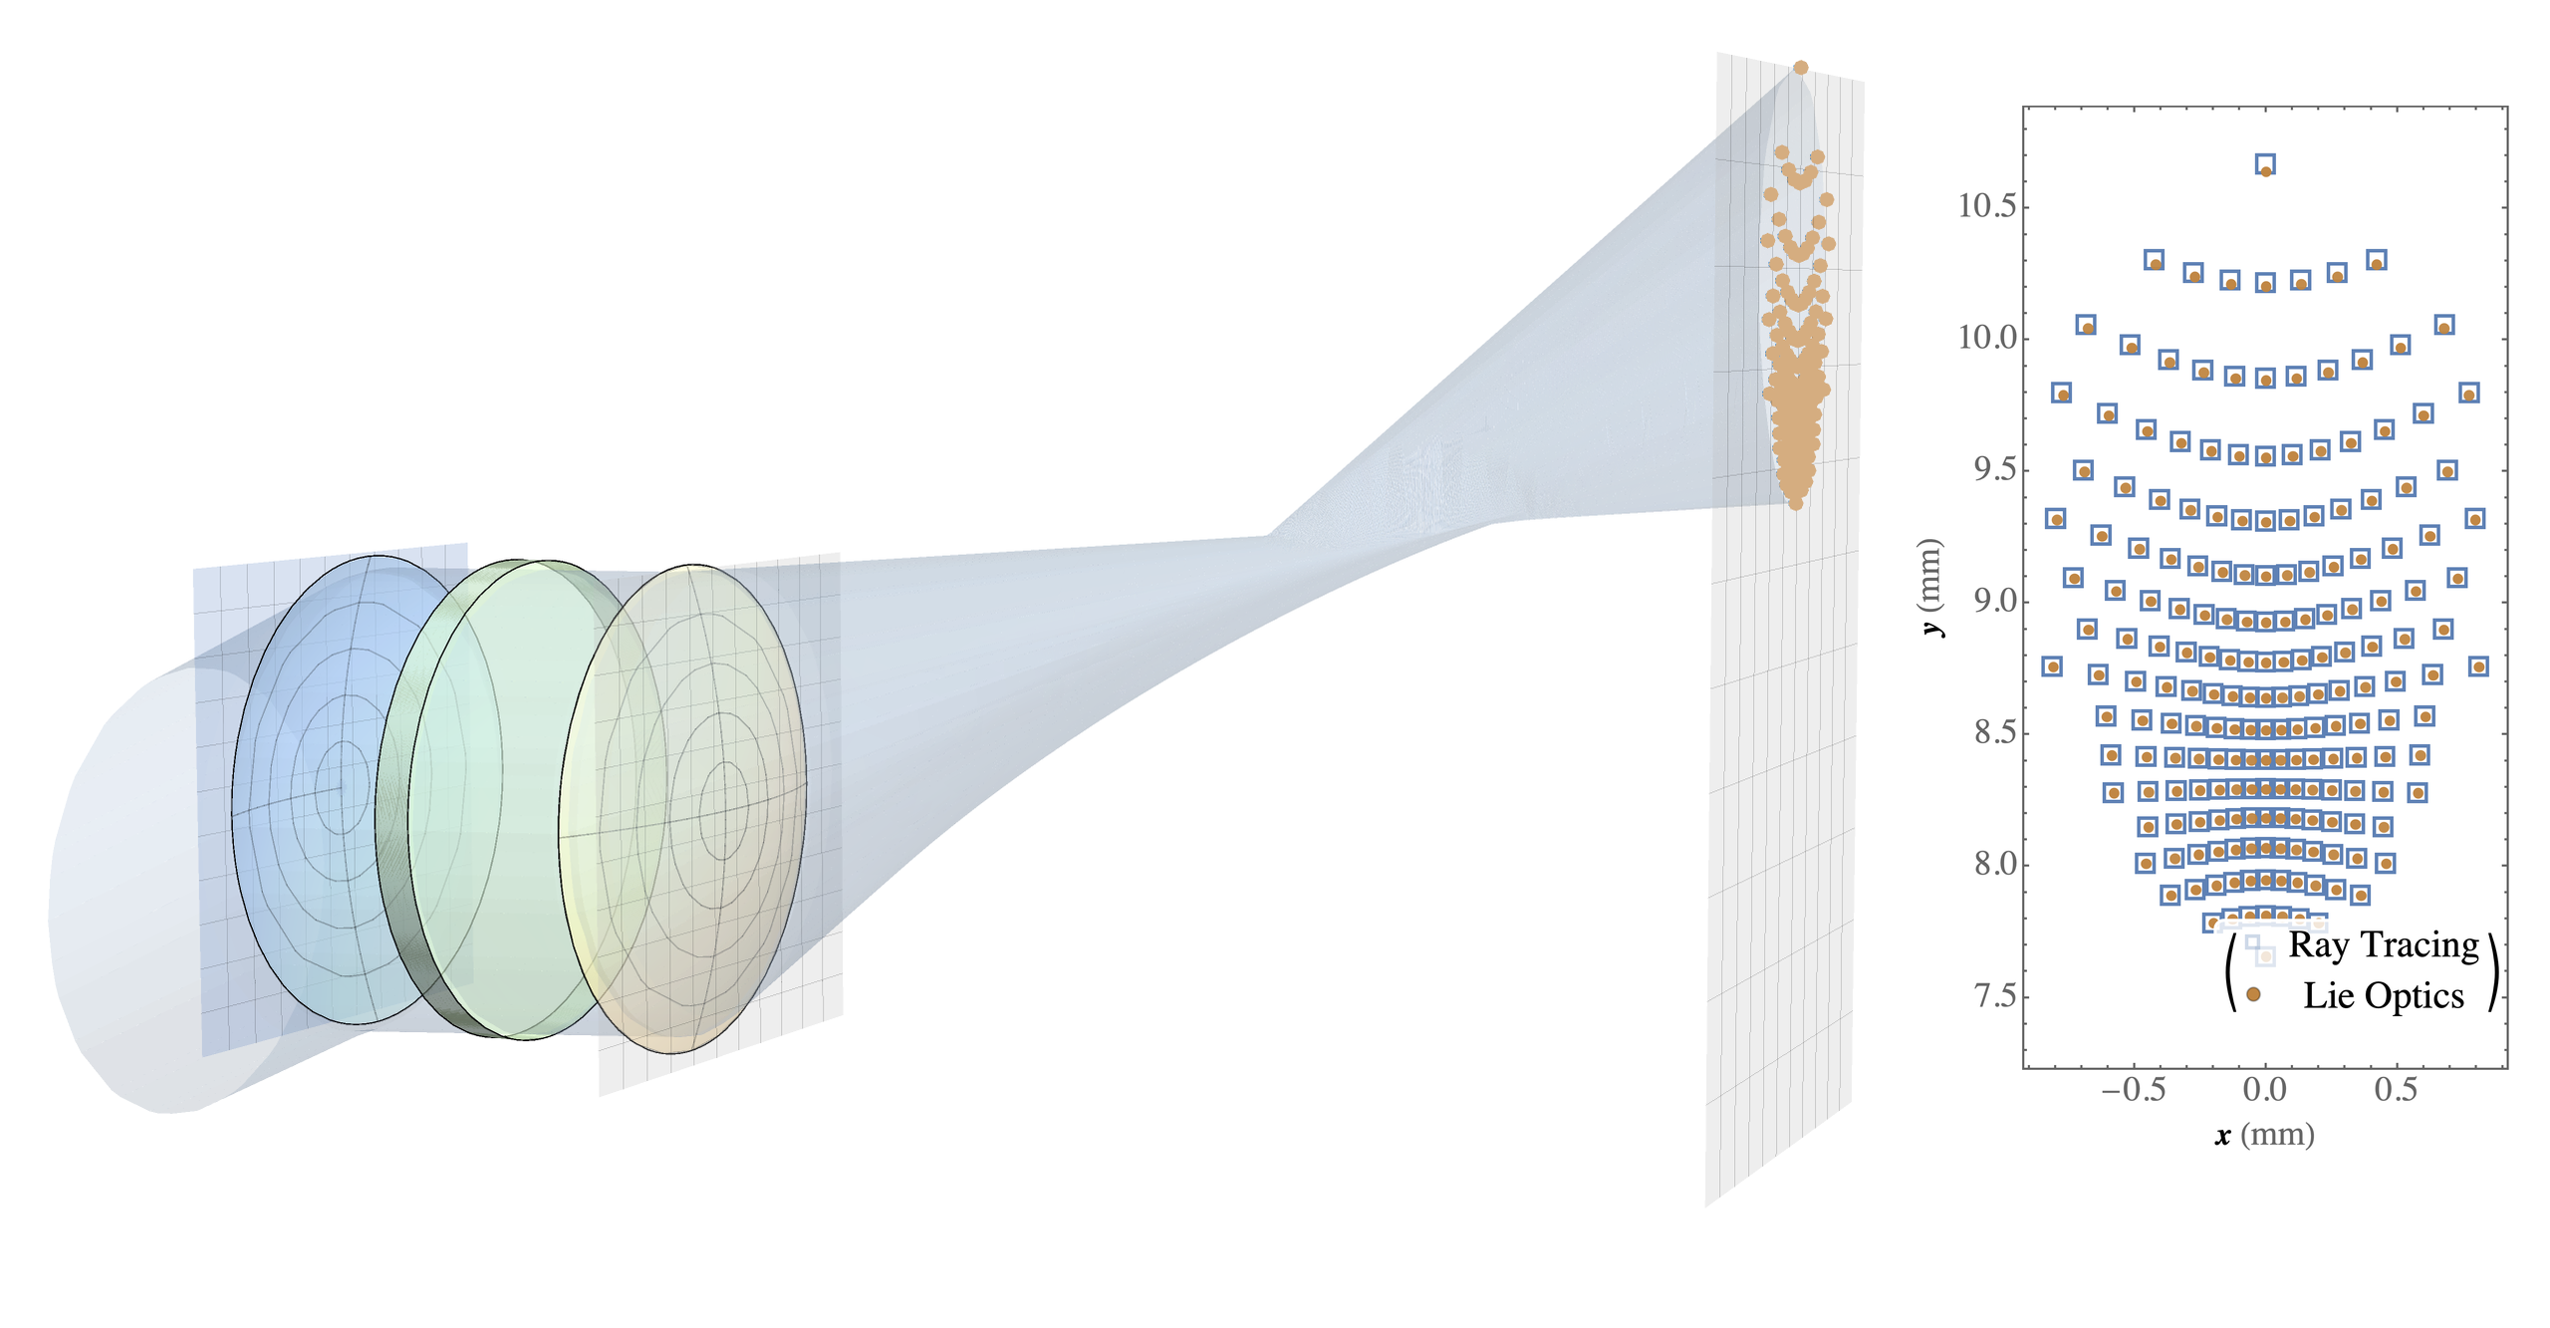
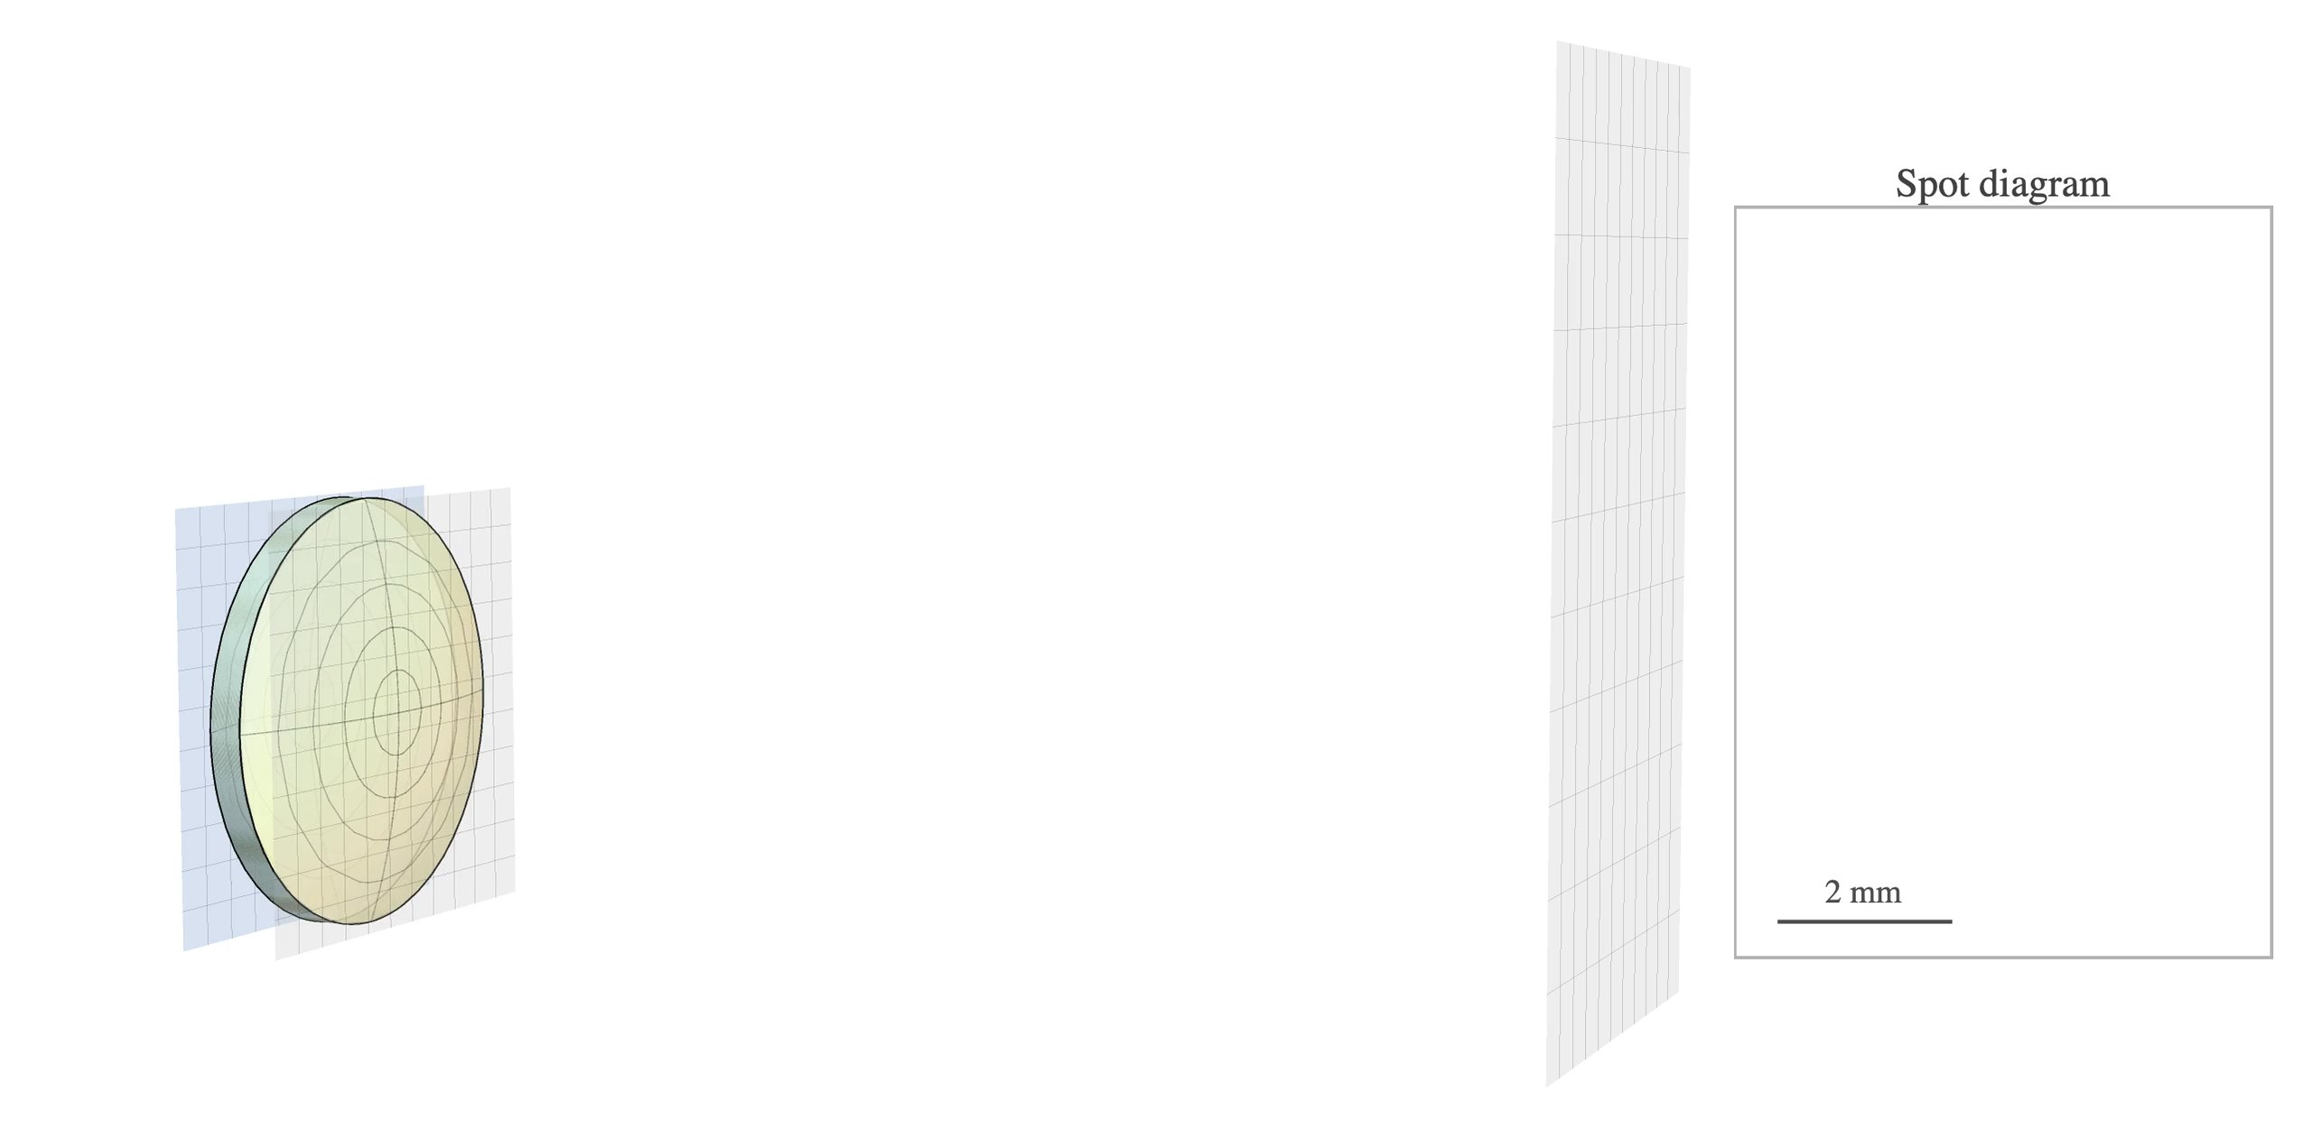

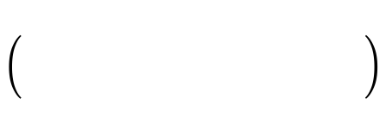





THE PROBLEM
Ray tracing obscures the origin of aberrations
1
Pointwise sampling
Does not model a ray bundle or a lens as a whole.
Ray Tracing
LieOptics
2
Aggregate metrics
Folds every aberration type together, with limited breakdown by element.
3
Heuristic diagnosis
composition
Different lenses, same spot pattern Can not tell them apart.
$$G_{1}$$
$$G_{2}$$
$$G_{3}$$
$$G_{4}$$
$$G$$
$$lens$$
Haosheng Shi, Praneeth Chakravarthula · 2
Notes:
Aberration arises from the collective behavior of a ray bundle through a lens.
1. Pointwise sampling Does not model the ray bundle or the lens as a whole.
2. Aggregate metrics Single-number scores (spot size, wavefront error) fold every aberration type together, with no breakdown by element.
3. Heuristic diagnosis Design falls back on expert intuition and trial-and-error.
Outcome: Structurally distinct lens designs can look identical in a spot diagram. Ray tracing can't tell them apart.

Slide 3
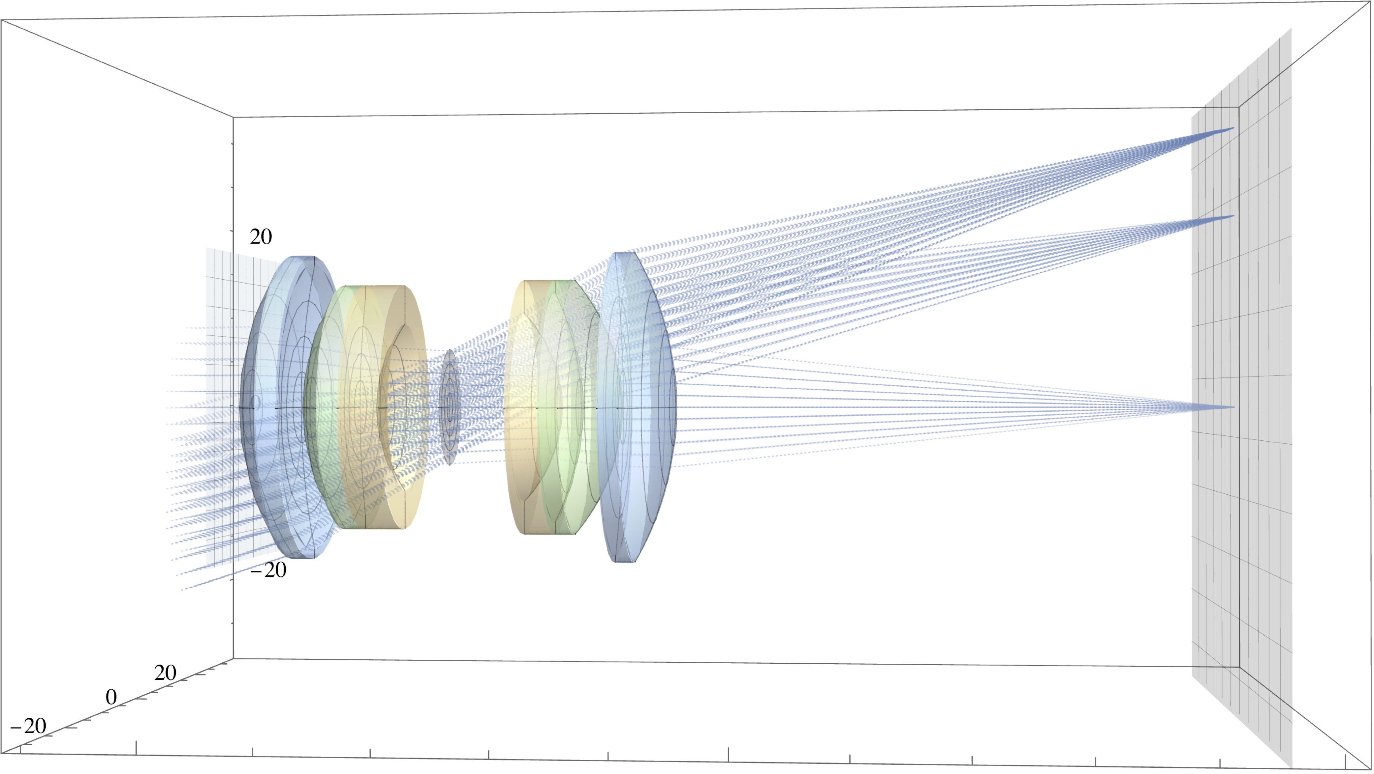
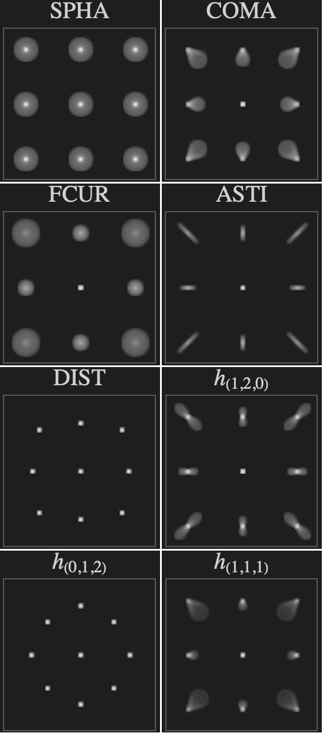
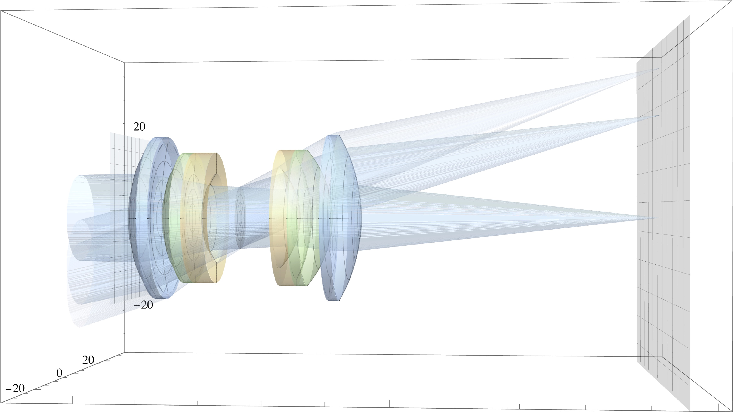
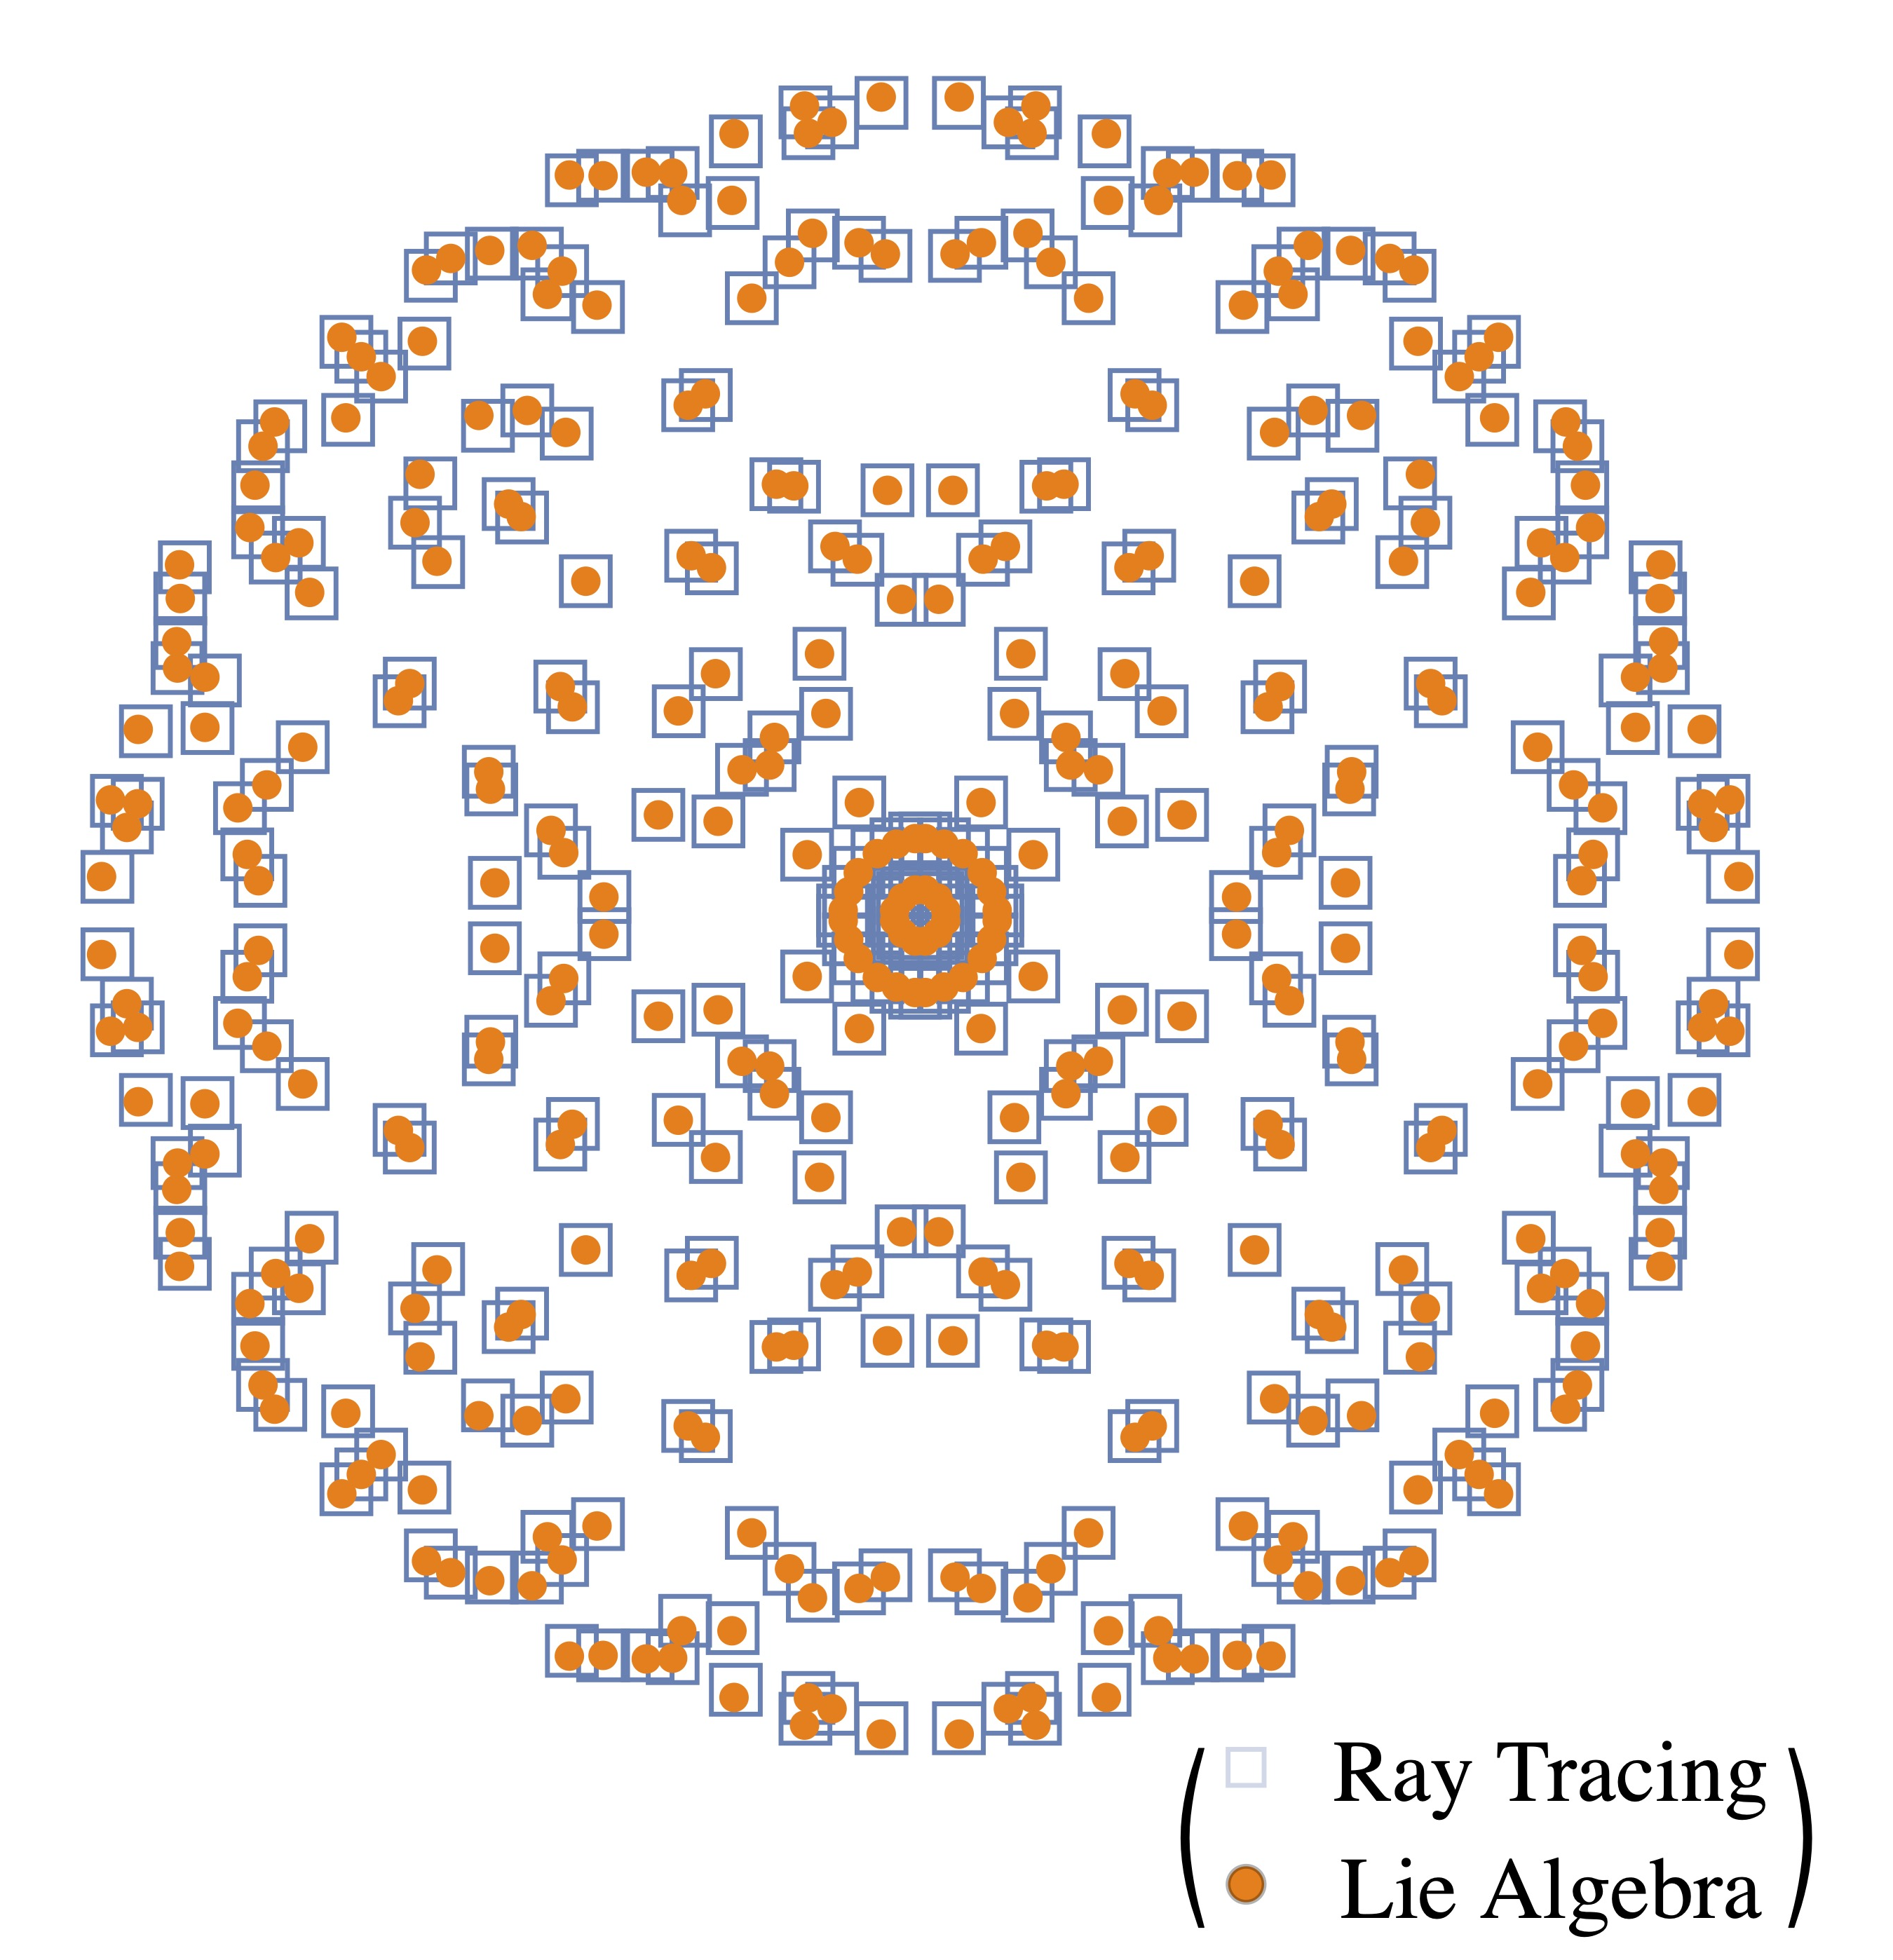













THE IDEA
LieOptics models the whole ray bundle
Analytical Aberration and Characterization
Ray Tracing
20$°$
14$°$
0$°$
LieOptics
Composition
$$G$$
$$G_{1}$$
$$G_{2}$$
$$G_{3}$$
$$G_{4}$$
$$G_{5}$$
$$G_{6}$$
$$sys$$
$$⋯$$
1
Element $→$ operator
2
Compose $→$ lens system
3
Operator $→$ aberration
Each element is a Lie operator, acting directly on the ray bundle.
Elements compose into a lens-system operator.
Lens operator yields the full aberration structure.
Haosheng Shi, Praneeth Chakravarthula · 3
Notes:
3. LieOptics models the whole ray bundle
Element → operator. each optical element is a Lie operator, acting directly on the ray bundle.
Compose → lens-system operator. operators compose of all elements into one system operator; no ray intersection needed.
Operator → aberrations. Lens operator yields the full aberration spot pattern analytically, and the detailed aberration structure up to 9th order.
Visual: fig teaser, ray tracing (per-ray) vs. LieOptics (per-bundle operator) side by side; feeding into direct metrics; aberration breakdown.
Slide 3 (The Idea) is the deck's centerpiece and probably needs the most airtime — it's introducing the whole ray-bundle → operator → composition → aberration pipeline in one shot with a dense diagram (ray tracing render, composition chain, aberration spot grid). Budget 90 seconds minimum; if you're tight, consider whether the small spot-grid panel on the right (SPHA/COMA/FCUR/ASTI/DIST/h-terms) needs to be explained in the talk itself or can just be gestured at ("this gives us a full breakdown, more in the paper").

Slide 4
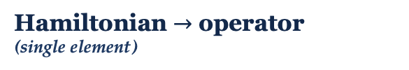


FORMULATION
Hamiltonian evolution gives structured aberrations
1
Hamiltonian $→$ operator
(single element)
$u_{image}=G\left(H\right)⋅u_{object}$ each $H$ characterize a lens/medium.
The Hamiltonian of each element generates the evolution.
2
Dragt–Finn Factorization
$$H =H_{1}+H_{2}+H_{3}+⋯, G\left(H\right)=⋯G(H_{3})·G(H_{2})·G(H_{1})$$
Identifies the aberration structure.
$H_{1}$ generates the linear (ABCD) transfer; $H_{k}$ the aberration order $2k−1$.
3
Composition $→$ system operator
Composing element operators encodes the full aberration structure.
$h_{composed}=ℱ\left(h_{front},h_{rear}\right)$ $h$: coefficients of Hamiltonian
$ℱ$: closed-form rule (BCH)
Full derivations: paper §3.1–3.3 and Supplementary Material.
Haosheng Shi, Praneeth Chakravarthula · 4
Notes:
Analytical modeling: Hamiltonian evolution of a ray bundle factors into aberration orders
1 Phase-space evolution: a ray bundle $u = (p,q)$ evolves with the optical Hamiltonian. The Hamiltonian gives the Lie operator $G\left(H\right)= e^{−z\hat{H}}$, the nonlinear ray-transfer map for the bundle $G\left(H\right) u$,
2 Dragt–Finn Factorization → aberration orders
$$H =H_{1}+H_{2}+H_{3}+⋯, G(H) = G(H₅)·G(H₄)···G(H₁)$$
$H₁$ is the linear paraxial ABCD ray-transfer, and $H_{k} (k≥2)$ the nonlinear aberration of successive orders.
3 Composing elements → a lens system in closed form, without ray sampling
Outcomes: aberration coefficients directly, element by element; no intermediate ray-traced expressions.
Slide 4 (Formulation) has three equation blocks plus Dragt–Finn factorization — for a SIGGRAPH audience (not necessarily optics specialists), this is the slide most likely to lose people if you dwell on derivation. Since you've already noted "full derivations in paper §3.1–3.3," lean into that — narrate the intuition (Hamiltonian → operator → compose) rather than walking every symbol.

Slide 5
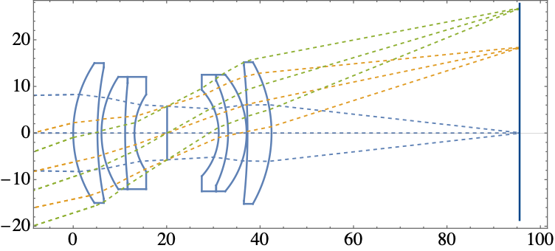
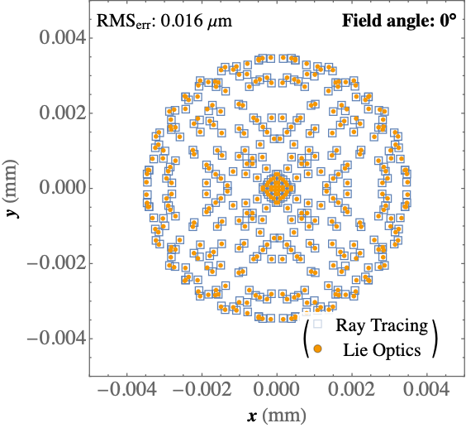
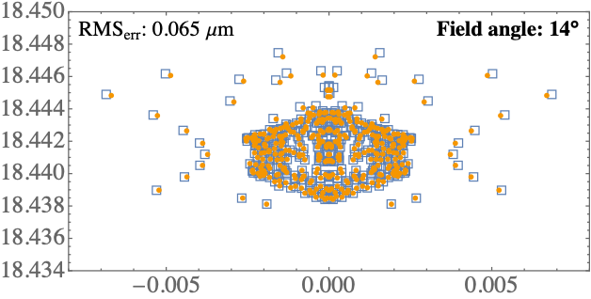
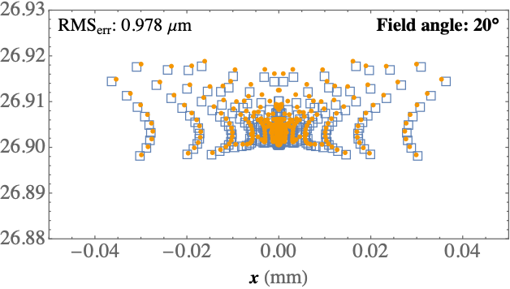
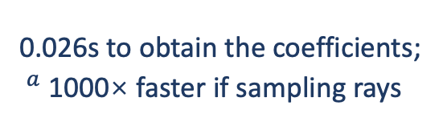


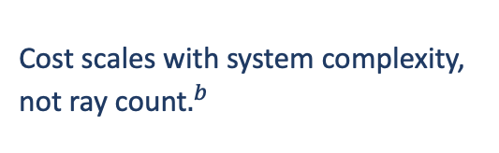
ACCURACY & SPEED
Analytic aberration advantages
3
Speedup$^{a}$
✓
Accurate
0$°$
14$°$
20$°$
2
Spot diagram on Double Gauss yields sub-micron accuracy
1
✓
Fast
0.026s to obtain the coefficients; $^{a}$1000× faster if sampling rays
2
✓
Scalable
Haosheng Shi, Praneeth Chakravarthula · 5
Cost scales with system complexity, not ray count$.^{b}$
1
3
$.^{b}$Obtaining the aberration coefficients.
Haosheng Shi, Praneeth Chakravarthula · 5
Notes:
LieOptics obtains the aberration coefficients analytically. Since we don’t need to sample rays, it can scale up to model complex lens systems.

Slide 6
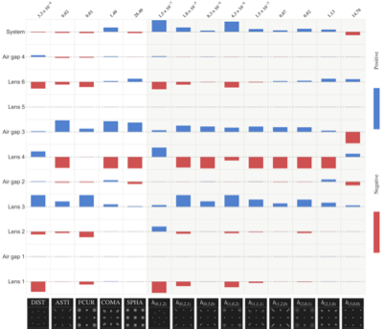
CAPABILITY
Aberration attribution
1
1
By element
2
By aberration type
3
3
Diagnostics
reveals design that cancels aberrations
2
6 · Haosheng Shi, Praneeth Chakravarthula
Notes:
Double Gauss lens: Diagnostics of the lens pair (3, 4). Each generates large aberrations of every type; and their signed contributions cancel at the System row.
Every bar here is computed directly from the composed operator, without per-element perturbation experiments.
Outcome: revealing design that cancels aberrations in a structured way. Offers fine-grained insights into prototyping and design.
Slide 6 (Aberration attribution) has a large, information-dense heatmap (14 columns × 9 rows) plus a lens ray diagram plus 12 tiny diagnostic thumbnails. This is a lot to parse live in a talk. You likely want to talk to the three numbered callouts (element view, aberration-type view, cancellation diagnostic) rather than the grid itself — the heatmap reads better as a "for detail, see paper" reference than something you walk cell-by-cell.

Slide 7
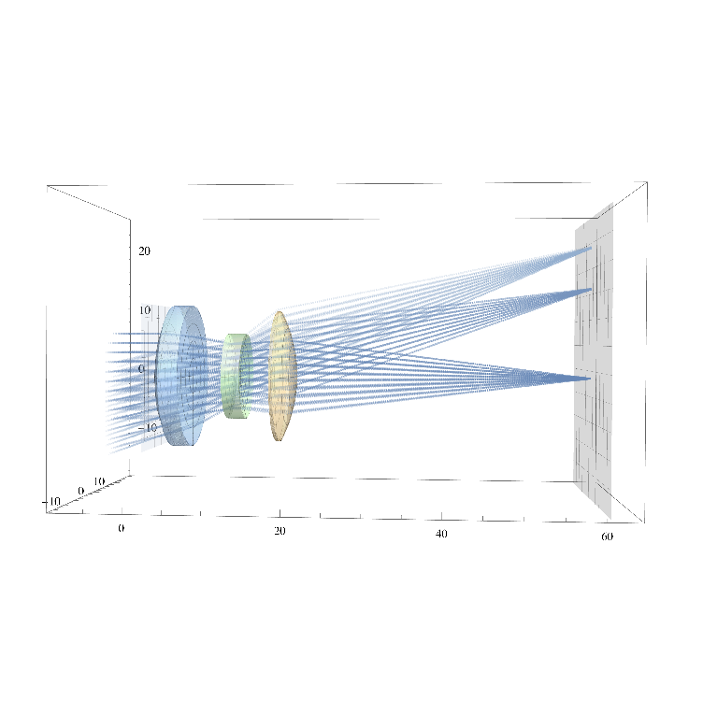
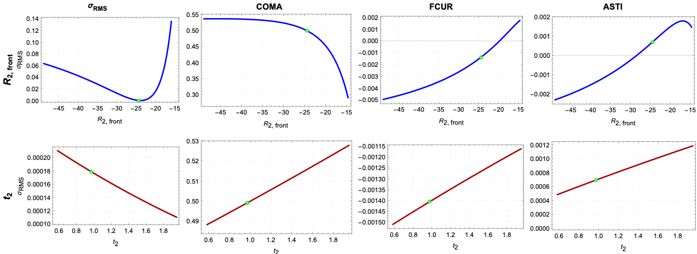
CAPABILITY
Sensitivity Analysis
Real-time design space exploration
No need to perturb-and-retrace the lens.
Sweep front curvature
Individual aberrations decrease but overall spot size rises.
Sweep thickness
Global blur falls monotonically; every aberration type grows.
Haosheng Shi, Praneeth Chakravarthula · 7
Notes:
Real-time sensitivity analysis reveals aberration and design trade-offs
Demonstrated on a simpler triplet lens, sweeping Lens 2.
Sweep thickness. overall spot size falls monotonically, but every aberration type grows: thickness trades global blur for corner sharpness.
Design trade-off (sweep front curvature): moving off the nominal value reduces individual aberrations (COMA, FCUR, ASTI) but increases overall spot size.
Outcome: real-time design-space exploration, no perturb-and-retrace the lens.

Slide 8
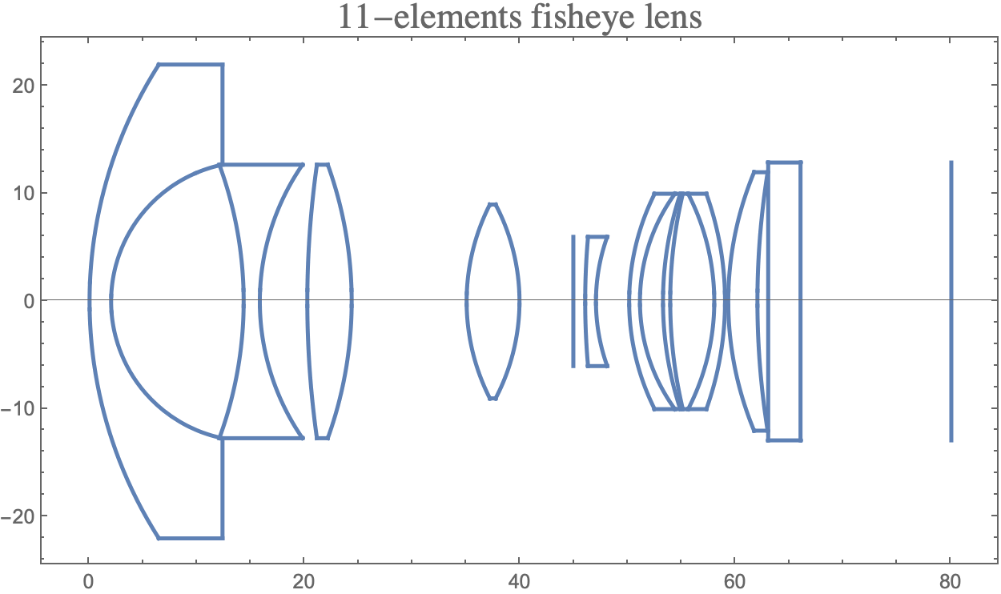
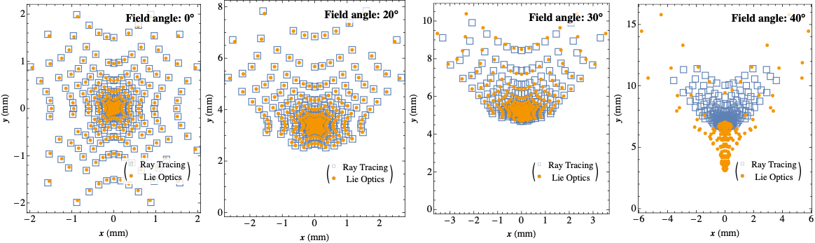
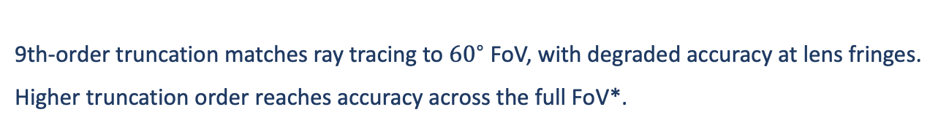
LIMITATIONS & FUTURE WORK
Truncation order sets an accuracy ceiling
▸
Wide-field accuracy
9th-order truncation matches ray tracing to ${60}^{∘}$ FoV, with degraded accuracy at lens fringes.
Higher truncation order reaches accuracy across the full FoV*.
✓
✓
✓
❌
Field of View (Full) $0^{∘}$ ${ 40}^{∘}$ ${60}^{∘}$ ${80}^{∘}$
$.^{∗}$ Schrade et al. 2016. Sparse High-degree Polynomials for Wide-angle Lenses. CGF 35, 4.
Haosheng Shi, Praneeth Chakravarthula · 8
Notes:
Slide 8 (Limitations) does good work owning a real weakness (accuracy degrades past 60° FoV) — keep this, it's a strength for Q&A credibility, but it can go fast (30–40 sec) since the checkmarks/X already tell the story visually.

Slide 9
LieOptics
Thank you!
Optical modeling in closed-form, element by element, 1000× faster than ray tracing.
Haosheng Shi, Praneeth Chakravarthula · 9

