Slide 1

25424971
June 2026
Coffee Hub
Brief
An analysis of the potential coffee distributors for Coffee Hub, Stellenbosch. The cost, the roaster company, the roast strength, and reviews of the coffees are considered.

Slide 2
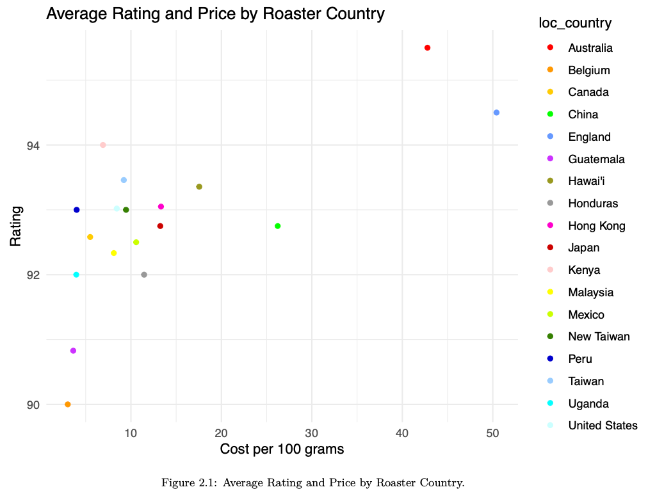
Average Rating and Price by Roaster Location
Australia and England are clear outliers. Although roasters in these
countries have, on average, the highest ratings, all the countries receive an average rating of 90 or
above. I would suggest that the prices disqualify the further consideration of Australian and English
roasters.

Slide 3
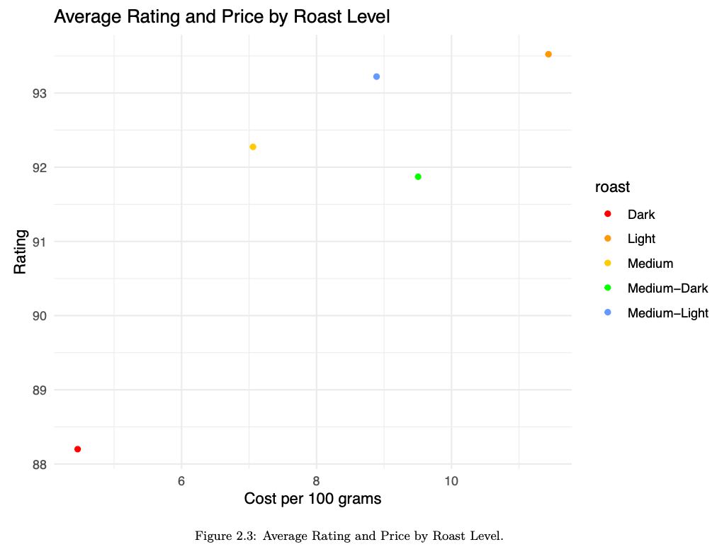
Average Rating and Price by Roast Level
Light roast has the highest average rating, but also the highest average cost. Dark has the lowest
average rating and the lowest cost. Medium-light and medium roast offer a middle-ground.

Slide 4
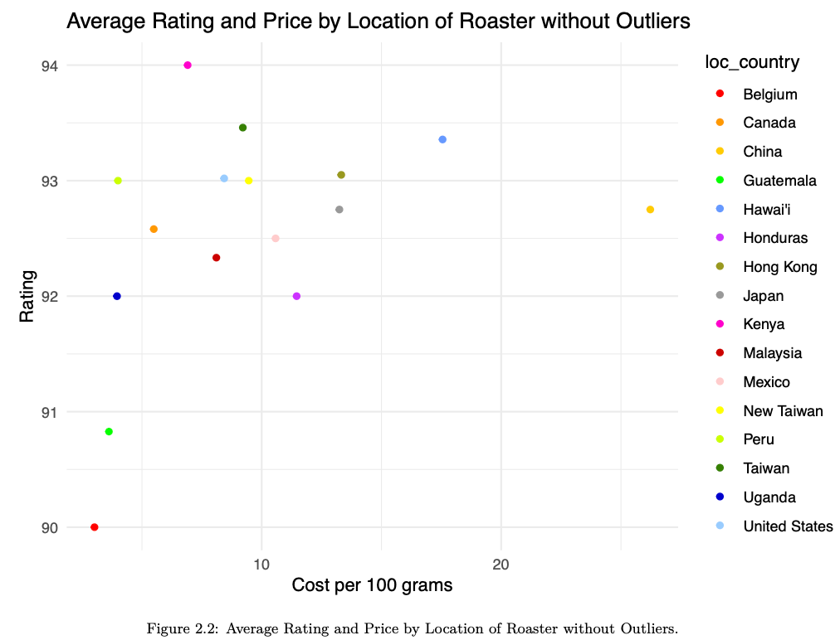
Average Rating and Price by Roaster Location, excluding Outliers
Ratings cluster between 92 and 94, however, outliers in price remain.

Slide 5
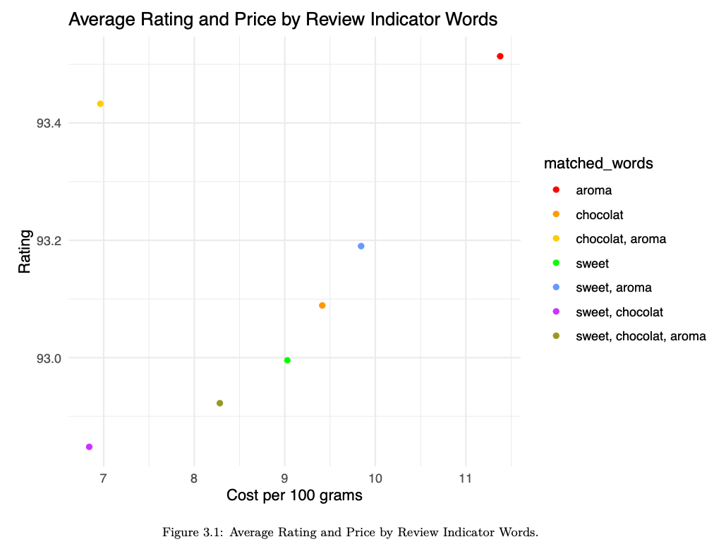
Average Rating and Price by Review Indicator Words
Coffee brands that have reviews describing the aroma and chocolatiness of the
coffee are the best deal when it comes to the ratings-price relationship. Subsequent analysis will be focused on these observations.

Slide 6
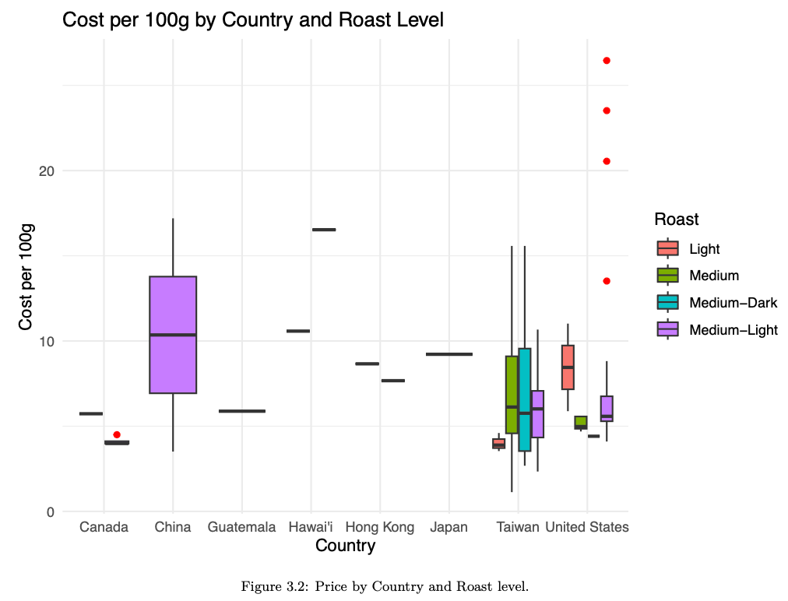
Boxplot by Country and Roast Level
The goal is to trim the most expensive coffee products. The boxplot shows the outliers in red. The boxplot
also illustrates that Taiwan and the US are the have the most roasters.

Slide 7
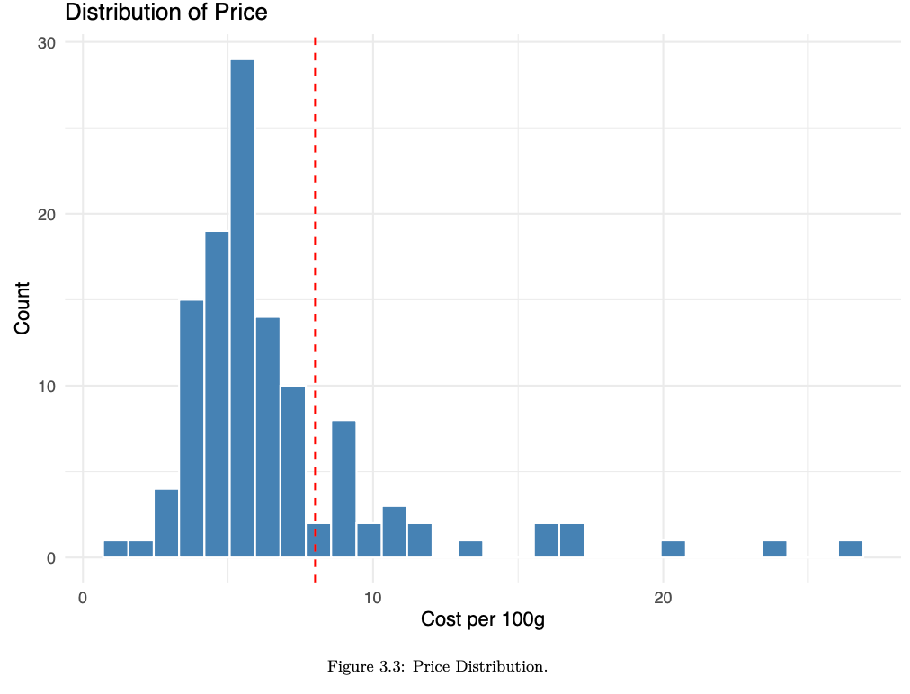
Price Distribution
The distribution in price aids in determining where a hard cap on the price should be. At USD8 per
100 grams, there is a fall in the number of coffee products sold at this price, and provides a reasonable cap.

Slide 8
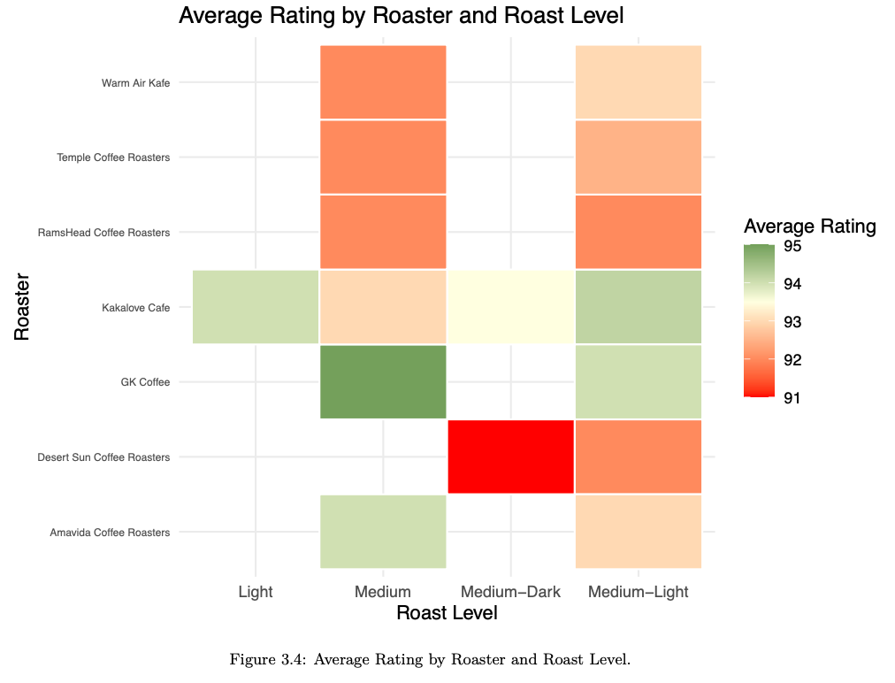
Average ratings by roaster and roast level
This plot depicts the average ratings by roaster and roast level once the coffee products that have a cost larger than USD8 and roasters that only supply one remaining product have been filtered out. The reasoning is that a distributor can provide a diversified selction of products.

Slide 9
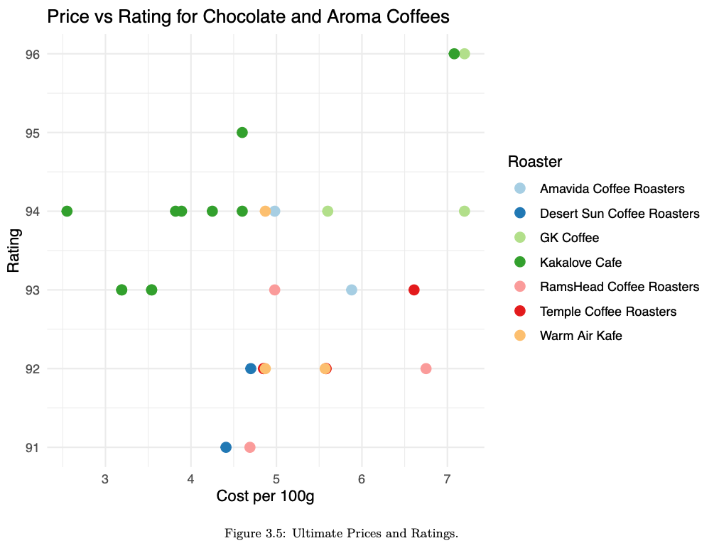
Prices and Ratings for Roasters
The plot displays the price-ratings relationship for narrowd-down roasters. Kakalove Cafe is promising supplier, with most of its product prices falling the lowest, and receiving the highest
some of the highest ratings. They also produce a variety of products.

Slide 10
Conclusion
Roast level, cost, reviews, ratings, and country of production are all reviewed to determine that Kakalove Cafe is the best distributor for Coffee Hub.

