Slide 1
TypeScript（一）
三毛

Slide 2
01
About TypeScript
02
Why TypeScript
03
Demo

Slide 3
01
About TypeScript

Slide 4
JavaScript 发展现状

Slide 5
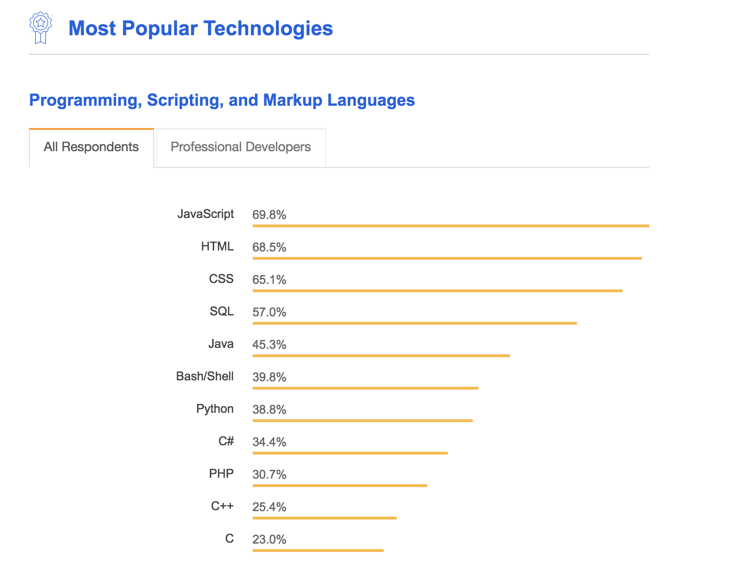

Slide 6
Explosive growth in the last 10 years
JavaScript in everywhere
More and more JavaScript developer

Slide 7
JavaScript 并不是为大型应用而设计
Dynamic typing
Lack of modularity
...

Slide 8
2012 年十月 微软发布首个公开版本的 TypeScript

Slide 9
A statically typed superset of JavaScript that compiles to plain JavaScript

Slide 10
A statically typed
Superset of JavaScript
Compiles to JavaScript
Optionally typed
No special runtime
…

Slide 11
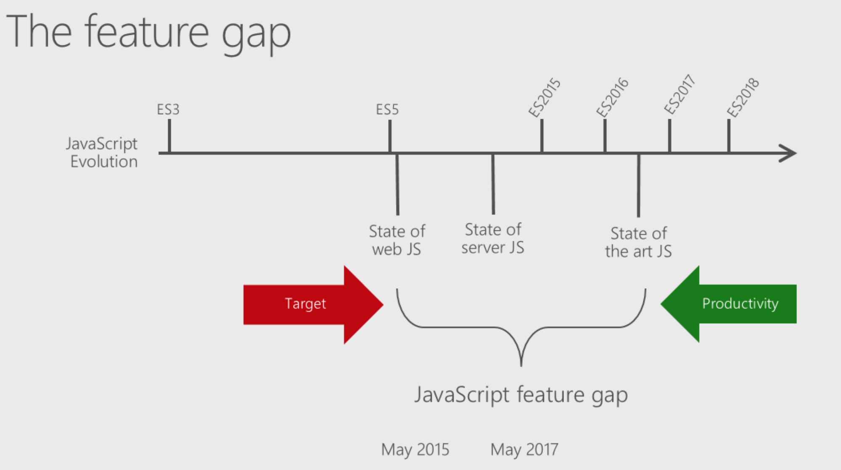

Slide 12
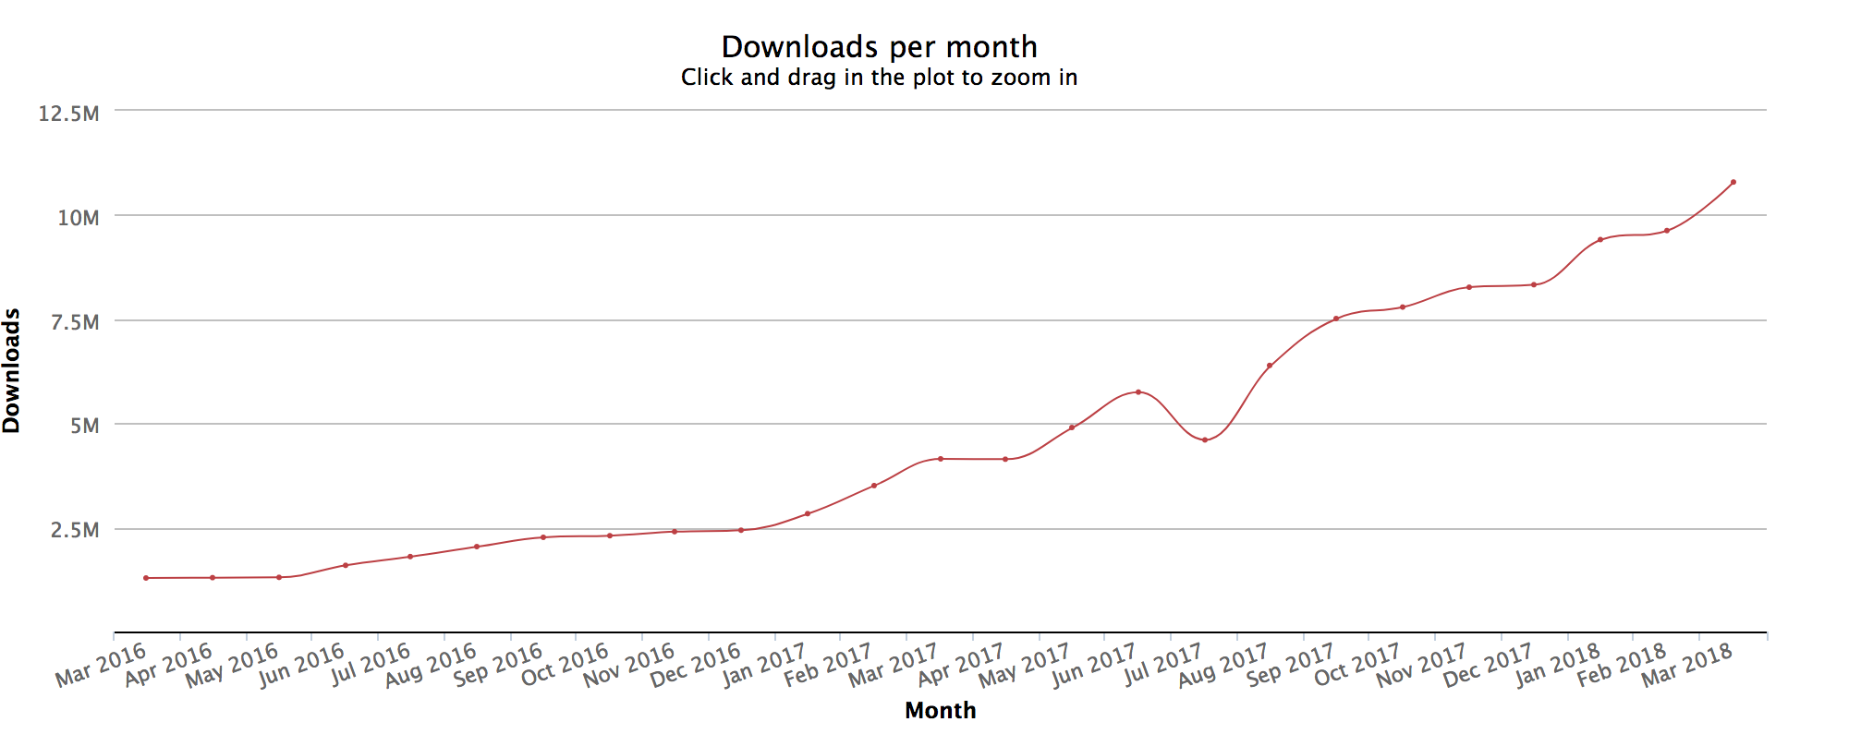

Slide 13
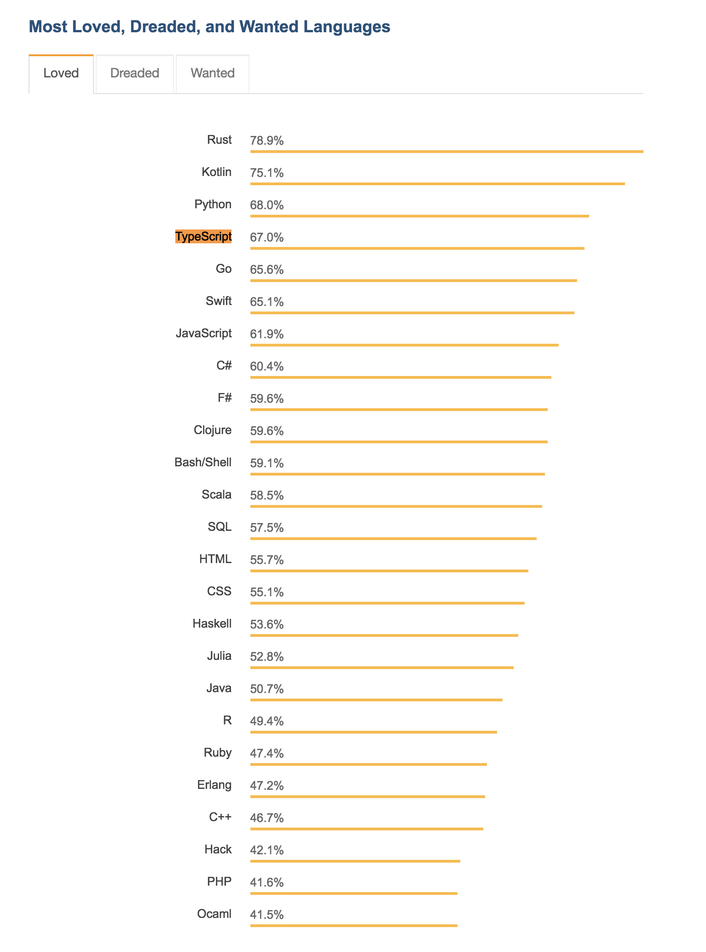

Slide 14
02
Why TypeScript

Slide 15
「 Developers should be able to focus on creating amazing things 」

Slide 16
Understand Code | Maintain Existing Code | Write New Code
Read source code Trace flow of execution Read library documentation Find bugs | Prepare for new features Fix bugs Refactor code | function/class file/modules

Slide 19
Optionally statically type

Slide 20
Why statically typed is important

Slide 21
Early fail

Slide 22
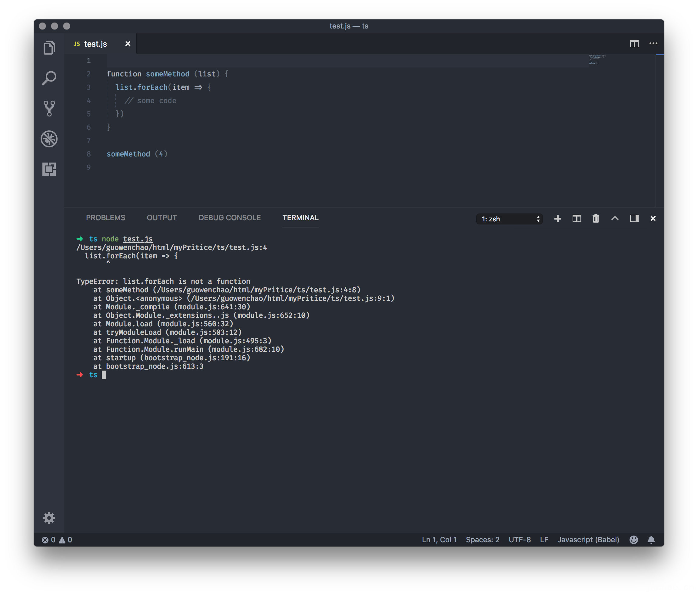

Slide 23
TypeScript

Slide 24
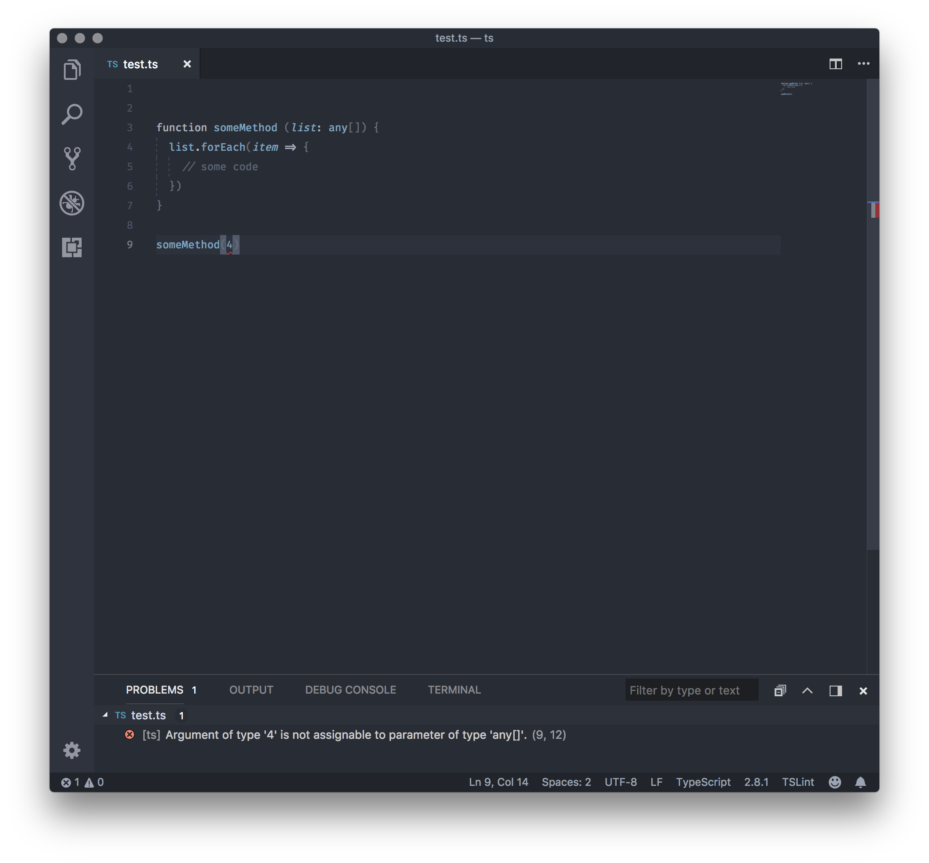

Slide 25
阅读代码的友好性，文档化

Slide 26
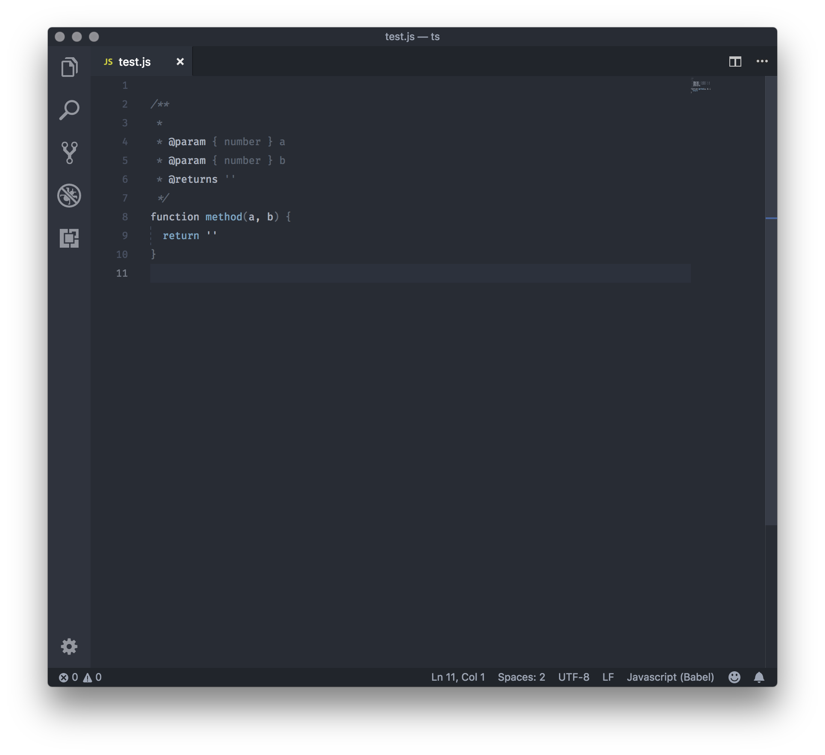
JSDoc?

Slide 27
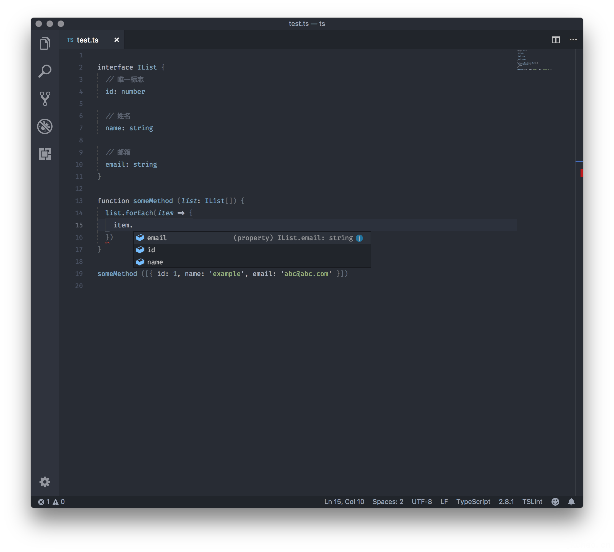

Slide 28
03
Demo

Slide 29
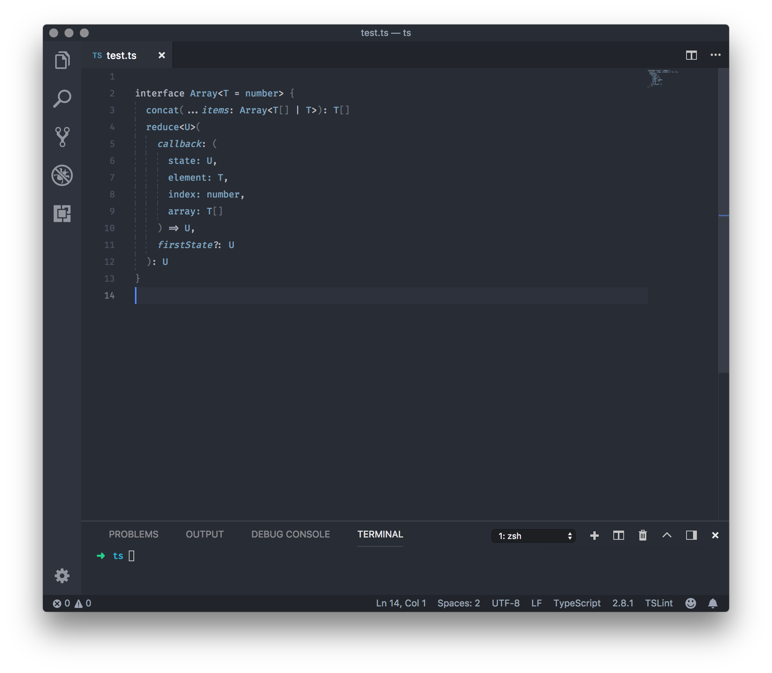
下集预告

Slide 30
Thanks

