Slide 1
Sensor Programming Fundamentals & Arduino Basics
Program Structure • Execution Flow • Pin Configuration • Hardware Abstraction

Slide 2
Sensor Programming Fundamentals
Basics of interfacing sensors with microcontrollers
Reading analog and digital sensor data
Processing and converting sensor signals
Real-time data acquisition and response

Slide 3
Program Structure (Arduino)
setup(): runs once, used for initialization
loop(): runs continuously
Global declarations: variables, constants, libraries
Functions: modular and reusable code blocks

Slide 4
Execution Flow
Power ON / Reset
setup() function executes first
loop() executes repeatedly
Interrupts handle urgent events

Slide 5
Pin Configuration
Digital Pins: INPUT, OUTPUT, INPUT_PULLUP
Analog Pins: Read sensor values (0–1023)
PWM Pins: Simulate analog output
pinMode(), digitalWrite(), digitalRead()

Slide 6
Hardware Abstraction
Hides low-level hardware details
Arduino libraries simplify sensor usage
Improves portability and reusability
Example: digitalRead() instead of register access

Slide 7
Arduino Programming Basics
Based on C/C++
Uses Arduino IDE
Large community support
Built-in libraries for sensors and communication

Slide 8
Block Diagram: Sensor Interfacing with Arduino
Sensor
Arduino
Microcontroller
Output
(LED / Display)

Slide 9
Circuit Diagram (Conceptual)
Sensor VCC → 5V on Arduino
Sensor GND → GND on Arduino
Sensor OUT → Analog/Digital Pin
Output device connected via resistor

Slide 10
Sample Arduino Code
int sensorPin = A0;
void setup()
{
pinMode(sensorPin, INPUT);
Serial.begin(9600);
}
void loop()
{
int value = analogRead(sensorPin);
Serial.println(value);
}

Slide 11
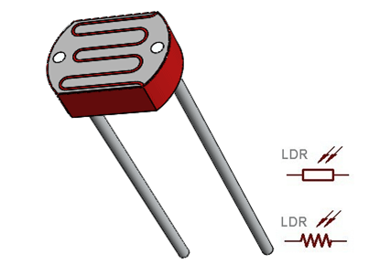
LDR Interfacing
LDR (Light Dependent Resistor), also called a photoresistor, is a sensor that responds to light. It is used to detect the intensity, presence, or absence of light. In darkness, the resistance of an LDR is high, and when sufficient light falls on it, the resistance decreases significantly.

Slide 12
Code(Interfacing with LDR)
const int ledPin = 5; // digital pin 5
const int ldrPin = A0; // analog pin 0
void setup() {
Serial.begin(9600);
pinMode(ledPin, OUTPUT); // Here LED is determined as an ouput or an indicator.
pinMode(ldrPin, INPUT); // Here LDR sensor is determined as input.
}
void loop() {
int ldrStatus = analogRead(ldrPin);
if (ldrStatus <= 200) {
digitalWrite(ledPin, HIGH); // If LDR ← darkness led ← high that means led will glow.
Serial.print("Darkness over here, turn on the LED : ");
Serial.println(ldrStatus);
} else
{
digitalWrite(ledPin, LOW); // LDR←light, the LED ←LOW, so the LED stops glowing.
Serial.print("There is sufficeint light , turn off the LED : ");
Serial.println(ldrStatus);
}
}

Slide 13
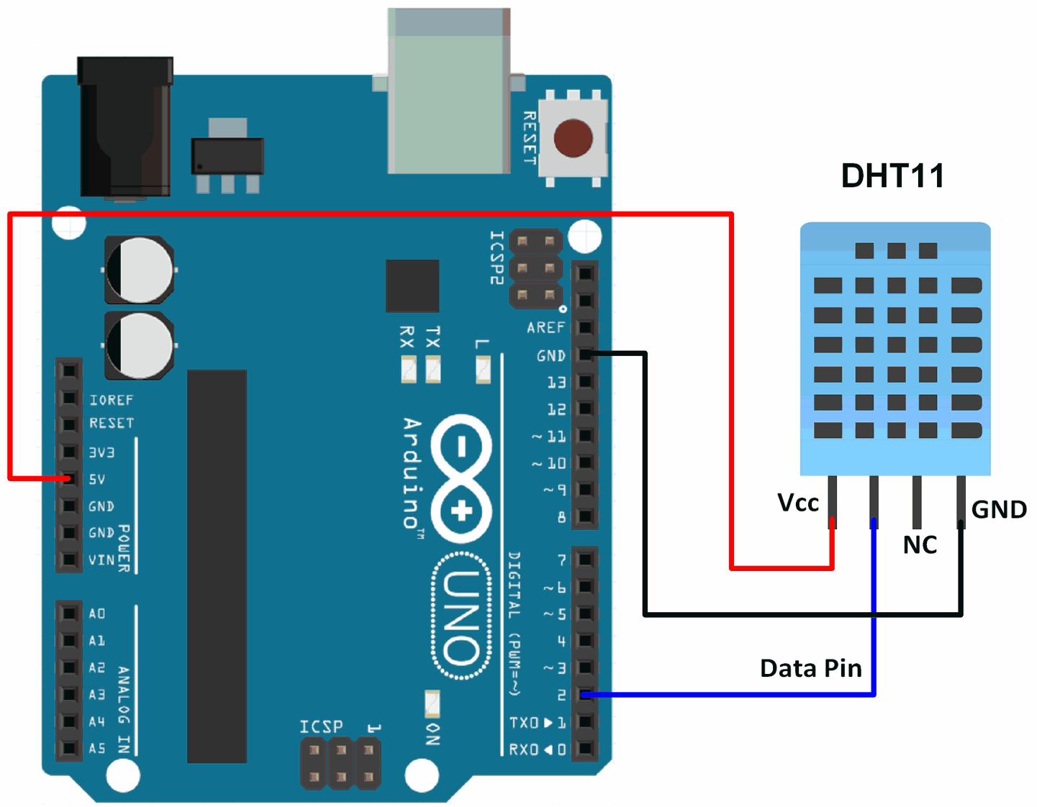
DHT11 (Four Pin)
DHT11 sensor with 4 pin is used for Humidity and Temperature Reading
DHT11 sensor with 3 pin is used only for Humidity.
DHT11 Library
https://www.youtube.com/watch?v=p_aKKp_nRUM

Slide 14
DHT11
#include <dht11.h>
#define DHT11PIN 4
dht11 DHT11;
void setup()
{
Serial.begin(9600);
}
void loop()
{
Serial.println();
int chk = DHT11.read(DHT11PIN);
Serial.print("Humidity (%): ");
Serial.println((float)DHT11.humidity, 2);
Serial.print("Temperature (C): ");
Serial.println((float)DHT11.temperature, 2);
delay(2000);
}
https://lastminuteengineers.com/dht11-module-arduino-tutorial/

Slide 15
Ultrasonic Sensor (HC-SR04)
The ultrasonic sensor uses sonar to determine the distance to an object. Here’s what happens:
The ultrasound transmitter (trig pin) emits a high-frequency sound (40 kHz).
The sound travels through the air. If it finds an object, it bounces back to the module.
The ultrasound receiver (echo pin) receives the reflected sound (echo).

Slide 16
Ultrasonic Sensor (HC-SR04)
Features
Power Supply :+5V DC
Quiescent Current : <2mA
Working Current: 15mA
Effectual Angle: <15°
Ranging Distance : 2cm – 400 cm/1″ – 13ft
Resolution : 0.3 cm
Measuring Angle: 30 degree
Trigger Input Pulse width: 10uS TTL pulse
Echo Output Signal: TTL pulse proportional to the distance range
Dimension: 45mm x 20mm x 15mm

Slide 17
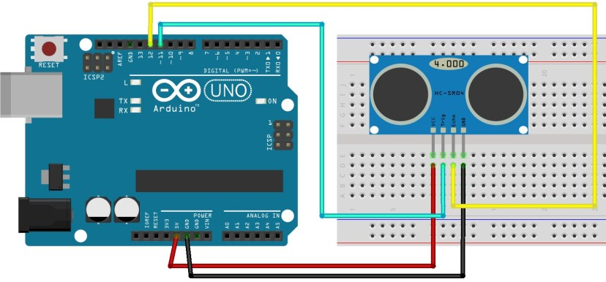
Wiring

Slide 18
Code
int trigPin = 11; // Trigger
int echoPin = 12; // Echo
long duration, cm, inches;
void setup()
{
//Serial Port begin
Serial.begin (9600);
//Define inputs and outputs
pinMode(trigPin, OUTPUT);
pinMode(echoPin, INPUT);
}

Slide 19
Code
void loop()
{
// The sensor is triggered by a HIGH pulse of 10 or more microseconds.
// Give a short LOW pulse beforehand to ensure a clean HIGH pulse:
digitalWrite(trigPin, LOW);
delayMicroseconds(5);
digitalWrite(trigPin, HIGH);
delayMicroseconds(10);
digitalWrite(trigPin, LOW);
// Read the signal from the sensor: a HIGH pulse whose
// duration is the time (in microseconds) from the sending
// of the ping to the reception of its echo off of an object.
pinMode(echoPin, INPUT);
duration = pulseIn(echoPin, HIGH);
// Convert the time into a distance
cm = (duration/2) / 29.1;
// Divide by 29.1 or multiply by 0.0343
inches = (duration/2) / 74;
// Divide by 74 or multiply by 0.0135
Serial.print(inches);
Serial.print("in, ");
Serial.print(cm);
Serial.print("cm");
Serial.println();
delay(250); }

Slide 20
Gas Sensor Working
A gas sensor is a device used to detect the presence and concentration of gases
Converts gas concentration into an electrical signal
Commonly used for safety, monitoring, and automation

Slide 21
Types of Gas Sensors
Semiconductor (MQ series)
Electrochemical
Infrared (IR)
Catalytic bead
Photoionization sensors

Slide 22
Semiconductor Gas Sensor (Most Common)
Uses metal oxide semiconductor (SnO₂)
Resistance changes when gas is present
Requires a heater for operation
Low cost and widely used

Slide 23
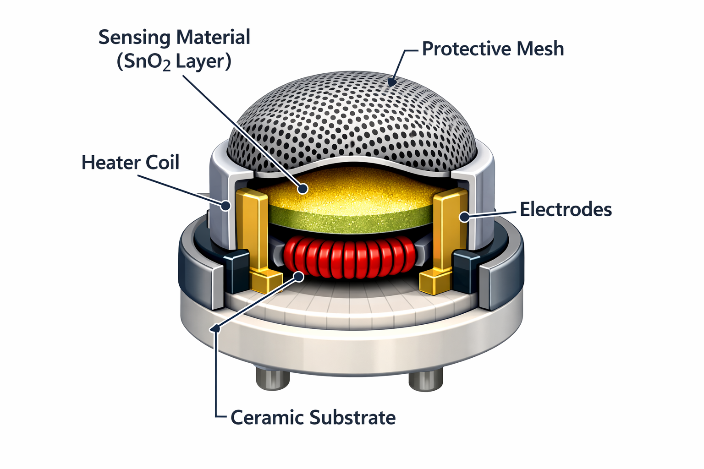
Construction of Gas Sensor
Sensing material (SnO₂ layer)
Heater coil
Electrodes
Protective mesh
Ceramic substrate

Slide 24
Working
Sensor surface absorbs oxygen from air
Oxygen captures free electrons → increases resistance
When target gas is present, it reacts with oxygen
Electrons are released → resistance decreases
https://www.youtube.com/watch?v=usEe3spV5vI

Slide 25
Signal Generation
Change in resistance alters output voltage
Voltage is proportional to gas concentration
Output can be analog or digital
Interfaced with microcontrollers

Slide 26
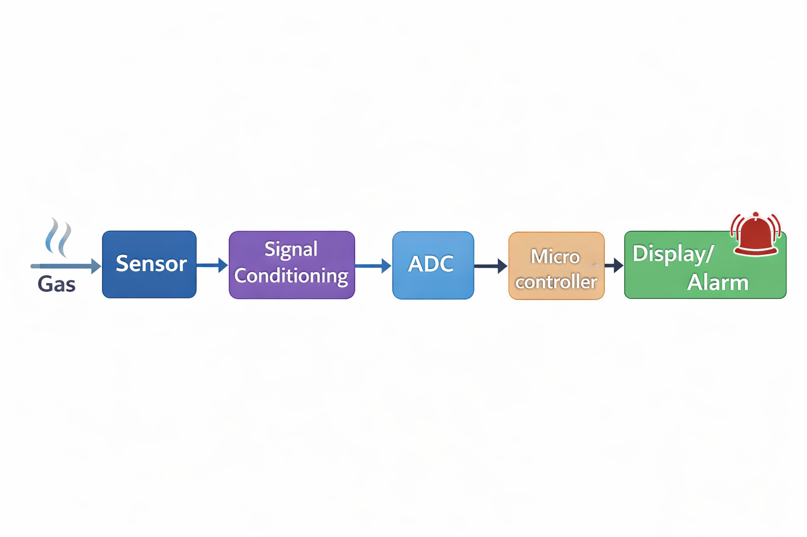
Block Diagram

Slide 27
Characteristics of Gas Sensors
Sensitivity
Selectivity
Response time
Recovery time
Operating temperature

Slide 28
Applications
LPG gas leakage detection
Industrial safety systems
Air quality monitoring
Medical applications
Smart homes and IoT

Slide 29
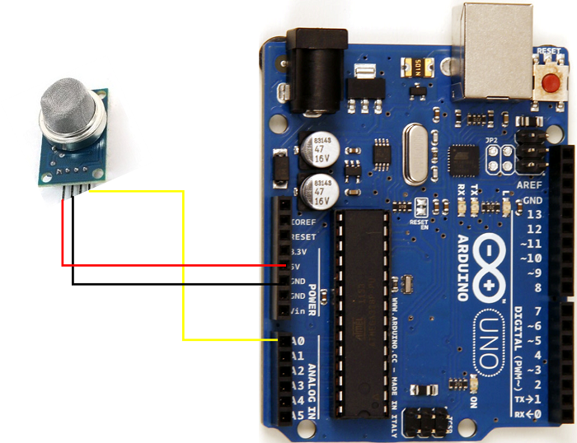
Code

Slide 30
Code for MQ2
int sensorPin = A0;
int sensorThreshold = 300;
void setup() { // put your setup code here, to run once:
Serial.begin(9600);
pinMode(sensorPin, INPUT);
}
void loop() { // put your main code here, to run repeatedly:
if (analogRead(sensorPin) > sensorThreshold)
{
Serial.println("Gas concentration too high!");
} else
{
Serial.println("Gas concentration in control");
}
}

Slide 31
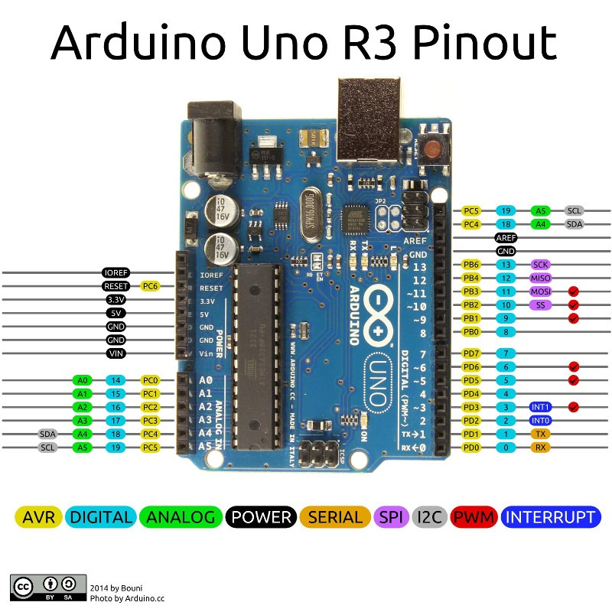

Slide 32
What Is Arduino UNO?
Microcontroller board based on ATmega328P
Widely used for embedded systems & electronics projects
Operates at 5V logic level

Slide 33
Types of Pins on Arduino UNO
Power Pins
Digital I/O Pins
Analog Input Pins
Communication Pins
Special Function Pins (AREF, Reset, ICSP)

Slide 34
Power Pins Overview
Power pins & purpose:
5V & 3.3V: Regulated supply output
Vin: External power input (7–12 V recommended)
GND: Ground reference
AREF: Reference voltage for ADC

Slide 35
Digital I/O Pins (0–13)
14 Digital I/O pins configurable as input or output
Use pinMode(), digitalRead(), digitalWrite() in code
Operate at 5V; safe current up to ~20 mA per pin

Slide 36
Serial Communication (UART)
Pins 0 (RX) and 1 (TX)
Used for serial communication with computer or peripherals
Connected to USB-to-serial chip on board

Slide 37
External Interrupt Pins
Interrupts allow reacting immediately to signal changes
Pin 2 (INT0) & Pin 3 (INT1) supported
Useful for buttons, encoders, and fast sensor signals

Slide 38
PWM Pins (Pulse Width Modulation)
PWM simulates analog output by switching digital signal
PWM pins: 3, 5, 6, 9, 10, 11
Great for LED dimming, motor speed control, and sound

Slide 39
SPI Communication Pins
High-speed communication protocol
10 (SS), 11 (MOSI), 12 (MISO), 13 (SCK)
Used for SD cards, displays, sensors, etc

Slide 40
Analog Input Pins
A0–A5 analog input pins
Reads real voltage levels (0–5 V)
10-bit ADC converts voltage to digital (0–1023

Slide 41
Analog Pins as Digital I/O
Analog pins can also serve as digital I/O
Enabled through software configuration
Software Configuration
Analog pins are enabled as digital I/O using standard digital functions:
pinMode(A0, INPUT / OUTPUT);
digitalWrite(A0, HIGH / LOW);
digitalRead(A0);
Here, A0–A5 act like digital pins D14–D19

Slide 42
AREF & ADC Reference
AREF – sets reference for analog inputs
Improves measurement accuracy
Useful for external sensors with different voltage ranges
Example: Using AREF for Accurate Analog Measurement
A temperature sensor outputs voltage in the range 0–3.3 V
Arduino Uno default ADC reference is 5 V
This causes lower resolution and reduced accuracy
Soln
Apply 3.3 V to the AREF pin
Configure the ADC reference in software
analogReference(EXTERNAL);

Slide 43
Reset & ICSP Header
RESET – resets the board
ICSP header – for programming microcontroller directly
Useful for bootloader or advanced debugging

Slide 44
Pin Current & Safety
Recommended: ≤ 20 mA per I/O pin
Absolute max: 40 mA per pin
Total current across all pins should stay below limits to avoid damage

