Slide 1



Ozz: Identifying Kernel Out-of-Order Concurrency Bugs with In-Vivo Memory Access Reordering
Dae R. Jeong¹², Yewon Choi², Byoungyoung Lee³, Insik Shin², Youngjin Kwon²
¹Georgia Institute of Technology
²Korea Advanced Institute of Science & Technology
³Seoul National University
Notes:
Good morning, my name is 대룡 정 and I am a post-doctoral researcher at Georgia Tech.
Today I’m going to talk about our research to find concurrency bugs in the kernel.

Slide 2
Ozz: Identifying Kernel Out-of-Order Concurrency Bugs with In-Vivo Memory Access Reordering
Dae R. Jeong¹², Yewon Choi², Byoungyoung Lee³, Insik Shin², Youngjin Kwon²
¹Georgia Institute of Technology
²Korea Advanced Institute of Science & Technology
³Seoul National University
Notes:
However, concurrency bugs that I’m going to talk about is a specific type of concurrency bugs.
As you can see in the title, it is a concurrency bug, but related to out-of-order execution.
So, let’s see what it is first.

Slide 3
Concurrency bugs caused by
Out-of-order execution
The culprit!
Syscall A
Syscall B
Syscall A initializes ptr
then announces it is ready
ptr = malloc();
ready = true;
if (ready)
*ptr = 1
If it is ready,
Syscall B accesses ptr
Uninitialized access!
Okay, Syscall B seems to access ptr only if it is ready
In Apple Silicon M3, however… What?
Why?
Notes:
Here is an example of such concurrency bugs.
There are two system calls where
<click> systcall A initializes a pointer, and announces that the pointer is ready
<click> And Syscall B checks that the pointer is ready and then accesses the pointer
<click> This seems correct. Syscall B seems to access the pointer only if the pointer is ready
<click> However, when we run this example in, for example, Applic Silicon M3,
<click> then we may see that syscall B accesses an uninitialized pointer.
This is counterintuitive and why does this happen.
<click> The reason is in the title. This bug occurs because of out-of-order execution.

Slide 4
Concurrency bugs caused by
Out-of-order execution
In reality…
Syscall A
Syscall B
ptr = malloc();
ready = true;
Syscall A announces it is ready
Wait… it seems something is missing?
if (ready)
*ptr = 1
Okay, it is ready,
I am going to access ptr
Uninitialized access!
What is the correct implementation?
Notes:
In real execution,
<click> Syscall A can announce that the pointer is ready even before initializing the pointer.
In the perspective of the architecture, this is an entirely legal behavior.
<click> So syscall B does not know that the pointer has not been initialized
<click> And the uninitialized access bug occurs as it keeps running
<click> Then, What is the root cause of this bug? How can we prevent this bug?

Slide 5
Memory barrier to prevent out-of-order execution
Syscall A
Syscall B
ptr = malloc();
ready = true;
The processor guarantees that
ptr is initialized
before setting ready to true
memory_barrier();
if (ready)
*ptr = 1
If developers misses memory barriers,
out-of-order execution causes concurrency bugs
Notes:
The answer is a memory barrier.
If we look at Syscall A, these two instructions have the ordering invariant that the first instruction should be executed before the second one.
<click> Accordingly, developers need to insert a memory barrier between the two instructions in syscall A.
<click> When executing the memory barrier, the processor guarantees that the first instruction is finished before the second instruction.
<click> As you can see in this example, developers should be aware of where to correctly put memory barriers.
Otherwise, out-of-order execution may cause concurrency bugs.

Slide 6
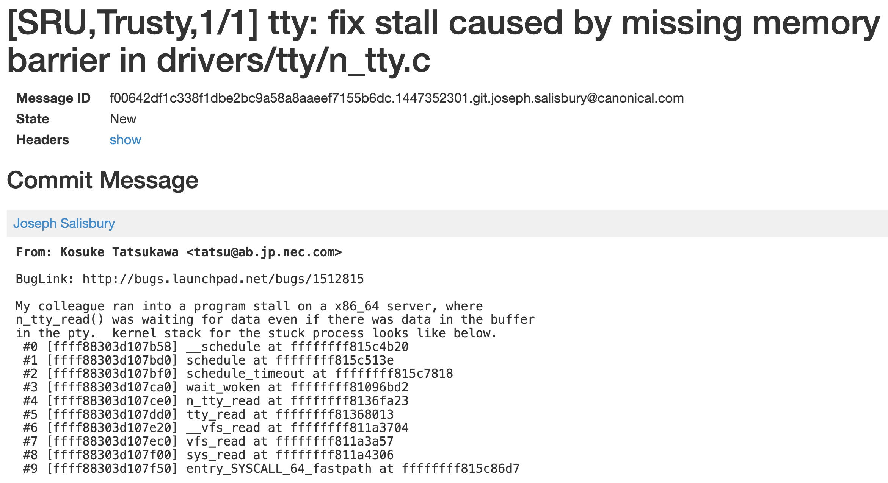

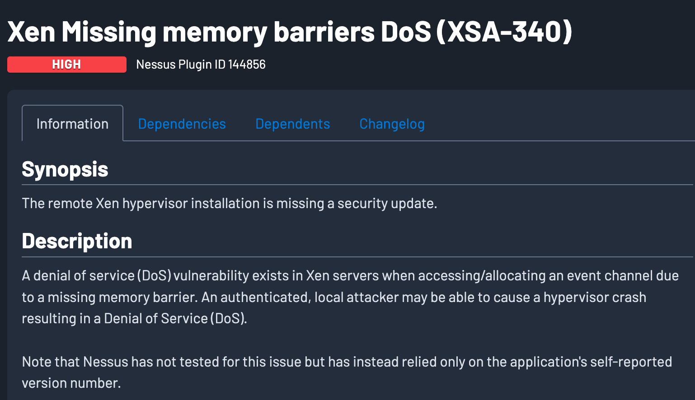


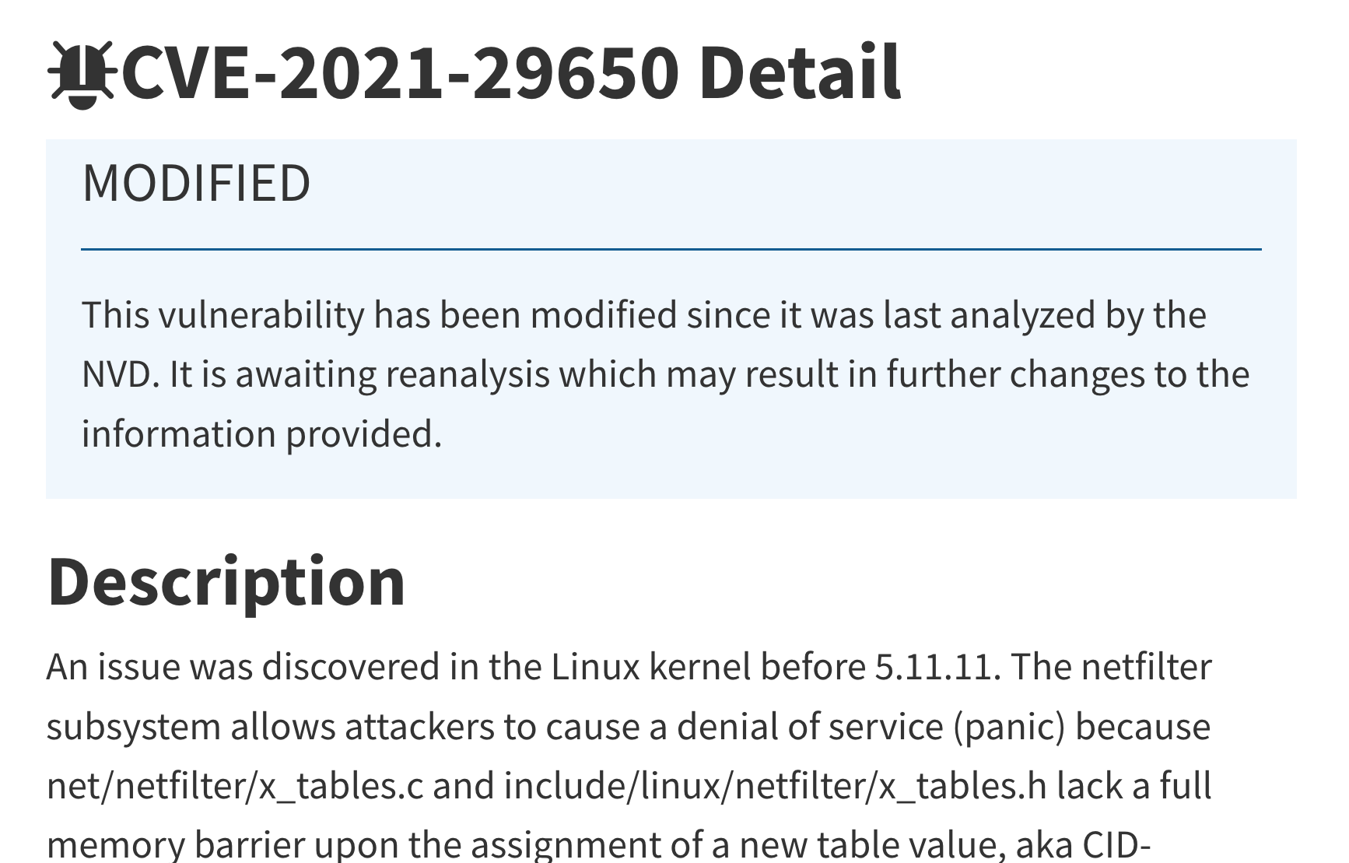
Machines exhibiting this behavior
ARM-based machines are getting more popular these days
The goal of this work is to identify
concurrency bugs that are caused by missing memory barriers
Memory ordering is hard to think about,
and people won't even realize that they may be wrong.
- Linux developer
Notes:
In these days, machines which exhibit this behavior is getting more popular.
For example, there are high-performance ARM-based servers, or high-end mobile devices.
Most notably, macbooks you are using right now exhibit this behavior.
<click> However, as one linux developer whose last name is torvads said, it is really hard to think about the ordering and memory barriers,
<click> Unfortunatley, consequences of such bugs severely harm the security and reliability of systems.
<click>So, the goal this work is to find concurrency bugs that are caused by missing memory barriers.

Slide 7
Challenges in identifying out-of-order bugs
OoO bugs manifests depending on two types of non-deterministic behaviors
Thread interleaving
The order of memory accesses between multiple threads
Out-of-order execution
The order of memory accesses inside a single thread
Notes:
However, finding such concurrency bugs is extremely difficult because they depends on two types of nondeterministic behaviors, thread interleaving and out-of-order execution.

Slide 8
Challenges in identifying out-of-order bugs
OoO bugs manifests depending on two types of non-deterministic behaviors
No approach has been proposed to
control out-of-order execution
Even worse, previous approaches obscure
the observation of out-of-order execution!
Previous work:
- DataCollider [OSDI’10], SKI [OSDI’14],
- Razzer [S&P’19], Snowboard [SOSP’21], …
- Various methods are used
(e.g., breakpoints, suspending vCPUs...)
Thread interleaving
The order of memory accesses between multiple threads
Out-of-order execution
The order of memory accesses inside a single thread
Notes:
For decades, many works are proposed to control thread interleavings to better identify concurrency bugs.
They control thread interleaving with various mechanisms such as breakpoints.
Based on the ability of controlling thread interleaving, they have achieved remarkable success in identifying concurrency bugs.
<click>However, among the two non-deterministic behaviors,
<click> we still lack an understanding of how to control out-of-order execution.
Unlike thread interleaving, out-of-order execution happens at a microarchitectural level inside a processor, and we don’t have a mechanism to control it.
Even worse, controlling thread interleaving obscures the effect of out-of-order execution.

Slide 9
Challenges in identifying out-of-order bugs
Controlling thread interleaving obscures the effect of out-of-order execution
Syscall A
Syscall B
ptr = malloc();
ready = true;
BP
BP acts as a memory barrier
if (ready)
*ptr = 1
ptr is always initialized…
Controlling out-of-order execution requires a completely new approch
Notes:
In a previous example, we may adopt a breakpoint to control thread interleaving.
<click> Let’s say we use a breakpoint to do scheduling after executing the second instruction of syscall A.
<click> However, hitting the breakpoint enforces the ordering between the two instructions, <click> so syscall B always sees the initialized pointer.
<click> As such, in order to effectively identify out-of-order concurrency bugs, we need a completely new approach to control out-of-order execution.

Slide 10
In this work, we introduce…
OEMU
  A mechanism to tame the non-deterministic behavior of out-of-order execution
  during runtime
Ozz
  A kernel fuzzer tailored to find OoO bugs by deterministically controlling
    Out-of-order execution through OEMU, and
    Thread interleaving thruugh a custom scheduler from a previous work¹
1: Jeong, Dae R., Byoungyoung Lee, Insik Shin, and Youngjin Kwon.
"Segfuzz: Segmentizing thread interleaving to discover kernel concurrency bugs through fuzzing." In 2023 IEEE Symposium on Security and Privacy (SP).
Notes:
In this work, we introduce two software.
The first one is OEMU which is a mechanism to control out-of-order exeucution during kernel runtime.
And the second one is Ozz which is a kernel fuzzer to identify out-of-order bugs.

Slide 11
In this work, we introduce…
OEMU
  A mechanism to tame the non-deterministic behavior of out-of-order execution
  during runtime
Ozz
  A kernel fuzzer tailored to find OoO bugs by deterministically controlling
    Out-of-order execution through OEMU, and
    Thread interleaving through a custom scheduler from a previous work¹
1: Jeong, Dae R., Byoungyoung Lee, Insik Shin, and Youngjin Kwon.
"Segfuzz: Segmentizing thread interleaving to discover kernel concurrency bugs through fuzzing." In 2023 IEEE Symposium on Security and Privacy (SP).
Notes:
Now let me introduce OEMU first.

Slide 12
OEMU
A mechanism to control out-of-order execution during runtime
  Consisting of a compiler pass and callback functions
X = 1;
r1 = Y;
store_value(&X, 1);
r1 = load_value(&Y);
Compile
Source code
Compiled binary
Providing two primitive operations
  Delayed store operation
  Versioned load operation
Notes:
As I said, OEMU is a mechanism to control out-of-order execution during runtime.
It consists of a compiler pass and callback functions
<click> When compiling a kernel source code,
<click> it replaces instructions which access global memory objects to function calls.
Note that r1 is a local variable on a stack, so OEMU does not consider about it.
<click> Then, during the kernel execution, these functions provide two primitive operations to control out-of-order execution, which are delayed store operation and versioned load operation.

Slide 13
Delayed store operation
Emulating how hardware reorders store operations
Store buffer
- A small hardware component that temporary
holds the results of store operations
- It may change the order in which the results
of store operations are written to memory
CPU0
CPU1
Store
buffer
Store
buffer
Memory
➔ OEMU emulates the store buffer!
Notes:
Among the two operations, delayed store operation emulates how hardware reorders store operations.
Let’s look at this picture to explain about it.
<click> In this piecture, we can see a small microarchitectural component which is called a store buffer.
The store buffer temporary holds the results of store operations,
and it may change the order of store operations.
<click> So, delayed store operations emulates the store buffer to reorder store operations.

Slide 14
Delayed store operation
through emulating the store buffer
During runtime…
Syscall A
Syscall B
We want to reorder
the exec. order B ➔ A
A: ptr = malloc();
B: ready = true;
We instruct the store buffer to
1) hold the value of ptr
2) flush the value of ready
<ptr, addr>
if (ready)
*ptr = 1
<ready, true>
Per-core virtual store buffer
Uninitialized access!
ptr
ready
uninit.
true
false
Memory
Notes:
Now let’s see how emulating the store buffer can reorder store operations
As you can see, at the beginning, the pointer is not initialized, and the value of ready is false
<click> Then, suppose we want to reorder instructions A and B.
<click> For this, we implement a per-core virtual store buffer.
Then, before running the system call, we instruct the store buffer to hold the value of ptr, but flush the value of ready
<click> Now, let’s start the execution.
<click> When the instruction A is executed, the store buffer holds the value of the pointer instead of writing it to memory. it is just because we instructed the store buffer to do that.
So even after executing the instruction A, the value of the pointer remains unchanged in memory.
<click> Then, when the instruction B is executed, the store buffer flushes the value of ready to memory. This is also because we instructed the store buffer to do that.
So, the state of memory is what we want.
The value of pointer is not initialized and ready is true.
<click> Lastly, when syscall B runs, the uninitialized access bug occurs.

Slide 15
Versioned load operation
Genuine architectural behavior
Syscall A
Syscall B
A processor may read memory ahead of previous instructions
Ex) reading the address of ptr before ready in Syscall B
Read the invalid addr of ptr
ptr = malloc();
memory_barrier();
ready = true;
*ptr = 1
if (ready)
Another memory barrier is needed here!
Uninitialized access!
Notes:
While delayed store operations reorders store operations, OEMU provies versioned load operation to reorder load operations.
Versioned load operation is needed to identify another missing memory barrier in syscall B.
<click>What I mean is that, in this example,
<click>a processor can read the address of ptr before all other instructions.
At this point, the pointer has not been initialized so the address is invalid.
<click> And then syscall A does the intialization.
so when syscall B runs, the value of ready is true.
But syscall B has the invalid address of pointer, causing the uninitialized access bug.
<click>To prevent this, another memory barrier is needed in syscall B,
and versioned load operation is to find concurrency bugs due to missing this barrier.

Slide 16
Versioned load operation
Emulating the architectural behavior
Syscall A
Syscall B
A processor may read memory ahead of previous instructions
Ex) reading the address of ptr before ready in Syscall B
A versioned load operation emulates this hardware behavior
- It allows a load operation to read an old version of the value
Record the invalid addr of ptr
ptr = malloc();
memory_barrier();
ready = true;
*ptr = 1
if (ready)
OEMU manages multiple versions of a value
Please check the paper for detail!
may read the old and invalid
address of ptr
Notes:
Similar to delayed store operations, versioned load operations also emulates how hardware reorders load operations.
<click>it records the invalid address of the pointer in advance,
<click>and when syscall B needs to read the address of pointer,
It allows syscall B to read the old and invalid address of pointer.
<click> Because of the time limit, I’ll omit the details of the implementation, and please check our paper for details.

Slide 17
In this work, we introduce…
OEMU
  A mechanism to tame the non-deterministic behavior of out-of-order execution
  during runtime
Ozz
  A kernel fuzzer tailored to find OoO bugs by deterministically controlling
    Out-of-order execution through OEMU, and
    Thread interleaving through a custom scheduler from a previous work¹
1: Jeong, Dae R., Byoungyoung Lee, Insik Shin, and Youngjin Kwon.
"Segfuzz: Segmentizing thread interleaving to discover kernel concurrency bugs through fuzzing." In 2023 IEEE Symposium on Security and Privacy (SP).
Notes:
Now let’s move on to Ozz
Ozz is a kernel fuzzer to find out-of-order concurrency bugs in the kernel.
Based on OEMU and a custom scheduler from a previous work, Ozz deterministically control out-of-order execution and thread interleaving.

Slide 18

Ozz
A kernel fuzzer tailored to identify OoO bugs through two steps
  Step 1: Running single-threaded inputs to dynamically profile memory accesses
  Step 2: Running multi-threaded inputs to find OoO bugs
Step 1
Step 2
Sequential Input
Sequential Input
Sequential Input
fd = syscall A(x, y)
syscall B(fd, z)
syscall C(fd, w)
Thread
interleaving
Out-of-order
execution
Notes:
Ozz consists of two steps
<click> The first step is to run single-threaded inputs to dynamically profile memory accesses,
<click> and the second step is to run multi-threaded inputs to find out-of-order bugs.

Slide 19

Step 1: Profiling memory accesses
Sequential Input
Sequential Input
fd = syscall Ay)
Sequential Input
syscall B(fd, z)
fd = syscall A()
syscall C(fd, w)
syscall B(fd, z)
fd = syscall A(x, y)
syscall C(fd, w)
syscall B(fd, z)
Ozz utilizes fuzzing to generate sequential inputs
- Exploring execution paths as much as possible
- Dynamically tracing memory accesses of system calls
Select system call pairs accessing shared memory objects
- Ozz will run them concurrently in Step 2
syscall C(fd, w)
fd = syscall A(x,y)
syscall B(fd, z)
…
Notes:
In the first step,
<click>Ozz utilizes fuzzing to generate sequential inputs while exploreing execution paths as much as possible.
<click> it also dynamically traces memory accesses of each system call.
<click>Then, among all system calls, Ozz selects pairs of system calls which access shared memory objects.
In this example, colors represent a memory object and syscall A and B access shared memory objects.
They will run concurrnely in Step 2

Slide 20

Step 2: Finding OoO bugs
1. Guess where a memory barrier is missing
Syscall A
Syscall B
How?
ptr = malloc();
ptr = malloc();
ready = true;
memory_barrier();
2. Execute instructions in a way that would
not happen if the memory barrier existed
If a memory barrier existed,
the store to ptr would not be delayed
if (ready)
*ptr = 1
Uninitialized access!
3. Observe whether the kernel malfunctions
Notes:
With such pairs of system calls, Ozz finds concurrency bugs due to out-of-order execution.
The idea is simple.
<click> First, Ozz gueses where a memory barrier is possibly missing
In this example, it is represented as the red arrow
<click> Then, Ozz executes instructions in a way that would never happen if the memory barrier existed.
For example, if there was a memory barrier at the red arrow,
the processor always guarantees that the first store is finished before the second store.
<click> However, in this example, there is no memory barrier, and the processor can delay the first store operation until syscall B accesses the pointer.
<click> Lastly, ozz simply runs instructions and observes whether the kernel malfunctions or not.
<click> Second and third setps relatively straightforward, so let me explain how Ozz guesses where a memory barrier is missing.

Slide 21
Step 2: Finding OoO bugs
Guess where a memory barrier is missing
Maximizing the number of reordered memory accesses
Syscall A
Syscall B
ptr->len = len;
ptr->ops = &ops;
ready = true;
Case 1
Case 2
if (ready) {
len = ptr->len;
ptr->ops->confirm(len);
}
The more execution deviates from a sequential order,
the harder it becomes to reason about
Notes:
Ozz gueses the location of missing memory barrier by maximizing the number of reordered memory accesses.
<click>Our insight is that the more execution deviates from a sequential order,
the harder it becomes to reason about, increasing the chance of introducing subtle bugs.
Meaning that, our approach improves the effectiveness of bug detection by aggressively creating non-sequential behavior in kernel execution.
<click> I’m going to explain about this with a slightly modified example.
For simplity, let’s focus on syscall A,
<click>And I’m going to compare two cases of possible missing memory barriers.

Slide 22
Step 2: Finding OoO bugs
Guess where a memory barrier is missing
Maximizing the number of reordered memory accesses
Syscall A
Syscall B
ptr->ops = &ops;
ready = true;
ptr->len = len;
ptr->len = len;
Delayed by OEMU
Case 1
Enforced by the custom scheduler
if (ready) {
len = ptr->len;
ptr->ops->confirm(len);
}
Notes:
In case 1, Ozz guesses a memory barrier is missing after the first instruction in syscall A.
Then, among all execution scenarios, Ozz tries to run the case that maximize the number of reordered memory accesses.
<click>Ozz instructs the OEMU to delay the first instruction, and
<click> instructs the custom scheduler to enforce thread interleaving as represented as the black arrow.
In this case, just one store operation is reordered

Slide 23
Step 2: Finding OoO bugs
Guess where a memory barrier is missing
Maximizing the number of reordered memory accesses
Syscall A
Syscall B
ptr->len = len;
ptr->ops = &ops;
ready = true;
ptr->len = len;
ptr->ops = &ops;
Case 2
Delayed by OEMU
Enforced by the custom scheduler
if (ready) {
len = ptr->len;
ptr->ops->confirm(len);
}
In Case2, more memory accesses are reordered than in Case 1
Ozz prioritizes Case 2 as it is harder for developers to reason about
Notes:
On the other hand, in the case 2, Ozzs gusses a memory barrier is missing after the second instruction.
In that case,
<click> Ozz instructs OEMU to delay the first two store operations, and
<click> instructs the custom scheduler to enforce thread interleaving as represented as the black arrow as well.
<click> So, In Case 2, more memory accesses are reordered than in Case 1.
Like this, Ozz prioritizes cases that reorder more memory accesses as they are harder for developers to reason about, and they are more likely to cause concurrency bugs.

Slide 24
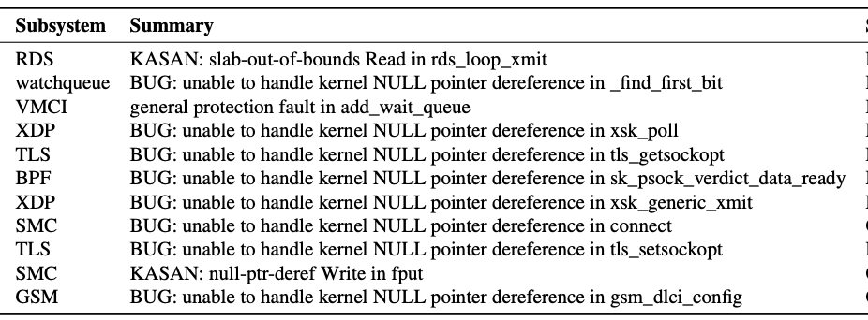
Evaluation
Finding unknown bugs / reproducing known bugs
We found 11 new OoO bugs in the Linux kernel
  Some were found in popular subsystemssuch as TLS or eBPF
  We reported all of them, and they were accordingly patched by the kernel developers
We show OMEU/Ozz can reproduce 8 out of 9 known OoO bugs
  The one failing case involves another non-deterministic behavior, thread migration
Please check our paper for more evaluation
Notes:
With Ozz, we conducted the evaluation to confirm that Ozz is effective in identifying out-of-order concurrency bugs in the kernel.
During our evaluation, we found 11 new out-of-order bugs in the Linux kernel.
Some were found in popular subsystems such as TLS or eBPF, and we reported all of them to the developers.
<click>We also confirmed that OEMU and Ozz can reproduce 8 out of 9 known bugs.
The reason of the one failing case is thread migration which is another non-deterministic behavior that we don’t consider in this work.
<click> For more evaluation, please checkout paper.

Slide 25
Conclusion
Our work introduces
  OEMU
    A mechanism to tame the non-deterministic behavior of out-of-order execution during runtime
  Ozz
    A kernel fuzzer tailored to find OoO bugs by deterministically controlling
      Out-of-order execution through OEMU, and
      Thread interleaving through a custom scheduler from a previous work
Ozz finds 11 new out-of-order concurrency bugs in the Linux kernel
Notes:
In conclusion, our work introduces two software, OEMU and Ozz with a purpose of identifying kernel concurrency bugs caused by out-of-order execution.
During our evaluation, we find 11 new out-of-order concurrency bugs in the Linux kernel, showing its effectiveness in identifying such concurrency bugs.

Slide 26
Ozz: Identifying Kernel Out-of-Order Concurrency Bugs with In-Vivo Memory Access Reordering
Q&A
Notes:
Thank you for listening and I'm happy to take any questions.

