Slide 1




PeTAL: Ensuring Access Control Integrity against Data-only Attacks on Linux
Juhee Kim, Jinbum Park, Yoochan Lee,
Chengyu Song, Taesoo Kim, Byoungyoung Lee
Notes:
Good morning everyone. My name is Juhee Kim and I am a phd student at Seoul National University.
Today, I am glad to present our work titled PeTAL: Ensuring Access Control Integrity against Data-only Attacks on Linux.
This is a joint work between Seoul National University, Samsung Research, UC Riverside, and Georgia Tech.

Slide 2
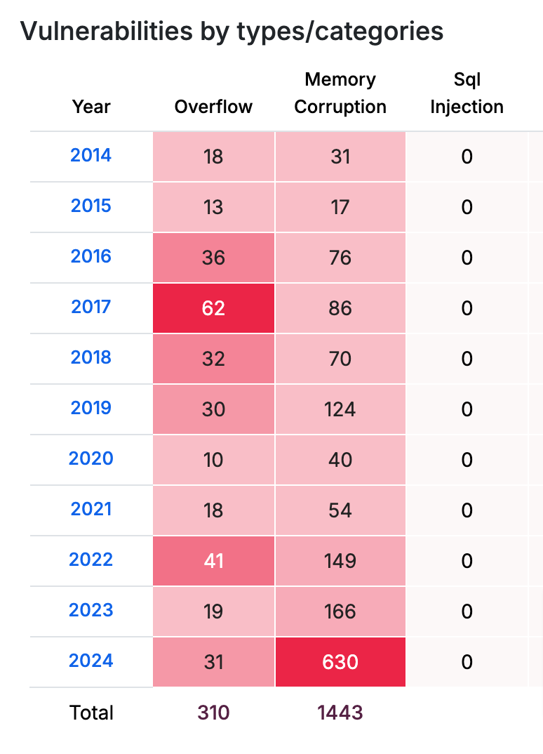

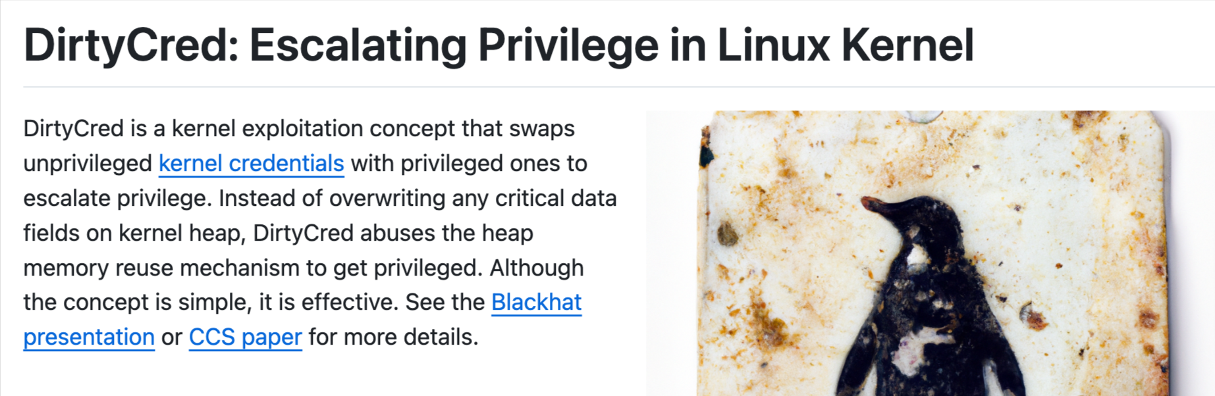
Linux kernel is an attractive attack target
Widely used
  Mobile devices, Servers, and IoT devices
Increasing number of vulnerabilities and exploit techniques
CVEdetails.com
Notes:
The Linux kernel has been an attractive target for attackers, because it's widely used in various systems.
However, due to its complexity and size, and the usage of unsafe C language, the Linux kernel has been vulnerable to memory corruption attacks and more vulnerabilities have been discovered and exploited over the years.
Therefore, we aim to protect the Linux kernel from memory corruption attacks and privilege escalations.

Slide 3

Kernel Privilege Escalation Attacks
Attacker
Attacker
Attacker
Privilege
: Low
Privilege
: High
Vulnerable SYSCALLs
Kernel
Kernel
Kernel
Access control
Access control
Memory Corruption
struct cred
struct cred
modprobe_path
modprobe_path
struct file
File
File
struct file
File
File
/home/attacker/my_file
Access control-related kernel data
/home/attacker/my_file
/etc/shadow
/etc/shadow
Notes:
First, let's take a look at a typical flow of kernel privilege escalation attacks.
Initially, the attacker has the lowest privilege in the system.
The kernel enforces access control when the attacker tries to access a resource like a file.
With the low privilege, the attacker can access their own files, but not sensitive files such as /etc/shadow, which stores password hashes.
But, the attacker can call vulnerable system calls to trigger kernel memory corruption vulnerabilities, and corrupt some kernel data.
As a result, the kernel's access control becomes compromised, allowing the attacker access any resource, including /etc/shadow. This escalates the attacker's privilege to the highest.

Slide 4

Protecting Access Control to Prevent Attacks
Attacker
Attacker
Attacker
Privilege
: Low
Privilege
: Low
Vulnerable SYSCALLs
Kernel
Kernel
Kernel
Access control
Access control
struct cred
modprobe_path
File
File
struct file
File
File
/home/attacker/my_file
Access control-related kernel data
/home/attacker/my_file
/etc/shadow
/etc/shadow
Notes:
To prevent these attacks, we need to protect the kernel's access control system.
That is, even with memory corruption vulnerabilities, some access control related data are protected, so that the attacker cannot gain an illegal access to resources.

Slide 5
PeTAL’s Data Flow Integrity
DFI is known to be performance-heavy
Selectively protect access control-related data
Leverage hardware extensions : ARM MTE for objects, PAC for pointers
T
MTE
P
T
P
PAC
T
P
P
T
P
T
Key questions:
1. What should be protected?
2. How should they be protected?
T
T
P
P
Kernel objects
Notes:
PeTAL tries to protect those data with data-flow integrity, DFI in short.
However, DFI is known to be performance heavy.
Therefore, PeTAL selectively protects access control-related data.
leveraging hardware extensions, ARM MTE for objects, and ARM PAC for pointers.
The key questions here are: What data should be protected, and how should they be protected?

Slide 6
Access Control System
Policy
: Data defining the allowed access
Enforcement
: Code enforcing the access control
Resource
: Data being protected
Notes:
To answer these questions, we need to understand the access control system, which consists policy, enforcement, and resource.
Policy defines the allowed access, enforcement is the code responsible for enforcing access control, and resource is the data being protected.

Slide 7
Access Control System in the Linux Kernel
User
Kernel
open(‘/home/attacker/my_file’, write)
→ fd
struct task_struct
struct cred
struct inode
Policy
: cred, uid, owner, mode
Policy
: Data defining the allowed access
cred
uid: attacker
owner: attacker
mode : rw / r-
DAC permission check (cred, inode, mode)
Enforcement
: DAC permission check
Enforcement
: Code enforcing the access control
↳ success: Grant file access
by creating a file descriptor & return fd
struct task_struct
struct
files_struct
struct
fdtable
Resource
: files, fdt, fd, mode, mapping
Resource
: Data being protected
struct file
mode
mapping
files
fdt
fd
Notes:
In the Linux kernel, the access control is exercised when a user attempts to access resource.
when a user tries to open my_file with write permission:
Policy required for file access are loaded from cred and inode objects.
Then, the kernel enforces the DAC permission check to evaluate whether the user has permission to access the file.
If the permission check is successful, the kernel grants access by creating a file descriptor and returning it to the user.

Slide 8
Access Control System in the Linux Kernel
User
Kernel
open(‘/etc/shadow’, write)
→ -EACCES
struct task_struct
struct cred
struct inode
Policy
: cred, uid, owner, mode
cred
uid: attacker
owner: root
mode : rw / --
DAC permission check (cred, inode, mode)
Enforcement
: DAC permission check
↳ fail: return –EACCES.
Resource
: files, fdt, fd, mode, mapping
Notes:
When a user tries to write /etc/shadow, which is writable only by root, the DAC permission check fails, and the kernel returns an error code, denying the access.

Slide 9
Attack 1: Corrupting Policy
Vulnerable SYSCALLs
Attacker
open( '/etc/shadow’ , write )
Kernel
→ fd
↳ passed: open file.
struct task_struct
struct cred
struct inode
Policy
: cred, uid, owner, mode
cred
uid
owner mode
DAC permission check (cred, inode, mode)
Enforcement
: DAC permission check
↳ success: Grant file access
by creating a file descriptor & return fd
struct task_struct
struct
files_struct
struct
fdtable
Resource
: files, fdt, fd, mode, mapping
struct file
mode
mapping
files
fdt
fd
Notes:
To compromise the access control system, an attacker can corrupt policy by memory corruption. The attacker can overwrite cred or inode objects, or the pointers to these objects.
Once the kernel reads the corrupted policy during the permission check, it grants the file access. As a result, a file descriptor to /etc/shadow is created and returned to the attacker.

Slide 10
Attack 2: Bypassing Enforcement & Corrupting Resource
Vulnerable SYSCALLs
Attacker
Kernel
→ fd
↳ passed: open file.
struct task_struct
struct cred
struct inode
Policy
: cred, uid, owner, mode
cred
uid
owner mode
DAC permission check (cred, inode, mode)
Enforcement
: DAC permission check
Bypass permission check
↳ Grant file access by forging file descriptor
struct task_struct
struct
files_struct
struct
fdtable
Resource
: files, fdt, fd, mode, mapping
struct file
mode
mapping
files
fdt
fd
Notes:
Another way is to bypass enforcement and corrupt the resource directly.
By corrupting one of the file descriptor-related data structures, the attacker can illegally gain file descriptor to /etc/shadow.

Slide 11
PeTAL’s Access Control Integrity
What should be protected?
Policy should be protected
Policy Integrity
: Ensure policy is not corrupted
struct task_struct
struct cred
struct inode
cred
uid capabilities
owner mode
Resource should also be protected
Complete Enforcement
: Ensure enforcement is always enforced when resource is accessed
DAC permission check (cred, inode, mode)
struct task_struct
struct
files_struct
struct
fdtable
struct file
mode
mapping
files
fdt
fd
Notes:
To prevent these attacks, PeTAL introduces a new concept named Access Control Integrity.
First, policy integrity ensures that policy is not corrupted.
Second, complete enforcement ensures that the access control is always enforced when accessing resources.
PeTAL's access control integrity addresses the question of what should be protected.
To provide policy integrity, policies should be protected.
To ensure complete enforcement, resource should be protected.

Slide 12
Collecting Policy and Resource from user interfaces
User
System calls e.g., SYSCALL_open()
Pseudo filesystems e.g., /sys/kernel/modeprobe_path
Kernel
↳ passed: open file.
User interface handler
Error code
Deny
Allow
Access Control
Resource
Notes:
Now, how do we collect them?
When a user accesses a resource, the user interacts with the kernel through user interfaces like system calls and pseudo file systems.
The kernel implements user interface handlers to process the user's requests, which involve access control to allow or deny the request.
If the kernel allows the request, the user can access the resource.
If the kernel denies the request, it returns an error code.

Slide 13

Collecting Policy and Resource from user interfaces
User
System calls e.g., SYSCALL_open()
Pseudo filesystems e.g., /sys/kernel/modeprobe_path
Kernel
↳ passed: open file.
Policy
Error code
copy_to/from_user()
Fail
raw data
Static Taint Analysis
Enforcement
Permission check
Success
Static Taint Analysis
Resource
Notes:
Internally, the kernel implements permission check as for the access control enforcement.
This permission check is based on policy.
Leveraging this observation, PeTAL collects policy used in permission check using static taint analysis.
If the permission check succeeds, the kernel reads or writes the resource on behalf of the user, either by directly transferring the raw data or through
copy_to/from_user functions.
Here, resource is collected by tracking the data that is read or written through the user interfaces with static taint analysis, particularly those accessed after successful permission checks.

Slide 14
PeTAL’s Data Flow Integrity
2. How should they be protected?
Selectively protect access control-related data
Leverage hardware extensions : ARM MTE for objects, PAC for pointers
P
struct inode
T
MTE
inode_hashtable
T
i_uid
struct task_struct
struct cred
i_mode
P
PAC
P
T
T
current
uid
P
cred
struct file
Heap object
P
files
T
struct files_struct
struct fdtable
f_mode
Global Variable
P
fdt
P
fd
Pointer
T
T
Notes:
Now we have the protection scope, then how should they be protected?
As mentioned earlier, PeTAL protects objects using MTE and pointers using PAC.

Slide 15
ARM MTE and PAC
Memory Tagging Extensions (MTE)
Memory object protection
Hardware memory tagging/tag checking
Dedicated tag storage in physical memory
Pointer Authentication Code (PAC)
Pointer protection
Hardware pointer signing/authentication
PAC key + PAC context + Pointer value
→ PAC Signiture
Pointer
Access
Object
Pointer
T1
&obj1
obj1
T1
Store
Memory
PAC Context
✓
&obj
Sign
PAC
T2
T2
&other_obj
&obj2
obj2
&obj
𝙓
Auth
T3
&obj2
T3
&other_obj
Load
obj3
Tag Check Fault
Authentication Failure
Notes:
Memory Tagging Extension, MTE, is hardware memory tagging based memory protection.
Physical memory has dedicated tag storage, and the tag is also stored in the pointer top bits.
On a memory access, the CPU checks whether the pointer tag matches the memory tag. If the tags do not match, it raises a tag check fault.
Pointer authentication code, protects the pointer by signing and authenticating the pointer.
The PAC signiture is created based on the PAC key in a register, a runtime configurable PAC context, and the pointer value.
The pointer is typically signed when it is stored to memory, and authenticated when it’s loaded.
So if the pointer is corrupted in memory, the PAC signiture mismatches when it is loaded and the pointer authentication failure is raised.

Slide 16
Protecting Objects with ARM MTE
Privileged Objects:
Objects that contain policy, resource, or their pointer
Non-privileged Objects:
Other objects
Random Tag (Tag 1-14)
Enforce Pointer’s tag on access
Fixed Tag (Tag 0)
Enforce tag 0 on access
Privileged Pointer
Privileged object
Non-privileged Pointer
Non-privileged object
T1
&obj1
obj1
T1
T0
&obj1
obj1
T0
T2
&obj2
T2
T0
&obj2
T0
obj2
obj2
T3
&obj2
T3
T0
&obj2
T0
obj3
obj3
Notes:
To protect objects using MTE, PeTAL divides kernel memory objects into privileged and non-privileged. Privileged objects contain policy, resource, or pointers to those data.
For them, a random tag from tag 1 to 14 is assigned for each object and pointer,
For other non-privileged objects, a fixed tag 0 is assigned and PeTAL enforces tag 0 on memory access.
By enforcing different ranges of tags, PeTAL ensures that privileged and non-privileged objects are isolated from each other, and further isolates privileged objects within themselves.

Slide 17
Protecting Pointers with ARM PAC
Privileged Pointers:
Pointers to privileged objects
Non-privileged Pointers:
Other pointers
PAC Sign/Authentication
No PAC Sign/Authentication
Pointer storage address as PAC Context
→ Bind PAC to the stored address
Privileged Pointer
Non-privileged Pointer
Memory
Memory
✓
Store
?
&priv_obj
&nonpriv_obj
Store
Sign
PAC
&priv_obj
-
&priv_obj
&nonpriv_obj
Auth
𝙓
✓
&priv_obj
?
Load
&nonpriv_obj
Load
Arbitrary read/write
Authentication Failure
Notes:
To protect pointers with PAC, PeTAL divides pointers into privileged and non-privileged pointers.
Privileged pointers are the pointers to the privileged objects
PeTAL signs and authenticates these pointers with PAC.
It also uses the address the pointer is stored as a PAC context, binding the pointer to the stored address.
This ensures that when a privileged pointer is corrupted, the PAC authentication failure is raised.
PeTAL does not protect other pointers to avoid performance overhead.

Slide 18
Complementary Relationship of MTE and PAC
MTE Tag Reuse
Prevent with PAC
: PAC is bound to the pointer stored address
Object1
Object2
No Tag Check Fault
Object1
Object2
Authentication Failure
Use ptr
PAC1
PAC2
T1
T2
PAC1
Use ptr
T1
T1
T2
&priv1
&priv1
T1
&priv2
&priv1
&priv2
&priv1
Leak pointer
Corrupt pointer
Leak pointer
Corrupt pointer
T1
&priv1
T1
PAC1
&priv1
Notes:
You might wonder why PETAL uses both MTE and PAC, not either MTE or PAC.
The reason is that MTE and PAC complements each other, speicifcally on reuse attacks.
First, assume the attacker reuses MTE tag, which means leaking a tagged pointer and corrupting another pointer with the leaked one. When the corrupted pointer is used, no tag check fault would be raised because the pointer has the correct MTE tag.
PeTAL prevents this with PAC, by binding the PAC to the pointer's stored address.
If the pointer is illegally leaked and copied to another place, it will cause an authentication failure because the PAC is bound to the original object.

Slide 19
Complementary Relationship of MTE and PAC
PAC Reuse (Temporal)
Prevent with MTE
T4
&obj2
Object2
&obj2
Object1
Object2
&obj1
Freed
T3
&obj1
T4
Leak Pointer
PAC
PAC
&priv1
Leak Pointer
&priv2
&priv1
&priv2
PAC
PAC
&priv1
Corrupt pointer
&priv1
Corrupt pointer
Use ptr
Tag check fault
!=
No Authentication Failure
T3
T4
Notes:
Next, assume the attacker reuses PAC in a temporal vulnerability like Use-after-free,
The attacker first leaks the pointer and triggers use after free to corrupt the pointer in the exact same address with the leaked one.
Here, PAC cannot detect the attack because the pointer is correctly bound to the stored address.
MTE can detect this, because the object containing the pointer is randomly tagged for new allocation, and triggering use-after-free is likely to trigger tag check fault.

Slide 20


PeTAL Implementation
Clang/LLVM IR Pass
PeTAL
PeX - indcall resolution
Static Taint Analysis
Linux kernel source code
wllvm
vmlinux.bc
User Interfaces
Syscalls
Pseudo-fs
AArch64
Privileged Objects
Privileged Pointers
Inter-procedural
Points-to Analysis
Struct Types, GV Names
MTE
PAC
Data Flow Integrity Instrumentation
PeTAL-hardened Kernel
Priv/Non-priv Obj access
Priv/Non-priv Ptr access
Notes:
For the implementation, PeTAL mainly consists of three Clang/LLVM IR passes.
First, a static taint analysis collects policy and resource from the user interfaces, resulting in privileged objects and pointers.
They are in the form of struct types or global variable names.
Second, an inter-procedural points-to analysis classifies instructions, whether they are accessing privileged or non-privileged objects or pointers.
Third, the DFI instrumentation pass performs code instrumentation on the Linux kernel to enforce MTE and PAC based on the classification.
The result is a PeTAL-hardened kernel that operates on ARM devices supporting MTE and PAC.

Slide 21
Performance Evaluation
Evaluation setup
  Samsung Galaxy S22 – supports PAC and MTE*
  * MTE was enabled with the assistance of Samsung Electronics
  Android kernel 5.10.136
Kernel workloads
  LMBench 1.18x (MTE async) / 1.32x (MTE sync)
User workloads
  Nbench: 1.00x / LevelDB 1.03x / Apache httpd: 1.04x (MTE sync)
Security evaluations in the paper
Notes:
For performance evaluation, we used a Samsung Galaxy S22 device, which supports both ARM PAC and MTE.
This device is originally shipped without MTE, but were able to enable it with the assistance of Samsung Electronics. Now Pixel 8 and 9 are available with the MTE support.
For kernel workloads, focusing on system call overheads, PeTAL incurred 18, and 32% overhead on MTE async and sync mode respectively.
For user workloads, PeTAL incurred less than 5% overhead on average.
We also included a comprehensive security evaluation in the paper.

Slide 22
Summary
PeTAL defines Access Control integrity for the Linux kernel.
PeTAL proposes a novel way to identify protection targets leveraging the kernel’s user interfaces.
PeTAL’s DFI solution based on ARM MTE and PAC demonstrates acceptable performance overhead.
Notes:
PeTAL is a new approach to define access control integrity for the Linux kernel.
It proposes a novel way to identify protection targets based on kernel user interfaces.
PeTAL provides a DFI solution based on ARM MTE and PAC, demonstrating that it incurs acceptable performance overhead.

Slide 23
Thank you!
Notes:
Thank you for your attention. I am happy to take any questions.

Slide 24
Threat Model and Assumptions
Hardware
  AArch64, ARM MTE PAC
Kernel
  State-of-the-art self-protections (e.g., ASLR, NX/DEP, SMAP, CFI)
  1+ Memory coruption vulnerabilities
Attack vector
  Memory corruption attack through vulnerable system calls
  Corrupting access control policies/resources
Out of scope
  Access control system implementation error
  Page allocator error (e.g., GPU driver vulnerabilities)
  In-kernel executions (e.g., eBPF)
  Hardware side-channel attacks (e.g., Spectre, PACMAN, TikTag)

Slide 25
Correctness of the Static Analyses
Static Taint Analysis
  Goal: Collect kernel objects/pointers used as policy or resource from the user intefaces
  Evaluation: Manual inspection
    3 false positives due to complex data flows
    No false negatives
Coarse-grained Points-to Analysis
  Goal: Classify instructions to enforce the DFI
    Privileged / Non-privileged / Mixed
  Evaluation: Emperical verification
    The PeTAL-hardened kernel worked on QEMU and the Galaxy device

