Slide 1

Pangenome graph construction by pggb Vs. minigraph-cactus
Dr. Zuyu(Zoe) Yang
23-Sep-2022

Slide 2
Datasets for pangenome graph
4Sim genomes

Slide 3
Pangenome graph of Neisseria meningitidis
Example from 3STs of NZmenB
Notes:
NMI97349=NMI97348,
NMI97348 was removed due to duplication

Slide 4
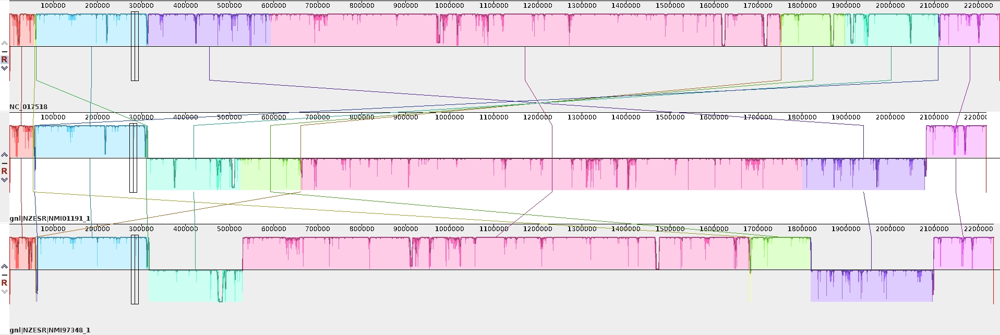
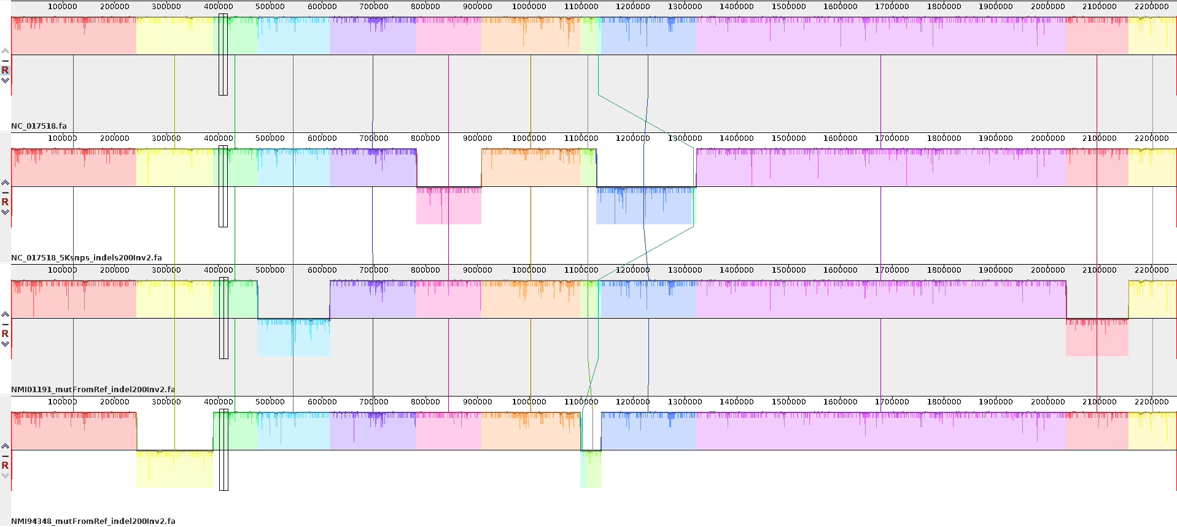
Simulate Neisseria meningitidis genomes
As there are big inversions among the 3ST genomes, to better understand how the pggb graph build and vg variant calling pipeline work, I simulated three genomes from ST42 reference (the best linear reference ), NC_017518 by simuG
ST42: NC_017518, mutate genome based on known SNPs from ST41, ST154
ST42, NMI01191, 2892SNPs
ST154, NMI97348, 4183SNPs
NC_017518, 5K random SNPs
ST42
ST41
NMI01191mutFromRef
NMI97349mutFromRef
NC_017518_5ksnps
ST154
3ST genome alignment showing big rearrangements
200indels, and 2 inversions
NC_017518
NC_017518_5KsnpsIndel200Inv2
ST41, NMI01191mutRefIndel200Inv2
ST154, NMI97348mutRefIndel200Inv2
Three simulated genomes + original ref as 4Sim genomes
4Sim genome alignment showing big rearrangements

Slide 5
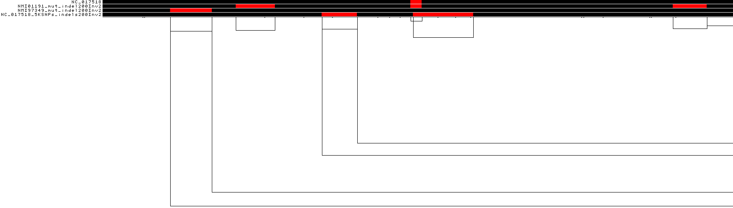
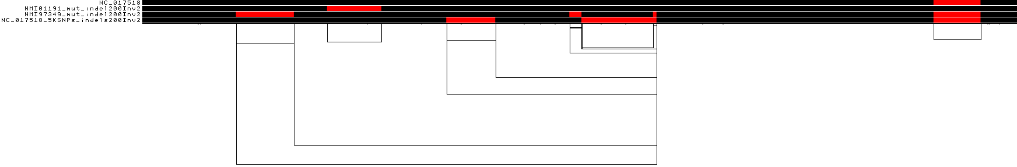
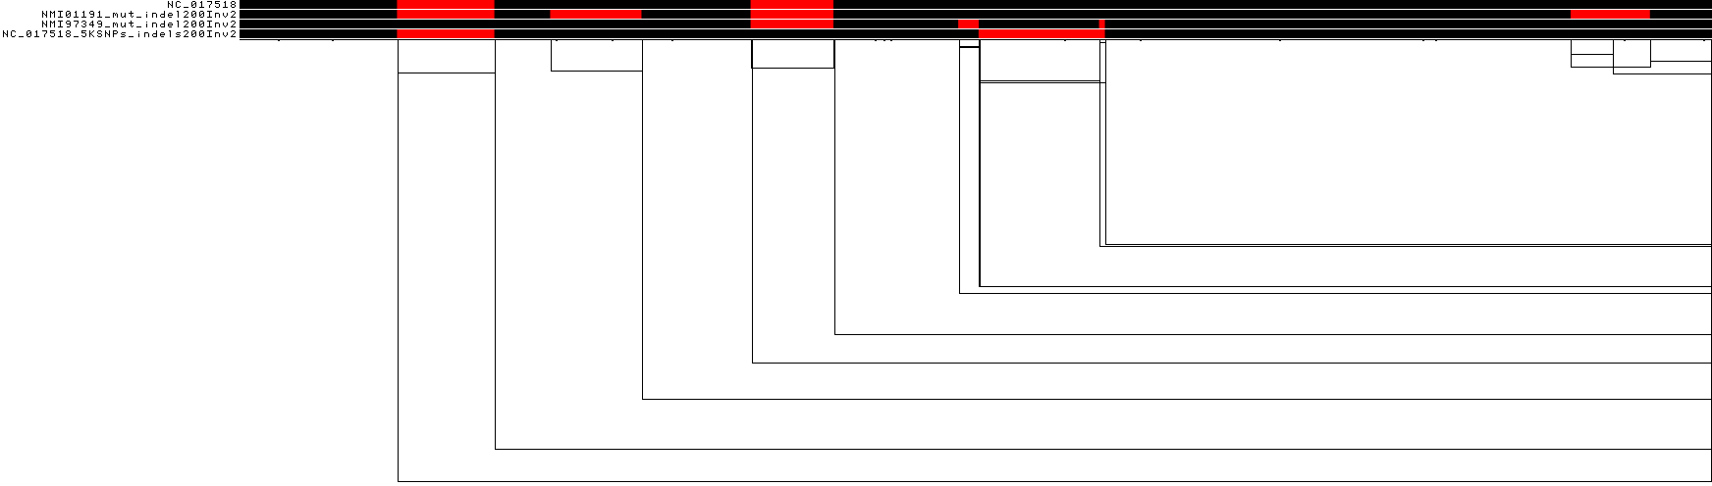
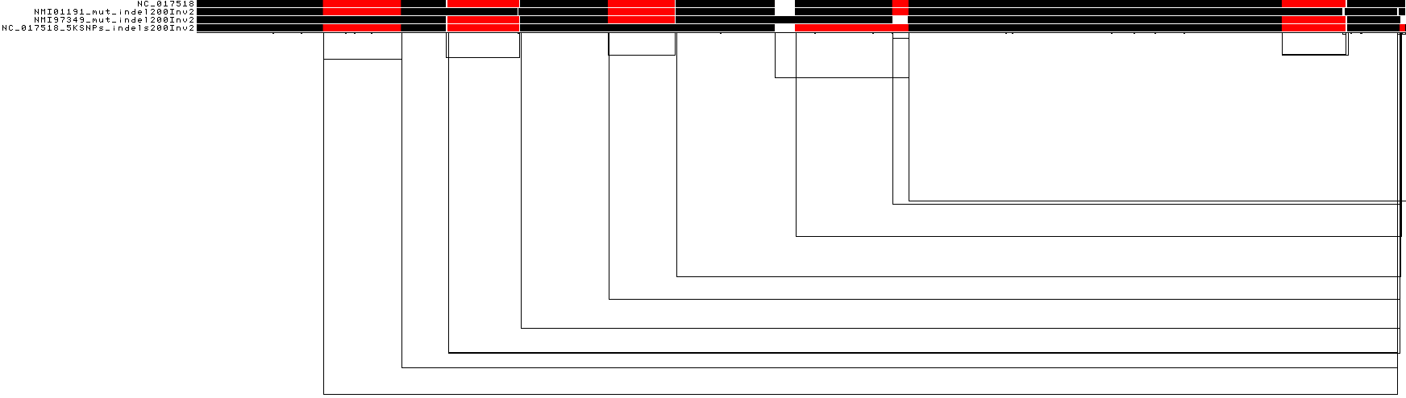
Pangenome graph of 4Sim genomes by different pggb settings
4Sim_1_1k95
4Sim_2_1k96
4Sim_3_2k96
4Sim_4_5k96
4Sim_5_10K95
4Sim_6_1k95N
4Sim_7_1k96N
-N, --no-split
-s segment length
-p percent identity for alignment

Slide 6
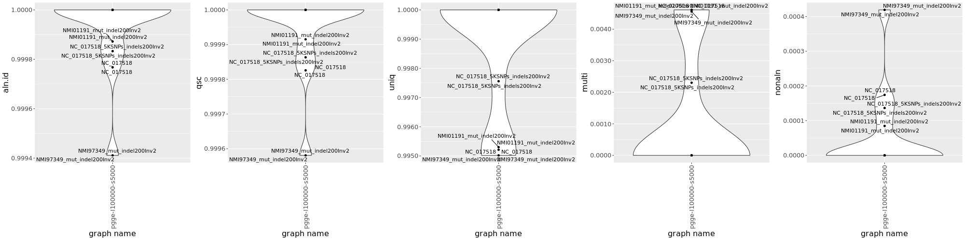
4Sim genome graphs by pgge
 | sample.name | cons.jump | aln.id | qsc | uniq | multi | nonaln
1k,p95 | NC_017518 | pgge-l100000-s5000 | 1 | 1 | 1 | 0 | 0
1k,p96 | NC_017518 | pgge-l100000-s5000 | 1 | 1 | 1 | 0 | 0
2k,p96 | NC_017518 | pgge-l100000-s5000 | 1 | 1 | 1 | 0 | 0
5k,96 | NC_017518 | pgge-l100000-s5000 | 1 | 1 | 1 | 0 | 0
10k,p95 | NC_017518 | pgge-l100000-s5000 | 1 | 1 | 1 | 0 | 0
1k,p95,-N | NC_017518 | pgge-l100000-s5000 | 0.999768 | 0.999826 | 0.995213 | 0.004613 | 0.000174
1k,p95,-N | NC_017518 | pgge-l100000-s5000 | 0.999767 | 0.999826 | 0.995212 | 0.004613 | 0.000174
1k,p95 | NC_017518_5KSNPs_indels200Inv2 | pgge-l100000-s5000 | 1 | 1 | 1 | 0 | 0
1k,p96 | NC_017518_5KSNPs_indels200Inv2 | pgge-l100000-s5000 | 1 | 1 | 1 | 0 | 0
2k,p96 | NC_017518_5KSNPs_indels200Inv2 | pgge-l100000-s5000 | 1 | 1 | 1 | 0 | 0
5k,96 | NC_017518_5KSNPs_indels200Inv2 | pgge-l100000-s5000 | 1 | 1 | 1 | 0 | 0
10k,p95 | NC_017518_5KSNPs_indels200Inv2 | pgge-l100000-s5000 | 1 | 1 | 1 | 0 | 0
1k,p95,-N | NC_017518_5KSNPs_indels200Inv2 | pgge-l100000-s5000 | 0.999833 | 0.999863 | 0.997559 | 0.002305 | 0.000137
1k,p95,-N | NC_017518_5KSNPs_indels200Inv2 | pgge-l100000-s5000 | 0.999833 | 0.999863 | 0.997559 | 0.002305 | 0.000137
1k,p95 | NMI01191_mut_indel200Inv2 | pgge-l100000-s5000 | 1 | 1 | 1 | 0 | 0
1k,p96 | NMI01191_mut_indel200Inv2 | pgge-l100000-s5000 | 1 | 1 | 1 | 0 | 0
2k,p96 | NMI01191_mut_indel200Inv2 | pgge-l100000-s5000 | 1 | 1 | 1 | 0 | 0
5k,96 | NMI01191_mut_indel200Inv2 | pgge-l100000-s5000 | 1 | 1 | 1 | 0 | 0
10k,p95 | NMI01191_mut_indel200Inv2 | pgge-l100000-s5000 | 1 | 1 | 1 | 0 | 0
1k,p95,-N | NMI01191_mut_indel200Inv2 | pgge-l100000-s5000 | 0.999872 | 0.999915 | 0.995302 | 0.004613 | 8.48E-05
1k,p95,-N | NMI01191_mut_indel200Inv2 | pgge-l100000-s5000 | 0.999872 | 0.999915 | 0.995302 | 0.004613 | 8.48E-05
1k,p95 | NMI97349_mut_indel200Inv2 | pgge-l100000-s5000 | 1 | 1 | 1 | 0 | 0
1k,p96 | NMI97349_mut_indel200Inv2 | pgge-l100000-s5000 | 1 | 1 | 1 | 0 | 0
2k,p96 | NMI97349_mut_indel200Inv2 | pgge-l100000-s5000 | 1 | 1 | 1 | 0 | 0
5k,96 | NMI97349_mut_indel200Inv2 | pgge-l100000-s5000 | 1 | 1 | 1 | 0 | 0
10k,p95 | NMI97349_mut_indel200Inv2 | pgge-l100000-s5000 | 1 | 1 | 1 | 0 | 0
1k,p95,-N | NMI97349_mut_indel200Inv2 | pgge-l100000-s5000 | 0.999411 | 0.999581 | 0.99502 | 0.004561 | 0.000419
1k,p95,-N | NMI97349_mut_indel200Inv2 | pgge-l100000-s5000 | 0.999411 | 0.999581 | 0.99502 | 0.004561 | 0.000419

Slide 7
Vg deconstruct to check variants in the graphs
vg deconstruct -p $path (multiple allowed) $gfa –o $outfile
-e, Only consider traversals that correspond to paths in the graph
-k, Retain conflicted genotypes in output
-a, Process all snarls, including nested snarls (by default only top-level snarls reported)
each path –a, or –a –K are the same, results don’t contain the inversions, but include the SNPs and indels in the inverted regions
each path –e, or –e, -K, some difference results, all the –e settings contains the inversion and also get genotypes for other paths too.

Slide 8
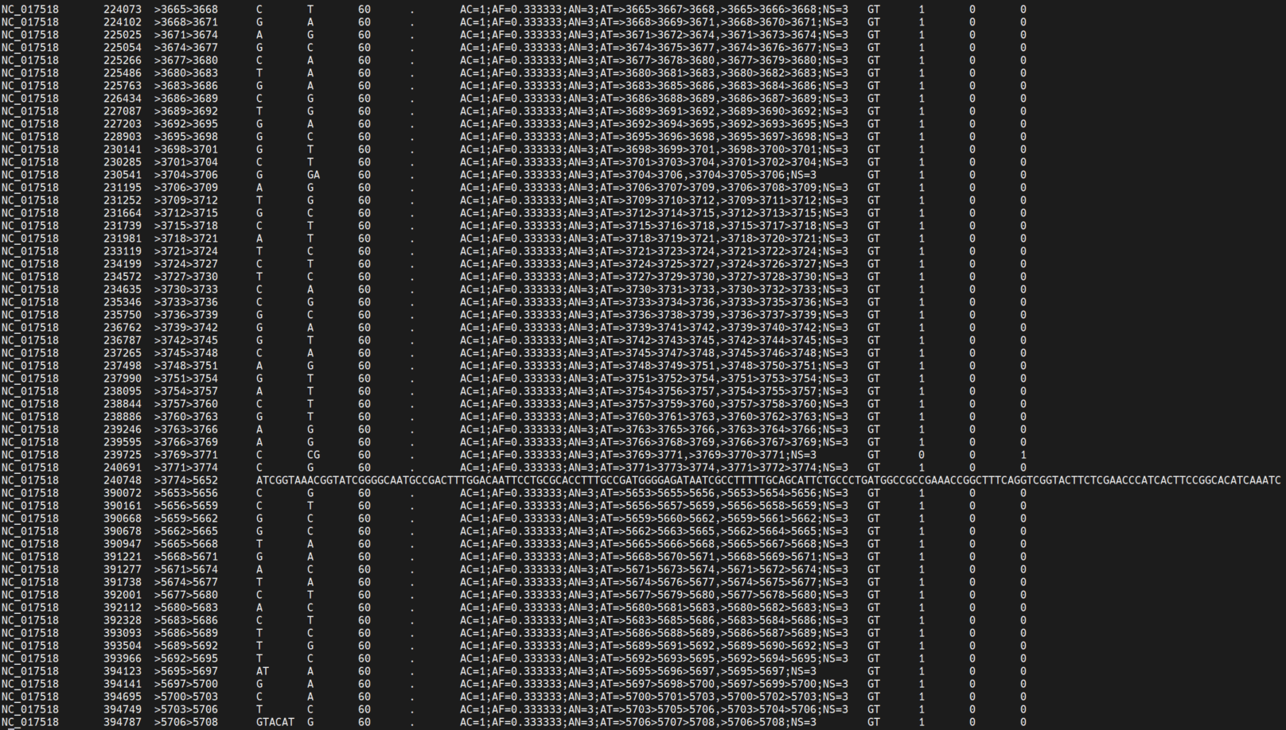
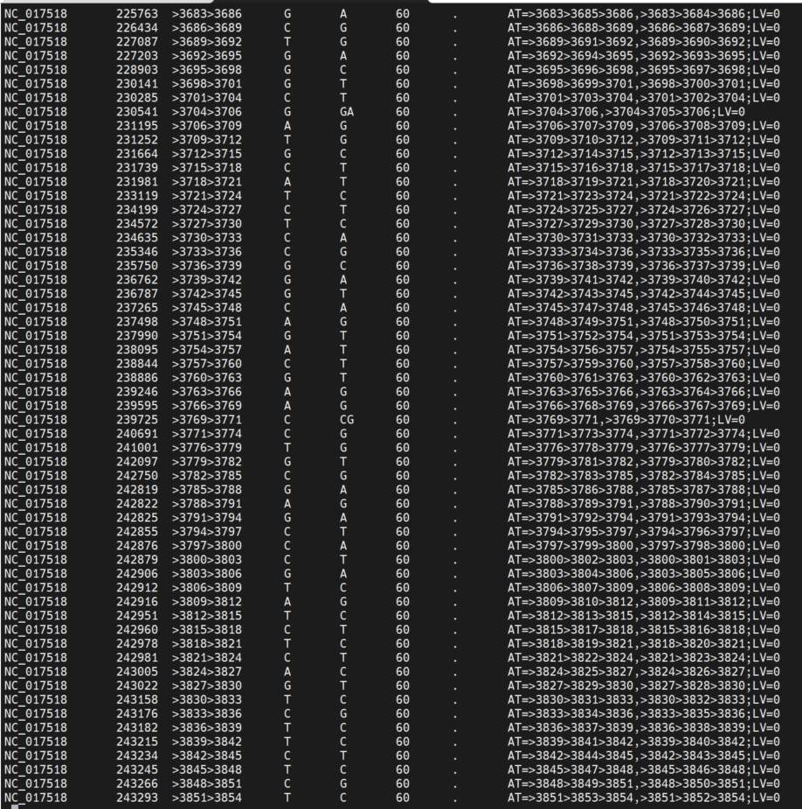
One path –e
One path –a

Slide 9
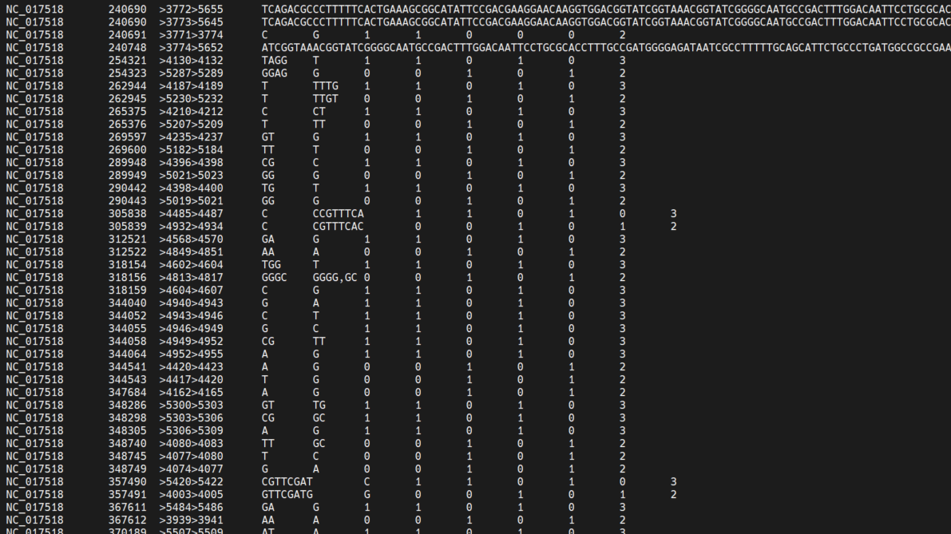
Vg deconstruct
Number of graph shared the same variant
Vg deconstruct –p $path –a –e –k will get the full list of variants
1k95
1k96
2k96
5k96
10k95
For the 4Sim pangenome graph
1k95
1k96
2k96
5k96
10k95
Captured almost the same variant among the paths, only a few being inconsistent.
Especially by 1k95, 1k96 and 5k96
Examples of inconsistent variant in the graphs by different setting of pggb

Slide 10
Vg deconstruct 1k96 4Sim Vs ground truth
 |  | NC_017518Sim | NMI01191Sim | NMI97348Sim
GroundTruth to NC_017518 | SNPs | 5000 | 2892 | 4183
 | Indels | 200 | 200 | 200
 | Inversion | 2 | 2 | 2
vg deconstruct 1k96 | small variant | 5134 | 3025 | 4307
 | variant sites with different coordinates | 62 | 64 | 74
 | missed sites | 4 | 3 | 2
 | FP |  |  | 7
NC_017518sim: 62[(13same+46(Decon_L)+3(Decon_R)]
NMI01191Sim:64[6same+54(Decon_L)+3(Decon_R)+1(decon_L, not same, reverse in inversions)]
NMI97348Sim:74[(7same)+61(Decon_L)+6(Decon_R)]
Indel regions alignment:
align to the left or right by pggb alignment caused a lot inconsistent, most are left aligned

Slide 11
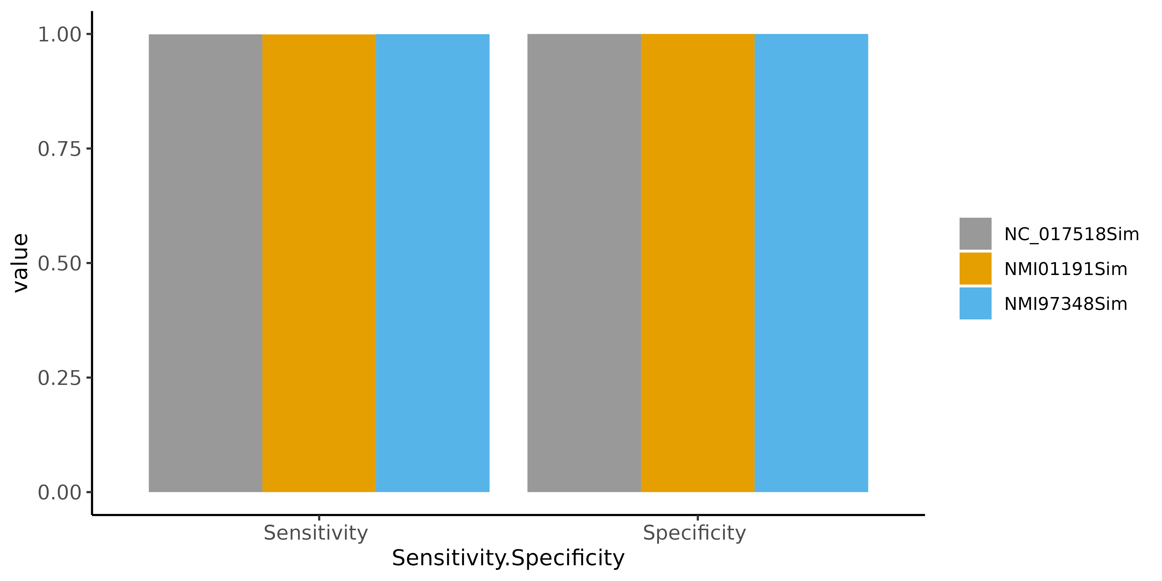
Sensitivity and specificity of graph capturing variants
vg deconsrtucted 4Sim by 1k96
 |  | ground truth | called | FN | FP | Sensitivity | Specificity | Note about inconsistant corrdinates
small variants (SNPs+indels) | NC_017518Sim | 5200 | 5196 | 4 |  | 0.999230769 | 1 | 62(13same, +46(Decon_L)+3(Decon_R))
 | NMI01191Sim | 3092 | 3089 | 3 |  | 0.999029754 | 1 | 64((6same)+54(Decon_L)+3(Decon_R)+1(decon_L, not same, reverse in inversions)
 | NMI97348Sim | 4383 | 4381 | 2 | 7 | 0.999543692 | 0.99999 | 74((7same)+61(Decon_L)+6(Decon_R)
inversions | NC_017518Sim | 2 | 2
 | NMI01191Sim | 2 | 2
 | NMI97348Sim | 2 | 2
Sensitivity | TP/TP+FN
Specificity | TN/FP+TN

Slide 12
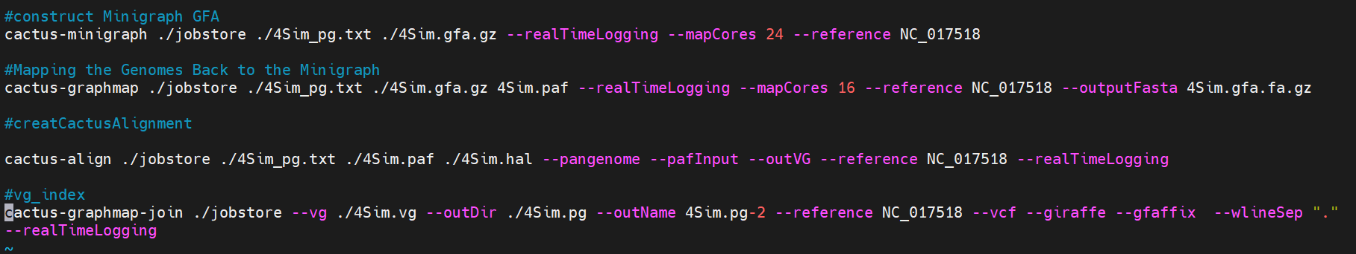
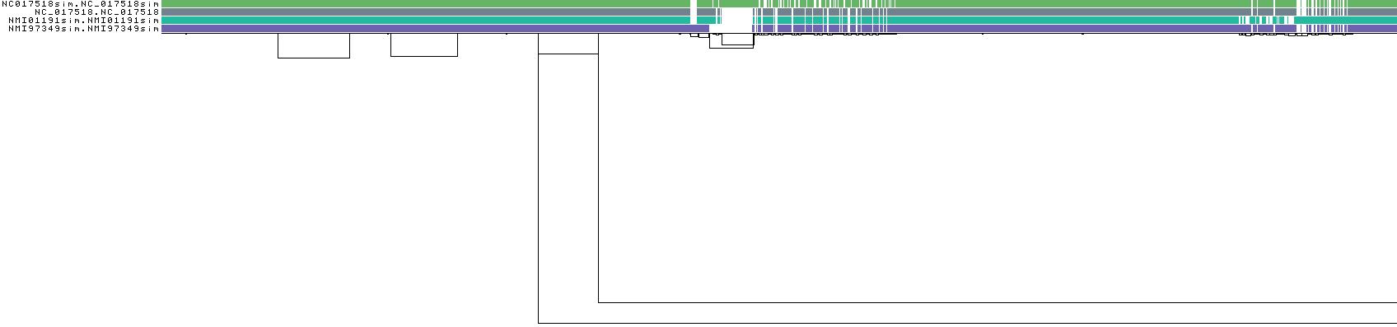
Minigraph-Cactus pipeline
https://github.com/ComparativeGenomicsToolkit/cactus/blob/master/doc/pangenome.md
Graph by minigraph-cactus, viewed by odgi viz
Poorly aligned the 4-5 and 6 inversion regions
Graph by pggb
Mauve alignment showing the big inversions

Slide 13
Uploaded data for sharing
Pggb | 4Sim.fa, 4Sim.pggb1k96.gfa and the shell script
Minigraph-Cactus | 4 genomes, txt file for input, and the shell script
Ground truth of variants in vcf files | Ground truth of separated SNPs, indels, and inversions for the three simulated genomes compared to NC_017518
4Sim_GT_true.tab | Ground truth of small variants (no inversions) in tab format
4Sim.minicac.vcf | the vcf file obtained by minigraph-cactus
4Sim_pggb1k96_aekp1decon.vcf | the vcf file deconstructed from graph by pggb
There are name differencec for pggb and minigraph-cactus input
NC_017518 is the original ref, and are consistent for both input.
NC017518sim = NC_017518_5KSNPs_indels200Inv2
NMI01191sim = NMI01191_mut_indel200Inv2
NMI97349sim = NMI97349_mut_indel200Inv2

Slide 14
Summary of pangenome graph construction by pggb and minigraph-cactus
The graph building by pggb works well.
Different settings generate high similar graph.
The variants deconstructed from the pggb graph are in good line with the ground truth
The minigraph-cactus alignment for some certain regions need to be improved.

