Slide 1

Pangenome graph construction by minigraph-cactus
Dr. Zuyu(Zoe) Yang
27-Sep-2022

Slide 2
Datasets for pangenome graph
4Sim genomes

Slide 3
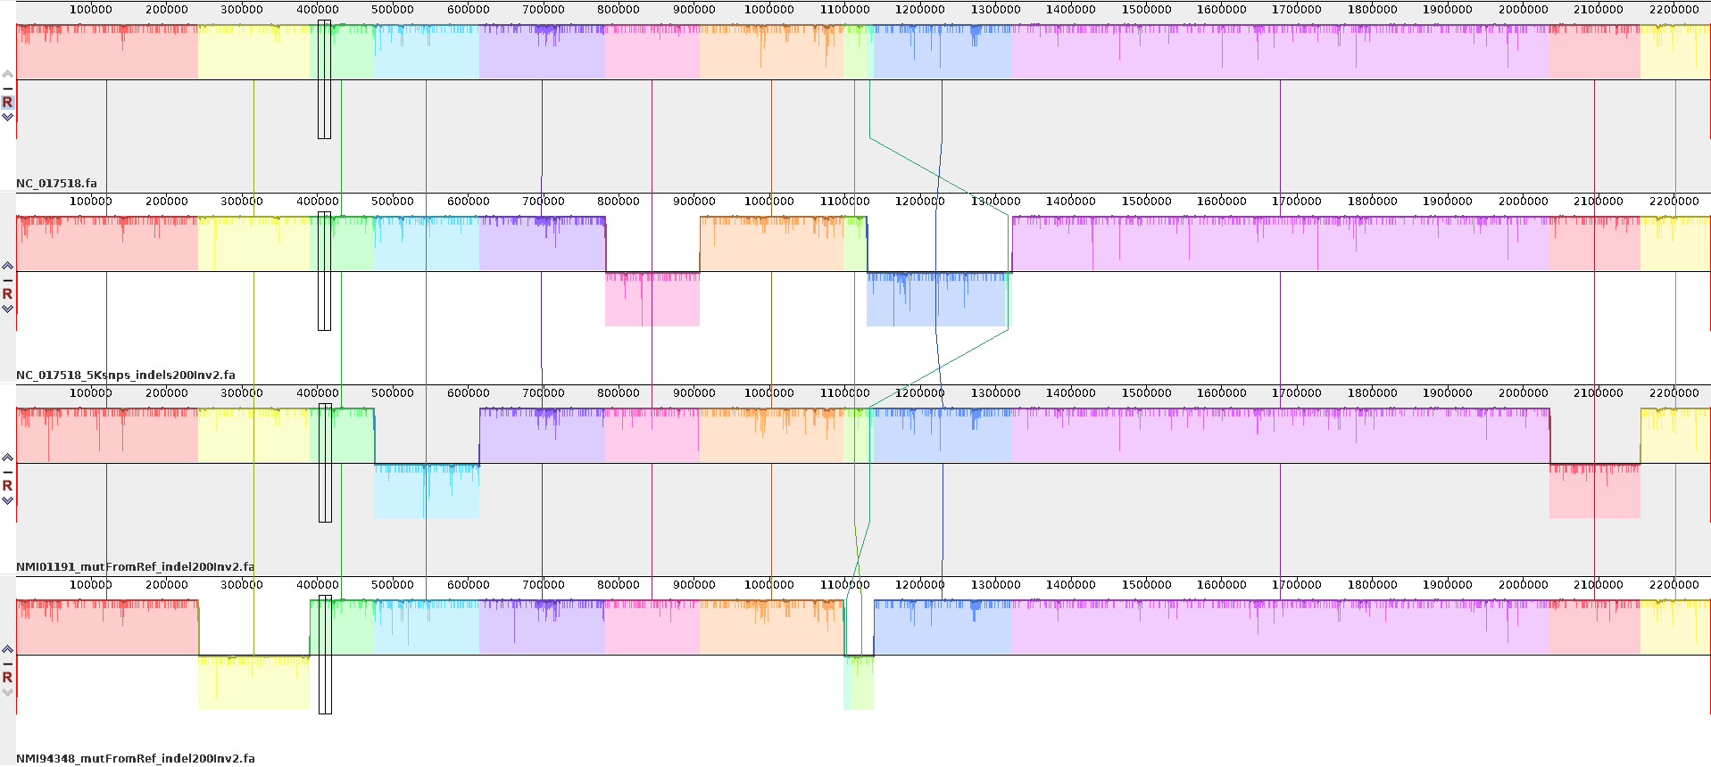
Simulate Neisseria meningitidis genomes
As there are big inversions among Neisseria genomes, to better understand how the minigraph-cactus work for different variant, I simulated three genomes from NC_017518 by simuG
ST42: NC_017518, mutate genome based on known SNPs from ST41, ST154
ST42, NMI01191, 2892SNPs
ST154, NMI97348, 4183SNPs
NC_017518, 5K random SNPs
4Sim genome alignment showing big rearrangements
NMI01191mutFromRef
NMI97349mutFromRef
NC_017518_5ksnps
200indels, and 2 inversions
NC_017518
NC_017518_5KsnpsIndel200Inv2, renamed as NC017518sim
ST41, NMI01191mutRefIndel200Inv2, renamed as NMI01191sim
ST154, NMI97348mutRefIndel200Inv2, renamed as NMI97348sim
Three simulated genomes + original ref as 4Sim genomes

Slide 4
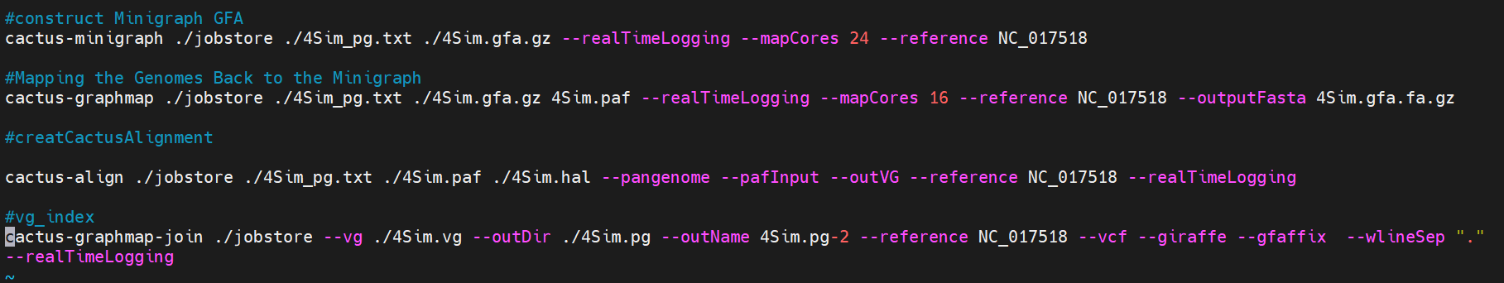
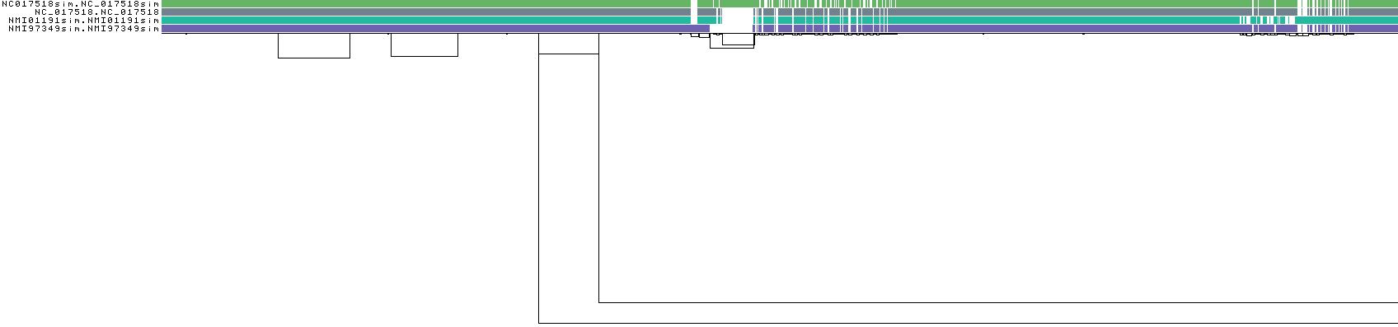
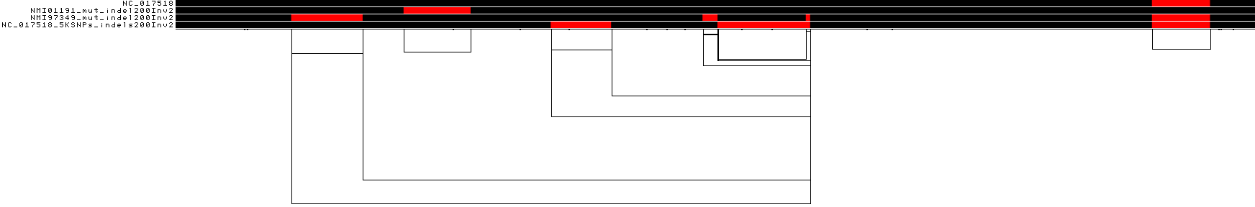
Minigraph-Cactus pipeline
https://github.com/ComparativeGenomicsToolkit/cactus/blob/master/doc/pangenome.md
Graph by minigraph-cactus, viewed by odgi viz
Poorly aligned the 4-5 and 6 inversion regions
Graph by pggb
Mauve alignment showing the big inversions

Slide 5
Uploaded data for sharing
Minigraph-Cactus | 4 genomes, txt file for input, and the shell script
minigraph-cactus input
NC_017518 is the original ref
NC017518sim = NC_017518_5KSNPs_indels200Inv2
NMI01191sim = NMI01191_mut_indel200Inv2
NMI97349sim = NMI97349_mut_indel200Inv2

