Slide 1
Vim Internals
A Gentle Introduction
Speaker: Jason Franklin
Date: 2019-10-23
Slides: https://bit.ly/325MOhT
Files: https://bit.ly/2VvzD7k
Notes:
This topic really deserves a workshop.
Initially detailed, this is detailed topic!
I want it to be entertaining.
I just want you to see what goes on in my mind.

Slide 2
The Roadmap
Why Vim?
Going to the source.
Fixing a “high-level” bug! (VimL)
Fixing a “low-level” bug! (C)
Where to?

Slide 3
Part I: Why Vim?

Slide 4
Greetings…
#include <stdio.h>
int main(void) {
printf("Hello, World!\n");
}
Notes:
When did it become okay not to return an int?

Slide 5
Greetings…
public class Hello {
public static void main(String[] args) {
System.out.println("Hello, World!");
}
}
Notes:
This is called a regression...

Slide 6
Greetings…
#include <stdio.h>
int main(void) {
printf("Hello, World!\n");
}
Notes:
When did it become okay not to return an int?

Slide 7
Greetings…
ssize_t write(int fd, const void *buf, size_t count);

Slide 8

It’s turtles all the way down.
Notes:
Did that get you in the stomach like it got me?
We deal with…
Ever shifting
And uncomfortable
Levels of abstraction.

Slide 9
Why Vim?
Vim is forever. Well, at least since 1976.
https://www.youtube.com/watch?v=VADudzQGvU8 (1:08:44)
Vim allows you to achieve mastery.
https://www.youtube.com/watch?v=1qLstQV2j8w (6:40)
Vim demands that you grok the toolchain.
Vim is free!
Notes:
“Tool permanence.”
(Perry Metzger)
(Mike Levin)
Vim is free. - assuming your time has no value.

Slide 10
Part II: Going to the source.

Slide 11
You will need:
The repository.
$ git clone https://github.com/vim/vim.git
Some packages.
$ sudo apt install gcc libncurses-dev \
python3-dev xorg-dev
Or… some packages the easy way!
$ sudo apt build-dep vim

Slide 12
You will need to run:
$ cd vim/src/
$ make
$ ./vim --clean; # We did it!
$ make test

Slide 13
Part III: A high-level bug.

Slide 14
The process.
Identify the bug with a precise reproduction.
Confirm the bug still exists.
Research: Is someone else working on it?
Fix the bug if you can!
Report the bug with the solution. (fastest!)

Slide 15
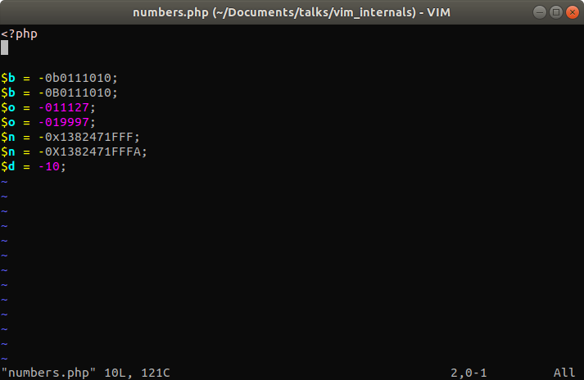
Notes:
Fourth is not valid!

Slide 16
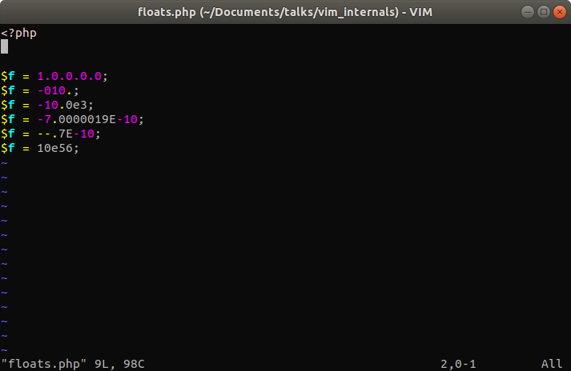
Notes:
First and second from last are not valid!

Slide 17
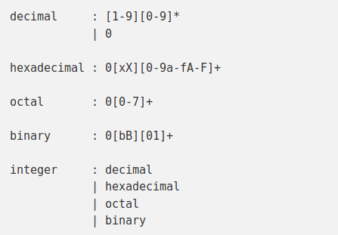
From the PHP website:

Slide 18
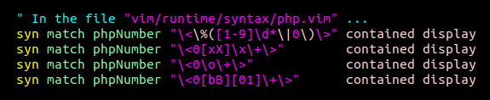
The new rules for Numbers:

Slide 19
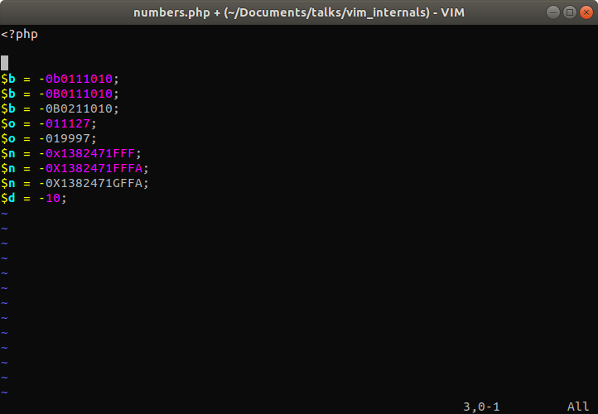

Slide 20
Summary for bug #1
How did I know what to do?
What did I do next?
How did my discussion with the maintainer proceed?
See the patch: php.diff

Slide 21
Demo.
Notes:
Show header of php.vim.

Slide 22
Part IV: A low-level bug.

Slide 23
The details…
The patch: https://bit.ly/2MyrOeg
The email: https://bit.ly/2o1KERA
Now for a demo and some analysis!

Slide 24
Demo.
Notes:
Is a bug like this worth fixing?
Confidence in one’s tools.
One wrong note eventually destroys the symphony.
Tags:
showmode()
win_enter()

Slide 25
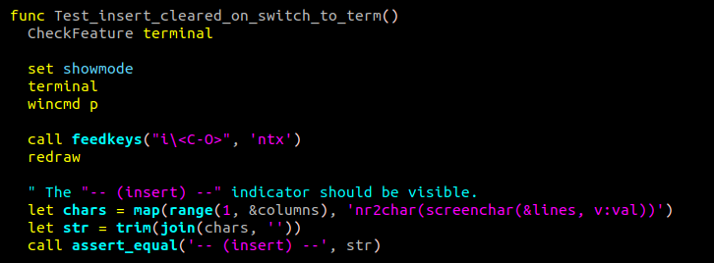
The test (part I)

Slide 26
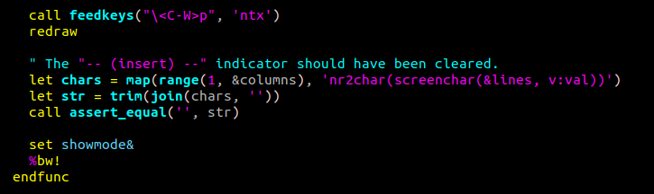
The test (part II)

Slide 27
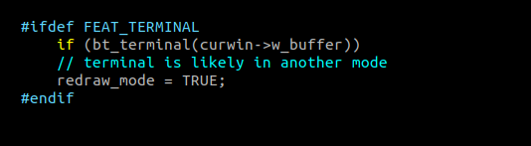
The fix!

Slide 28
The perfect patch…
… fixes a bug.
… adds a test case.
… reduces complexity.
This is the “hat trick” in software development.

Slide 29
Part V: Where to?

Slide 30
The future of Vim...
The Matrix
Star Trek
Blade Runner
Mad Max
The Road
Notes:
For vim to die, computer input methods would have to change so radically, that we don’t recognize it anymore.

Slide 31
A Quote.
Notes:
Slowly…
The future remains uncertain and so it should, for it is the canvas upon which we paint our desires. Thus always the human condition faces a beautifully empty canvas. We possess only this moment in which to dedicate ourselves continuously to the sacred presence which we share and create.

Slide 32
The end.
Questions?

