Slide 1
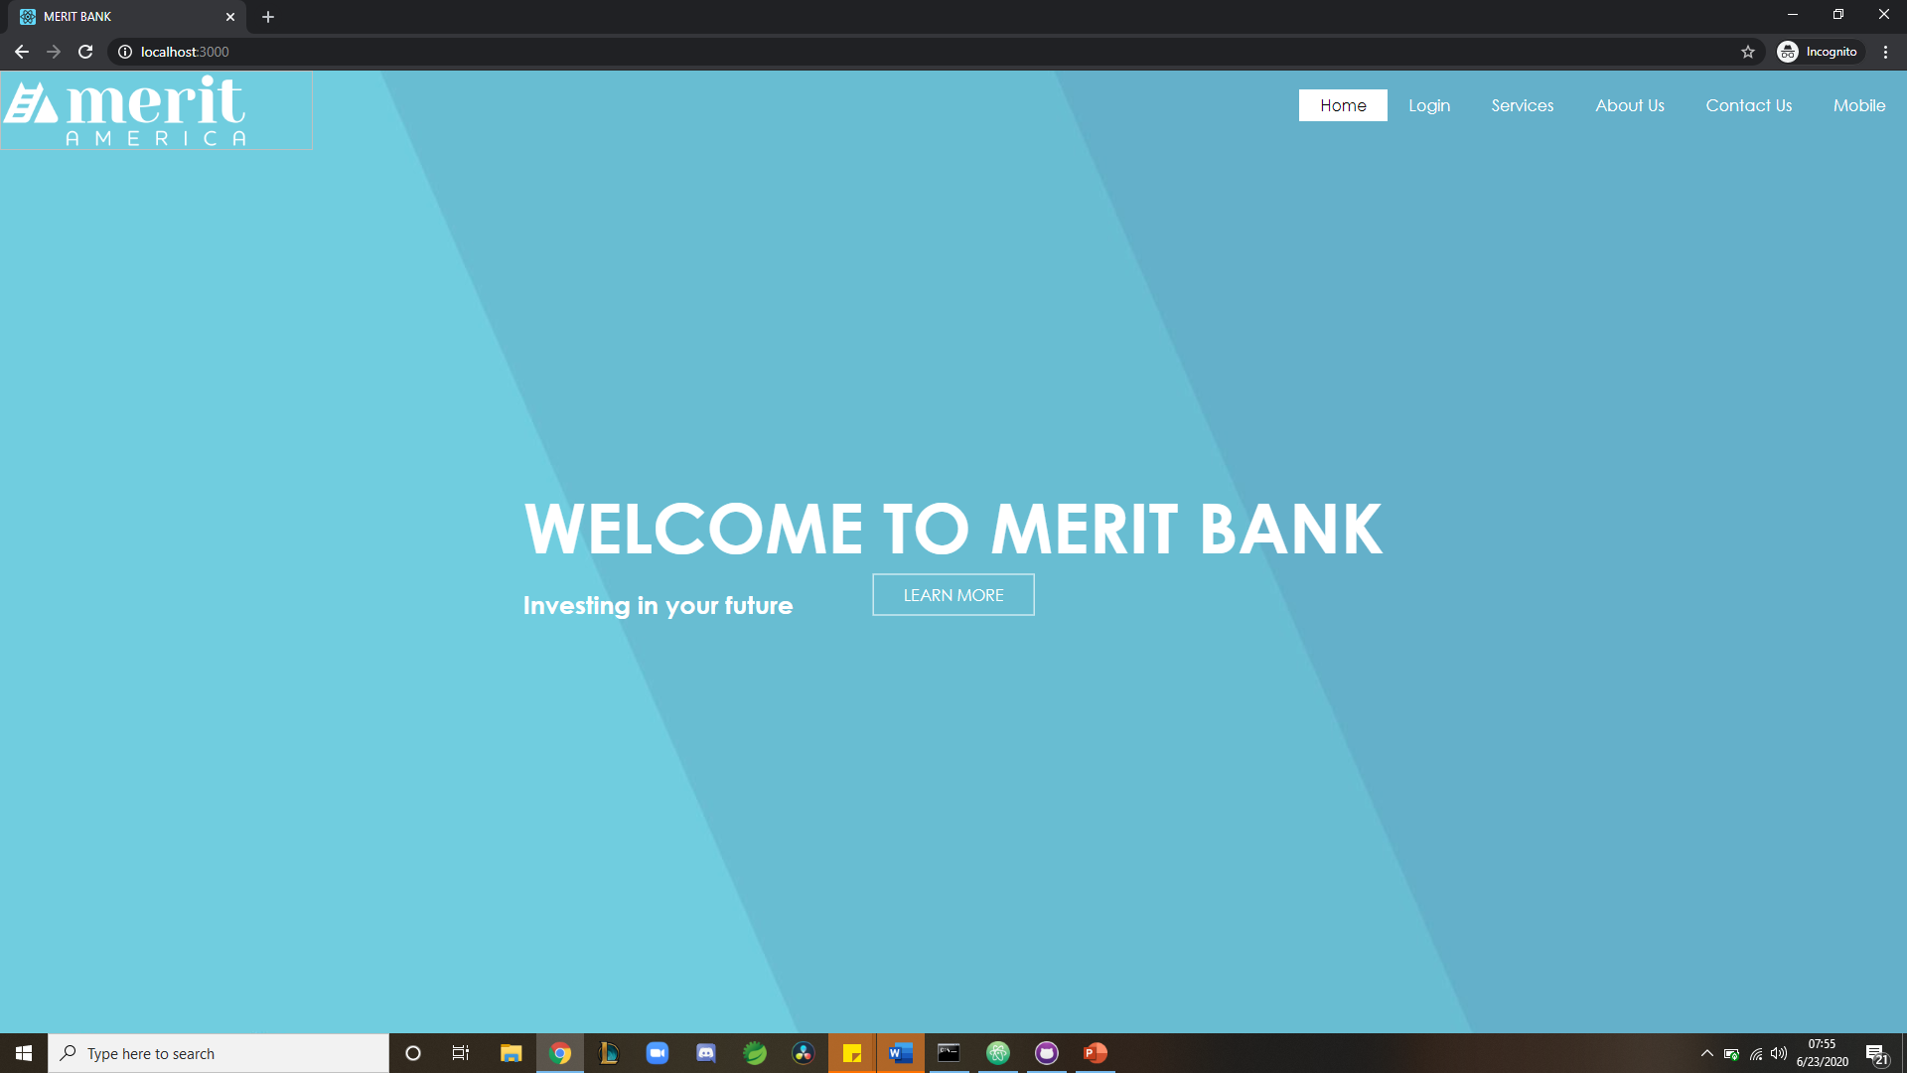
HOME PAGE
Nav:
-Learn More button → Services Page
-Merit Logo → Home Page

Slide 2
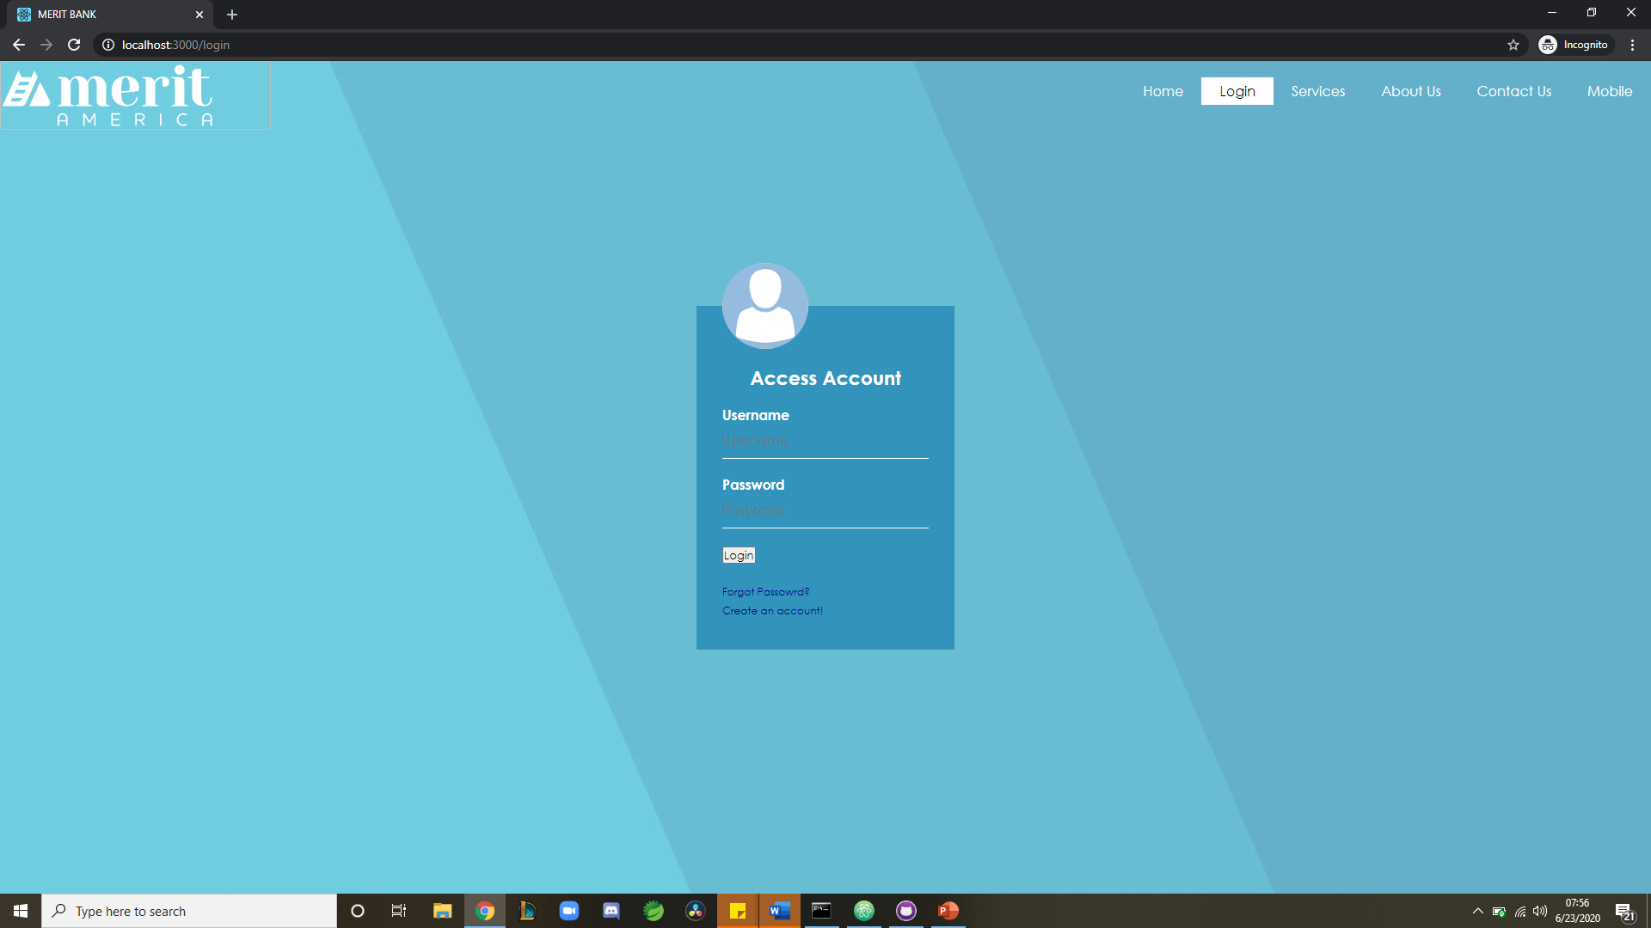
LOGIN PAGE
Nav:
-Login button → User page
-Login button → Admin page
-Forgot Password → Account Lookup/ recovery page
-Create Account → Register Page

Slide 3
USER PAGE

Slide 4
REGISTRATION

Slide 5
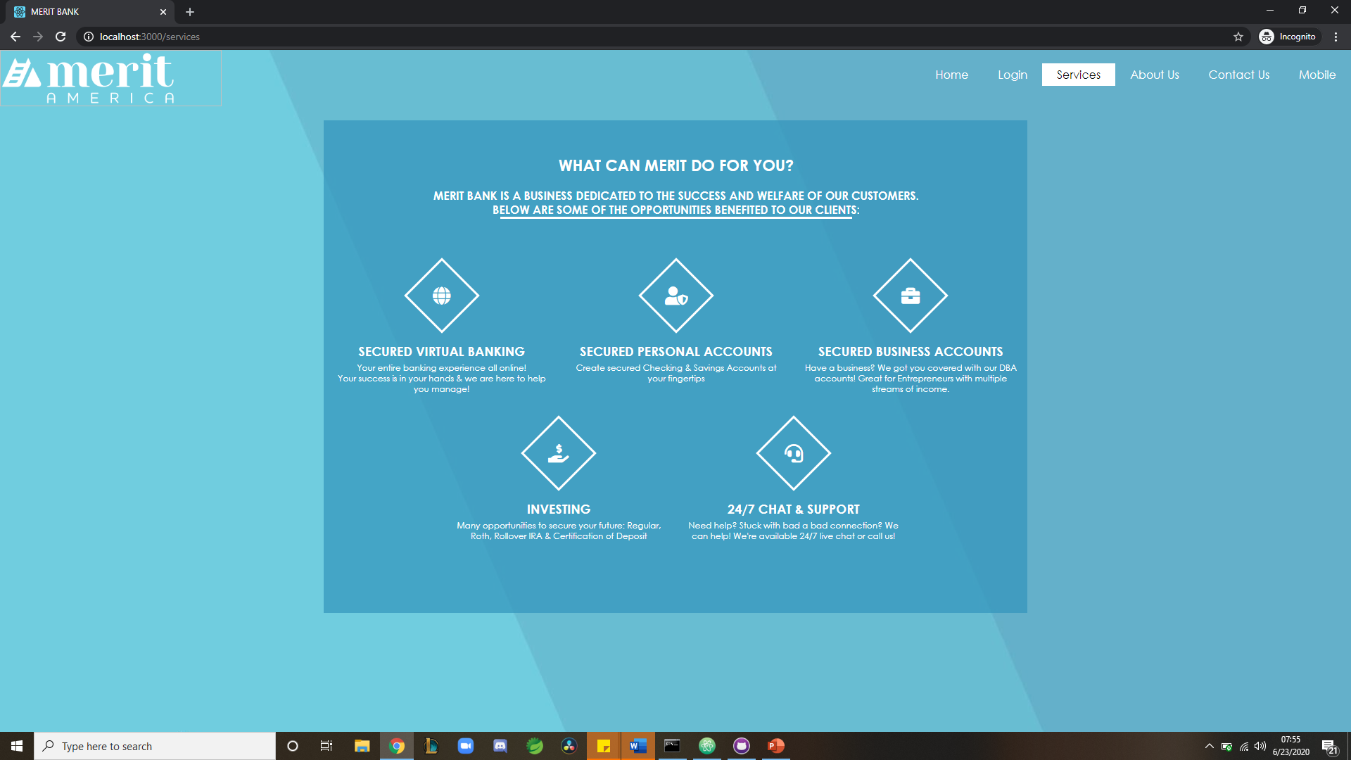
SERVICES PAGE
Nav:
-EACH icon on click to lead to section detailing below
-Secured bank
-secured personal and business
-investing
-support
(if highlight = to do)

Slide 6
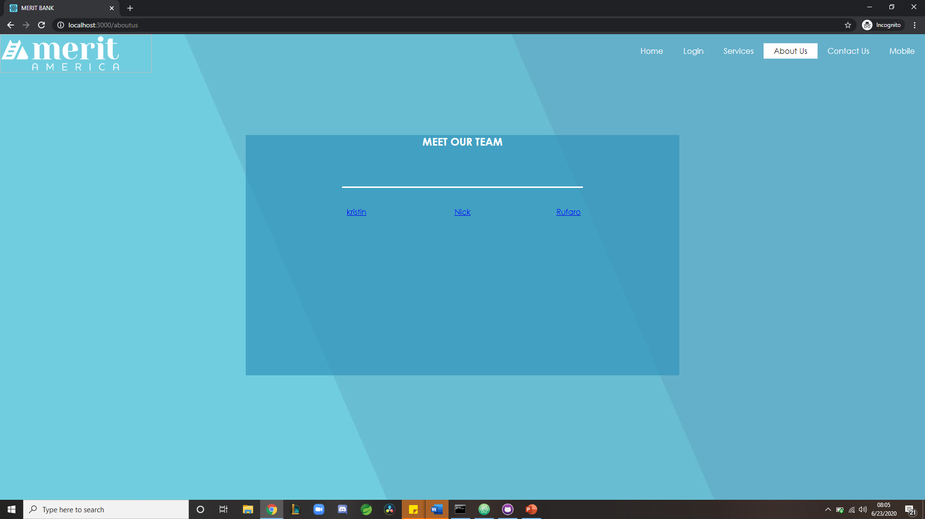
ABOUT US PAGE
Nav:
-Pictures to show each member
-Each member will show description upon click

Slide 7
KRISTIN

Slide 8
NICK

Slide 9
RUFARO

Slide 10
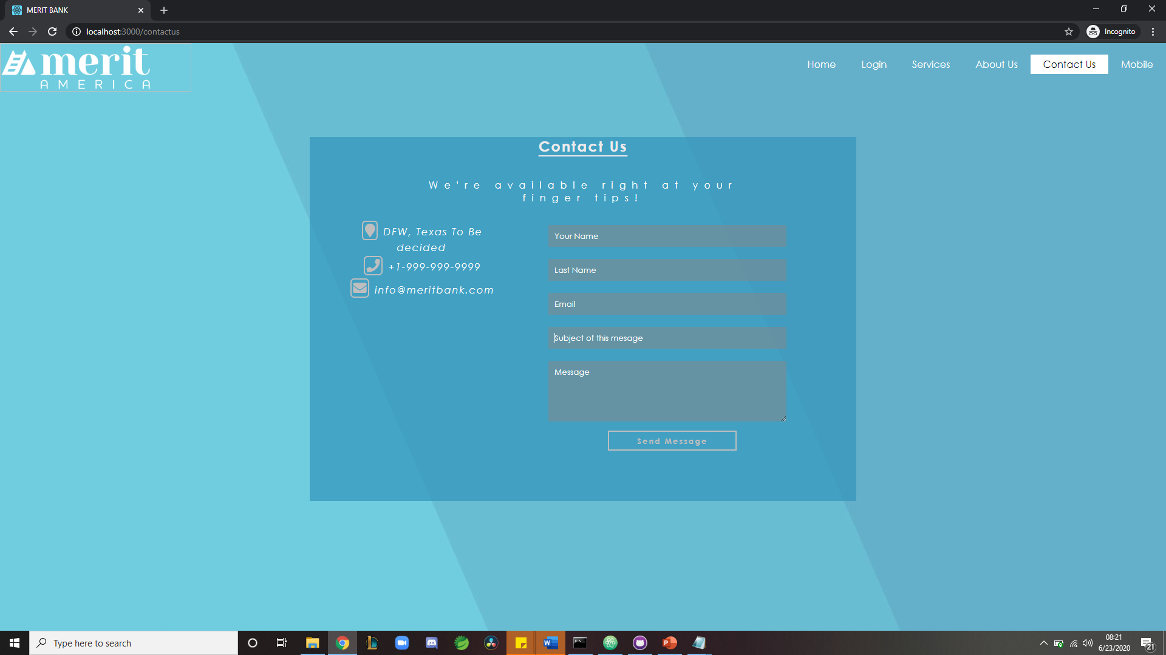
CONTACT US PAGE
Nav:
-SEND MESSAGE: BACK END, TO BE ABLE TO MESSAGE OR QUEUE MESSAGE TO ADMIN UPON CLICKING SEND
-SPACING OF THE ICONS

Slide 11
MOBILE

