Slide 1
A Color Cube Example and
OpenGL Shading Language
(GLSL)
Sang Il Park
Dept. of Software

Slide 2
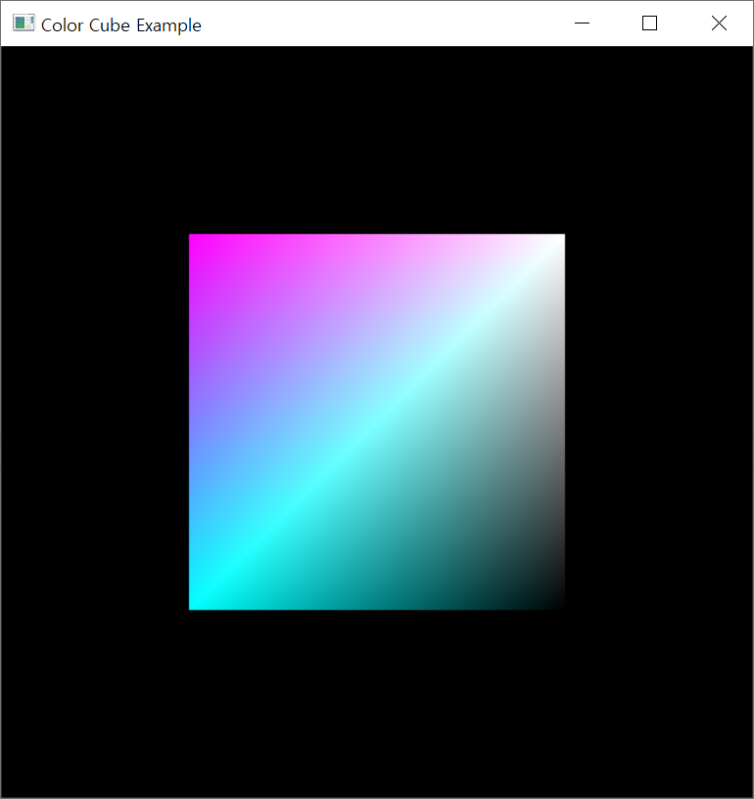
Review: Summary
We learnt the very basic of defining geometry and use it on GPU
Today, we will learn how to code the shaders
Vertex Shader :
  Determining the positions of vertex
  Useful for scaling, rotating, deforming and so on.
  Also important for preparing some information sending to Fragment Shader
Fragment Shader :
  Determining the color of each fragment

Slide 3
OpenGL Shading Language
(GLSL)

Slide 4
GLSL Syntax Overview
GLSL is like C without
  Pointers
  Recursion
  Dynamic memory allocation
GLSL is like C with
  Built-in vector, matrix and sampler types
  Constructors
  A great math library
  Input and output qualifiers
Allow us to write concise, efficient shaders.

Slide 5
GLSL Syntax
GLSL has a preprocesssor
All Shaders have main()
#version 430
#ifdef FAST_EXACT_METHOD
FastExact();
#else
SlowApproximate();
#endif
// ... many others
void main(void)
{
}

Slide 6
GLSL Data Types
Scalar types: float, int, bool
Vector types: vec2, vec3, vec4
ivec2, ivec3, ivec4
bvec2, bvec3, bvec4
Matrix types: mat2, mat3, mat4
Texture sampling: sampler1D, sampler2D, sampler3D, samplerCube
C++ style constructors: vec3 a = vec3(1.0, 2.0, 3.0);
Notes:
As with any programming language, GLSL has types for variables. However, it includes vector-, and matrix-based types to simplify the operations that occur often in computer graphics.
In addition to numerical types, other types like texture samplers are used to enable other OpenGL operations. We’ll discuss texture samplers in the texture mapping section.

Slide 7
Operators
Standard C/C++ arithmetic and logic operators
Operators overloaded for matrix and vector operations
mat4 m;
vec4 a, b, c;
b = a*m;
c = m*a;
Notes:
The vector and matrix classes of GLSL are first-class types, with arithmetic and logical operations well defined. This helps simplify your code, and prevent errors.
Note in the above example, overloading ensures that both a*m and m*a are defined although they will not in general produce the same result.

Slide 8
Components and Swizzling
For vectors can use [ ], xyzw, rgba or stpq
Example:
vec3 v;
v[1], v.y, v.g, v.t all refer to the same element
Swizzling:
vec3 a, b;
a.xy = b.yx;
Notes:
For GLSL’s vector types, you’ll find that often you may also want to access components within the vector, as well as operate on all of the vector’s components at the same time. To support that, vectors and matrices (which are really a vector of vectors), support normal “C” vector accessing using the square-bracket notation (e.g., “[i]”), with zero-based indexing. Additionally, vectors (but not matrices) support swizzling, which provides a very powerful method for accessing and manipulating vector components.
Swizzles allow components within a vector to be accessed by name. For example, the first element in a vector – element 0 – can also be referenced by the names “x”, “s”, and “r”. Why all the names – to clarify their usage. If you’re working with a color, for example, it may be clearer in the code to use “r” to represent the red channel, as compared to “x”, which make more sense as the x-positional coordinate

Slide 9
GLSL Syntax: Vectors
Constructors
vec3 xyz = vec3(1.0, 2.0, 3.0);
vec3 xyz = vec3(1.0); // [1.0, 1.0, 1.0]
vec3 xyz = vec3(vec2(1.0, 2.0), 3.0);
vec3 xyz (1.0, 2.0, 3.0); // ← Error!

Slide 10
GLSL Syntax: Vectors
vec4 c = vec4(0.5, 1.0, 0.8, 1.0);
vec3 rgb = c.rgb; // [0.5, 1.0, 0.8]
vec3 bgr = c.bgr; // [0.8, 1.0, 0.5]
vec3 rrr = c.rrr; // [0.5, 0.5, 0.5]
c.a = 0.5; // [0.5, 1.0, 0.8, 0.5]
c.rb = 0.0; // [0.0, 1.0, 0.0, 0.5]
float g = rgb[1]; // 0.5, indexing, not swizzling

Slide 11
GLSL Syntax: Matrices
Matrices are built-in types:
  Square: mat2, mat3, mat4
  Rectangular: matmxn ( m columns, n rows)
  mat2x3, mat3x4, mat4x4
Stored column major

Slide 12
GLSL Syntax: Matrices
Constructors
Accessing elements
mat3 i = mat3(1.0); // 3x3 identity matrix
mat2 m = mat2(1.0, 2.0, // [1.0 3.0]
3.0, 4.0); // [2.0 4.0]
Column major!
Treat matrix as array of column vectors
float f = m[column][row];
float x = m[0].x; // x component of first column
vec2 yz = m[1].yz; // yz components of second column
Can swizzle too!

Slide 13
GLSL Syntax: Vectors and Matrices
Matrix and vector operations are easy and fast:
For more information:
  http://en.wikibooks.org/wiki/GLSL_Programming/Vector_and_Matrix_Operations
  http://en.wikibooks.org/wiki/GLSL_Programming/Applying_Matrix_Transformations
vec3 xyz = // ...
vec3 v0 = 2.0 * xyz; // scale
vec3 v1 = v0 + xyz; // component-wise
vec3 v2 = v0 * xyz; // component-wise
mat3 m = // ...
mat3 t = // ...
mat3 mt = t * m; // matrix * matrix
vec3 xyz2 = mt * xyz; // matrix * vector
vec3 xyz3 = xyz * mt; // vector * matrix ( = transposed_matrix * vector )

Slide 14
Qualifiers
in, out
  Copy vertex attributes and other variables to/from shaders
  in vec2 tex_coord;
  out vec4 color;
Uniform: variable from application
  uniform float time;
  uniform vec4 rotation;
Notes:
In addition to types, GLSL has numerous qualifiers to describe a variable usage. The most common of those are:
in qualifiers that indicate the shader variable will receive data flowing into the shader, either from the application, or the previous shader stage.
out qualifier which tag a variable as data output where data will flow to the next shader stage, or to the framebuffer
uniform qualifiers for accessing data that doesn’t change across a draw operation

Slide 15
GLSL Syntax: in/ out/ uniform
Uniform (constant) input
Vertex
Shader
Fragment
Shader
Streaming input
in
out
in
out
Color
gl_Position

Slide 16
GLSL Syntax: in/ out/ uniform
Example
uniform: shader input constant across glDraw
#version 430
uniform mat4 u_ModelView;
in vec3 Position;
in vec3 Color;
out vec3 fs_Color;
void main(void)
{
fs_Color = Color;
gl_Position = u_ModelView * vec4(Position, 1.0);
}
in: shader input varies per vertex attribute
out: shader output

Slide 17
Flow Control
if
if else
expression ? true-expression : false-expression
while, do while
for
Notes:
Like the “C” language, GLSL supports all of the logical flow control statements you’re used to.

Slide 18
Functions
Built in
  Arithmetic: sqrt, power, abs
  Trigonometric: sin, asin
  Graphical: length, reflect
User defined
Notes:
GLSL also provides a rich library of functions supporting common operations. While pretty much every vector- and matrix-related function available you can think of, along with the most common mathematical functions are built into GLSL, there’s no support for operations like reading files or printing values. Shaders are really data-flow engines with data coming in, being processed, and sent on for further processing.

Slide 19
Built-in Variables
gl_Position: output position from vertex shader
gl_FragColor: output color from fragment shader
  Only for ES, WebGL and older versions of GLSL
  Present version use an out variable
Notes:
Fundamental to shader processing are a couple of built-in GLSL variable which are the terminus for operations. In particular, vertex data, which can be processed by up to for shader stages in OpenGL are all ended by setting a positional value into the built-in variable, gl_Position. Similarly, the output of a fragment shader (in version 3.1 of OpenGL) is set by writing values into the built-in variable gl_FragColor. Later versions of OpenGL allow fragment shaders to output to other variables of the user’s designation as well.

Slide 20
Simple Vertex Shader for Cube
#version 330
in vec4 vPosition;
in vec4 vColor;
out vec4 color;
void main() {
color = vColor;
gl_Position = vPosition;
}
Notes:
Here’s the simple vertex shader we use in our cube rendering example. It accepts two vertex attributes as input: the vertex’s position and color, and does very little processing on them; in fact, it merely copies the input into some output variables (with gl_Position being implicitly declared). The results of each vertex shader execution are passed further down the OpenGL pipeline, and ultimately end their processing in the fragment shader.

Slide 21
The Simplest Fragment Shader
#version 330
in vec4 color;
out vec4 FragColor;
void main() {
FragColor = color;
}
Notes:
Here’s the associated fragment shader that we use in our cube example. While this shader is as simple as they come – merely setting the fragment’s color to the input color passed in, there’s been a lot of processing to this point. In particular, every fragment that’s shaded was generated by the rasterizer, which is a built-in, non-programmable (i.e., you don’t write a shader to control its operation). What’s magical about this process is that if the colors across the geometric primitive (for multi-vertex primitives: lines and triangles) is not the same, the rasterizer will interpolate those colors across the primitive, passing each iterated value into our color variable.

Slide 22
Using Shaders: A Simpler Way
We’ve created a routine for this course to make it easier to load your shaders
  available at course website:
GLuint InitShader (char* vFile, char* fFile);
InitShaders takes two filenames
  vFile for the vertex shader
  fFile for the fragment shader
Fails if shaders don’t compile, or program doesn’t link
Notes:
To simplify our lives, we created a routine that simplifies loading, compiling, and linking shaders: InitShaders(). It implements the shader compilation and linking process shown on the previous slide. It also does full error checking, and will terminate your program if there’s an error at some stage in the process (production applications might choose a less terminal solution to the problem, but it’s useful in the classroom).
InitShaders() accepts two parameters, each a filename to be loaded as source for the vertex and fragment shader stages, respectively.
The value returned from InitShaders() will be a valid GLSL program id that you can pass into glUseProgram().

Slide 23
Determining Locations After Linking
Assumes you already know the variables’ name
  GLint idx =
  glGetAttribLocation(program, “name”);
  GLint idx =
  glGetUniformLocation(program, “name”);
Notes:
Once you know the names of variables in a shader – whether they’re attributes or uniforms – you can determine their location using one of the glGet*Location() calls.
If you don’t know the variables in a shader (if, for instance, you’re writing a library that accepts shaders), you can find out all of the shader variables by using the glGetActiveAttrib() function.

Slide 24
Vertex Attributes Setting
// set up vertex arrays (after shaders are loaded)
GLuint vPosition = glGetAttribLocation(program, "vPosition”);
glEnableVertexAttribArray(vPosition);
glVertexAttribPointer(vPosition, 4, GL_FLOAT, GL_FALSE, 0, BUFFER_OFFSET(0));
GLuint vColor = glGetAttribLocation(program, "vColor”);
glEnableVertexAttribArray(vColor);
glVertexAttribPointer(vColor, 4, GL_FLOAT, GL_FALSE, 0, BUFFER_OFFSET(sizeof(points)));
Notes:
To complete the “plumbing” of associating our vertex data with variables in our shader programs, you need to tell OpenGL where in our buffer object to find the vertex data, and which shader variable to pass the data to when we draw. The above code snippet shows that process for our two data sources. In our shaders (which we’ll discuss in a moment), we have two variables: vPosition, and vColor, which we will associate with the data values in our VBOs that we copied form our vertex_positions and vertex_colors arrays.
The calls to glGetAttribLocation() will return a compiler-generated index which we need to use to complete the connection from our data to the shader inputs. We also need to “turn the valve” on our data by enabling its attribute array by calling glEnableVertexAttribArray() with the selected attribute location.
This is the most flexible approach to this process, but depending on your OpenGL version, you may be able to use the layout construct, which allows you to specify the attribute location, as compared to having to retrieve it after compiling and linking your shaders. We’ll discuss that in our shader section later in the course.
BUFFER_OFFSET is a simple macro defined to make the code more readable
#define BUFFER_OFFSET( offset ) ((GLvoid*) (offset))

Slide 25
Initializing Uniform Variable Values
Uniform Variables
  glUniform1f(index, value);
  glUniform4f(index, x, y, z, w);
  Glboolean transpose = GL_TRUE;
  // Since we’re C programmers
  Glfloat mat[3][4][4] = { … };
  glUniformMatrix4fv(index, 3, transpose, mat);
row
column
Notes:
You’ve already seen how one associates values with attributes by calling glVertexAttribPointer(). To specify a uniform’s value, we use one of the glUniform*() functions. For setting a vector type, you’ll use one of the glUniform*() variants, and for matrices you’ll use a glUniformMatrix *() form.

Slide 26
Shader Applications
Moving vertices
  Morphing
  Wave motion
  Fractals
Lighting
  More realistic models
  Cartoon shaders
And more and more!

Slide 27
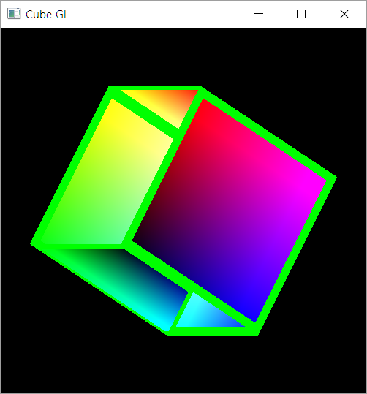
One little problem
Incorrect Depth Handling

Slide 28
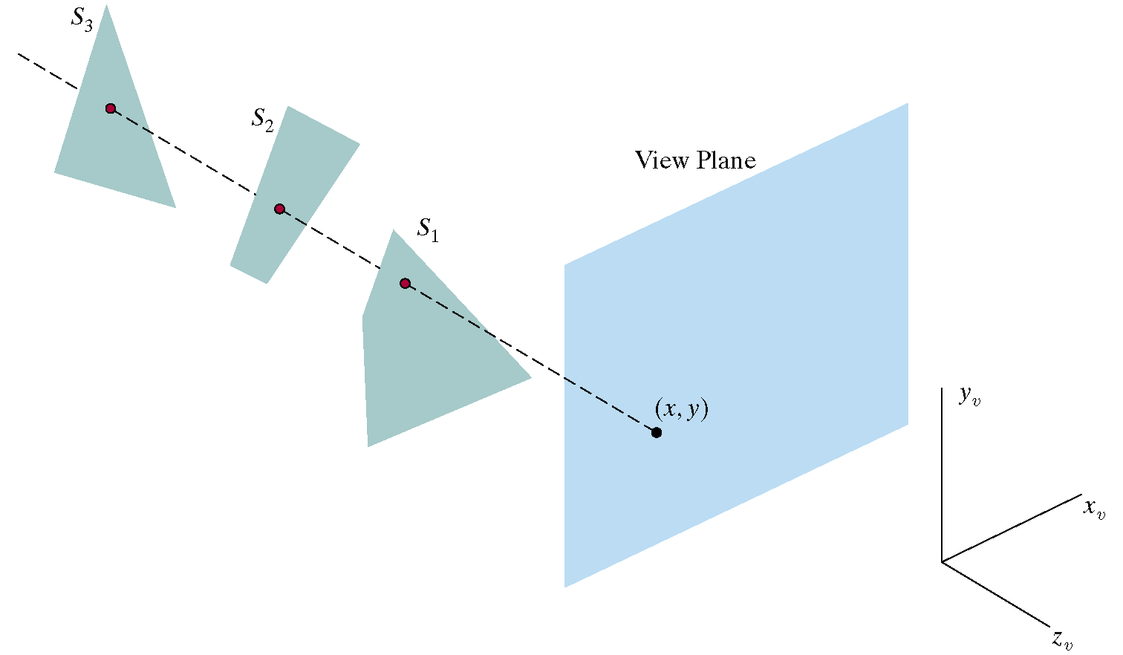
Depth-Buffer (Z-Buffer)
Z-Buffer has memory corresponding to each pixel location for storing the current depth value (distance from view plane)
  Useful for determining whether a new drawing pixel is visible or not
    Is visible when the its distance is closer than the previously stored one
    Is not visible when it is farer

Slide 29
Enabling the Depth Buffer in OPENGL
On Initialization :
On Drawing :
glutInitDisplayMode(GLUT_DOUBLE |
GLUT_RGBA |
GLUT_DEPTH);
glClear (GL_COLOR_BUFFER_BIT |
GL_DEPTH_BUFFER_BIT);
glEnable(GL_DEPTH_TEST);

Slide 30
Interaction:
Callbacks

Slide 31
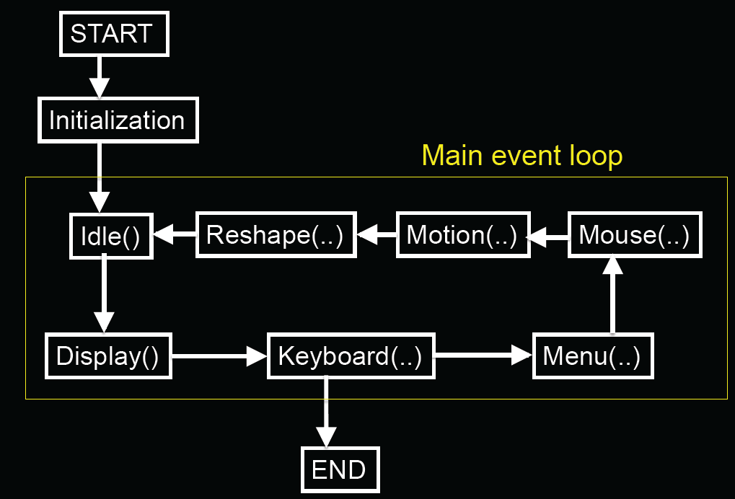
GLUT Program with Callbacks

Slide 32
Event Types
Window: resize, expose, iconify
Mouse: click one or more buttons
Motion: move mouse
Keyboard: press or release a key
Idle: non-event
  Define what should be done if no other event is in queue
E. Angel and D. Shreiner : Interactive Computer Graphics 6E © Addison-Wesley 2012

Slide 33
Callbacks
Programming interface for event-driven input
Define a callback function for each type of event the graphics system recognizes
This user-supplied function is executed when the event occurs
GLUT example: glutMouseFunc(mymouse)
mouse callback function
E. Angel and D. Shreiner : Interactive Computer Graphics 6E © Addison-Wesley 2012

Slide 34
GLUT callbacks
GLUT recognizes a subset of the events recognized by any particular window system (Windows, X, Macintosh)
  glutDisplayFunc
  glutMouseFunc
  glutReshapeFunc
  glutKeyboardFunc
  glutIdleFunc
  glutMotionFunc, glutPassiveMotionFunc
E. Angel and D. Shreiner : Interactive Computer Graphics 6E © Addison-Wesley 2012

Slide 35
Types of Callbacks
Display ( ) : when window must be drawn
Idle ( ) : when no other events to be handled
Keyboard (unsigned char key, int x, int y) : key pressed
Menu (...) : after selection from menu
Mouse (int button, int state, int x, int y) : mouse button
Motion (...) : mouse movement
Reshape (int w, int h) : window resize
Any callback can be NULL

Slide 36
GLUT Event Loop
Recall that the last line in main.c for a program using GLUT must be
  glutMainLoop();
which puts the program in an infinite event loop
In each pass through the event loop, GLUT
  looks at the events in the queue
  for each event in the queue, GLUT executes the appropriate callback function if one is defined
  if no callback is defined for the event, the event is ignored
E. Angel and D. Shreiner : Interactive Computer Graphics 6E © Addison-Wesley 2012

Slide 37
Example : Idling Callback
Idling Callback is useful for defining a periodic work
  Ex. ) making an animation (rotating a cube and so on)
How to use:
  Registering your function as an Idling Callback Function
  Implement what you want to do repeatedly
glutIdleFunc ( myIdle );
void myIdle()
{
// do some periodic job
Sleep(16);
glutPostRedisplay();
}
Wait for 16 mille-sec.
(Ensuring 60 FPS)
Invoking redrawing

Slide 38

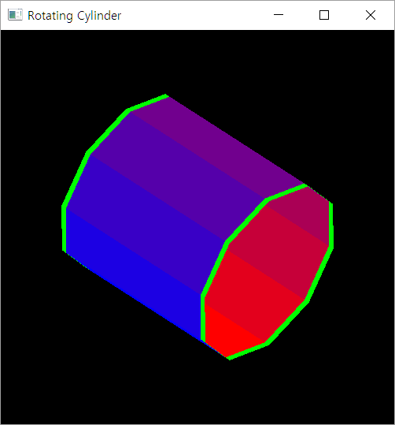
Coding Practice : A Color Cylinder

