Slide 1
Chapter 3:
Other Geometric Objects
Sang Il Park
Dept. of Software

Slide 2

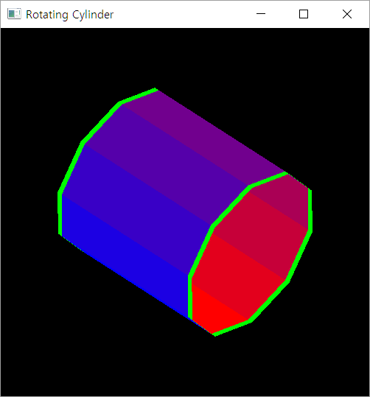
Coding Practice : A Color Cylinder

Slide 3

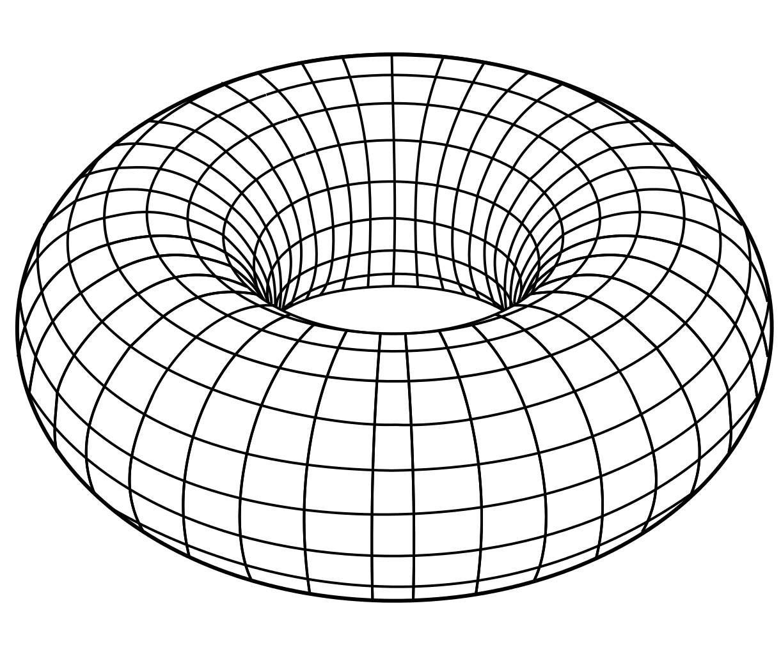
Sphere and Torus

Slide 4


z
z
(i, j)
j
i
y
y
x
x

