Slide 1
Chapter 3:
Other Geometric Objects
Sang Il Park
Dept. of Software

Slide 2
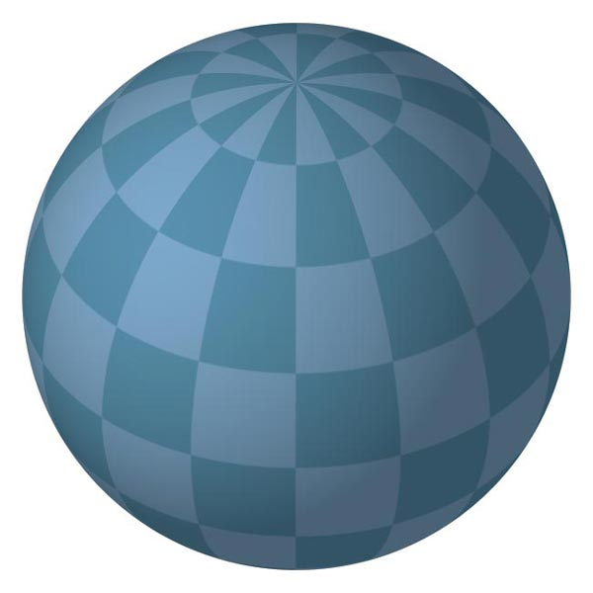
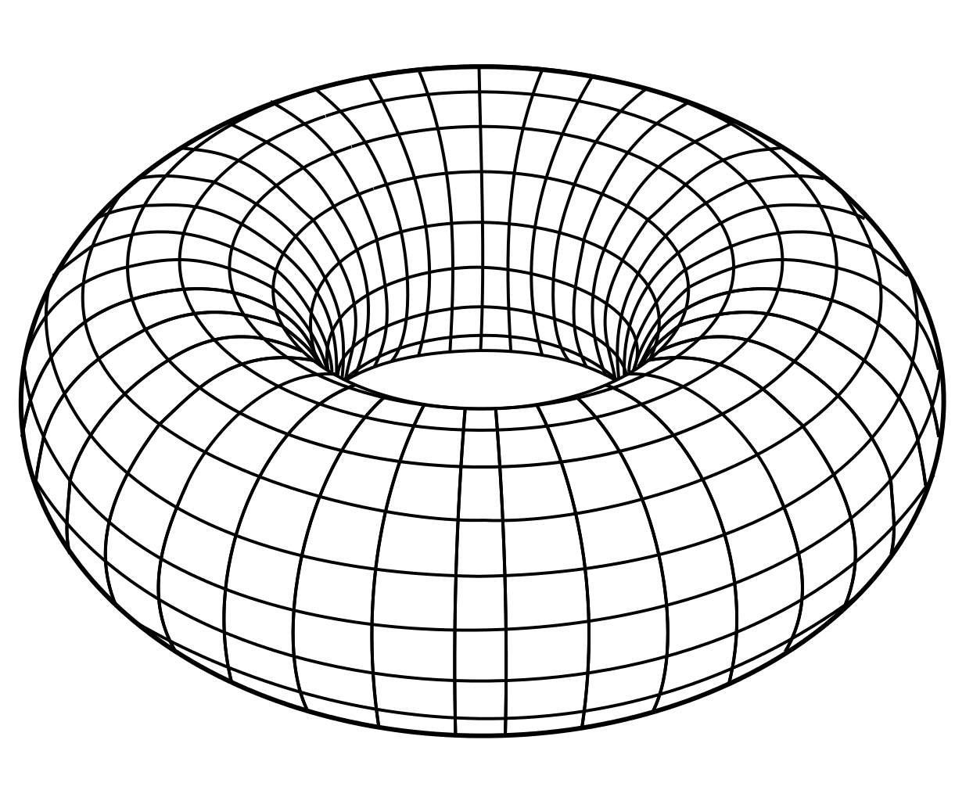
Coding Practice : Sphere and Torus

Slide 3
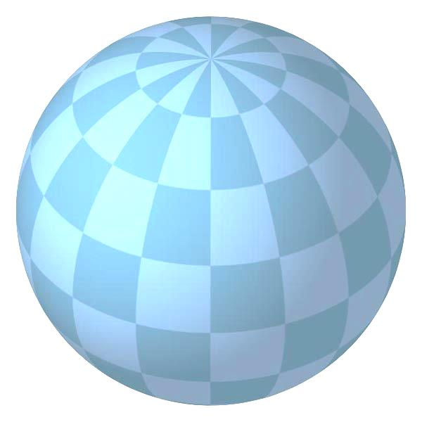
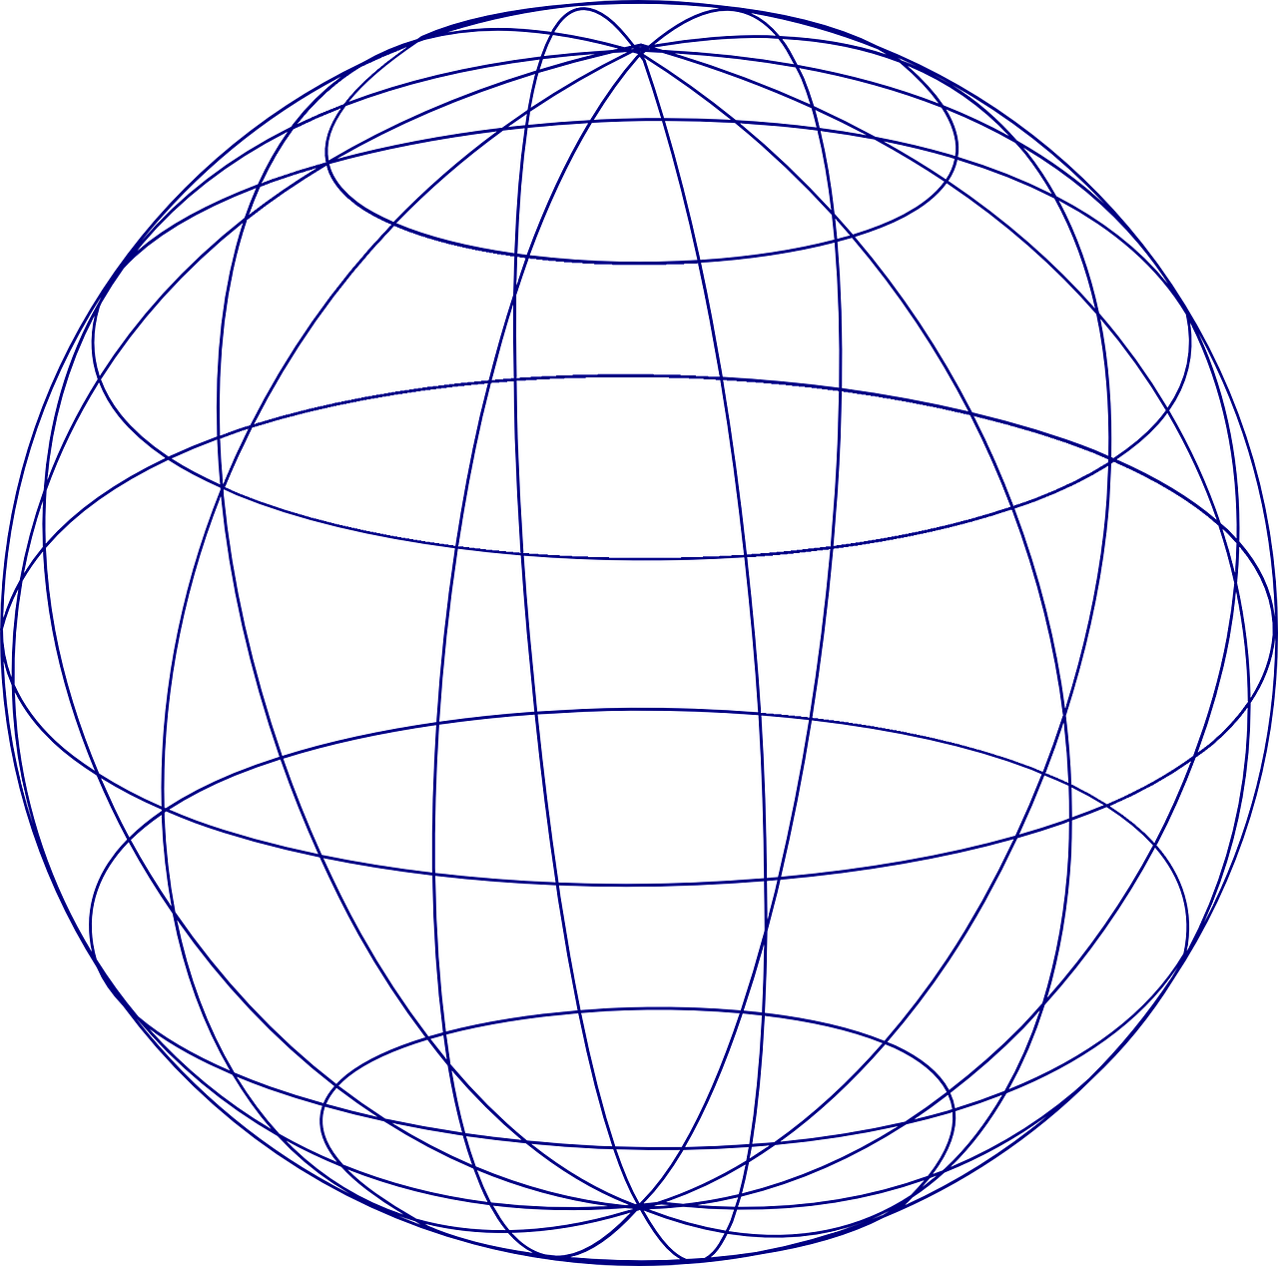
z
z
(i, j)
j
i
y
y
x
x

Slide 4
Geometric objects and Its representations

Slide 5
Scalars
Scalars α, β, γ from a scalar field
Operations α+β, α∙β, 0, 1, -α, ( )⁻¹
“Expected” laws apply
Examples: rationals or reals with addition and multiplication

Slide 6
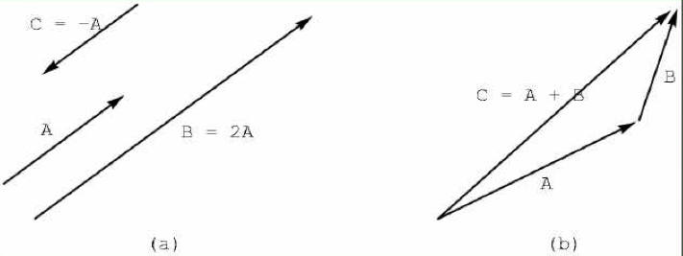
Vectors
Vectors u, v, w from a vector space
Vector addition u + v , subtraction u - v
Zero vector 0
Scalar multiplication α v

Slide 7
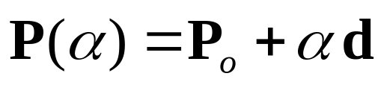
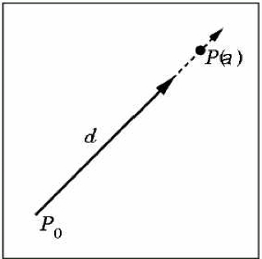
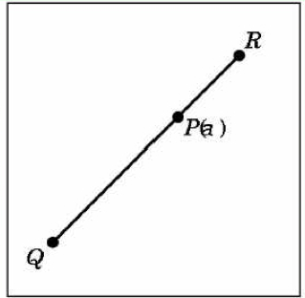
Lines and line Segments
Parametric form of line:
Line segment between Q and R:

Slide 8
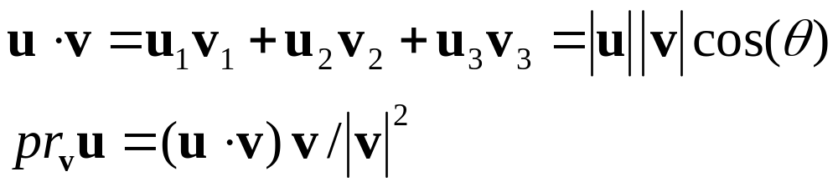
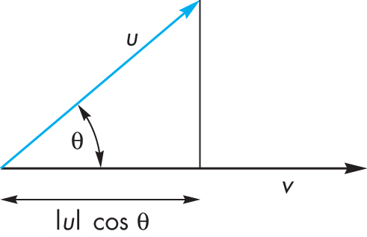
Dot Product (Projection)
Dot product projects one vector onto another vector

Slide 9
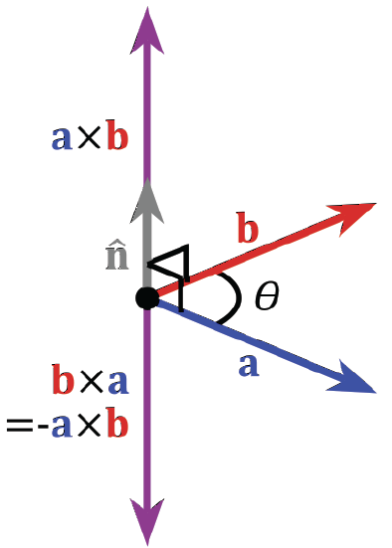
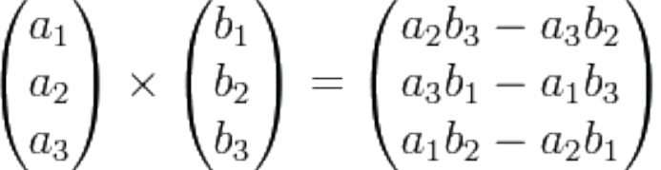
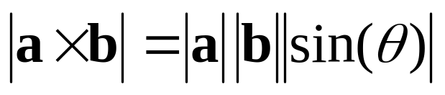
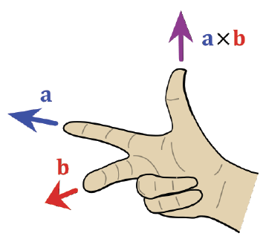
Cross Product
Cross product is
perpendicular to both a and b
Right-hand rule

Slide 10
Planes
A plane can be defined by a point and two vectors or by three points
P
v
Q
R
u
R
P(α,β)=R+αu+βv
P(α,β)=R+α(Q-R)+β(P-Q)

Slide 11
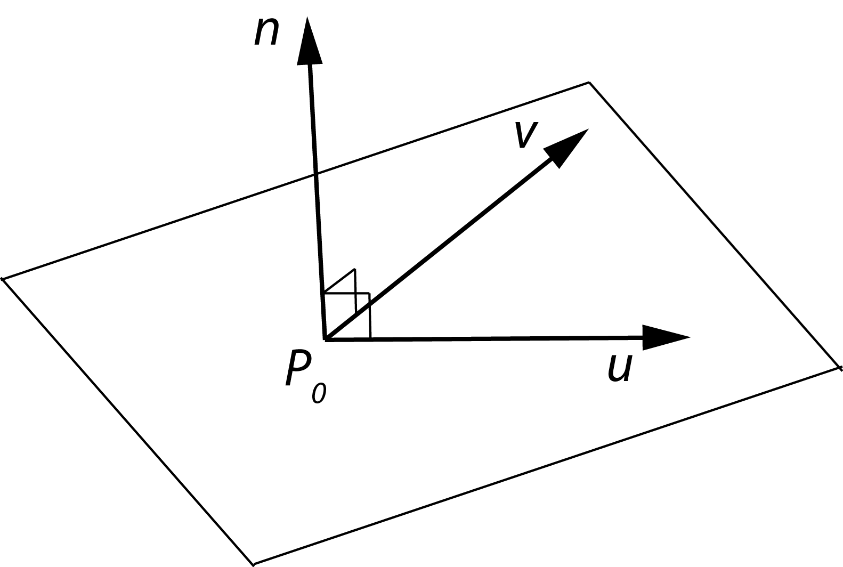
Planes and normal
Plane defined by point P₀
and vectors u and v
u and v should not
be parallel
Parametric form:
T(α, β) = P₀ + α u + β v
(α and β are scalars)
n = u x v / |u x v| is the normal
n∙(P – P₀) = 0 if and only if P lies in plane

Slide 12
Geometric Transformations

Slide 13
Transformations
Linear transformations
Rigid transformations
Affine transformations
Projective transformations
T
Global reference frame

Slide 14
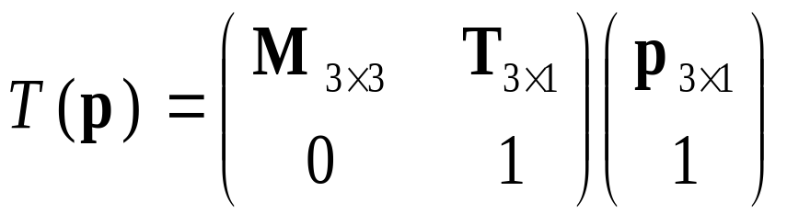
Homogeneous Coordinates
Any affine transformation between 3D spaces can be represented by a 4x4 matrix
Affine transformation is linear in homogeneous coordinates

Slide 15
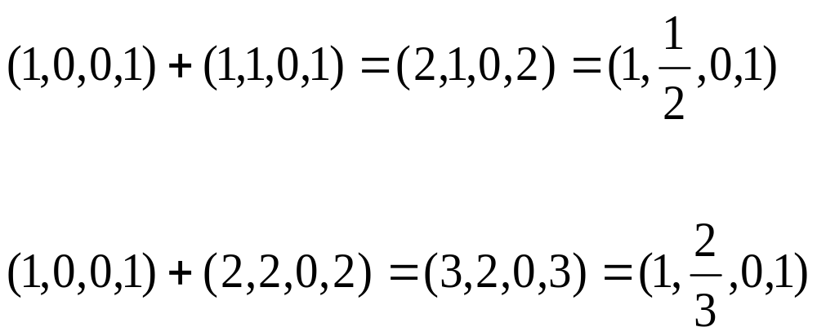
Projective Spaces
Homogeneous coordinates
  (x, y, z, w) = (x/w, y/w, z/w, 1)
  Useful for handling perspective projection
But, it is algebraically inconsistent !!

Slide 16


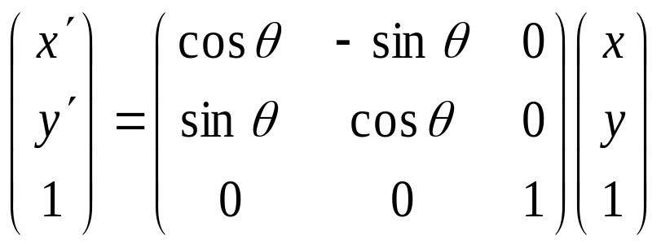
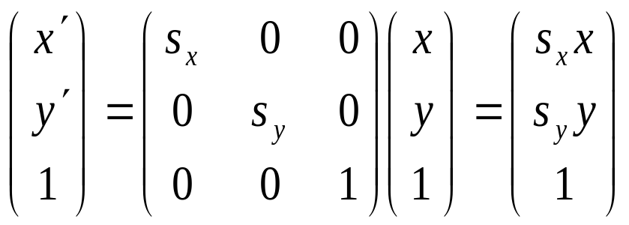
Examples of Affine Transformations
2D rotation
2D scaling

Slide 17
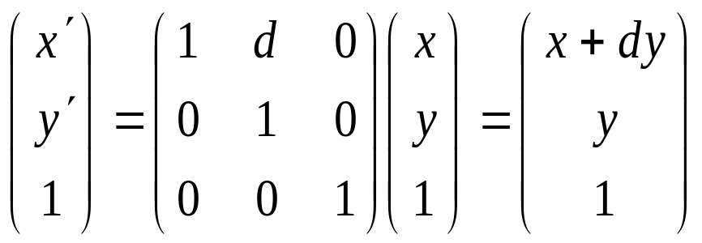
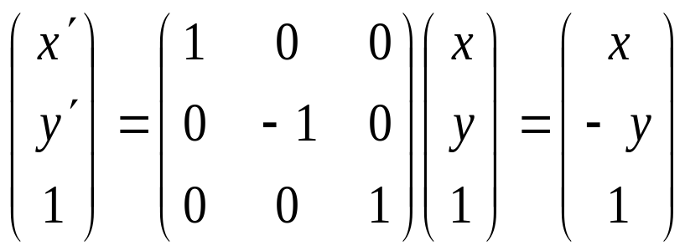
Examples of Affine Transformations
2D shear
2D reflection

Slide 18
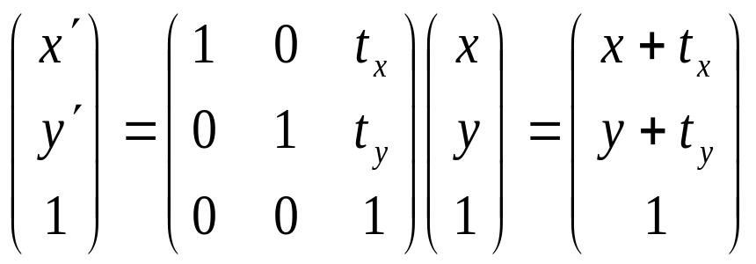
Examples of Affine Transformations
2D translation

Slide 19
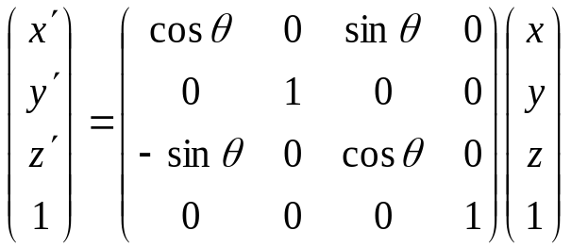
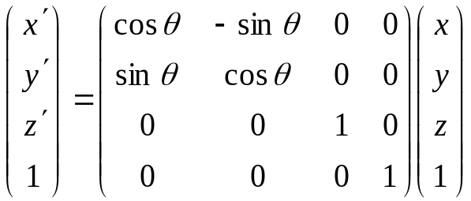
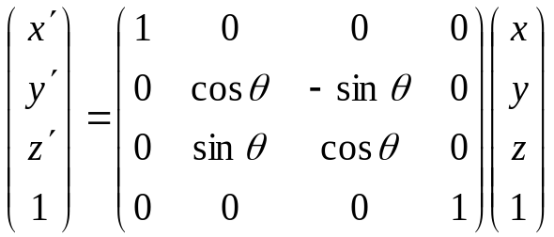
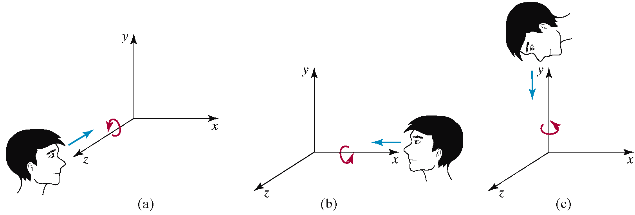
Examples of Affine Transformations
3D rotation

Slide 20
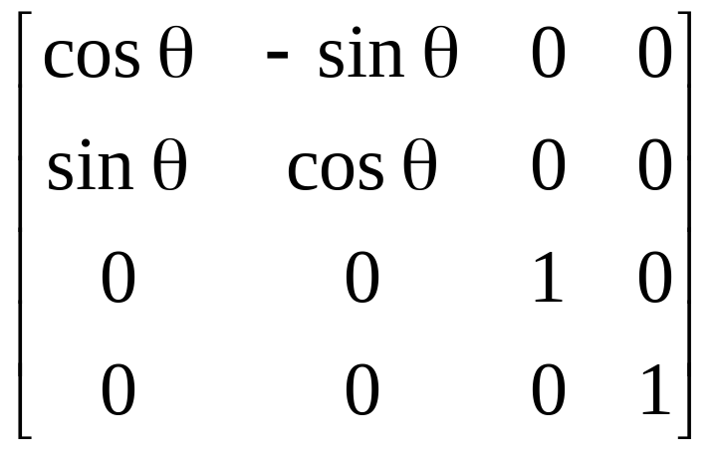
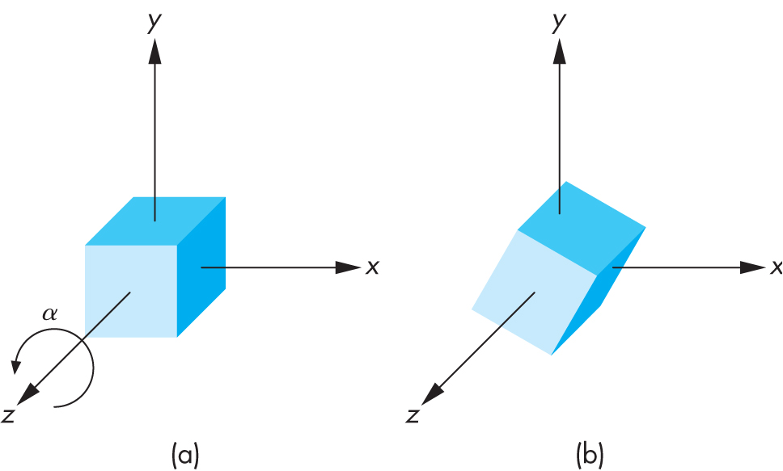
3D Rotation Matrix about Z Axis
R = R_{z}(θ) =

Slide 21
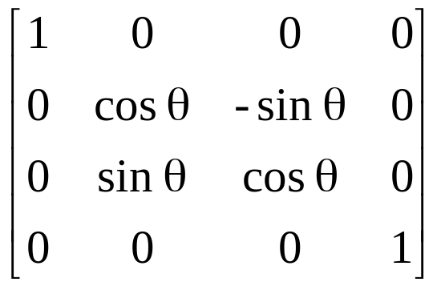
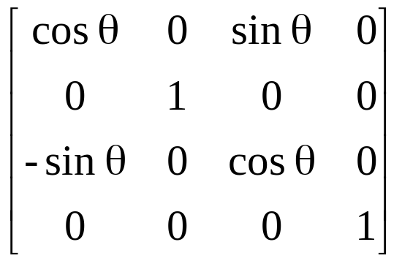
3D Rotation about x and y axes
Same argument as for rotation about z axis
  For rotation about x axis, x is unchanged
  For rotation about y axis, y is unchanged
R = R_{x}(θ) =
R = R_{y}(θ) =

Slide 22
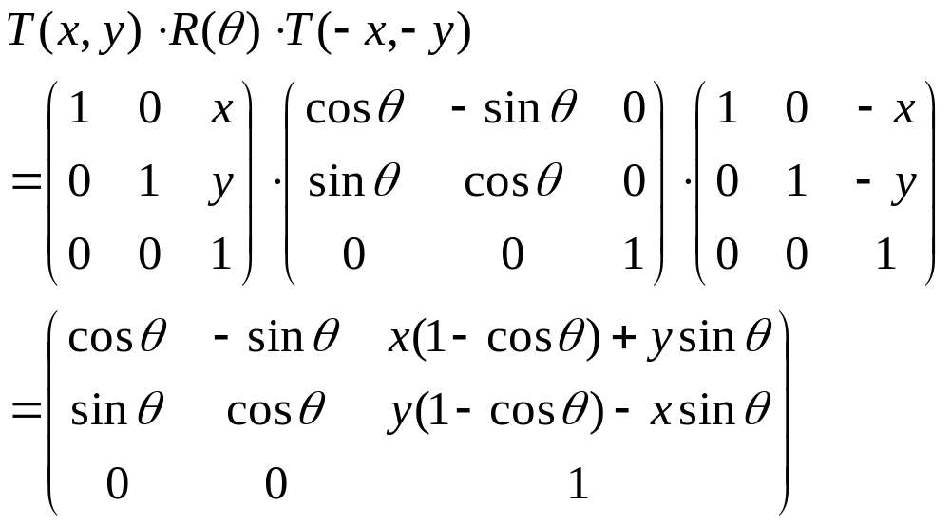
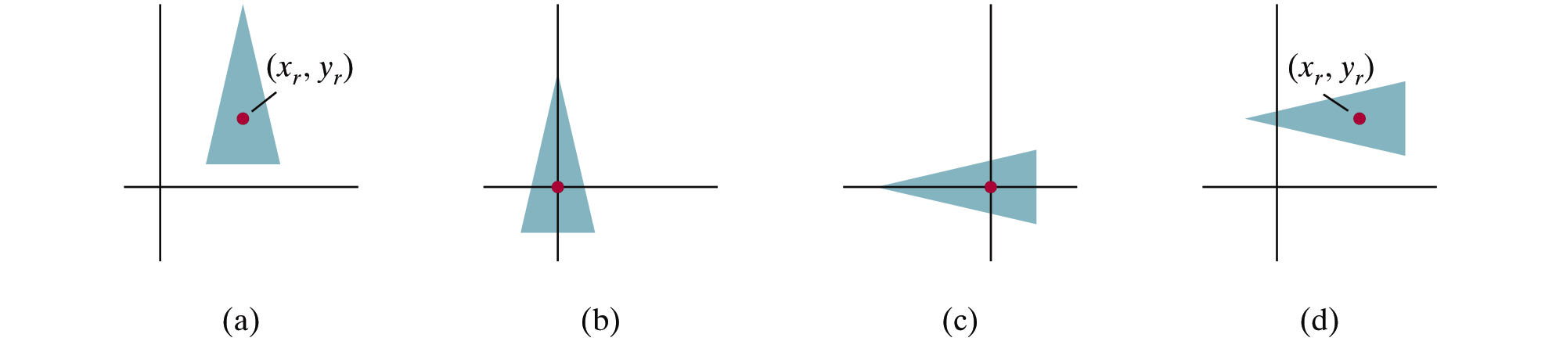
2D Pivot-Point Rotation
Rotation with respect to a pivot point (x,y)

Slide 23
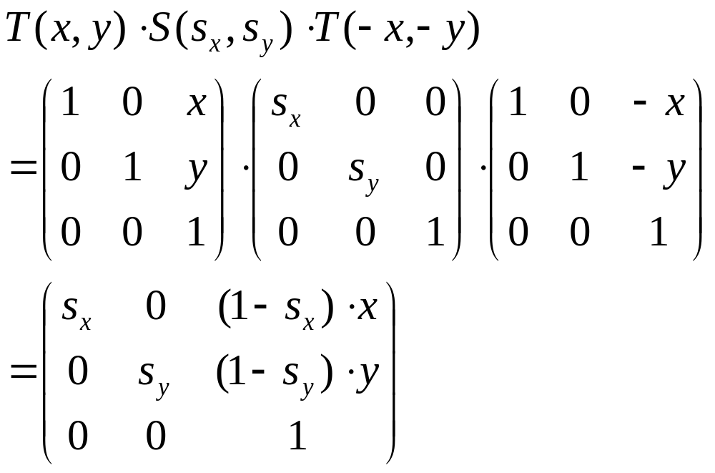
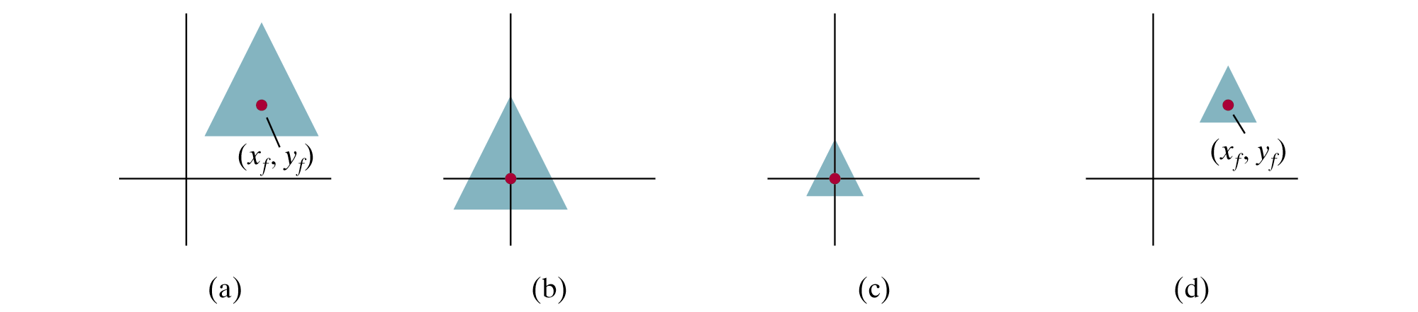
2D Fixed-Point Scaling
Scaling with respect to a fixed point (x,y)

Slide 24
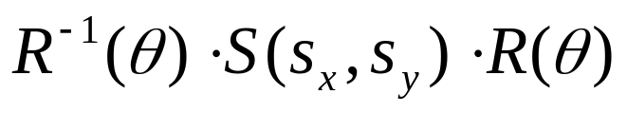

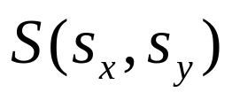
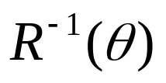
Scaling Direction
Scaling along an arbitrary axis

Slide 25
Properties of Affine Transformations
Any affine transformation between 3D spaces can be represented as a combination of a linear transformation followed by translation
An affine transf. maps lines to lines
An affine transf. maps parallel lines to parallel lines
An affine transf. preserves ratios of distance along a line
An affine transf. does not preserve absolute distances and angles

Slide 26
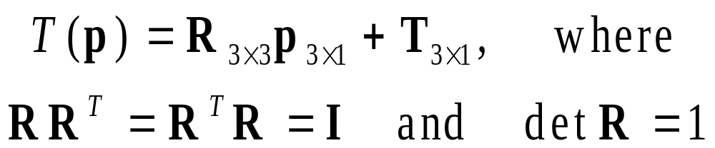
Rigid Transformations
A rigid transformation T is a mapping between affine spaces
  T maps vectors to vectors, and points to points
  T preserves distances between all points
  T preserves cross product for all vectors (to avoid reflection)
In 3-spaces, T can be represented as

Slide 27


Rigid Body Rotation
Rigid body transformations allow only rotation and translation
Rotation matrices form SO(3)
  Special orthogonal group
(Distance preserving)
(No reflection)

Slide 28
Rigid Body Rotation
R is normalized
  The squares of the elements in any row or column sum to 1
R is orthogonal
  The dot product of any pair of rows or any pair columns is 0
The rows (columns) of R correspond to the vectors of the principle axes of the rotated coordinate frame

Slide 29
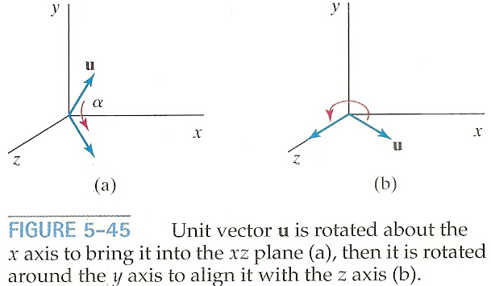
3D Rotation About Arbitrary Axis
How to rotate around u vector
(u = given rotation axis)
➔ Rotate about x and y axes to make u align with the z-axis

Slide 30
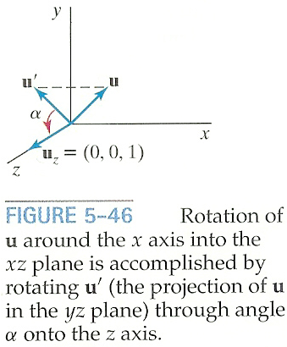
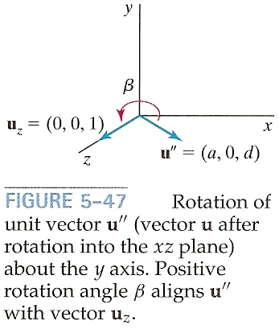
3D Rotation About Arbitrary Axis
Rotate u onto the z-axis
  u’: Project u onto the yz-plane to compute angle α
  u’’: Rotate u about the x-axis by angle α
  Rotate u’’ onto the z-asis

Slide 31
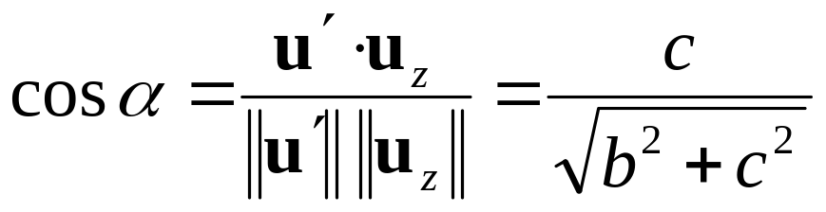
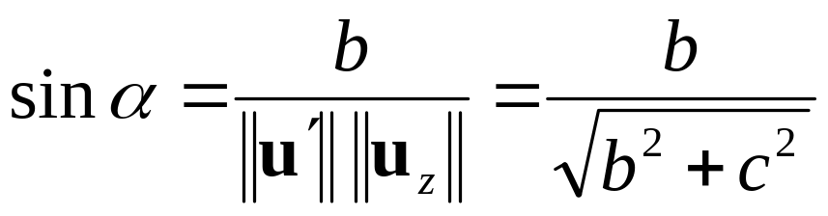
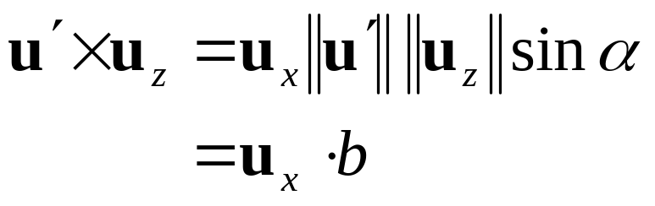
3D Rotation About Arbitrary Axis
Rotate u’ about the x-axis onto the z-axis
  Let u=(a,b,c) and thus u’=(0,b,c)
  Let uz=(0,0,1)

Slide 32
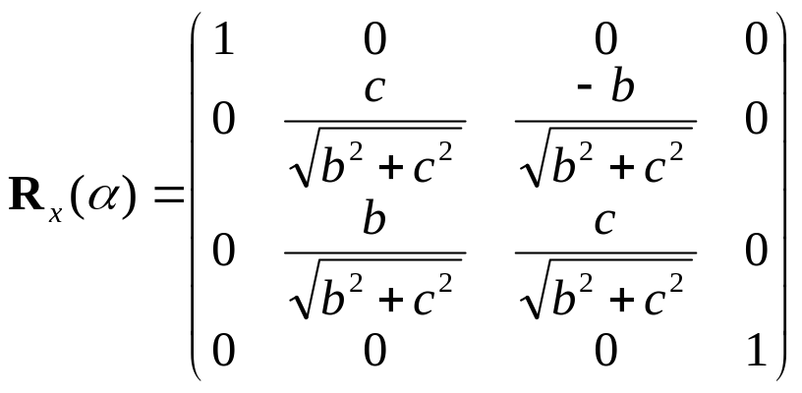
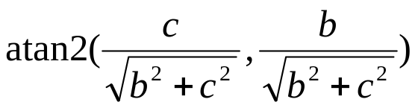
3D Rotation About Arbitrary Axis
Rotate u’ about the x-axis onto the z-axis
  Since we know both cos α and sin α, the rotation matrix can be obtained
  Or, we can compute the signed angle α
  Do not use acos() since its domain is limited to
  [-1,1]

Slide 33
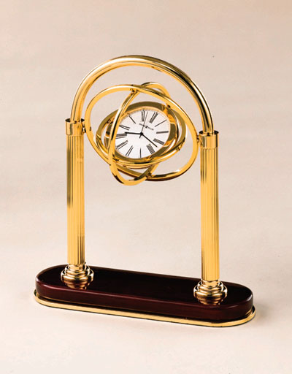
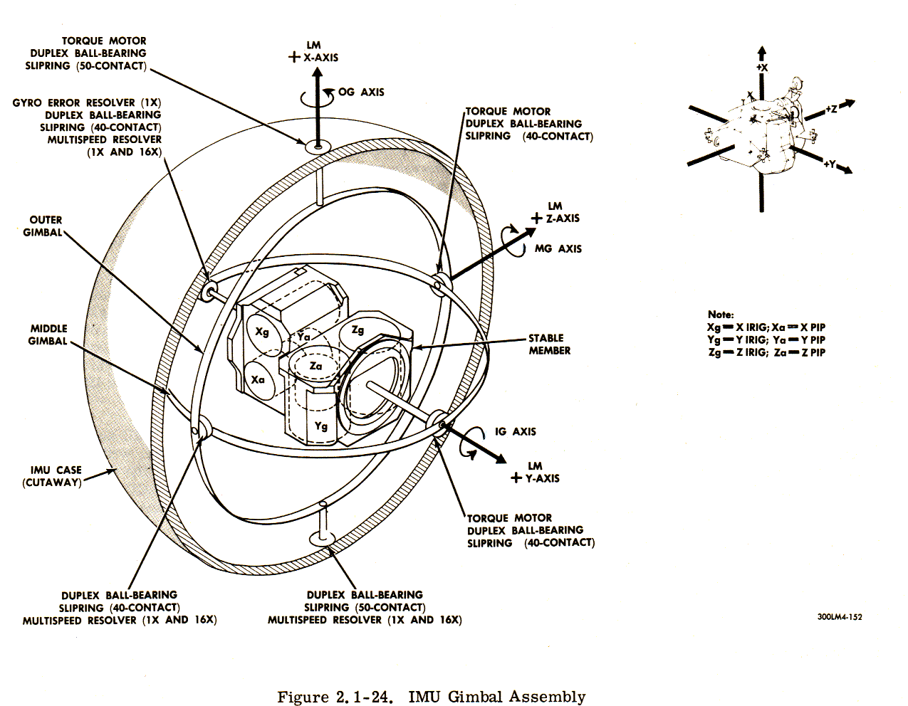
Gimble
Hardware implementation of Euler angles
Aircraft, Camera

Slide 34
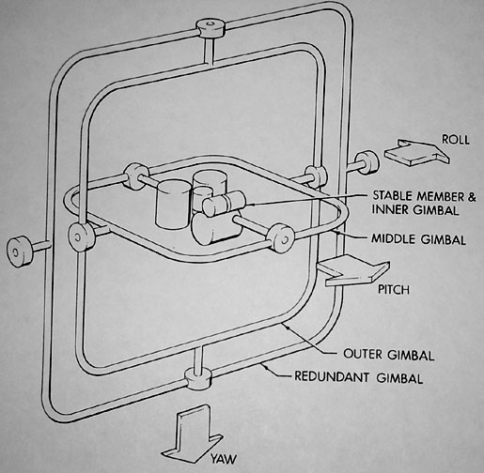
Euler Angles
Rotation about three orthogonal axes
  12 combinations
    XYZ, XYX, XZY, XZX
    YZX, YZY, YXZ, YXY
    ZXY, ZXZ, ZYX, ZYZ
Gimble lock
  Coincidence of inner most and outmost gimbles’ rotation axes
  Loss of degree of freedom

Slide 35
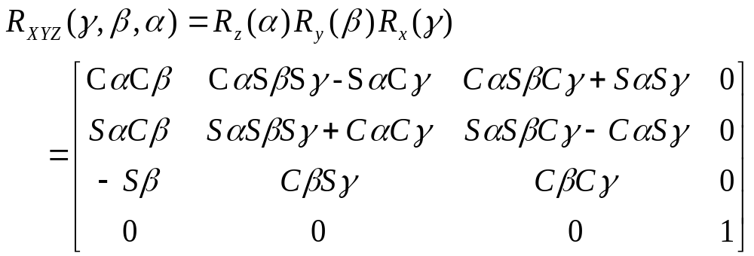
Euler angles
Arbitrary rotation can be represented by three rotation along x,y,z axis

Slide 36

Euler Angles
Euler angles are ambiguous
  Two different Euler angles can represent the same orientation
  This ambiguity brings unexpected results of animation where frames are generated by interpolation.

Slide 37
Smooth Rotation
Create transformations from M₀ to M_{n} smoothly
  Problem: find a sequence of model-view matrices M₀,M₁,…..,M_{n} for each frame
  to see a smooth transition
One solution for rotation (using Euler angles):
  Find R₀= R_{0z} R_{0y} R_{0x} and R_{n}= R_{nz} R_{ny} R_{nx}
  Then, Create a sequence of rotation R₀,R₁,…..,R_{n} :
  R_{i}= R_{iz} R_{iy} R_{ix} (where, ix, iy, iz is the interpolated angles from the beginning and the end)
  Not very effective!
  Quaternions can do it better!

Slide 38

Quaternions
Extension of imaginary numbers from two to three dimensions
Requires one real and three imaginary components i, j, k
Quaternions can express rotations on sphere smoothly and efficiently. Process:
  Model-view matrix → quaternion
  Carry out operations with quaternions
  Quaternion → Model-view matrix
q=q₀+q₁i+q₂j+q₃k
Computer Animation 수업에서 다룹니다.

Slide 39
Taxonomy of Transformations
Rigid
Affine
Projective

Slide 40


Composite Transformations
Composite 2D Translation

Slide 41


Composite Transformations
Composite 2D Scaling

Slide 42


Composite Transformations
Composite 2D Rotation

