Slide 1
Model View Matrix and its implementation
Sang Il Park

Slide 2
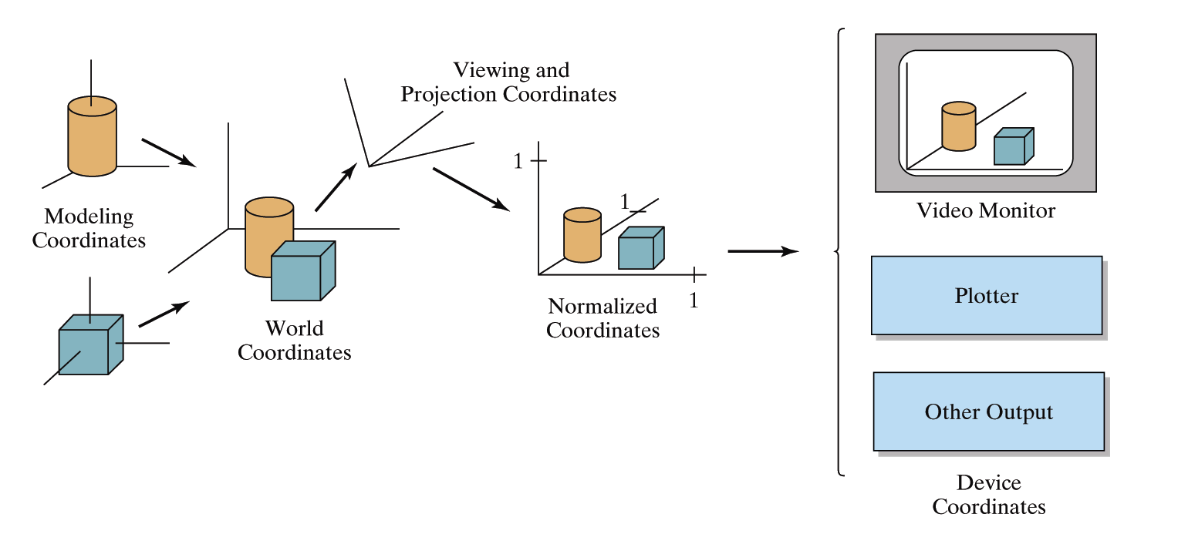
OpenGL Geometric Transformations
(old style)
glMatrixMode(GL_MODELVIEW);

Slide 3
Topics of Model View Matrix
Local to World Coordinate Transform
Camera Positioning

Slide 4
Model View Matrix II:
Camera Positioning

Slide 5
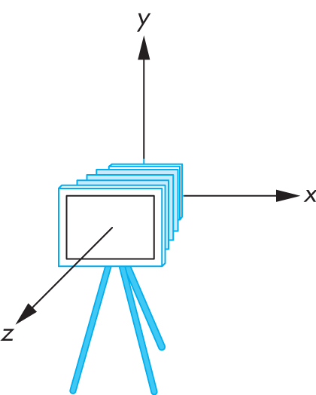
Transform Camera = Transform Scene
Camera position is identified with a frame
Either move and rotate the objects
Or move and rotate the camera
Initially, camera at origin, pointing in negative z-direction

Slide 6
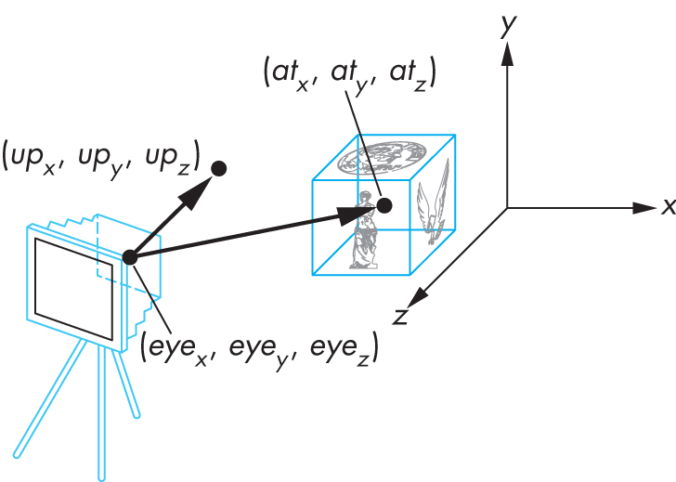
The Look-At Function
Convenient way to position camera with three parameters:

Slide 7
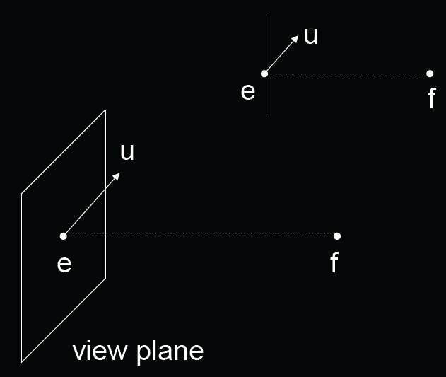
The Look-At Function
(OLD Style)
gluLookAt (ex,ey,ez, fx,fy,fz, ux,uy,uz);
e = eye point (eye)
f = focus point (at)
u = up vector (up)

Slide 8

Old OpenGL code
void display()
{
glClear (GL_COLOR_BUFFER_BIT |
GL_DEPTH_BUFFER_BIT);
glMatrixMode (GL_MODELVIEW);
glLoadIdentity ();
gluLookAt (ex,ey,ez,fx,fy,fz,ux,uy,uz);
...
renderObjects();
glutSwapBuffers();
}

Slide 9


How to Compute?
Cx
Cz
eye
at
Wx
Wz

Slide 10


2D case: Translate + Rotation
Cx
Cz
eye
Cx
at
Cz
R_{c}
T_{c}=translate(-eye)
eye
Wx
at
Wz

Slide 11

2D case: Translate + Rotation
Cx
Cz
eye
at
at
V=R_{c}T_{c}
R_{c}
T_{c}
eye
Cx
Wx
Cz
Wz
R_{c} is not easy to compute!

Slide 12
Instead,
Think about inverse transform:
Cx
Cz
eye
R_{c}=(R_{w})⁻¹
Wx
at
Wz
=(R_{w})^{T}
R_{w}
Wx
Wz

Slide 13
Implementing the Look-At Function
Plan:
Transform world frame to camera frame
  Compose a rotation R with translation T
  W = T R
Invert W to obtain viewing transformation V
  V = W⁻¹ = (T R)⁻¹ = R⁻¹ T⁻¹
  Derive R, then T, then R⁻¹ T⁻¹

Slide 14
Viewing in OpenGL
Remember:
camera is pointing in the negative z direction

Slide 15

World Frame to Camera Frame I
Camera points in negative z direction
n = (f – e) / |f – e| is unit normal to view plane
Therefore, R_{w} maps [0 0 -1]^{T} to [nx ny nz]^{T}
Cy
u
n
Cz
e
f
Cx
Camera plane

Slide 16

World Frame to Camera Frame II
R_{w} maps [0,1,0]^{T} to projection of u onto view plane
This projection v equals:
  α = (u · n) / |n| = u · n
  v₀ = u – α n
  v = v₀ / |v₀|
Cy
u
v₀
α
n
Cz
e
f
Cx
Camera plane

Slide 17

World Frame to Camera Frame III
Set w to be orthogonal to n and v
w = n x v
(w, v, -n) is right-handed
Cy
v
n
Cz
e
f
Cx
w
Camera plane

Slide 18

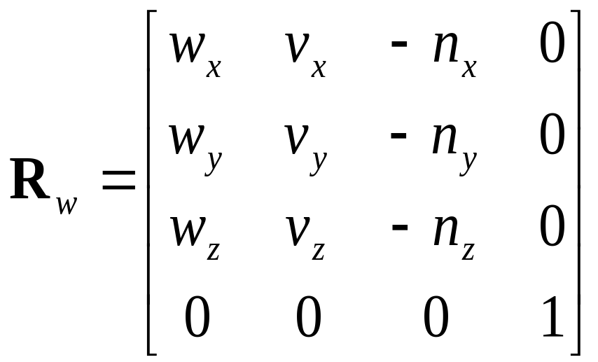
Summary of Rotation
gluLookAt (ex,ey,ez, fx,fy,fz, ux,uy,uz);
n = (f – e) / |f – e|
v = (u – (u · n) n) / |u – (u · n) n|
w = n x v
Rotation must map:
  (1,0,0) to w
  (0,1,0) to v
  (0,0,-1) to n
Cy
v
n
Cz
e
f
Cx
w
Camera plane

Slide 19
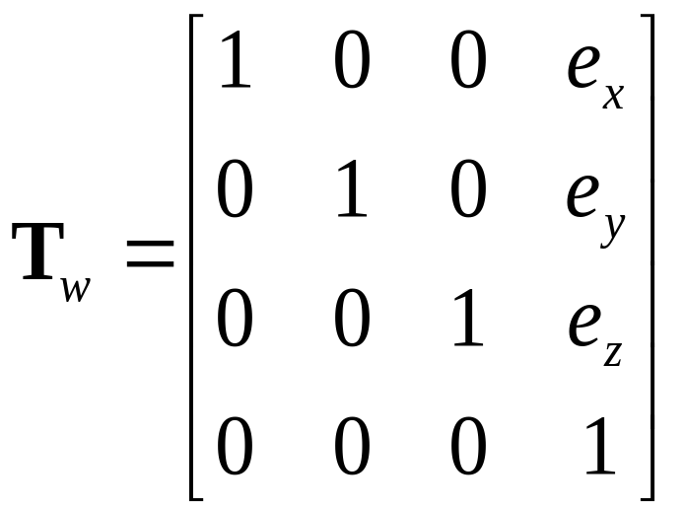
World Frame to Camera Frame IV
Translation of origin to e = [e_{x} e_{y} e_{z} 1]^{T}

Slide 20
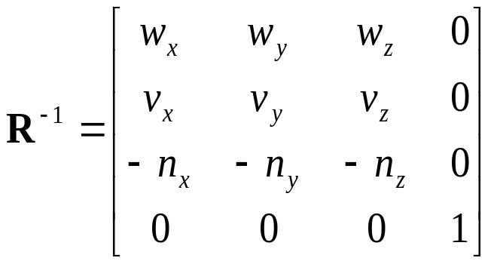
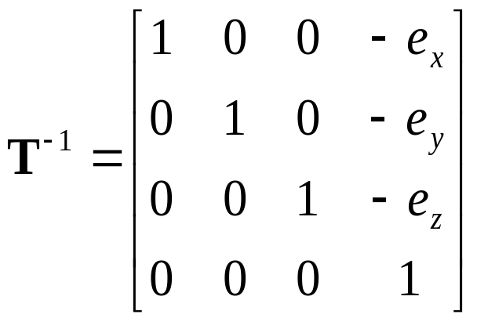
Camera Frame to Rendering Frame
V = W⁻¹ = (T_{w} R_{w})⁻¹ = R_{w}⁻¹ T_{w}⁻¹
R is rotation, so R_{w}⁻¹ = R_{w}^{T}
T is translation, so T⁻¹ negates displacement

Slide 21
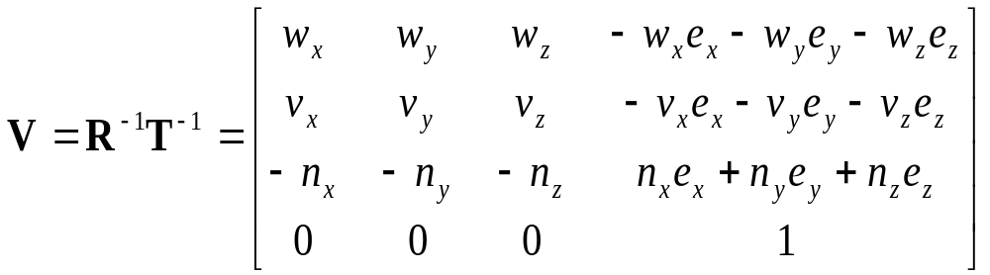
Putting All Together
Calculate V = R_{w}⁻¹ T_{w}⁻¹
This is different from book [Angel, Ch. 4.3.2]
There, u, v, n are right-handed (here: u, v, -n)

Slide 22
Projection Matrix and its implementation

Slide 23
Topics
Simple Parallel Projections
Simple Perspective Projections

Slide 24
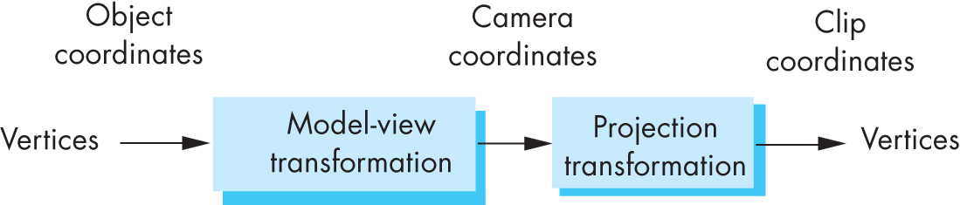
Projection Matrices
Recall geometric pipeline
Projection takes 3D to 2D
Projections are not invertible
Projections also described by 4x4 matrix
Homogenous coordinates crucial
Parallel and perspective projections

Slide 25
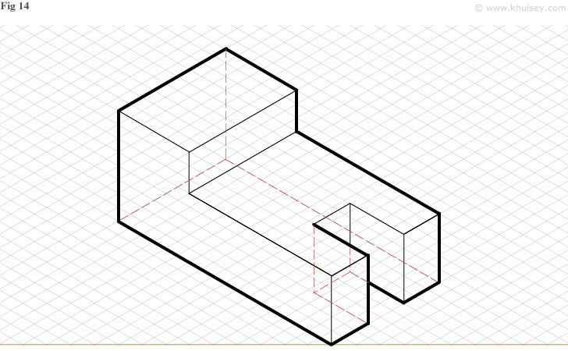
Simple Parallel Projection

Slide 26
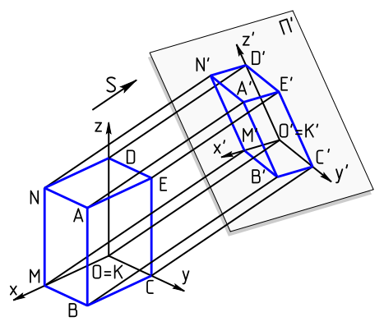
Parallel Projection
Project 3D object to 2D via parallel lines
The lines are not necessarily orthogonal to projection plane

Slide 27
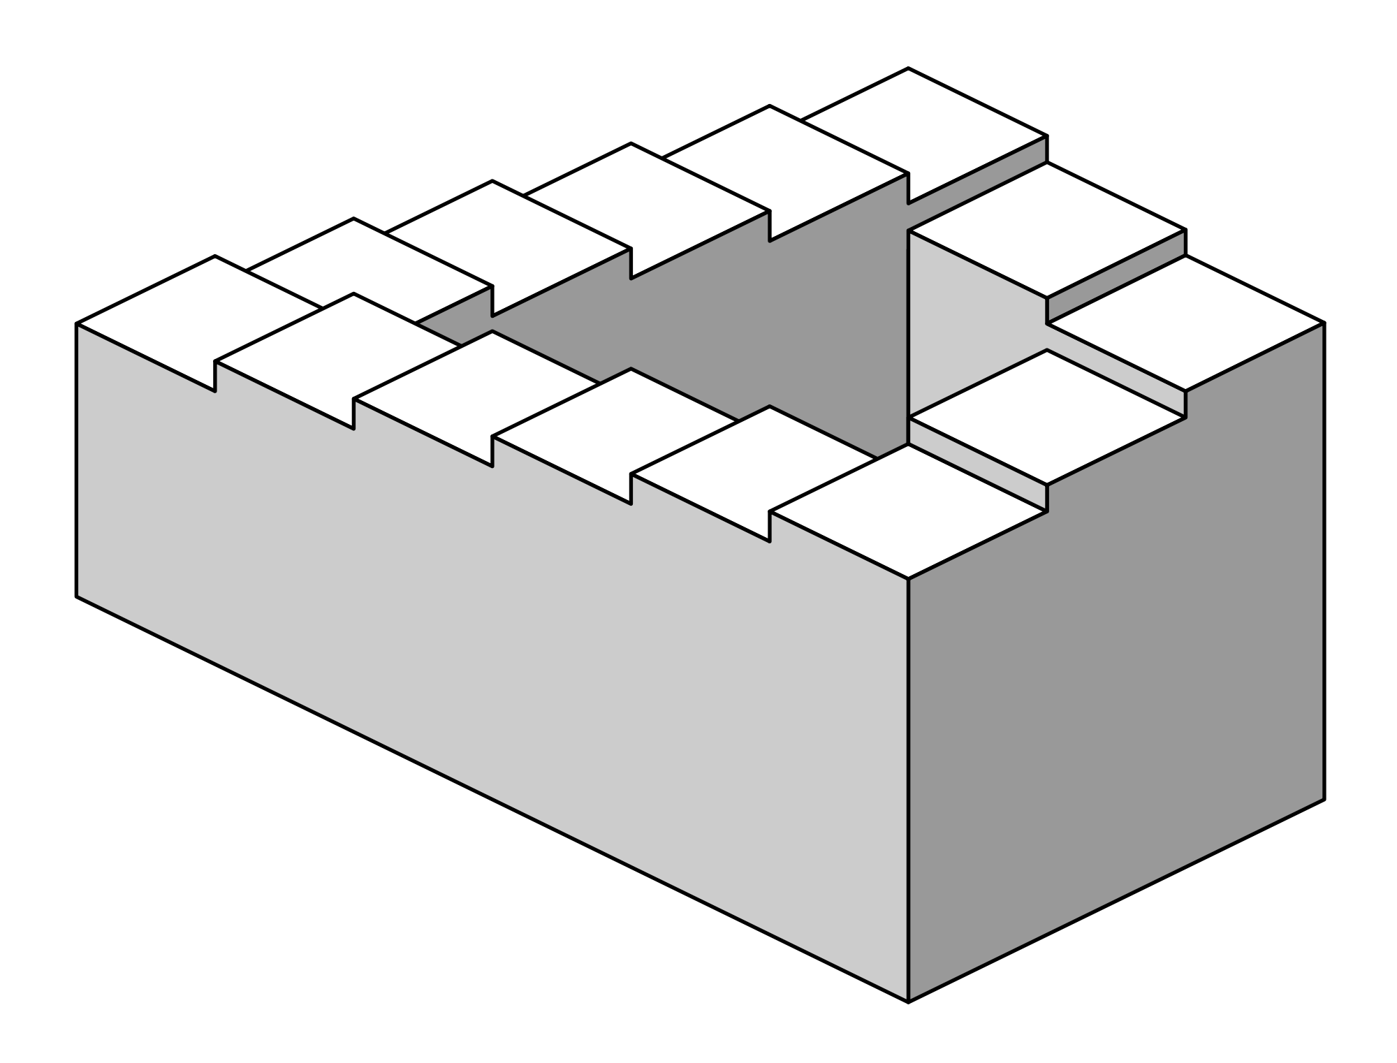
Parallel Projection
Problem: objects far away do not appear smaller
Can lead to “impossible objects” :
Echochrome: https://www.youtube.com/watch?v=QfICeBtVv8U
Penrose stairs

Slide 28
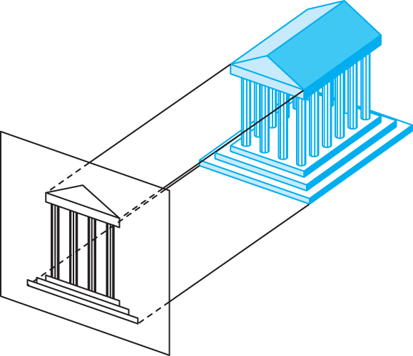

Orthographic Projection
A special kind of parallel projection:
projectors perpendicular to projection plane
Simple, but not realistic
Used in blueprints (multiview projections)

Slide 29
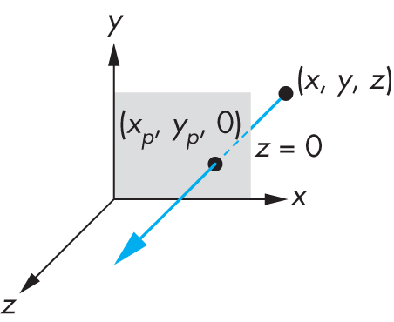
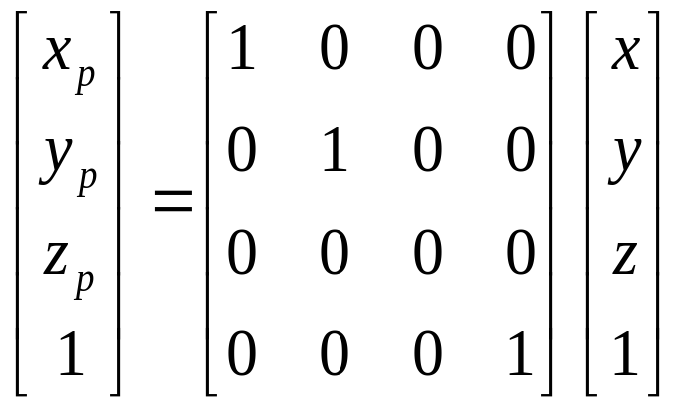
Simple Orthographic Projection Matrix
Project onto z = 0
x_{p} = x, y_{p} = y, z_{p} = 0
In homogenous coordinates

Slide 30
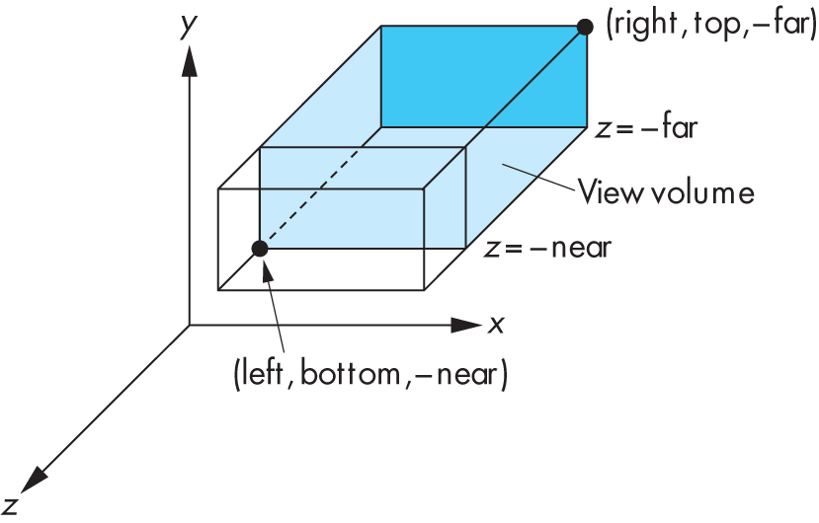
Orthographic Viewing in Old OpenGL
glOrtho(xmin, xmax, ymin, ymax, near, far)

Slide 31
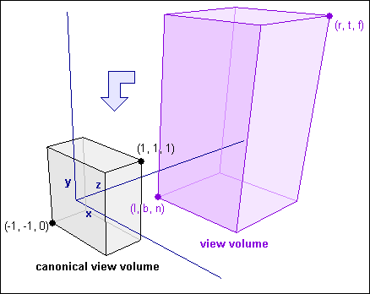
The Normalized view volume
How exactly do we take contents of an arbitrary view volume and project them to a 2D surface?
Arbitrary view volume is too complex…
Reduce it to a simpler problem! The Normalized view volume!
Can also be called the standard or unit or canonical view volume

Slide 32
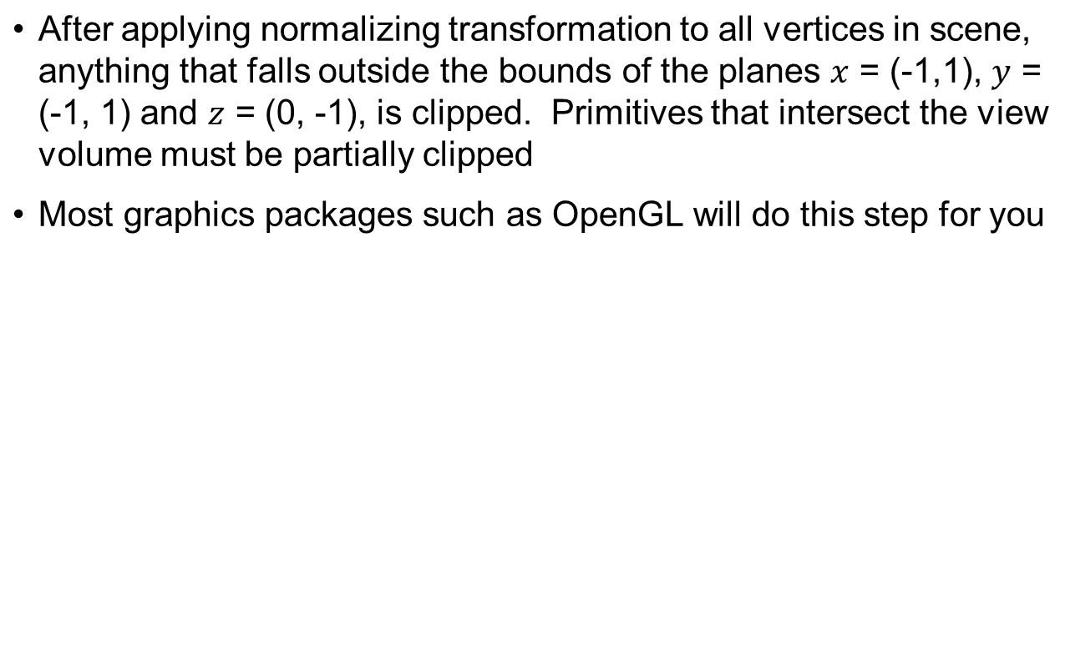
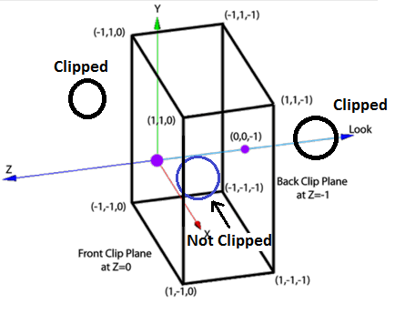
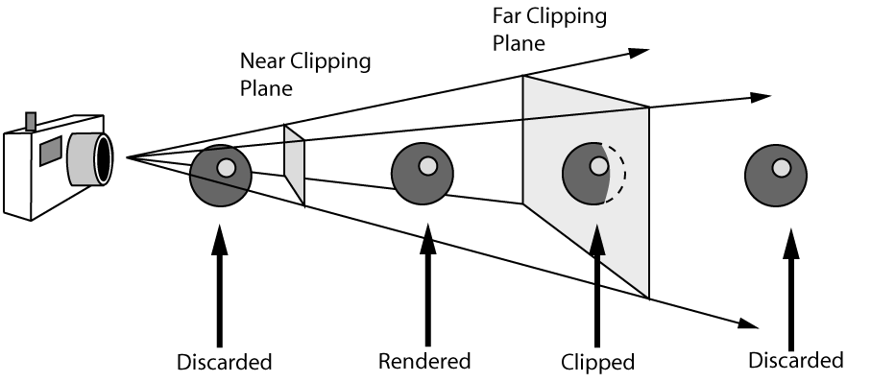
Clipping against the normalized view volume

Slide 33
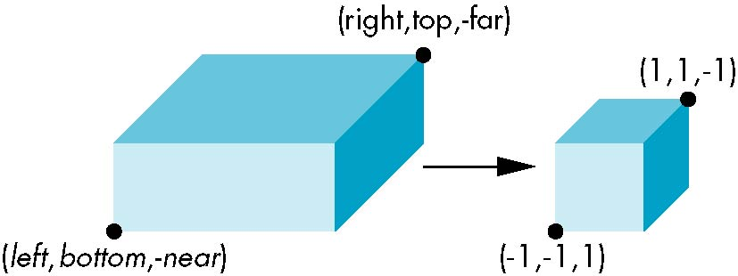
Orthogonal Normalization I
Ortho(left,right,bottom,top,near,far)
normalization ⇒ find transformation to convert
specified clipping volume to default

Slide 34
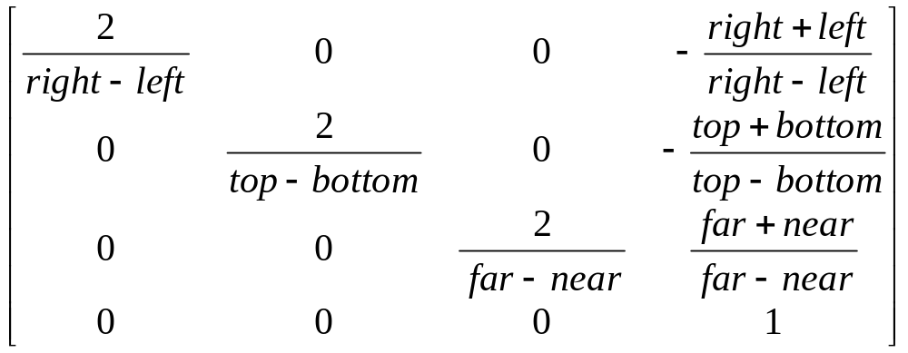
Orthogonal Matrix I
Two steps
  Move center to origin
    T(-(left+right)/2, -(bottom+top)/2, (near+far)/2)
  Scale to have sides of length 2
    S(2/(left-right),2/(top-bottom),2/(far-near))
P = ST =
E. Angel and D. Shreiner: Interactive Computer Graphics 6E © Addison-Wesley 2012

Slide 35
Orthogonal Normalization II
Ortho(left,right,bottom,top,near,far)
normalization ⇒ find transformation to convert
specified clipping volume to default
0

Slide 36
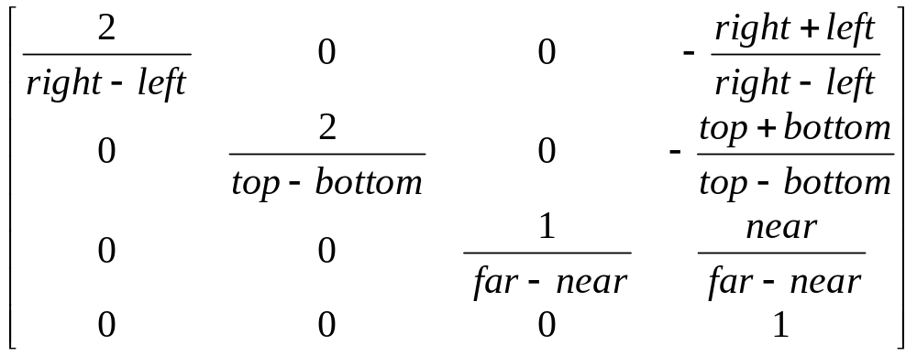
Orthogonal Matrix II
Two steps
  Move center to origin
    Translate(-(left+right)/2, -(bottom+top)/2, near)
  Scale to have sides of length 2 for x, y,
  and length 1 for z
    Scale(2/(left-right),2/(top-bottom),1/(far-near))
P = ST =

