Slide 1
Projection Matrix and its implementation

Slide 2
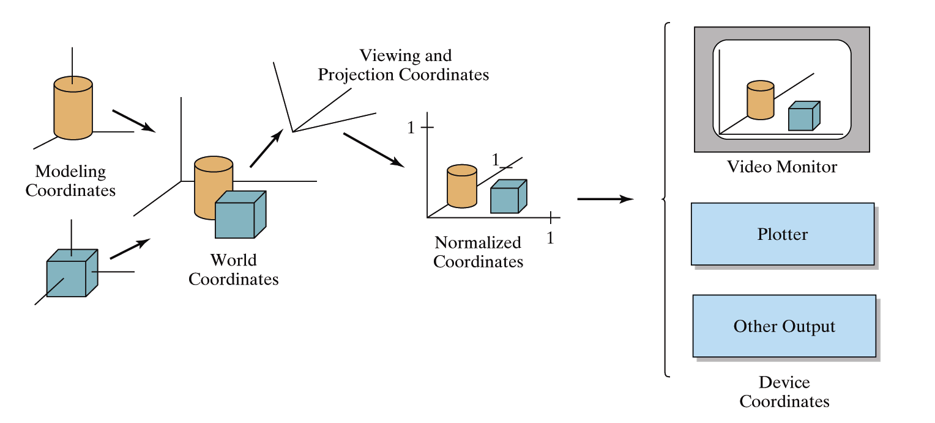
Review : OpenGL Geometric Transformations
glMatrixMode(GL_MODELVIEW);

Slide 3
Review: Projection Transformation
Simple Parallel Projections
Simple Perspective Projections

Slide 4
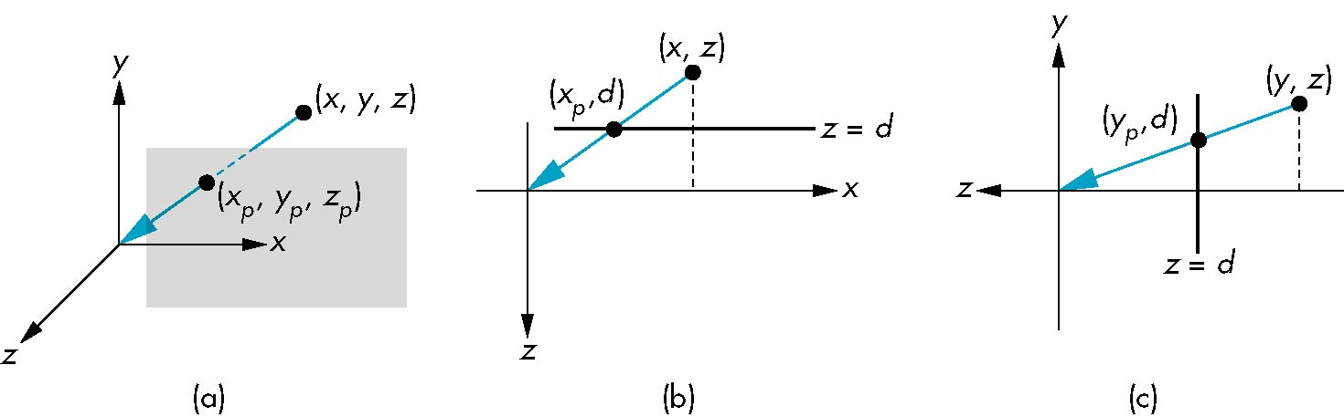
Simple Perspective
Center of projection at the origin
Projection plane z = d, d < 0

Slide 5
Perspective Equations
Consider top and side views
x_{p} =
y_{p} =
z_{p} = d

Slide 6
Homogeneous Coordinate Form
consider q = Mp where
M =
p =
⇒ q =

Slide 7
Perspective Division
However w ≠ 1, so we must divide by w to return from homogeneous coordinates
This perspective division yields
the desired perspective equations
x_{p} =
y_{p} =
z_{p} = d

Slide 8
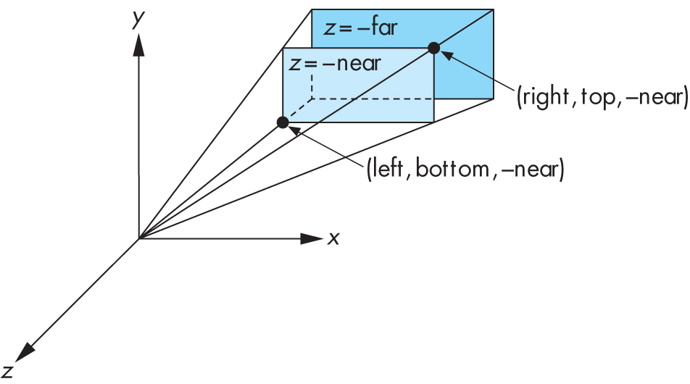
Perspective Viewing in Old OpenGL
Two interfaces: glFrustum and gluPerspective
glFrustum(xmin, xmax, ymin, ymax, near, far);

Slide 9
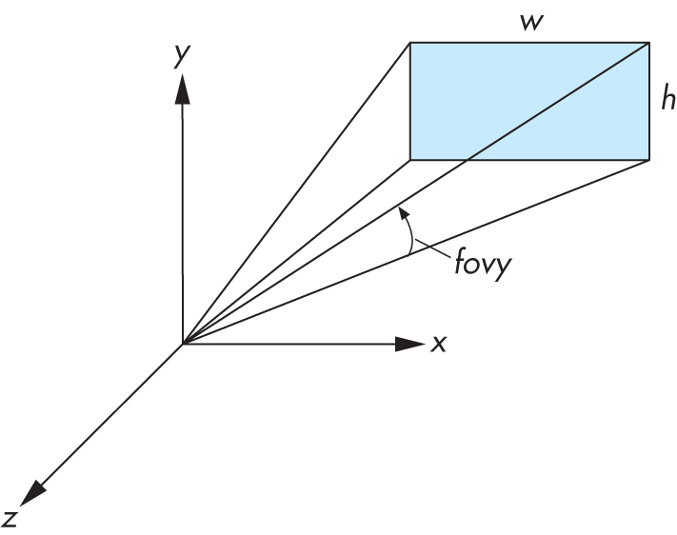
Field of View Interface in Old OpenGL
gluPerspective(fovy, aspectRatio, near, far);
aspectRatio = w / h
fovy specifies field of view as height (y) angle

Slide 10
Old OpenGL code
void reshape(int x, int y)
{
glViewport(0, 0, x, y);
glMatrixMode(GL_PROJECTION);
glLoadIdentity();
gluPerspective(60.0, x/float(y), 0.01, 10.0);
}

Slide 11
Implementing your own Frustum Function
glFrustum(xmin,xmax, ymin,ymax, near,far);
gluPerspective(fovy,aspectRatio, near,far);

Slide 12




The Perspective View Volume
Canonical view volume (frustum):
Far clipping plane
(-1,1,-1)
Near clipping plane
(1,-1,-1)

Slide 13

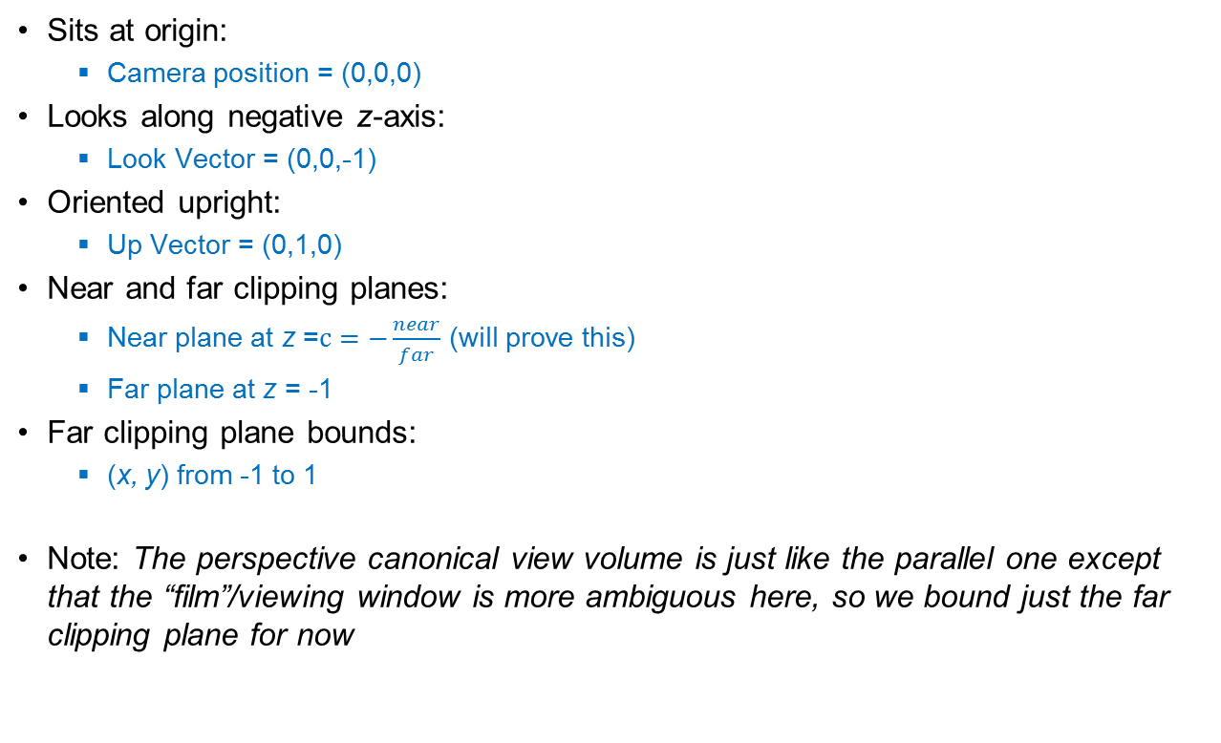



Properties of the canonical view volume
Far clipping plane
(-1,1,-1)
Near clipping plane

Slide 14
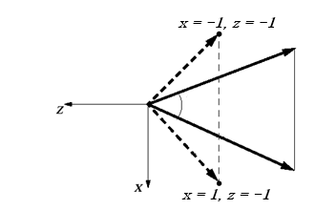
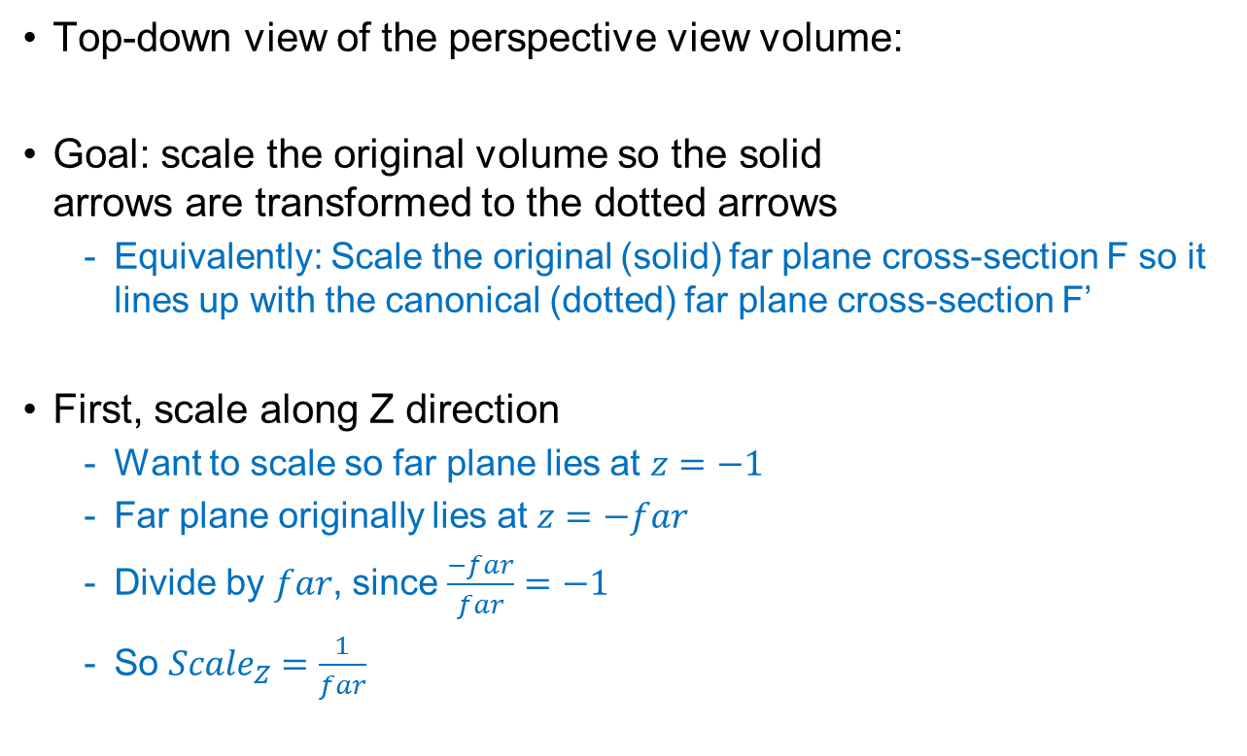
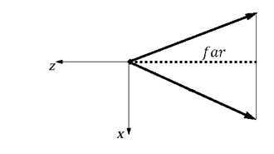
Scaling the perspective view volume (1/4)
F’
F

Slide 15
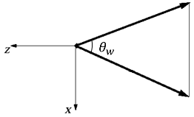
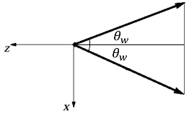


Scaling the perspective view volume (2/4)
Next, scale along X direction
Use the same trick: divide by size of volume along the X axis
How long is the side of the volume along X? Find out using trig…
Start with the original volume
Cut in half along the Z axis

Slide 16
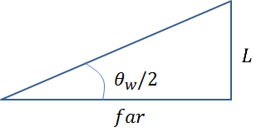
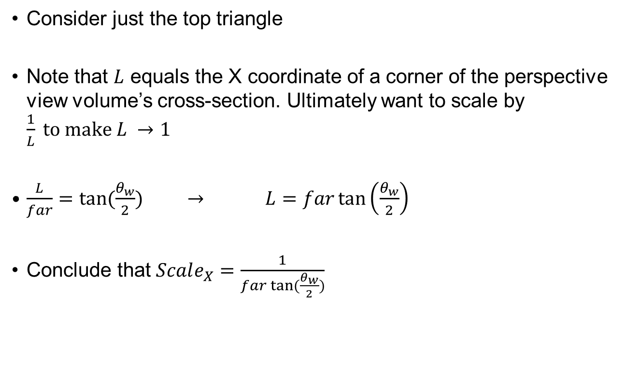
Scaling the perspective view volume (3/4)

Slide 17
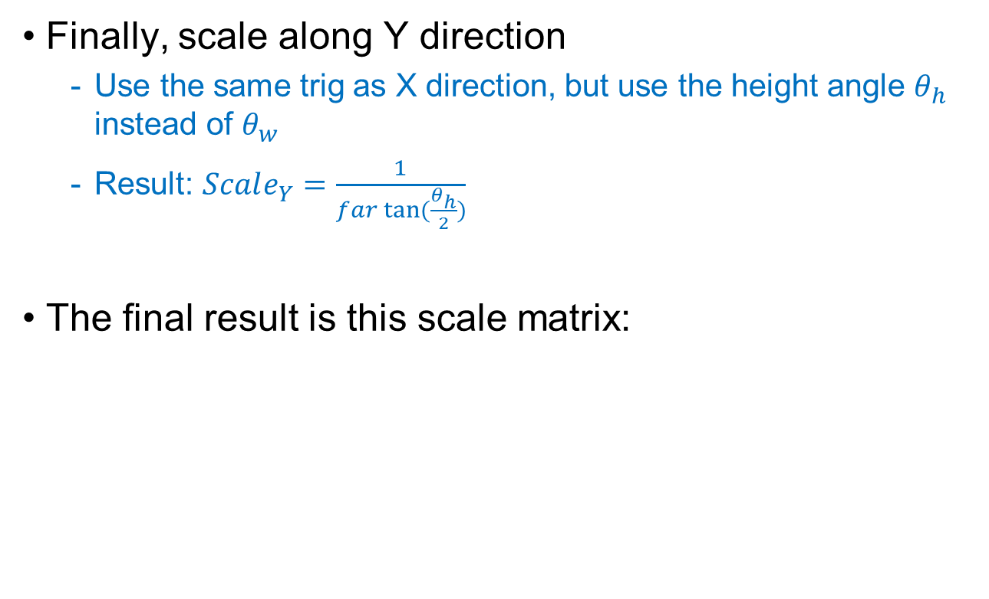
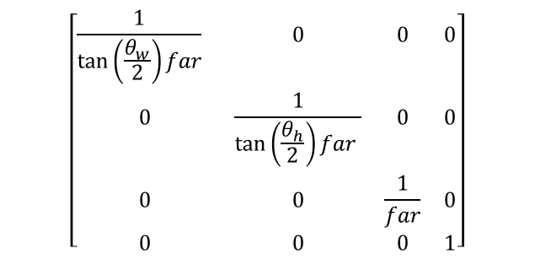
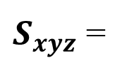
Scaling the perspective view volume (4/4)

Slide 18
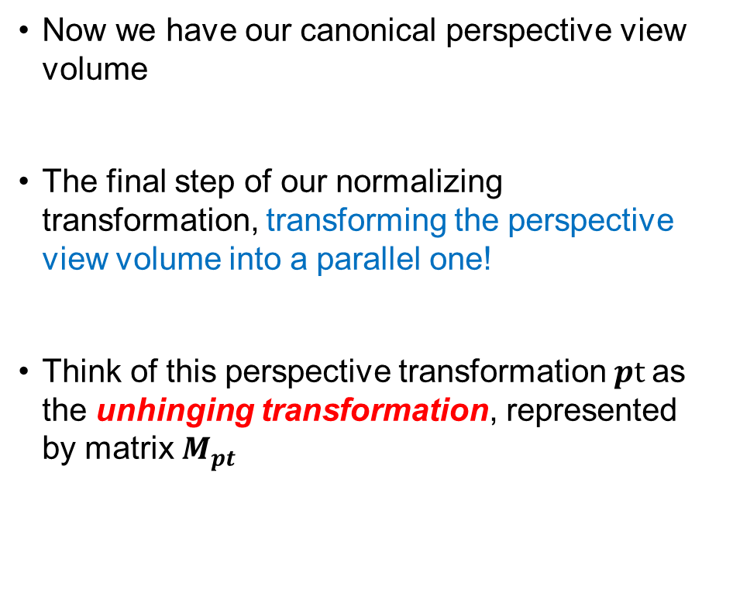
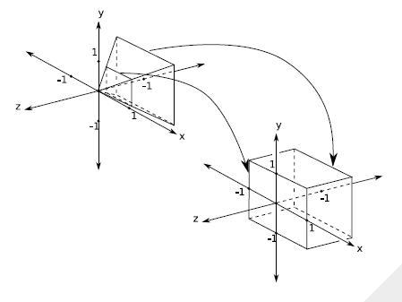
Perspective and Projection

Slide 19
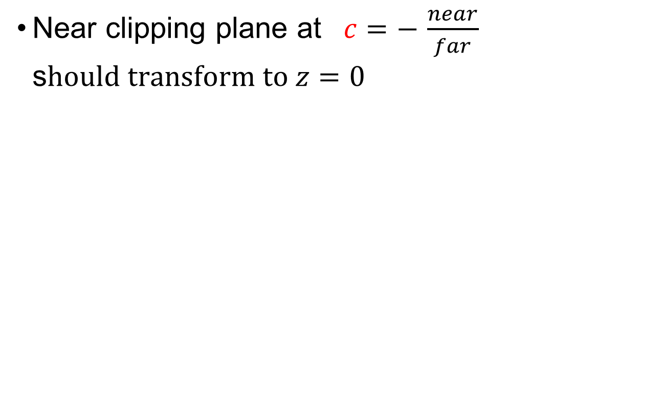




Unhinging View Volume to Become a Parallel View Volume (1/4)
-z

Slide 20
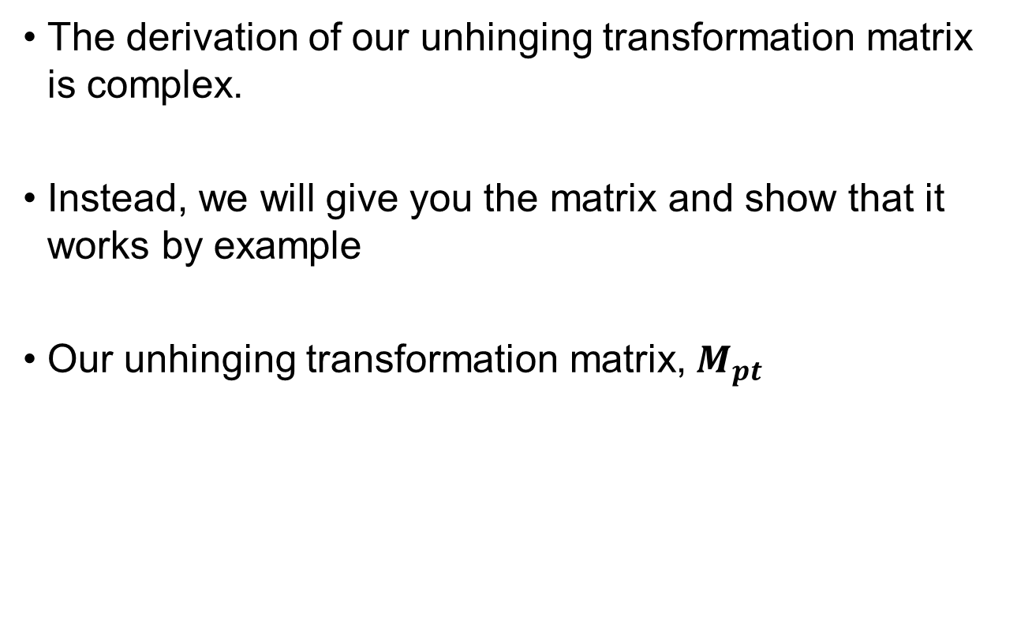
Unhinging View Volume to Become a Parallel View Volume(2/4)
$$\left[\begin{matrix}1 & 0 & 0 & 0 \\ 0 & 1 & 0 & 0 \\ 0 & 0 & \frac{1}{c+1} & \frac{−c}{c+1} \\ 0 & 0 & −1 & 0\end{matrix}\right]$$

Slide 21
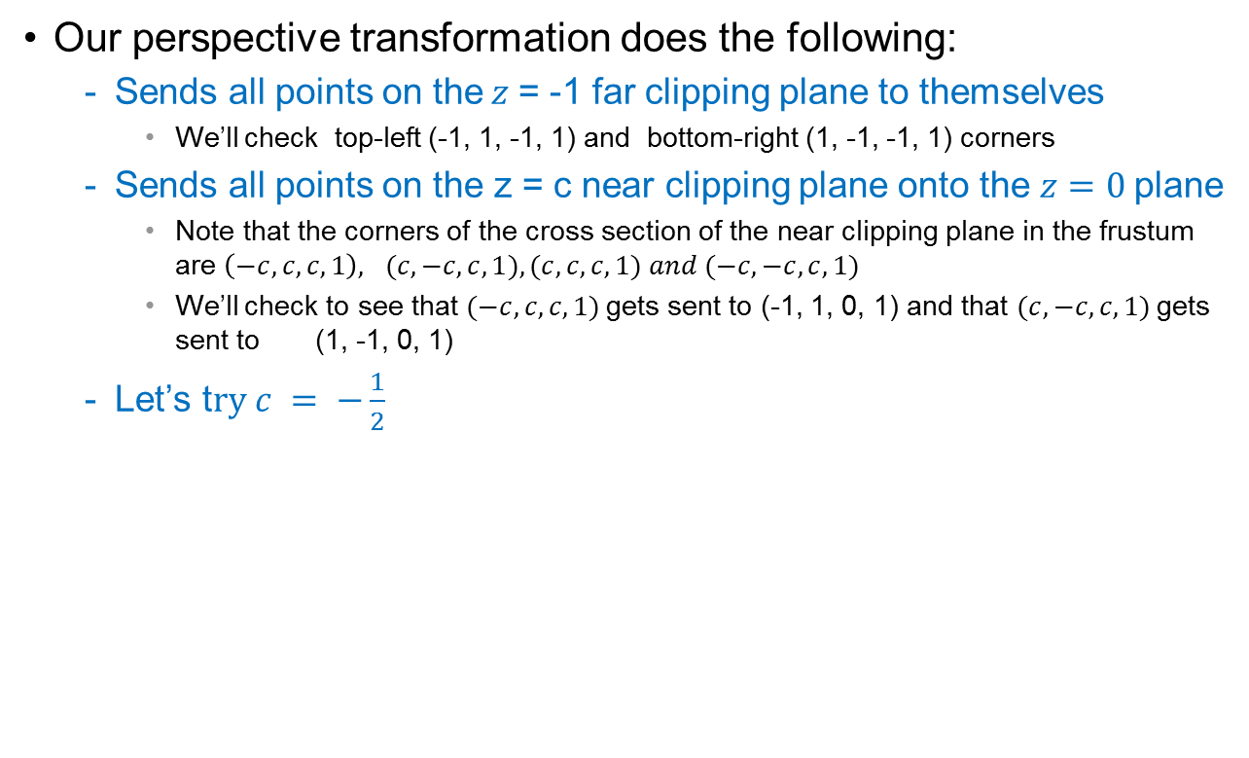
Unhinging View Volume to Become a Parallel View Volume(3/4)
$\left[\begin{matrix}1 & 0 & 0 & 0 \\ 0 & 1 & 0 & 0 \\ 0 & 0 & \frac{1}{c+1} & \frac{−c}{c+1} \\ 0 & 0 & −1 & 0\end{matrix}\right]$ =
$$\left[\begin{matrix}1 & 0 & 0 & 0 \\ 0 & 1 & 0 & 0 \\ 0 & 0 & 2 & 1 \\ 0 & 0 & −1 & 0\end{matrix}\right]$$

Slide 22

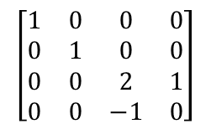
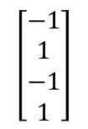
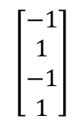
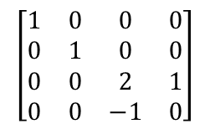
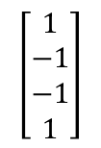
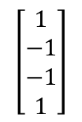
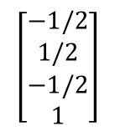
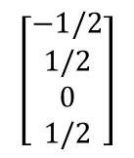
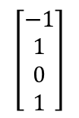
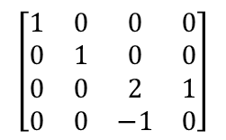
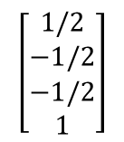
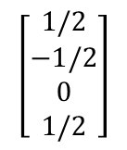
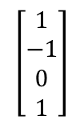
Unhinging View Volume to Become a Parallel View Volume(4/4)
Don’t forget to
homogenize!

Slide 23
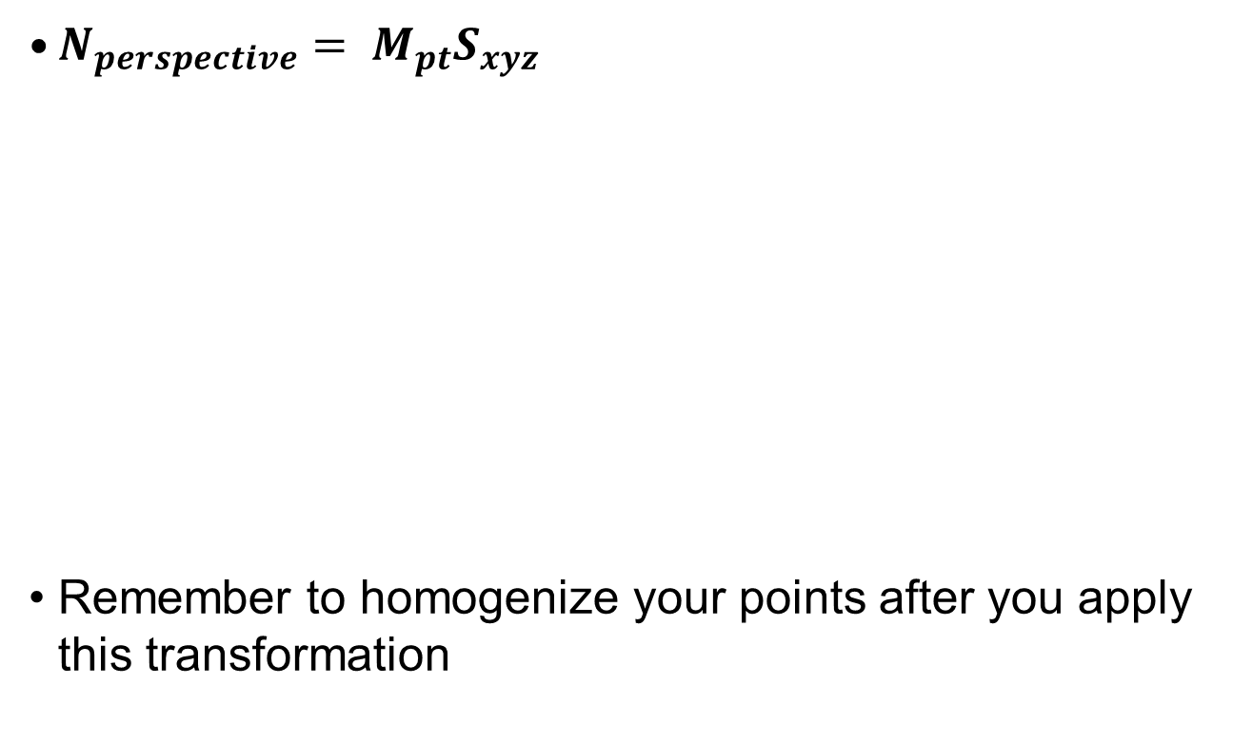
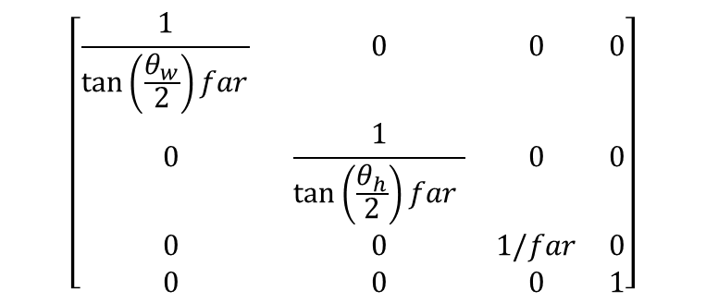
The normalizing transformation (perspective)
=$\left[\begin{matrix}1 & 0 & 0 & 0 \\ 0 & 1 & 0 & 0 \\ 0 & 0 & \frac{1}{c+1} & \frac{−c}{c+1} \\ 0 & 0 & −1 & 0\end{matrix}\right]$

Slide 24


Why it works (1/2)
The key is in the unhinging step
We can take an intuitive approach to see this
The closer the object is to the near clipping plane, the more it is enlarged during the unhinging step
Thus, closer objects are larger and farther away objects are smaller, as is to be expected
Another way to see it is to use the parallel lines
Draw parallel lines in a perspective volume
When we unhinge the volume, the lines fan out at the near clipping
The result is converging lines, the railroad track

Slide 25
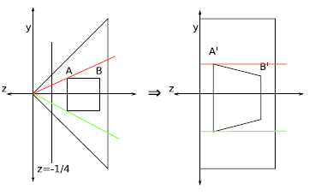
Why it works (2/2)
Yet another way to demonstrate how this works is to use occlusion (when elements in the scene are blocked by other elements)
Looking at the top view of the frustum, we see a square
Draw a line from your eye point to the left corner of the square, we can see that points behind this corner are obscured
Now unhinge the perspective and draw a line again to the left corner, we can see that all points obscured before are still obscured and all points that were visible before are still visible

Slide 26
Chapter 5. Lighting and Shading

Slide 27
Photorealism in Computer Graphics
Photorealism in computer graphics involves
Accurate representations of surface properties, and
Good physical descriptions of the lighting effects
Modeling the lighting effects that we see on an object is a complex process, involving principles of both physics and psychology
Physical illumination models involve
Material properties, object position relative to light sources and other objects, the features of the light sources, and so on

Slide 28
Illumination and Rendering
An illumination model in computer graphics
also called a lighting model or a shading model
used to calculate the color of an illuminated position on the surface of an object
Approximations of the physical laws
A surface-rendering method determine the pixel colors for all projected positions in a scene

Slide 29
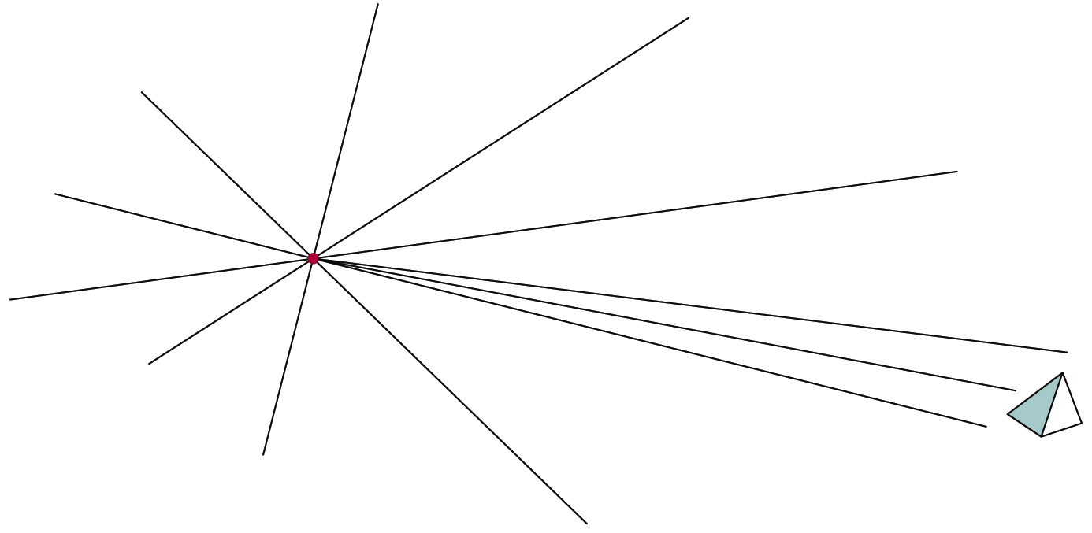
Light Sources
Point light sources
Emitting radiant energy at a single point
Specified with its position and the color of the emitted light
Infinitely distant light sources
A large light source, such as sun, that is very far from a scene
Little variation in its directional effects
Specified with its color value and a fixed direction for the light rays

Slide 30
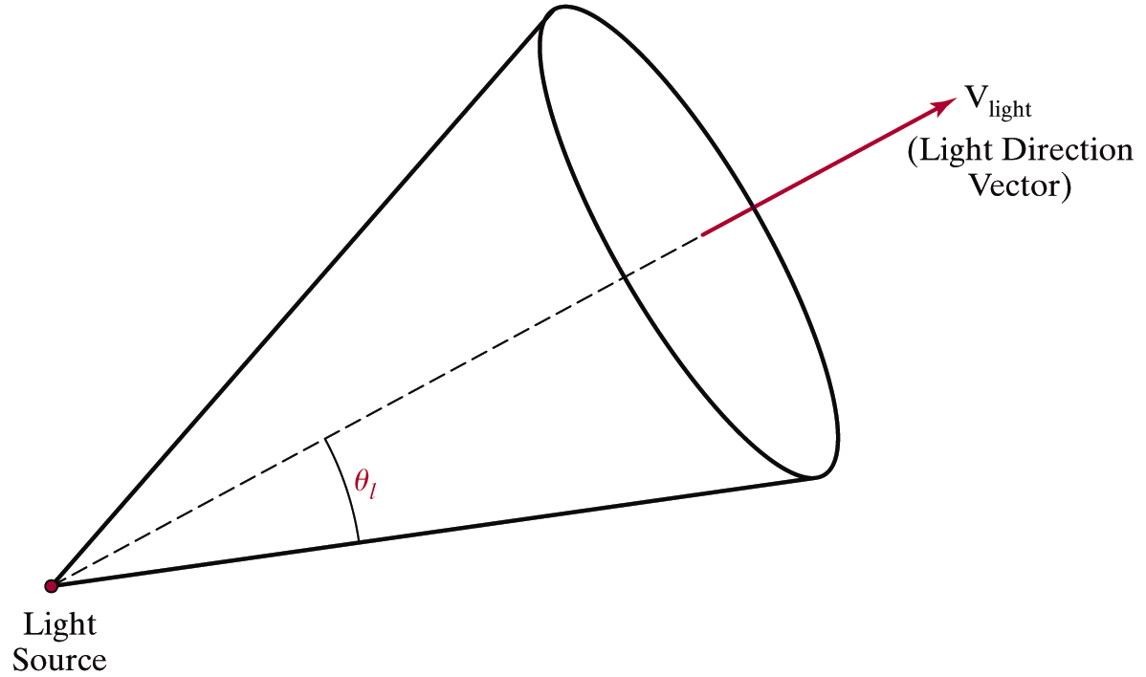
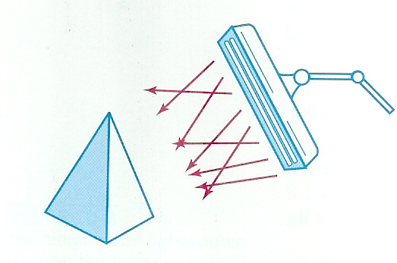
Light Sources
Directional light sources
Produces a directional beam of light
Spotlight effects
Area light sources

Slide 31
Light Sources
Radial intensity attenuation
As radiant energy travels, its amplitude is attenuated by the factor
Sometimes, more realistic attenuation effects can be obtained with an inverse quadratic function of distance
The intensity attenuation is not applied to light sources at infinity because all points in the scene are at a nearly equal distance from a far-off source

Slide 32
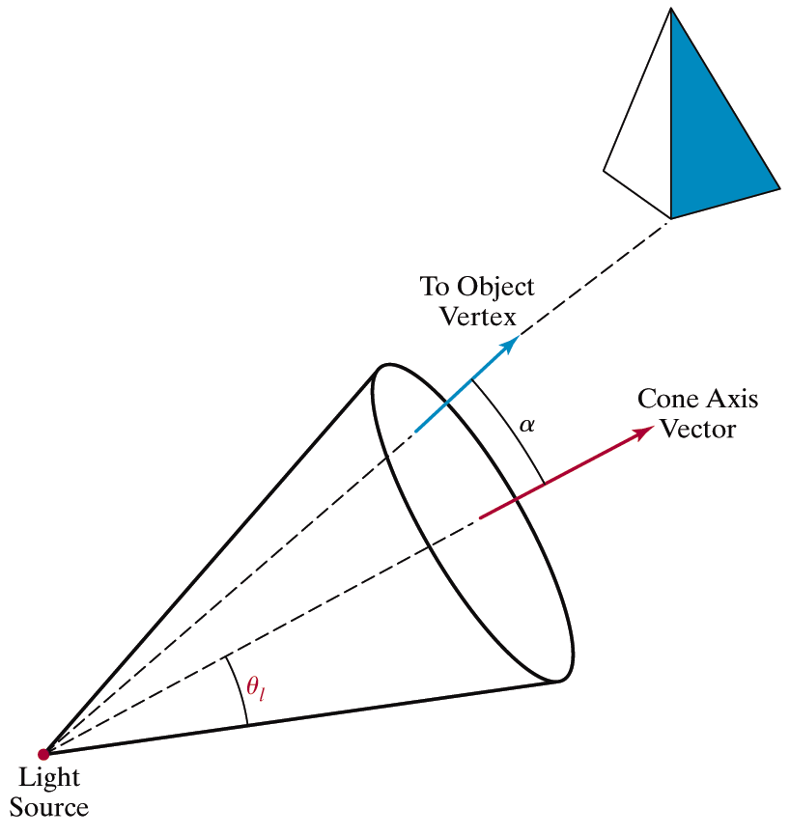
Light Sources
Angular intensity attenuation
For a directional light, we can attenuate the light intensity angularly as well as radially

Slide 33
Surface Lighting Effects
An illumination model computes the lighting effects for a surface using the various optical properties
Degree of transparency, color reflectance, surface texture
The reflection (phong illumination) model describes the way incident light reflects from an opaque surface
Diffuse, ambient, specular reflections
Simple approximation of actual physical models

Slide 34

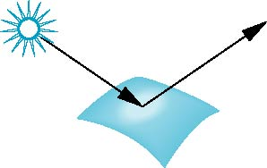
Surface Types
The smoother a surface, the more reflected light is concentrated in the direction a perfect mirror would reflected the light
A very rough surface scatters light in all directions
smooth surface
rough surface

Slide 35
Phong Model
A simple model that can be computed rapidly
Has three components
Diffuse
Specular
Ambient

Slide 36
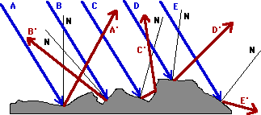
Diffuse Reflection
Incident light is scattered with equal intensity in all directions
Such surfaces are called ideal diffuse reflectors (also referred to as Lambertian reflectors)

Slide 37
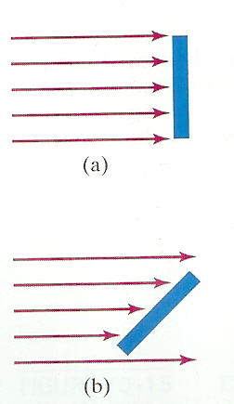
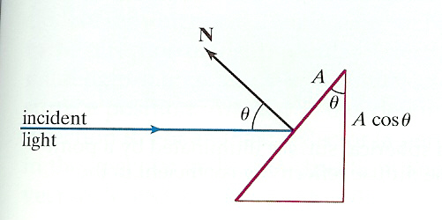
Diffuse Reflection
Light intensity is independent of angle of reflection
Light intensity depends on angle of incidence

Slide 38
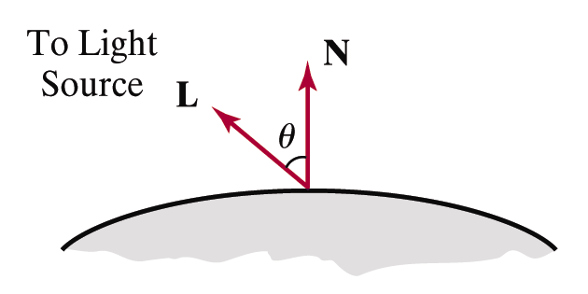
Diffuse Reflection
: the intensity of the light source
: diffuse reflection coefficient,
: the surface normal (unit vector)
: the direction of light source, (unit vector)

Slide 39
Ambient Light
Multiple reflection of nearby (light-reflecting) objects yields a uniform illumination
A form of diffuse reflection independent of he viewing direction and the spatial orientation of a surface
Ambient illumination is constant for an object
: the incident ambient intensity
: ambient reflection coefficient, the proportion reflected away from the surface

Slide 40
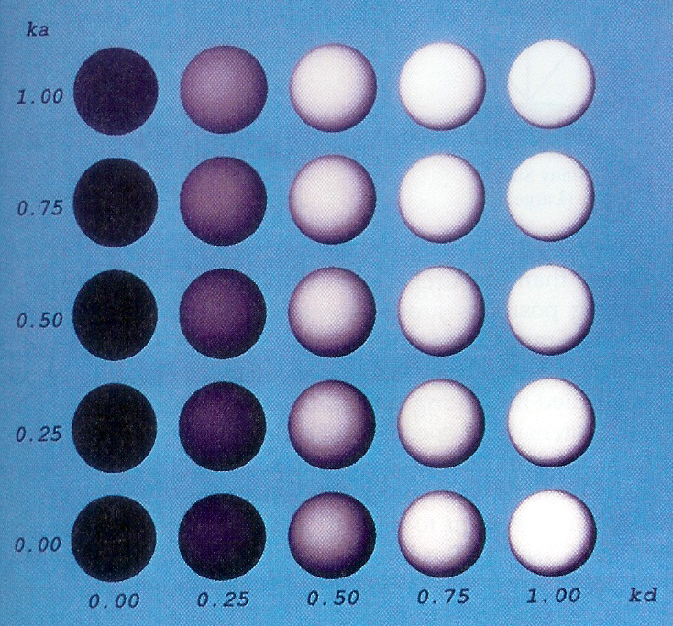
Ambient + Diffuse

Slide 41
Specular Reflection
Perfect reflector (mirror) reflects all lights to the direction where angle of reflection is identical to the angle of incidence
It accounts for the highlight
Near total reflector reflects most of light over a range of positions close to the direction

Slide 42
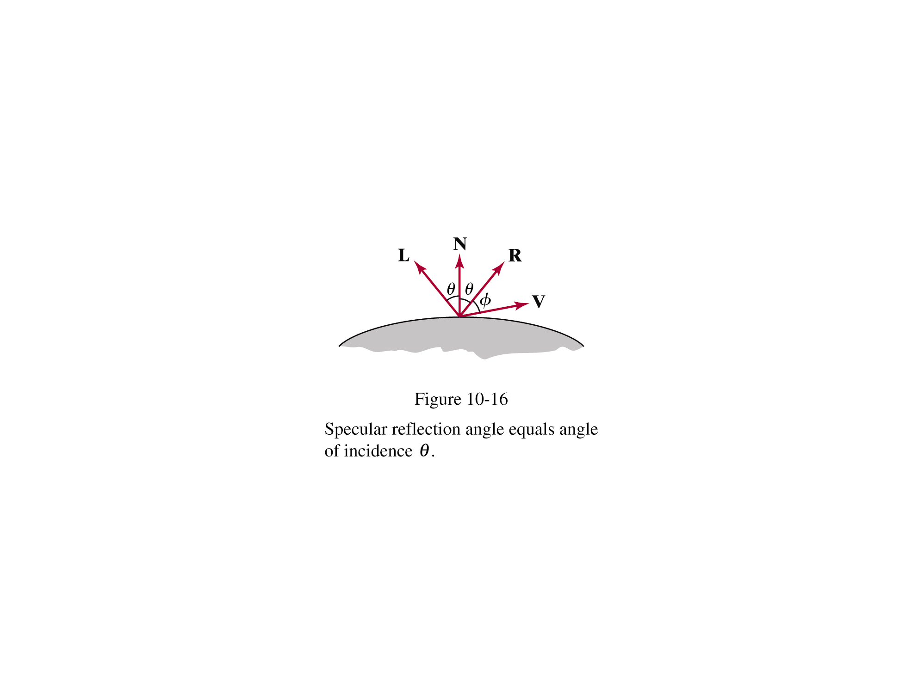
Specular Reflection
Phong specular-reflection model
Note that N, L, and R are coplanar, but V may not be coplanar to the others
: intensity of the incident light
: color-independent specular coefficient
: the gloss of the surface

Slide 43
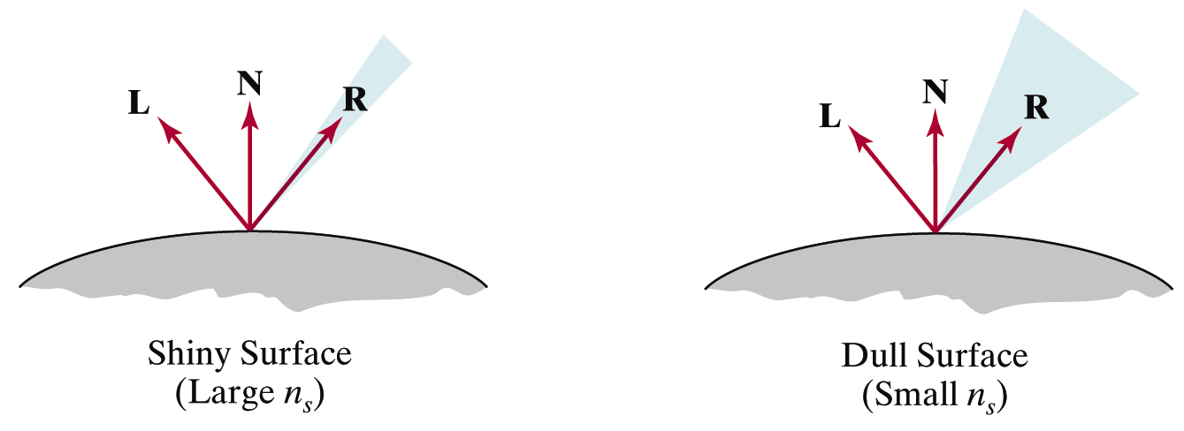
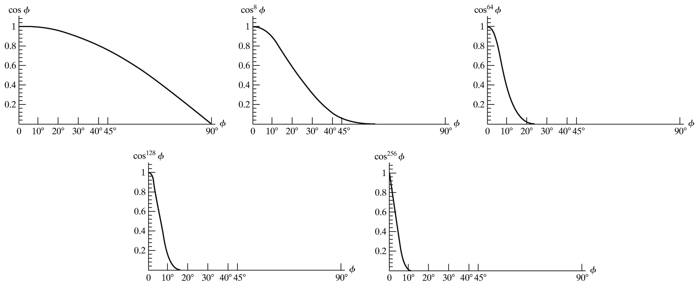
Specular Reflection
Glossiness of surfaces

Slide 44
Specular Reflection
Specular-reflection coefficient ks is a material property
For some material, ks varies depending on θ
ks =1 if θ =90°
Calculating the reflection vector R

Slide 45
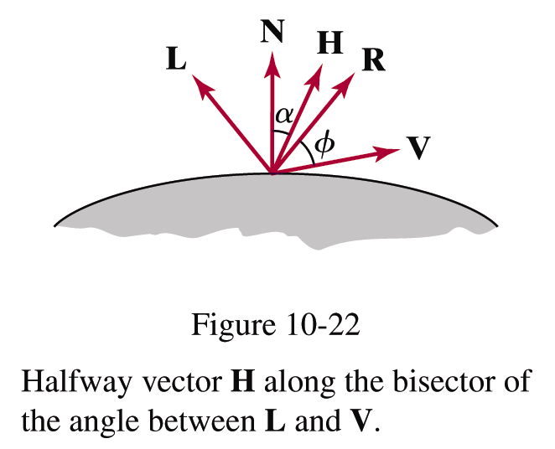
Specular Reflection
Simplified Phong model using halfway vector
H is constant if both viewer and the light source are sufficiently far from the surface

Slide 46
Ambient+Diffuse+Specular Reflections
Single light source
Multiple light source
Emission and attenuation

Slide 47
Parameter Choosing Tips
For a RGB color description, each intensity and reflectance specification is a three-element vector
The sum of reflectance coefficients is usually smaller than one
Try n in the range [0, 100]
Use a small ka (~0.1)
Example
Metal: n=90, ka=0.1, kd=0.2, ks=0.5

Slide 48


