Slide 1
Chapter 5. Lighting and Shading

Slide 2
Photorealism in Computer Graphics
Photorealism in computer graphics involves
Accurate representations of surface properties, and
Good physical descriptions of the lighting effects
Modeling the lighting effects that we see on an object is a complex process, involving principles of both physics and psychology
Physical illumination models involve
Material properties, object position relative to light sources and other objects, the features of the light sources, and so on

Slide 3
Illumination and Rendering
An illumination model in computer graphics
also called a lighting model or a shading model
used to calculate the color of an illuminated position on the surface of an object
Approximations of the physical laws
A surface-rendering method determine the pixel colors for all projected positions in a scene

Slide 4
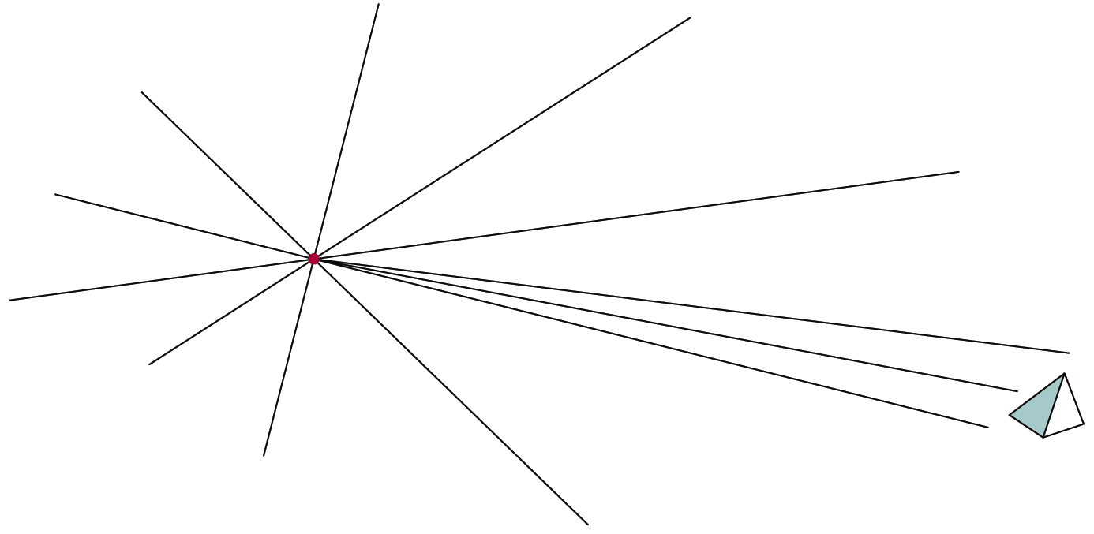
Light Sources
Point light sources
Emitting radiant energy at a single point
Specified with its position and the color of the emitted light
Infinitely distant light sources
A large light source, such as sun, that is very far from a scene
Little variation in its directional effects
Specified with its color value and a fixed direction for the light rays

Slide 5
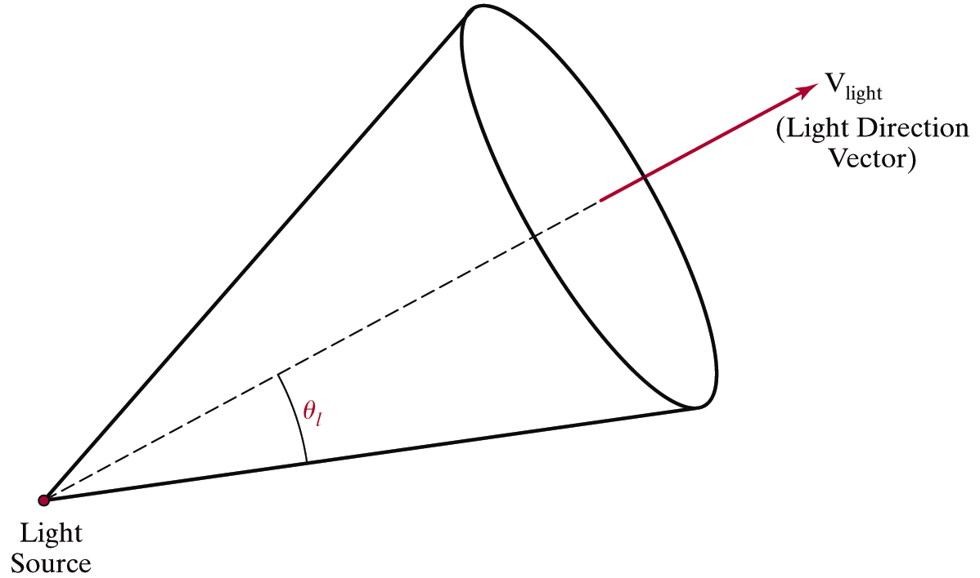
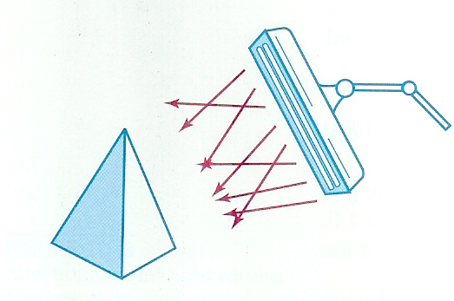
Light Sources
Directional light sources
Produces a directional beam of light
Spotlight effects
Area light sources

Slide 6
Light Sources
Radial intensity attenuation
As radiant energy travels, its amplitude is attenuated by the factor
Sometimes, more realistic attenuation effects can be obtained with an inverse quadratic function of distance
The intensity attenuation is not applied to light sources at infinity because all points in the scene are at a nearly equal distance from a far-off source

Slide 7
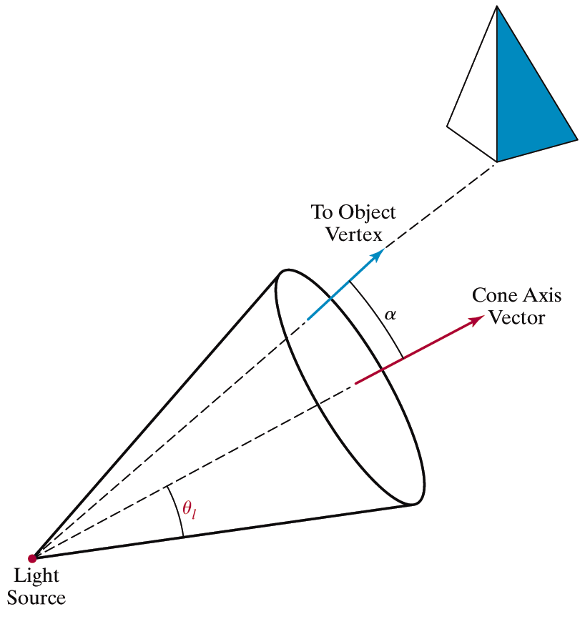
Light Sources
Angular intensity attenuation
For a directional light, we can attenuate the light intensity angularly as well as radially

Slide 8
Surface Lighting Effects
An illumination model computes the lighting effects for a surface using the various optical properties
Degree of transparency, color reflectance, surface texture
The reflection (phong illumination) model describes the way incident light reflects from an opaque surface
Diffuse, ambient, specular reflections
Simple approximation of actual physical models

Slide 9

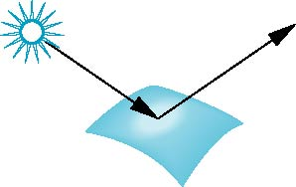
Surface Types
The smoother a surface, the more reflected light is concentrated in the direction a perfect mirror would reflected the light
A very rough surface scatters light in all directions
smooth surface
rough surface

Slide 10
Phong Model
A simple model that can be computed rapidly
Has three components
Diffuse
Specular
Ambient

Slide 11
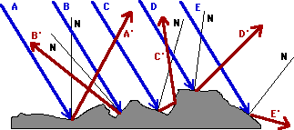
Diffuse Reflection
Incident light is scattered with equal intensity in all directions
Such surfaces are called ideal diffuse reflectors (also referred to as Lambertian reflectors)

Slide 12
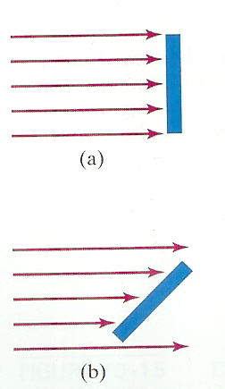
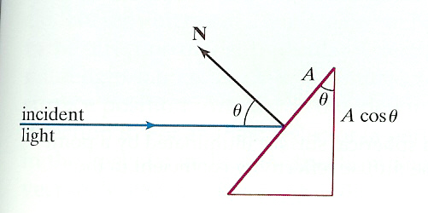
Diffuse Reflection
Light intensity is independent of angle of reflection
Light intensity depends on angle of incidence

Slide 13
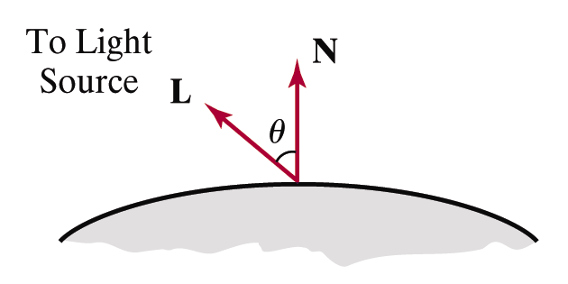
Diffuse Reflection
: the intensity of the light source
: diffuse reflection coefficient,
: the surface normal (unit vector)
: the direction of light source, (unit vector)

Slide 14
Ambient Light
Multiple reflection of nearby (light-reflecting) objects yields a uniform illumination
A form of diffuse reflection independent of he viewing direction and the spatial orientation of a surface
Ambient illumination is constant for an object
: the incident ambient intensity
: ambient reflection coefficient, the proportion reflected away from the surface

Slide 15
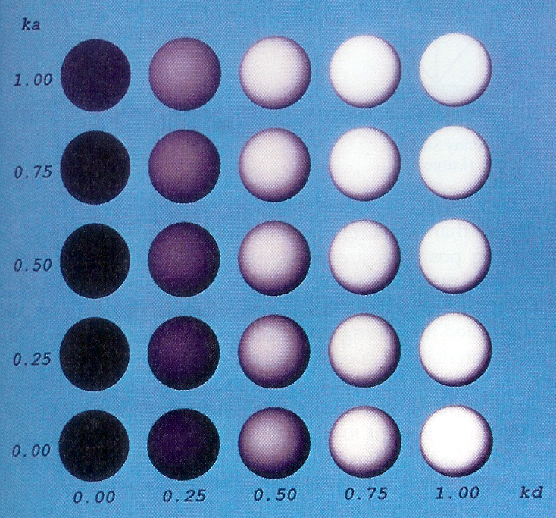
Ambient + Diffuse

Slide 16
Specular Reflection
Perfect reflector (mirror) reflects all lights to the direction where angle of reflection is identical to the angle of incidence
It accounts for the highlight
Near total reflector reflects most of light over a range of positions close to the direction

Slide 17
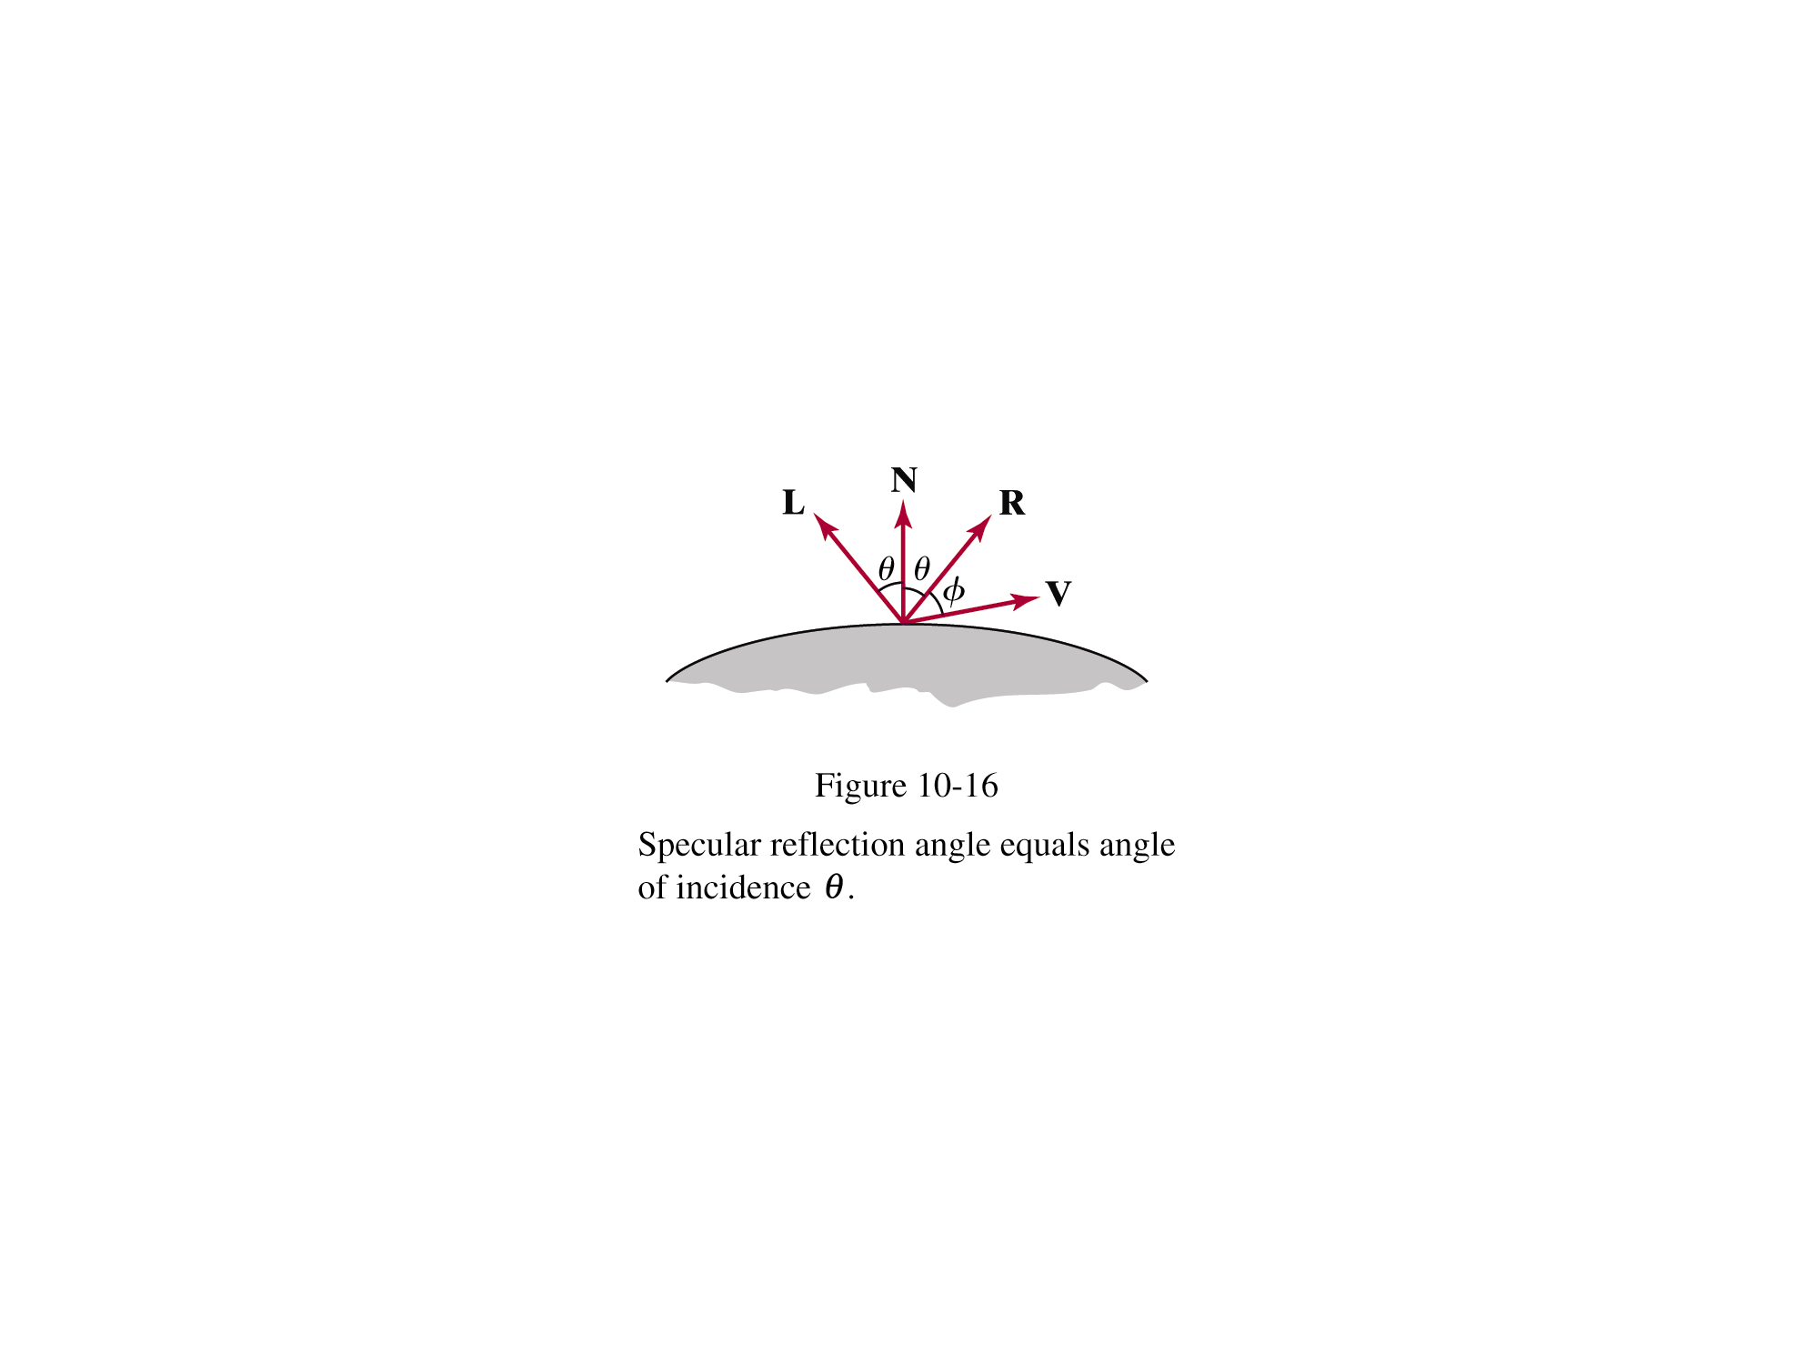
Specular Reflection
Phong specular-reflection model
Note that N, L, and R are coplanar, but V may not be coplanar to the others
: intensity of the incident light
: color-independent specular coefficient
: the gloss of the surface

Slide 18
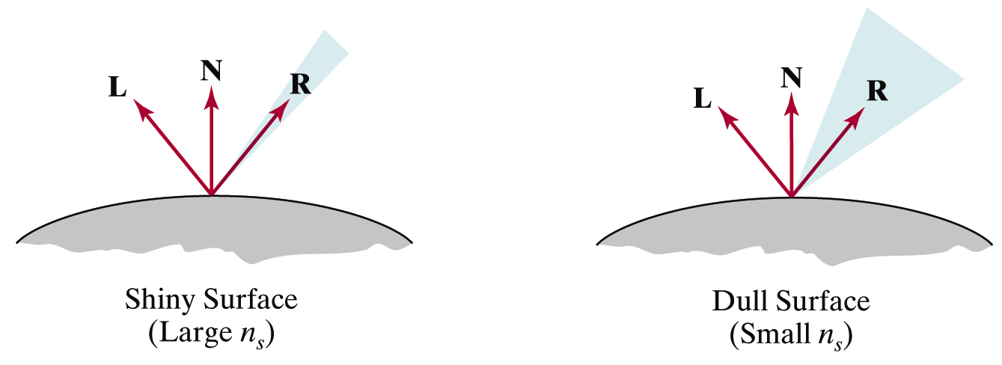
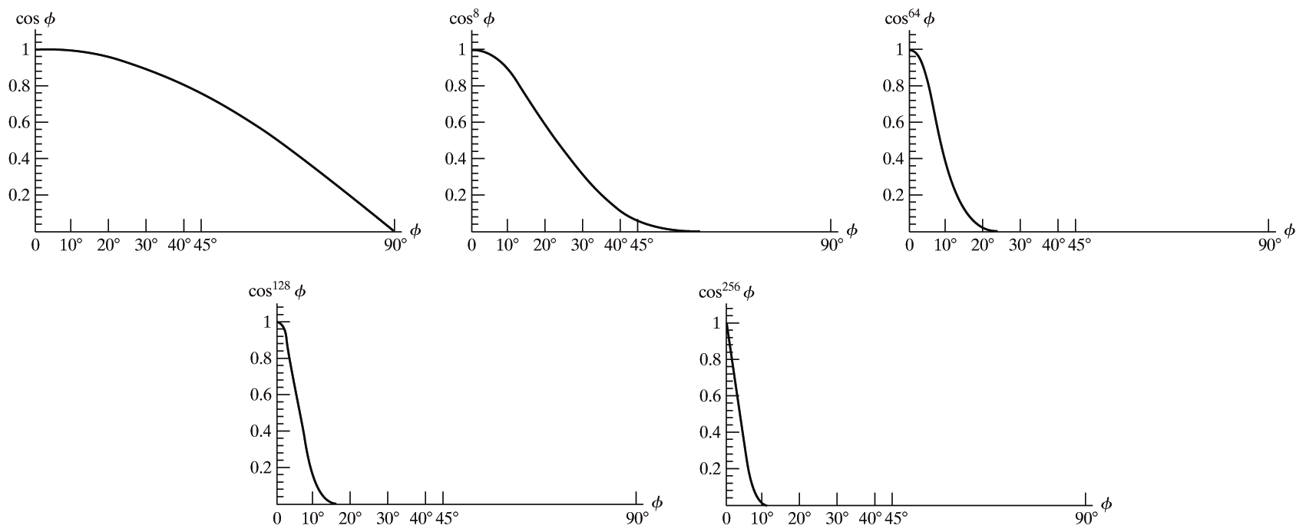
Specular Reflection
Glossiness of surfaces

Slide 19
Specular Reflection
Specular-reflection coefficient ks is a material property
For some material, ks varies depending on θ
ks =1 if θ =90°
Calculating the reflection vector R

Slide 20
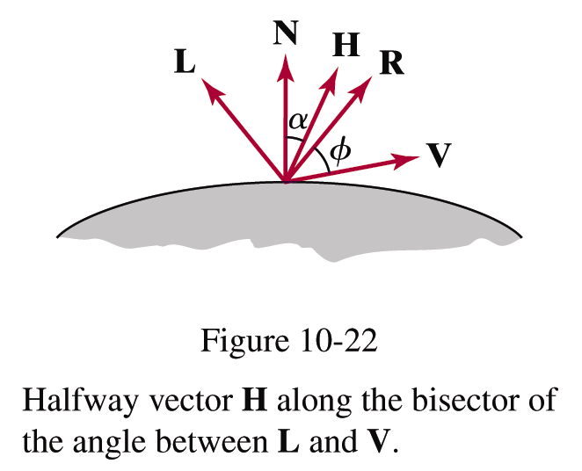
Specular Reflection
Simplified Phong model using halfway vector
H is constant if both viewer and the light source are sufficiently far from the surface

Slide 21
Ambient+Diffuse+Specular Reflections
Single light source
Multiple light source
Emission and attenuation

Slide 22
Parameter Choosing Tips
For a RGB color description, each intensity and reflectance specification is a three-element vector
The sum of reflectance coefficients is usually smaller than one
Try n in the range [0, 100]
Use a small ka (~0.1)
Example
Metal: n=90, ka=0.1, kd=0.2, ks=0.5

Slide 23
