Slide 1
Shading in OpenGL

Slide 2
Review: Phong Model
A simple model that can be computed rapidly
Has three components
Diffuse
Specular
Ambient

Slide 3
Ambient+Diffuse+Specular Reflections
Single light source
Multiple light source
Emission and attenuation

Slide 4
Parameter Choosing Tips
For a RGB color description, each intensity and reflectance specification is a three-element vector
The sum of reflectance coefficients is usually smaller than one
Try n in the range [0, 100]
Use a small ka (~0.1)
Example
Metal: n=90, ka=0.1, kd=0.2, ks=0.5

Slide 5
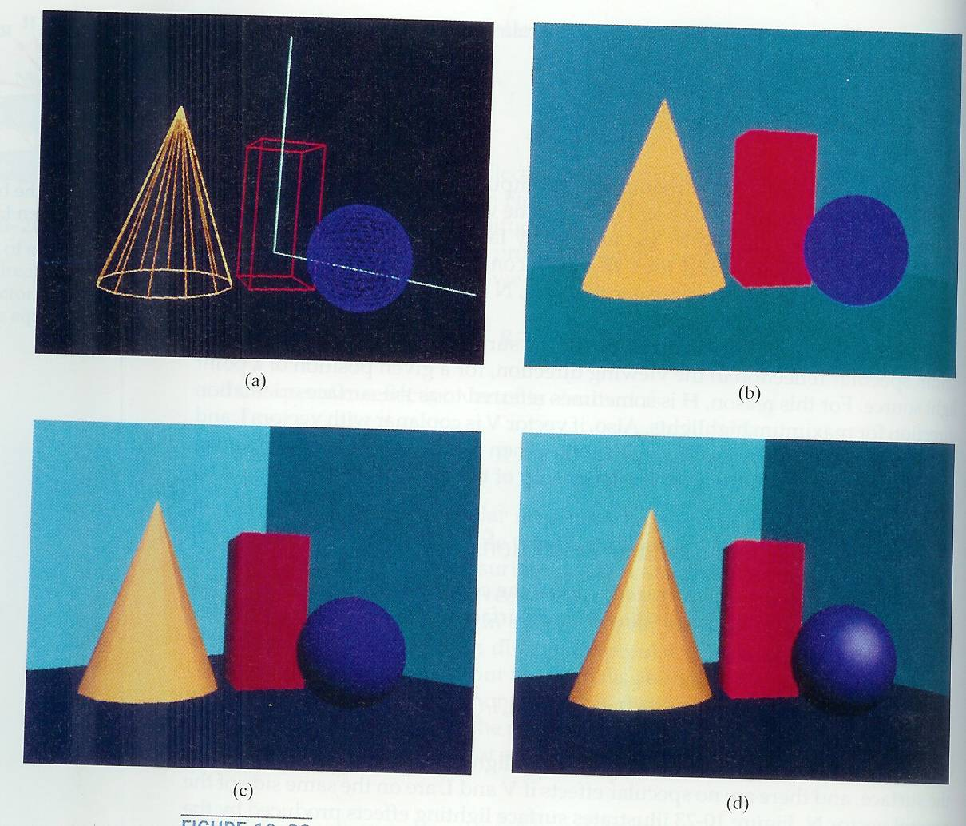

Slide 6
Implementation with GLSL

Slide 7
OpenGL shading
Need
Normals
material properties
Lights
State-based shading functions have been deprecated (glNormal, glMaterial, glLight)
send attributes or uniforms to shaders

Slide 8
Normal for Triangle
n
plane n ·(p - p₀ ) = 0
p₂
n = (p₂ - p₀ ) ×(p₁ - p₀ )
p
p₁
normalize n ← n/ |n|
p₀
Note that right-hand rule determines outward face

Slide 9
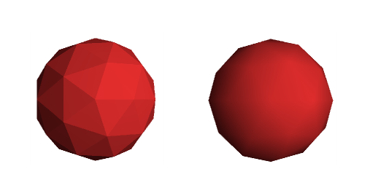
Polygon Rendering Methods
Curved surfaces are often approximated by polygonal surfaces
So, polygonal (piecewise planar) surfaces often need to be rendered as if they are smooth
Flat shading
Smooth shading

Slide 10
Flat Shading
We set a single normal for each triangle
Because three vertices of a triangle has the same normal, shades computed by the Phong model can be almost same
n
p₂
p₁
p₀

Slide 11
Smooth Shading
We set a new normal at each vertex as if the polygon is the approximation of a smooth surface
For a shpere model, it is easy
If centered at origin n = p
Note silhouette edge
n
p₂
n
n
p₁
p₀

Slide 12
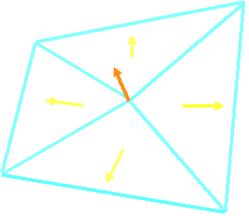
Vertex Normal Vector
Normal vectors at vertices
Averaging the normal vectors for each polygon sharing that vertex
(
N
+
N
+
N
+
N
)
N
=
1
2
3
4
v
N
+
N
+
N
+
N
1
2
3
4

Slide 13
Applying Phong Model in two different ways
Applying Phong model at each vertex ➔ Gouroud Shading
Applying Phong model at each fragment ➔ Phong Shading

Slide 14
Intensity-Interpolation Surface Rendering
Gouraud shading
Rendering a curved surface that is approximated with a polygon mesh
Interpolate intensities at polygon vertices
Procedure
Determine the average unit normal vector at each vertex
Apply an illumination model at each polygon vertex to obtain the light intensity at that position
Linearly interpolate the vertex intensities over the projected area of the polygon

Slide 15
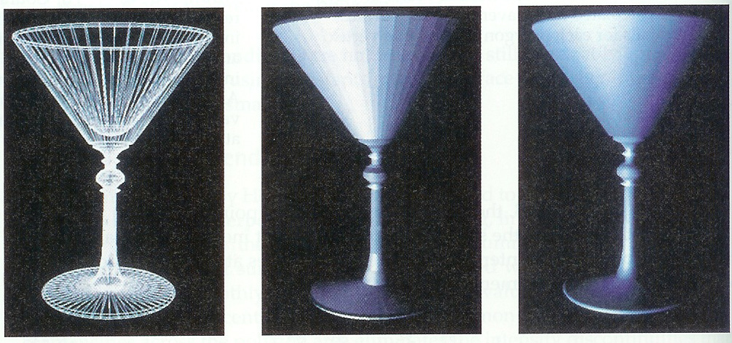
Applying Phong Model at Vertices

Slide 16
Applying Phong Model at Vertices
In per vertex shading, shading calculations are done for each vertex
Vertex colors become vertex shades and can be sent to the vertex shader as a vertex attribute
Alternately, we can send the parameters to the vertex shader and have it compute the shade
By default, vertex shades are interpolated across an object if passed to the fragment shader as a varying variable (smooth shading)
We can also use uniform variables to shade with a single shade (flat shading)

Slide 17
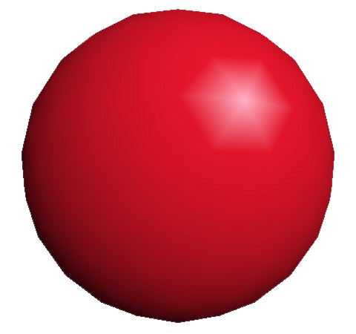
Gouraud Shading Problems
Lighting in the polygon interior is inaccurate

Slide 18
Normal-Vector Interpolation Surface Rendering
Phong shading
Interpolate normal vectors at polygon vertices
Procedure
Determine the average unit normal vector at each vertex
Linearly interpolate the vertex normals over the projected area of the polygon
Apply an illumination model at positions along scan lines to calculate pixel intensities
n1
n2
n3

Slide 19
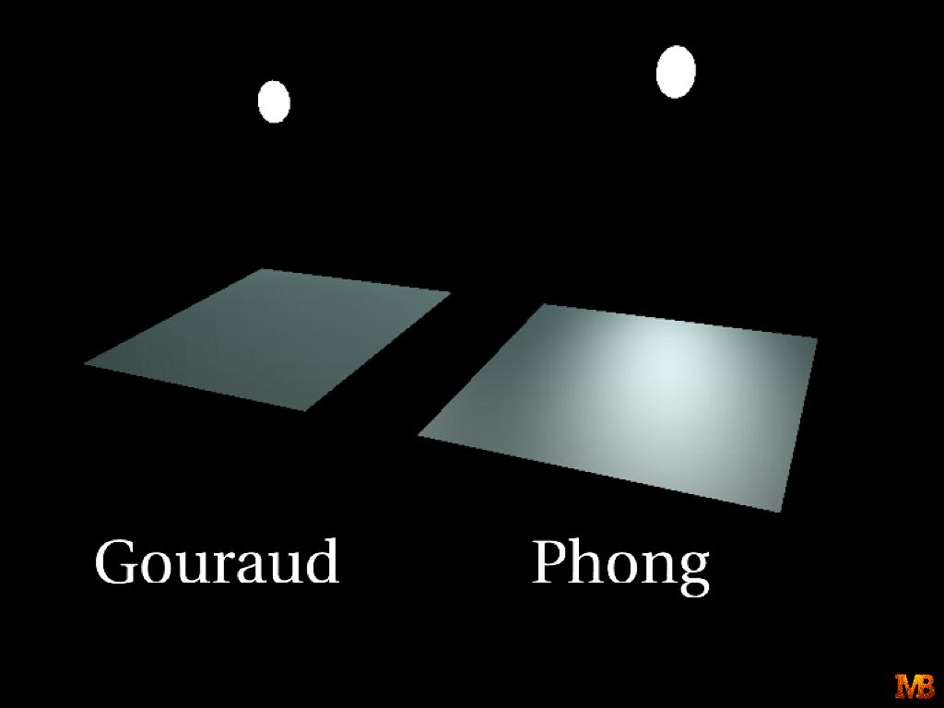
Gouraud versus Phong Shading
Gouraud shading is faster than Phong shading
OLD OpenGL supports Gouraud shading
Phong shading is more accurate.
Can be implemented using Fragment shader

Slide 20
Gouraud and Phong Shading
Gouraud Shading
Find average normal at each vertex (vertex normals)
Apply Phong model at each vertex
Interpolate vertex shades across each polygon
Phong shading
Find vertex normals
Interpolate vertex normals across edges
Interpolate edge normals across polygon
Apply Phong model at each fragment

Slide 21
Comparison
If the polygon mesh approximates surfaces with a high curvatures, Phong shading may look smooth while Gouraud shading may show edges
Phong shading requires much more work than Gouraud shading
Until recently not available in real time systems
Now can be done using fragment shaders
Both need data structures to represent meshes so we can obtain vertex normals

Slide 22
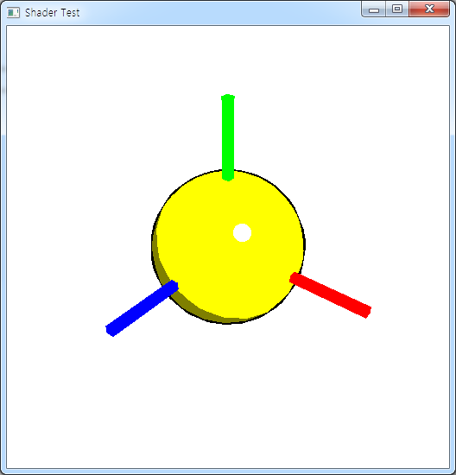
Simple Non-Photorealistic Rendering
Observation:
Only Two Colors for diffuse
One Color for Highlights
At Silhouette:
Black line

