Slide 1
Environmental Mapping

Slide 2
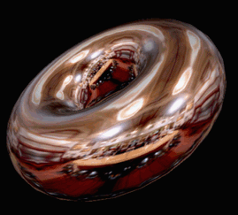
Environmental Mapping

Slide 3
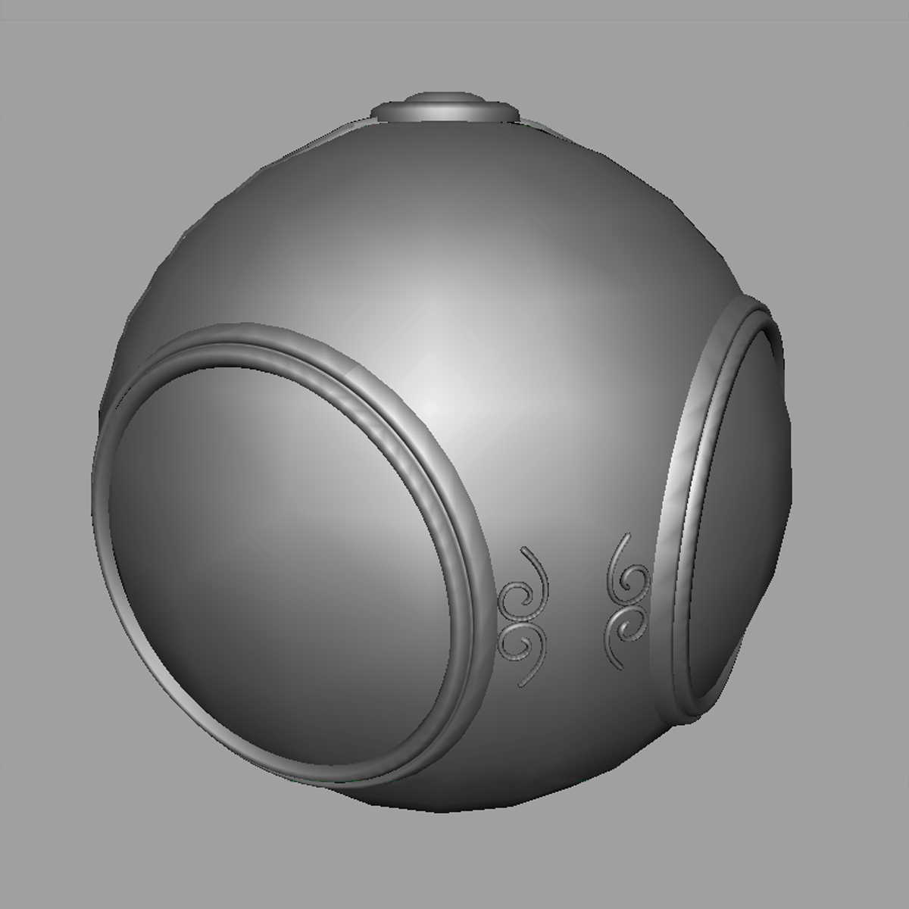
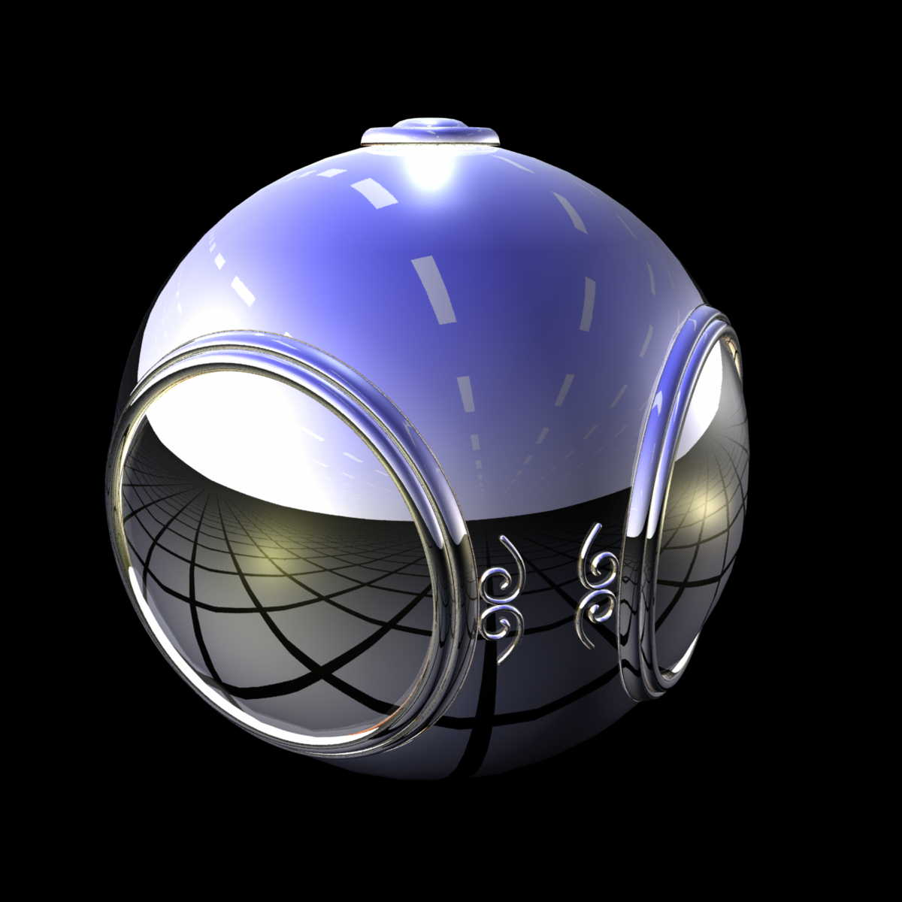
Example

Slide 4
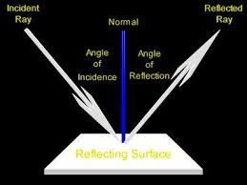
Key observation: Parameterization
Directions
Texture coordinates

Slide 5
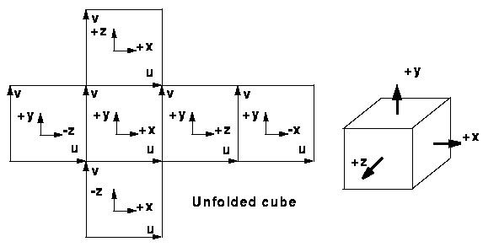
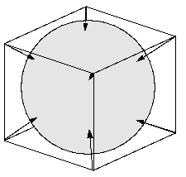
Cube Mapping
a simplified method uses the surface normal as an index for the texel on the cube surface

Slide 6
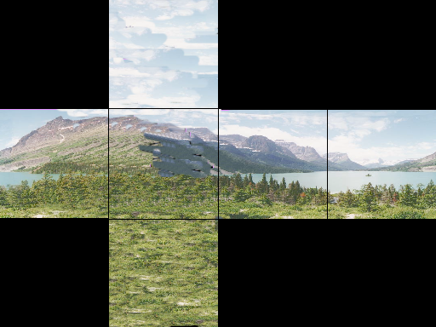
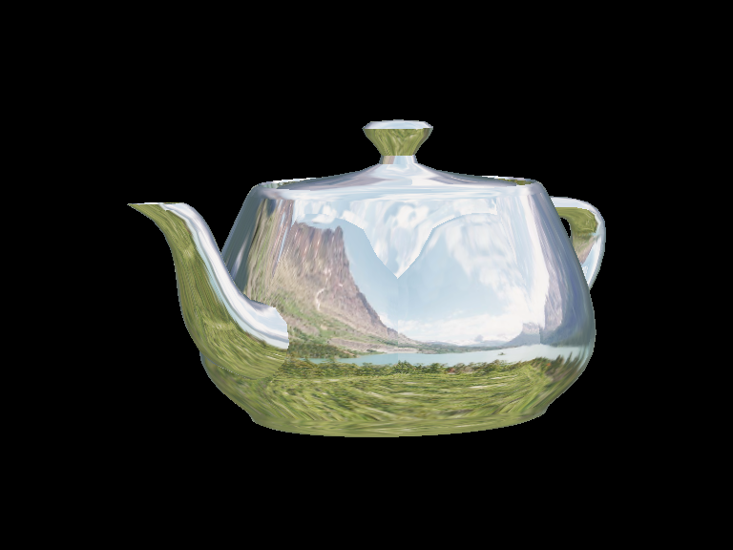
Cube Environment Mapping

Slide 7
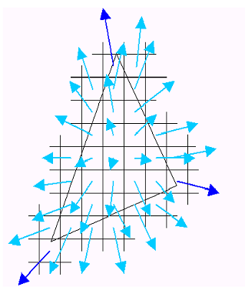
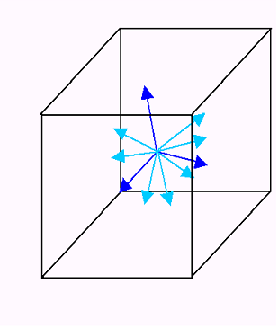
Cube Maps assumption

Slide 8
OpenGL Implementation
OpenGL supports spherical and cube maps.
First, form map :
Use images from a real camera.
Form images with OpenGL.
Texture map it on to object.

Slide 9
Cubemap in OpenGL
Preparation: Make one texture object out of the six images.
Load 6 Images (image1, image2, … image 6) and send it to GPU
Same for other five images.
GLuint cubeMap;
glGenTextures(1, &cubeMap);
glActiveTexture(GL_TEXTURE0);
glBindTexture(GL_TEXTURE_CUBE_MAP, cubeMap);
glTexImage2D(GL_TEXTURE_CUBE_MAP_POSITIVE_X,
level, GL_RGB, width, height, border,
GL_RGB, GL_UNSIGNED_BYTE, image1);

Slide 10
OpenGL Cube Map (cont)
Parameters apply to all six images.
Same for t and r.
Note that texture coordinates are in 3D space (s, t, r).
Set the filtering options too.
glTexParameteri(GL_TEXTURE_CUBE_MAP,
GL_TEXTURE_MAP_WRAP_S, GL_REPEAT);
glTexParameteri(GL_TEXTURE_CUBE_MAP,
GL_TEXTURE_MAG_FILTER, GL_LINEAR);
glTexParameteri(GL_TEXTURE_CUBE_MAP,
GL_TEXTURE_MIN_FILTER, GL_LINEAR);

Slide 11
In Fragment Shader
Using uniform variable of “samplerCube”
#version 430
in vec4 dir;
out vec4 fColor;
uniform samplerCube uCubeTex;
void main()
{
fColor = texture(uCubeTex, dir);
}

Slide 12
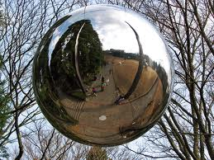
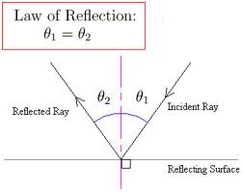
Reflection
R = 2(N·V)N-V

Slide 13
In Fragment Shader
Using the function “reflect”
view_dir: direction from the eye to the position in world coord. view_dir = position – eye_positoin
Normal: normal vector of the surface in world coord.
vec3 dir = reflect(view_dir, normal);
fColor = texture(uCubeTex, dir);

Slide 14
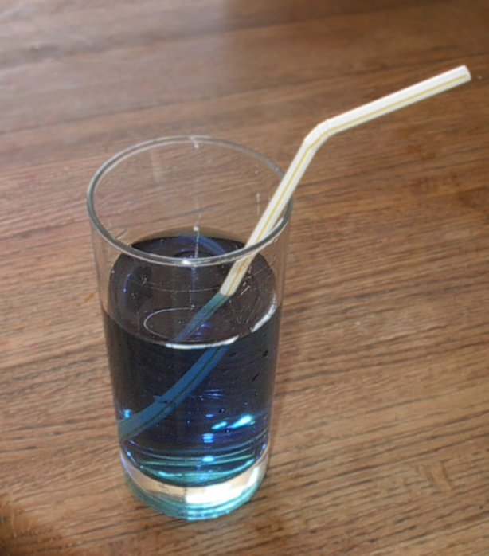
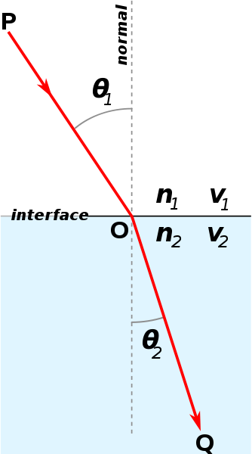
Refraction
Snell’s law
n: speed of light
(refractive index)
- air = 1
- water = 1.333
http://www.youtube.com/watch?v=gwggONU0QZQ

Slide 15
In Fragment Shader
Using the function “refract”
Refractive index:
Example: from air to water = 1/1.3 from water to air = 1.3/1
vec3 dir = refract(view_dir, normal, index);
fColor = texture(uCubeTex, dir);

Slide 16
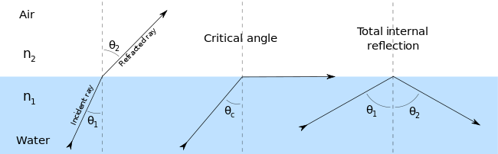
Issue:
Critical angle of refraction
????
Refraction becomes Reflection

Slide 17
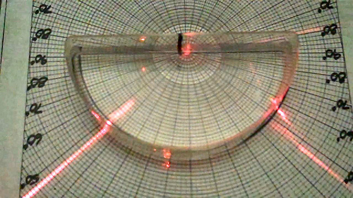
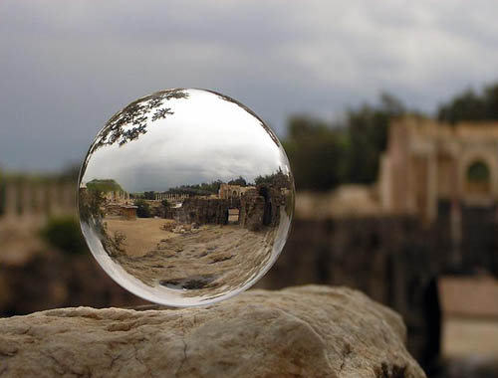
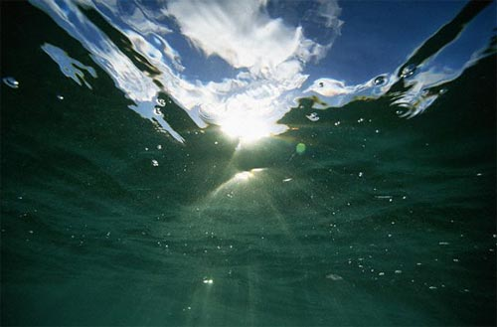
Issue:
Critical angle of refraction in real world

Slide 18
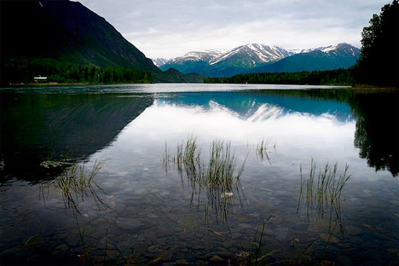
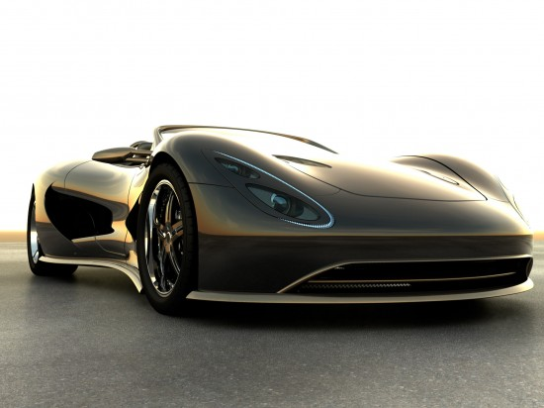
Fresnel Effect
Fresnel equation describe the movement of light in different media.

Slide 19
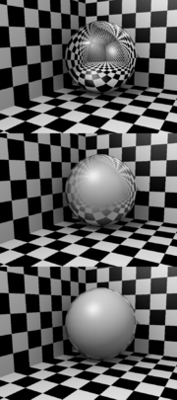
Fresnel Equation
Equation about how strong the reflect effect is:
Coefficient n ≈ (0.5~10) larger n : smaller reflect smaller n : stronger reflect
The reflection strength depends on the incident angle!
fr = offset + scale * (1+ V∙N)^{n}
small
기본값≈0
가중치≈(0.1~0.5)
n
large

Slide 20
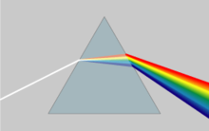
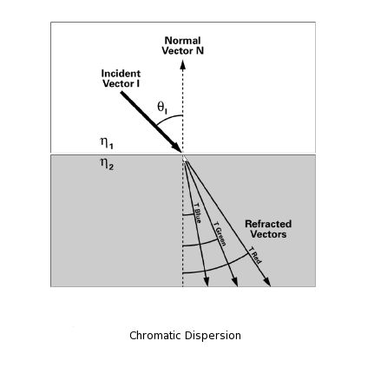
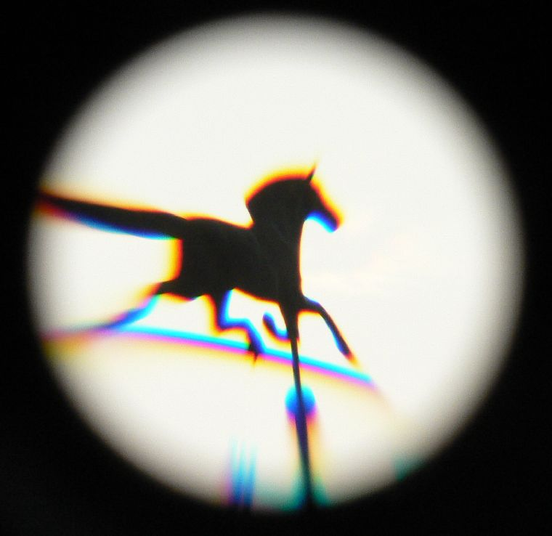
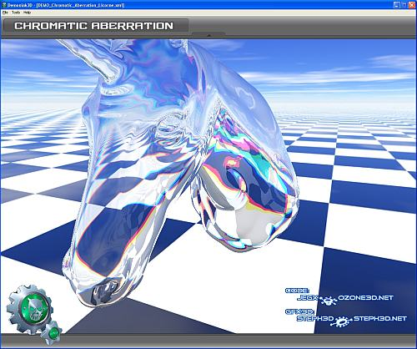
Chromatic dispersion (aberration)
Light separates in many colors because of the refraction of each color is different.

Slide 21
Bump Mapping: Creating complexity without triangles

Slide 22
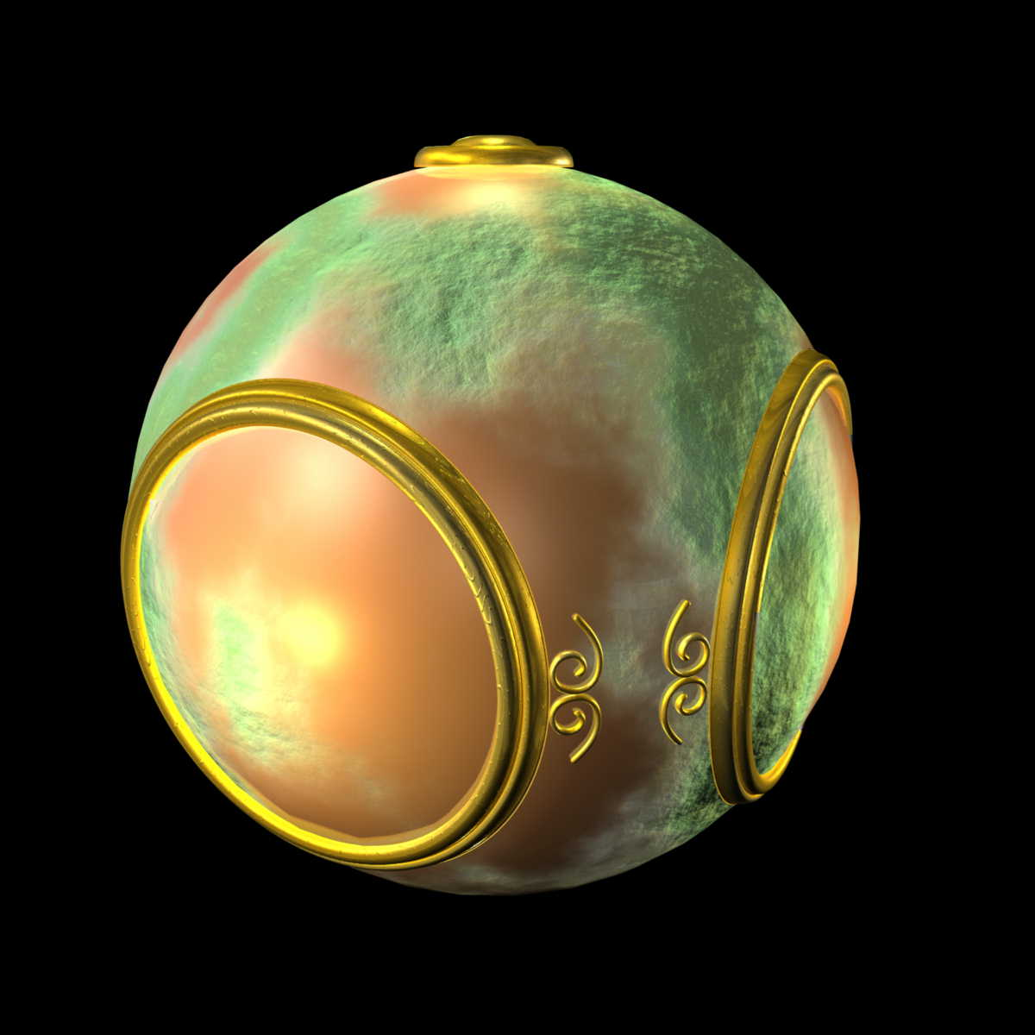
Bump Mapping
Adding Complexity to the surface without adding geometry.
Idea:
Perturb normal for each fragment.
Store perturbation as textures.

Slide 23
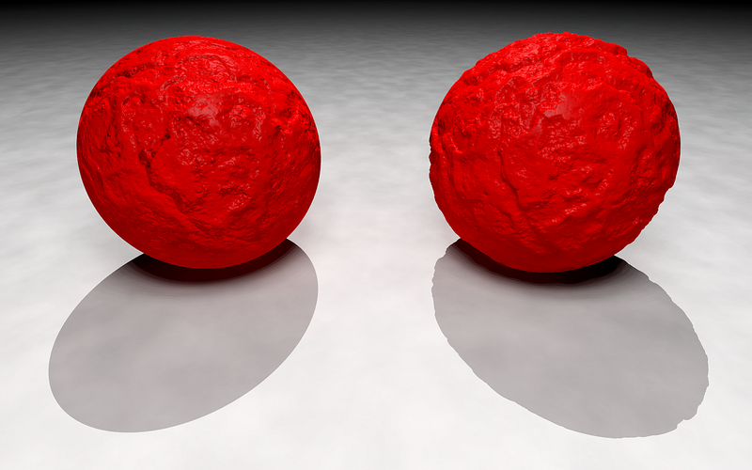
Which one is fake?
With bump mapping
(not many triangles)
With actual geometry (many triangles)

Slide 24
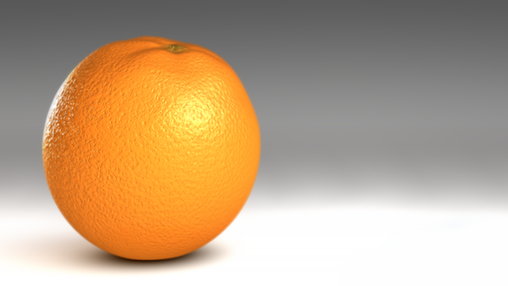
Modeling an Orange
Texture map a photo of an orange onto a sphere
Normal vectors are smooth.
Shades of dimples are not correct if viewer or light is moving.
How to compute (store) the correct normal?

Slide 25
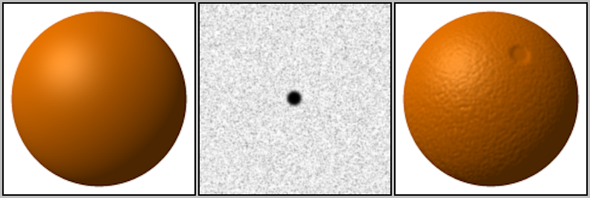
Bump Mapping Process
Consider a smooth surface
n
p

Slide 26
Perturb the normals
Change the normal as if it is rough.
n’
p’
p

Slide 27
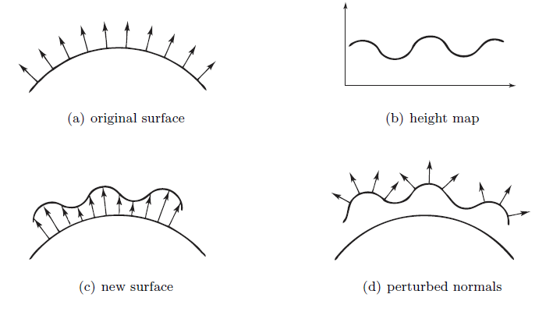
Process outline

Slide 28
Process:
Find Texture Local Coord. (u,v,n) on the surface
Change normal into u, and v direction
Apply the phong shading with the new normal

Slide 29
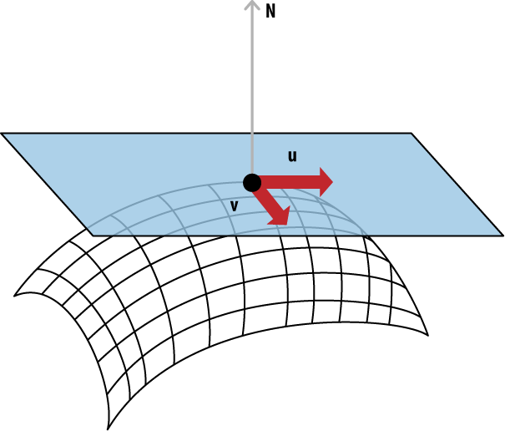
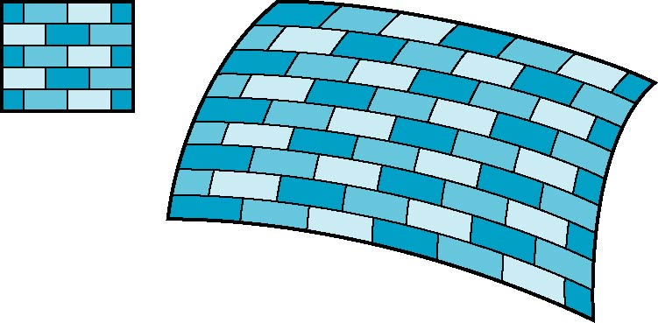
Tangent Plane: texture coord. in world coord.
Texture uv coord.
(x,y,z)
p_{u}
v
u
p_{v}
Texture coord.
In world coord.
World coord.

Slide 30
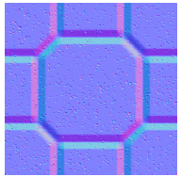

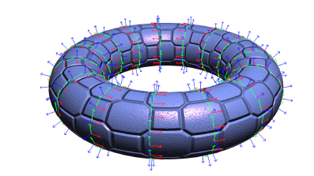
Tangent Coordinate System
p_{v}
p_{u}
n

Slide 31
Equations to find the texture plane
좌표: p(u,v) = [x(u,v), y(u,v), z(u,v)]^{T}
n
p_{v}
p_{u}=[ ∂x/ ∂u, ∂y/ ∂u, ∂z/ ∂u]^{T}
p_{v}=[ ∂x/ ∂v, ∂y/ ∂v, ∂z/ ∂v]^{T}
p_{u}
n = (p_{u} × p_{v} ) / | p_{u} × p_{v} |

Slide 32
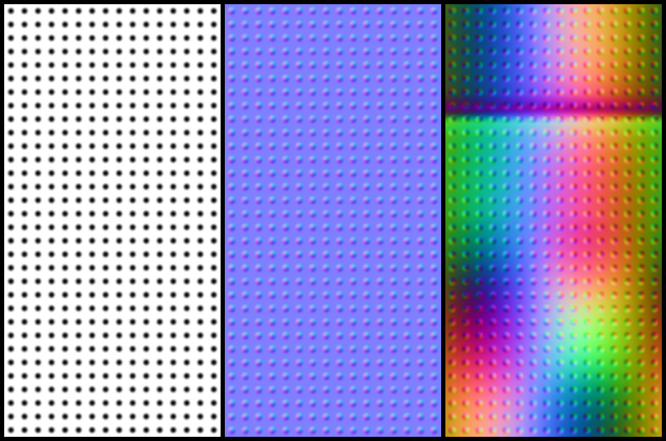
Displacement Function
p’ = p + d(u,v) n
d(u,v) is the bump or displacement (height).
|d(u,v)| << 1
p’
p

Slide 33
Perturbed New Normal
n’ = p’_{u} × p’_{v}
p’_{u} = p_{u} + (∂d/∂u)n + d(u,v)n_{u}
p’_{v} = p_{v} + (∂d/∂v)n + d(u,v)n_{v}
If d is small, we can neglect last term
n
n’

Slide 34
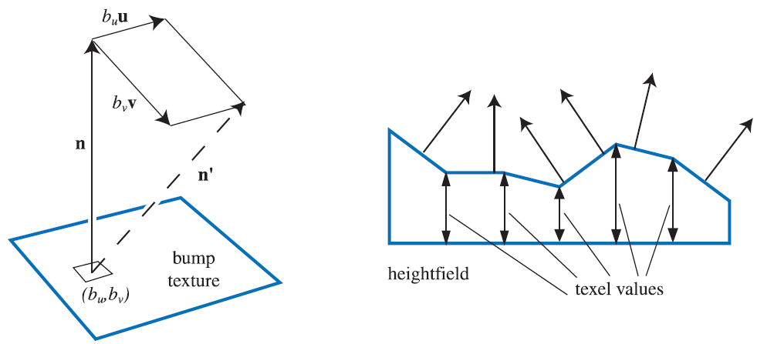
Approximating the Normal
n’ = p’_{u} × p’_{v}
≈ n + (∂d/∂u)n × p_{v} + (∂d/∂v)n × p_{u}
≈ n + (∂d/∂u)p_{u} + (∂d/∂v)p_{v}
Perturb the normal during shading as much as (∂d/ ∂u , ∂d/ ∂v, 0)!!

Slide 35
Store the perturbation as an image
Suppose that we start with a function d(u,v)
We can sample it to form an array D=[d_{ij}]
Then ∂d/ ∂u ≈ d_{ij} – d_{i-1,j}
and ∂d/ ∂v ≈ d_{ij} – d_{i,j-1}
Save it as a texture: (∂d/ ∂u , 0, ∂d/ ∂v ) → (r,g,b)
d(u,v)
(∂d/ ∂u, 0, ∂d/ ∂v)
red
blue

Slide 36
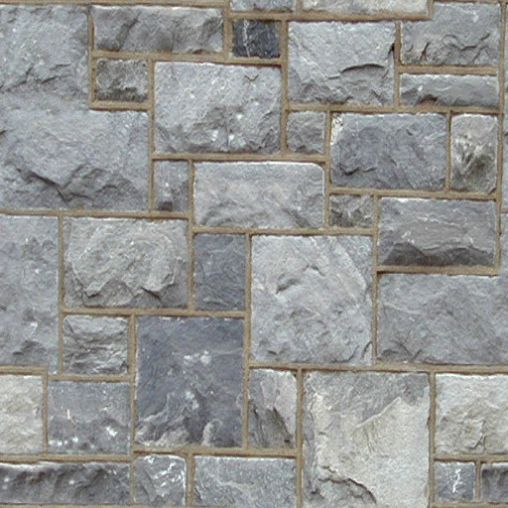
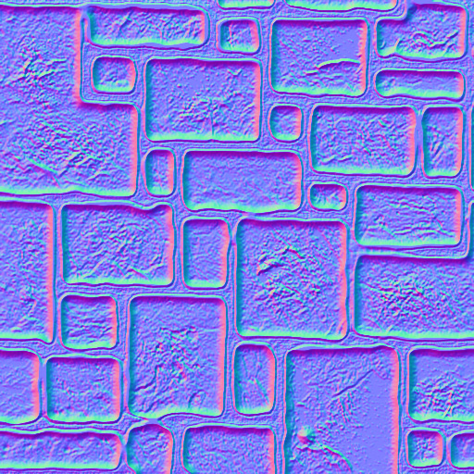
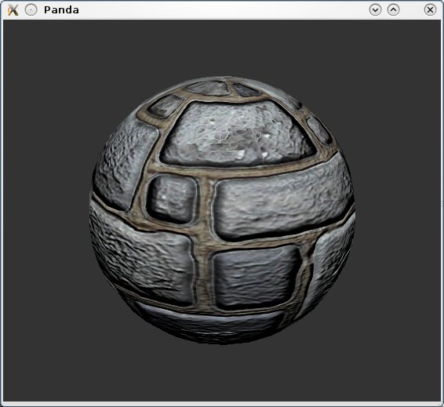
Example
Normal Perturbation map
Regular texture
Applied on a sphere
이미지 출처: http://bcchang.com/immersive_blog/?p=589

Slide 37
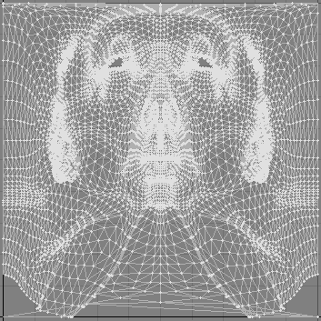
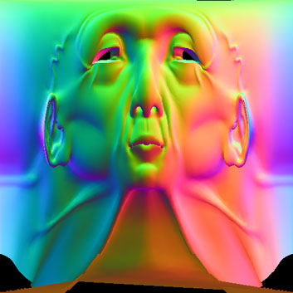
Normal map
Compute the normal in the model coord. space (not in the texture tangential coord.)
Encode it as a texture and override the vertex normal attributes. (x, y, z) ➔ (r, g, b)
Texture uv coord.
Normal vector as a texture
이미지 출처: http://amber.rc.arizona.edu/lw/normalmaps.html

Slide 38
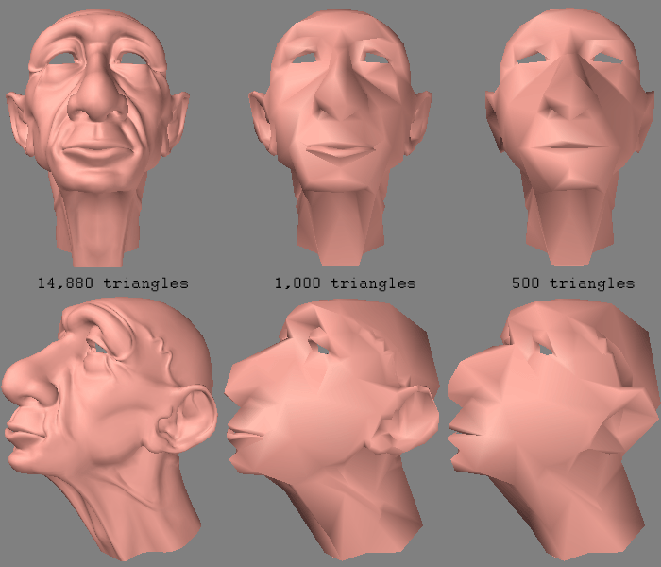
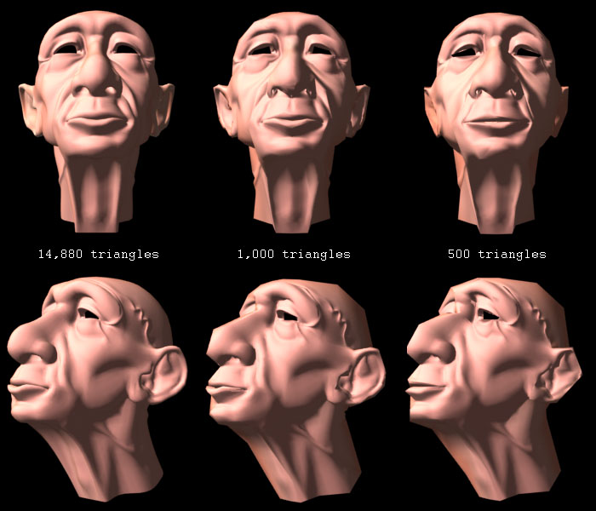
Normal map results:
Before applying normal map
After applying normal map
이미지 출처: http://amber.rc.arizona.edu/lw/normalmaps.html

Slide 39
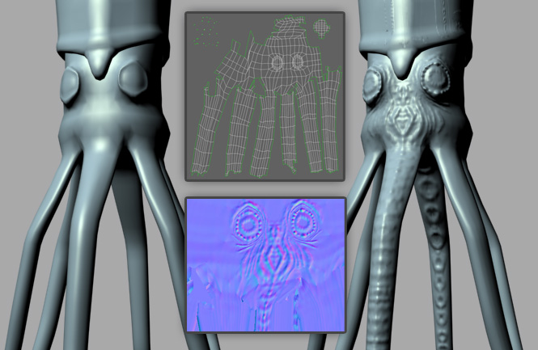
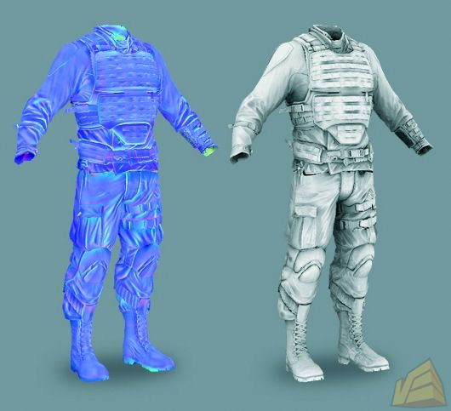
Normal map results:
이미지 출처:
http://tom.drastic.net/stuff/mudbox--3ds-max/
이미지 출처: http://ve3d.ign.com/images/fullsize/46667/PC/Crysis/Screenshots/CryEngine-3-Image

Slide 40
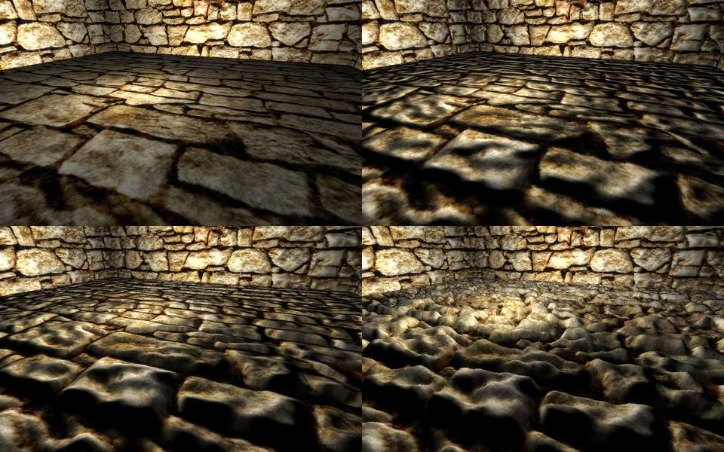
The State-of-the-art techniques:
Texture mapping
Bump mapping
Parallax mapping
Relief mapping
이미지 출처: http://www.esenthel.com/?id=feature/rendering

