Slide 1
Chapter 3:
Geometric Objects and Transformations
Sang Il Park
Dept. of Software

Slide 2
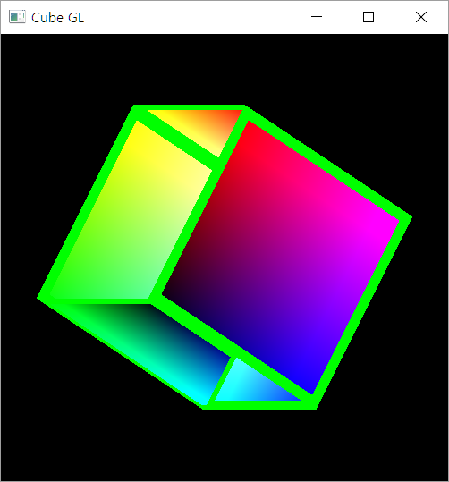
One little problem
Incorrect Depth Handling

Slide 3
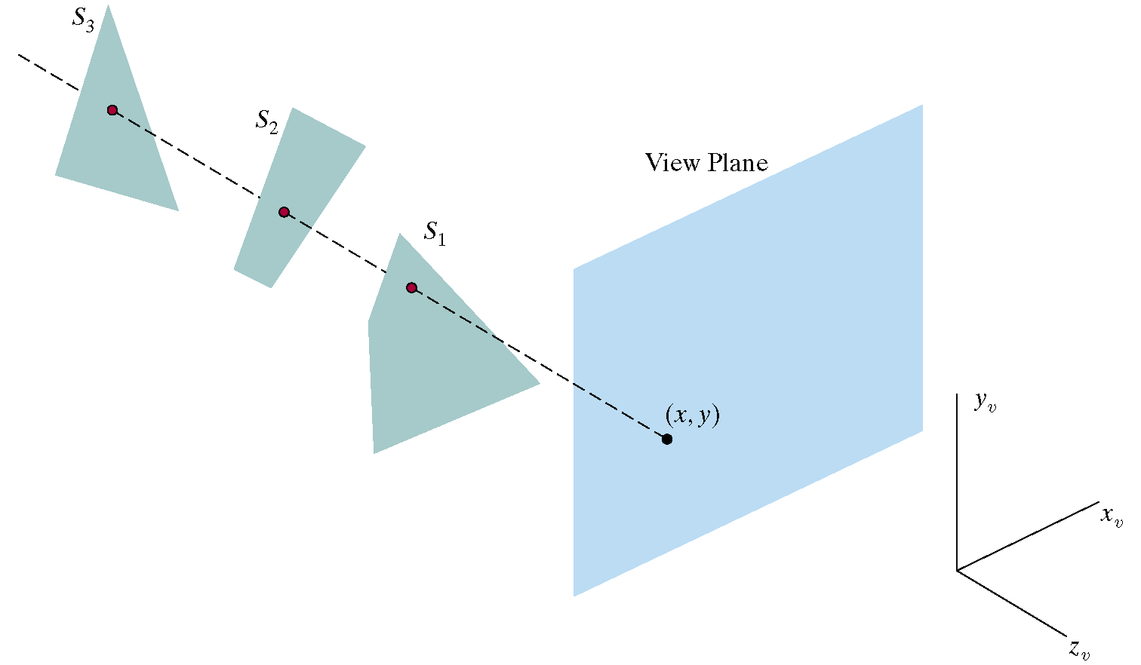
Depth-Buffer (Z-Buffer)
Z-Buffer has memory corresponding to each pixel location for storing the current depth value (distance from view plane)
  Useful for determining whether a new drawing pixel is visible or not
    Is visible when the its distance is closer than the previously stored one
    Is not visible when it is farer

Slide 4
Enabling the Depth Buffer in OPENGL
On Initialization :
On Drawing :
glutInitDisplayMode(GLUT_DOUBLE |
GLUT_RGBA |
GLUT_DEPTH);
glClear (GL_COLOR_BUFFER_BIT |
GL_DEPTH_BUFFER_BIT);
glEnable(GL_DEPTH_TEST);

Slide 5
Interaction:
Callbacks

Slide 6
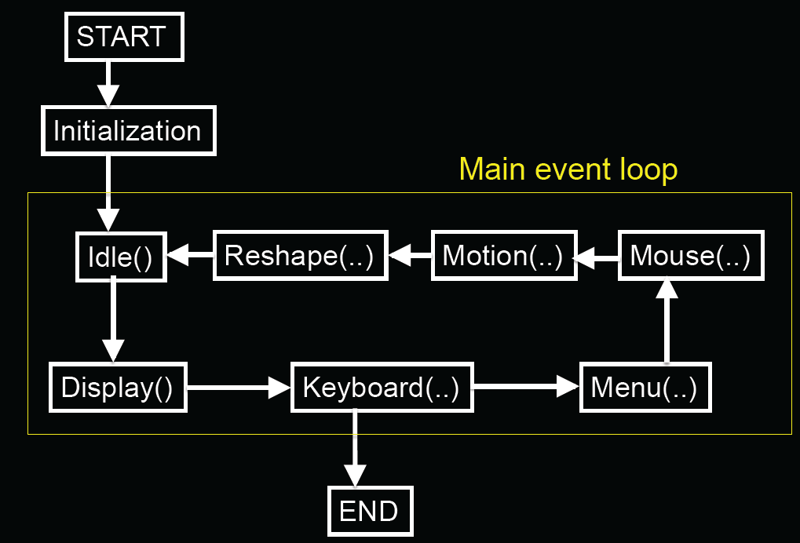
GLUT Program with Callbacks

Slide 7
Event Types
Window: resize, expose, iconify
Mouse: click one or more buttons
Motion: move mouse
Keyboard: press or release a key
Idle: non-event
  Define what should be done if no other event is in queue
E. Angel and D. Shreiner : Interactive Computer Graphics 6E © Addison-Wesley 2012

Slide 8
Callbacks
Programming interface for event-driven input
Define a callback function for each type of event the graphics system recognizes
This user-supplied function is executed when the event occurs
GLUT example: glutMouseFunc(mymouse)
mouse callback function
E. Angel and D. Shreiner : Interactive Computer Graphics 6E © Addison-Wesley 2012

Slide 9
GLUT callbacks
GLUT recognizes a subset of the events recognized by any particular window system (Windows, X, Macintosh)
  glutDisplayFunc
  glutMouseFunc
  glutReshapeFunc
  glutKeyboardFunc
  glutIdleFunc
  glutMotionFunc, glutPassiveMotionFunc
E. Angel and D. Shreiner : Interactive Computer Graphics 6E © Addison-Wesley 2012

Slide 10
Types of Callbacks
Display ( ) : when window must be drawn
Idle ( ) : when no other events to be handled
Keyboard (unsigned char key, int x, int y) : key pressed
Menu (...) : after selection from menu
Mouse (int button, int state, int x, int y) : mouse button
Motion (...) : mouse movement
Reshape (int w, int h) : window resize
Any callback can be NULL

Slide 11

GLUT Event Loop
Recall that the last line in main.c for a program using GLUT must be
  glutMainLoop();
which puts the program in an infinite event loop
In each pass through the event loop, GLUT
  looks at the events in the queue
  for each event in the queue, GLUT executes the appropriate callback function if one is defined
  if no callback is defined for the event, the event is ignored
E. Angel and D. Shreiner : Interactive Computer Graphics 6E © Addison-Wesley 2012

Slide 12
Example : Idling Callback
Idling Callback is useful for defining a periodic work
  Ex. ) making an animation (rotating a cube and so on)
How to use:
  Registering your function as an Idling Callback Function
  Implement what you want to do repeatedly
glutIdleFunc ( myIdle );
void myIdle()
{
// do some periodic job
Sleep(16);
glutPostRedisplay();
}
Wait for 16 mille-sec.
(Ensuring 60 FPS)
Invoking redrawing

Slide 13
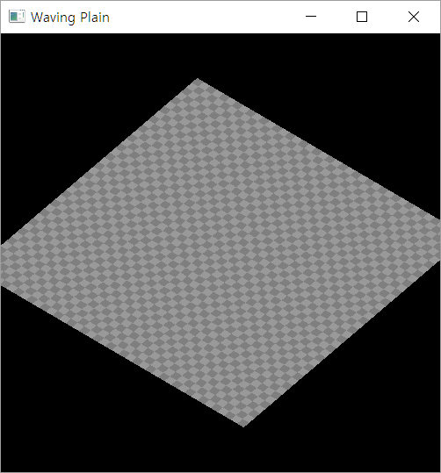
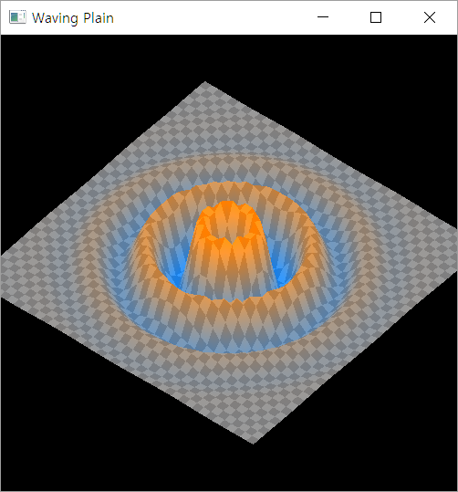
Homework: A Waving Plain
Condition:
  Draw a checker pattern plain
  (create a “MyPlain” class)
  Draw waving pattern when [w] key is pressed using only shader
  Start rotating and “WAVING” when space bar is pressed
  Increase or decrease the Number of Division when pressing [1] or [2] key.
  Stop when space bar is pressed again.
  Quit when [q] is pressed

Slide 14
How to submit:
Submit your codes to blackboard
  .cpp file + .h file + vshader.glsl + fshader.glsl
Also include your report about
  Ideas
    Especially how you can get the waving patterns
  Describe any errors and resolutions you tried and found
Due date: 9/26(Monday) PM 23:59

Slide 15
Hint for the homework:
Organizing into Classes
Make MyColorCube Class to increase the readability and portability of the code :
MyColorCube.h
class MyColorCube
{
public:
…
};

Slide 16

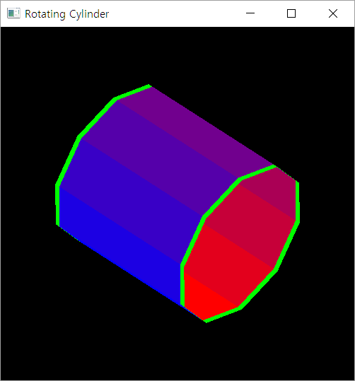
Coding Practice : A Color Cylinder

Slide 17

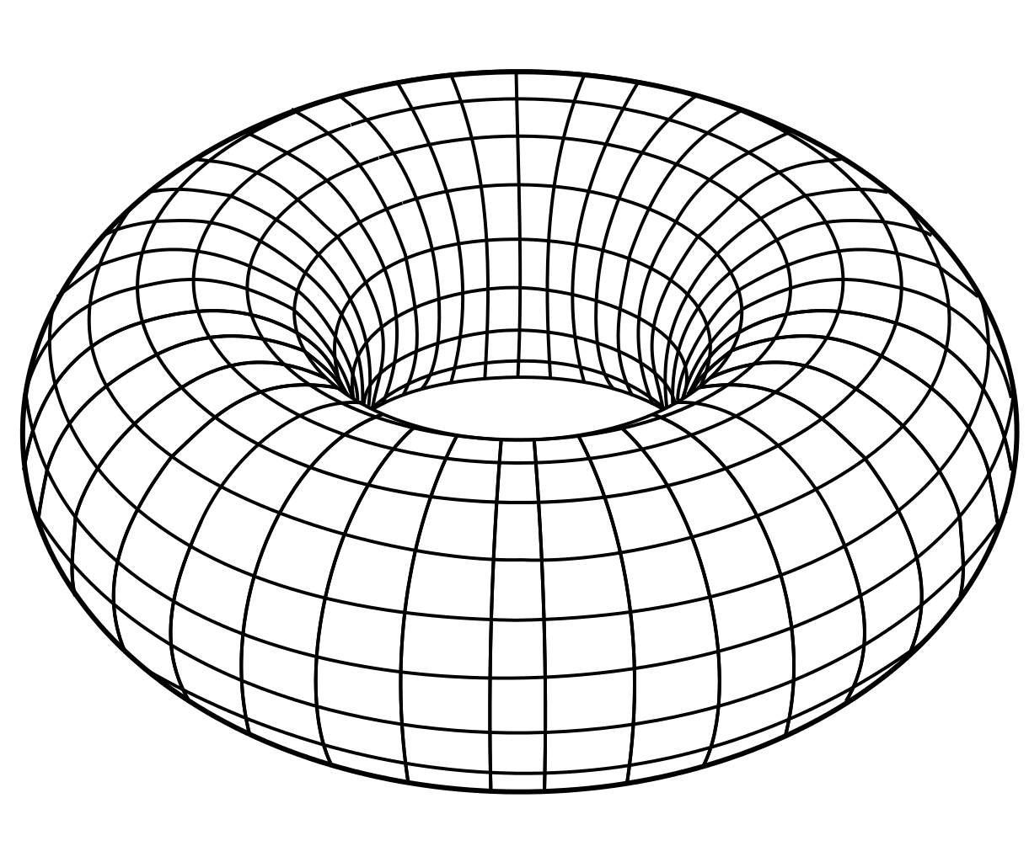
Sphere and Torus

Slide 18
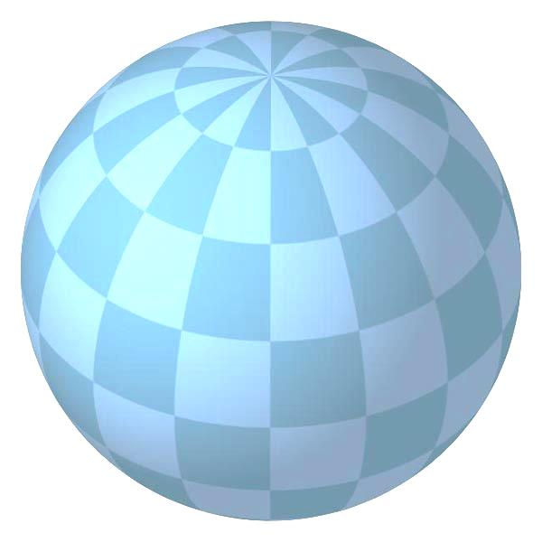
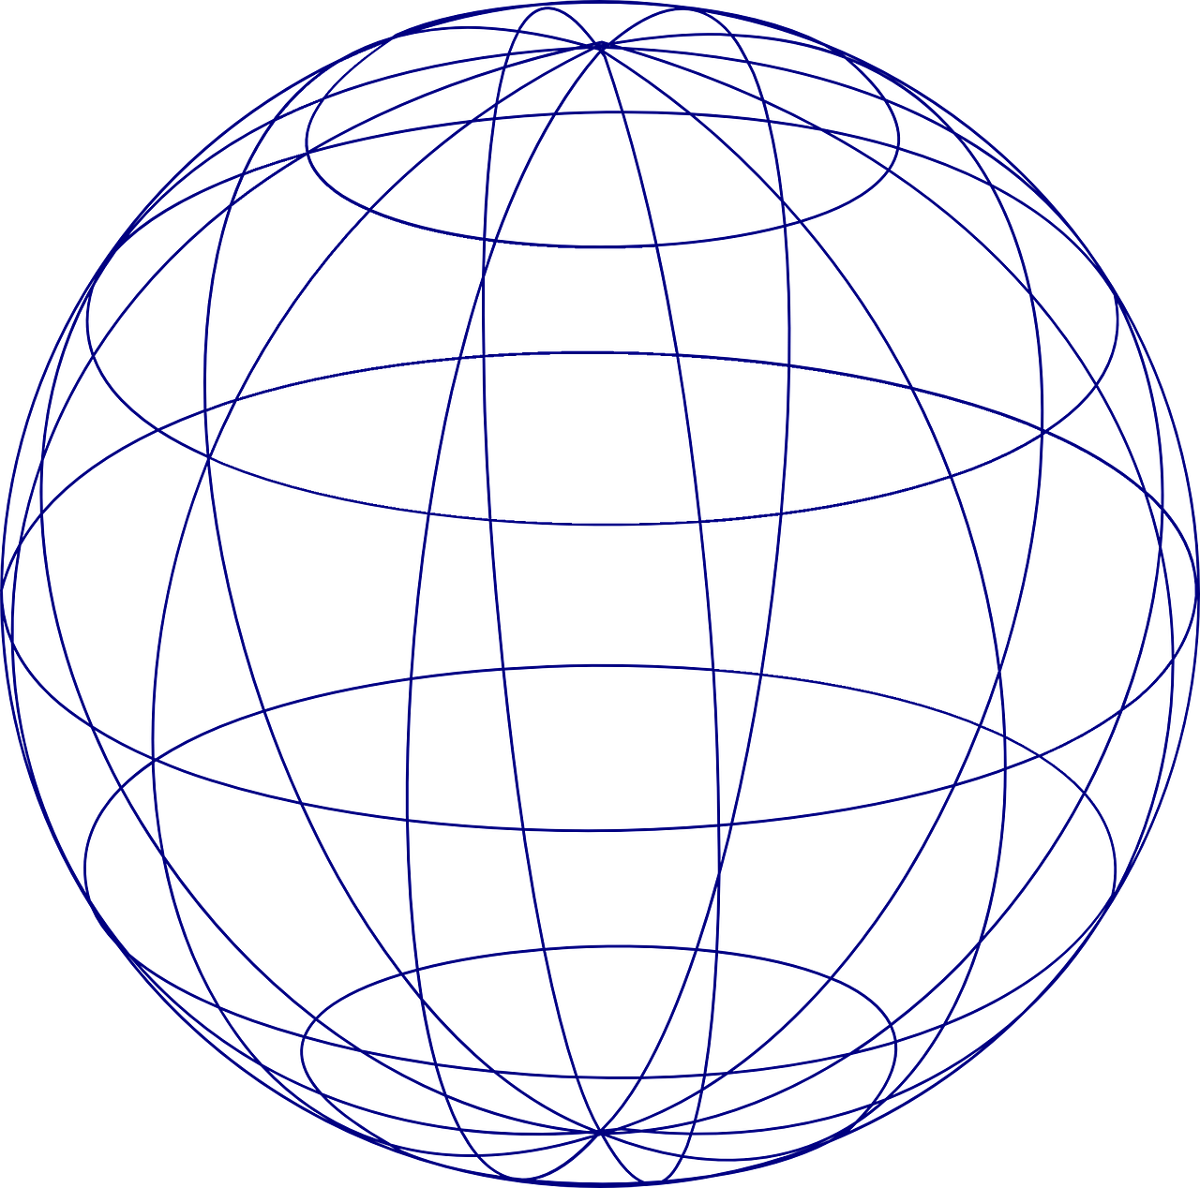
z
z
(i, j)
j
i
y
y
x
x

Slide 19
Chapter 3:
Geometric Objects and Transformations

Slide 20
Scalars
Scalars α, β, γ from a scalar field
Operations α+β, α∙β, 0, 1, -α, ( )⁻¹
“Expected” laws apply
Examples: rationals or reals with addition and multiplication

Slide 21
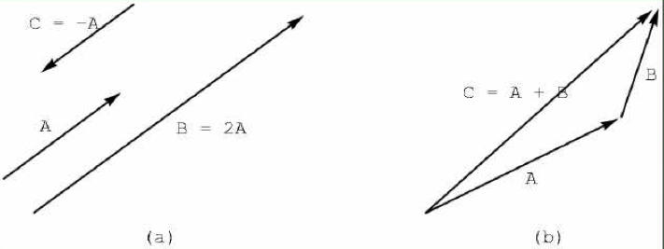
Vectors
Vectors u, v, w from a vector space
Vector addition u + v , subtraction u - v
Zero vector 0
Scalar multiplication α v

Slide 22
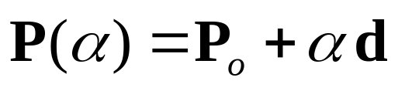
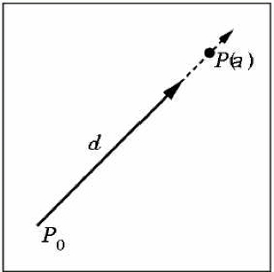
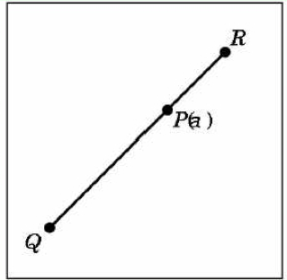
Lines and line Segments
Parametric form of line:
Line segment between Q and R:

Slide 23
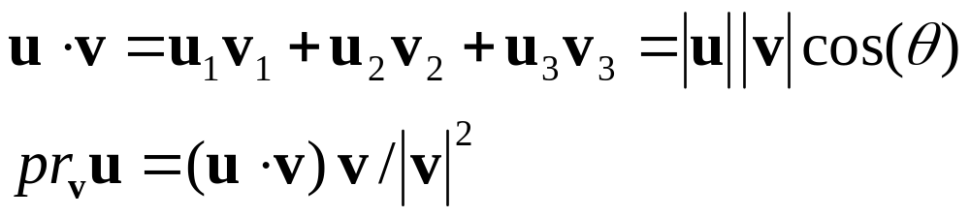
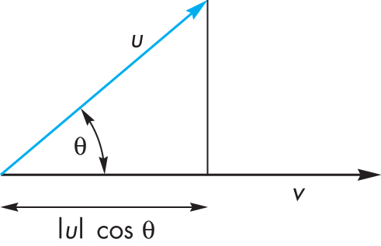
Dot Product (Projection)
Dot product projects one vector onto another vector

Slide 24
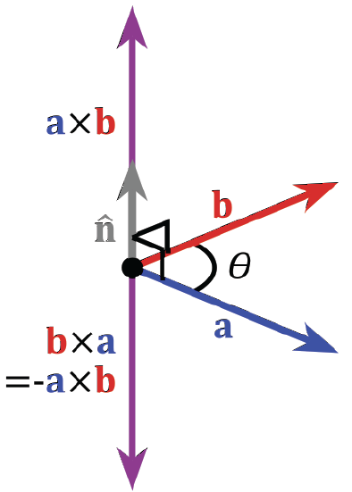
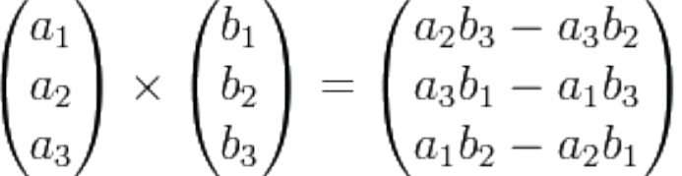
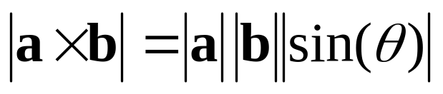
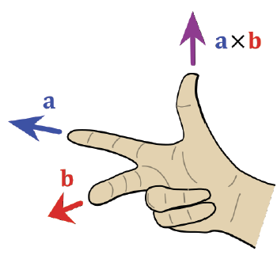
Cross Product
Cross product is
perpendicular to both a and b
Right-hand rule

Slide 25
Planes
A plane can be defined by a point and two vectors or by three points
P
v
Q
R
u
R
P(α,β)=R+αu+βv
P(α,β)=R+α(Q-R)+β(P-Q)

Slide 26
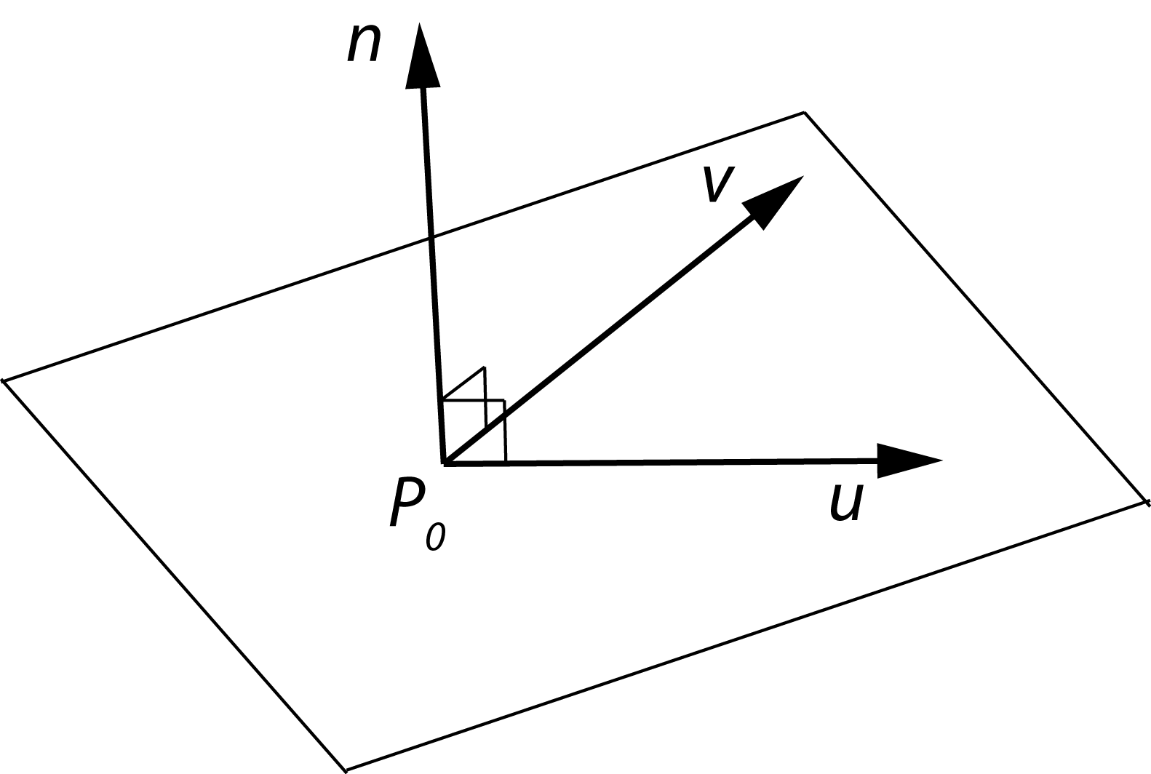
Planes and normal
Plane defined by point P₀
and vectors u and v
u and v should not
be parallel
Parametric form:
T(α, β) = P₀ + α u + β v
(α and β are scalars)
n = u x v / |u x v| is the normal
n∙(P – P₀) = 0 if and only if P lies in plane

Slide 27
Geometric Transformations

Slide 28
Transformations
Linear transformations
Rigid transformations
Affine transformations
Projective transformations
T
Global reference frame

Slide 29
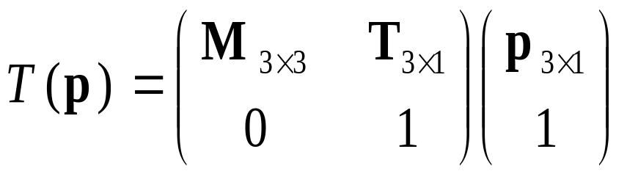
Homogeneous Coordinates
Any affine transformation between 3D spaces can be represented by a 4x4 matrix
Affine transformation is linear in homogeneous coordinates

Slide 30
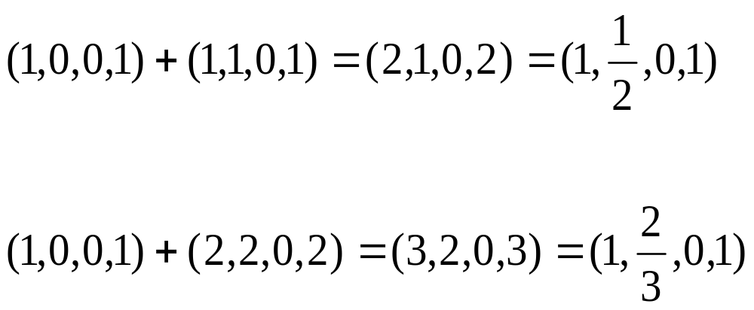
Projective Spaces
Homogeneous coordinates
  (x, y, z, w) = (x/w, y/w, z/w, 1)
  Useful for handling perspective projection
But, it is algebraically inconsistent !!

Slide 31


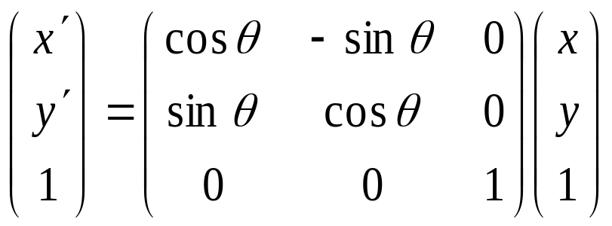
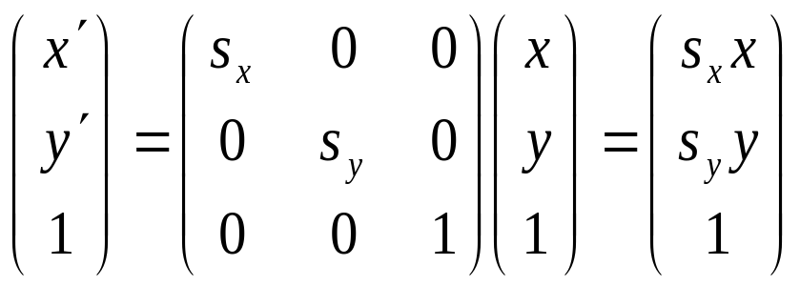
Examples of Affine Transformations
2D rotation
2D scaling

Slide 32
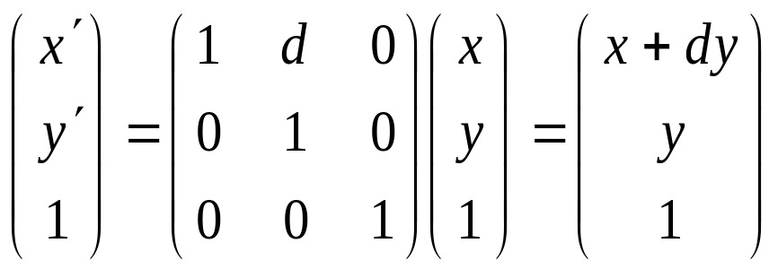
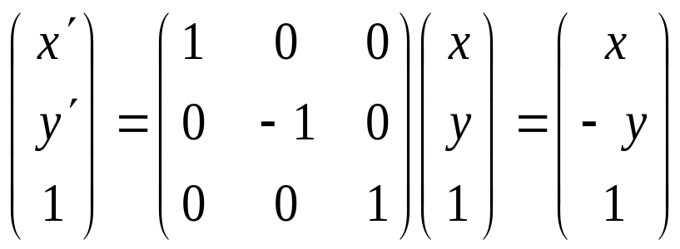
Examples of Affine Transformations
2D shear
2D reflection

Slide 33
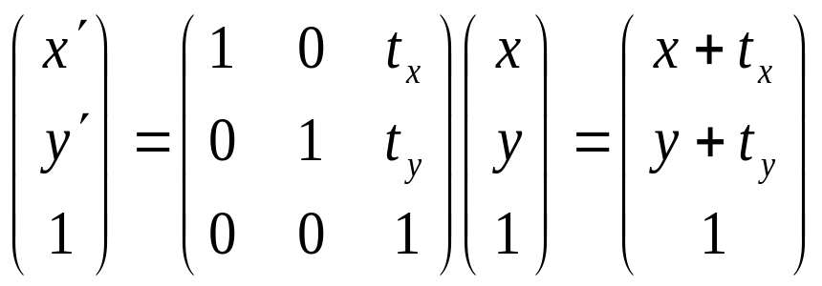
Examples of Affine Transformations
2D translation

Slide 34
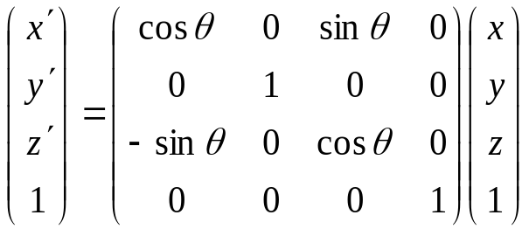
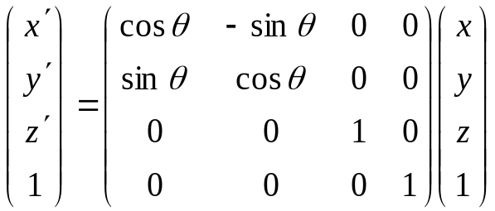
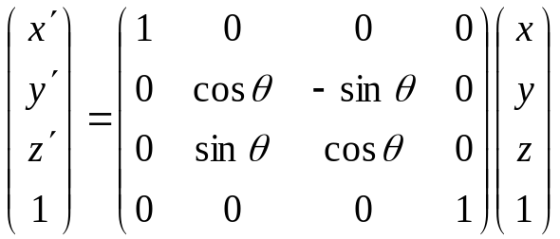
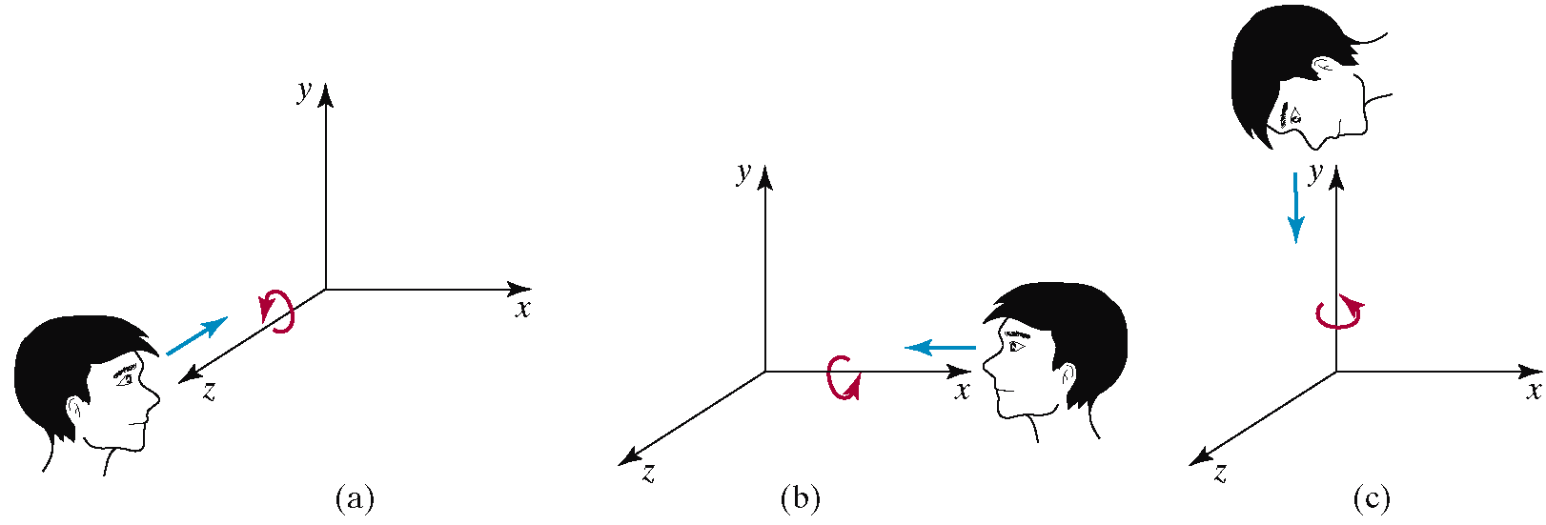
Examples of Affine Transformations
3D rotation

Slide 35
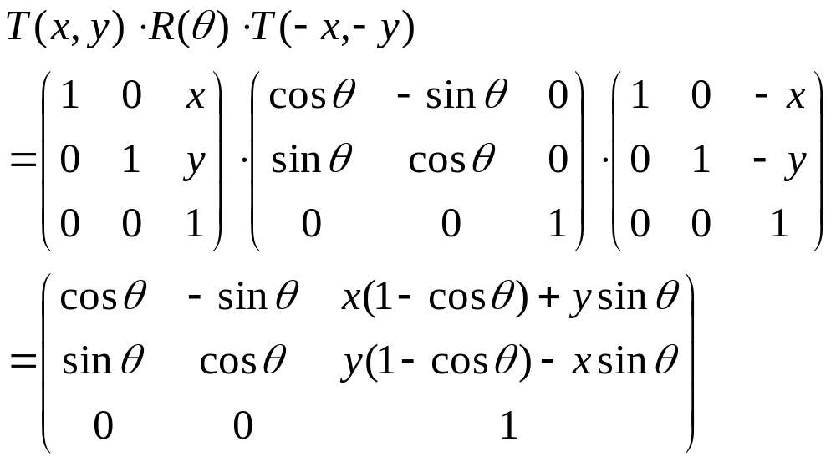
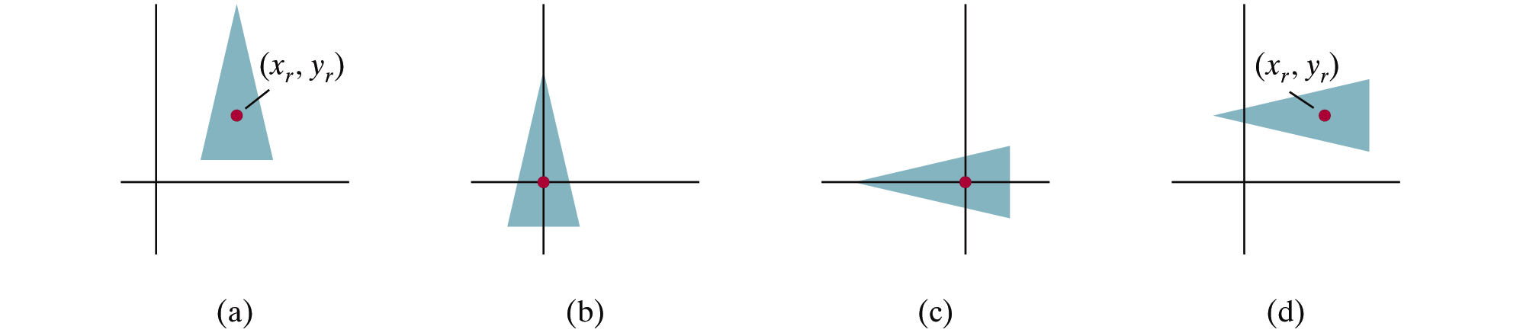
Pivot-Point Rotation
Rotation with respect to a pivot point (x,y)

Slide 36
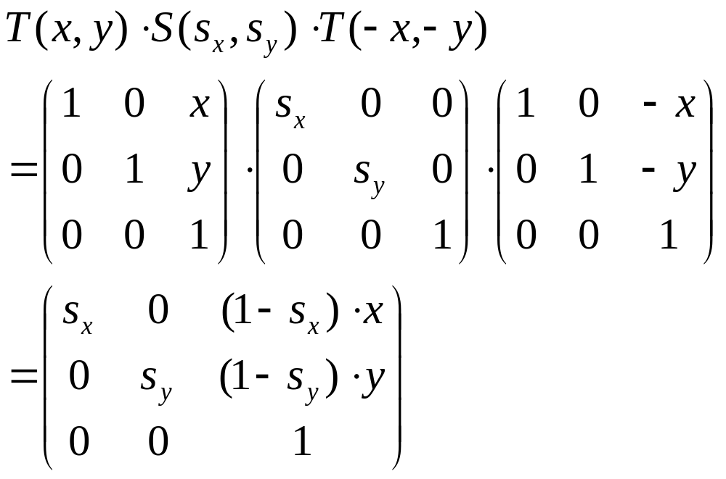
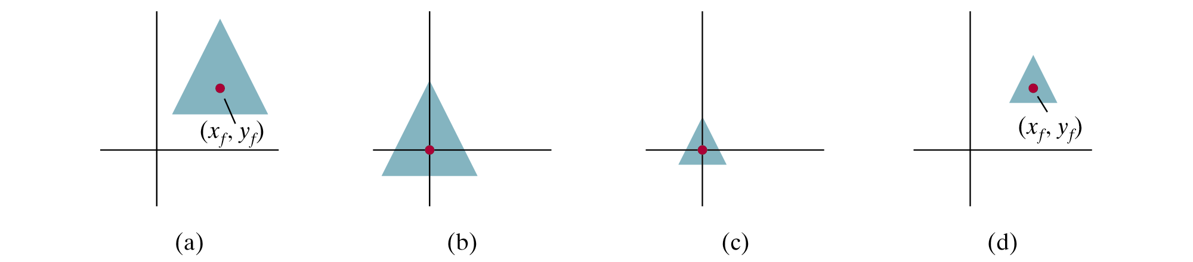
Fixed-Point Scaling
Scaling with respect to a fixed point (x,y)

Slide 37
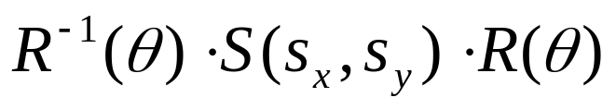

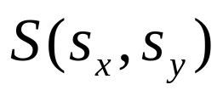
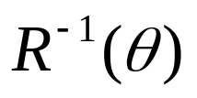
Scaling Direction
Scaling along an arbitrary axis

Slide 38
Properties of Affine Transformations
Any affine transformation between 3D spaces can be represented as a combination of a linear transformation followed by translation
An affine transf. maps lines to lines
An affine transf. maps parallel lines to parallel lines
An affine transf. preserves ratios of distance along a line
An affine transf. does not preserve absolute distances and angles

Slide 39
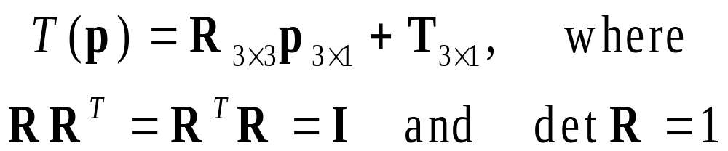
Rigid Transformations
A rigid transformation T is a mapping between affine spaces
  T maps vectors to vectors, and points to points
  T preserves distances between all points
  T preserves cross product for all vectors (to avoid reflection)
In 3-spaces, T can be represented as

Slide 40


Rigid Body Rotation
Rigid body transformations allow only rotation and translation
Rotation matrices form SO(3)
  Special orthogonal group
(Distance preserving)
(No reflection)

Slide 41
Rigid Body Rotation
R is normalized
  The squares of the elements in any row or column sum to 1
R is orthogonal
  The dot product of any pair of rows or any pair columns is 0
The rows (columns) of R correspond to the vectors of the principle axes of the rotated coordinate frame

Slide 42
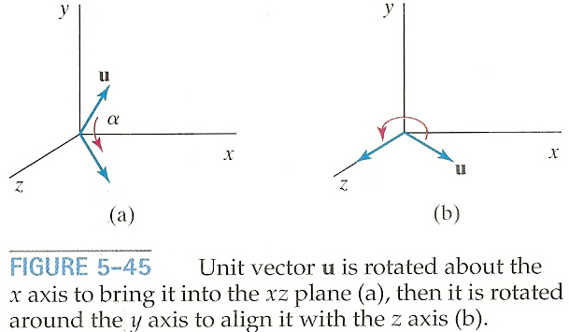
3D Rotation About Arbitrary Axis
Rotate u onto the z-axis

Slide 43
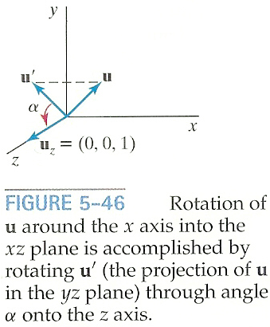
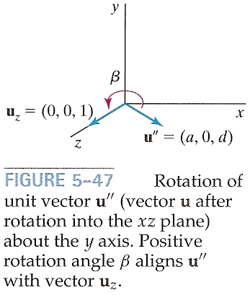
3D Rotation About Arbitrary Axis
Rotate u onto the z-axis
  u’: Project u onto the yz-plane to compute angle α
  u’’: Rotate u about the x-axis by angle α
  Rotate u’’ onto the z-asis

Slide 44
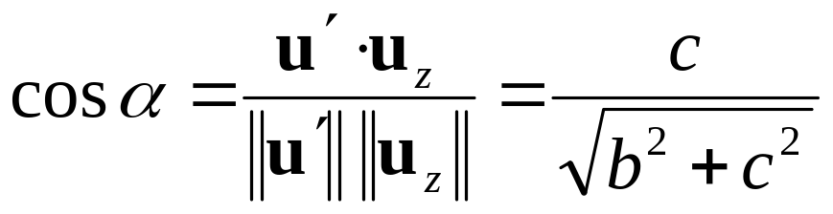
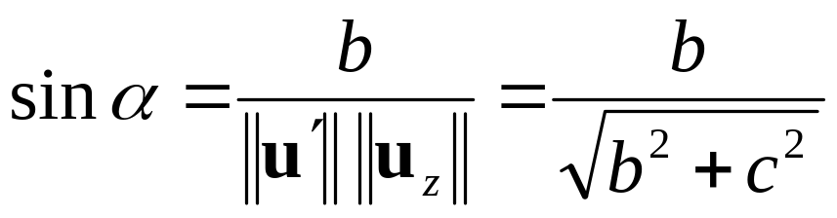
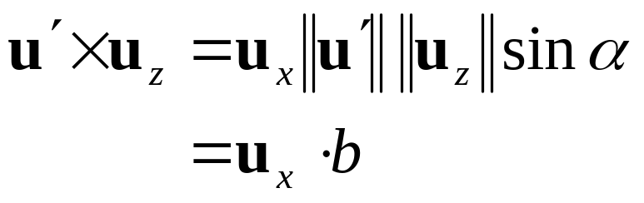
3D Rotation About Arbitrary Axis
Rotate u’ about the x-axis onto the z-axis
  Let u=(a,b,c) and thus u’=(0,b,c)
  Let uz=(0,0,1)

Slide 45
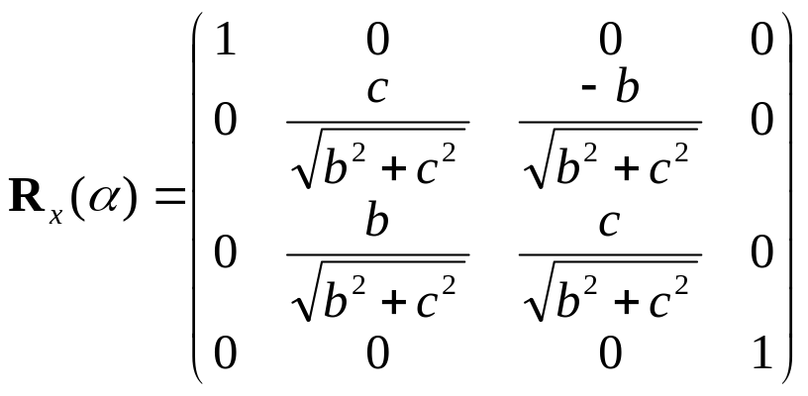
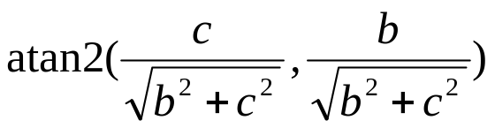
3D Rotation About Arbitrary Axis
Rotate u’ about the x-axis onto the z-axis
  Since we know both cos α and sin α, the rotation matrix can be obtained
  Or, we can compute the signed angle α
  Do not use acos() since its domain is limited to
  [-1,1]

Slide 46
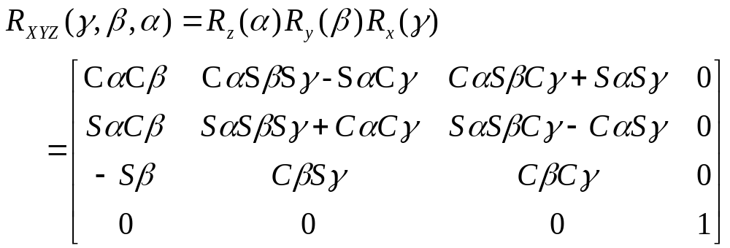
Euler angles
Arbitrary rotation can be represented by three rotation along x,y,z axis

Slide 47
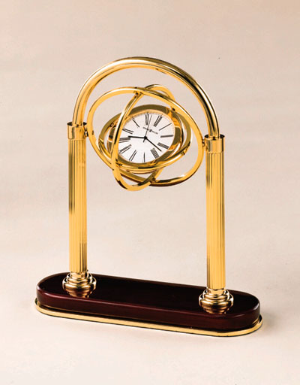
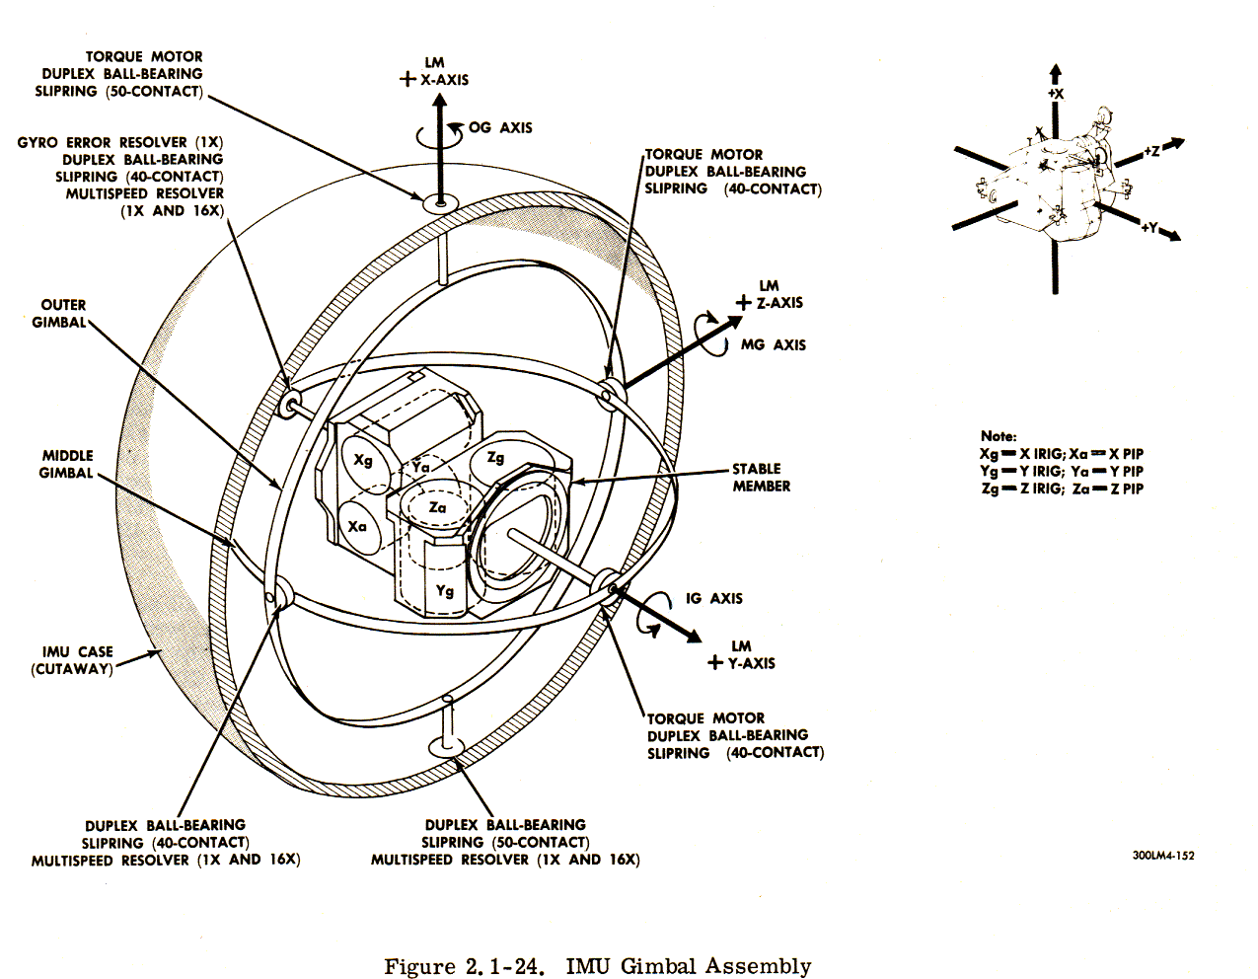
Gimble
Hardware implementation of Euler angles
Aircraft, Camera

Slide 48

Euler Angles
Rotation about three orthogonal axes
  12 combinations
    XYZ, XYX, XZY, XZX
    YZX, YZY, YXZ, YXY
    ZXY, ZXZ, ZYX, ZYZ
Gimble lock
  Coincidence of inner most and outmost gimbles’ rotation axes
  Loss of degree of freedom

Slide 49

Euler Angles
Euler angles are ambiguous
  Two different Euler angles can represent the same orientation
  This ambiguity brings unexpected results of animation where frames are generated by interpolation.

Slide 50
Taxonomy of Transformations
Linear transformations
  3x3 matrix
  Rotation + scaling + shear
Rigid transformations
  SO(3) for rotation
  3D vector for translation
Affine transformation
  3x3 matrix + 3D vector or 4x4 homogenous matrix
  Linear transformation + translation
Projective transformation
  4x4 matrix
  Affine transformation + perspective projection

Slide 51
Taxonomy of Transformations
Rigid
Affine
Projective

Slide 52


Composite Transformations
Composite 2D Translation

Slide 53


Composite Transformations
Composite 2D Scaling

Slide 54


Composite Transformations
Composite 2D Rotation

