Slide 1

Link layer, LANs: roadmap
introduction
error detection, correction
multiple access protocols
LANs
addressing, ARP
Ethernet
switches

Slide 2
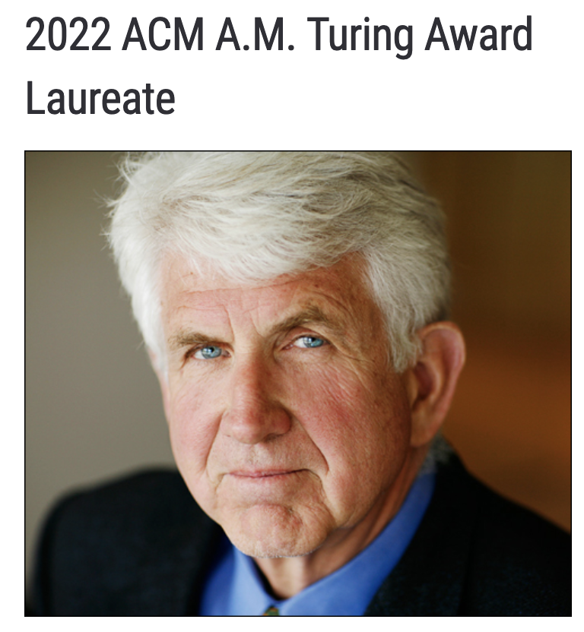
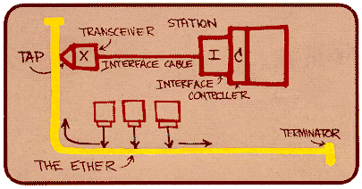
Ethernet
“dominant” wired LAN technology:
first widely used LAN technology
simpler, cheap
kept up with speed race: 10 Mbps – 400 Gbps
single chip, multiple speeds (e.g., Broadcom BCM5761)
Bob Metcalfe: Ethernet co-inventor,
2022 ACM Turing Award recipient
Metcalfe’s Ethernet sketch
https://www.uspto.gov/learning-and-resources/journeys-innovation/audio-stories/defying-doubters

Slide 3


Ethernet: physical topology
bus: popular through mid 90s
all nodes in same collision domain (can collide with each other)
switched: prevails today
active link-layer 2 switch in center
each “spoke” runs a (separate) Ethernet protocol (nodes do not collide with each other)
bus: coaxial cable
switched

Slide 4
Ethernet frame structure
sending interface encapsulates IP datagram (or other network layer protocol packet) in Ethernet frame
type
preamble
dest.
address
source
address
data (payload)
CRC
preamble:
used to synchronize receiver, sender clock rates
7 bytes of 10101010 followed by one byte of 10101011

Slide 5
Ethernet frame structure (more)
type
preamble
dest.
address
source
address
data (payload)
CRC
addresses: 6 byte source, destination MAC addresses
if adapter receives frame with matching destination address, or with broadcast address (e.g., ARP packet), it passes data in frame to network layer protocol
type: indicates higher layer protocol
mostly IP but others possible, e.g., Novell IPX, AppleTalk
used to demultiplex up at receiver
CRC: cyclic redundancy check at receiver
error detected: frame is dropped

Slide 6
Ethernet: unreliable, connectionless
connectionless: no handshaking between sending and receiving NICs
unreliable: receiving NIC doesn’t send ACKs or NAKs to sending NIC
data in dropped frames recovered only if initial sender uses higher layer rdt (e.g., TCP), otherwise dropped data lost
Ethernet’s MAC protocol: unslotted CSMA/CD with binary backoff

Slide 7
802.3 Ethernet standards: link & physical layers
many different Ethernet standards
common MAC protocol and frame format
different speeds: 2 Mbps, ... 100 Mbps, 1Gbps, 10 Gbps, 40 Gbps, 80 Gbps
different physical layer media: fiber, cable
application
transport
network
link
physical
MAC protocol
and frame format
100BASE-TX
100BASE-T2
100BASE-FX
100BASE-T4
100BASE-SX
100BASE-BX
copper (twister pair) physical layer
fiber physical layer

Slide 8
Link layer, LANs: roadmap
introduction
error detection, correction
multiple access protocols
LANs
addressing, ARP
Ethernet
switches

Slide 9
Ethernet switch
Switch is a link-layer device: takes an active role
store, forward Ethernet (or other type of) frames
examine incoming frame’s MAC address, selectively forward frame to one-or-more outgoing links when frame is to be forwarded on segment
transparent: hosts unaware of presence of switches
plug-and-play, self-learning
switches do not need to be configured

Slide 10
Switch: multiple simultaneous transmissions
hosts have dedicated, direct connection to switch
switches buffer packets
Ethernet protocol used on each incoming link, so:
no collisions; full duplex
each link is its own collision domain
A
C’
B
1
2
6
3
5
4
B’
C
A’
switching: A-to-A’ and B-to-B’ can transmit simultaneously, without collisions
switch with six interfaces (1,2,3,4,5,6)

Slide 11

Switch: multiple simultaneous transmissions
hosts have dedicated, direct connection to switch
switches buffer packets
Ethernet protocol used on each incoming link, so:
no collisions; full duplex
each link is its own collision domain
A
C’
B
1
2
6
3
5
4
B’
C
A’
switching: A-to-A’ and B-to-B’ can transmit simultaneously, without collisions
but A-to-A’ and C to A’ can not happen simultaneously
switch with six interfaces (1,2,3,4,5,6)

Slide 12
Switch forwarding table
Q: how does switch know A’ reachable via interface 4, B’ reachable via interface 5?
A
C’
B
A: each switch has a switch table, each entry:
(MAC address of host, interface to reach host, time stamp)
looks like a routing table!
1
2
6
3
5
4
B’
C
A’
Q: how are entries created, maintained in switch table?
something like a routing protocol?

Slide 13
Switch: self-learning
Source: A
switch learns which hosts can be reached through which interfaces
Dest: A’
A A’
A
C’
B
when frame received, switch “learns” location of sender: incoming LAN segment
1
2
6
3
5
4
records sender/location pair in switch table
B’
C
A’
Switch table
(initially empty)
MAC addr interface TTL
A
1
60

Slide 14
Switch: frame filtering/forwarding
when frame received at switch:
1. record incoming link, MAC address of sending host
2. index switch table using MAC destination address
3. if entry found for destination then {
if destination on segment from which frame arrived then drop frame
else forward frame on interface indicated by entry
}
else flood /* forward on all interfaces except arriving interface */

Slide 15
Self-learning, forwarding: example
Source: A
Dest: A’
frame destination, A’, location unknown:
A A’
flood
A
C’
B
destination A location known:
selectively send
on just one link
1
2
6
A A’
A A’
A A’
A A’
A A’
3
5
4
B’
C
A’ A
A’
MAC addr interface TTL
A
1
60
switch table
(initially empty)
A’
4
60

Slide 16


Interconnecting switches
self-learning switches can be connected together:
S₄
S₁
S₃
A
S₂
F
I
B
C
D
E
G
H
Q: sending from A to G - how does S₁ know to forward frame destined to G via S₄ and S₃?
A: self learning! (works exactly the same as in single-switch case!)

Slide 17
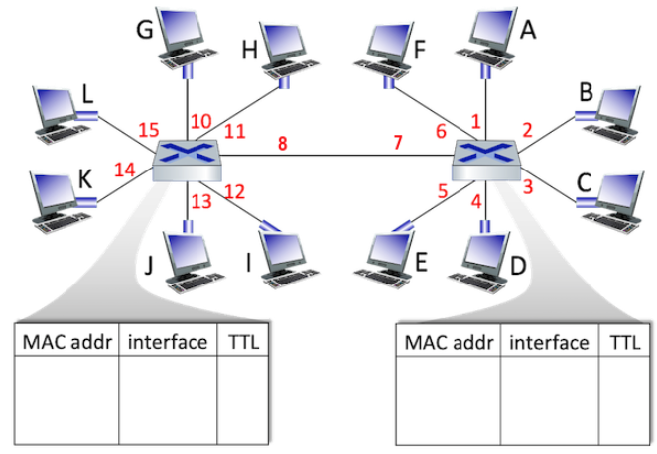
Interactive Exercises
At t=0 the switch table entries for both switches are empty
At t = 1, 2, 3, and 4, a source sends to a destination as shown below, and the destination replies immediately before the next time step
t=1: G -> I
t=2: E -> J
t=3: A -> L
t=4: B -> C
Fill out the two switch tables

Slide 18
Interactive Exercises
At t=0 the switch table entries for both switches are empty
At t = 1, 2, 3, and 4, a source sends to a destination as shown below, and the destination replies immediately before the next time step
t=1: B -> H
t=2: F -> D
t=3: B -> A
t=4: E -> H
Fill out the two switch tables

Slide 19
Switches vs. routers
application
transport
network
link
physical
both are store-and-forward:
routers: network-layer devices (examine network-layer headers)
switches: link-layer devices (examine link-layer headers)
datagram
frame
link
physical
frame
switch
network
link
physical
datagram
both have forwarding tables:
routers: compute tables using routing algorithms, IP addresses
switches: learn forwarding table using flooding, learning, MAC addresses
frame
application
transport
network
link
physical
6-19

