Slide 1
Computer Network

Slide 2

Network layer: “control plane” roadmap
Introduction
Routing algorithms
Link state
Distance vector
Intra-ISP routing: OSPF
Routing among ISPs: BGP
SDN control plane
Internet Control Message Protocol

Slide 3
Network-layer functions
Forwarding: move packets from router’s input to appropriate router output
data plane
Routing: determine route taken by packets from source to destination
control plane
Two approaches to structuring network control plane:
per-router control (traditional)
logically centralized control (software defined networking)

Slide 4

Per-router control plane
Individual routing algorithm components in each and every router interact in the control plane
Routing
Algorithm
control
plane
data
plane
values in arriving
packet header
0111
1
3
2

Slide 5
Software-Defined Networking (SDN) control plane
Remote controller computes, installs forwarding tables in routers
Remote Controller
control
plane
data
plane
CA
CA
CA
CA
CA
values in arriving
packet header
0111
1
3
2

Slide 6
Network layer: “control plane” roadmap
introduction
routing algorithms
link state
distance vector
intra-ISP routing: OSPF
routing among ISPs: BGP
SDN control plane
Internet Control Message Protocol
network management, configuration
SNMP
NETCONF/YANG

Slide 7
















Routing Algorithm
mobile network
Routing algorithm: determine “good” paths (equivalently, routes), from sending hosts to receiving host, through network of routers
path: sequence of routers packets traverse from given initial source host to final destination host
“good”: least “cost”, “fastest”, “least congested”
routing: a “top-10” networking challenge!
national or global ISP
application
transport
network
link
physical
network
link
physical
network
link
physical
network
link
physical
network
link
physical
network
link
physical
datacenter
network
application
transport
network
link
physical
enterprise
network

Slide 8
Graph abstraction: link costs
5
c_{a,b}: cost of direct link connecting a and b
e.g., c_{w,z} = 5, c_{u,z} = ∞
cost defined by network operator: could always be 1, or inversely related to bandwidth, or related to congestion
v
3
w
2
5
u
2
1
z
3
1
2
x
y
1
graph: G = (N,E)
N: set of routers = { u, v, w, x, y, z }
E: set of links ={ (u,v), (u,x), (v,x), (v,w), (x,w), (x,y), (w,y), (w,z), (y,z) }

Slide 9
Routing algorithm classification
global: all routers have complete topology, link cost info
“link state” algorithms
dynamic: routes change more quickly
periodic updates or in response to link cost changes
How fast do routes change?
static: routes change slowly over time
decentralized: iterative process of computation, exchange of info with neighbors
routers initially only know link costs to attached neighbors
“distance vector” algorithms
global or decentralized information?

Slide 10
Network layer: “control plane” roadmap
introduction
routing protocols
link state
distance vector
intra-ISP routing: OSPF
routing among ISPs: BGP
SDN control plane
Internet Control Message Protocol
network management, configuration
SNMP
NETCONF/YANG

Slide 11
Dijkstra’s link-state routing algorithm
centralized: network topology, link costs known to all nodes
accomplished via “link state broadcast”
all nodes have same info
computes least cost paths from one node (“source”) to all other nodes
gives forwarding table for that node
iterative: after k iterations, know least cost path to k destinations
notation
c_{x,y}: direct link cost from node x to y; = ∞ if not direct neighbors
D(v): current estimate of cost of least-cost-path from source to destination v
p(v): predecessor node along path from source to v
N': set of nodes whose least-cost-path definitively known

Slide 12
Dijkstra’s link-state routing algorithm
1 Initialization:
2 N' = {u} /* compute least cost path from u to all other nodes */
3 for all nodes v
4 if v adjacent to u /* u initially knows direct-path-cost only to direct neighbors */
5 then D(v) = c_{u,v} /* but may not be minimum cost! */
6 else D(v) = ∞
7
8 Loop
9
10
11
12
13
14
15 until all nodes in N'
find w not in N' such that D(w) is a minimum
add w to N'
update D(v) for all v adjacent to w and not in N' :
D(v) = min ( D(v), D(w) + c_{w,v} )
/* new least-path-cost to v is either old least-cost-path to v or known
least-cost-path to w plus direct-cost from w to v */

Slide 13
Dijkstra’s algorithm: an example
v
w
x
y
z
Step
0
1
2
3
4
5
N'
D(v),p(v)
D(w),p(w)
D(x),p(x)
D(y),p(y)
D(z),p(z)
u
2,u
5,u
1,u
∞
∞
5
Initialization (step 0):
For all a: if a adjacent to u then D(a) = c_{u,a}
v
3
w
2
5
u
2
1
z
3
1
2
x
y
1

Slide 14
Dijkstra’s algorithm: an example
v
w
x
y
z
Step
0
1
2
3
4
5
N'
D(v),p(v)
D(w),p(w)
D(x),p(x)
D(y),p(y)
D(z),p(z)
u
2,u
5,u
1,u
∞
∞
ux
8 Loop
9
10
find a not in N' such that D(a) is a minimum
add a to N'
5
v
3
w
2
5
u
2
1
z
3
1
2
x
y
1

Slide 15

Dijkstra’s algorithm: an example
v
w
x
y
z
Step
0
1
2
3
4
5
N'
D(v),p(v)
D(w),p(w)
D(x),p(x)
D(y),p(y)
D(z),p(z)
u
2,u
5,u
1,u
∞
∞
ux
2,u
4,x
2,x
∞
8 Loop
9
10
11
find a not in N' such that D(a) is a minimum
add a to N'
5
v
3
w
2
5
update D(b) for all b adjacent to a and not in N' :
D(b) = min ( D(b), D(a) + c_{a,b} )
u
2
1
z
3
1
2
D(v) = min ( D(v), D(x) + c_{x,v} ) = min(2, 1+2) = 2
x
y
1
D(w) = min ( D(w), D(x) + c_{x,w} ) = min (5, 1+3) = 4
D(y) = min ( D(y), D(x) + c_{x,y} ) = min(inf,1+1) = 2

Slide 16
Dijkstra’s algorithm: an example
v
w
x
y
z
Step
0
1
2
3
4
5
N'
D(v),p(v)
D(w),p(w)
D(x),p(x)
D(y),p(y)
D(z),p(z)
u
2,u
5,u
1,u
∞
∞
ux
2,u
4,x
2,x
∞
uxy
8 Loop
9
10
find a not in N' such that D(a) is a minimum
add a to N'
5
v
3
w
2
5
u
2
1
z
3
1
2
x
y
1

Slide 17
Dijkstra’s algorithm: an example
v
w
x
y
z
Step
0
1
2
3
4
5
N'
D(v),p(v)
D(w),p(w)
D(x),p(x)
D(y),p(y)
D(z),p(z)
u
2,u
5,u
1,u
∞
∞
ux
2,u
4,x
2,x
∞
uxy
2,u
3,y
4,y
8 Loop
9
10
11
find a not in N' such that D(a) is a minimum
add a to N'
5
v
3
w
2
5
update D(b) for all b adjacent to a and not in N' :
D(b) = min ( D(b), D(a) + c_{a,b} )
u
2
1
z
3
1
2
D(w) = min ( D(w), D(y) + c_{y,w} ) = min (4, 2+1) = 3
x
y
1
D(z) = min ( D(z), D(y) + c_{y,z} ) = min(inf,2+2) = 4

Slide 18
Dijkstra’s algorithm: an example
v
w
x
y
z
Step
0
1
2
3
4
5
N'
D(v),p(v)
D(w),p(w)
D(x),p(x)
D(y),p(y)
D(z),p(z)
u
2,u
5,u
1,u
∞
∞
ux
2,u
4,x
2,x
∞
uxy
2,u
3,y
4,y
uxyv
8 Loop
9
10
find a not in N' such that D(a) is a minimum
add a to N'
5
v
3
w
2
5
u
2
1
z
3
1
2
x
y
1

Slide 19
Dijkstra’s algorithm: an example
v
w
x
y
z
Step
0
1
2
3
4
5
N'
D(v),p(v)
D(w),p(w)
D(x),p(x)
D(y),p(y)
D(z),p(z)
u
2,u
5,u
1,u
∞
∞
ux
2,u
4,x
2,x
∞
uxy
2,u
3,y
4,y
uxyv
3,y
4,y
8 Loop
9
10
11
find a not in N' such that D(a) is a minimum
add a to N'
5
v
3
w
2
5
update D(b) for all b adjacent to a and not in N' :
D(b) = min ( D(b), D(a) + c_{a,b} )
u
2
1
z
3
1
2
D(w) = min ( D(w), D(v) + c_{v,w} ) = min (3, 2+3) = 3
x
y
1

Slide 20
Dijkstra’s algorithm: an example
v
w
x
y
z
Step
0
1
2
3
4
5
N'
D(v),p(v)
D(w),p(w)
D(x),p(x)
D(y),p(y)
D(z),p(z)
u
2,u
5,u
1,u
∞
∞
ux
2,u
4,x
2,x
∞
uxy
2,u
3,y
4,y
uxyv
3,y
4,y
uxyvw
8 Loop
9
10
find a not in N' such that D(a) is a minimum
add a to N'
5
v
3
w
2
5
u
2
1
z
3
1
2
x
y
1

Slide 21
Dijkstra’s algorithm: an example
v
w
x
y
z
Step
0
1
2
3
4
5
N'
D(v),p(v)
D(w),p(w)
D(x),p(x)
D(y),p(y)
D(z),p(z)
u
2,u
5,u
1,u
∞
∞
ux
2,u
4,x
2,x
∞
uxy
2,u
3,y
4,y
uxyv
3,y
4,y
uxyvw
4,y
8 Loop
9
10
11
find a not in N' such that D(a) is a minimum
add a to N'
5
v
3
w
2
5
update D(b) for all b adjacent to a and not in N' :
D(b) = min ( D(b), D(a) + c_{a,b} )
u
2
1
z
3
1
2
D(z) = min ( D(z), D(w) + c_{w,z} ) = min (4, 3+5) = 4
x
y
1

Slide 22
Dijkstra’s algorithm: an example
v
w
x
y
z
Step
0
1
2
3
4
5
N'
D(v),p(v)
D(w),p(w)
D(x),p(x)
D(y),p(y)
D(z),p(z)
u
2,u
5,u
1,u
∞
∞
ux
2,u
4,x
2,x
∞
uxy
2,u
3,y
4,y
uxyv
3,y
4,y
uxyvw
4,y
uxyvwz
8 Loop
9
10
find a not in N' such that D(a) is a minimum
add a to N'
5
v
3
w
2
5
u
2
1
z
3
1
2
x
y
1

Slide 23
Dijkstra’s algorithm: an example
v
w
x
y
z
Step
0
1
2
3
4
5
N'
D(v),p(v)
D(w),p(w)
D(x),p(x)
D(y),p(y)
D(z),p(z)
u
2,u
5,u
1,u
∞
∞
ux
2,u
4,x
2,x
∞
uxy
2,u
3,y
4,y
uxyv
3,y
4,y
uxyvw
4,y
uxyvwz
8 Loop
9
10
11
find a not in N' such that D(a) is a minimum
add a to N'
5
v
3
w
2
5
update D(b) for all b adjacent to a and not in N' :
D(b) = min ( D(b), D(a) + c_{a,b} )
u
2
1
z
3
1
2
x
y
1

Slide 24
Dijkstra’s algorithm: an example
v
w
x
y
z
Step
0
1
2
3
4
5
N'
D(v),p(v)
D(w),p(w)
D(x),p(x)
D(y),p(y)
D(z),p(z)
u
2,u
5,u
1,u
∞
∞
ux
2,u
4,x
2,x
∞
uxy
2,u
3,y
4,y
uxyv
3,y
4,y
uxyvw
4,y
uxyvwz
Initialization (step 0): For all a: if a adjacent to then D(a) = c_{u,a}
5
find a not in N' such that D(a) is a minimum
add a to N'
update D(b) for all b adjacent to a and not in N' :
D(b) = min ( D(b), D(a) + c_{a,b} )
v
3
w
2
5
u
2
1
z
3
1
2
x
y
1

Slide 25
Dijkstra’s algorithm: an example
5
v
3
w
2
5
u
2
1
z
3
1
2
x
y
1
resulting least-cost-path tree from u:
resulting forwarding table in u:
v
w
destination
outgoing link
v
x
y
w
z
(u,v)
(u,x)
(u,x)
(u,x)
(u,x)
route from u to v directly
u
z
x
route from u to all other destinations via x
y

Slide 26
Dijkstra’s algorithm: another example
v
w
x
y
z
x
D(v),
p(v)
D(w),
p(w)
D(x),
p(x)
D(y),
p(y)
D(z),
p(z)
9
Step
N'
0
u
7,u
3,u
5,u
∞
∞
5
7
4
1
uw
6,w
5,u
11,w
∞
8
2
uwx
6,w
11,w
14,x
u
3
w
y
z
2
3
uwxv
10,v
14,x
3
4
uwxvy
12,y
7
4
5
uwxvyz
v
notes:
construct least-cost-path tree by tracing predecessor nodes
ties can exist (can be broken arbitrarily)

Slide 27
Dijkstra’s algorithm: discussion
algorithm complexity: n nodes
each of n iteration: need to check all nodes, w, not in N
n(n+1)/2 comparisons: O(n²) complexity
more efficient implementations possible: O(nlogn)

Slide 28
Dijkstra’s algorithm: oscillations possible
when link costs depend on traffic volume, route oscillations possible
sample scenario:
routing to destination a, traffic entering at d, c, ｂ with rates 1, e (<1), 1
link costs are directional, and volume-dependent
a
a
a
a
1
1+e
2+e
0
0
2+e
2+e
0
d
b
d
1
b
d
b
d
b
0
0
1+e
0
0
1+e
1
1
0
e
1
0
c
0
1
1
1
c
1+e
1
1
0
0
1
c
1
c
e
e
e
e
given these costs,
find new routing….
resulting in new costs
given these costs,
find new routing….
resulting in new costs
given these costs,
find new routing….
resulting in new costs
initially

Slide 29
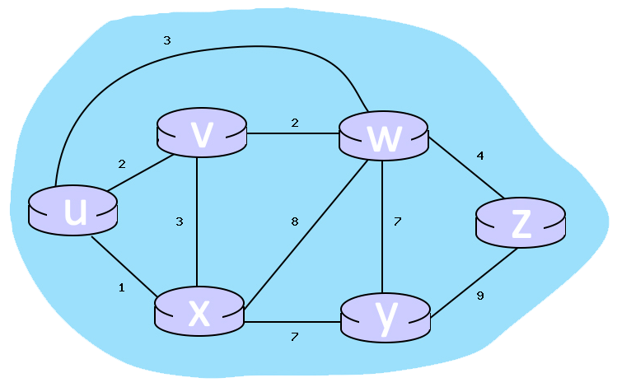
Interactive Exercises
Using Dijkstra's algorithm, find the least cost path from source node U to all other destinations
What is the shortest distance to node v/w/z and what is its predecessor?
D(v),
p(v)
D(w),
p(w)
D(x),
p(x)
D(y),
p(y)
D(z),
p(z)
Step
N'

Slide 30
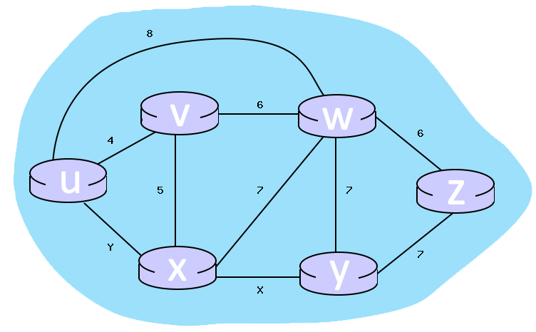
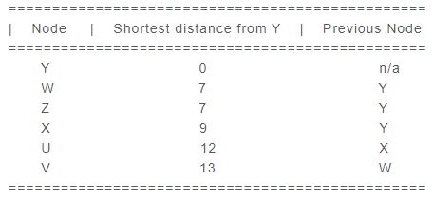
Interactive Exercises
Consider the completed table below, which calculates the shortest distance to all nodes from y
What is the cost associated with link X/Y?

