Slide 1
Random access protocols
when node has packet to send
transmit at full channel data rate R
no a priori coordination among nodes
two or more transmitting nodes: “collision”
random access protocol specifies:
how to detect collisions
how to recover from collisions (e.g., via delayed retransmissions)
examples of random access MAC protocols:
ALOHA, slotted ALOHA
CSMA, CSMA/CD, CSMA/CA

Slide 2
Slotted ALOHA
operation:
when node obtains fresh frame, transmits in next slot
if no collision: node can send new frame in next slot
if collision: node retransmits frame in each subsequent slot with probability p until success
t₀
t₀+1
assumptions:
all frames same size
time divided into equal size slots (time to transmit 1 frame)
nodes start to transmit only slot beginning
nodes are synchronized
if 2 or more nodes transmit in slot, all nodes detect collision
randomization – why?

Slide 3
Slotted ALOHA
node 1
1
1
1
1
C: collision
S: success
E: empty
node 2
2
2
2
node 3
3
3
3
C
E
C
S
E
C
E
S
S
Pros:
single active node can continuously transmit at full rate of channel
highly decentralized: only slots in nodes need to be in sync
simple
Cons:
collisions, wasting slots
idle slots
nodes may be able to detect collision in less than time to transmit packet
clock synchronization

Slide 4

Slotted ALOHA: efficiency
efficiency: long-run fraction of successful slots (many nodes, all with many frames to send)
suppose: N nodes with many frames to send, each transmits in slot with probability p
prob that given node has success in a slot = p(1-p)^{N-1}
prob that any node has a success = Np(1-p)^{N-1}
max efficiency: find p* that maximizes Np(1-p)^{N-1}
for many nodes, take limit of Np*(1-p*)^{N-1} as N goes to infinity, gives:
max efficiency = 1/e = .37
at best: channel used for useful transmissions 37% of time!

Slide 5
Pure ALOHA
unslotted Aloha: simpler, no synchronization
when frame first arrives: transmit immediately
collision probability increases with no synchronization:
frame sent at t₀ collides with other frames sent in [t₀-1,t₀+1]
will overlap
with start of
i’s frame
will overlap
with end of
i’s frame
t₀ - 1
t₀
t₀ + 1
pure Aloha efficiency: 18% !

Slide 6
Interactive Exercises
There are 3 active nodes, each of which has an infinite supply of frames they want to transmit
For slotted ALOHA, given a probability of transmission p = 0.34, what is the prob that any node has a success?

Slide 7
CSMA (carrier sense multiple access)
simple CSMA: listen before transmit:
if channel sensed idle: transmit entire frame
if channel sensed busy: defer transmission
human analogy: don’t interrupt others!
CSMA/CD: CSMA with collision detection
collisions detected within short time
colliding transmissions aborted, reducing channel wastage
human analogy: the polite conversationalist

Slide 8
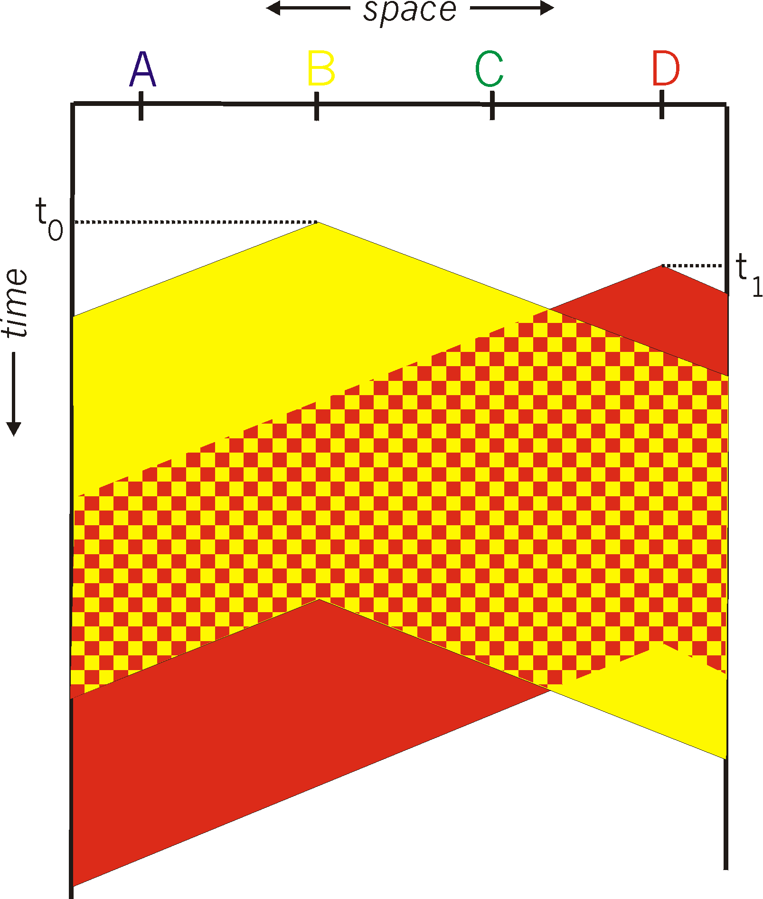

CSMA: collisions
spatial layout of nodes
collisions can still occur with carrier sensing:
propagation delay means two nodes may not hear each other’s just-started transmission
collision: entire packet transmission time wasted
distance & propagation delay play role in determining collision probability

Slide 9
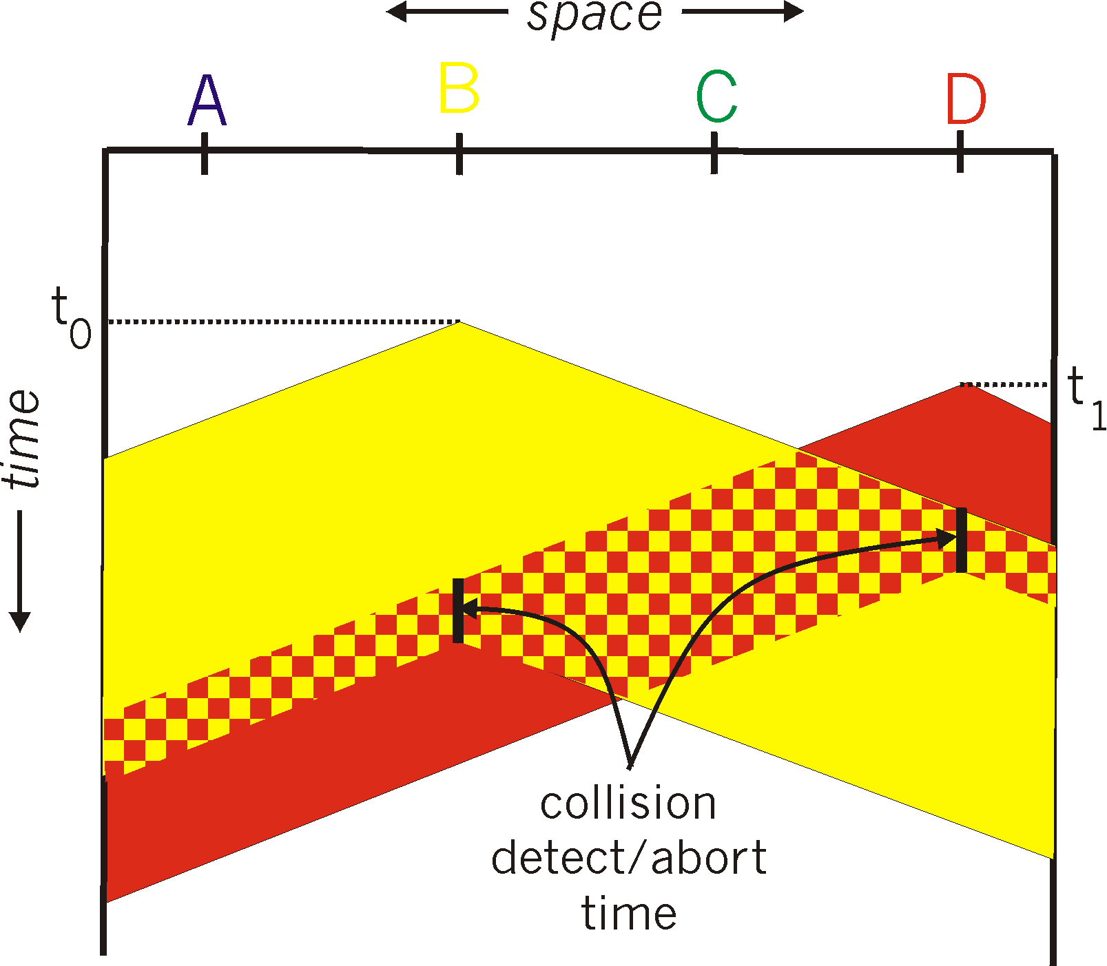
CSMA/CD:
spatial layout of nodes
CSMA/CD reduces the amount of time wasted in collisions
transmission aborted on collision detection

Slide 10
Ethernet CSMA/CD algorithm
Ethernet receives datagram from network layer, creates frame
If Ethernet senses channel:
if idle: start frame transmission.
if busy: wait until channel idle, then transmit
If entire frame transmitted without collision - done!
If another transmission detected while sending: abort, send jam signal
After aborting, enter binary (exponential) backoff:
after mth collision, chooses K at random from {0,1,2, …, 2^{m}-1}. Ethernet waits K·512 bit times, returns to Step 2
more collisions: longer backoff interval

Slide 11
CSMA/CD efficiency
t_{prop} = max prop delay between 2 nodes in LAN
t_{trans} = time to transmit max-size frame
efficiency goes to 1
as t_{prop} goes to 0
as t_{trans} goes to infinity
better performance than ALOHA: and simple, cheap, decentralized!

Slide 12
“Taking turns” MAC protocols
channel partitioning MAC protocols:
share channel efficiently and fairly at high load
inefficient at low load: delay in channel access, 1/N bandwidth allocated even if only 1 active node!
random access MAC protocols
efficient at low load: single node can fully utilize channel
high load: collision overhead
“taking turns” protocols
look for best of both worlds!

Slide 13

“Taking turns” MAC protocols
polling:
centralized controller “invites” other nodes to transmit in turn
concerns:
polling overhead
latency
single point of failure (master)
data
poll
centralized controller
data
client devices

Slide 14
“Taking turns” MAC protocols
T
token passing:
control token message explicitly passed from one node to next, sequentially
transmit while holding token
concerns:
token overhead
latency
single point of failure (token)
(nothing
to send)
T
data

Slide 15
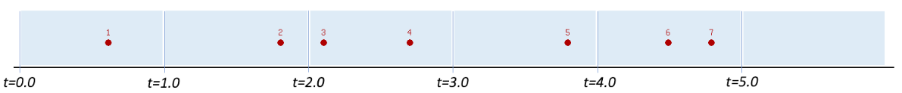
Interactive Exercises
This figure shows the arrival of 7 messages at different multiple access wireless nodes at t = <0.6, 1.8, 2.1, 2.7, 3.8, 4.5, 4.8>
Each transmission requires exactly one time unit
Ignore retransmission
Which messages transmit successfully in ALOHA?
Which messages transmit successfully in slotted ALOHA?

Slide 16
Interactive Exercises
This figure shows the arrival of 7 messages at different multiple access wireless nodes at t = <0.6, 1.8, 2.1, 2.7, 3.8, 4.5, 4.8>
Each transmission requires exactly one time unit
Ignore retransmission
Propagation delay is 0.4 time units: if a node begins transmitting a message at t=2.0, then any node sense the channel busy in the interval [2.4, 3.4]
Which messages transmit successfully in CSMA?

Slide 17

Link layer, LANs: roadmap
introduction
error detection, correction
multiple access protocols
LANs
addressing, ARP
Ethernet
switches
VLANs

Slide 18
MAC addresses
32-bit IP address:
network-layer address for interface
used for layer 3 (network layer) forwarding
e.g.: 128.119.40.136
MAC (or LAN or physical or Ethernet) address:
function: used “locally” to get frame from one interface to another physically-connected interface (same subnet, in IP-addressing sense)
48-bit MAC address (for most LANs) burned in NIC ROM, also sometimes software settable
e.g.: 1A-2F-BB-76-09-AD
hexadecimal (base 16) notation
(each “numeral” represents 4 bits)

Slide 19
MAC addresses
each interface on LAN
has unique 48-bit MAC address
has a locally unique 32-bit IP address (as we’ve seen)
137.196.7.78
1A-2F-BB-76-09-AD
LAN
(wired or wireless)
137.196.7/24
71-65-F7-2B-08-53
58-23-D7-FA-20-B0
137.196.7.23
137.196.7.14
0C-C4-11-6F-E3-98
137.196.7.88

Slide 20
MAC addresses
MAC address allocation administered by IEEE
manufacturer buys portion of MAC address space (to assure uniqueness)
analogy:
MAC address: like Social Security Number
IP address: like postal address
MAC flat address: portability
can move interface from one LAN to another
recall IP address not portable: depends on IP subnet to which node is attached

Slide 21
ARP: address resolution protocol
Question: how to determine interface’s MAC address, knowing its IP address?
ARP table: each IP node (host, router) on LAN has table
ARP
137.196.7.78
IP/MAC address mappings for some LAN nodes:
< IP address; MAC address; TTL>
TTL (Time To Live): time after which address mapping will be forgotten (typically 20 min)
1A-2F-BB-76-09-AD
ARP
ARP
LAN
71-65-F7-2B-08-53
58-23-D7-FA-20-B0
137.196.7.23
137.196.7.14
ARP
0C-C4-11-6F-E3-98
137.196.7.88

Slide 22
ARP protocol in action
example: A wants to send datagram to B
B’s MAC address not in A’s ARP table, so A uses ARP to find B’s MAC address
A broadcasts ARP query, containing B's IP addr
destination MAC address = FF-FF-FF-FF-FF-FF
all nodes on LAN receive ARP query
1
Ethernet frame (sent to FF-FF-FF-FF-FF-FF)
C
Source MAC: 71-65-F7-2B-08-53
Source IP: 137.196.7.23
Target IP address: 137.196.7.14
…
ARP table in A
IP addr
MAC addr
TTL
TTL
A
B
1
71-65-F7-2B-08-53
58-23-D7-FA-20-B0
137.196.7.23
137.196.7.14
D

Slide 23
ARP protocol in action
example: A wants to send datagram to B
B’s MAC address not in A’s ARP table, so A uses ARP to find B’s MAC address
ARP message into Ethernet frame (sent to 71-65-F7-2B-08-53)
C
Target IP address: 137.196.7.14
Target MAC address:
58-23-D7-FA-20-B0
…
ARP table in A
IP addr
MAC addr
TTL
TTL
A
B
2
71-65-F7-2B-08-53
58-23-D7-FA-20-B0
137.196.7.23
137.196.7.14
2
B replies to A with ARP response, giving its MAC address
D

Slide 24
ARP protocol in action
example: A wants to send datagram to B
B’s MAC address not in A’s ARP table, so A uses ARP to find B’s MAC address
C
ARP table in A
IP addr
MAC addr
TTL
TTL
A
B
137.196.
7.14
58-23-D7-FA-20-B0
500
71-65-F7-2B-08-53
58-23-D7-FA-20-B0
137.196.7.23
137.196.7.14
3
A receives B’s reply, adds B entry into its local ARP table
D

Slide 25

Routing to another subnet: addressing
walkthrough: sending a datagram from A to B via R
focus on addressing – at IP (datagram) and MAC layer (frame) levels
assume that:
A knows B’s IP address
A knows IP address of first hop router, R (how?)
A knows R’s MAC address (how?)
A
R
B
111.111.111.111
74-29-9C-E8-FF-55
222.222.222.222
49-BD-D2-C7-56-2A
222.222.222.220
1A-23-F9-CD-06-9B
111.111.111.112
111.111.111.110
CC-49-DE-D0-AB-7D
E6-E9-00-17-BB-4B
222.222.222.221
88-B2-2F-54-1A-0F

Slide 26
Routing to another subnet: addressing
A creates IP datagram with IP source A, destination B
A creates link-layer frame containing A-to-B IP datagram
R's MAC address is frame’s destination
MAC src: 74-29-9C-E8-FF-55
MAC dest: E6-E9-00-17-BB-4B
IP
Eth
Phy
IP src: 111.111.111.111
IP dest: 222.222.222.222
A
R
B
111.111.111.111
74-29-9C-E8-FF-55
222.222.222.222
49-BD-D2-C7-56-2A
222.222.222.220
1A-23-F9-CD-06-9B
111.111.111.112
111.111.111.110
CC-49-DE-D0-AB-7D
E6-E9-00-17-BB-4B
222.222.222.221
88-B2-2F-54-1A-0F

Slide 27
Routing to another subnet: addressing
frame sent from A to R
frame received at R, datagram removed, passed up to IP
MAC src: 74-29-9C-E8-FF-55
MAC dest: E6-E9-00-17-BB-4B
IP src: 111.111.111.111
IP dest: 222.222.222.222
IP
Eth
Phy
IP src: 111.111.111.111
IP dest: 222.222.222.222
IP
Eth
Phy
A
R
B
111.111.111.111
74-29-9C-E8-FF-55
222.222.222.222
49-BD-D2-C7-56-2A
222.222.222.220
1A-23-F9-CD-06-9B
111.111.111.112
111.111.111.110
CC-49-DE-D0-AB-7D
E6-E9-00-17-BB-4B
222.222.222.221
88-B2-2F-54-1A-0F

Slide 28
Routing to another subnet: addressing
R determines outgoing interface, passes datagram with IP source A, destination B to link layer
R creates link-layer frame containing A-to-B IP datagram. Frame destination address: B's MAC address
MAC src: 1A-23-F9-CD-06-9B
MAC dest: 49-BD-D2-C7-56-2A
IP
Eth
Phy
IP src: 111.111.111.111
IP dest: 222.222.222.222
A
R
B
111.111.111.111
74-29-9C-E8-FF-55
222.222.222.222
49-BD-D2-C7-56-2A
222.222.222.220
1A-23-F9-CD-06-9B
111.111.111.112
111.111.111.110
CC-49-DE-D0-AB-7D
E6-E9-00-17-BB-4B
222.222.222.221
88-B2-2F-54-1A-0F

Slide 29
Routing to another subnet: addressing
R determines outgoing interface, passes datagram with IP source A, destination B to link layer
R creates link-layer frame containing A-to-B IP datagram. Frame destination address: B's MAC address
MAC src: 1A-23-F9-CD-06-9B
MAC dest: 49-BD-D2-C7-56-2A
transmits link-layer frame
IP
Eth
Phy
IP
Eth
Phy
IP src: 111.111.111.111
IP dest: 222.222.222.222
A
R
B
111.111.111.111
74-29-9C-E8-FF-55
222.222.222.222
49-BD-D2-C7-56-2A
222.222.222.220
1A-23-F9-CD-06-9B
111.111.111.112
111.111.111.110
CC-49-DE-D0-AB-7D
E6-E9-00-17-BB-4B
222.222.222.221
88-B2-2F-54-1A-0F

Slide 30
Routing to another subnet: addressing
B receives frame, extracts IP datagram destination B
B passes datagram up protocol stack to IP
IP src: 111.111.111.111
IP dest: 222.222.222.222
IP
Eth
Phy
IP
Eth
Phy
A
R
B
111.111.111.111
74-29-9C-E8-FF-55
222.222.222.222
49-BD-D2-C7-56-2A
222.222.222.220
1A-23-F9-CD-06-9B
111.111.111.112
111.111.111.110
CC-49-DE-D0-AB-7D
E6-E9-00-17-BB-4B
222.222.222.221
88-B2-2F-54-1A-0F

Slide 31
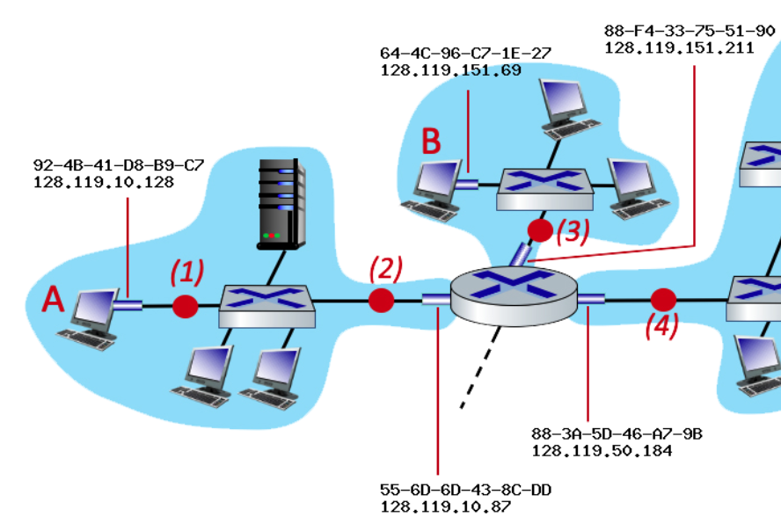
Interactive Exercises
The IP and MAC addresses are shown for nodes A, B, C and D, as well as for the router's interfaces
Consider an IP datagram being sent from A to B
What is the destination MAC address at point (1)?
What is the destination IP address at point (2)?
What is the source MAC address at point (3)?
What is the source MAC address at point (3)?

