Slide 1

Network layer: “data plane” roadmap
Network layer: overview
data plane
control plane
What’s inside a router
input ports, switching, output ports
buffer management, scheduling
IP: the Internet Protocol
datagram format
addressing
network address translation
IPv6
Generalized Forwarding, SDN
match+action
OpenFlow: match+action in action

Slide 2
IPv6: motivation
initial motivation: 32-bit IPv4 address space would be completely allocated
additional motivation:
speed processing/forwarding: 40-byte fixed length header
enable different network-layer treatment of “flows”

Slide 3
IPv6 datagram format
flow label: identify datagrams in same "flow.” (concept of “flow” not well defined).
32 bits
priority: identify priority among datagrams in flow
ver
pri
flow label
payload len
next hdr
hop limit
source address
(128 bits)
128-bit
IPv6 addresses
destination address
(128 bits)
2001:0DB8:FFFF:0000:0000:0D0C
payload (data)
What’s missing (compared with IPv4):
no checksum (to speed processing at routers)
no fragmentation/reassembly
no options (available as upper-layer, next-header protocol at router)

Slide 4
Transition from IPv4 to IPv6
not all routers can be upgraded simultaneously
no “flag days”
how will network operate with mixed IPv4 and IPv6 routers?
tunneling: IPv6 datagram carried as payload in IPv4 datagram among IPv4 routers (“packet within a packet”)
tunneling used extensively in other contexts (4G/5G)
IPv4 header fields
IPv6 header fields
IPv4 payload
IPv4 source, dest addr
IPv6 source dest addr
UDP/TCP payload
IPv6 datagram
IPv4 datagram

Slide 5
Tunneling and encapsulation
Ethernet connecting two IPv6 routers:
A
B
Ethernet connects two IPv6 routers
E
F
IPv6
IPv6
IPv6
IPv6
IPv6 datagram
Link-layer frame
The usual: datagram as payload in link-layer frame
IPv4 network connecting two IPv6 routers
A
B
E
F
IPv6
IPv6/v4
IPv6/v4
IPv6
IPv4 network

Slide 6
Tunneling and encapsulation
Ethernet connecting two IPv6 routers:
A
B
Ethernet connects two IPv6 routers
E
F
IPv6
IPv6
IPv6
IPv6
IPv6 datagram
Link-layer frame
The usual: datagram as payload in link-layer frame
IPv4 tunnel connecting two IPv6 routers
A
B
IPv4 tunnel
connecting IPv6 routers
E
F
IPv6
IPv6/v4
IPv6/v4
IPv6
IPv6 datagram
IPv4 datagram
tunneling: IPv6 datagram as payload in a IPv4 datagram

Slide 7
Tunneling
A
B
IPv4 tunnel
connecting IPv6 routers
E
F
logical view:
IPv6
IPv6/v4
IPv6/v4
IPv6
A
B
C
D
E
F
physical view:
IPv6
IPv6/v4
IPv4
IPv4
IPv6/v4
IPv6
flow: X
src: A
dest: F
data
src:B
dest: E
src:B
dest: E
src:B
dest: E
flow: X
src: A
dest: F
data
Flow: X
Src: A
Dest: F
data
Flow: X
Src: A
Dest: F
data
Flow: X
Src: A
Dest: F
data
Note source and destination addresses!
A-to-B:
IPv6
B-to-C:
IPv6 inside
IPv4
B-to-C:
IPv6 inside
IPv4
B-to-C:
IPv6 inside
IPv4
E-to-F:
IPv6

Slide 8
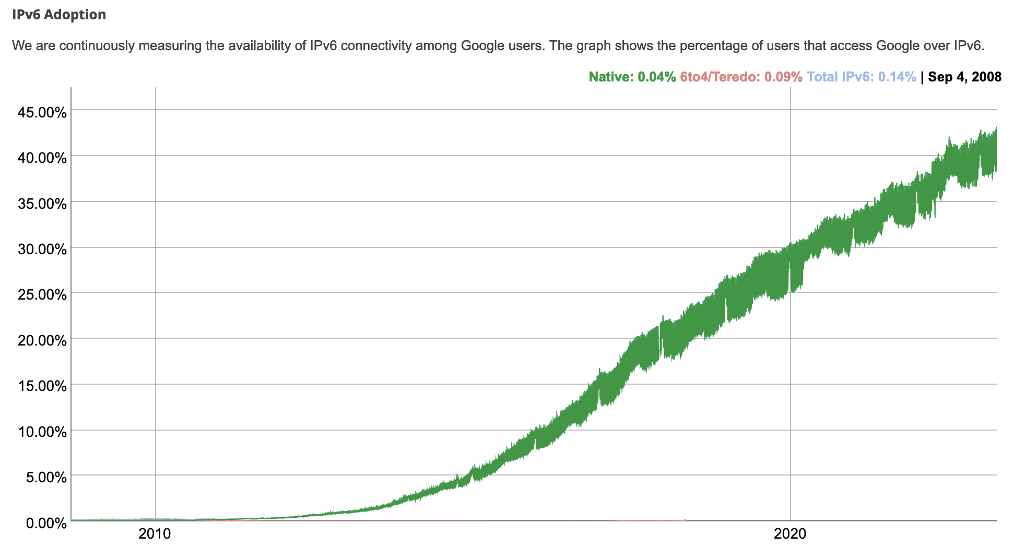
IPv6: adoption
Google¹: ~ 40% of clients access services via IPv6 (2023)
NIST: 1/3 of all US government domains are IPv6 capable

Slide 9
IPv6: adoption
Google¹: ~ 40% of clients access services via IPv6 (2023)
NIST: 1/3 of all US government domains are IPv6 capable
Long (long!) time for deployment, use
25 years and counting!
think of application-level changes in last 25 years: WWW, social media, streaming media, gaming, telepresence, …
Why?
¹ https://www.google.com/intl/en/ipv6/statistics.html

Slide 10
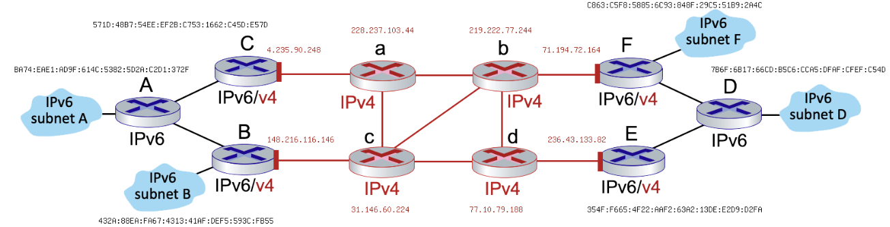
Interactive Exercises
IPv6 tunneling & encapsulation
Suppose that a host of subnet B wants to send an IPv6 datagram to a host on subnet F. Assume that the forwarding between these two hosts goes along the path: B --> c --> b --> F
Is the datagram being forwarded from B to c an IPv4 or IPv6 datagram?
What is the source address of this B to c datagram?
What is the destination address of this B to c datagram?

Slide 11
Network layer: “data plane” roadmap
Network layer: overview
data plane
control plane
What’s inside a router
input ports, switching, output ports
buffer management, scheduling
IP: the Internet Protocol
datagram format
addressing
network address translation
IPv6
Generalized Forwarding, SDN
Match+action
OpenFlow: match+action in action

Slide 12
Generalized forwarding: match plus action
Review: each router contains a forwarding table
“match plus action” abstraction: match bits in arriving packet, take action
(aka: flow table)
destination-based forwarding: forward based on dest. IP address
generalized forwarding:
many header fields can determine action
many action possible: drop/copy/modify/log packet
forwarding table
(aka: flow table)
values in arriving
packet header
0111
1
3
2

Slide 13
Flow table abstraction
flow: defined by header field values (in link-, network-, transport-layer fields)
generalized forwarding: simple packet-handling rules
match: pattern values in packet header fields
actions: for matched packet: drop, forward, modify matched packet or send matched packet to controller
priority: disambiguate overlapping patterns
counters: #bytes and #packets
Flow table
Router’s flow table define router’s match+action rules
match
action

Slide 14
Flow table abstraction
flow: defined by header fields
generalized forwarding: simple packet-handling rules
match: pattern values in packet header fields
actions: for matched packet: drop, forward, modify, matched packet or send matched packet to controller
priority: disambiguate overlapping patterns
counters: #bytes and #packets
src = *.*.*.*, dest=3.4.*.* forward(2)
Flow table
match
action
src=1.2.*.*, dest=*.*.*.* drop
src=10.1.2.3, dest=*.*.*.* send to controller
* : wildcard
1
4
3
2

Slide 15
OpenFlow: flow table entries
Match
Action
Stats
Packet + byte counters
Forward packet to port(s)
Drop packet
Modify fields in header(s)
Encapsulate and forward to controller
Header fields to match:
Ingress Port
Src MAC
Dst MAC
Eth Type
VLAN
ID
VLAN
Pri
IP Src
IP Dst
IP Proto
IP
ToS
TCP/UDP Src Port
TCP/UDP Dst Port
Link layer
Network layer
Transport layer

Slide 16
OpenFlow: examples
Destination-based forwarding:
Switch
Port
MAC
src
MAC
dst
Eth
type
VLAN
ID
VLAN
Pri
IP
Src
IP
Dst
IP
Prot
IP
ToS
TCP
s-port
TCP
d-port
Action
*
*
*
*
*
*
*
51.6.0.8
*
*
*
*
port6
IP datagrams destined to IP address 51.6.0.8 should be forwarded to router output port 6
Firewall:
Switch
Port
MAC
src
MAC
dst
Eth
type
VLAN
ID
VLAN
Pri
IP
Src
IP
Dst
IP
Prot
IP
ToS
TCP
s-port
TCP
d-port
Action
*
*
*
*
*
*
*
*
*
*
*
22
drop
Block (do not forward) all datagrams destined to TCP port 22 (ssh port #)
Switch
Port
MAC
src
MAC
dst
Eth
type
VLAN
ID
VLAN
Pri
IP
Src
IP
Dst
IP
Prot
IP
ToS
TCP
s-port
TCP
d-port
Action
*
*
*
*
*
*
128.119.1.1
*
*
*
*
*
drop
Block (do not forward) all datagrams sent by host 128.119.1.1

Slide 17
OpenFlow: examples
Layer 2 destination-based forwarding:
Switch
Port
MAC
src
MAC
dst
Eth
type
VLAN
ID
VLAN
Pri
IP
Src
IP
Dst
IP
Prot
IP
ToS
TCP
s-port
TCP
d-port
Action
*
*
22:A7:23:
11:E1:02
*
*
*
*
*
*
*
*
*
port3
layer 2 frames with destination MAC address 22:A7:23:11:E1:02 should be forwarded to output port 3

Slide 18
OpenFlow abstraction
match+action: abstraction unifies different kinds of devices
Router
match: longest destination IP prefix
action: forward out a link
Switch
match: destination MAC address
action: forward or flood
Firewall
match: IP addresses and TCP/UDP port numbers
action: permit or deny
NAT
match: IP address and port
action: rewrite address and port

Slide 19


OpenFlow example
Orchestrated tables can create network-wide behavior, e.g.,:
datagrams from hosts h5 and h6 should be sent to h3 or h4, via s1 and from there to s2
Host h6
10.3.0.6
1
s3
controller
2
3
4
Host h5
10.3.0.5
1
s1
s2
Host h1
10.1.0.1
1
2
Host h4
10.2.0.4
4
2
4
3
3
Host h2
10.1.0.2
Host h3
10.2.0.3

Slide 20
OpenFlow example
match
action
Orchestrated tables can create network-wide behavior, e.g.,:
datagrams from hosts h5 and h6 should be sent to h3 or h4, via s1 and from there to s2
IP Src = 10.3.*.*
IP Dst = 10.2.*.*
Host h6
10.3.0.6
forward(3)
1
s3
controller
2
3
4
Host h5
10.3.0.5
1
s1
s2
Host h1
10.1.0.1
1
2
Host h4
10.2.0.4
4
2
4
3
3
match
action
match
action
Host h2
10.1.0.2
Host h3
10.2.0.3
ingress port = 2
IP Dst = 10.2.0.3
ingress port = 2
IP Dst = 10.2.0.4
ingress port = 1
IP Src = 10.3.*.*
IP Dst = 10.2.*.*
forward(3)
forward(4)
forward(4)

Slide 21
Problems
P21. Specify the flow table entries in s2 that implement this behaviors:
Any datagrams arriving on input port 1 from hosts h5 or h6 that are destined to hosts h1 or h2 should be forwarded over output port 2
Any datagrams arriving on input port 2 from hosts h1 or h2 that are destined to hosts h5 or h6 should be forwarded over output port 1
Host h6
10.3.0.6
1
s3
controller
2
3
4
Host h5
10.3.0.5
match
action
Host h4
10.2.0.4
1
s1
s2
Host h1
10.1.0.1
1
2
4
4
2
3
3
Host h2
10.1.0.2
Host h3
10.2.0.3

Slide 22
Problems
P22. Specify the flow table entries in s2 that implement this behaviors:
Any datagrams arriving from h3 and destined for h1, h2, h5, or h6 should be forwarded in a clockwise direction in the network
Any datagrams arriving from h4 and destined to h1, h2, h5, or h6 should be forwarded in a counter-clockwise direction in the network
Host h6
10.3.0.6
1
s3
controller
2
3
4
Host h5
10.3.0.5
match
action
Host h4
10.2.0.4
1
s1
s2
Host h1
10.1.0.1
1
2
4
4
2
3
3
Host h2
10.1.0.2
Host h3
10.2.0.3

Slide 23
Generalized forwarding: summary
“match plus action” abstraction: match bits in arriving packet header(s) in any layers, take action
matching over many fields (link-, network-, transport-layer)
local actions: drop, forward, modify, or send matched packet to controller
“program” network-wide behaviors
simple form of “network programmability”
programmable, per-packet “processing”
historical roots: active networking
today: more generalized programming: P4 (Programming Protocol-independent Packet Processors)

Slide 24
Chapter 4: done!
Network layer: overview
What’s inside a router
IP: the Internet Protocol
Generalized Forwarding, SDN
Question: how are forwarding tables (destination-based forwarding) or flow tables (generalized forwarding) computed?
Answer: by the control plane (next chapter)

