Slide 1
IoT-Enabled Distributed SCADA & Machine Learning-Based Predictive Anomaly Detection for Multi-Process Industrial Systems
Developed By
Eklavya Vaid (B117), B.Tech (CE)
Arka Dhamani (A103), B.Tech (IT)
Krishna Solanki (I075), MBA Tech (IT)
Under the Guidance of
Dr. Dattatray Sawant
Sem : V Subject : SCADA
B Tech CE / IT | MBA Tech (IT)
Academic Year : 2026 - 2027
Notes:
Introduce the team and the project: a four-layer SCADA testbed with an ESP32 edge node, LabVIEW supervision, a Python intelligence layer and a web digital twin.

Slide 2
Aim & Objectives
1
Edge node
Aim
ESP32 reads 6 sensors, drives 3 actuators, serves Modbus TCP with fail-safe interlocks
Build a low-cost SCADA testbed that keeps a multi-hazard process safe with deterministic interlocks and adds machine learning that spots developing faults before they cause a trip.
2
Supervision
LabVIEW polls the node and exchanges JSON with the Python bridge
3
Intelligence
Advisory ML: anomalies, fault class, pump health, gas calibration, forecasts
4
Visibility
Web HMI with a 3D digital twin, alerts and a detection log
Notes:
Aim: catch developing faults before they cause a trip, while keeping safety rule-based. Walk through the four objectives, one per layer.

Slide 3
Four-Layer System Architecture
Layer 1 · ESP32 edge node
Level, temperature, gas, current, ambient, supply voltage · pump, valve, fan · local interlocks · Modbus TCP server
Modbus TCP
Layer 2 · LabVIEW SCADA
Layer 3 · Python bridge
Modbus master, scaling, alarms, operator HMI, HTTP JSON client
Validation, rule-based safety, ML engine, alerts and logs
REST / WebSocket
Layer 4 · Web HMI & digital twin
3D workbench, live predictions, alert pop-ups, detection log
Safety stays rule-based: the same thresholds run on the ESP32 and in the bridge. ML only raises alerts and advice, never switches an actuator.
Notes:
Data flows ESP32 -> LabVIEW (Modbus TCP) -> Python bridge (HTTP JSON) -> web HMI. Commands flow back down. Safety is enforced in the ESP32 and the bridge; ML is advisory.

Slide 4
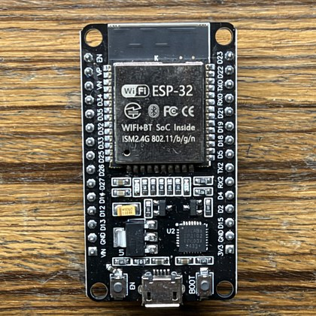
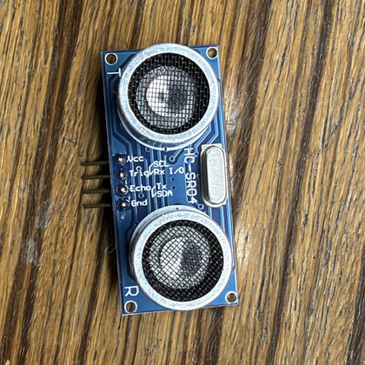
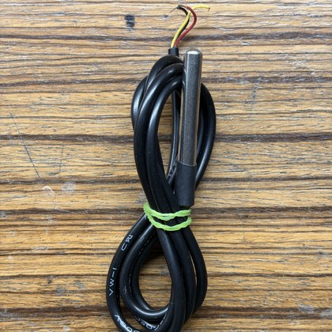
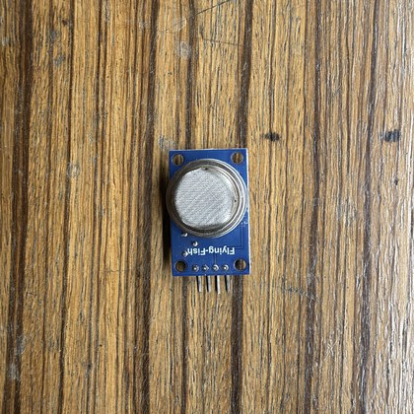
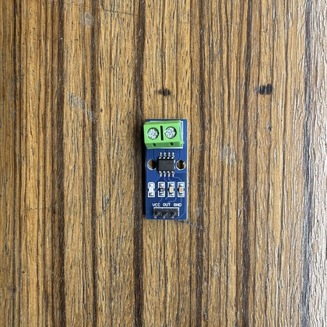
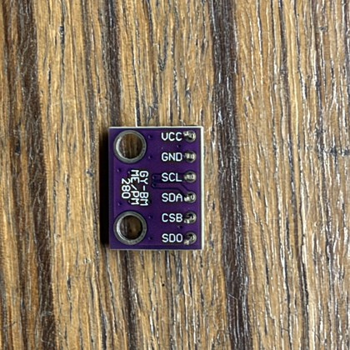
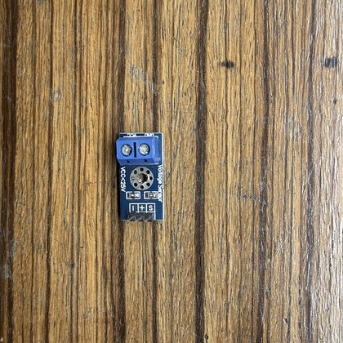
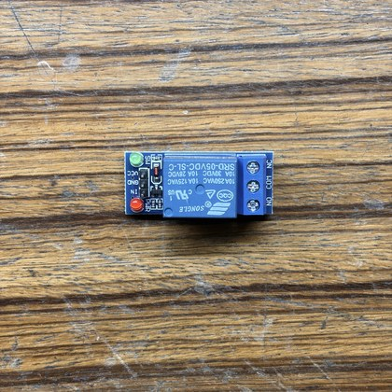
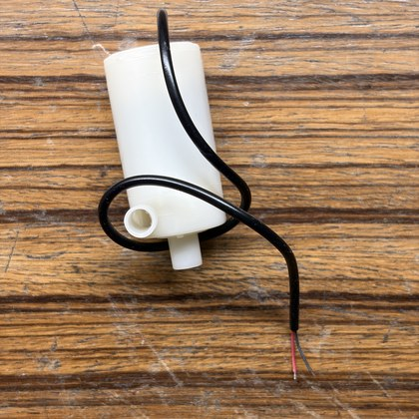
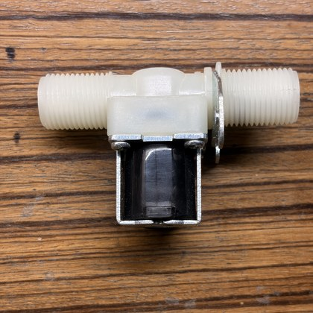
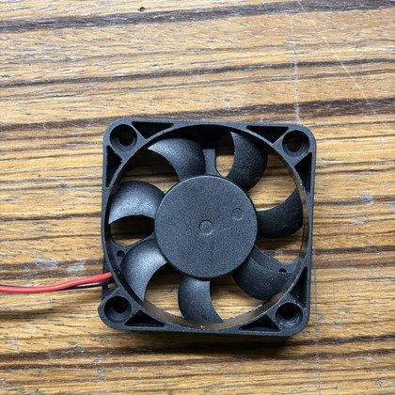
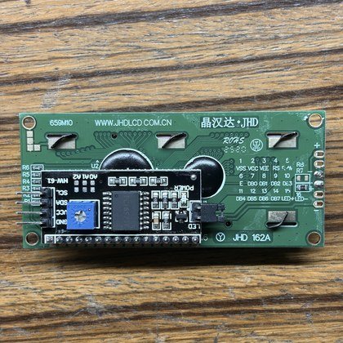
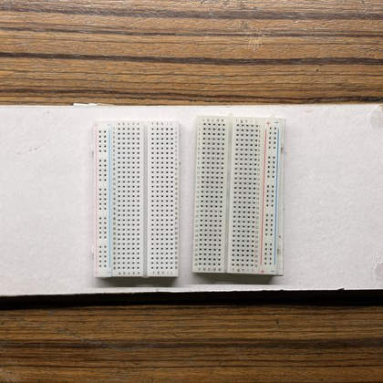
Components used in Hardware
ESP32 DevKit V1
HC-SR04 level
DS18B20 temp
MQ-2 gas
ACS712 current
BME280 ambient
0-25 V sensor
Relay module
Submersible pump
Solenoid valve
40 mm fan
16x2 I2C LCD
Breadboards
Notes:
Thirteen parts make up the as-built rig. Sensors on the top rows, actuators and HMI below. The pump is a 12 V / 5 V mini centrifugal pump (about 0.1-0.5 A).

Slide 5
Hardware Connections: ESP32 Pin Map
GPIO | Connected to
34 | HC-SR04 ECHO (1k/1.5k divider)
25 | HC-SR04 TRIG
4 | DS18B20 data (4.7 kΩ pull-up)
32 | MQ-2 AO (divider)
33 | ACS712 OUT
35 | 0-25 V sensor S
21 / 22 | I2C: LCD + BME280
GPIO | Connected to
26 | Pump relay IN
27 | Drain valve driver
14 | Exhaust fan driver
23 | Green LED (healthy)
13 | Red LED (alarm)
2, 12, 15 | Kept free (boot pins)
TX0 / RX0 | Kept free (USB flashing)
Power: 5 V 2 A rail for logic, sensors, relay and LCD; separate 12 V 2-3 A rail for pump, valve and fan; common ground. ESP32 3.3 V feeds the BME280 and DS18B20. Flyback diodes on the valve and fan coils.
Notes:
Boot-strapping pins 2, 12 and 15 are left free; the LEDs were moved to 23 and 13 for that reason. All 5 V signals into the ESP32 go through dividers.

Slide 6
Hardware Setup & Integration Status
[TO ADD] Insert photo of the assembled hardware rig
Integration checklist
✓
Power rails, 12 V barrel jack
✓
HC-SR04, MQ-2, BME280
✓
ACS712, voltage sensor
✓
Pump relay, LCD, status LEDs
DS18B20 4.7 kΩ pull-up
Valve + fan driver wiring
MQ-2 R0, tank depth, divider ratios
Wi-Fi credentials, node IP
Notes:
Most wiring is verified. Remaining: DS18B20 pull-up, valve and fan driver wiring, and the calibration constants in the firmware. Replace the box with a photo of the assembled rig.

Slide 7
ESP32 Firmware & Fail-Safe Interlocks
Condition | Action | LED
Tank ≥ 88 %, gas ≥ 250 ppm, temp ≥ 70 °C or current ≥ 3.8 A | Master trip: pump off, drain opens on overflow | Red strobe
Sensor faulty or MQ-2 warming up | Fail-safe: pump off, fan on while gas unknown | Red solid
Gas > 80 ppm | Exhaust fan on (off below 45 ppm) | —
Tank ≤ 25 %, all sensors healthy | Auto refill: pump on, valve closed | Green
Real conversions
Non-blocking
Builds
ACS712 (V - V0)/185 mV/A with boot zero; MQ-2 LPG curve
DS18B20 converts in the background so Modbus stays responsive
Board + Wokwi targets · 14.9 % RAM · 81.7 % flash
Notes:
The firmware trips on hard limits and also fails safe on any sensor fault: a dead sensor writes 0x7FFF so the bridge can never mistake it for a real reading.

Slide 8
Modbus TCP Register Map
Address | Signal | Scaling
40001 | Tank level | ÷10 → %
40002 | Process temperature (signed) | ÷10 → °C
40003 | Gas concentration | ppm
40004 | Pump current | ÷100 → A
40005 | Ambient temperature (signed) | ÷10 → °C
40006 | Relative humidity | ÷10 → %RH
40007 | Pressure | ÷10 → hPa
40008 | Supply voltage | ÷100 → V
40009 | MQ-2 raw output | mV
00001-3 | Pump / valve / fan coils | Boolean
0x7FFF
Fault sentinel
Written instead of a reading when a sensor is faulty, missing or warming up. It is out of range for signed and unsigned reads, so the bridge rejects it and inhibits the pump.
Notes:
LabVIEW reads 9 holding registers and 3 coils from port 502, unit 1. Registers 40002 and 40005 are signed. 32767 means the sensor is faulty or warming up.

Slide 9
VI’s used in Front Panel
1
JKI Flat UI Controls
[TO ADD] Insert screenshot of the LabVIEW front panel
Flat gauges, indicators and switches
2
Waveform charts
Live trends of level, temperature, gas, current
3
Boolean indicators
Alarm lamps and actuator states
4
String indicator
Bridge recommendation and ML advisory
Notes:
Show the front panel: tank, temperature, gas and current indicators, alarm lamps and actuator switches. Replace the box with a screenshot of SCADA_Master_Controller.vi.

Slide 10
VI’s used in Block Diagram
1
NI Modbus Library
[TO ADD] Insert screenshot of the LabVIEW block diagram
TCP master: read 9 registers + 3 coils, write coils
2
Scaling & alarm logic
Engineering units, signed reads for 40002/40005
3
Flatten / Unflatten JSON
Telemetry cluster ↔ JSON packet
4
HTTP Client POST
Sends telemetry, receives actuator commands
Notes:
Walk through one polling cycle: open Modbus session, read registers and coils, scale, build the JSON packet, POST to the bridge, parse the reply and write the actuator coils.

Slide 11
Python Bridge: From Telemetry to Alerts
Validate
Safety rules
ML engine
Debounce
Alert & log
Reject bad or out-of-range data
HEALTHY / WARNING / TRIP + interlocks
5 advisory models
Raise after 4, clear after 8
HMI pop-up, events.csv
Endpoint | Purpose
POST /api/telemetry | LabVIEW packet in, health + actuator commands out
GET /api/predictions | Live ML predictions, alerts, model status
GET /api/alerts | Active alerts and detection history
POST /api/control | Operator command, subject to interlocks
Notes:
Every packet goes through the same pipeline. Invalid data trips to UNKNOWN immediately. Alerts need 4 consecutive detections to raise and 8 clean samples to clear.

Slide 12
Predictive Analytics: Five Models
1
Anomaly detection
Mode envelope + Isolation Forest
Is something off?
2
Fault classification
Random Forest, 24-sample window
Which of 9 faults is it?
3
Pump health
Gradient Boosting regressor
How worn is the pump (0-100)?
4
MQ-2 calibration
Gradient Boosting + datasheet
True ppm at this temperature and humidity?
5
Forecasting
Linear trend over ~60 samples
When will a limit be reached?
Notes:
Each model answers one operator question. None of them can switch an actuator. Gas compensation and forecasts work even before any training.

Slide 13
Why Two Anomaly Detectors
1.6%
false alarms per sample before debouncing
Envelope catches out-of-range dynamics; the forest is a second opinion on odd combinations of in-range readings.
Notes:
Isolation Forest alone missed nearly every fault: its splits stop at the edge of the training data, so readings far outside it are not isolated faster. The mode envelope measures distance from normal and catches them.

Slide 14
Machine Learning Results
96.0%
34% → 6%
0
fault classifier accuracy (sim)
MQ-2 error with T/RH compensation
false alerts in a 60 s normal live run
Notes:
Evaluated on held-out simulated episodes with a different seed. Overall fault accuracy is about 96 % on both profiles; the weakest classes are overheating (sim) and motor overload (rig).

Slide 15
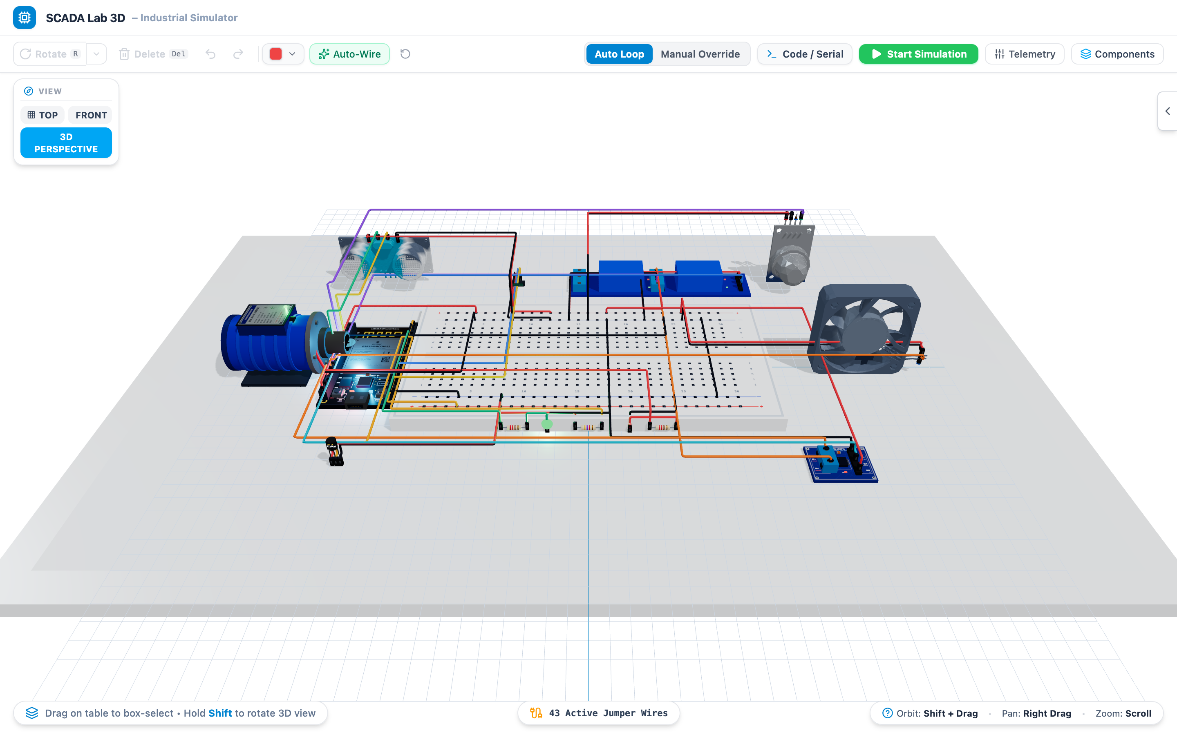
Digital Twin & Web HMI
[TO ADD] Insert screenshot of the Predict panel during a fault
3D workbench: CAD models, wiring check, firmware model, fault injection
Notes:
The 3D workbench mirrors the rig, validates wiring and runs the firmware model with fault injection. The Predict panel shows live predictions; alerts pop up from any view.

Slide 16
Testing & Validation
Completed
On the rig (pending)
Backend tests 15 / 15, frontend tests 15 / 15
Firmware builds for board and Wokwi
Live feeder run: dry run, gas leak, stuck relay, overload, worn pump all detected
Normal run: zero false alerts
Test | Result
Level vs ruler (±1 cm) | [TO ADD]
DS18B20 vs thermometer | [TO ADD]
ACS712 vs multimeter | [TO ADD]
LabVIEW 200 ms poll | [TO ADD]
Overflow / gas trip | [TO ADD]
Sensor-fault fail-safe | [TO ADD]
Alarm latency < 1 s | [TO ADD]
Notes:
Software and simulation testing is complete. Hardware validation is planned; fill in measured values after final wiring.

Slide 17
Conclusion & Future Scope
Conclusion
Future scope
Complete four-layer SCADA stack, firmware to web HMI
Rule-based safety on ESP32 and bridge
ML catches faults that never cross a threshold
Remaining: final wiring, calibration, on-rig tests
Retrain models on logged rig data
Calibrate MQ-2 against a reference meter
Scale to three nodes (gas/fire, electrical load)
Secure Modbus / VPN and HMI login
Time-series historian and trend views
Notes:
Close with what was delivered, what remains (final wiring, calibration, on-rig retraining) and where it can go next.

Slide 18
THANK YOU
Questions & Discussion
Notes:
Invite questions.

