Slide 1
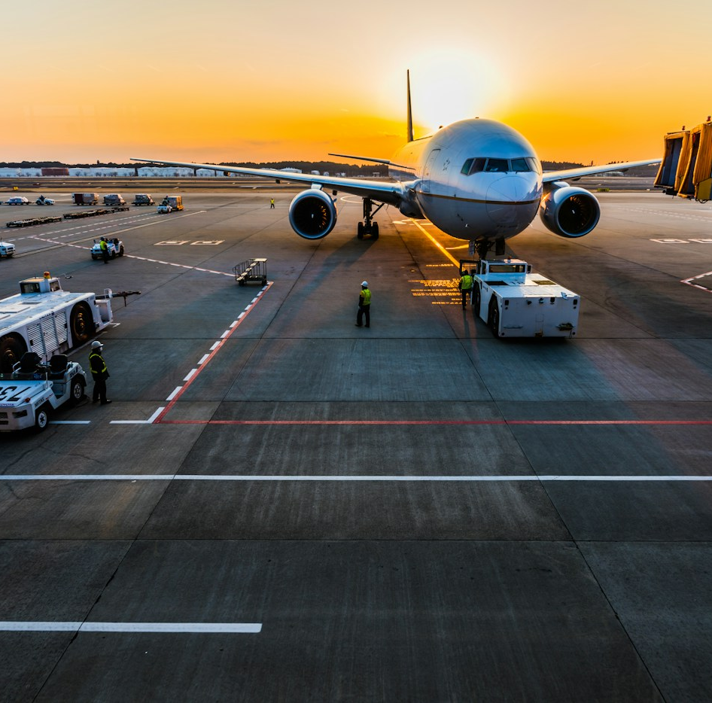

SAPHIRE
International Airport
Project team
Roles and module ownership
Software Engineering Project · October 2026
KS
Krishna Solanki
I075
Database & System Integration Lead
Saphire AOCS
PostgreSQL · Flyway · API integration
CT
Chaitanya Tikku
I078
Airport Operations Coordination System
Documentation, UML & QA Lead
SRS · UML diagrams · test suite
A full-stack platform that coordinates flight turnaround, gate assignment, check-in, baggage reconciliation, runway status and airline billing for one hub airport.
AT
Anuvrat Tripathi
I080
Frontend UI/UX Lead
React 19 · TypeScript · Material UI
43
158k+
16
109
AM
Anay Modi
I088
Backend API & Logic Lead
Relational tables
Seed records
Pages and consoles
Automated tests
Spring Boot 3 · security · dispatch logic
Submitted for evaluation · 5 October 2026

Slide 2

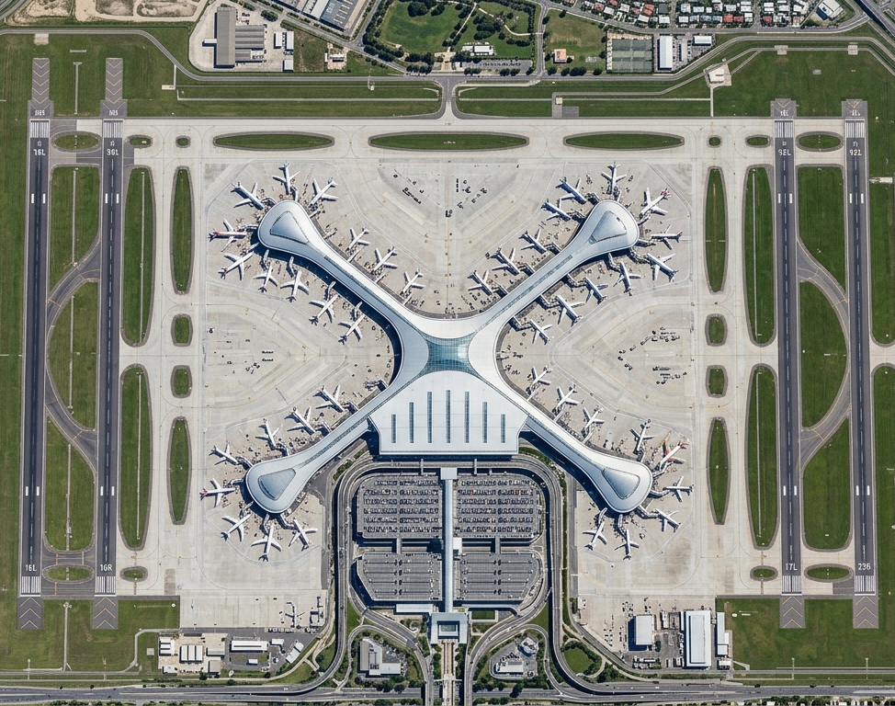




Domain
Domain analysis and aerodrome topology
The Saphire International Masterplan
Modelled on CSMIA Mumbai: an X-shaped terminal with radial concourse limbs and parallel runways
Terminal Topography
X-shaped central terminal with radial concourse limbs (Concourses A, B and C in the live data).
Gates & Stands
248 gates and 248 stands (71 remote), with boarding bridges, ground power and pre-conditioned air.
Parallel Runway System
Independent IFR arrivals and departures; each runway carries a live status such as CAT III.
Baggage Transit Corridors
Underground conveyors and tilt-tray sorters link check-in desks to aircraft stands.
Logistics & Cargo City
Multi-bay freight terminal with HAZMAT vaults and customs staging.
Aerial masterplan · Saphire International (SPH)
Saphire AOCS · Software Engineering Project 2026
02 / 22

Slide 3






Lab 01
Requirement analysis and problem formulation
Problem Definition & Operational Scope
Six pain points across traditional airport operations, and the platform that answers them
Operational Silos
Turnaround Bottlenecks
Gate Allocation Conflicts
Airlines, ground handlers, security and ATC run on separate systems, so updates arrive late and delays cascade.
Fuelling, catering, cleaning and baggage work have no shared schedule or real-time delay attribution.
Gates are assigned by hand without wingspan checks, risking unsafe stand use and clashes.
Baggage Tracing Gaps
Tariff Billing Leakage
Solution: Saphire AOCS
No end-to-end bag tag tracking from screening and sorting to the apron and reclaim belt.
Landing, parking and aerobridge fees are consolidated by hand, which leaks revenue and delays invoices.
One real-time A-CDM platform linking check-in, turnaround, security clearance and billing on a single relational core.
Saphire AOCS · Software Engineering Project 2026
03 / 22

Slide 4




Lab 01
Requirement analysis and agile specification
User Stories & Acceptance Criteria
Four primary personas, each story paired with testable acceptance criteria
AOCC
DCS
Airside
Public
AOCC Duty Controller
Check-In Agent
Airside Dispatcher
Passenger
“As an AOCC duty manager, I want live turnaround progress for every active flight, so I can spot delay risks early and log IATA delay codes.”
“As a check-in agent, I want to find a booking by PNR, choose a seat on the cabin map and tag bags, so I can issue a boarding pass.”
“As an airside officer, I want gate checks against aircraft wingspan, so a widebody is never parked at a gate that is too narrow.”
“As a passenger, I want live flight status, baggage tracking and online lost-and-found reports without needing an account.”
Acceptance criteria
Acceptance criteria
Acceptance criteria
Acceptance criteria
Progress per active flight
IATA delay codes on delays
Delay log on the AOCC board
Lookup by PNR or passport
Seat clash returns 409
BCBP barcode and bag tag
Wingspan vs gate limit
Conflicts rejected with 409
Live gate occupancy board
No login for public pages
Tracked inquiry tickets
Claimant contacts private
Saphire AOCS · Software Engineering Project 2026
04 / 22

Slide 5




Lab 01
System architectural specifications
Non-Functional Requirements
Targets for performance, availability, security and data integrity
Performance & Latency
350 ms
Availability & Scalability
99.9%
REST responses within 350 ms at 1,000 concurrent requests
Every paged endpoint capped at 100 rows
Indexes on foreign keys and common filter columns
Stateless Spring Boot services behind Nginx
Multi-stage Docker images and Docker Compose
Health endpoint for container checks
Security & Sessions
HS256
Data Integrity
3NF
Signed JWT carries a session ID checked on every request
One active session per user, revocable server-side
BCrypt password hashes, never serialised
43 tables in third normal form
ON DELETE RESTRICT on clearance and audit records
Unique seat per flight; wingspan checked per gate
Saphire AOCS · Software Engineering Project 2026
05 / 22

Slide 6
Lab 02
Software process methodology
Agile Scrum Process & Sprint Cadence
Five two-week sprints, from domain modelling to an integrated, tested release
1
2
3
4
5
Sprint 1 · Weeks 1-2
Sprint 2 · Weeks 3-4
Sprint 3 · Weeks 5-6
Sprint 4 · Weeks 7-8
Sprint 5 · Weeks 9-10
Domain & Relational Core
Backend Services & Auth
UI Scaffolding & Public Portal
Role Consoles & Workflows
Integration, Testing & Deploy
3NF relational schema
Flyway migrations V1 to V3
Aerodrome seed data
Spring Boot REST controllers
JWT and role-based access
Sessions and login lockout
React 19, TypeScript, Vite
7 public passenger pages
Website design tokens
9 staff dashboards
Check-in and boarding desk
AOCC turnaround board
Live API wiring end to end
109 automated tests
Docker Compose and CI
Schema live
Secured API
Portal online
Consoles ready
Release
Saphire AOCS · Software Engineering Project 2026
06 / 22

Slide 7
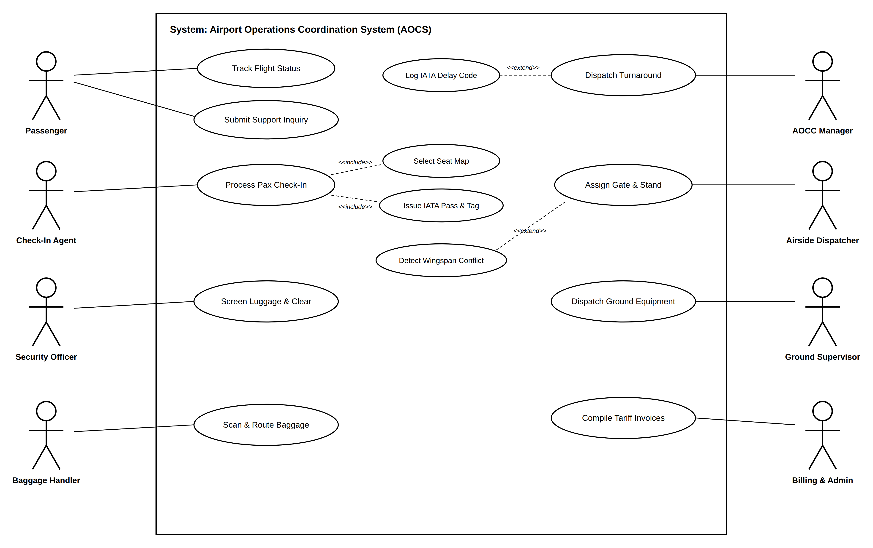
Lab 03
Object-oriented modelling
UML Use Case Model
One system boundary, eight actors and the include and extend relationships between use cases
Actors
8 actors · 10 RBAC roles in the database
Passenger
Check-in agent
Security officer
Baggage handler
AOCC manager
Airside dispatcher
Ground supervisor
Billing and admin
Relationships
«include»
Process Pax Check-In → Select Seat Map
«include»
Process Pax Check-In → Issue IATA Pass & Tag
«extend»
Detect Wingspan Conflict → Assign Gate & Stand
«extend»
Log IATA Delay Code → Dispatch Turnaround
Saphire AOCS · Software Engineering Project 2026
07 / 22

Slide 8
Lab 03
Use case specifications
Use Case Specifications
Actors, preconditions, main flow, postconditions and the exception path for two core operations
UC-05
DCS Check-In
UC-03
Gate Allocation
Actor
Check-in agent (CHECKIN_AGENT role)
Actor
Airside dispatcher or AOCC manager
Preconditions
Flight is SCHEDULED or BOARDING; the counter is assigned
Preconditions
Flight is scheduled; the target gate is active
Main flow
Dispatcher selects a flight and a target gate
System locks the gate row, then the flight row
Aircraft wingspan is checked against the gate limit
Time window is checked against flights at that gate
gate_id is saved on the flight
Main flow
Agent searches by PNR or passport number
System returns the traveller and flight segment
Agent picks a free seat on the cabin map
System saves the pass: ticket number and IATA BCBP barcode data
Agent tags each bag: 10-digit tag and a check-in scan event
Postconditions
Gate saved on the flight; boards update
Postconditions
Seat taken, boarding pass issued, bags tagged and scanned
Exception E1 Seat already taken: HTTP 409 Conflict and nothing is saved
Exception E1 Aircraft too wide or slot overlap: HTTP 409 Conflict
Saphire AOCS · Software Engineering Project 2026
08 / 22

Slide 9
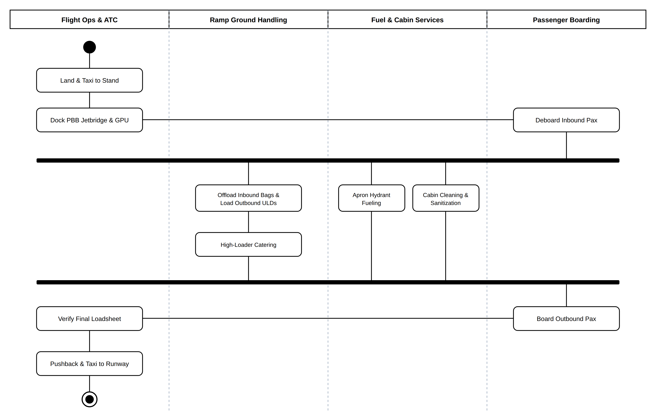
Lab 04
Behavioural and workflow modelling
Activity Diagram: Aircraft Turnaround
The critical path, with a fork into four parallel servicing streams and a join before boarding
Critical path
1
Arrival
Land, taxi to stand, dock the jet bridge and ground power, deboard.
2
Fork: parallel servicing
Bags, catering, refuelling and cabin cleaning run at the same time.
3
Join: synchronisation
Boarding starts only after every servicing task is COMPLETED.
4
Departure
Board, verify the final loadsheet, push back and taxi.
Saphire AOCS · Software Engineering Project 2026
09 / 22

Slide 10
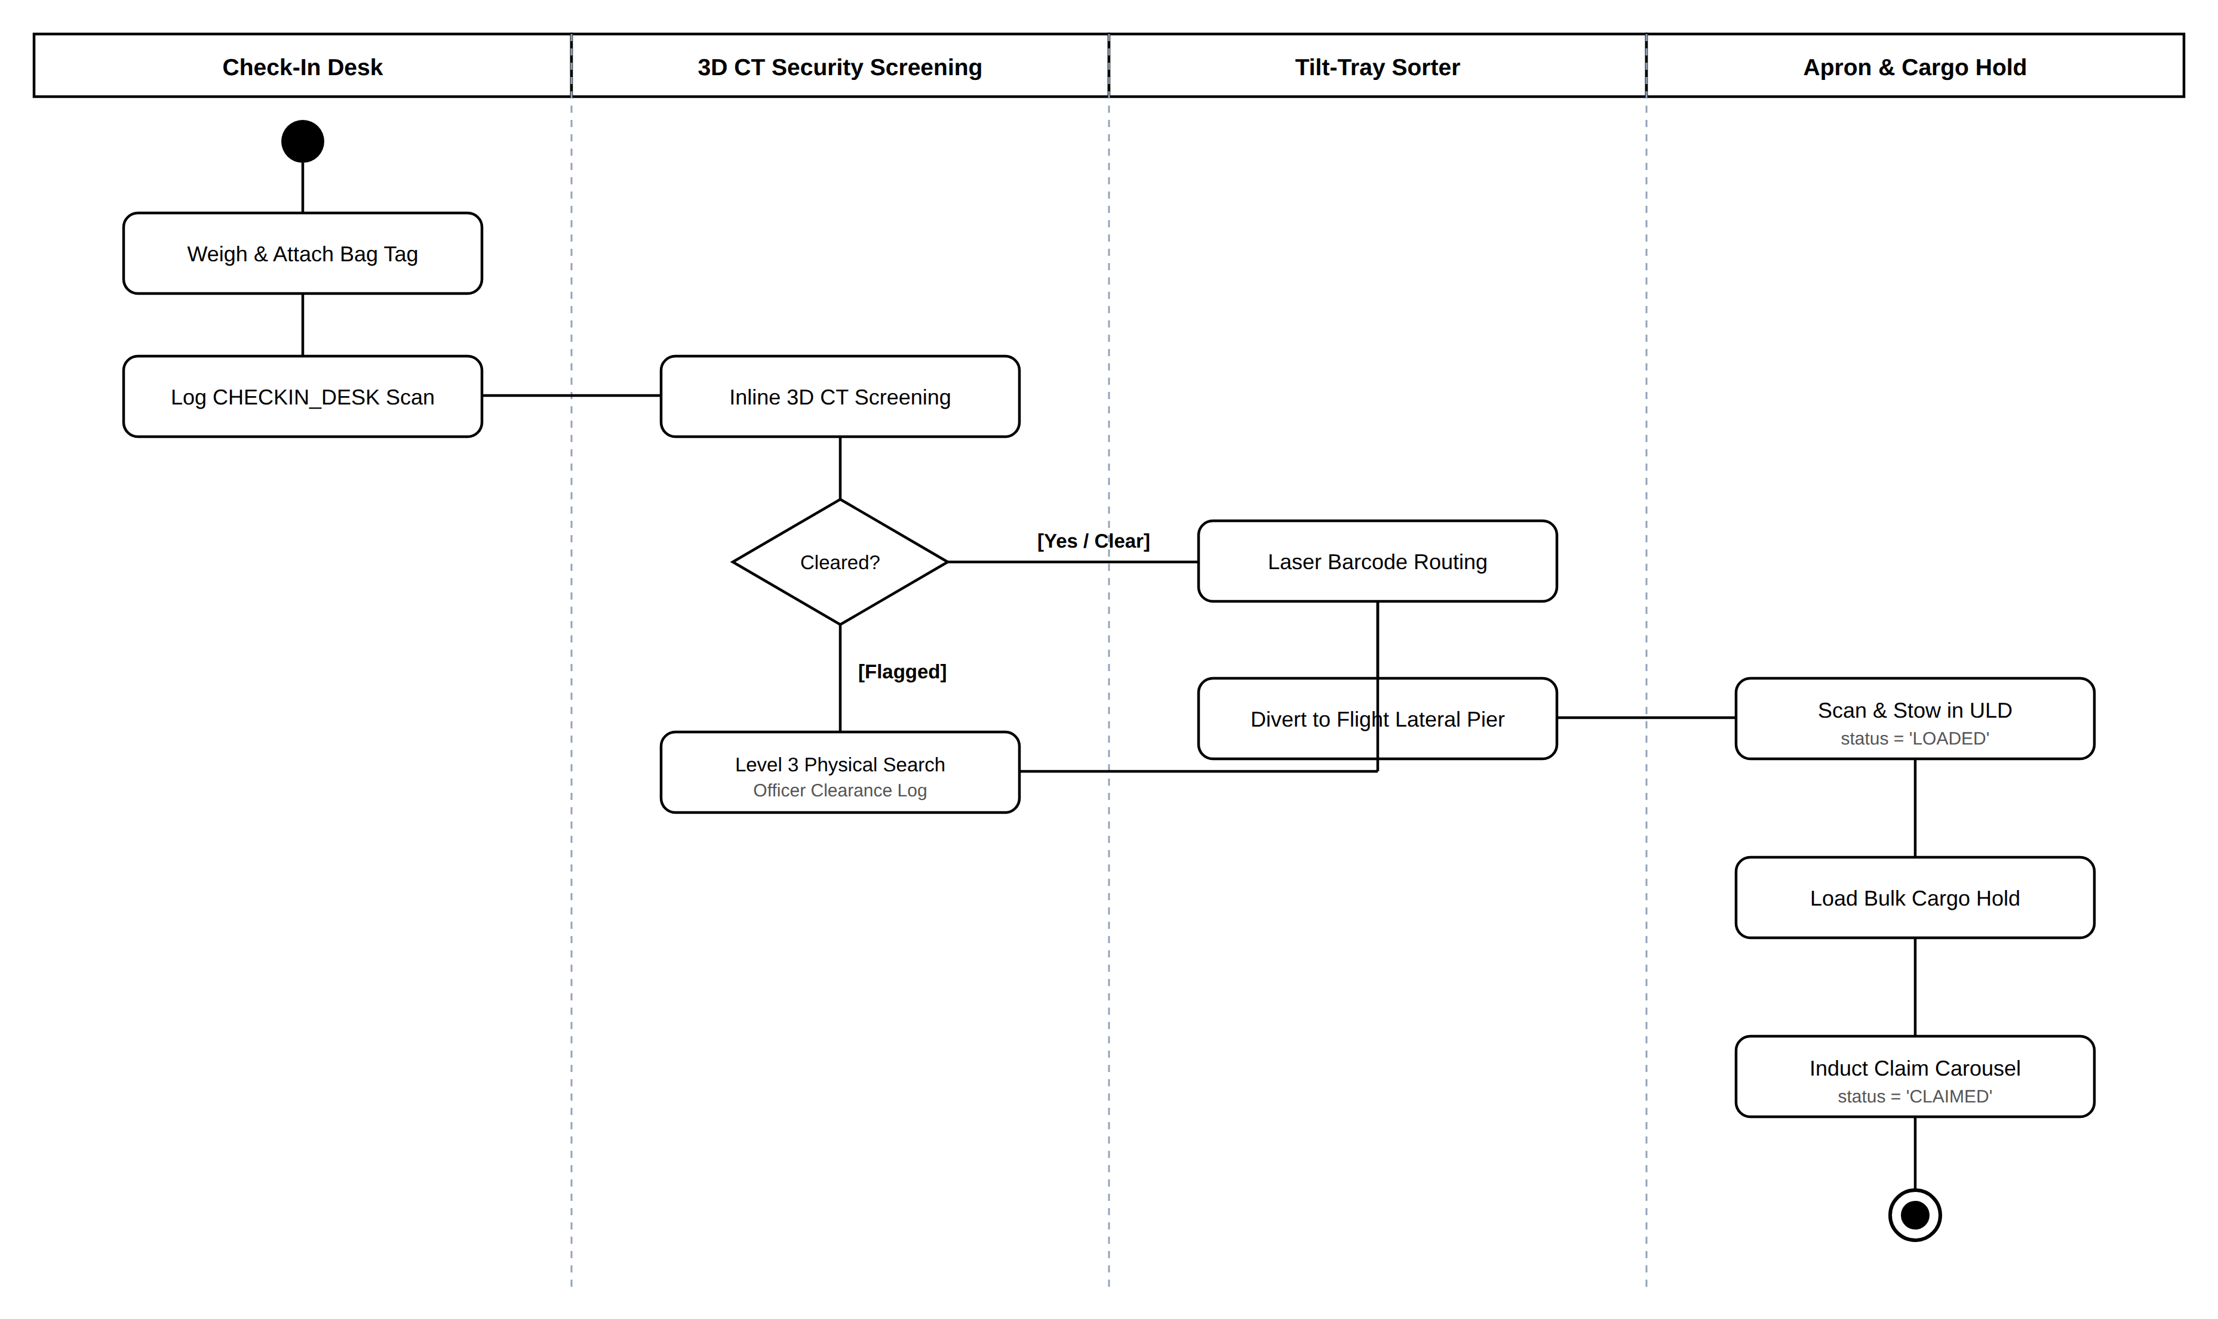
Lab 04
Behavioural and workflow modelling
Activity Diagram: Baggage Handling
Five scan checkpoints from the check-in desk to the reclaim carousel, with a screening decision
Bag journey
1
Check-in
Bag weighed and tagged; CHECKIN_DESK scan logged.
2
3D CT screening
Cleared bags go on; flagged bags get a Level 3 search.
3
Sortation
Laser barcode routing diverts each bag to its flight lateral.
4
Apron loading
Scanned into the ULD and hold; status LOADED.
5
Arrival reclaim
Inducted onto the claim carousel; status CLAIMED.
Saphire AOCS · Software Engineering Project 2026
10 / 22

Slide 11
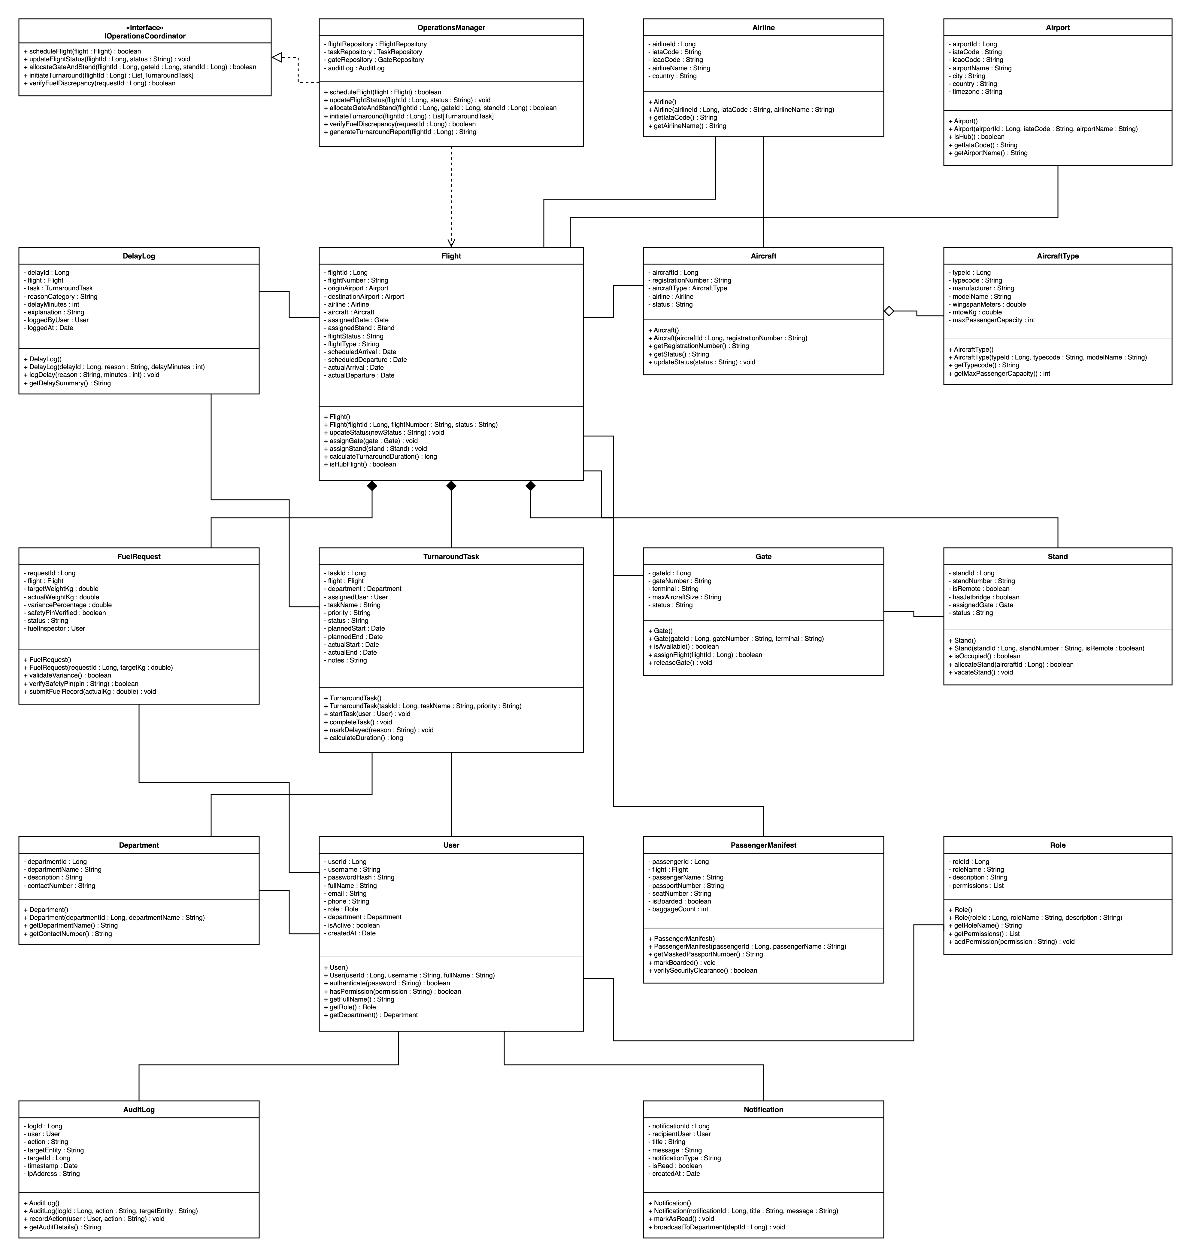
Lab 05
Structural architecture
UML Class Diagram & Domain Model
Domain classes map directly onto the Spring Data JPA entities, with multiplicities and an interface
Core classes
Flight
Number, status, scheduled and actual times; links airline, aircraft, gate and stand; 1:N turnaround tasks and delay logs.
Aircraft · AircraftType
Type holds wingspan, MTOW and capacity; each aircraft belongs to an airline.
Gate · Stand
Gate has a terminal and maximum aircraft size; stands can be remote and have jet bridges.
TurnaroundTask · User
Tasks are assigned to staff with planned and actual times; users carry a role and a department.
IOperationsCoordinator
Interface realised by OperationsManager: schedule, update status, allocate gate and stand, start turnaround.
Saphire AOCS · Software Engineering Project 2026
11 / 22

Slide 12



Lab 05
Object-oriented design patterns
Design Patterns in Saphire AOCS
Four patterns that structure the persistence, web and security layers of the backend
Repository
Global Exception Handler
Spring Data JPA interfaces hide SQL behind type-safe query methods, so services never build queries by hand.
One @RestControllerAdvice turns every exception into a consistent RFC 7807 error body with a correlation ID.
FlightRepository
GateRepository
TaskRepository
GlobalExceptionHandler
ProblemDetail
Filter Chain
Data Transfer Object
Chain of responsibility: each request passes the logging filter, then the JWT filter that checks the session and loads the role.
DTOs decouple JPA entities from the JSON API and keep fields like password hashes out of responses.
RequestLoggingFilter
JwtAuthFilter
FlightDTO
CheckinLookupDTO
AuditLogDTO
Saphire AOCS · Software Engineering Project 2026
12 / 22

Slide 13
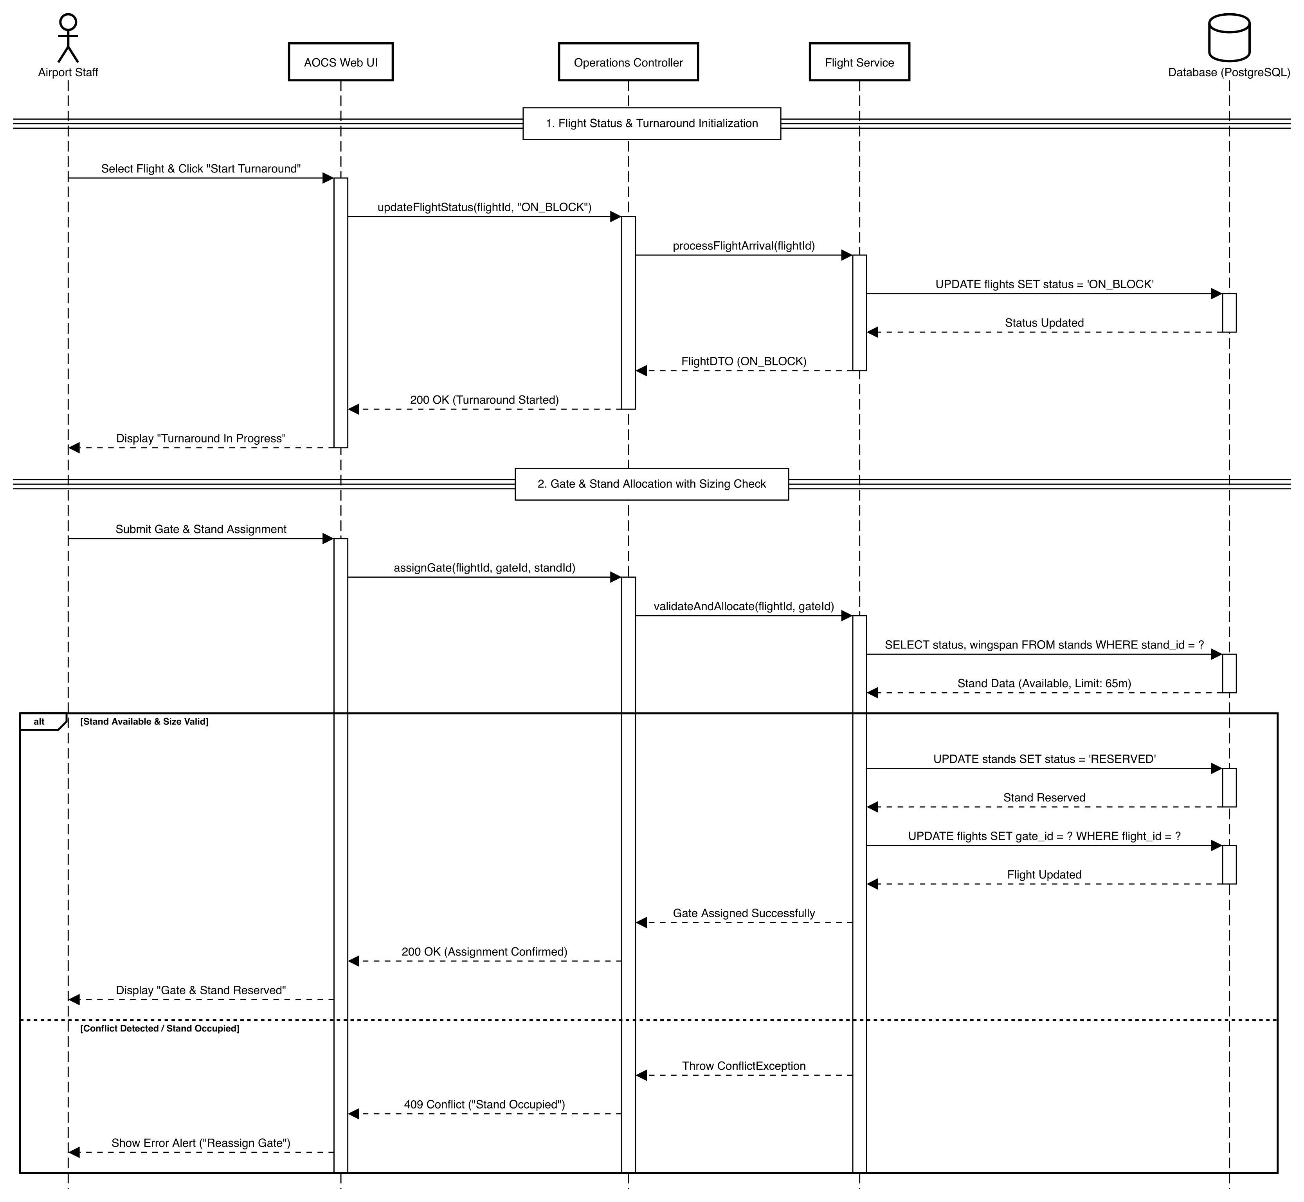
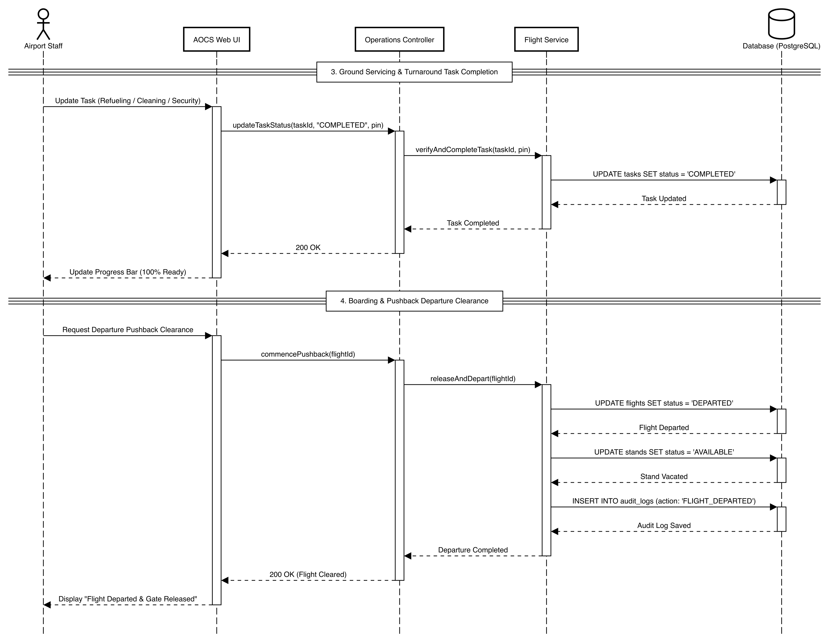
Lab 06
Dynamic and interaction modelling
Sequence Diagram: Turnaround & Delays
Lifelines from airport staff through the web UI, controller and service to PostgreSQL
Part 1 · phases 1 and 2
Part 2 · phases 3 and 4
Four phases
1
Turnaround start
Staff starts the turnaround; the flight is set ON_BLOCK.
2
Gate and stand
Wingspan and availability checked; a conflict returns 409.
3
Ground servicing
Tasks set to COMPLETED through PUT /api/tasks/{id}/status.
4
Pushback
Flight DEPARTED, stand released, audit log written.
Saphire AOCS · Software Engineering Project 2026
13 / 22

Slide 14



Lab 06
Dynamic and interaction modelling
Sequence Flow: Check-In & Boarding Pass
Four calls from the check-in desk to the database, in two separate transactions
Check-in agent
DCS console (React)
CheckinController
CheckinService
PostgreSQL
1
Read only
2
Read only
3
Transaction 1
4
Transaction 2
Find the booking
Read the seat map
Issue the boarding pass
Tag the baggage
GET
/api/checkin/lookup
?query={PNR or passport}
GET
/api/checkin/flights/
{id}/seatmap
POST
/api/checkin/
issue-boarding-pass
POST
/api/checkin/
tag-baggage
Search by PNR or passport; returns the traveller, the flight and any existing pass.
Occupied and free seats come straight from issued boarding passes.
Seat checked (409 if taken), then ticket number and IATA BCBP barcode data saved.
Saves a 10-digit bag tag and a CHECKIN_DESK scan event together.
Saphire AOCS · Software Engineering Project 2026
14 / 22

Slide 15
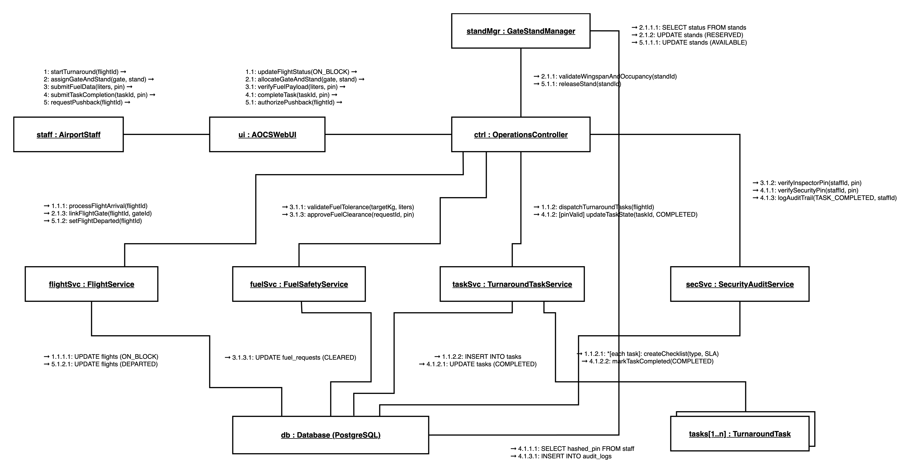
Lab 07
Collaborative object interaction
Collaboration Diagram: Turnaround Control
Objects linked by numbered messages, from the first ON_BLOCK update to pushback
Top-level messages
1
startTurnaround(flightId)
Flight set ON_BLOCK; turnaround tasks dispatched.
2
assignGateAndStand(gate, stand)
Wingspan and occupancy validated; stand RESERVED.
3
submitFuelData(liters, pin)
Fuel tolerance checked; inspector PIN verified.
4
submitTaskCompletion(taskId, pin)
Task COMPLETED; audit trail written.
5
requestPushback(flightId)
Stand released; flight DEPARTED.
Saphire AOCS · Software Engineering Project 2026
15 / 22

Slide 16
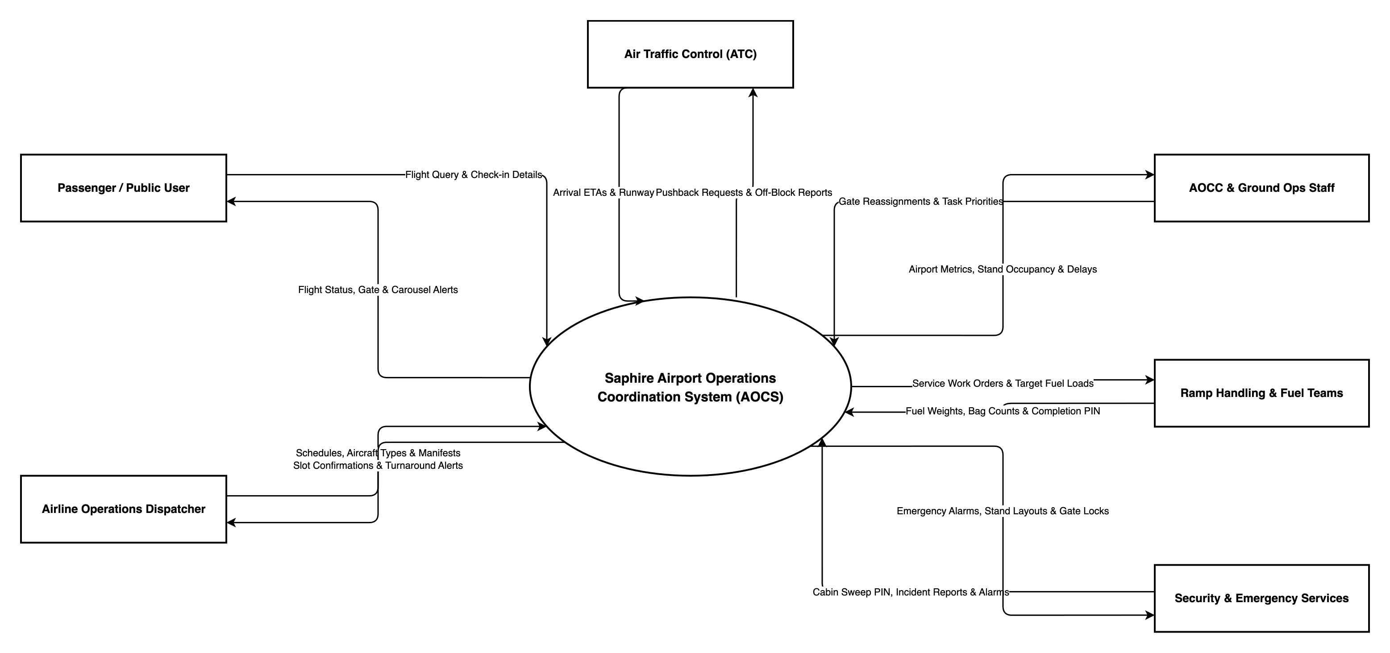
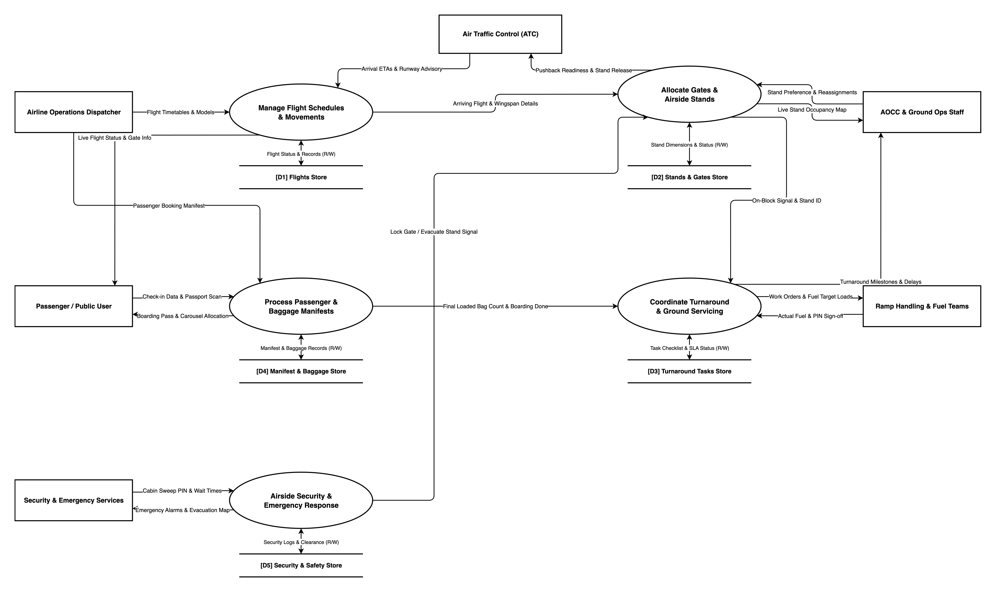
Lab 08
Data flow architecture
Data Flow Diagrams: Level 0 & Level 1
The system in its context, then decomposed into five processes and five data stores
Level 0 · context diagram
Level 1 · subsystem decomposition
External entities (6)
Processes (5) · data stores D1 to D5
Airline dispatcher
Passengers
Air traffic control
Flight schedules
Gates & stands
Passengers & bags
AOCC & ground staff
Ramp & fuel teams
Security services
Turnaround
Airside security
Saphire AOCS · Software Engineering Project 2026
16 / 22

Slide 17
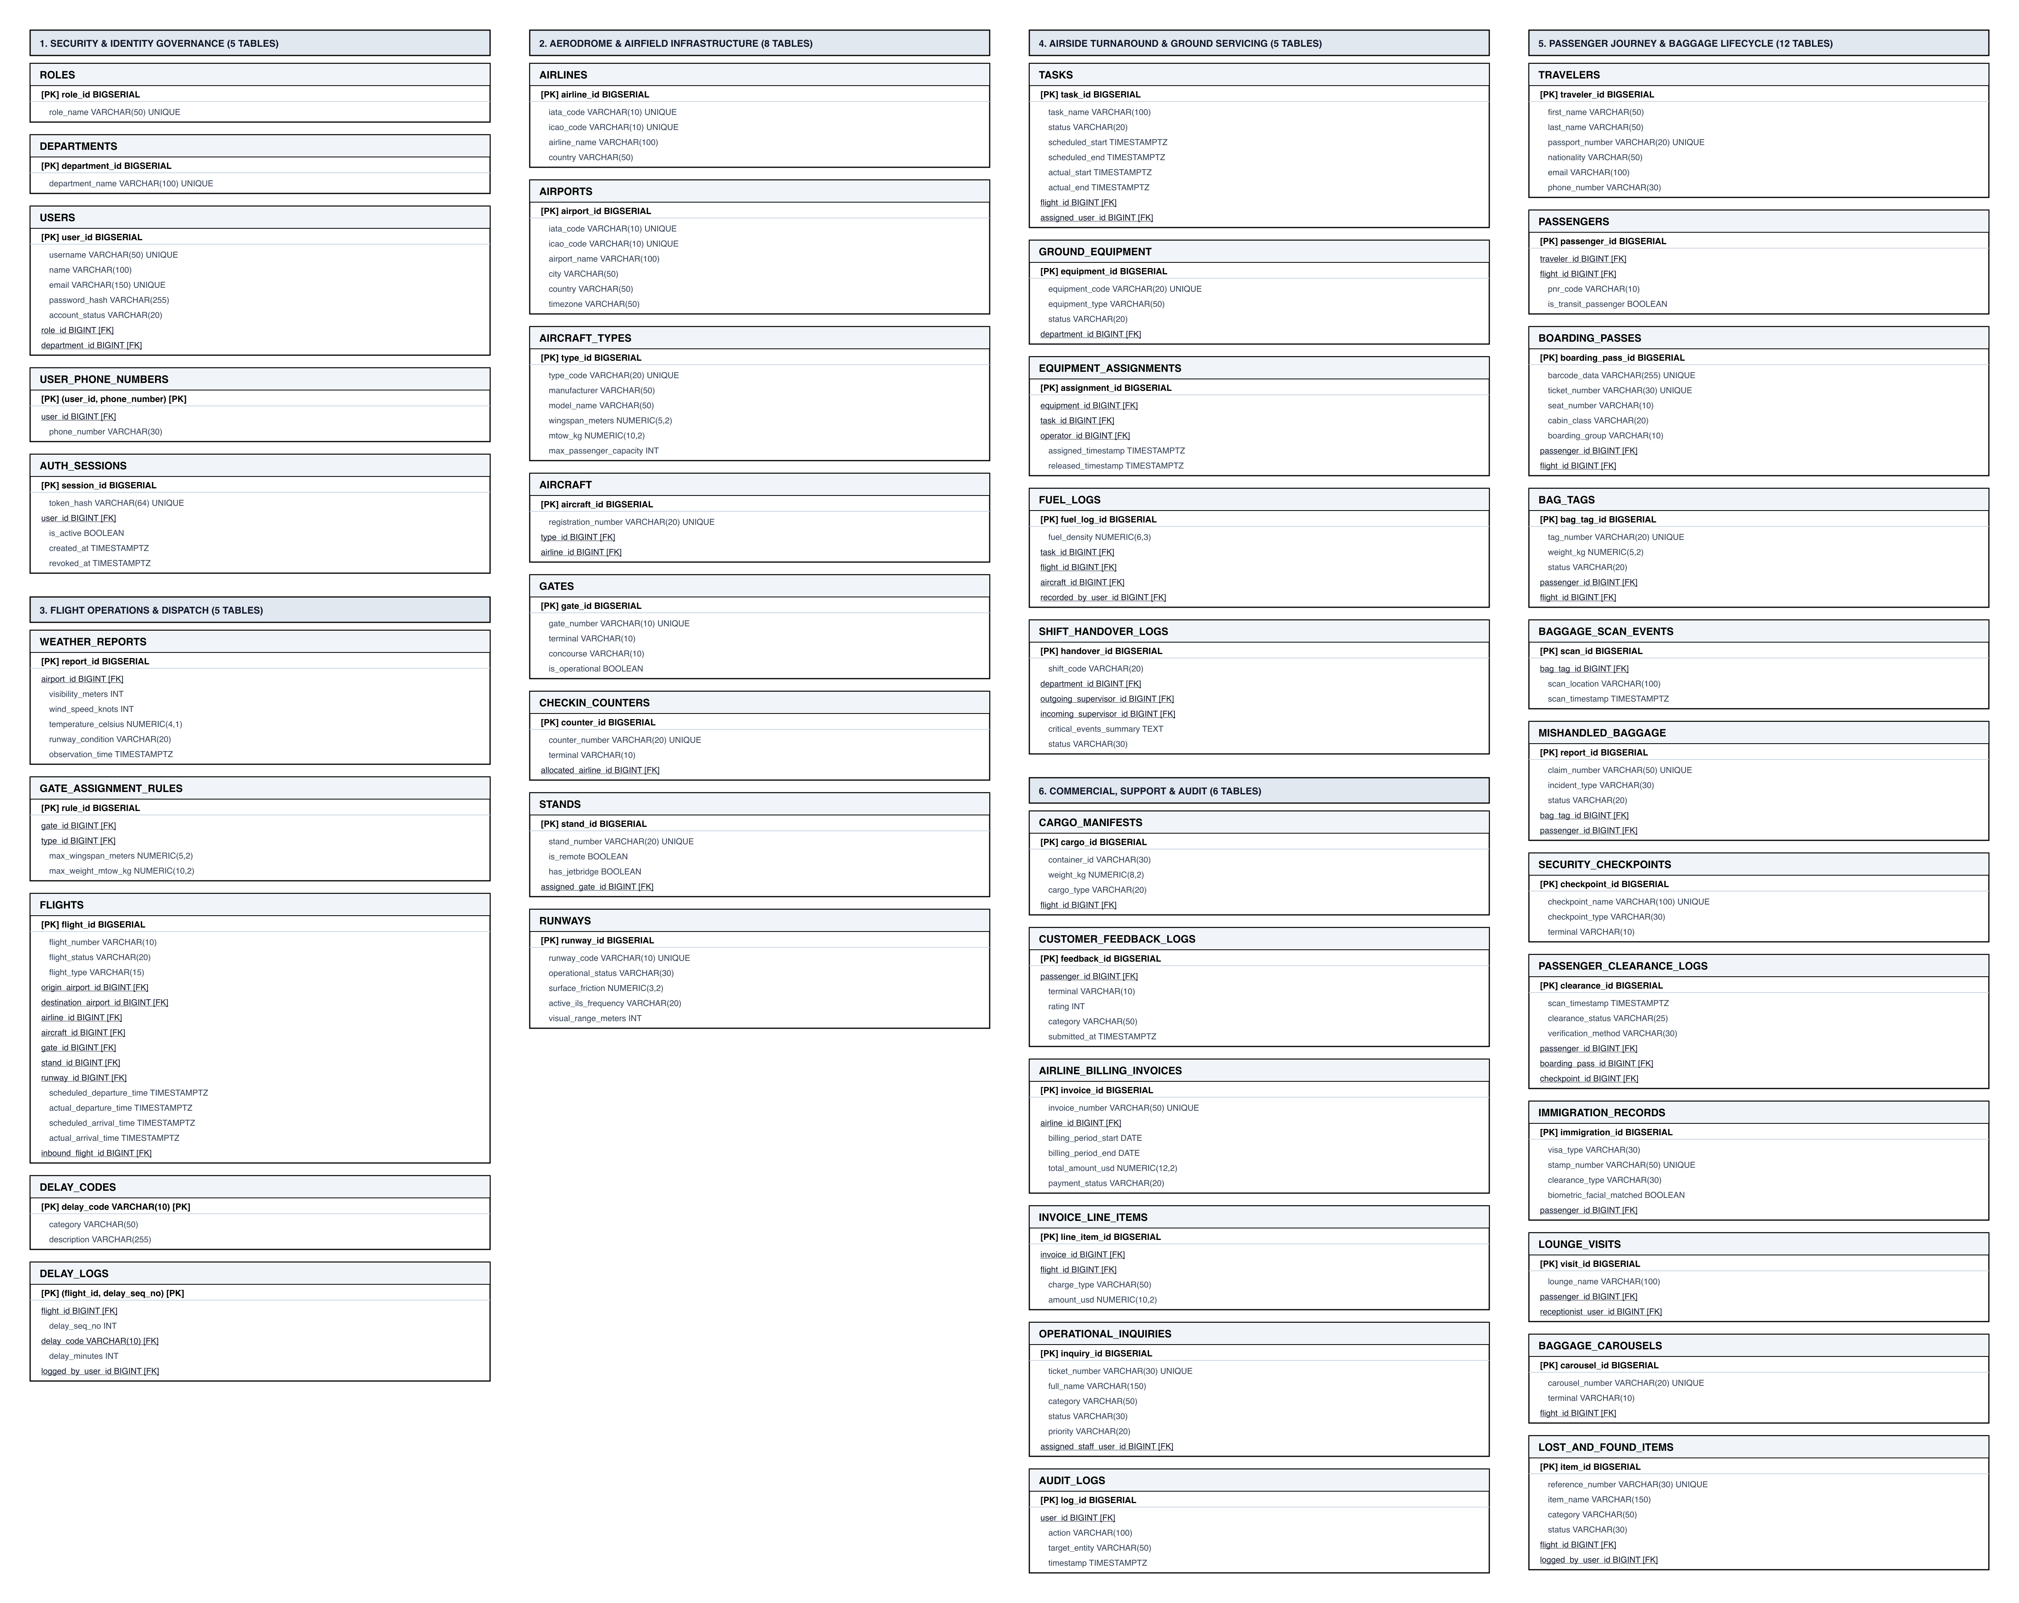
Database
Database engineering and schema design
Relational Database Schema
43 tables in third normal form on PostgreSQL, built by 17 Flyway migrations (V1 to V20)
Six functional domains
Security & identity
5 tables
Passenger & baggage
12 tables
roles, departments, users, user_phone_numbers, auth_sessions
travelers, passengers, boarding_passes, bag_tags, baggage_scan_events, mishandled_baggage, security_checkpoints, passenger_clearance_logs, immigration_records, lounge_visits, baggage_carousels, lost_and_found_items
Aerodrome & airfield
8 tables
airlines, airports, aircraft_types, aircraft, gates, checkin_counters, stands, runways
Flight operations
5 tables
Commercial & audit
6 tables
weather_reports, gate_assignment_rules, flights, delay_codes, delay_logs
cargo_manifests, customer_feedback_logs, airline_billing_invoices, invoice_line_items, operational_inquiries, audit_logs
Airside turnaround
5 tables
tasks, ground_equipment, equipment_assignments, fuel_logs, shift_handover_logs
The figure shows 41 tables. The live database adds notifications and security_incidents, for 43 in total.
Saphire AOCS · Software Engineering Project 2026
17 / 22

Slide 18
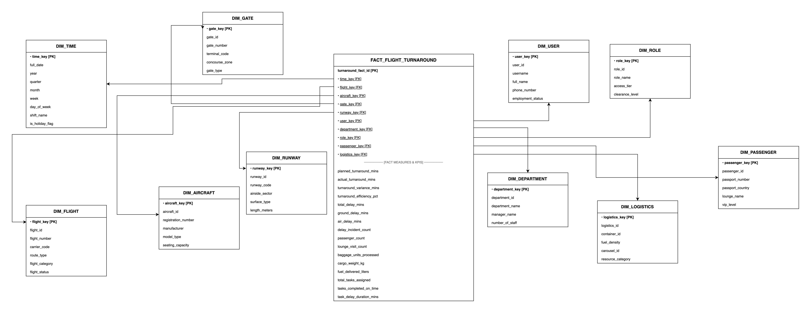
Database
Database engineering and data warehouse
Star Schema for OLAP Analytics
A denormalised model for turnaround KPIs, separate from the operational tables
OLTP vs OLAP
1
10
16
fact table
dimensions
measures
Grain
One row per completed aircraft turnaround
Why keep it separate
The 43 operational tables stay in 3NF for safe writes. The star schema denormalises them so KPI queries never lock production tables.
Dimensions
16 measures in FACT_FLIGHT_TURNAROUND
Time · flight · aircraft · gate · runway · user · department · role · passenger · logistics
Planned, actual and variance turnaround minutes · efficiency % · total, ground and air delay minutes · delay incidents · passengers · lounge visits · baggage units · cargo kg · fuel litres · tasks assigned, on time and delayed
Saphire AOCS · Software Engineering Project 2026
18 / 22

Slide 19

Build
System implementation and full-stack integration
Technology Stack & Integration
Three tiers, one request path: browser to REST API to PostgreSQL, every console on live data
Frontend
Backend
Data & Infrastructure
Browser · port 3000
REST API · port 8080
PostgreSQL · port 5432
React 19 and TypeScript on Vite 8
Material UI 9 and Tailwind CSS 4
Axios client with a JWT interceptor
React Router 7 with role-guarded routes
7 public pages and 9 staff consoles
Java 17 and Spring Boot 3.2.5
Spring Security 6 with stateless JWT
Role checks with @PreAuthorize
Spring Data JPA and Hibernate
22 REST controllers and DTOs
PostgreSQL 16 or newer
17 Flyway migrations, V1 to V20
auth_sessions: one active session per user
Docker Compose with an Nginx proxy
CI boots the app on Postgres 16
Request path for one console action
React console
Axios + JWT
JwtAuthFilter
@PreAuthorize
Controller + service
JPA repository
PostgreSQL
Locally the Vite dev server proxies /api to port 8080; in Docker, Nginx does the same.
Saphire AOCS · Software Engineering Project 2026
19 / 22

Slide 20



Lab 09
Verification and quality assurance
Testing & Quality Assurance
109 automated JUnit 5 and Mockito tests, run in CI on every push
Equivalence Partitioning
Boundary Values
./mvnw test
✓ TurnaroundTaskServiceTest 17
✓ UserServiceTest 10
✓ GateServiceTest 9
✓ LoginAttemptServiceTest 9
✓ FlightControllerValidationTest 9
✓ FlightServiceTest 14
✓ AuthServiceTest 7
✓ SecurityAuditServiceTest 6
✓ SecurityOpsServiceTest 6
✓ 8 more test classes 22
Valid and invalid flight status transitions: SCHEDULED to BOARDING passes, SCHEDULED to LANDED is rejected.
Login lockout: one failure below the limit stays open, the failure at the limit locks the account.
State Transitions
Regression in CI
Turnaround tasks and flights may only move along their state machines; illegal jumps are refused.
Every push runs the suite, then boots the app on an empty PostgreSQL 16 to prove migrations run.
Tests run: 109
Failures: 0 Errors: 0
Saphire AOCS · Software Engineering Project 2026
20 / 22

Slide 21
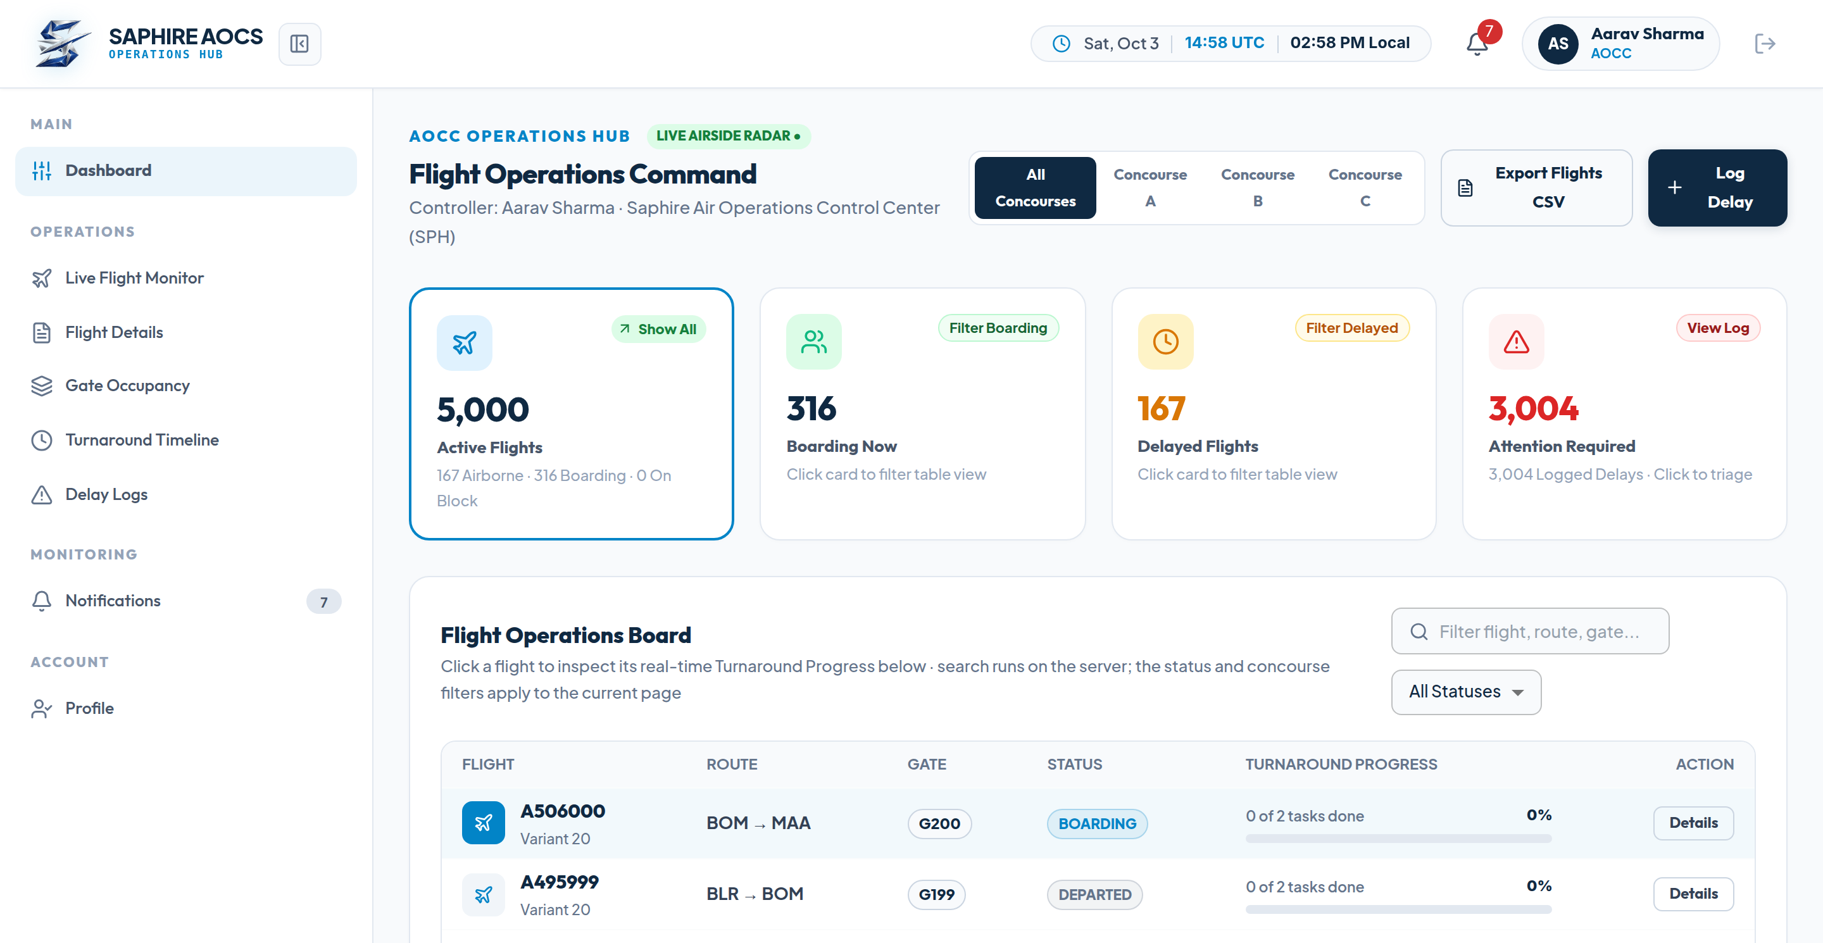
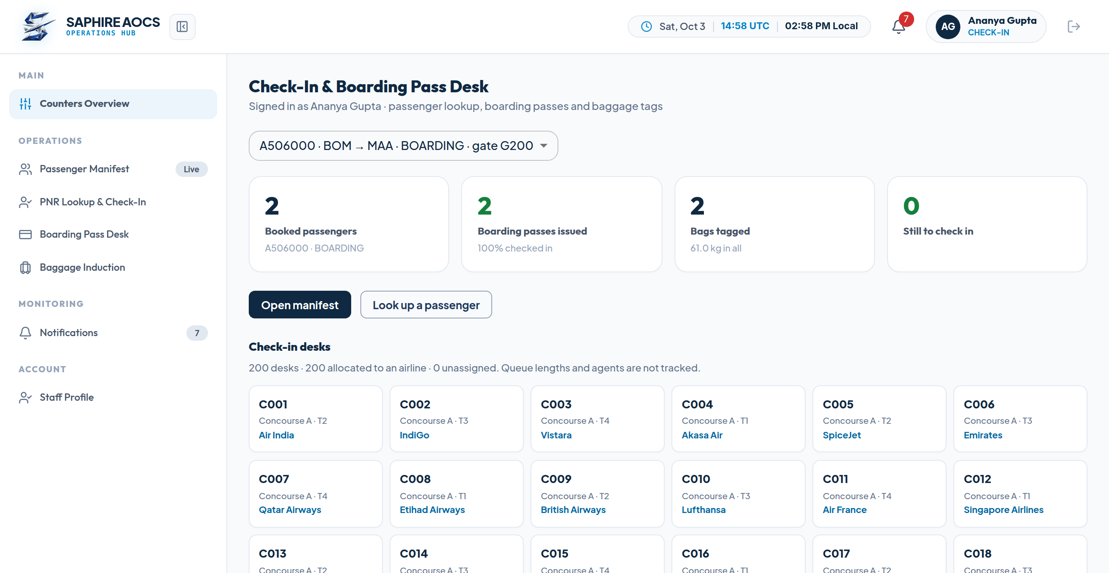
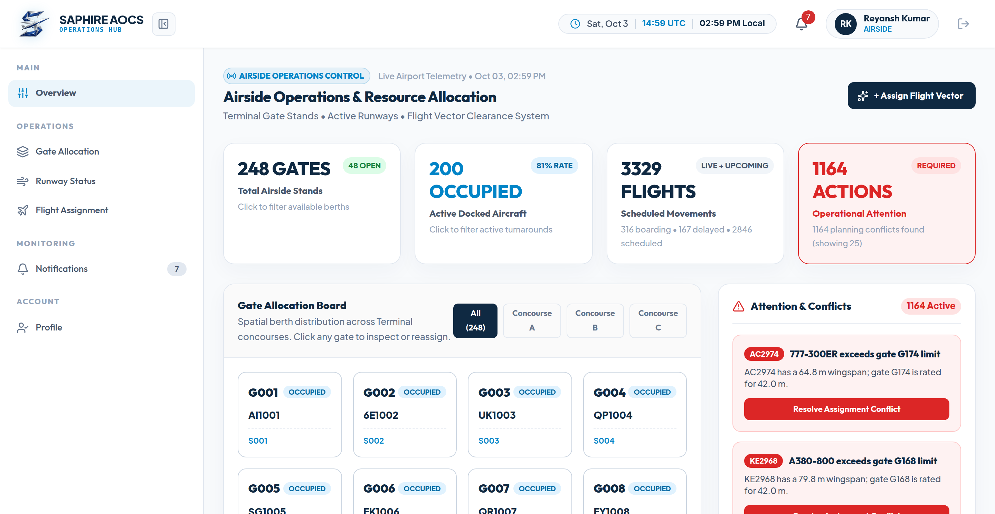
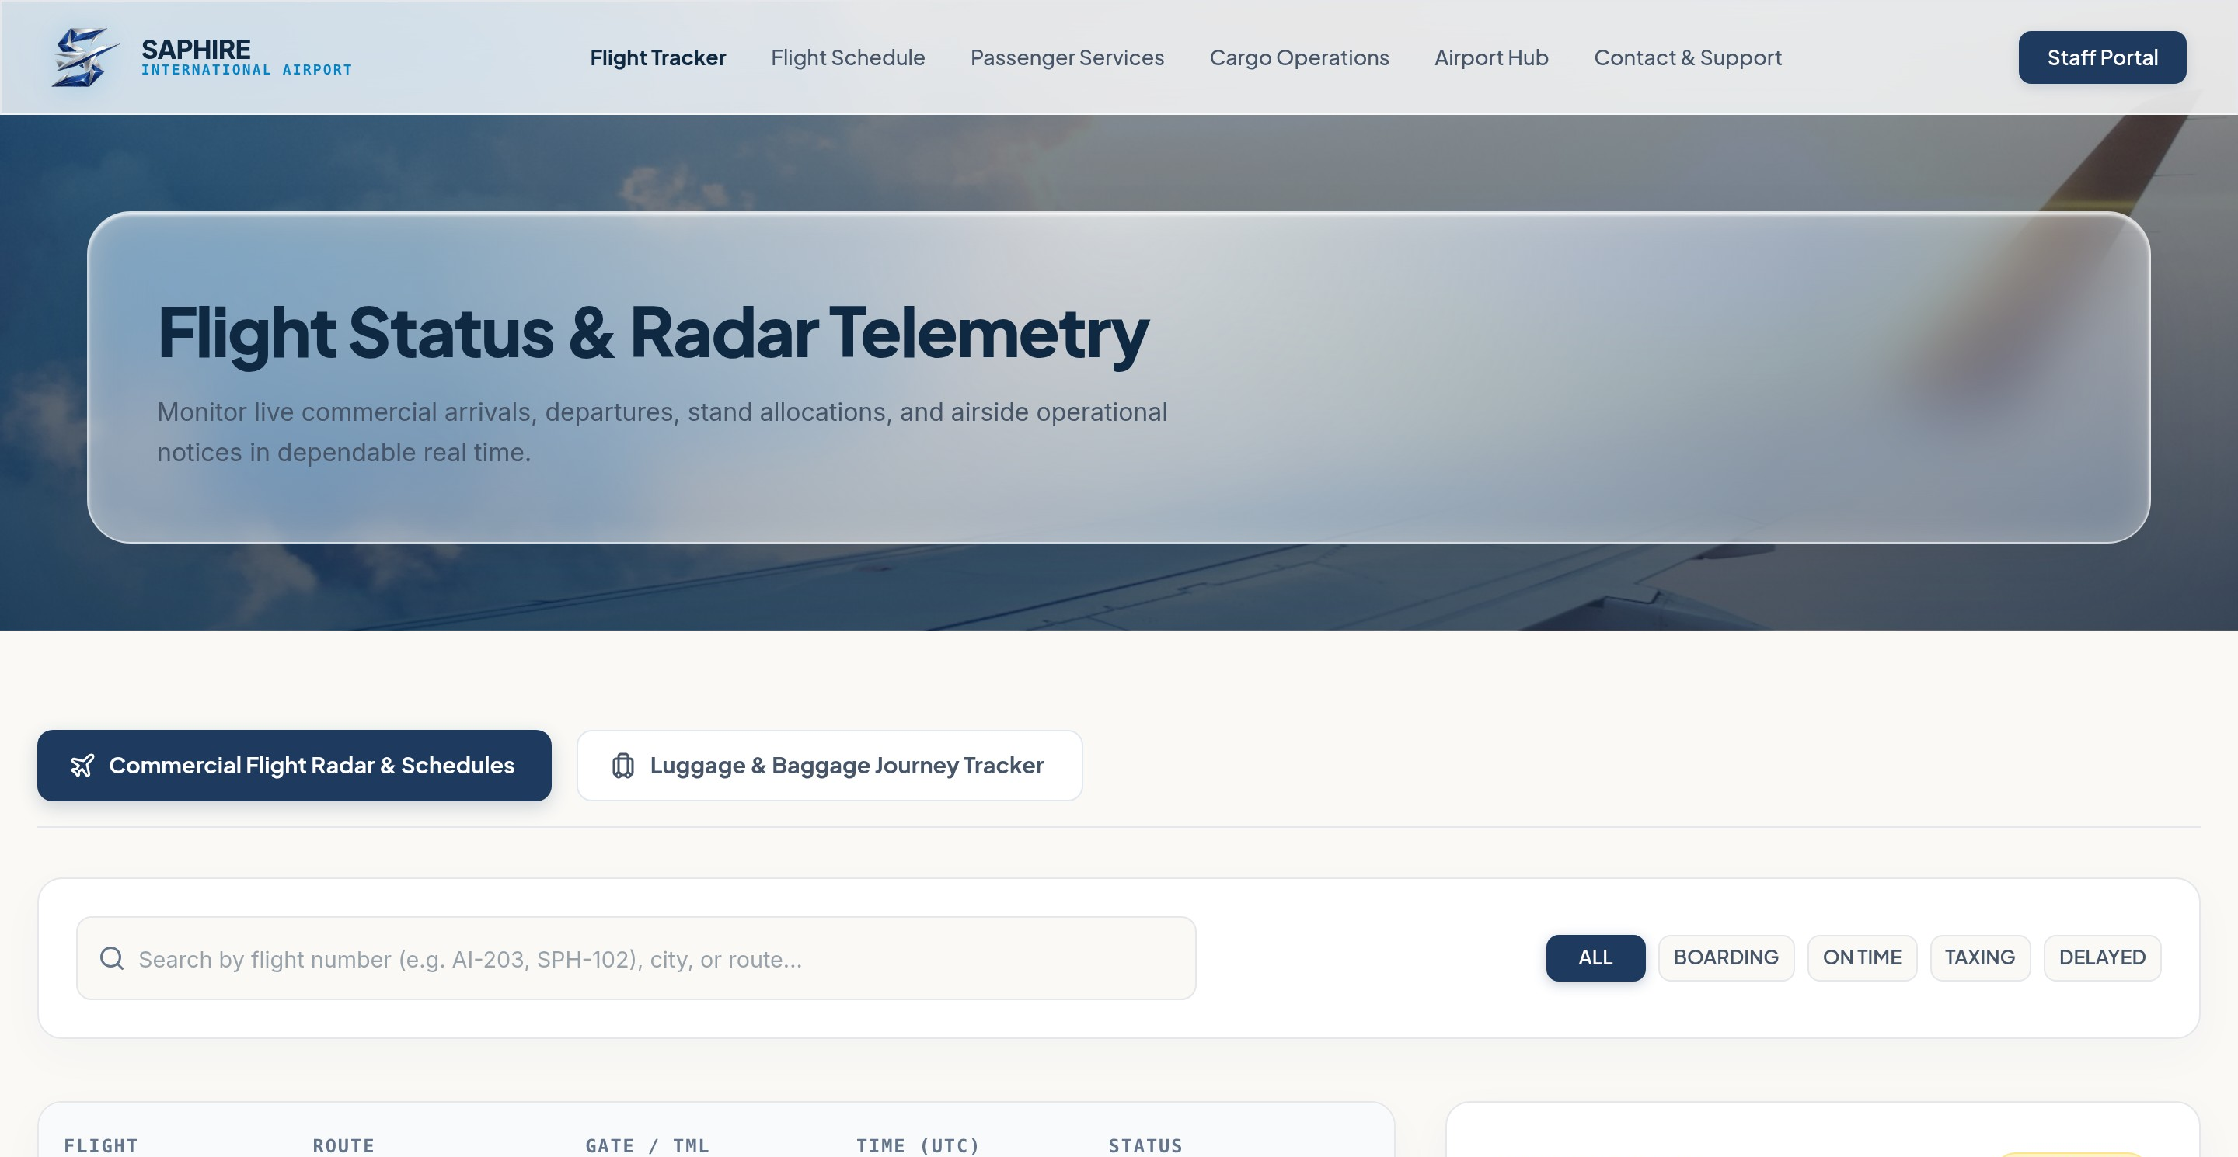
Demo
System demonstration and user interfaces
Live Consoles & Public Portal
16 pages on live data: seven public pages and nine role consoles behind server-checked sessions
localhost:3000/dashboard/aocc
localhost:3000/dashboard/check-in
7
Public portal
Home
/
Flight tracker
/tracker
Timetable
/schedule
Passenger services
/passenger-services
Cargo
/cargo
Airport guide
/airport
Support
/contact
9
Staff consoles
under /dashboard/
Check-in desk
check-in
localhost:3000/dashboard/airside-ops
localhost:3000/tracker
AOCC controller
aocc
Ground operations
ground-ops
Airside operations
airside-ops
Logistics & BHS
logistics
Passenger security
passenger-security
Airline billing
billing
System admin
system-admin
Department services
department
Saphire AOCS · Software Engineering Project 2026
21 / 22

Slide 22




Summary
Project summary and future outlook
Conclusion & Future Roadmap
What was built, what is distinctive, and where the platform goes next
Engineering Summary
Key Innovations
Future Roadmap
Full-stack airport operations platform across nine lab experiments
43 tables, about 158,000 seed records, 109 automated tests
16 pages wired to a live PostgreSQL database
Wingspan vs gate conflict detection (HTTP 409)
Server-side session revocation through auth_sessions
Shift handover logbook with digital sign-off
CSV report exports for flights and billing
Machine-learning turnaround delay forecasting
RFID and IoT apron vehicle tracking over MQTT
DigiYatra biometric e-gates integration
Krishna Solanki · Chaitanya Tikku · Anuvrat Tripathi · Anay Modi
Saphire AOCS · Software Engineering Project 2026
22 / 22

