Slide 1
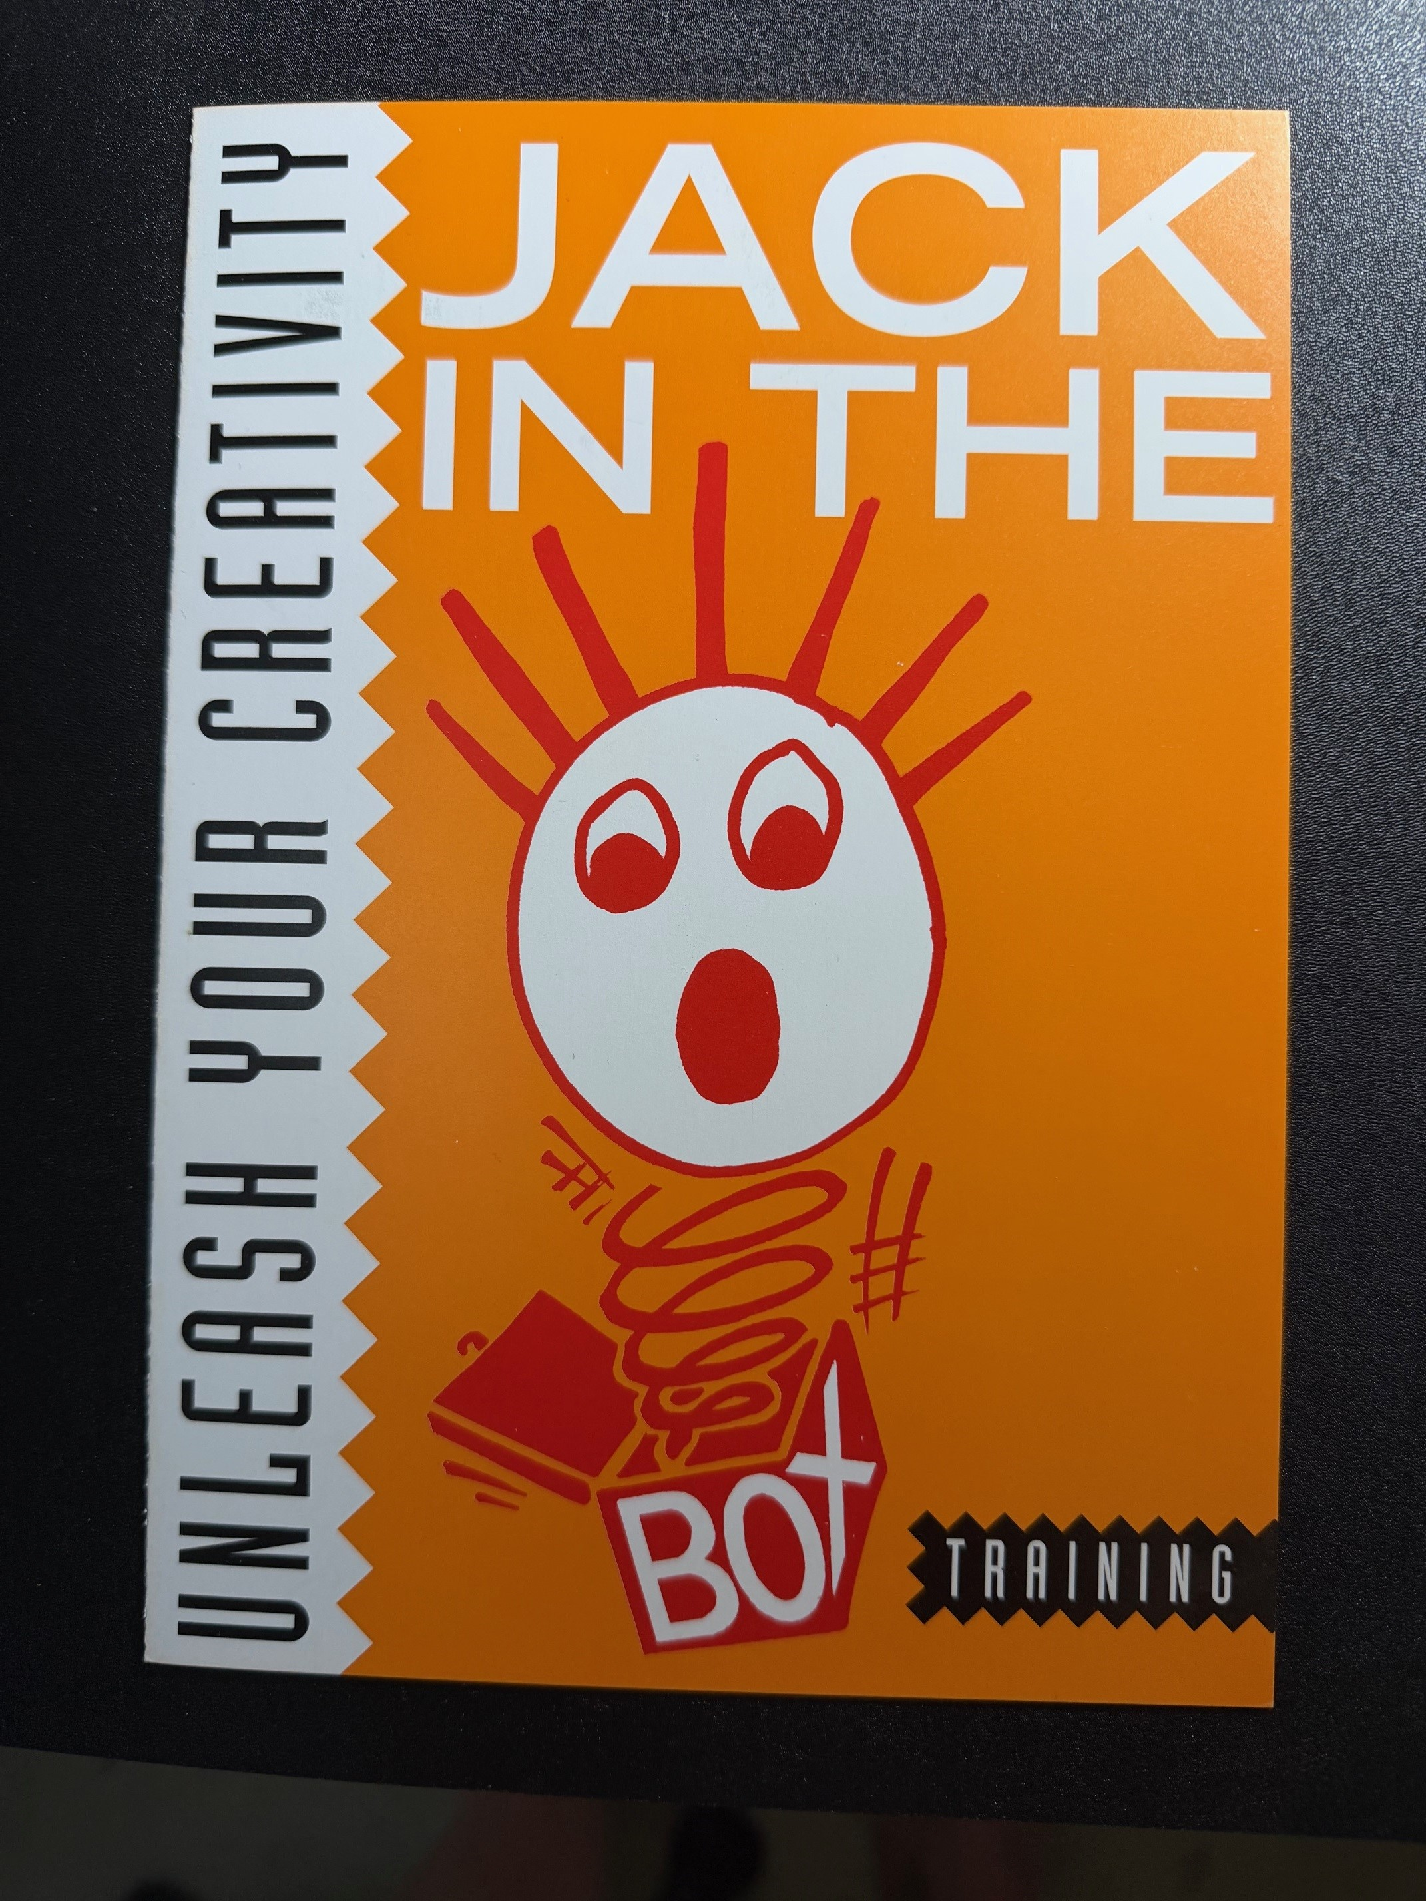
UNLEASH YOUR
CREATIVITY
Creative & Innovative Training
Built Specifically for Micro Business
JACK IN THE BOX
Helping Micro Businesses Think Outside the Box
TRAINING

Slide 2




THE CHALLENGE FACING MICRO BUSINESSES
Creativity and innovation are declining in the micro business sector
75%
Many businesses are not growing to their full potential
of all UK businesses
are micro businesses
(1–9 employees)
Owners are stuck in their comfort zones — trapped in 'The Box'
Existing training is designed for large businesses with specialist teams — it simply doesn't transfer to micro businesses
Jack in the Box Training was created to solve exactly this problem.

Slide 3
WHO WE ARE & WHAT WE DO
Jack in the Box Training
We have developed a powerful set of tools, techniques and solutions specifically designed for micro business owners and their teams.
Unlike mainstream training programmes built for large corporates with dedicated teams and resources, our workshops are built from the ground up for businesses with 1–9 people.
We also harness the power of AI in a simple and accessible way — freeing up time for your team to focus on what matters most: creativity, growth and building a better business.
If it works for a micro business, it transfers seamlessly to larger organisations too.

Slide 4




OUR WORKSHOPS & PROGRAMMES
1
Getting to Eureka!
2
From Eureka to the Marketplace
A full-day, high-energy workshop giving individuals and organisations the tools and techniques to produce creative and innovative solutions and ideas.
A full-day workshop tackling the hardest step — turning your idea into a market-ready product or service. Covers resilience, flexibility and learning from mistakes.
3
Start-Up Accelerator
4
Creative Consultancy
A distillation of Workshops 1 & 2, designed for new and potential micro business owners and start-ups. Builds creativity and innovation into your business from day one.
A bespoke, tailored service working exclusively with your business to design and deliver custom training and creative solutions built around your specific needs.
Workshops 1, 2 & 3 are all full-day workshops • Consultancy is tailored to your needs

Slide 5
WORKSHOP DETAIL
Workshop 1
Workshop 2
"Getting to Eureka!"
"From Eureka to the Marketplace"
A powerful, energising full-day workshop giving individuals and organisations the information, tools and techniques to produce creative and innovative ideas and solutions.
Participants leave with practical frameworks they can apply immediately to generate ideas, solve problems and drive innovation within their business.
One of the most critical — and most frequently failed — steps in innovation is taking the 'Eureka moment' and turning it into a viable, market-ready product or service.
This full-day workshop covers flexibility, resilience, persistence, and the mindset needed to make mistakes, learn from them and evolve great ideas into real business growth.
Both workshops are full-day sessions — energetic, practical and immediately applicable.

Slide 6
WORKSHOP DETAIL (CONTINUED)
Workshop 3
Service 4
"Start-Up Accelerator"
"Creative Consultancy"
A distillation of Workshops 1 and 2, specifically designed for potential and new micro business owners, start-ups and their teams.
This full-day session provides the key tools, techniques and processes to help new businesses build creativity and innovation as a core driver from the very beginning — giving them the best possible foundation for growth.
Our bespoke consultancy service works exclusively with you to build and deliver tailormade training and creative solutions designed around the specific needs of your business.
This is a truly personalised service — no off-the-shelf solutions. Just expert guidance, creative thinking and practical tools crafted entirely for your organisation.
Every solution is built for micro business first — but transfers effortlessly to larger organisations.

Slide 7
THE POWER
OF AI
We show you how to harness the power of AI in a simple, practical and immediately accessible way.
By integrating AI into your working day, you free up valuable time for your team — creating more space for the creative and innovative thinking that drives real business growth.
No technical expertise required. Just smarter ways of working.

Slide 8
WHO WE'VE WORKED WITH
Jack in the Box Training has worked with hundreds of micro businesses across a wide range of sectors — as well as some of the UK's most recognised larger organisations.
100s
The Co-op Bank
Sanders & Sidney
Heineken
of Micro
Businesses
The Chartered Institute of Marketing
Russian Standard
Our approach works across all sectors and all sizes — from solo traders to national brands.
Trusted by micro businesses and major brands alike.

Slide 9

WHY JACK IN THE BOX TRAINING?
Built for Micro Business
Creativity at the Core
Unlike generic corporate training, every workshop is designed specifically for businesses with 1–9 people.
We put creative thinking and innovation at the heart of everything — not as a nice-to-have, but as a growth driver.
Proven Results
AI-Enhanced
Hundreds of micro businesses and major brands have used our tools to think differently and grow.
We show you how to use AI practically to free up time and amplify creative output without technical expertise.
Bespoke Options
Transferable
From off-the-shelf full-day workshops to fully tailored consultancy — we flex to your needs.
Solutions built for micro businesses are lean, effective and scale effortlessly to larger organisations.
It's time to think outside the box.

Slide 10

READY TO THINK
OUTSIDE THE BOX?
We'd love to talk to you about how Jack in the Box Training can help your business unlock its creative potential and grow.
Get in touch
ijcass63@gmail.com
JACK IN THE BOX
TRAINING
"Unleash Your Creativity"

