Slide 1
Comparison of two cities:
Toronto and New York

Slide 2
Both cities
New York City and Toronto are the major cities of their countries, United States and Canada.
They are both the most populous New York City is the most populous cities for their countries ( 2,731,571 Toronto and 8,336,817 New York City).
New York City, as well as Toronto, are both deemed as international centres of business and culture and are recognized for their multicultural and cosmopolitan aspects.

Slide 3
So…...
How similar and dissimilar are this cities?
Can we find out by the type of venues there are ?
People looking to transfer to this cities will find the insights that this study will reveal, useful.

Slide 4
The Data
Toronto ‘s data was obtained from two different sources.
  The postcode and Neighbourhood list was downloaded from https://en.wikipedia.org/wiki/List_of_postal_codes_of_Canada:_M
  The location information (latitude and longitude) was obtained from http://cocl.us/Geospatial_data
The two list were merged using the postcode.
The table consists of 5boroughs and 103 neighbourhoods.

Slide 5
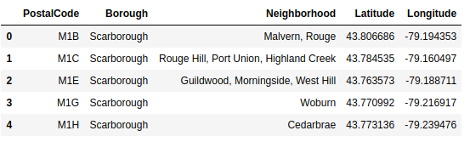

Slide 6
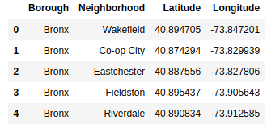
Data part 2
The data from New York City was obtained from https://cocl.us/new_york_dataset
The table consists of 10 boroughs and 306 neighbourhoods.

Slide 7
Data part 3
Using the Foursquare API, we obtained venues within 500m from the neighbourhood location.
This yielded 2154 venues in Toronto and 10097 in New York City.

Slide 8
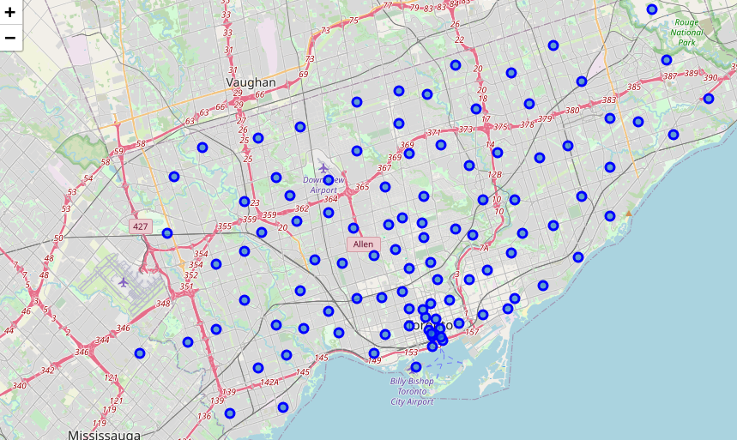
Toronto Neighbourhoods

Slide 9
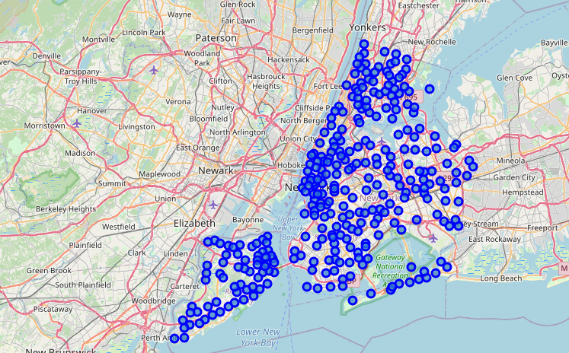
New York Neighbourhoods

Slide 10
What we did
First, we calculated the frequency of the types of venues per neighbourhood and selected the top 10 types.
We then used Kmeans to segment the neighbourhoods into 5 clusters for each city.

Slide 11
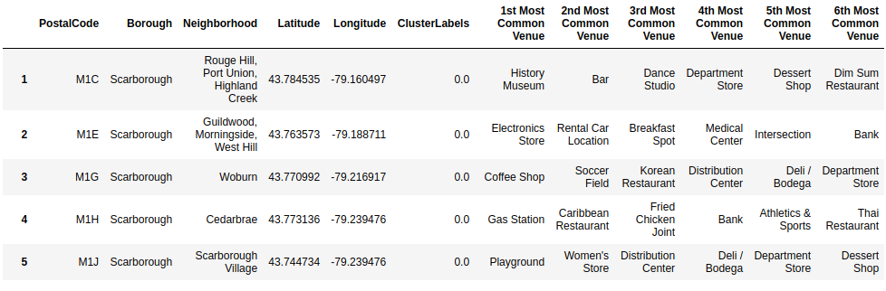

Slide 12
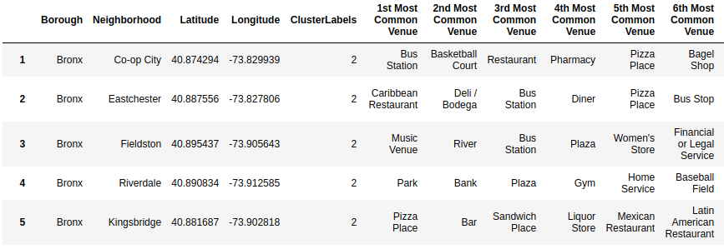
New York City Final Table

Slide 13
What we found
Their love for pizza. One cluster in Toronto was segmented because they had Pizza places in the first or second place.
The culture of the Deli/Bodegas in New York City was observed in one of the clusters.
On the other hand,

