Slide 1
AgriIntel
Yield, profit and supply-aware
crop advisory
Data Science Programming
Course Project Final Review
Manish H 24MID0294
Anshul Singh 24MID0291
Aryan Sinha 24MID0244
Batch 22
Faculty: Padma Priya M
Regional crop advisory prototype
Notes:
AgriIntel combines district-level yield forecasting, financial scenarios and a regional planting-coordination design. Team details supplied directly by the user. Existing landscape artwork is an illustration from frontend/public/bg-night.webp; it is not a photograph or an image of an observed farm.
Sources:
/Users/manishharigovind/Downloads/DSP Course Project.pdf
/Users/manishharigovind/Desktop/VIT Vellore/5th semester/Data science proogramming/DSP_project/logs/feasibility_review_2026-10-13/ASSESSMENT.md
/Users/manishharigovind/Desktop/VIT Vellore/5th semester/Data science proogramming/DSP_project/frontend/public/bg-night.webp

Slide 2
Crop choice and market oversupply
Intended users: farmers and regional agricultural advisers
A crop can look profitable before planting,
then lose value when many farmers choose it.
Same advice
More acreage
More supply
Lower price
Many farmers
Same crop
At harvest
Selling market
Yield is output per hectare. Oversupply primarily affects the selling price.
Project question: can crop advice account for both uncertainty and planting commitments?
02
Notes:
The chain is a conceptual mechanism under the project price simulation, not a universal causal law. Total marketed supply, demand, transport, procurement and storage also affect prices. Do not say that adoption directly reduces yield per hectare.
Sources:
/Users/manishharigovind/Desktop/VIT Vellore/5th semester/Data science proogramming/DSP_project/logs/feasibility_review_2026-10-13/ASSESSMENT.md
https://proceedings.mlr.press/v119/perdomo20a.html

Slide 3
Objectives and scope
Five-state historical data with a bounded regional feedback demonstration
01
Forecast yield uncertainty
Report lower, median and upper yield estimates.
02
Explain financial scenarios
Show costs, price assumptions and downside scenarios.
03
Coordinate voluntary commitments
Accept planting area only within defined capacity constraints.
04
Compare against simple baselines
Measure held-out error, interval coverage and ranking quality.
Scope excludes nationwide validated forecasts, personalized farm yields and guaranteed income gains.
03
Notes:
Project objectives connect yield uncertainty and transparent financial scenarios to bounded planting coordination. The existing five states are Madhya Pradesh, Maharashtra, Punjab, Tamil Nadu and Uttar Pradesh. Historical metrics and prospective economic benefits have different evidence requirements.
Sources:
/Users/manishharigovind/Downloads/DSP Course Project.pdf
/Users/manishharigovind/Desktop/VIT Vellore/5th semester/Data science proogramming/DSP_project/logs/feasibility_review_2026-10-13/ASSESSMENT.md

Slide 4
Proposed regional architecture
R / Python pipeline, FastAPI service and React dashboard
Historical inputs
Audit + features
Yield forecasts
Yield, climate, soil
R / Python
Quantile LightGBM
Planting ledger
Dashboard
Scenario ranking
Scoped, durable state
Ranked crop choices
Supply, price + profit
New commitments update supply and subsequent advice.
Price scenarios include an estimate of supply outside the application.
04
Notes:
The diagram specifies the proposed connection between the React/FastAPI advisory flow and ledger-based supply estimates. This is a regional simulation architecture. No live national supply is observed. The existing service serves saved recommendation artifacts.
Sources:
/Users/manishharigovind/Desktop/VIT Vellore/5th semester/Data science proogramming/DSP_project/backend/main.py
/Users/manishharigovind/Desktop/VIT Vellore/5th semester/Data science proogramming/DSP_project/modules/m6_market/supply_ledger.py
/Users/manishharigovind/Desktop/VIT Vellore/5th semester/Data science proogramming/DSP_project/logs/feasibility_review_2026-10-13/ASSESSMENT.md

Slide 5
Dataset and data preparation
District–crop–season records with starting years 2000–2019
95,674
95,667
212
45
raw records
cleaned records
state–district pairs
crop types
Inputs
Target
Historical yield, rainfall, irrigation and soil indices
State, district, crop and planting season
Yield in tonnes per hectare
Madhya Pradesh Maharashtra Punjab
Tamil Nadu Uttar Pradesh
Direct source: project CSV. Economic prices and costs include modeled proxies.
05
Notes:
Counts verified by reading project CSV/Parquet in this chat. Raw has 29 columns, cleaned has 34 including provenance flags. The repository attributes upstream agronomic sources to official datasets, but a complete preserved raw lineage has not been verified. Use the local merged CSV as the direct data source. The cleanup is not seven duplicate deletions: manifest reports one exact duplicate, five key collisions and one quarantined record. Inflation source code uses World Bank CPI. MSP registry and cultivation costs are generated proxies.
Sources:
/Users/manishharigovind/Desktop/VIT Vellore/5th semester/Data science proogramming/DSP_project/agriIntel_merged_final_v.csv
/Users/manishharigovind/Desktop/VIT Vellore/5th semester/Data science proogramming/DSP_project/data/processed/m0_audit_manifest.json
/Users/manishharigovind/Desktop/VIT Vellore/5th semester/Data science proogramming/DSP_project/modules/m1_economic_etl/msp_generator.py
/Users/manishharigovind/Desktop/VIT Vellore/5th semester/Data science proogramming/DSP_project/modules/m1_economic_etl/profit_calculator.py
https://data.desagri.gov.in/website/apy-query-report-web

Slide 6
Information available before sowing
Historical isolation is part of preprocessing, not just the train/test split
Key integrity
Remove duplicates and resolve colliding records.
Missing values
Use training-period imputation and preserve flags.
Physical consistency
Check units, irrigation denominators and yield ranges.
Past observations
Trailing features
Planting decision
Same state + district
Past years only
As-of date
Group keys include state. Future records must not change earlier feature values.
06
Notes:
Historical isolation requires group-local rolling windows and fold-local fitted statistics. A calendar-based window should handle missing years explicitly. Realized full-season rainfall and final observed yield cannot supply pre-sowing inputs. Tree models do not require standardization as a default; encoding and cutoff handling remain necessary. Source inspection identified group-boundary and all-period fallback issues in the historical pipeline, so its metrics require cautious interpretation.
Sources:
/Users/manishharigovind/Desktop/VIT Vellore/5th semester/Data science proogramming/DSP_project/modules/m3_yield/features.py
/Users/manishharigovind/Desktop/VIT Vellore/5th semester/Data science proogramming/DSP_project/modules/m3_yield/baselines.py
/Users/manishharigovind/Desktop/VIT Vellore/5th semester/Data science proogramming/DSP_project/modules/m0_audit_gate/sanitizer.R
/Users/manishharigovind/Desktop/VIT Vellore/5th semester/Data science proogramming/DSP_project/logs/feasibility_review_2026-10-13/ASSESSMENT.md

Slide 7
Model development and validation
LightGBM quantile models handle nonlinear relationships in tabular data
Lower 10% model
Median 50% model
Upper 90% model
Training
Calibration
Testing
Years before calibration
Most recent past year
Next held-out year
Learning rate | Leaves | Max depth | Boosting rounds
0.05 | 31 | 8 | 500
Baseline: trailing three-year yield mean
Walk-forward reference folds: 2015–2019
07
Notes:
Parameters taken from config/pipeline.yaml and ensemble.py. Three LightGBM quantile models per temporal fold; no XGBoost, Optuna tuning or actual trained GNN is claimed. Calibration aims at an 80% interval but coverage must be evaluated across crop families and changing seasons. Imputation and feature statistics must use available past data. Prospective accuracy requires a fresh backtest with historical isolation. Configuration includes early_stopping_rounds, but existing fit does not actually use it; the slide does not claim early stopping.
Sources:
/Users/manishharigovind/Desktop/VIT Vellore/5th semester/Data science proogramming/DSP_project/config/pipeline.yaml
/Users/manishharigovind/Desktop/VIT Vellore/5th semester/Data science proogramming/DSP_project/modules/m3_yield/ensemble.py
https://lightgbm.readthedocs.io/en/stable/Parameters.html

Slide 8
Yield and price become profit scenarios
One hectare: yield in tonnes, price in rupees per quintal
Scenario profit = 10 × yield × price − cultivation cost
The factor 10 converts tonnes to quintals.
Central scenario
Median yield and median price, with costs known before sowing
Downside scenario
A conservative yield–price combination with explicit assumptions
Scenario score = central profit − 0.5 × downside gap
08
Notes:
Median yield times median price is a central scenario, not a mathematical expectation. Pairing marginal lower quantiles does not identify a profit quantile or VaR. Costs must be known or entered before sowing, rather than derived from final observed yield. Price response is a disclosed structural simulation; no empirical price forecasting accuracy is claimed. A common scenario objective keeps recommendation and allocation economically consistent. True expected profit and calibrated tails would require a joint distribution and validation.
Sources:
/Users/manishharigovind/Desktop/VIT Vellore/5th semester/Data science proogramming/DSP_project/modules/m5_profit/engine.py
/Users/manishharigovind/Desktop/VIT Vellore/5th semester/Data science proogramming/DSP_project/modules/m5_profit/ranker.py
/Users/manishharigovind/Desktop/VIT Vellore/5th semester/Data science proogramming/DSP_project/modules/m4_price/quantile_regressor.py
/Users/manishharigovind/Desktop/VIT Vellore/5th semester/Data science proogramming/DSP_project/logs/feasibility_review_2026-10-13/ASSESSMENT.md

Slide 9
Commitments change subsequent advice
A voluntary commitment updates regional supply state
Read advice
Farmer confirms
Atomic check
Save + refresh
Current supply state
Crop + positive area
Crop caps + retries
Accepted state
Illustrative onion capacity example
Capacity | Committed | Remaining | New request
700 ha | 600 ha | 100 ha | 200 ha
Request exceeds remaining capacity. Offer a supported alternative crop.
09
Notes:
Illustrative scenario, not measured allocator performance. Onion threshold 700 ha comes from the current demo context and illustrates a capacity contract. The proposed transaction must enforce quantity-aware crop thresholds and land totals, validate finite positive area, and support idempotent retries, expiry, revision and cancellation. Ledger identity includes location/market catchment, season and harvest year. Farmer-specific quantities require valid farmer-specific yields; otherwise use clearly district-level forecasts.
Sources:
/Users/manishharigovind/Desktop/VIT Vellore/5th semester/Data science proogramming/DSP_project/modules/m6_market/supply_ledger.py
/Users/manishharigovind/Desktop/VIT Vellore/5th semester/Data science proogramming/DSP_project/modules/m7_allocator/online_allocator.py
/Users/manishharigovind/Desktop/VIT Vellore/5th semester/Data science proogramming/DSP_project/backend/ledger.py
/Users/manishharigovind/Desktop/VIT Vellore/5th semester/Data science proogramming/DSP_project/logs/feasibility_review_2026-10-13/ASSESSMENT.md

Slide 10
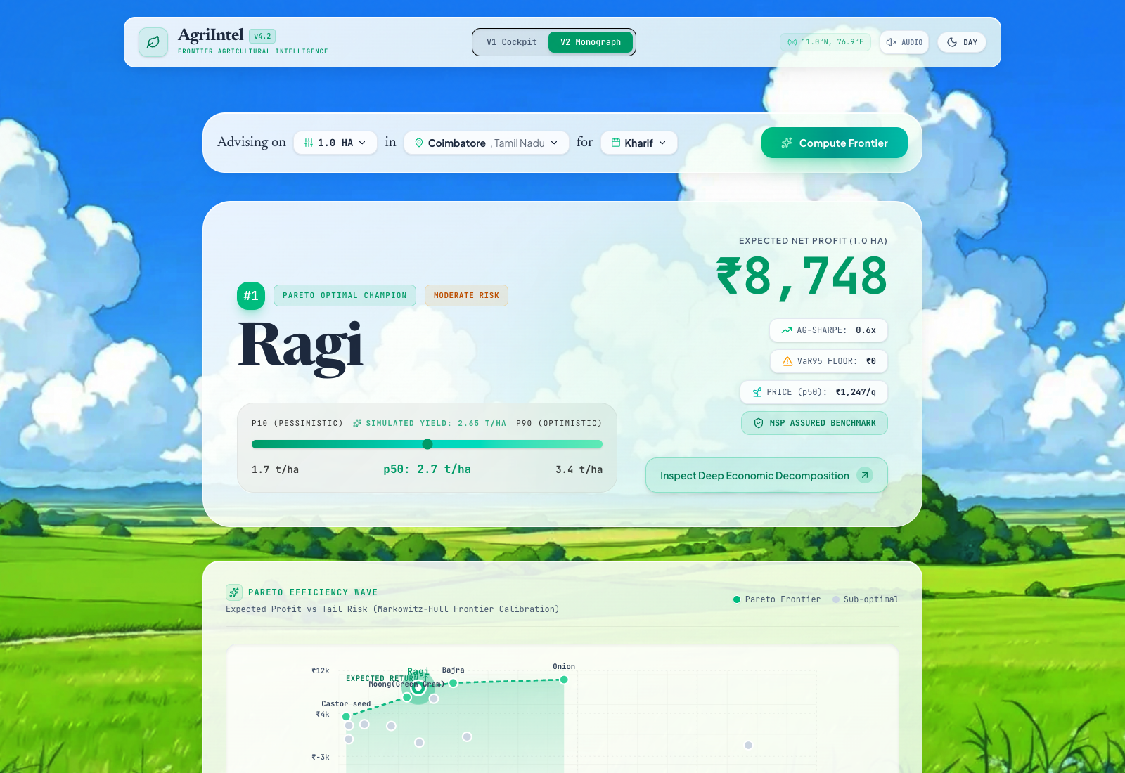
Application and representative output
Existing interface captured from this project, with a saved 2019 scenario
Tamil Nadu
Coimbatore
Kharif, 1 hectare
Ragi
2.65 t/ha median yield
₹8,748 central profit
−₹4,741 pessimistic profit
Existing UI retains legacy labels. Values here are modeled scenarios, not assured income.
10
Notes:
Genuine screenshot captured on 13 October 2026 from the current React interface with read-only recommendation API calls. Inputs Tamil Nadu / Coimbatore / Kharif / 1 ha. Existing frontend labels Expected Net Profit, VaR95 floor, Ag-Sharpe and MSP Assured are not validated as those statistical/guarantee meanings. The screenshot shows a historical output and interface example. Native output captions use central/pessimistic scenario interpretation. API returned exact central profit 8748.139150108567, pessimistic -4741.139105695569, median yield 2.6504485472375223. Economic values are real-price modeled estimates based on the repository cost/price proxies.
Sources:
/Users/manishharigovind/Desktop/VIT Vellore/5th semester/Data science proogramming/DSP_project/.codex-ppt-build/app_capture_metadata.json
/Users/manishharigovind/Desktop/VIT Vellore/5th semester/Data science proogramming/DSP_project/backend/main.py
/Users/manishharigovind/Desktop/VIT Vellore/5th semester/Data science proogramming/DSP_project/frontend/src/services/adapters.js

Slide 11
Historical yield results
Saved walk-forward backtest outputs for 2015–2019
RMSE reduction relative to baseline
Overall RMSE (t/ha)
Baseline 4.6048
Model 4.6189
78.09%
interval coverage
80% nominal target
Best saved overall point predictor: baseline. Prospective accuracy needs further evaluation.
11
Notes:
All numbers are saved project metrics independently recomputed from historical artifacts. This does not validate prospective accuracy: both feature construction and baseline preprocessing had information-isolation defects. Chart: (baseline RMSE-model RMSE)/baseline RMSE. Positive values favor LightGBM, negative favor baseline. Full family names Spices & Plantation and Vegetables & Tubers shortened on chart only.
Sources:
/Users/manishharigovind/Desktop/VIT Vellore/5th semester/Data science proogramming/DSP_project/data/processed/m3_yield_evaluation_manifest.json
/Users/manishharigovind/Desktop/VIT Vellore/5th semester/Data science proogramming/DSP_project/data/processed/fact_yield_predictions_oof.parquet
/Users/manishharigovind/Desktop/VIT Vellore/5th semester/Data science proogramming/DSP_project/logs/feasibility_review_2026-10-13/ASSESSMENT.md

Slide 12
Historical recommendation results
Targets use simulated prices and cultivation-cost proxies
NDCG@3
Top choice in realized top 3
The previous-year baseline leads on both saved ranking metrics.
Historical reference only. These results do not demonstrate improved farmer income.
12
Notes:
Saved M5 metrics: baseline NDCG@3 0.8805343955 vs model 0.7581938299; baseline top1-in-top3 85.2358168% vs model 68.7286398%. NDCG compares top-three ordering quality, higher is better. Top-choice metric checks whether recommended rank 1 is in modeled realized top 3. Simulated prices define the economic target, not observed farmer sale outcomes. Best saved overall ranker is previous-year modeled-profit baseline. No prospective field-income study is available.
Sources:
/Users/manishharigovind/Desktop/VIT Vellore/5th semester/Data science proogramming/DSP_project/data/processed/m5_ranking_manifest.json
/Users/manishharigovind/Desktop/VIT Vellore/5th semester/Data science proogramming/DSP_project/modules/m5_profit/evaluator.py
/Users/manishharigovind/Desktop/VIT Vellore/5th semester/Data science proogramming/DSP_project/logs/feasibility_review_2026-10-13/ASSESSMENT.md

Slide 13
Challenges and safeguards
Reliability requirements for the regional workflow
Challenge | Safeguard
Future information | Past-only features and train-period statistics
Concurrent commitments | Atomic caps, positive area and safe retries
Costs and units | One score with consistent cost and units
Stale or missing data | Visible data date and unavailable-data message
Engineering gate: no violations in historical-isolation,
capacity, retry/recovery and unit-reconciliation checks.
13
Notes:
Engineering acceptance criteria define the checks needed for dependable operation. They are not new measured pass results. Existing selected tests passed despite counterexamples in the audit. Model-performance claims need historically isolated evaluation, and economic-benefit claims need prospective outcomes. Edge/privacy helpers remain separate research scope and are not asserted production-ready.
Sources:
/Users/manishharigovind/Desktop/VIT Vellore/5th semester/Data science proogramming/DSP_project/logs/feasibility_review_2026-10-13/ASSESSMENT.md
/Users/manishharigovind/Desktop/VIT Vellore/5th semester/Data science proogramming/DSP_project/logs/feasibility_review_2026-10-13/targeted_tests.txt
/Users/manishharigovind/Desktop/VIT Vellore/5th semester/Data science proogramming/DSP_project/logs/feasibility_review_2026-10-13/correctness_probes.json

Slide 14
Conclusion and future scope
Regional advisory design
A regional workflow with safeguarded planting commitments
and transparent yield and financial scenarios
Key finding
Historical performance is mixed. Prospective accuracy
and actual farmer income effects require new evaluation.
National expansion
Audit crop–region coverage across 28 states and 8 UTs.
Publish predictions only where data and validation support them.
Notes:
The regional architecture links crop advice to planting coordination. Future national scope is a coverage audit and staged validated forecasting, not uniform reliable predictions everywhere. No patentability, Nash equilibrium, no-harm, guaranteed glut prevention or demonstrated welfare claims. Broad prediction-induced feedback is established research. Existing illustration from frontend/public/bg-day.webp.
Sources:
/Users/manishharigovind/Desktop/VIT Vellore/5th semester/Data science proogramming/DSP_project/logs/feasibility_review_2026-10-13/ASSESSMENT.md
https://lgdirectory.gov.in/
https://proceedings.mlr.press/v119/perdomo20a.html
/Users/manishharigovind/Desktop/VIT Vellore/5th semester/Data science proogramming/DSP_project/frontend/public/bg-day.webp

Slide 15
References
Project evidence, methods and data-source documentation
Project data and saved results
Project implementation
agriIntel_merged_final_v.csv
M0 audit, M3 yield and M5 ranking manifests
config/pipeline.yaml
modules/ and backend/main.py
Official agricultural statistics
Climate and inflation sources
Directorate of Economics and Statistics
data.desagri.gov.in
IMD gridded rainfall / imdpune.gov.in
World Bank CPI / indicator FP.CPI.TOTL
Model and application libraries
Prediction feedback research
LightGBM / lightgbm.readthedocs.io
FastAPI / fastapi.tiangolo.com React / react.dev
Perdomo et al. (2020), Performative Prediction
ICML, Proceedings of Machine Learning Research 119
Full source paths, URLs and evidence qualifications appear in the speaker notes.
15
Notes:
Direct project sources and research references. Course presentation structure follows the user-supplied PDF. Upstream lineage completeness is unverified, and economic values use disclosed proxies.
Sources:
/Users/manishharigovind/Downloads/DSP Course Project.pdf
/Users/manishharigovind/Desktop/VIT Vellore/5th semester/Data science proogramming/DSP_project/agriIntel_merged_final_v.csv
/Users/manishharigovind/Desktop/VIT Vellore/5th semester/Data science proogramming/DSP_project/data/processed/m0_audit_manifest.json
/Users/manishharigovind/Desktop/VIT Vellore/5th semester/Data science proogramming/DSP_project/data/processed/m3_yield_evaluation_manifest.json
/Users/manishharigovind/Desktop/VIT Vellore/5th semester/Data science proogramming/DSP_project/data/processed/m5_ranking_manifest.json
/Users/manishharigovind/Desktop/VIT Vellore/5th semester/Data science proogramming/DSP_project/config/pipeline.yaml
/Users/manishharigovind/Desktop/VIT Vellore/5th semester/Data science proogramming/DSP_project/logs/feasibility_review_2026-10-13/ASSESSMENT.md
https://data.desagri.gov.in/website/apy-query-report-web
https://imdpune.gov.in/cmpg/Griddata/Rainfall_25_Bin.html
https://api.worldbank.org/v2/country/IND/indicator/FP.CPI.TOTL
https://lightgbm.readthedocs.io/en/stable/Parameters.html
https://fastapi.tiangolo.com/
https://react.dev/
https://proceedings.mlr.press/v119/perdomo20a.html

