Slide 1
Unknown Data Handling
Unknown Statistics (Total 45211 Records)
job unknow: 288 (0.6%)
education unknown: 1857 (4.1%)
contact unknown: 13020 (28.8%)
poutcome unknown: 36959 (81.7%)
Unknown Handling
poutcome: dropped due to over 80% unknown
[scipy.stats] Chi-Square Test with chose alpha value of 0.05
Measure whether [Feature] is independent to [Response]
p-value < alpha: Dependent, reject H0; Else: Independent, Fail to reject H0
job: p-value = 0.97 > alpha [Dropped unknown tuples]
education: p-value = 0.01 < alpha [Imputed with sklearn.impute]
contact : p-value = 0.00 < alpha [Imputed with sklearn.impute]

Slide 2
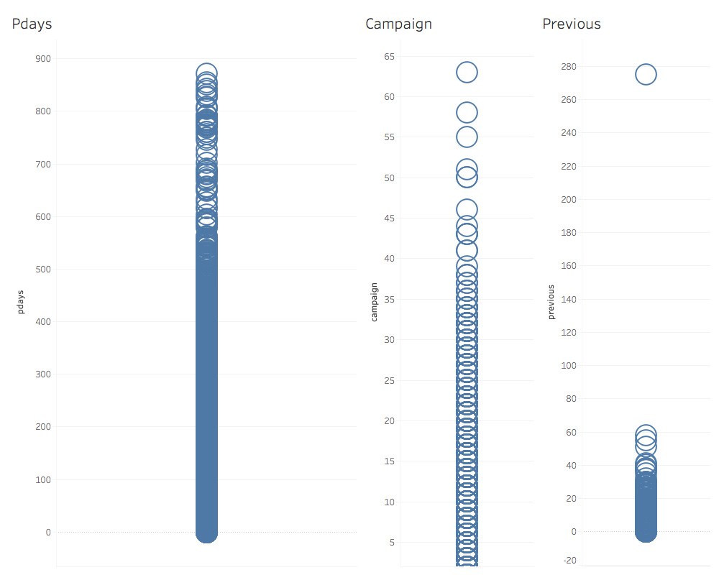
Outlier Data Handling
Possible with outlier
pdays
previous
campaign
Outlier handling
collections.Counter

Slide 3
Feature Engineering
New categorical feature: balanceGroup
From continuous balance feature
Dropped balance
Reduced job categories
entrepreneur + self_employed => self_employed
admin + management => management
blue-collar + technician => blue-collar
services + housemaid => services
Data Normalization & Conversions
Categorical to numerical

Slide 4
Imbalanced Data Handling
Over Sampling
Only on training dataset’s minority class
SMOTE/ADASYN/sklearn.resample
Terrible results with MCC ~ 0.4 and below
New generated data might be the cause
Under Sampling
On entire dataset’s majority class
Random under sampling
Better results

