Slide 1
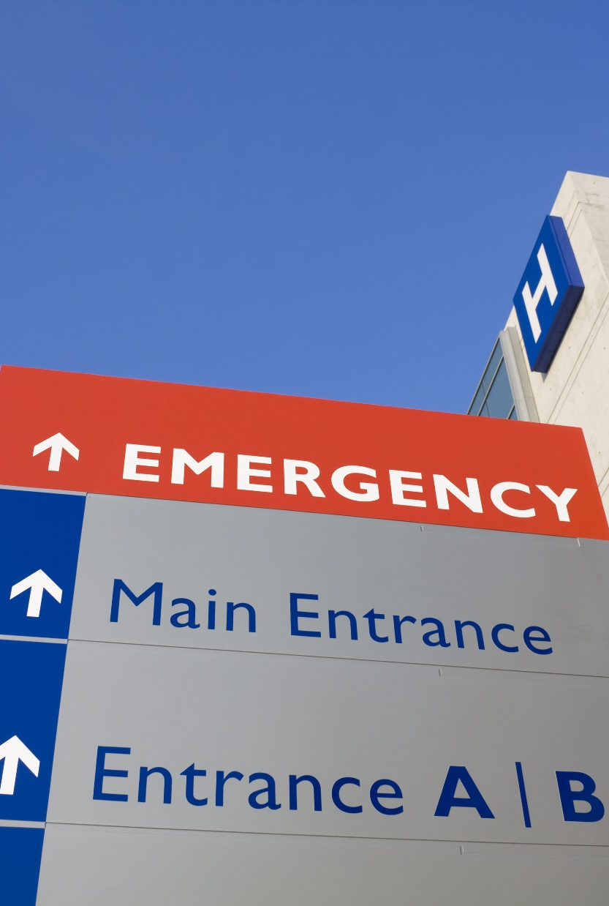


Ever felt alone and anxious in a hospital?

Slide 2
Solid market with stable growth rates!
Private clinic market in Germany
577 clinics
CAGR: 2, 7%

Slide 3
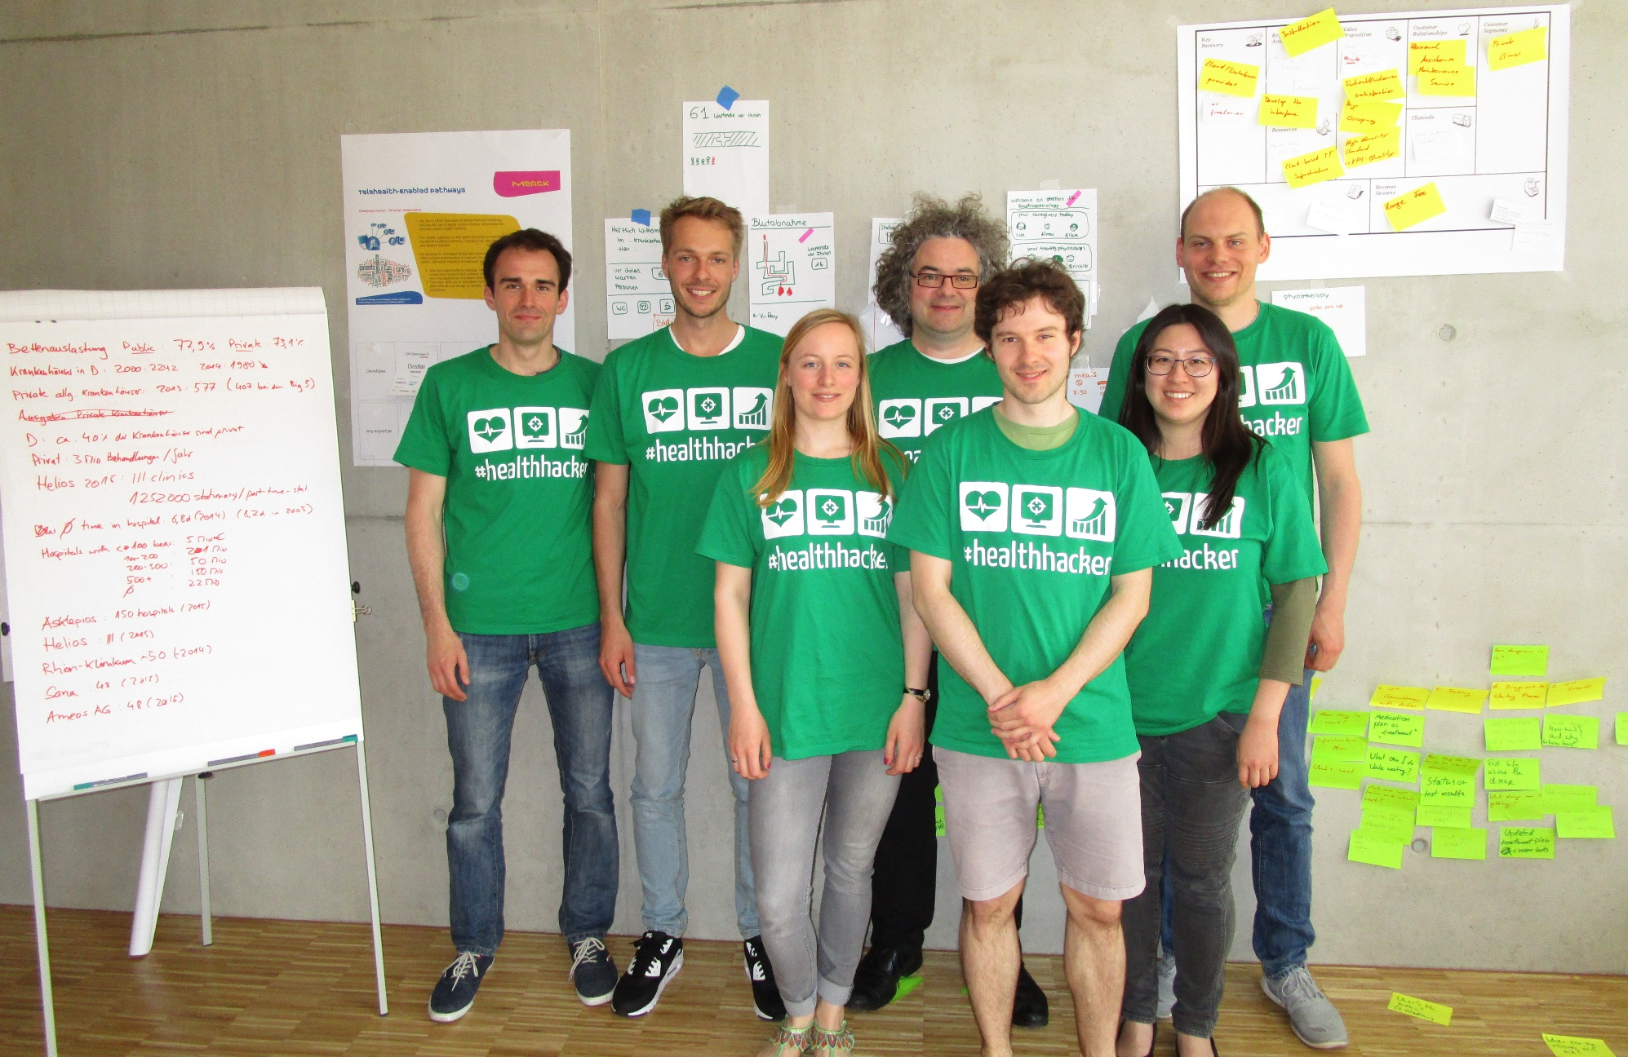

Broad expertise and a well aligned team for success!
Business experts
IT experts
Life Science experts
Data management experts
Science experts
Entrepreneurial experts
Innovation experts

