Slide 1
Operating Systems
Notes:
Motivation…
Operating systems most interesting piece of software in the system
Interface with both hardware and software
Need to have a good knowledge of computer architecture
Unlike normal programs, time plays a crucial role
A program may behave differently when run multiple times.
Strange behavior of functions.
A function call may not ever return
Or may return to some other location
Need to understand from the middle of the function
All these reasons make the OS code not very intuitive
What to expect from this course.
Good computer architecture background
A lot of playing around with pointers in C

Slide 2
A question to ponder
World of Applications
“Java/C/C++/Python” as a model of computation
Developer’s view of how a
computer system works
How does a program end up executing on hardware?
What happens in-between?
How is a device designed using logic gates and wires to satisfy diverse application goals?
HW designer’s view of how a
Computer works
Execution hardware
Notes:
How is the HW/SW interface designed

Slide 3
Layers in a Computer System
Applications
Operating Systems
Computer Architecture
VLSI
Transistors
Notes:
Eg. Take a mobile phone.

Slide 4
Use of Operating Systems
Hardware Abstraction
turns hardware into something that applications can use
Resource Management
manage system’s resources

Slide 5
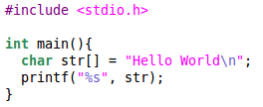
A Simple Program
What is the output of the following program?
How is the string displayed on the screen?

Slide 6
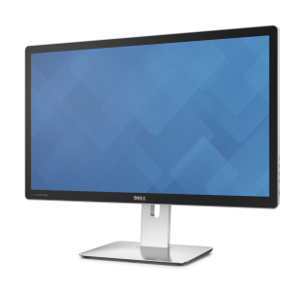
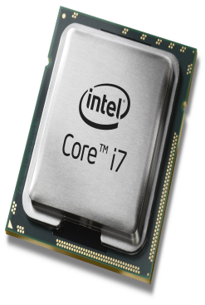
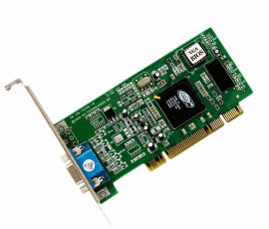
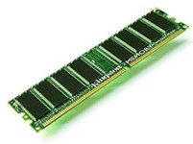
Displaying on the Screen
“Hello World”
“Hello World” +
coordinates, color,
depth, etc
Monitor
Processor
Processor Memory
Graphics Card
Can be complex and tedious
Hardware dependent
Without an OS, all programs need to take care of every nitty gritty detail.
Notes:
The programmer must
Determine coordinates for display
transfer the string “Hello World” to video card memory along with specifics such as color, depth for every pixel, etc
Each video card needs to be programmed for modes, depth, refresh rates, etc.
The programmer must keep therefore know which display and video card is being used.
Difficult and very tedious as it needs to be repeated for every program written
The programmer must
Determine coordinates for display
Transfer the string Hello World to Graphics card along with coordinates and attributes such as color, depth of every pixel etc.
Each video card needs to be programmed differently.

Slide 7
Operating Systems Provide Abstraction
On a desktop
App
system call
(write to STDOUT)
Operating System
Device
driver
Easy to program apps
  No more nitty gritty details for programmers
Reusable functionality
  Apps can reuse the OS functionality

Slide 8
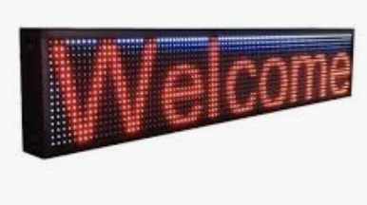
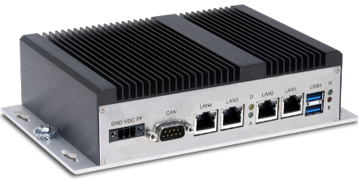
Operating Systems Provide Abstraction
On an embedded device
App
USB
system call
(write to STDOUT)
Operating System
Device
driver
Embedded System
Portable
  OS interfaces are consistent. The app does not change when hardware changes

Slide 9
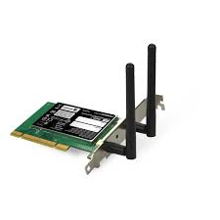
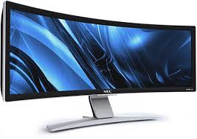

OS provides an abstraction
Threads
Address Spaces
Windows
Processes
Files
Sockets
Software
OS Hardware Virtualization
Hardware
ISA
Memory
Processor
Networks
storage
Displays
Inputs

Slide 10
Use of Operating Systems
Hardware Abstraction
turns hardware into something that applications can use
Resource Management
manage system’s resources

Slide 11
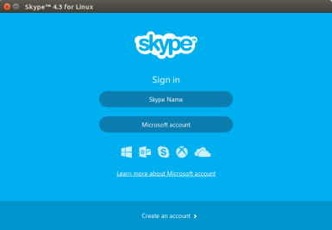
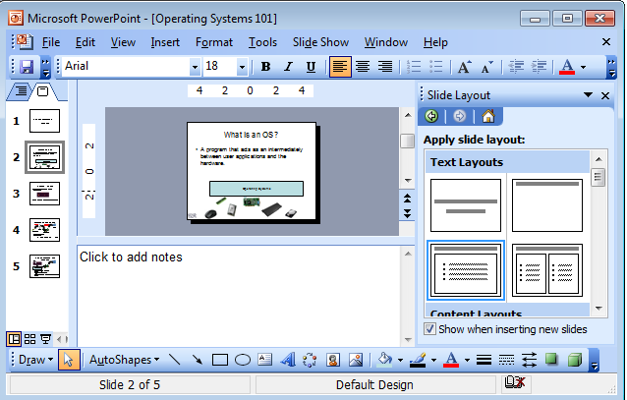
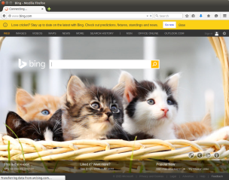
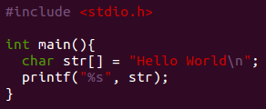

OS as a Resource Manager
Multiple apps but limited hardware
Apps
Operating Systems
A few processors

Slide 12
OS as Resource Manager
OS must manage CPU, memory, network, disk etc…
Resource management
  allows multiple apps to share resources
  protects apps from each other
  Improves performance by efficient utilization of resources

Slide 13
OS responsibilities as a manager
Process scheduling for resource sharing
Protection and isolation
Security

Slide 14
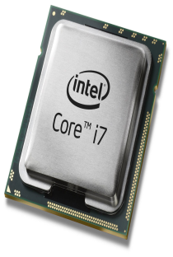
Sharing the CPU
App1
App2
App3
App4
Who uses the CPU?
App1
App2
App3
App4
time
pre<number>

Slide 15

Sharing the CPU
App1
App2
App3
App4
Who uses the CPU?
App1
App2
App3
App4
time
When one app completes the next starts

Slide 16

Idle CPU Cycles
App1
App2
App3
App4
Who uses the CPU?
CPU is idle
App1
App1
App2
App3
App4
Wait for an event
(like scanf)
Got event; continue execution
time
CPU is idle when executing app waits for an event.
Reduced performance.

Slide 17
When OS supports Multiprogramming
App1
App2
App3
App4
App1
App2
App3
App1
App4
Wait for an event
Got event; App1 put into queue
time
When CPU idle, switch to another app

Slide 18
Multiprogramming could cause starvation
App1
App2
App3
App4
while(1);
App1
App2
time
One app can hang the entire system

Slide 19

When OS supports Time Sharing (Multitasking)
Time sliced
Each app executes within a slice
Gives impression that apps run concurrently
No starvation. Performance improved
1
2
3
1
4
2
3
4
3
4
Time slice / time quanta
time

Slide 20
Priority Based Scheduling
Based on user choice or heuristics, some apps are given higher priority compared to others.
priority
Car Brakes
1
2
3
4
Music Player
Drive Analytics
1
2
3
1
1
2
3
2
3
1
Time slice / time quanta
time

Slide 21
Multiprocessors
Multiple processor chips in a single system
Multiple cores in a single chip
Multiple threads in a single core
Processor core
thread
chip

Slide 22
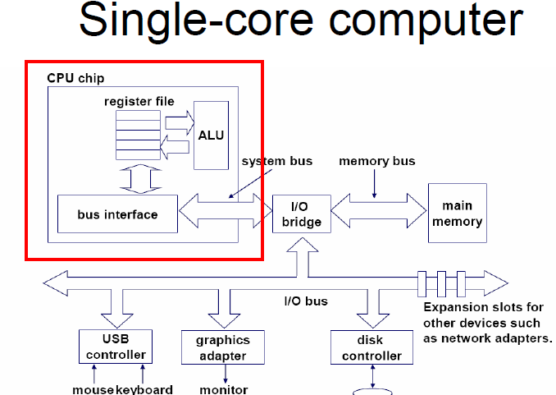
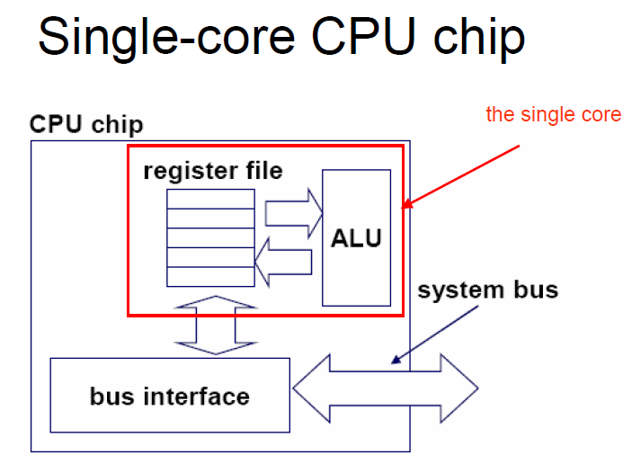
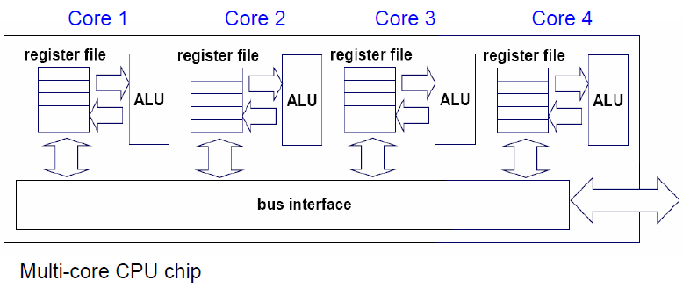

Aside

Slide 23
Multiprocessors
Each processor can execute an app independent of the others
App1
App2
App3
App4
App5
App6
App7
App8
time

Slide 24
Multiprocessors and Multithreading
2
3
1
4
2
3
4
3
4
5
6
7
5
6
8
7
5
6

Slide 25
Scheduling
  Algorithm that executes to determine which App should execute next
  Needs to be fair
  Needs to be able to prioritize some Apps over the others
1
2
3
1
4
2
3
4
3
4
Time slice / time quanta
time

Slide 26
Synchronization
2
Some resource
5
App2 and App5 want to write into some resource (like a file) simultaneously
This results in a race condition
  Need to synchronize between the two Apps

Slide 27
OS responsibilities as a manager
Process scheduling for resource sharing
Protection and isolation
Security

Slide 28
OS and Isolation
Why is it needed?
  Multiple apps execute concurrently, each app could be from a different user. Therefore needs isolation.
  Preventing a malfunctioning app from affecting other apps
Notes:
Reference to the cloud (for instance)

Slide 29
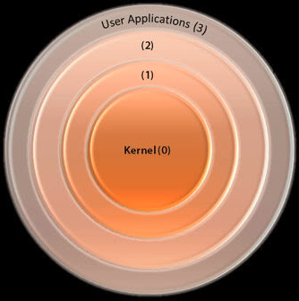
OS Isolation
Ensure that the OS itself runs in a protected mode
Least privileged
X86 model
Most privileged

Slide 30
OS responsibilities as a manager
Process scheduling for resource sharing
Protection and isolation
Security

Slide 31
OS and Security
Why is it needed?
  Defend against internal or external attacks from viruses, worms, identity theft, theft of service.
How is it achieved?
  Access Control
  Passwords and Cryptography
  Biometrics
  Security assessment
Notes:
Theft of service -→ unauthorized use of system

Slide 32
OS responsibilities as a manager
Process scheduling for resource sharing
Protection and isolation
Security
And many more …

Slide 33
Outline
Basics
OS Concepts
OS Structure

Slide 34
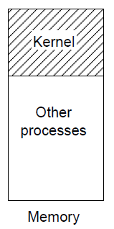
What is an OS?
a library of functions + set of programs
Kernel: core library that provides functions for basic operations (e.g., process creation / destruction) + interface to hardware via API (Application Programming Interface)
Processes / programs (we will distinguish between these terms later)
  system processes – daemons/servers (httpd,lpd, sendmail, etc.)
  user processes – shell, editor, compiler, utilities

Slide 35
Executing Apps
(Process)
Process
  A program in execution
  Comprises of
    Executable instructions
    Stack
    Heap
    State
$gcc hello.c
Process
Executable
(a.out)
$./a.out

Slide 36
Operating Modes
User Mode
  Where processes run
  Restricted access to resources
  Restricted capabilities
Kernel mode a.k.a. Privileged mode
  Where the OS runs
  Privileged (can do anything)
Software
User Mode
Kernel Mode
Hardware
Notes:
Why do we need different modes of operation?
---- protection. Ensure that user processes are less priviliged

Slide 37
Operating Modes
Software
User Mode
Kernel Mode
Linux on x86
Hardware
Notes:
Why do we need different modes of operation?
---- protection. Ensure that user processes are less priviliged

Slide 38
Communicating with the OS
(System Calls)
System call invokes a function in the kernel using a Trap
This causes
  Processor to shift from user mode to privileged mode
On completion of the system call, the execution gets transferred back to the user mode process
Process
System Calls
Kernel

Slide 39
Example (write system call)
libc invocation
User
space
write(STDOUT)
trap
Trap Handler
Kernel
space
Implementation
of
write syscall

Slide 40
System Call vs Procedure Call
System Call | Procedure Call
Uses a TRAP instruction (such as int 0x80 in x86) or ECALL in RISC V | Uses a CALL instruction
System shifts from user space to kernel space | Stays in user space (or kernel space)
TRAP always jumps to a fixed addess (depending on the architecture) | Re-locatable address

Slide 41
Files
Data persistent across reboot
What should the file system calls expose?
  Open a file, read/write file, creation date, permissions, etc.
  More sophisticated options like seeking into a file, linking, etc.
What should the file system calls hide?
  Details about the storage media.
  Exact locations in the storage media.
Process
file
System Calls
Kernel

Slide 42
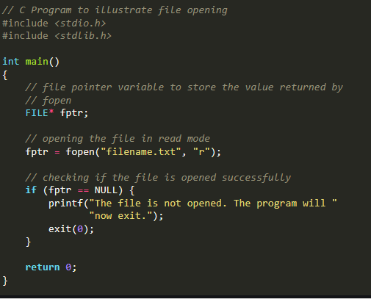
A file handling example
What help does
OS provide?

Slide 43
Outline
Basics
OS Concepts
OS Structure

Slide 44
What goes into an OS?
System Call Interface
Memory
Management
CPU
Scheduling
File System
Management
Networking
Stack
Inter Process
Communication
Device Drivers

Slide 45
OS Structure :
Monolithic Structure
User Space Processes
System Call Interface
Memory
Management
CPU
Scheduling
File System
Management
Kernel space
Networking
Stack
Inter Process
Communication
Deice Drivers
Linux, MS-DOS, xv6
All components of OS in kernel space
Cons : Large size, difficult to maintain, likely to have more bugs, difficult to verify
Pros : direct communication between modules in the kernel by procedure calls

Slide 46
OS Structure : Microkernel
User Space Processes
Highly modular.
  Every component has its own space.
  Interactions between components strictly through well defined interfaces (no backdoors)
Kernel has basic inter process communication and scheduling
  Everything else in user space.
  Ideally kernel is so small that it fits the first level cache
Process
Server
File
Management
Device
Drivers
Pager
Microkernel
(interprocess communication,
scheduling)
Kernel space
Eg. QNX and L4

Slide 47
Virtual Machines
Software
User Space
Processes
User Space
Processes
User Space
Processes
User Space
Processes
Kernel
Kernel
Kernel
VM1
VM2
VM3
Kernel
Virtual Machine Interface
Hardware
Hardware
No virtual Machines
With virtual Machines

Slide 48
Operating Systems Types
Application Specific
  Embedded OS
    eg. Contiki OS, for extremely memory constraint environments
  Mobile OS
    Android, iOS, Ubuntu Touch, Windows Touch
  RTOS
    QNX, VxWorks, RTLinux
  Secure Environments
    SeLinux, SeL4
  For Servers
    Redhat, Ubuntu, Windows Server
  Desktops
    Mac OS, Windows, Ubuntu, Linux

Slide 49
OS Research Trends
Small
(footprint,
Minimum energy
requirements)
Security, Reliability
(fewer errors,
Formally verified,
fault tolerant,
isolation)
Features
(better device support,
Multi core support)

Slide 50
Planned Syllabus
The following is the syllabus (not necessarily in this order).
  Introduction to the course and a historic perspective
  Overview of Operating Systems
  Hardware and Booting
  Memory Management
  Processes
  Interrupts, Traps, and System Calls
  Synchronization
  Scheduling
  File Systems
  Security

Slide 51
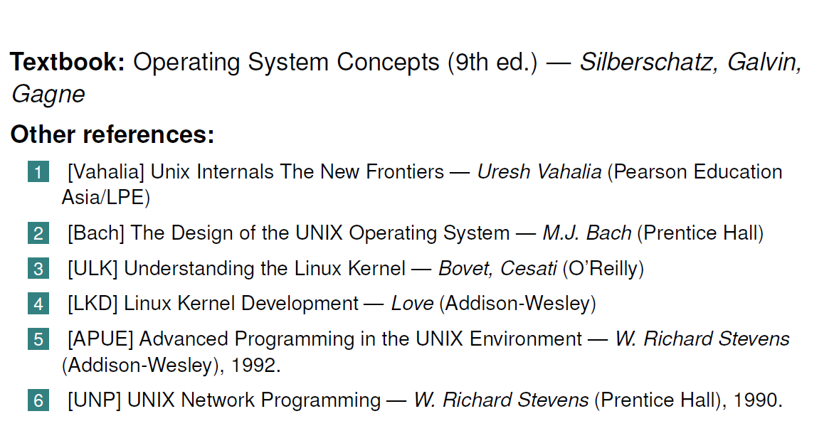
Textbook
Material courtesy:
  Prof. Chester Rebeiro, IITM
  Prof. John Kubiatowicz, Berkeley

Slide 52
Exercise 0
Install VirtualBox
Install Linux through VBox

