Slide 1
Hardware and Booting

Slide 2
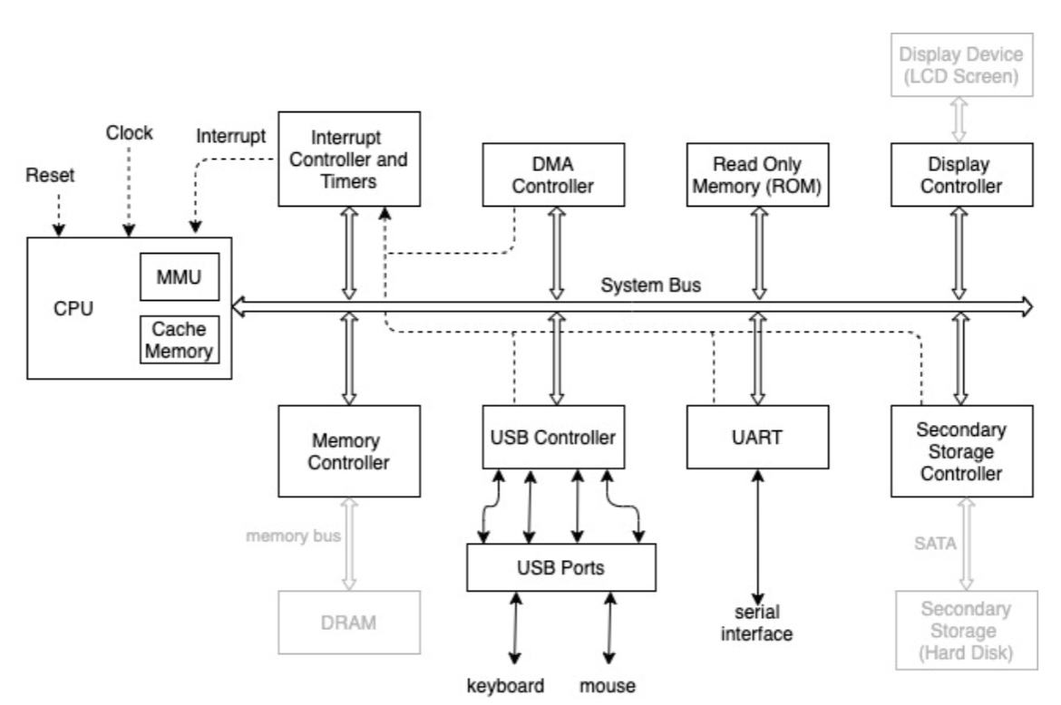
System Organization
Notes:
DMI bus is Intel specific

Slide 3
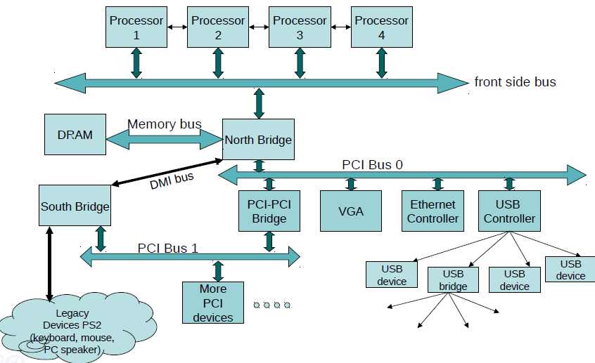
System Organization – Detailed view

Slide 4
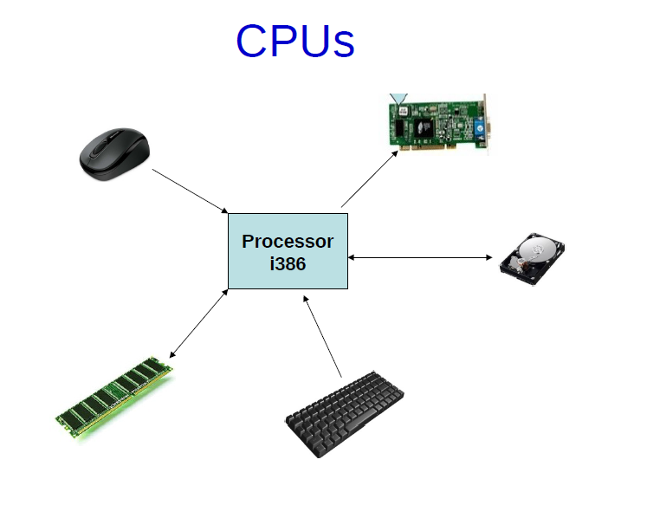
How OS recognizes the hardware?

Slide 5
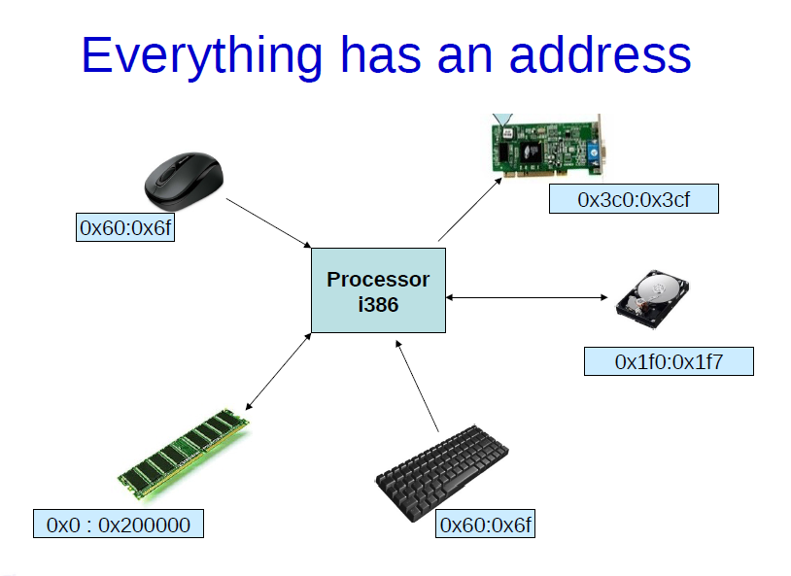

Slide 6

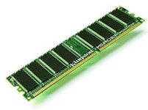
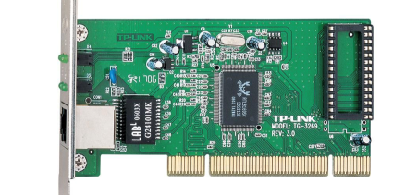
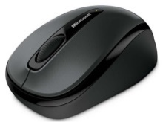
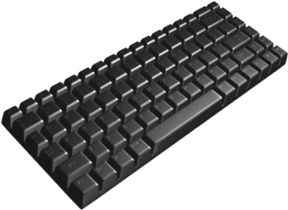
Memory Maps
0xFFFFFFFF
usb
0xC0000000
RAM
0x80000000
network
mouse
0x40000000
keyboard
0x10000000
0x0

Slide 7
Address Types
Memory Addresses
I/O addresses
Memory Mapped IO Addresses

Slide 8
Who defines address ranges?
Standard components
  Industry standards (e.g., IBM PC standard)
  Fixed for all PCs
  Ensures BIOS and OS to be portable across platforms
Plug and Play devices
  Address range set by BIOS or OS
  A device address range may vary every time the system is restarted

Slide 9
The Boot process

Slide 10
The chicken and egg problem!!!
The computer starts the OS
      OR
The OS starts the computer

Slide 11
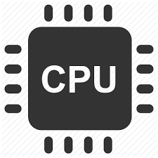
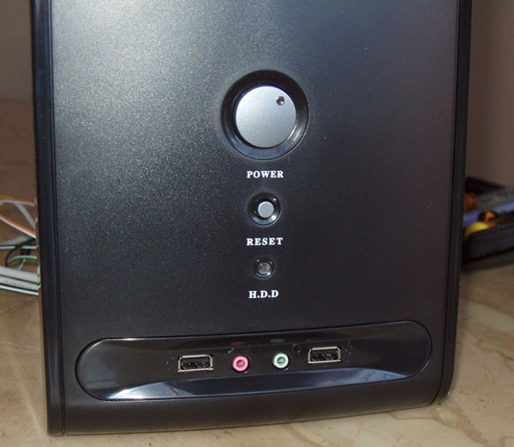
Powering Up
Power on Reset
reset

Slide 12
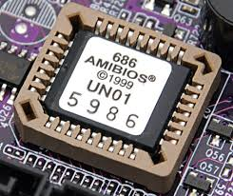
Powering up : Reset
Power on Reset
Every register initialized
to 0 except
CS=0xf000, IP=0xfff0
First instruction fetched from the
physical address = (CS << 4) + IP = 0xffff0
Processor in real mode
(backward compatible to 8088)
– Limited to 1MB addresses
– No protection / privilege levels
– Direct access to all memory
– No multi-tasking
Inaccessible
memory
first instructions
(Jump to rom bios)
0x100000
0xFFFF0
BIOS
0xF0000
First instruction is at right on
top of accessible memory
0
RAM

Slide 13
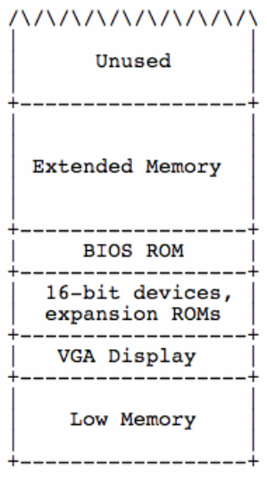

Powering up : BIOS
Power on Reset
Every register initialized
to 0 except
CS=0xf000, IP=0xfff0
BIOS
Present in a small chip connected to the processor
  Flash/EPROM/E²PROM
Does the following
  Power on self test
  Initialize video card and other devices
  Display BIOS screen
  Perform brief memory test
  Set DRAM memory parameters (e.g. refresh rate)
  Configure Plug & Play devices
  Assign resources (DMA channels & IRQs)
  Identify the boot device
    Read sector 0 from boot device into memory location 0x7c00
    Jumps to 0x7c00 (low memory)

Slide 14
Powering up : MBR
Power on Reset
Sector 0 in the disk called Master Boot Record (MBR)
Contains code that boots the OS or another boot loader
Copied from disk to RAM by BIOS and then begins to execute
Size 512 bytes
  446 bytes bootable code
  64 bytes disk partition information (16 bytes per partition)
  2 bytes signature
Typically, MBR code looks through partition table and loads the bootloader (such as Linux or Windows)
or, it may directly load the OS (kernel)
When you boot Linux and see LILO / GRUB on the screen followed by a bunch of dots, kernel is being loaded
Every register initialized
to 0 except
CS=0xf000, IP=0xfff0
BIOS
MBR Execution
MBR is optional, BIOS can directly jump to bootloader
Notes:
See the Makefile
Bootblock: $(LD) …. Has –Ttext 0x7c00
This means that code is not relocatable and starts at 0x7c00
Open bootblock.asm (which is created from objdump). The instructions start from 0x7c00

Slide 15
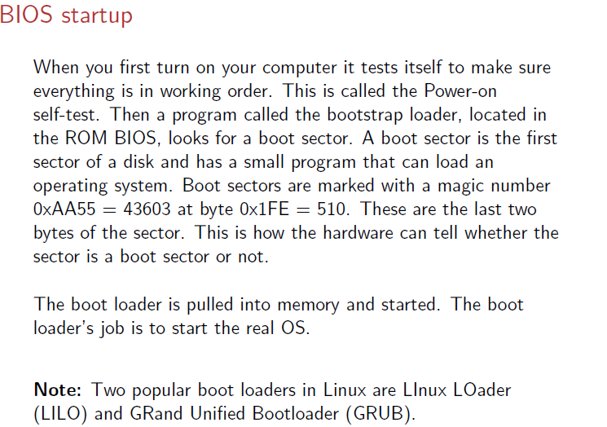

Slide 16
Powering Up : bootloader
Power on Reset
Loads the operating system from disk
  May also allow the user to select which OS to load (eg. Windows or Linux)
Other jobs done
  Disable interrupts :
    Don’t want to bother with interrupts at this stage
    Interrupts are re-enabled when OS is ready
  Setup GDT and IDT (Interrupt Descriptor Table)
  Switch modes (eg. Real Mode to Protected Mode)
  Switches to a mode where all features of processor can be used
Every register initialized
to 0 except
CS=0xf000, IP=0xfff0
BIOS
MBR Execution
Bootloader

Slide 17
Powering Up : OS
Power on Reset
Every register initialized
to 0 except
CS=0xf000, IP=0xfff0
Set up virtual memory
Initialize interrupt vectors
Initilize
  timers,
  monitors,
  hard disks,
  consoles,
  filesystems,
Initialize other processors (if any)
Startup user process
BIOS
MBR Execution
Bootloader
OS
Q: Does the bootloader stay in memory after starting the OS?

Slide 18
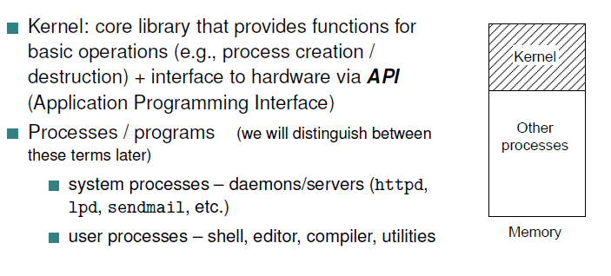
So OS kernel is loaded now…

Slide 19
A question
Why does not the BIOS load the kernel directly?
The BIOS was originally written for primitive 8-bit PCs with tiny disks, and literally cannot access enough of the disk to load the kernel directly. The boot loader step also lets you start one of several operating systems off different places on your disk, in the unlikely event that Unix is not good enough for you. In fact, Linux does not use the BIOS at all after the booting

Slide 20
The kernel in action
Once the kernel starts, it has to look around, find the rest of the hardware, and get ready to run programs. It does this by poking not at ordinary memory locations but rather at I/O ports – special addresses that are likely to have device controller cards listening at them for commands.
The kernel does not poke at random; it has a lot of built-in knowledge about what it is likely to find where, and how controllers will respond if they are present. This process is called autoprobing
Most of the messages you see at boot time are the kernel autoprobing your hardware through the I/O ports, figuring out what it has available to it and adapting itself to your machine
Getting the kernel fully loaded and running completes the first stage (sometimes called run level 1) of booting

Slide 21
Running OS with init
After completing run level 1, kernel hands over the control to a special process called init which spawns several housekeeping processes.
The init is a daemon process that continues running until the system is shut down
  Checks disks
  Start several other daemons
    A daemon is a program like a print spooler, a mail listener, a WWW server that remains in background, waiting for things to do
    Daemon processes coordinate among several requests that can conflict
  Other jobs mentioned in Slide 20

Slide 22
Logging in
The next step is to prepare for users. The init starts a copy of a program called getty to watch your console (and maybe more copies to watch dial-in serial ports).
This program is what issues the login prompt to your console.
At this level, you can log in and run programs.
Once all daemons and getty processes for each terminal are started, we are at run level 2
The next step is to start up various daemons that support other services. Once that is done, we are at run level 3 and the system is fully ready for use.

Slide 23
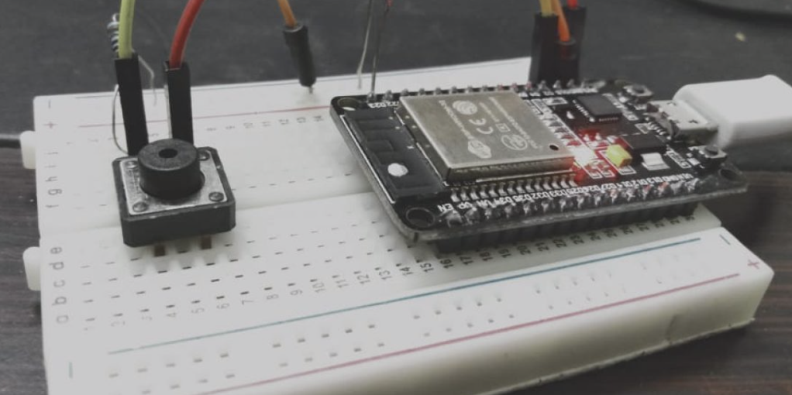
Powering up an
Embedded Device
Power on Reset
Every register initialized
to 0 except IP
Bootloader
Bare Metal Software
Operating System
reset
Applications

Slide 24
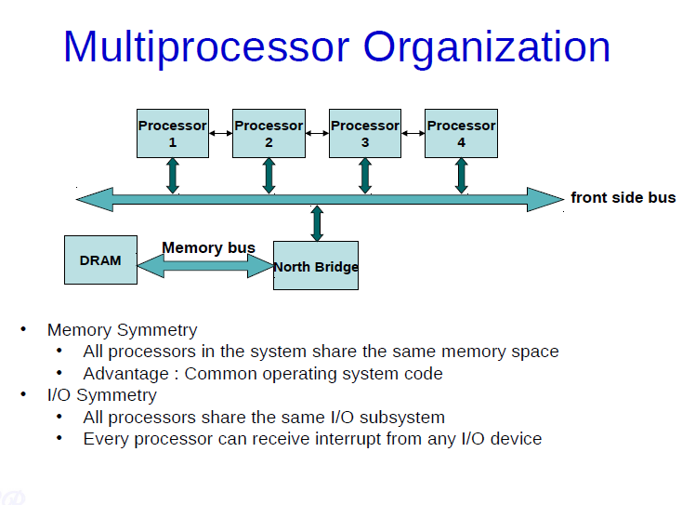

Slide 25
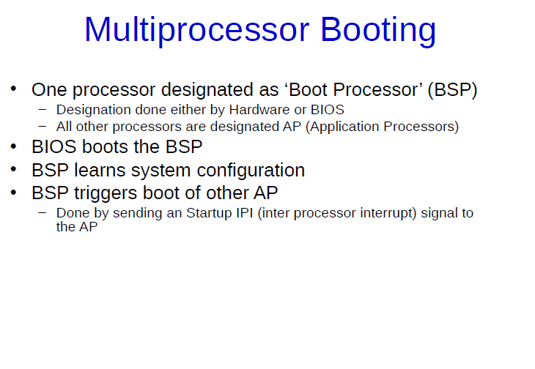

Slide 26
Chapter 3: Processes
Some additional slides
Taken from course
By Prof. Chester Rebeiro
On top of slides from
Textbook

Slide 27
Process Concept
An operating system executes a variety of programs that run as a process.
Process – a program in execution; process execution must progress in sequential fashion
Program is passive entity stored on disk (executable file); process is active
  Program becomes process when an executable file is loaded into memory
Execution of program started via GUI mouse clicks, command line entry of its name, etc.
One program can be several processes
  Consider multiple users executing the same program

Slide 28
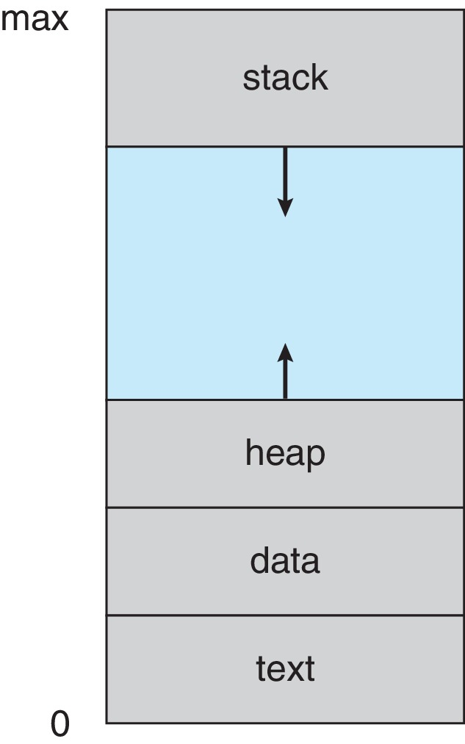
Process Concept
Multiple parts of a process
  The program code, also called text section
  Stack containing temporary data
    Function parameters, return addresses, local variables
    LIFO – Why?
  Data section containing global variables
  Heap containing memory dynamically allocated during run time
  Current activity including program counter, processor registers

Slide 29
Process in Memory

Slide 30
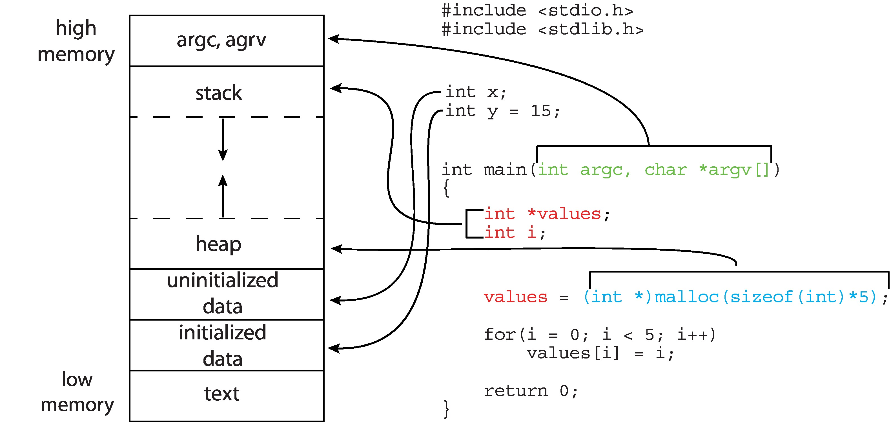
Memory Layout of a C Program

Slide 31
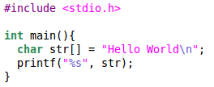
Process
Process
  A program in execution
  Most important abstraction in an OS
  Comprises of
    Code
    Data
    Stack
    Heap
    State in the OS
    Kernel stack
  State contains: registers, list of open files, related processes, etc.
In the
user space
of process
$gcc hello.c
Process
ELF
Executable
(a.out)
In the kernel space
$./a.out

Slide 32
Program ≠ Process
Program | Process
code + static and global data | Dynamic instantiation of code + data + heap + stack + process state
One program can create several processes | A process is unique isolated entity

Slide 33
Creating a Process by Cloning
Cloning
  Child process is an exact replica of the parent
  Fork system call
Parent
Child
Process 1
Process 1
Process 2
system call
fork
Kernel
(execute fork)
Kernel
(execute fork)
=>

Slide 34
Creating a Process by Cloning
(using fork system call)
In parent
  fork returns child pid
In child process
  fork returns 0
Other system calls
  Wait, returns pid of an exiting child
int pid;
pid = fork();
if (pid > 0){
printf(“Parent : child PID = %d”, pid);
pid = wait();
printf(“Parent : child %d exited\n”, pid);
} else{
printf(“In child process”);
exit(0);
}

Slide 35
Modifying Data in Parent or Child
Output
  parent : 0
  child : 1
int i=0, pid;
pid = fork();
if (pid > 0){
sleep(1);
printf("parent : %d\n", i);
wait();
} else{
i = i + 1;
printf("child : %d\n", i);
}

Slide 36
Modifying Data in Parent or Child
Output
  parent : 0
  child : 1
int i=0, pid;
pid = fork();
if (pid > 0){
sleep(1);
printf("parent : %d\n", i);
wait();
} else{
i = i + 1;
printf("child : %d\n", i);
}
printf(“Exiting now”);

Slide 37
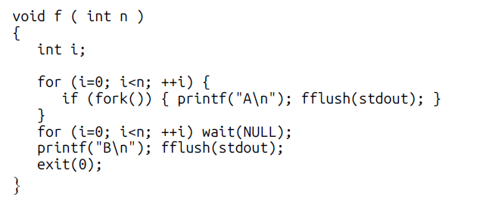
Exercise
Derive, as a function of n, how many A’s are printed by the call f(n)

Slide 38
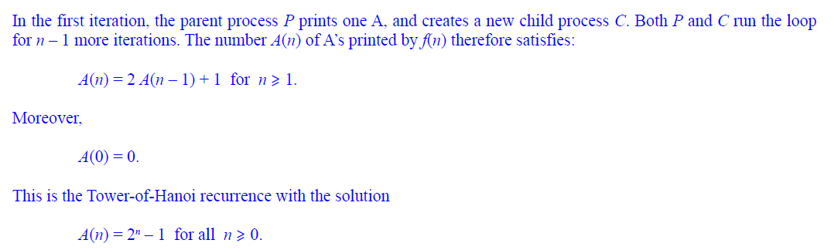
Solution

Slide 39
Slide acknowledgement
Prof. Chester Rebeiro
Prof. Malay Bhattacharya
Prof. Mandar Mitra

