Slide 1
Processes
Some additional slides
Taken from courses
By Prof. Chester Rebeiro,
Prof. Mandar Mitra,
Prof. Barsha Mitra
On top of slides from
Textbook

Slide 2
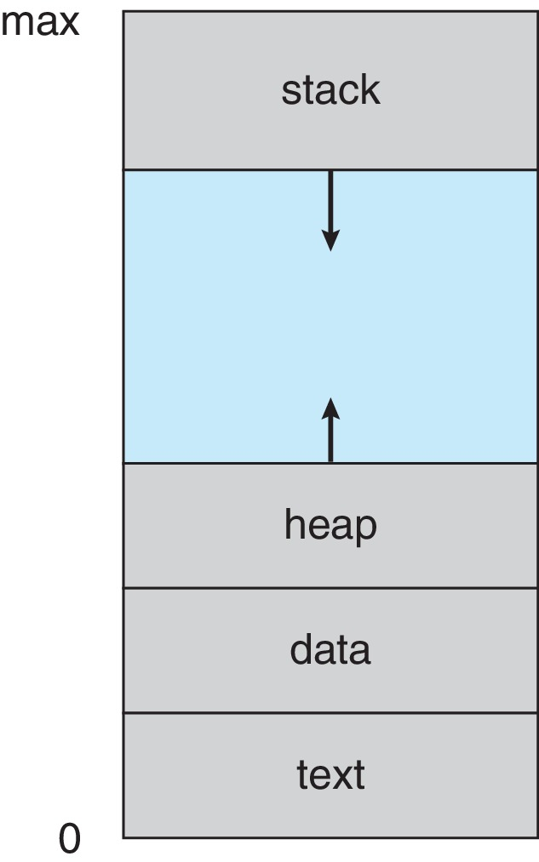
Process Concept
Multiple parts of a process
  The program code, also called text section
  Stack containing temporary data
    Function parameters, return addresses, local variables
    LIFO – Why?
  Data section containing global variables
  Heap containing memory dynamically allocated during run time
  Current activity including program counter, processor registers

Slide 3
Process Concept
Process – a program in execution; process execution must progress in sequential fashion
Program is passive entity stored on disk (executable file); process is active
  Program becomes process when an executable file is loaded into memory
Execution of program started via GUI mouse clicks, command line entry of its name, etc.
Stack
Heap
Data
Text
(instructions)
OS

Slide 4
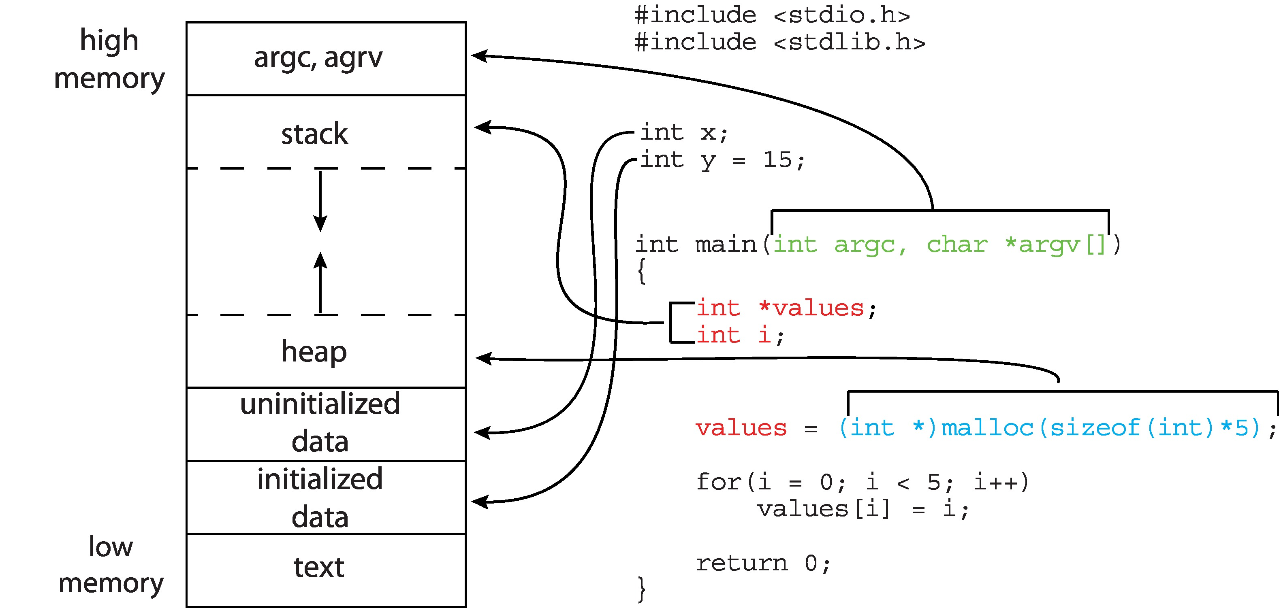
Memory Layout of a C Program

Slide 5
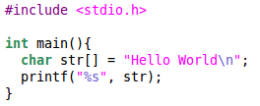
Process
Process
  A program in execution
  Most important abstraction in an OS
  Comprises of
    Code
    Data
    Stack
    Heap
    State in the OS
    Kernel stack
  State contains: registers, list of open files, related processes, etc.
In the
user space
of process
$gcc hello.c
Process
ELF
Executable
(a.out)
In the kernel space
$./a.out

Slide 6
Process Stacks
Each process has 2 stacks
  User space stack
    Used when executing user code
  Kernel space stack
    Used when executing kernel code (for eg. during system calls)
  Advantage : Kernel can execute even if user stack is corrupted
  (Attacks that target the stack, such as buffer overflow attack, will not affect the kernel)
Each process will have it’s own kernel stack
Why so many kernel stacks? Why not use the user stack? [Hint: Re-entrant kernel]
trampoline
trapframe
Heap
Kernel Stack for process
User stack
for process
Data
Text
(instructions)
Proc (PCB)
Process Address Space
Kernel Address Space

Slide 7
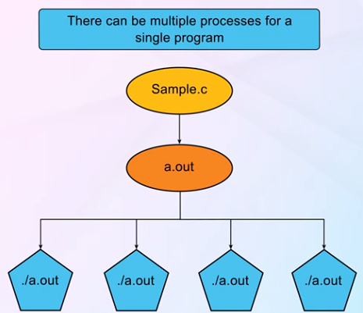
Program ≠ Process
Program | Process
code + static and global data | Dynamic instantiation of code + data + heap + stack + process state
One program can create several processes | A process is unique isolated entity

Slide 8
Operations on Processes
System must provide mechanisms for:
  Process creation
  Process termination

Slide 9
Creating a Process by Cloning
Cloning
  Child process is an exact replica of the parent
  Fork system call
Parent
Child
Process 1
Process 1
Process 2
system call
fork
Kernel
(execute fork)
Kernel
(execute fork)
=>

Slide 10
Process Creation
Use fork() for process creation
Child address space is a copy of the parent
  Same program
  Same Data
  Parent and child have their own copies of the variables
    Copy-On-Write (COW) optimization on Linux
Both child and parent continue execution at the instruction after fork()
fork() returns 0 to child, and pid of child to parent

Slide 11
Fork()
Parent
Child
Heap
Heap
Stack
Stack
Index
Index
Data
Data
Text
(instructions)
Text
(instructions)
Physical Memory

Slide 12
Copy-On-Write (COW)
Optimization on Linux
Child address space is same as the parent to begin with
  Copy only when there is a write

Slide 13
Copy-On-Write (COW)
When child writes to a variable
Parent
Child
Heap
Heap
Stack
Stack
Index
Index
Data
Data
Text
(instructions)
Text
(instructions)
Physical Memory

Slide 14

fork()
Defined in header file unistd.h
pid_t fork (void);
  Internally, pid_t is an integer (for POSIX systems)
  pid_t is defined in sys/types.h
#include <unistd.h>
#include <stdio.h>
int main() {
fork();
printf(“HELLO”):
return 0;
}

Slide 15
Another Example
#include <unistd.h>
#include <stdio.h>
int main() {
fork();
while (true);
return 0;
}

Slide 16
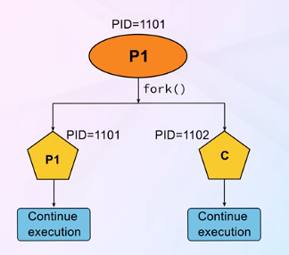
Process Creation flowchart

Slide 17
PID and PPID
getpid(), getppid() are defined in unistd.h
pid_t getpid (void); pid_t getppid(void);
RECALL: fork() returns 0 to child, and pid of child to parent
#include <unistd.h>
#include <stdio.h>
int main() {
pid_t p = fork();
if (p == 0) {
printf(“Child PID %d\n”, getpid());
printf(“Parent PID %d\n”, getppid());
}
else {
printf(“Parent PID %d\n”, getpid());
printf(“Parent PID %d\n”, getppid());
}
printf(“Exiting with %d\n”, getpid());
return 0;
}
Problem?

Slide 18
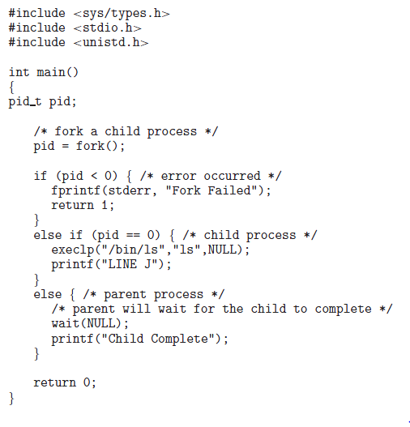
IMPORTANT

Slide 19
Quiz
int main()
{
if (fork() && fork()) {
printf("HELLO\n");
}
printf("PID = %d, PPID = %d\n", getpid(), getppid());
return 0;
}

Slide 20
Process Creation (Cont.)
Address space
  Child duplicate of parent
  Child has the same program (default) loaded into it
fork() system call creates new process
    Parent and child perform the same task
    Parent and child continue execution from the statement following the fork() call
    Parent and child can execute in parallel if we have more than 1 processor available
If parent needs to wait for the child?
  Parent process calls wait()waiting for the child to terminate

Slide 21

Example
Child prints Hello on console
Parent issues wait function call
  Definitely waits for child to
  get over
  wait(NULL) indicates that
  parent does not care about
  the status of child termination
  wait ensures the above order

Slide 22
wait()
pid_t wait (int * status); Defined in sys/wait.h
Calling process waits for the child
While the parent process is waiting for the child to terminate, the parent process transitions from running to waiting state
When child terminates (either explicitly calling exit or return or implicitly), its status is recorded in the variable status
  Parent gets to know the child exit status (normal or abnormal termination) – 0 if normal and non-zero for abnormal

Slide 23
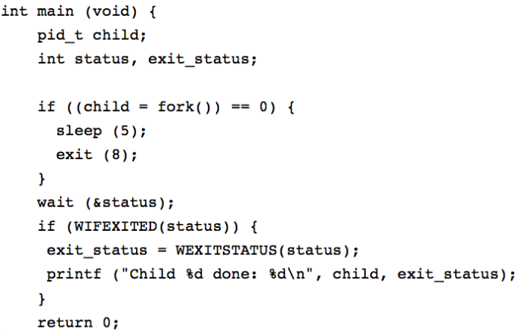
wait()
pid_t wait (int * status); Defined in sys/wait.h
Calling process waits for the child
When child terminates (either explicitly calling exit or return or implicitly), its status is recorded in the variable status
  Parent gets to know the child exit status (normal or abnormal termination) – 0 if normal and non-zero for abnormal
  }

Slide 24
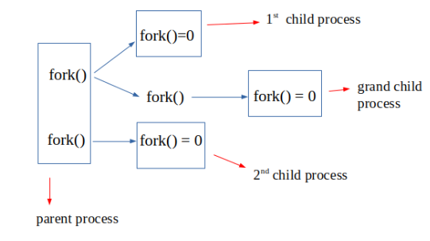
wait()
wait returns the pid of the terminated child
  Note: A parent can create multiple child processes

Slide 25
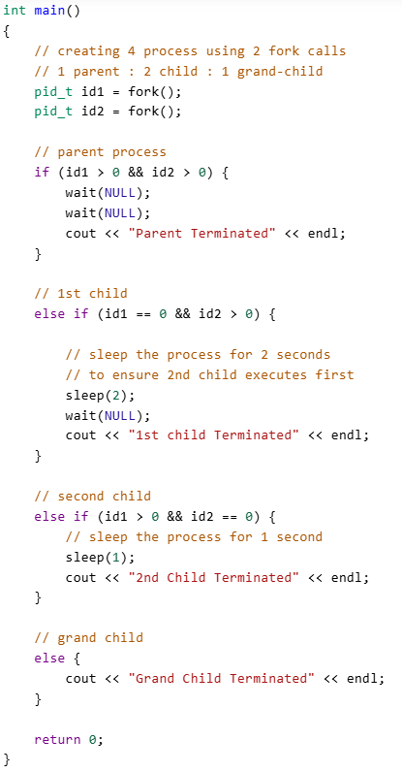

An example
Exercise: look at waitpid()
Create a program where the
Parent waits for multiple children
And listens to their status

Slide 26
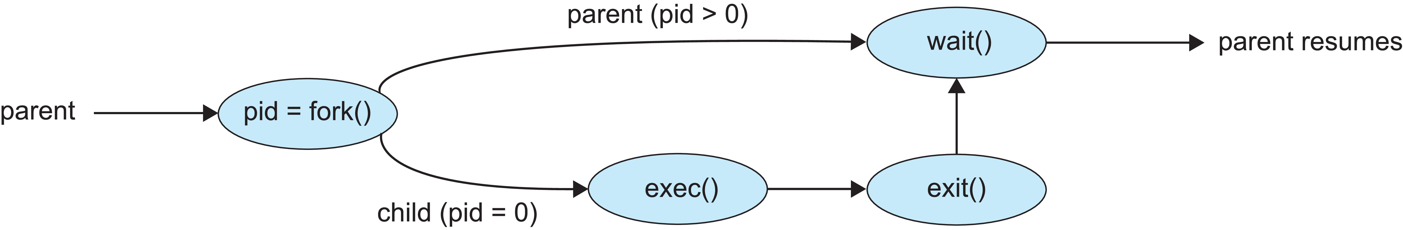
Parent and Child different tasks
exec() system call used after a fork() to replace the process’ memory space with a new program
  exec() family of functions
  Erase the current process image from child process
  Loads a new process image
Defined in unistd.h
int execlp (const char *path, const char *arg1, const char *arg2, .., const char *argN, NULL);
  path of the binary file to be loaded
  Strings arg specify the arguments / commands with which the binary file is to be executed
  NULL specifies the end of the argument list
NOTE: since the process image has been over-written, it does not return on successful execution – returns -1 only if error

Slide 27
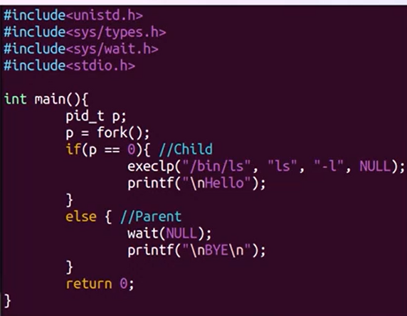
Some more examples
Parent waits
Question: Will hello
be printed?
BYE will be printed only
after ls –l output
Binary file corresponding to ls
has replaced the original binary file of the child

Slide 28
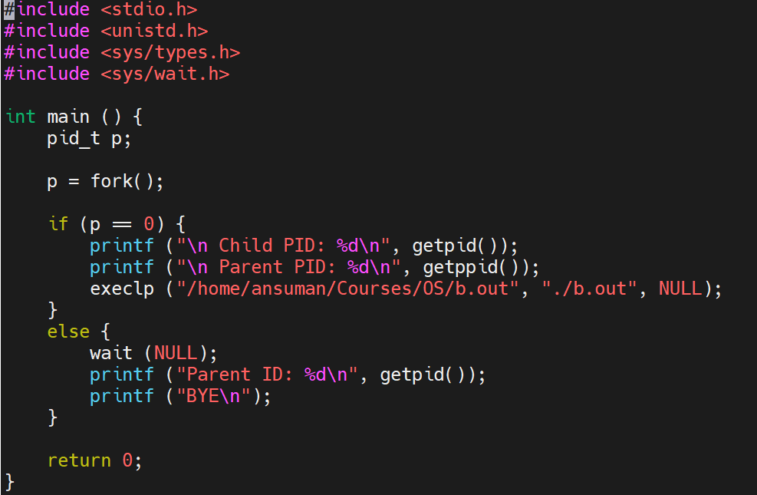
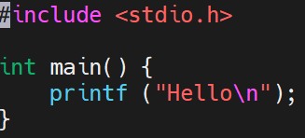
Some more examples
gcc b.c –o b.out
gcc a.c –o a.out
./a.out
b.c

Slide 29

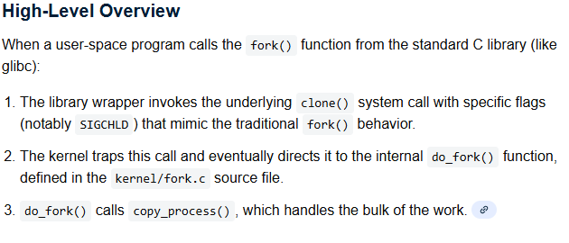
Inside the fork function

Slide 30
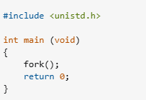

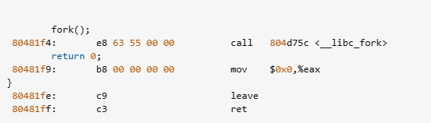
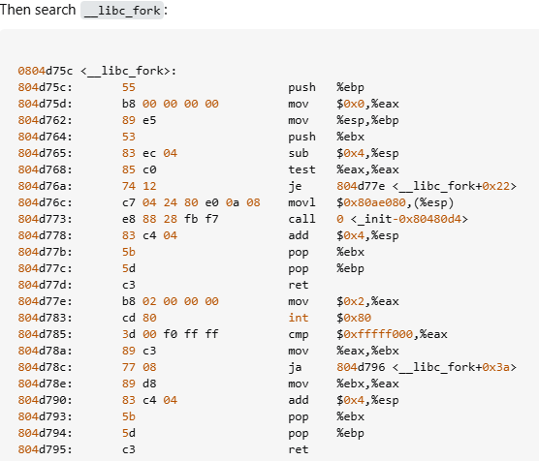
Inside the fork function
wget http://www.kernel.org/pub/linux/kernel/v2.6/linux-2.6.23.tar.bz2

