Slide 1
Chapter 5: CPU Scheduling

Slide 2
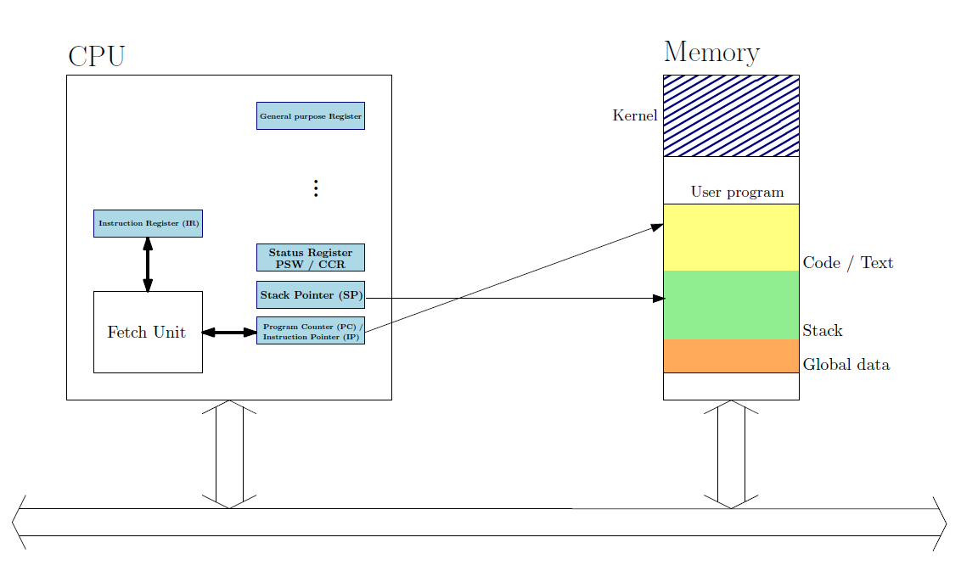
Review

Slide 3
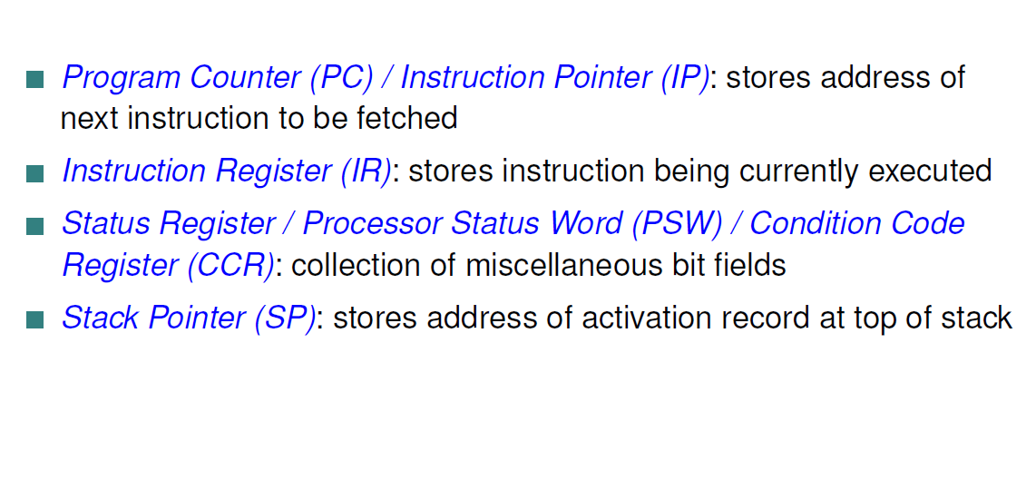
Review: Important Registers

Slide 4
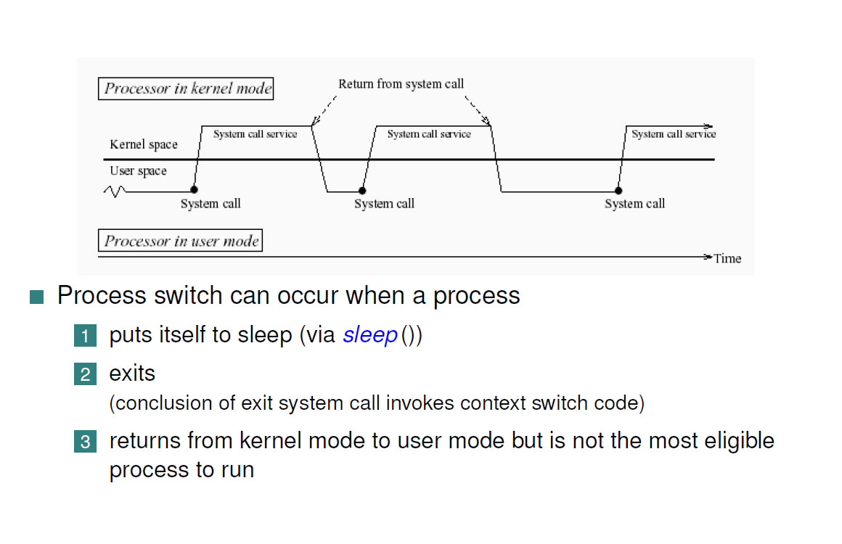
Process Switching

Slide 5
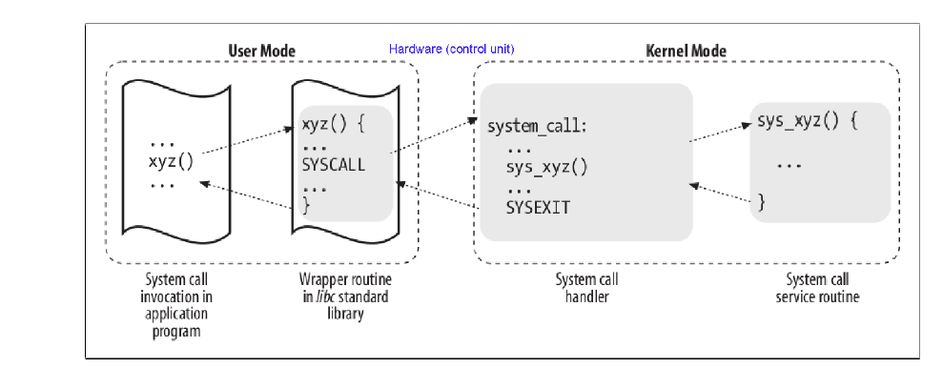
User mode to Kernel mode and back

Slide 6
CPU Scheduler
The CPU scheduler selects from among the processes in ready queue, and allocates a CPU core to one of them
  Queue may be ordered in various ways
CPU scheduling decisions may take place when a process:
  1. Switches from running to waiting state
  2. Switches from running to ready state
  3. Switches from waiting to ready
  Terminates
For situations 1 and 4, there is no choice in terms of scheduling. A new process (if one exists in the ready queue) must be selected for execution.
For situations 2 and 3, however, there is a choice.

Slide 7
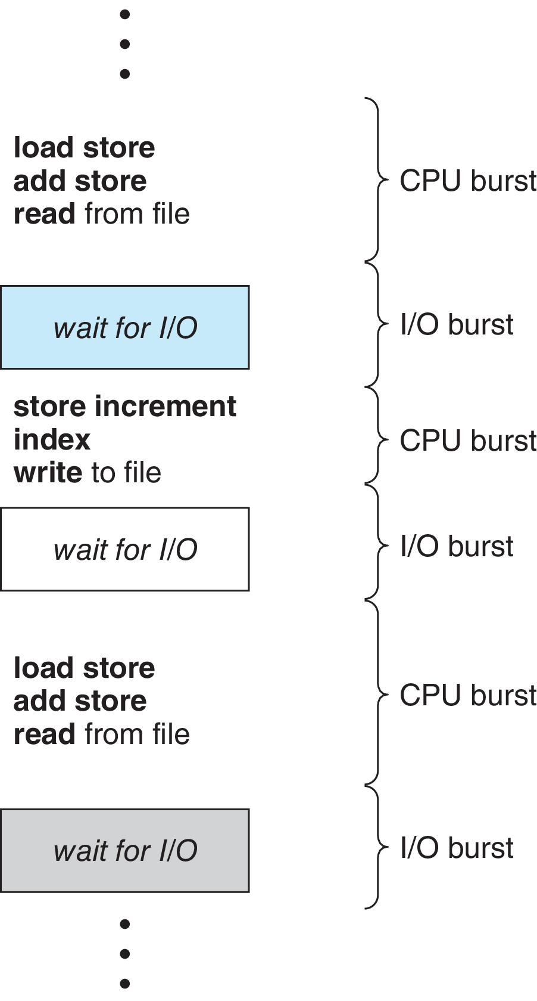
Nature of processes
Maximum CPU utilization obtained with multiprogramming
CPU–I/O Burst Cycle – Process execution consists of a cycle of CPU execution and I/O wait
CPU burst followed by I/O burst
CPU burst distribution is of main concern

Slide 8
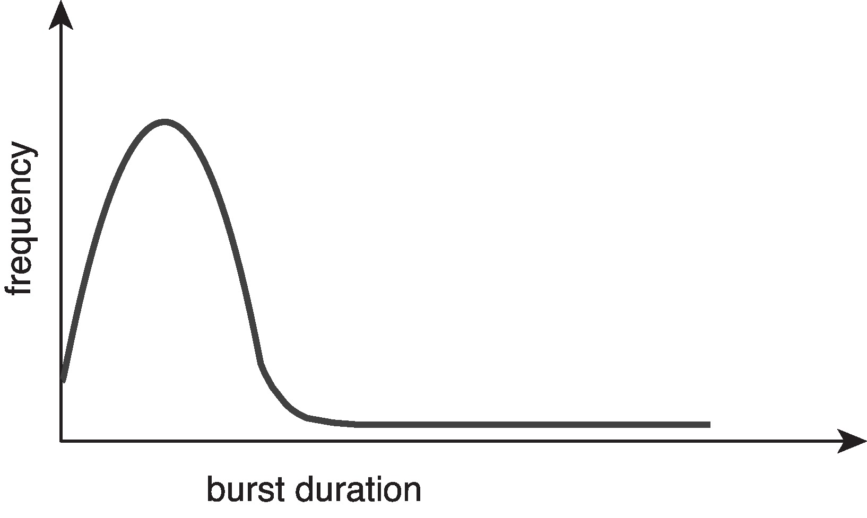
Histogram of CPU-burst Times
Large number of short bursts
Small number of longer bursts

Slide 9
Preemptive and Nonpreemptive Scheduling
When scheduling takes place only under circumstances 1 and 4, the scheduling scheme is nonpreemptive.
Otherwise, it is preemptive.
Under Nonpreemptive scheduling, once the CPU has been allocated to a process, the process keeps the CPU until it releases it either by terminating or by switching to the waiting state.
Virtually all modern operating systems including Windows, MacOS, Linux, and UNIX use preemptive scheduling algorithms.

Slide 10
Preemptive Scheduling and Race Conditions
Preemptive scheduling can result in race conditions when data are shared among several processes.
Consider the case of two processes that share data. While one process is updating the data, it is preempted so that the second process can run. The second process then tries to read the data, which are in an inconsistent state.
This issue will be explored in detail later

Slide 11
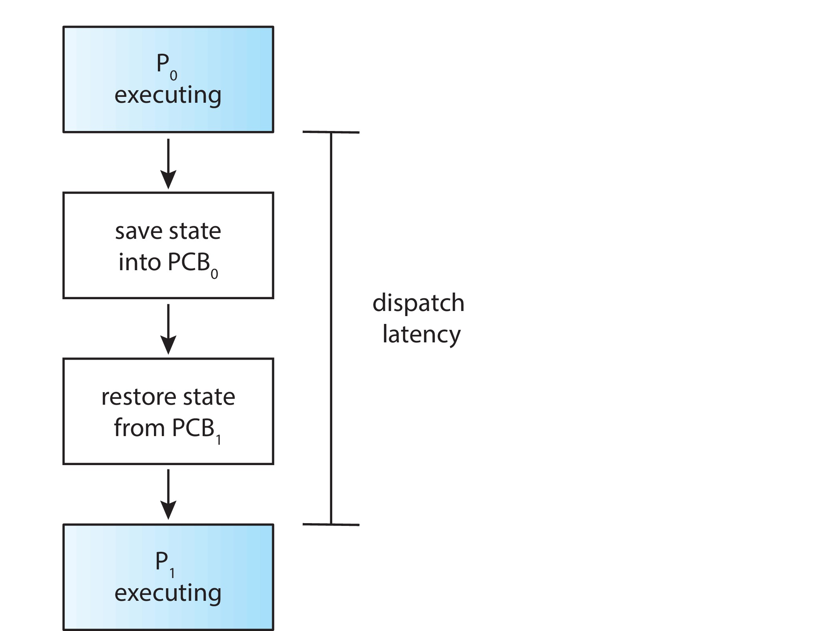
Dispatcher
Dispatcher module gives control of the CPU to the process selected by the CPU scheduler; this involves:
  Switching context
  Switching to user mode
  Jumping to the proper location in the user program to restart that program
Dispatch latency – time it takes for the dispatcher to stop one process and start another running

Slide 12
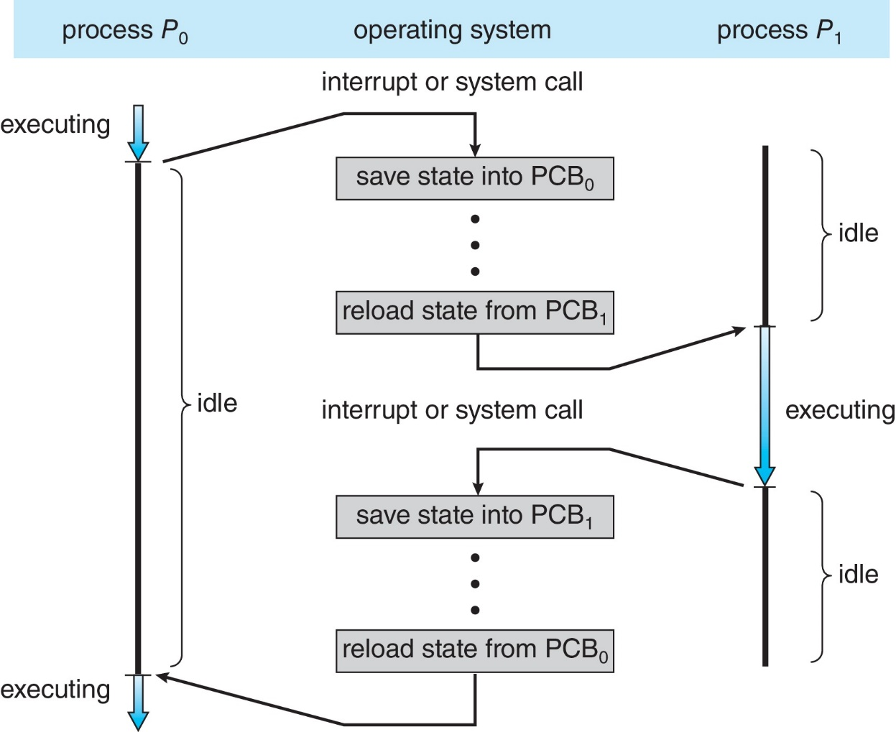
CPU Switch From Process to Process
A context switch occurs when the CPU switches from one process to another.

Slide 13
Context Switch
When CPU switches to another process, the system must save the state of the old process and load the saved state for the new process via a context switch
Context of a process represented in the PCB
Context-switch time is pure overhead; the system does no useful work while switching
  The more complex the OS and the PCB ➔ the longer the context switch
Time dependent on hardware support
  Some hardware provides multiple sets of registers per CPU ➔ multiple contexts loaded at once

Slide 14
Scheduling Criteria
CPU utilization – keep the CPU as busy as possible
Throughput – # of processes that complete their execution per time unit
Turnaround time – amount of time to execute a particular process
Waiting time – amount of time a process has been waiting in the ready queue
Response time – amount of time it takes from when a request was submitted until the first response is produced.

Slide 15
Scheduling Algorithm Optimization Criteria
Max CPU utilization
Max throughput
Min turnaround time
Min waiting time
Min response time

Slide 16
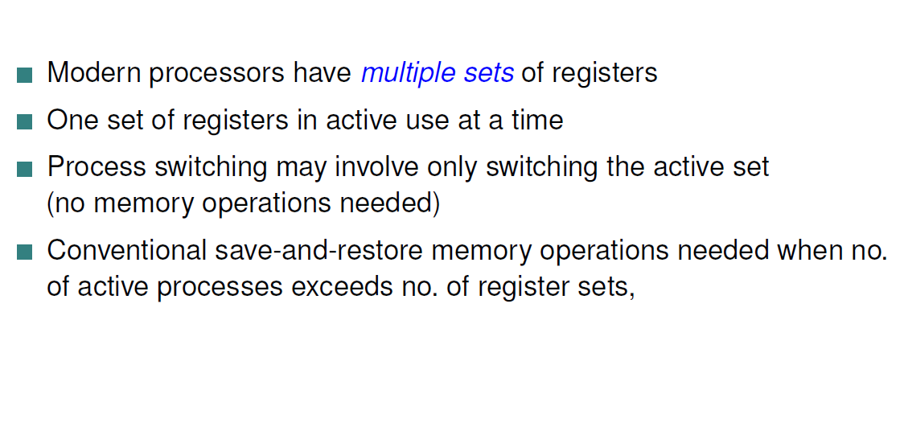
HyperThreading

Slide 17
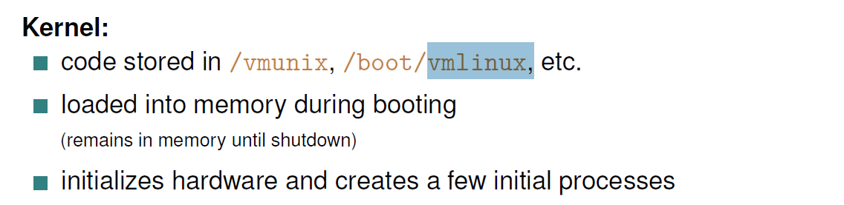
Linux code
Scheduling code: kernel/sched/core.c

Slide 18
FCFS Scheduling
(First Come First Serve)
First job that requests the CPU gets the CPU
Non preemptive
  Process continues till the burst cycle ends

Slide 19
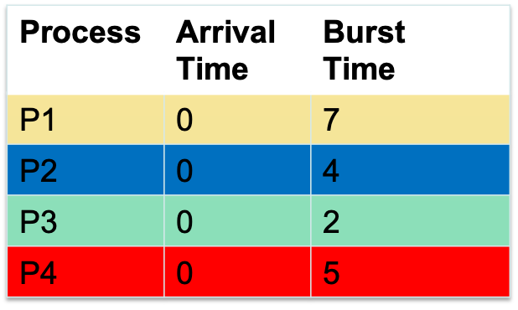
FCFS Example
Average Waiting Time
= (0 + 7 + 11 + 13) / 4
= 7.75
Average Response Time
= (0 + 7 + 11 + 13) / 4
= 7.75
(same as Average Waiting Time)
Gantt Chart
P1
P2
P3
P4
time
Notes:
A Gantt chart is a horizontal bar chart developed as a production control tool in 1917 by Henry L. Gantt, an American engineer and social scientist.

Slide 20
First- Come, First-Served (FCFS) Scheduling
Process Burst Time
P₁ 24
P₂ 3
P₃ 3
Suppose that the processes arrive in the order: P₁ , P₂ , P₃
The Gantt Chart for the schedule is:
Waiting time for P₁ = 0; P₂ = 24; P₃ = 27
Average waiting time: (0 + 24 + 27)/3 = 17

Slide 21
FCFS Scheduling (Cont.)
Suppose that the processes arrive in the order:
P₂ , P₃ , P₁
The Gantt chart for the schedule is:
Waiting time for P₁ = 6; P₂ = 0; P₃ = 3
Average waiting time: (6 + 0 + 3)/3 = 3
Much better than previous case

Slide 22
FCFS Pros and Cons
Advantages
  Simple
  Fair (as long as no process hogs the CPU, every process will eventually run)
Disadvantages
  Waiting time depends on arrival order
  short processes stuck waiting for long process to complete
    Convoy effect: Consider one CPU-bound and many I/O-bound processes

Slide 23
Shortest-Job-First (SJF) Scheduling
Associate with each process the length of its next CPU burst
  Use these lengths to schedule the process with the shortest time
SJF is optimal – gives minimum average waiting time for a given set of processes
Preemptive version called shortest-remaining-time-first
How do we determine the length of the next CPU burst?
  Predicting the future
  Could ask the user
  Estimate
Can lead to starvation for long jobs

Slide 24
Example of SJF
Process Burst Time
P₁ 6
P₂ 8
P₃ 7
P₄ 3
SJF scheduling chart
Average waiting time = (3 + 16 + 9 + 0) / 4 = 7

Slide 25
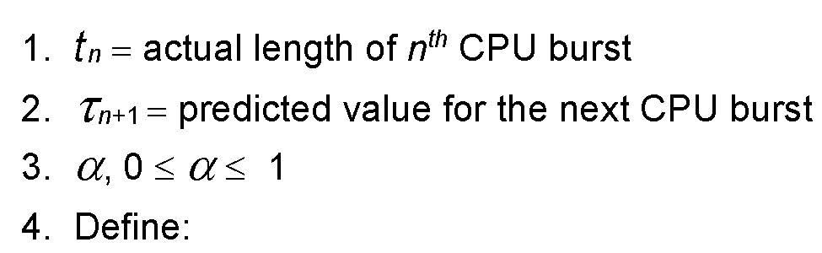

Determining Length of Next CPU Burst
Can only estimate the length – should be similar to the previous one
  Then pick process with shortest predicted next CPU burst
Can be done by using the length of previous CPU bursts, using exponential averaging
Commonly, α set to ½

Slide 26
Examples of Exponential Averaging
α =0
  τ_{n+1} = τ_{n}
  Recent history does not count
α =1
  τ_{n+1} = α t_{n}
  Only the actual last CPU burst counts
If we expand the formula, we get:
    τ_{n+1} = α t_{n}+(1 - α)α t_{n} ₋₁ + …
    +(1 - α )^{j} α t_{n} _{-j} + …
    +(1 - α )^{n +1} τ₀
Since both α and (1 - α) are less than or equal to 1, each successor predecessor term has less weight than its predecessor

Slide 27
Shortest Remaining Time First Scheduling
Preemptive version of SJN
Whenever a new process arrives in the ready queue, the decision on which process to schedule next is redone using the SJN algorithm.
Further reduces average waiting time and average response time

Slide 28

SRTF Example
Average wait time
= (7 + 0 + 2 + 1) / 4
= 2.5
Average response time
= (0 + 0 + 2 + 1) / 4
= 0.75
Gantt Chart
Arrival
P1
P2
P3
P4
Schedule
P1
P2
P3
P4
P1
P2 burst is 4, P1 remaining is 5
(preempt P1)
P3 burst is 2, P2 remaining is 2
(no preemption)

Slide 29
Example of Shortest-remaining-time-first
Now we add the concept of preemption to the analysis
Process i Arrival TimeT Burst Time
P₁ 0 8
P₂ 1 4
P₃ 2 9
P₄ 3 5
Preemptive SJF Gantt Chart
Average waiting time = [(10-1)+(1-1)+(17-2)+(5-3)]/4 = 26/4 = 6.5

Slide 30
Round Robin Scheduling
Run process for a time slice then move to FIFO

Slide 31
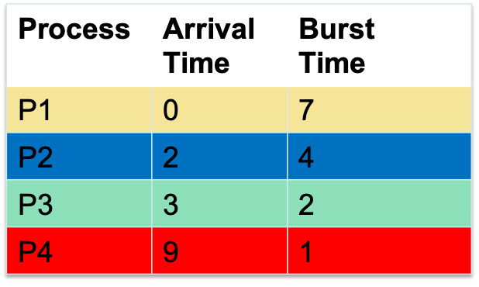
Round Robin Scheduling
Time slice = 2
Average Waiting time
= (7 + 4 + 3 + 3) / 4
= 4.25
Average Response Time
= (0 + 0 + 3 + 3) / 4
= 1.5
#Context Switches = 7
Arrival
P1 |  | P2 | P3 |  |  |  |  |  | P4
P1 |  | P2 |  | P1 |  | P3 |  | P2 |  | P1 |  | P4 | P1
 |  | P1 | P1 P3 | P3 P2 |  | P2 P1 |  | P1 | P1 P4 | P4 P1 |  | P1
schedule
FIFO

Slide 32
Round Robin (RR)
Each process gets a small unit of CPU time (time quantum q), usually 10-100 milliseconds. After this time has elapsed, the process is preempted and added to the end of the ready queue.
If there are n processes in the ready queue and the time quantum is q, then each process gets 1/n of the CPU time in chunks of at most q time units at once.
No process waits more than (n-1)q time units.
Timer interrupts every quantum to schedule next process
Performance
  q large ⇒ FIFO (FCFS)
  q small ⇒ RR
Note that q must be large with respect to context switch, otherwise overhead is too high

Slide 33
Example of RR with Time Quantum = 4
Process Burst Time
P₁ 24
P₂ 3
P₃ 3
The Gantt chart is:
Typically, higher average turnaround than SJF, but better response
q should be large compared to context switch time
  q usually 10 milliseconds to 100 milliseconds,
  Context switch < 10 microseconds

Slide 34
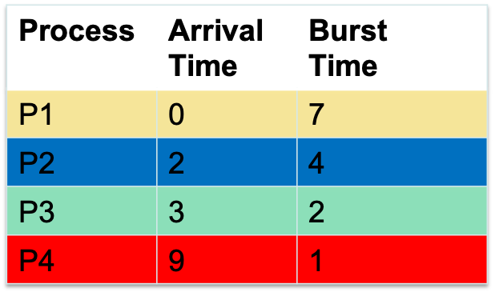
Example (smaller timeslice)
Time slice = 1
Average Waiting time
= (7 + 6 + 3 + 1) / 4
= 4.25
Average Response Time
= (0 + 0 + 1 + 1) / 4
= 1/2
#Context Switches = 11
Arrival
P1 |  | P2 | P3 |  |  |  |  |  | P4
P1 |  | P2 | P1 | P3 | P2 | P1 | P3 | P2 | P1 | P4 | P2 | P1 | P1
 |  | P1 | P3 P2 | P2 P1 | P1 P3 | P3 P2 | P2 P1 | P1 | P4 P2 | P2 P1 | P1
schedule
FIFO
More context switches but quicker response times

Slide 35
Example (larger timeslice)
Time slice = 5
Average Waiting time
= (7 + 3 + 6 + 2) / 4
= 4.25
Average Response Time
= (0 + 3 + 6 + 2) / 4
= 2.75
#Context Switches = 4
Arrival
P1 |  | P2 | P3 |  |  |  |  |  | P4
P1 |  |  |  |  | P2 |  |  |  | P3 |  | P4
 |  | P2 | P2 P3 | P2 P3 | P3 P1 | P3 P1 | P3 P1 | P3 P1 | P4 P1 | P4 P1 | P1
schedule
FIFO
Lesser context switches but looks more like FCFS (bad response time)

Slide 36
Round Robin Scheduling
Advantages
  Fair (Each process gets a fair chance to run on the CPU)
  Low average wait time, when burst times vary
  Faster response time
Disadvantages
  Increased context switching
    Context switches are overheads!!!
  High average wait time, when burst times have equal lengths

Slide 37
Need to adjust time slice
Depends on nature of application
Response time important → shorter time slice
Relook

Slide 38
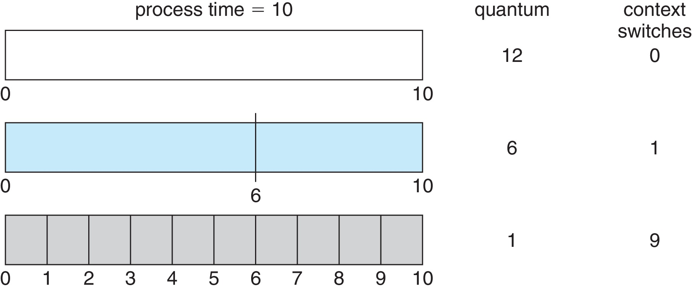
Time Quantum and Context Switch Time

Slide 39
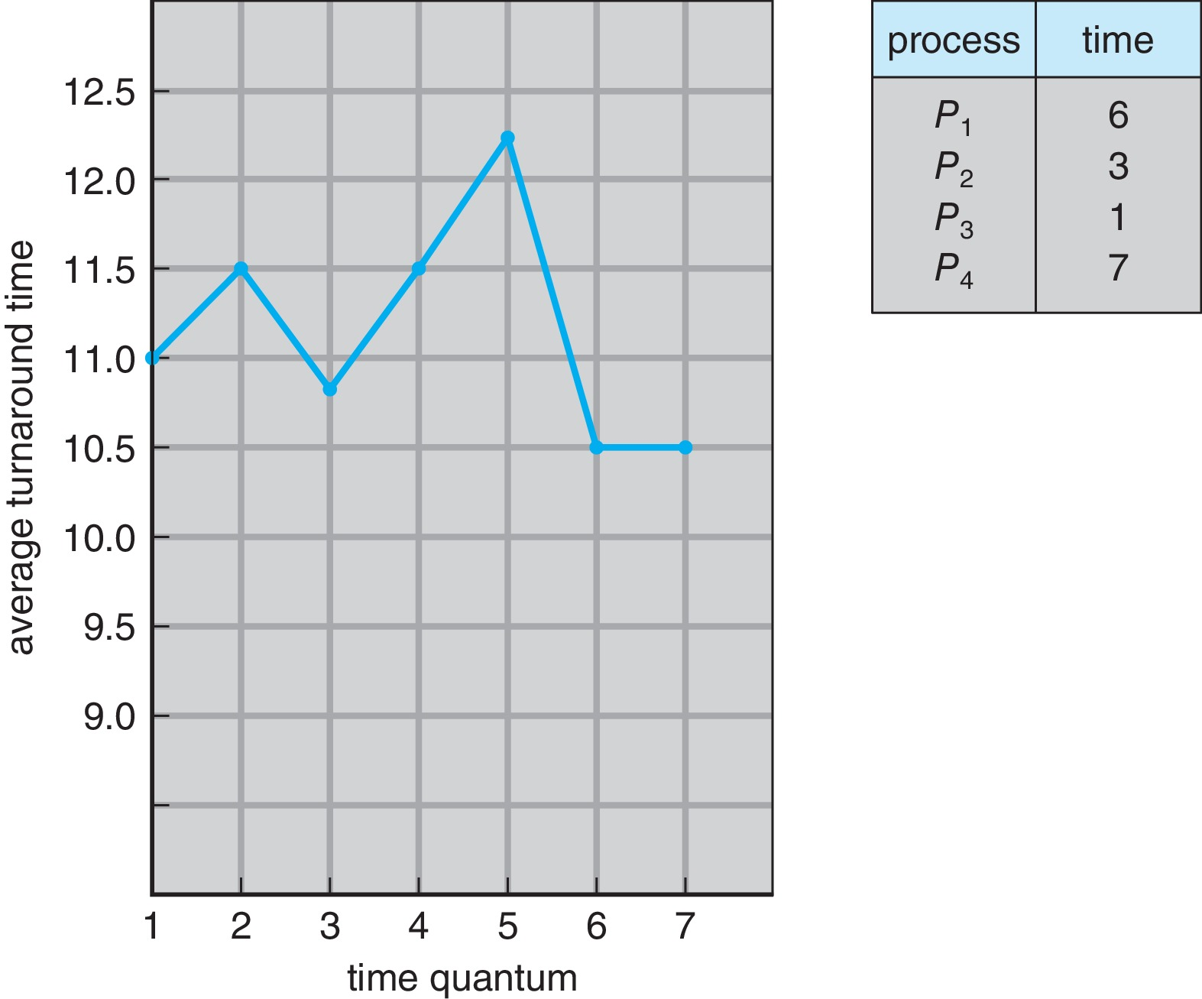
Turnaround Time Varies With The Time Quantum
80% of CPU bursts should be shorter than q

Slide 40
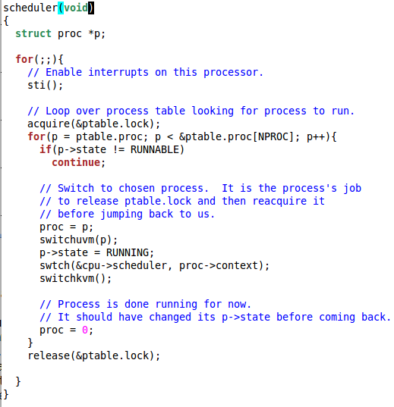
xv6 Scheduler Policy
Decided by the
Scheduling Policy
The xv6 schedule
Policy
--- Strawman Scheduler
organize processes in a list
pick the first one that
is runnable
put suspended task the
end of the list
Far from ideal!!
only round robin
scheduling policy
does not support
priorities
Notes:
Far from Ideal !!!
---- can only have round robin scheduling
---- cannot prioritize

