Slide 1
Round Robin Scheduling
Run process for a time slice then move to FIFO

Slide 2
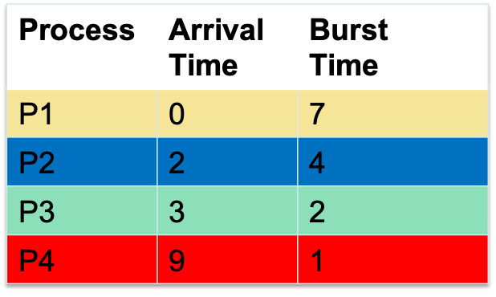
Round Robin Scheduling
Time slice = 2
Average Waiting time
= (7 + 4 + 3 + 3) / 4
= 4.25
Average Response Time
= (0 + 0 + 3 + 3) / 4
= 1.5
#Context Switches = 7
Arrival
P1 |  | P2 | P3 |  |  |  |  |  | P4
P1 |  | P2 |  | P1 |  | P3 |  | P2 |  | P1 |  | P4 | P1
 |  | P1 | P1 P3 | P3 P2 |  | P2 P1 |  | P1 | P1 P4 | P4 P1 |  | P1
schedule
FIFO

Slide 3
Round Robin (RR)
Each process gets a small unit of CPU time (time quantum q), usually 10-100 milliseconds. After this time has elapsed, the process is preempted and added to the end of the ready queue.
If there are n processes in the ready queue and the time quantum is q, then each process gets 1/n of the CPU time in chunks of at most q time units at once.
No process waits more than (n-1)q time units.
Timer interrupts every quantum to schedule next process
Performance
  q large ⇒ FIFO (FCFS)
  q small ⇒ RR
Note that q must be large with respect to context switch, otherwise overhead is too high

Slide 4

Example of RR with Time Quantum = 4
Process Burst Time
P₁ 24
P₂ 3
P₃ 3
The Gantt chart is:
Typically, higher average turnaround than SJF, but better response
q should be large compared to context switch time
  q usually 10 milliseconds to 100 milliseconds,
  Context switch < 10 microseconds

Slide 5
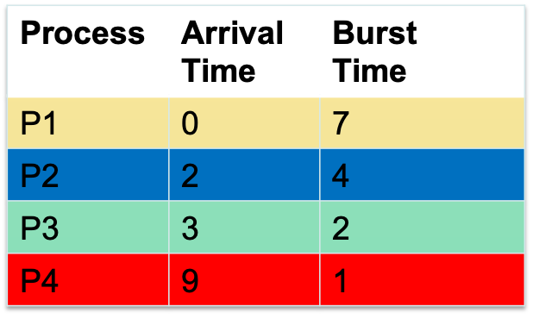
Example (smaller timeslice)
Time slice = 1
Average Waiting time
= (7 + 6 + 3 + 1) / 4
= 4.25
Average Response Time
= (0 + 0 + 1 + 1) / 4
= 1/2
#Context Switches = 11
Arrival
P1 |  | P2 | P3 |  |  |  |  |  | P4
P1 |  | P2 | P1 | P3 | P2 | P1 | P3 | P2 | P1 | P4 | P2 | P1 | P1
 |  | P1 | P3 P2 | P2 P1 | P1 P3 | P3 P2 | P2 P1 | P1 | P4 P2 | P2 P1 | P1
schedule
FIFO
More context switches but quicker response times

Slide 6
Example (larger timeslice)
Time slice = 5
Average Waiting time
= (7 + 3 + 6 + 2) / 4
= 4.25
Average Response Time
= (0 + 3 + 6 + 2) / 4
= 2.75
#Context Switches = 4
Arrival
P1 |  | P2 | P3 |  |  |  |  |  | P4
P1 |  |  |  |  | P2 |  |  |  | P3 |  | P4
 |  | P2 | P2 P3 | P2 P3 | P3 P1 | P3 P1 | P3 P1 | P3 P1 | P4 P1 | P4 P1 | P1
schedule
FIFO
Lesser context switches but looks more like FCFS (bad response time)

Slide 7
Round Robin Scheduling
Advantages
  Fair (Each process gets a fair chance to run on the CPU)
  Low average wait time, when burst times vary
  Faster response time
Disadvantages
  Increased context switching
    Context switches are overheads!!!
  High average wait time, when burst times have equal lengths

Slide 8
Need to adjust time slice
Depends on nature of application
Response time important → shorter time slice
Relook

Slide 9
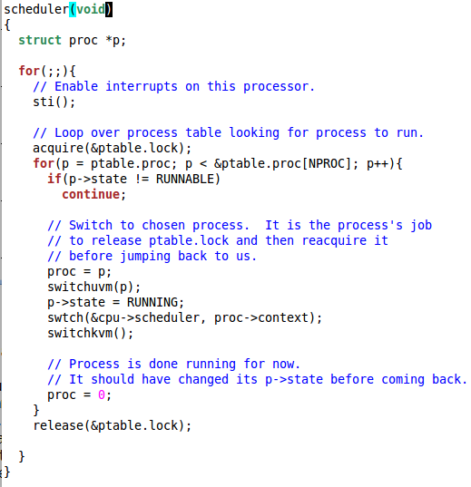
xv6 Scheduler Policy
Decided by the
Scheduling Policy
The xv6 schedule
Policy
--- Strawman Scheduler
organize processes in a list
pick the first one that
is runnable
put suspended task the
end of the list
Far from ideal!!
only round robin
scheduling policy
does not support
priorities
Notes:
Far from Ideal !!!
---- can only have round robin scheduling
---- cannot prioritize

Slide 10
How to Implement RR in the Kernel?
FIFO Queue, as in FCFS
But preempt job after quantum expires, and send it to the back of the queue
  How? Timer interrupt!
  And, of course, careful synchronization

Slide 11
Priority Based Scheduling Algorithms

Slide 12
Relook at Round Robin Scheduling
Time slice = 1
Process P2 is a critical process while
process P1, P3, and P4 are less critical
Process P2 is delayed considerably
Arrival
P1 |  | P2 | P3 |  |  |  |  |  | P4
P1 |  | P2 | P1 | P3 | P2 | P1 | P3 | P2 | P1 | P4 | P2 | P1 | P1
schedule

Slide 13
Priorities
Time slice = 1
Process P2 is a critical process while
process P1, P3, and P4 are less critical
We need a higher priority for P2,
compared to the other processes
_x0018_
This leads to priority based scheduling
algorithms _x0018_
Arrival
P1 |  | P2 | P3 |  |  |  |  |  | P4
P1 |  | P2 |  |  |  | P1
schedule

Slide 14

Starvation
Time slice = 1
Low priority process may never get a
chance to execute.
P4 is a low priority process
Arrival
P1 |  | P2 | P3 |  |  |  |  |  | P4
P1 |  | P2 |  |  |  | P1
schedule

Slide 15
Priority based Scheduling
Priority based Scheduling
  Each process is assigned a priority
    A priority is a number in a range (for instance between 0 and 255)
    A small number would mean high priority while a large number would mean low priority
  Scheduling policy : pick the process in the ready queue having the highest priority
  Advantage : mechanism to provide relative importance to processes
  Disadvantage:
    Could lead to starvation of low priority processes
    Slow?
Notes:
Compute intensive --- like factorizing a number

Slide 16
Dealing with Starvation
Scheduler adjusts priority of processes to ensure that they all eventually execute
Several techniques possible. For example,
  Every process is given a base priority
  After every time slot increment the priority of all other process
    This ensures that even a low priority process will eventually execute
  After a process executes, its priority is reset

Slide 17
Priorities are of two types
Static priority : typically set at start of execution
  If not set by user, there is a default value (base priority)
Dynamic priority : scheduler can change the process priority during execution in order to achieve scheduling goals
  eg1. decrease priority of a process to give another process a chance to execute
  eg.2. increase priority for I/O bound processes

Slide 18
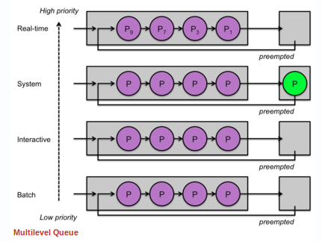
Multilevel Queues
Processes assigned to a priority classes
Each class has its own ready queue
Scheduler picks the highest priority queue (class) which has at least one ready process
Selection of a process within the class could have its own policy
  Typically round robin (but can be changed)
  High priority classes can implement first come first serve in order to ensure quick response time for critical tasks
Notes:
Priority classes allows us to categorize and separate system processes, interactive processes, low-priority interactive processes, and background non-interactive processes.

Slide 19
More on Multilevel Queues
Scheduler can adjust time slice based on the queue class picked
  I/O bound process can be assigned to higher priority classes with longer time slice
  CPU bound processes can be assigned to lower priority classes with shorter time slices
Disadvantage :
  Class of a process must be assigned apriori
Notes:
Not the most efficient way to do things
…. May not be able to predict the best class for a process
…. A process behavior may toggle between I/O bound and CPU bound
…. A process may be both IO bound and CPU bound (eg. X windows server)

Slide 20
Multilevel feedback Queues
Process dynamically moves between priority classes based on its CPU/ IO activity
Basic observation
  CPU bound process’ likely to complete its entire timeslice
  IO bound process’ may not complete the entire time slice
1
2
3
3
1
4
2
3
4
4
time
Process 1 and 4 likely CPU bound
Process 2 likely IO bound

Slide 21
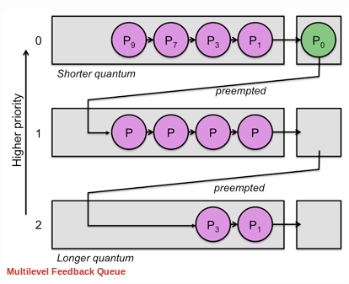
Multilevel feedback Queues
(basic Idea)
All processes start in the highest priority class
If it finishes its time slice (likely CPU bound)
  Move to the next lower priority class
If it does not finish its time slice (likely IO bound)
  Keep it on the same priority class
As with any other priority based scheduling scheme, starvation needs to be dealt with
Notes:
Does not finish its timeslice → block before time slice completes

Slide 22

Example of Multilevel Feedback Queue
Three queues:
  Q₀ – RR with time quantum 8 milliseconds
  Q₁ – RR time quantum 16 milliseconds
  Q₂ – FCFS
Scheduling
  A new process enters queue Q₀ which is served in RR
    When it gains CPU, the process receives 8 milliseconds
    If it does not finish in 8 milliseconds, the process is moved to queue Q₁
  At Q₁ job is again served in RR and receives 16 additional milliseconds
    If it still does not complete, it is preempted and moved to queue Q₂

Slide 23
Summary of Multi Level Queues
Multiple Queues at various levels
Static Priority, base priority
Dynamic priority set based on some heuristics
  IO bound processes should have a higher priority than CPU bound processes
Timeslice changed dynamically based on heuristics
Starvation dealt with
  Every process, even the lowest priority process should execute.
Notes:
Does not finish its timeslice → block before time slice completes

Slide 24
Gaming the System
A compute intensive process can trick the scheduler and remain in the high priority queue (class)
Sleep will force a context switch
while(1){
do some work for most of the time slice
sleep(till the end of the time slice)
}
Process 4 is gaming
the system
1
2
3
3
1
4
2
3
4
4
time

Slide 25
Scheduling in Linux
Daniel P. Bovet and Marco Cesati, Understanding the Linux Kernel, 3rd Edition

Slide 26
Process Types
Real time
  Deadlines that have to be met strictly
  Should never be blocked by a low priority task
  Invoke a system call to let OS know
Normal Processes
  Interactive (mostly I/O bound)
    Constantly interact with their users, therefore spend a lot of time waiting for key presses and mouse operations.
    When input is received, the process must wake up quickly (delay must be between 50 to 150 ms)
  Batch (Matrix Multiplication, ML..)
    Does not require any user interaction, often runs in the background.
  Note: Same program can switch between the different phases
Notes:
Real Time : eg. Robot control, data acquition from physical sensors

Slide 27
Process Types
Real time
  Deadlines that have to be met
  Should never be blocked by a low priority task
Normal Processes
  Interactive
    Constantly interact with their users, therefore spend a lot of time waiting for key presses and mouse operations.
    When input is received, the process must wake up quickly (delay must be between 50 to 150 ms)
  Batch
    Do not require any user interaction, often run in the background.
Once a process is specified real time, it is always considered a real time process
Notes:
Real Time : eg. Robot control, data acquition from physical sensors

Slide 28
Process Types
Real time
  Deadlines that have to be met
  Should never be blocked by a low priority task
Normal Processes
  Interactive
    Constantly interact with their users, therefore spend a lot of time waiting for key presses and mouse operations.
    When input is received, the process must wake up quickly (delay must be between 50 to 150 ms)
  Batch
    Do not require any user interaction, often run in the background.
A process may act as an interactive process for some time and then become a batch process.
Linux uses sophisticated heuristics based on past behavior of the process to decide whether a given process should be considered interactive or batch and adjust dynamic priority as needed
Notes:
Real Time : eg. Robot control, data acquition from physical sensors

Slide 29
History
O(n) scheduler (n = #processes in the ready queue)
  Linux 2.4 to 2.6
O(1) scheduler
  Linux 2.6 to 2.6.22
CFS scheduler
  Linux 2.6.23 onwards
EEVDF (Earliest Eligible Virtual Deadline First
  Replaced the long standing CFS in kernel 6.6

Slide 30
O(n) Scheduler
At every context switch
  Scan the list of runnable processes
  Compute priorities
  Select the best process to run
O(n), when n is the number of runnable processes … not scalable!!
Used a global run-queue in SMP systems
  Again, not scalable!!
Queue of Ready Processes

Slide 31
O(1) scheduler
Constant time required to pick the next process to execute
  easily scales to large number of processes
  Does not depend on how many processes are there in the ready queue
Processes divided into 2 types
  Real time
    Priorities from 0 to 99
    Considered separately (e.g. RR / FCFS)
    Can define your own scheduling algorithm
  Normal processes
    Interactive
    Batch
    Priorities from 100 to 139 (100 highest, 139 lowest priority)
    Typically, start with a priority value (e.g. 120) in between
Notes:
Eg of real time process
… audio frame must be sent at exactly the right time
if its late or early, it will sound unplesant

Slide 32
Challenges for scheduling
Static priority : typically set at start of execution
  If not set by user, there is a default value (base priority)
Dynamic priority : scheduler can change the process priority during execution in order to achieve scheduling goals
  eg1. decrease priority of a process to give another process a chance to execute
  eg.2. increase priority for I/O bound processes
For normal processes, several things to consider
  Understand whether it is I/O bound or CPU bound
  Assign priorities and adjust as needed
  Scheduler to be able to give CPU to processes quickly based on priority
  No starvation
  All above in O(1) time

Slide 33
Scheduling Normal Processes
Two ready queues in each CPU
  Each queue has 40 priority classes (100 – 139)
  100 has highest priority, 139 has lowest priority
  When a process starts, base priority of 120 is given if nothing specified
  Can be modified by the user after the program starts
Active Run queues
Expired Run queues
low
139
139
138
138
:
:
priority
priority
:
:
102
102
101
101
high
100
100

Slide 34
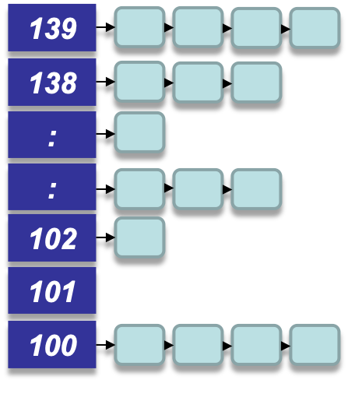
The Scheduling Policy
Every time there is a timer interrupt, pick the first task from the lowest numbered run queue
When done or time slice expires, put task in the appropriate queue in the expired run queue (either at 100 or at a different place?)
Active Run queues
Expired Run queues
139
138
:
priority
:
execute
102
101
100

Slide 35
The Scheduling Policy
Once active run queues are complete
  Make expired run queues active and vice versa
Active Run queues
Expired Run queues
low
139
139
138
138
:
:
priority
priority
:
:
102
102
101
101
high
100
100

Slide 36
Constant time?
There are 2 steps in the scheduling
  Find the lowest numbered queue with at least 1 task
  Choose the first task from that queue
Step 2 is obviously constant time
Is Step 1 constant time?
    Store bitmap of run queues with non-zero entries
    Use special instruction ‘find-first-bit-set’
      bsfl on intel

Slide 37
More on Priorities
0 to 99 meant for real time processes
100 is the highest priority for a normal process
139 is the lowest priority
Static Priorities
  120 is the base priority (default)
  nice : command line to change default priority of a process
  $nice –n N ./a.out
  N is a value from +19 to -20;
    most selfish ‘-20’; (I want to go first)
    most generous ‘+19’; ( I will go last)

Slide 38
Dynamic Priority
Based on a heuristic
To distinguish between batch and interactive processes
Uses a ‘bonus’, which changes based on a heuristic
  dynamic priority = MAX(100, MIN[(static priority – bonus + 5), 139])
Has a value between 0 and 10
If bonus < 5, implies less interaction with the user
thus more of a CPU bound process.
The dynamic priority is therefore decreased (toward 139)
If bonus > 5, implies more interaction with the user
thus more of an interactive process.
The dynamic priority is increased (toward 100).

Slide 39
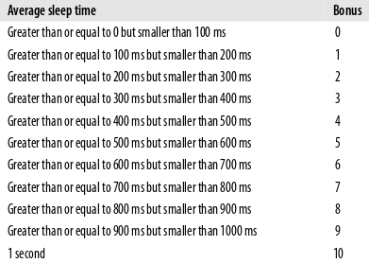
Dynamic Priority
(setting the bonus)
To distinguish between batch and interactive processes
Based on average sleep time
  An I/O bound process will sleep more therefore should get a higher priority
  A CPU bound process will sleep less, therefore should get lower priority
  dynamic priority = MAX(100, MIN[(static priority – bonus + 5), 139])
heuristic

Slide 40
Dynamic Priority and Run Queues
Dynamic priority used to determine which run queue to put the task after a task finished the current execution
As a process executes, it’s execution and sleep pattern changes, the scheduler detects that and modifies priority accordingly.
  Priority of a process also changes as it executes
No matter how ‘nice’ you are, you still need to wait on run queues --- prevents starvation
Active Run queues
Expired Run queues
139
138
:
:
execute
102
101
100

Slide 41
Points to think about
Notice that as a program executes, it’s priority gets boosted or demoted
Scheduler does one more thing
  For an interactive process (scanf), causes the program to go from running state to a sleeping state, waiting for user input
  User gives input, program comes back to run queue, and runs for a small CPU burst
  To make the process interactive, we want the CPU burst complete in the present allotted cycle
  Every time the timer interrupt occurs, the current burst goes out and the process has to go back to expired queue
  Not very good for interactive processes
  Low priority process executes while this process waits in expired queue
Scheduler not only modifies priorities, also the time slice
  Heuristic

Slide 42
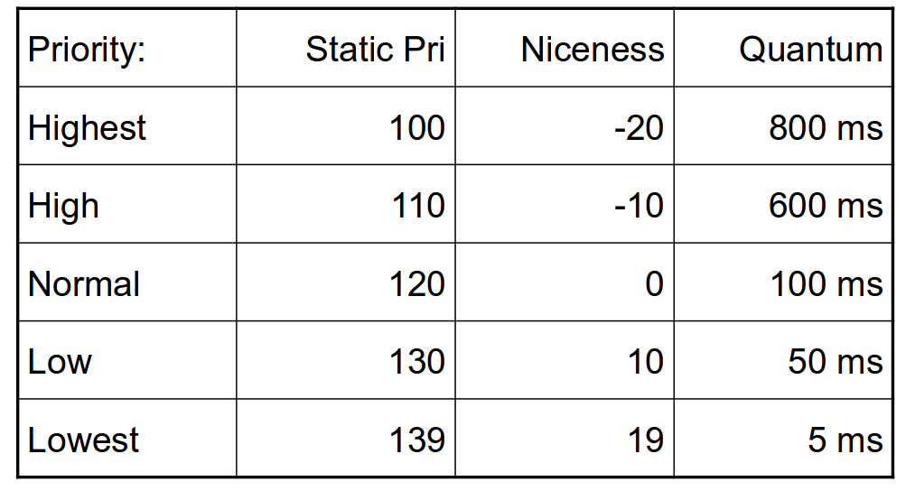
Setting the Timeslice
Interactive processes have high priorities.
  But likely to not complete their timeslice
  Give it the largest timeslice to ensure that it completes its burst without being preempted. More heuristics
  If priority < 120
    time slice = (140 – priority) * 20 milliseconds
  else
    time slice = (140 – priority) * 5 milliseconds
Longer
Shorter

Slide 43
Summarizing the O(1) Scheduler
Queues: Multi level feed back queues with 40 priority classes
Base Priority: Base priority set to 120 by default; modifiable by users using nice.
Dynamic Priority: Dynamic priority set by heuristics based on process’ sleep time
Dynamic timeslices: Time slice interval for each process is set based on the dynamic priority
Starvation: is dealt with by the two queues

Slide 44
Limitations of O(1) Scheduler
Too complex heuristics to distinguish between interactive and non-interactive processes
Dependence between timeslice and priority
Priority and timeslice values not uniform
Notes:
Consider two processes with lowest priority
every 5ms there will be a context switch

Slide 45




Slide 46
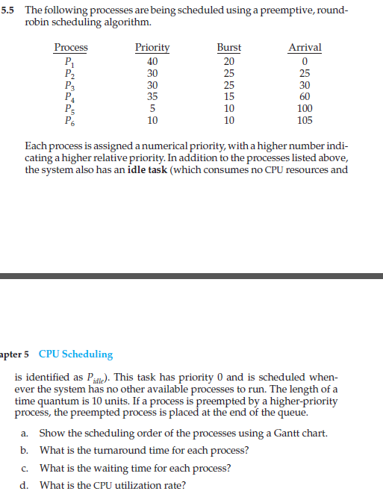
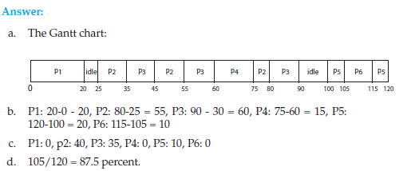

Slide 47
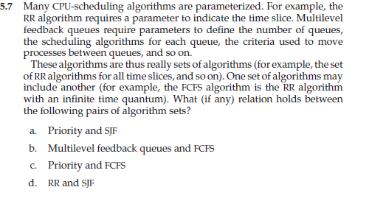
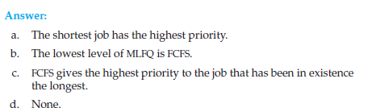

Slide 48


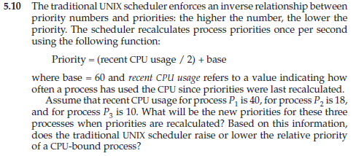


Slide 49
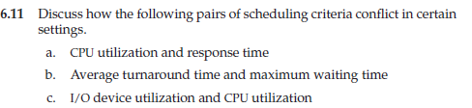
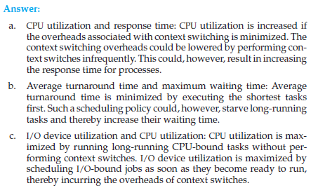

Slide 50
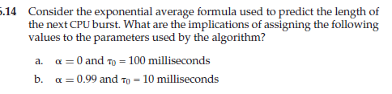
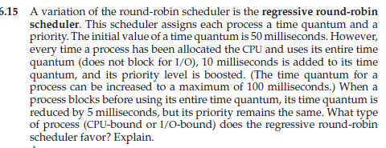


Slide 51


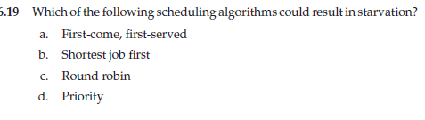

Slide 52
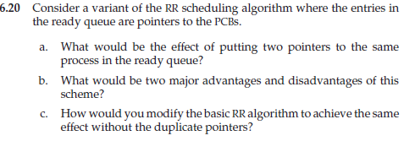
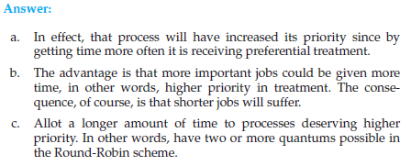

Slide 53
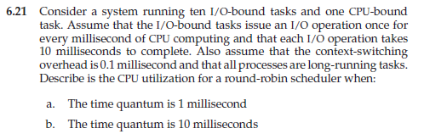
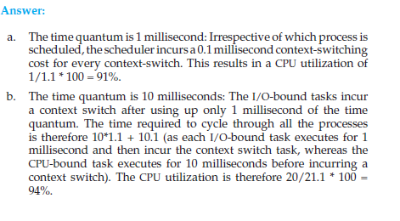

Slide 54
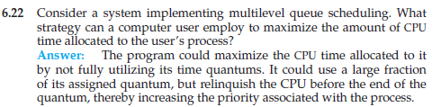
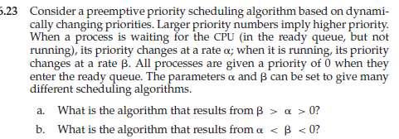


Slide 55
