Slide 1
CPU Scheduling
Slide courtesy: Prof. Chester Rebeiro, IITM
Prof. Silberschatz textbook slides
Wikipedia

Slide 2
Completely Fair Scheduling (CFS)
The Linux scheduler since 2.6.23
By Ingo Molnar
  based on the Rotating Staircase Deadline Scheduler (RSDL) by Con Kolivas.
  Incorporated in the Linux kernel since 2007
No heuristics.
Elegant handling of I/O and CPU bound processes.

Slide 3
Ideal Fair Scheduling
Process | burst time
A | 8ms
B | 4ms
C | 16ms
D | 4ms
Divide processor time equally among processes
Ideal Fairness : If there are N processes in the system, each process should have got (100/N)% of the CPU time
Ideal Fairness
A | 1 | 2 | 3 | 4 | 6 | 8
B | 1 | 2 | 3 | 4
C | 1 | 2 | 3 | 4 | 6 | 8 | 12 | 16
D | 1 | 2 | 3 | 4
4ms slice
execution with respect to time

Slide 4
Ideal Fair Scheduling
Process | burst time
A | 8ms
B | 4ms
C | 16ms
D | 4ms
Divide processor time equally among processes
Ideal Fairness : If there are N processes in the system, each process should have got (100/N)% of the CPU time
Ideal Fairness
Each process gets
4/4 = 1ms of the processor time
A | 1 | 2 | 3 | 4 | 6 | 8
B | 1 | 2 | 3 | 4
C | 1 | 2 | 3 | 4 | 6 | 8 | 12 | 16
D | 1 | 2 | 3 | 4
4ms slice
execution with respect to time

Slide 5
Ideal Fair Scheduling
Process | burst time
A | 8ms
B | 4ms
C | 16ms
D | 4ms
Divide processor time equally among processes
Ideal Fairness : If there are N processes in the system, each process should have got (100/N)% of the CPU time
Ideal Fairness
Each process gets
4/2 = 2ms of the processor time
A | 1 | 2 | 3 | 4 | 6 | 8
B | 1 | 2 | 3 | 4
C | 1 | 2 | 3 | 4 | 6 | 8 | 12 | 16
D | 1 | 2 | 3 | 4
4ms slice
execution with respect to time

Slide 6
Ideal Fair Scheduling
Process | burst time
A | 8ms
B | 4ms
C | 16ms
D | 4ms
Divide processor time equally among processes
Ideal Fairness : If there are N processes in the system, each process should have got (100/N)% of the CPU time
Ideal Fairness
The single process gets the entire
4ms of the processor time
A | 1 | 2 | 3 | 4 | 6 | 8
B | 1 | 2 | 3 | 4
C | 1 | 2 | 3 | 4 | 6 | 8 | 12 | 16
D | 1 | 2 | 3 | 4
4ms period
execution with respect to time

Slide 7
Virtual Runtimes
(keeping track of execution time)
With each runnable process is included a virtual runtime (vruntime)
  At every scheduling point, if process has run for t ms, then (vruntime += t)
  vruntime for a process therefore monotonically increases
Basic objective: vruntime should be similar for all long running processes

Slide 8
The CFS Idea
When timer interrupt occurs
  Choose the task with the lowest vruntime (min_vruntime)
  Compute its dynamic timeslice
    (sched_latency / #runnable processes)
  Program the high resolution timer with this timeslice
The process begins to execute in the CPU
When interrupt occurs again
  Context switch if there is another task with a smaller runtime or this process continues
  No starvation
Notes:
https://www.fizyka.umk.pl/~jkob/prace-mag/cfs-tuning.pdf

Slide 9
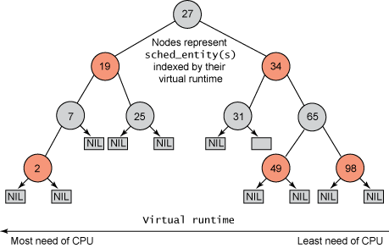
Picking the Next Task to Run
CFS uses a red-black tree.
  Each node in the tree represents a runnable task
  Nodes ordered according to their vruntime
  Nodes on the left have lower vruntime compared to nodes on the right of the tree
  The left most node is the task with the least vruntime
    This is cached in min_vruntime
Question: What happens if a parent forks a child process?
  Child has vruntime as 0 and runs for long!!
  Solution: Do not start vruntime with 0, better inherit vruntime from parent OR minimum vruntime currently in the tree
min_vruntime

Slide 10
Picking the Next Task to Run
At a context switch,
Pick the left most node of the tree
  This has the lowest runtime.
  It is cached in min_vruntime. Therefore accessed in O(1)
If the previous process is runnable, it is inserted into the tree depending on its new vruntime.
  Done in O(log(n))
  Tasks move from left to right of tree after its execution completes… starvation avoided
min_vruntime

Slide 11
Why Red Black Tree?
Self Balancing
  No path in the tree will be twice as long as any other path
All operations are O(log n)
  Thus inserting / deleting tasks from the tree is quick and efficient

Slide 12


Priorities and CFS
Priority (due to nice values) used to weigh the vruntime
  if process has run for t ms, then vruntime is adjusted as:
NICE_0_LOAD is the default weight assigned to a process with a nice value of 0 (which is 1024)

Slide 13
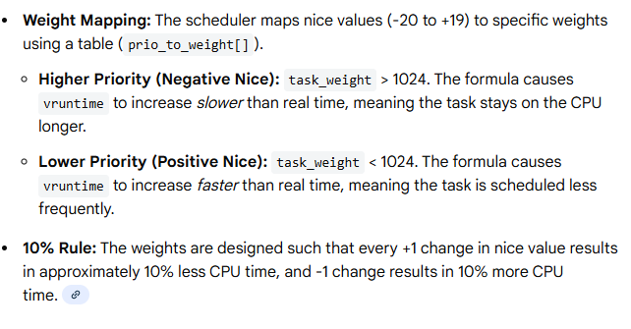
Weight mapping
A lower priority implies time moves at a faster rate compared to that of a high priority task

Slide 14
I/O and CPU bound processes
What we need,
  I/O bound should get higher priority and get a longer time to execute compared to CPU bound
  CFS achieves this efficiently
    I/O bound processes have small CPU bursts therefore will have a low vruntime. They would appear towards the left of the tree…. Thus are given higher priorities
    I/O bound processes will typically have larger time slices, because they have smaller vruntime

Slide 15
Dynamic Time Slice
Not a fixed quantum, but rather a calculated duration based on the priority (nice value) of a task and the total number of runnable tasks.
Instead of using a fixed quantum like traditional schedulers, CFS assigns a proportion of CPU time based on a target latency.

Slide 16
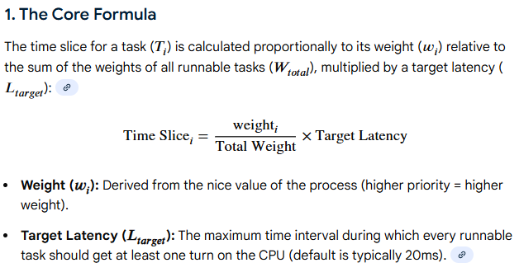
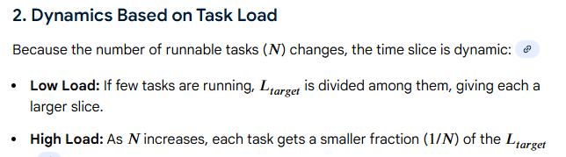
Dynamic time slice

Slide 17
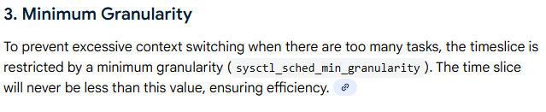
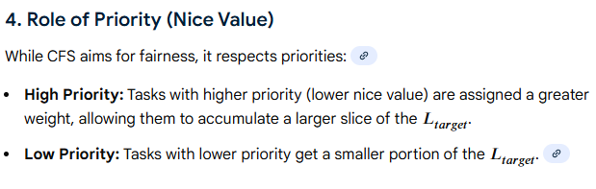
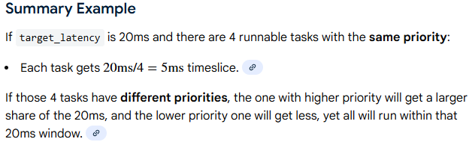
Dynamic time slice

Slide 18
New Process
Gets added to the RB-tree
Starts with an initial value of min_vruntime
This ensures that it gets to execute quickly
https://www.kernel.org/doc/Documentation/scheduler/sched-design-CFS.txt

Slide 19
EEVDF
Introduced in Linux kernel 6.6,
the Earliest Eligible Virtual Deadline First (EEVDF) scheduler
replaced the long-standing Completely Fair Scheduler (CFS) to improve task responsiveness and fairness.
Unlike CFS, which relied on virtual runtime (vruntime) for fairness, EEVDF utilizes virtual deadlines and eligibility
criteria to reduce latency for interactive applications, offering better performance and fewer tuning knobs.

Slide 20
Multiple-Processor Scheduling
CPU scheduling more complex when multiple CPUs are available
Multiprocess may be any one of the following architectures:
  Multicore CPUs
  Multithreaded cores
  NUMA systems
  Heterogeneous multiprocessing

Slide 21
Multiprocessor Scheduling
Process
1
Process
2
Process
3
Process
4
Process 1
Process 2
Process 3
Process 4
CPU
0
CPU
1
CPU
2
CPU
3
RAM

Slide 22
Process Migration
As a result of symmetrical multiprocessing
  A process may execute in a processor in one timeslice and another processor in the next time slice
  This leads to process migration
    Migration is expensive, it requires all memories to be repopulated
Processor affinity
    Hard affinity – strict affinity to specific processors
    Soft affinity

Slide 23
Multiprocessor Scheduling with a single scheduler
Process
1
Process
2
Process
3
Process
4
Process 1
Process 2
Process 3
Process 4
CPU
0
CPU
1
CPU
2
CPU
3
scheduler
RAM
Strawman approach!!
One processor decides for everyone
Notes:
Simple. One CPU controls the PCBs.
Drawback.
Longer context switch timing.

Slide 24
Multiprocessor Scheduling
(Symmetical Scheduling)
Process
1
Process
2
Process
3
Process
4
Process 1
Process 2
Process 3
Process 4
CPU
0
CPU
1
CPU
2
CPU
3
scheduler
scheduler
scheduler
scheduler
Each processor runs
a scheduler independently to select the process to execute
Requires locking to access the queues
Two variants,
Global queues
Per CPU queues
RAM
Notes:
Requires locking to access the queues

Slide 25
Symmetrical Scheduling
(with global queues)
Advantages
Good CPU Utilization
Fair to all processes
Disadvantages
Not scalable
(contention for the global queue)
Processor affinity not easily achieved
Locking needed in scheduler
(not a good idea. Schedulers need
to be highly efficient)
Global queue of runnable processes
CPU
0
CPU
1
CPU
2
CPU
3
Used in Linux 2.4, xv6

Slide 26
Symmetrical Scheduling
(with per CPU queues)
Static partition of processes across CPUs
Advantages
Easy to implement
Scalable (no contention)
Locality
Disadvantages
Load imbalance
CPU
0
CPU
1
CPU
2
CPU
3

Slide 27
Hybrid Approach
Use local and global queues
Load balancing across queues feasible
Locality achieved by processor affinity wrt the local queues
Similar approach followed in Linux 2.6
CPU
0
CPU
1
CPU
2
CPU
3

Slide 28
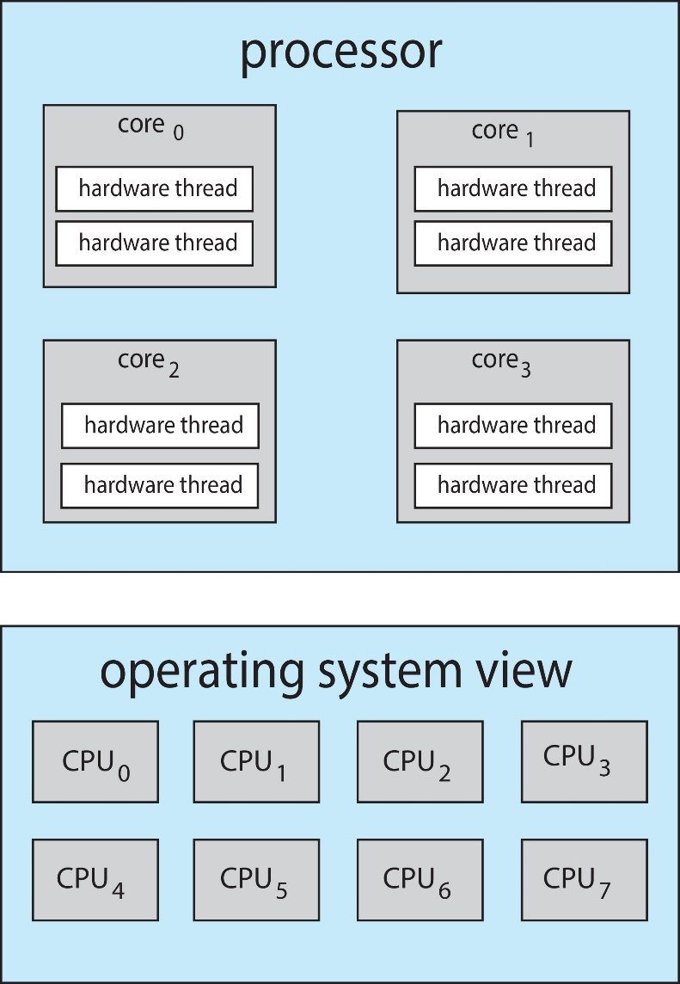
Multithreaded Multicore System
Chip-multithreading (CMT) assigns each core multiple hardware threads. (Intel refers to this as hyperthreading.)
On a quad-core system with 2 hardware threads per core, the operating system sees 8 logical processors.

Slide 29
Assignment
Given a binary nXm matrix, display the index of the row with maximum number of 1's
Given an array arr[] of positive integers, reverse every sub-array group of size K

