Slide 1
Process Synchronization-4

Slide 2
Semaphore Behaviour
Reference: Section 6.4
Definition: a counting semaphore S is an integer variable that can be accessed only through two atomic operations, wait (S ) (or P (S)) and signal (S ) (or V (S))
wait (S ): signal (S ):
{ while (S <= 0); S- -; } /* Done atomically */
{ S++; } /* Done atomically */
n-process CSP:
shared semaphore mutex = 1;
P_i()
{ wait(mutex);
critical_section();
signal(mutex); ...
}
Note: semaphore S initialized to # of processes that can call wait concurrently without blocking. For our purpose, initialization can ONLY be 1 for the kind of CS applications we want.

Slide 3
Semaphore Behaviour
S = 1
P1 calls wait → does not get stuck in wait → S is now 0
P2 calls wait → gets stuck
P1 calls signal (S) → S goes from 0 to 1
P2 comes out of while loop, decrements CS → S = 0
Initialized S to 1 → 1 process can enter CS at a time

Slide 4
Semaphore Behaviour
S = 2
P1 calls wait → does not get stuck in wait → S is now 1
P2 calls wait → does not get stuck → S is now 0
P3 calls wait → gets stuck
Either P1 or P2 calls signal (S) → S goes from 0 to 1
P3 comes out of while loop, decrements CS → S = 0
Initialized S to 2 → 2 processes can enter CS simultaneously

Slide 5
Semaphore implementation
Challenges:
wait and signal have to be implemented atomically in the kernel
  If it was implemented like S++ and S--, we would have the same issues at the kernel with S, due to context switches in between
We want S++ (increment) and S– (decrement) to be implemented as atomic operations
S-- and S++ together needed to ensure a CS
wait (S ):
CS
signal (S ):
{ while (S <= 0); S- -; } /* Done atomically */
{ S++; } /* Done atomically */

Slide 6
Semaphore implementation: Notes
We have given S++ and S-- to solve the application CS problem
We need CS for S++ and S-- now
Semaphores cannot be used here
Lamport’s Bakery / test-and-set for n-CSP comes to rescue

Slide 7
A first attempt
wait (S) { signal(S) {
while (S<= 0);
entry(); entry();
S--; S++;
exit(); exit();
} }
      wait (S); while (S <= 0);
      entry();
      S--;
      exit();
      CS; CS; /* Application CS*/
      signal (S); entry ();
      S++;
      exit();
Application P[i]

Slide 8
A first attempt
wait (S) { signal(S) {
while (S<= 0);
entry(); entry();
S--; S++;
exit(); exit();
} }
Code for P[i]:
wait (S) {
while (S<= 0);
choosing[i] = 1;
number[i] = MAX(number[0], number[1], ..., number[n-1]) + 1;
choosing[i] = 0;
for (j = 0; j < n; j++) {
while (choosing[j]) ;
while ((number[j] != 0) && (number[j],j < number[i],i)) ;
}
S--; / *CS for S */
number[i] = 0;
}
CS /* for application */
signal (S) {
entry();
S++;
exit();
}
entry
exit

Slide 9
A first attempt
Code for P[i]:
wait (S ):
CS /* for application */
signal (S ):
Code for P[i]:
wait (S ):
CS /* for application */
signal (S ):
S initialized to 1
Switch after this
wait (S) {
while (S<= 0);
choosing[i] = 1;
number[i] = MAX(number[0], number[1], ..., number[n-1]) + 1;
choosing[i] = 0;
for (k = 0; k < n; k++) {
while (choosing[k]) ;
while ((number[k] != 0) && (number[k],k < number[i],i)) ;
}
S--; / *CS for S */
number[i] = 0;
}
CS /* for application */
signal (S) {
entry();
S++;
exit();
}
wait (S) {
while (S<= 0);
choosing[j] = 1;
number[j] = MAX(number[0], number[1], ..., number[n-1]) + 1;
choosing[j] = 0;
for (k = 0; k < n; k++) {
while (choosing[k]) ;
while ((number[k] != 0) && (number[k],k < number[j],j)) ;
}
S--; / *CS for S */
number[j] = 0;
}
CS /* for application */
signal (S) {
entry();
S++;
exit();
}

Slide 10
What went wrong?
2 calls to S--
Bakery ensures 2 non-overlapping decrements and S is -1, which is inconsistent
Both P1 and P2 enter CS
Whoever checks S, the same value should be decremented first at S—
  If a process checks S and finds it as 1, it should decrement it first before a context switch
Between while and entry, there may be a context switch
Signal operation is 1 increment, and the entry / exit makes it atomic
wait is not atomic!!

Slide 11
A second attempt
wait (S) { signal(S) {
entry();
while (S<= 0); entry();
S--; S++;
exit(); exit();
} }
Code for P[i]:
wait (S) {
choosing[i] = 1;
number[i] = MAX(number[0], number[1], ..., number[n-1]) + 1;
choosing[i] = 0;
for (j = 0; j < n; j++) {
while (choosing[j]) ;
while ((number[j] != 0) && (number[j],j < number[i],i)) ;
}
while (S<= 0);
S--;
number[i] = 0;
}
CS /* for application */
signal (S) {
entry();
S++;
exit();
}
entry
exit

Slide 12
A second attempt
wait (S) { signal(S) {
entry();
while (S<= 0); entry();
S--; S++;
exit(); exit();
} }
S++ and S-- will not produce inconsistent result
Inside bakery, whoever does while, also does S-- and exits

Slide 13
A second attempt
Code for P[i]:
wait (S ):
CS /* for application */
signal (S ):
Code for P[j]:
wait (S ):
CS /* for application */
signal (S ):
wait (S) {
choosing[j] = 1;
number[j] = MAX(number[0], number[1], ..., number[n-1]) + 1;
choosing[j] = 0;
for (k = 0; k < n; k++) {
while (choosing[k]) ;
while ((number[k] != 0) && (number[k],k < number[j],j)) ;
}
while (S<= 0);
S--; / *CS for S */
number[j] = 0;
}
CS /* for application */
signal (S) {
choosing[j] = 1;
number[j] = MAX(number[0], number[1], ..., number[n-1]) + 1;
choosing[j] = 0;
for (k = 0; k < n; k++) {
while (choosing[k]) ;
while ((number[k] != 0) && (number[k],k < number[j],j)) ;
}
S++;
number[j] = 0;
}
wait (S) {
choosing[i] = 1;
number[i] = MAX(number[0], number[1], ..., number[n-1]) + 1;
choosing[i] = 0;
for (k = 0; k < n; k++) {
while (choosing[k]) ;
while ((number[k] != 0) && (number[k],k < number[i],i)) ;
}
while (S<= 0);
S--; / *CS for S */
number[i] = 0;
}
CS /* for application */
signal (S) {
choosing[i] = 1;
number[i] = MAX(number[0], number[1], ..., number[n-1]) + 1;
choosing[i] = 0;
for (k = 0; k < n; k++) {
while (choosing[k]) ;
while ((number[k] != 0) && (number[k],k < number[i],i)) ;
}
S++;
number[i] = 0;
}

Slide 14
A second attempt
wait (S) { signal(S) {
entry();
while (S<= 0); entry();
S--; S++;
exit(); exit();
} }
P1 calls wait → S is 1, nobody inside bakery, S > 0, decrement S, S is now 0, P1
exits bakery and does something else in application program’s CS
P2 calls wait → Enters bakery, finds S as 0, gets stuck in while (S <= 0)
P1 calls signal → Cannot enter bakery since P2 is stuck, P1 stuck at entry(), cannot execute S++
Everything gets stalled, no progress!!

Slide 15
A third attempt
Putting everything inside the same bakery entry and exit does not work
Need 2 separate bakeries, 1 to increment and decrement S atomically, another to ensure whoever does the while, also does S– atomically
2 separate arrays, choosing1, number1 for 1st bakery, and choosing2, number2 for 2nd
Never 2 processes in the same bakery, may be in separate bakeries
wait (S) { signal(S) {
entry1();
while (S<= 0); entry2();
entry2();
S--; S++;
exit2();
exit1(); exit2();
} }
Application P[i]
wait (S);
CS /*Application */
signal (S);

Slide 16
A third attempt
Code for P[i]:
wait (S ):
CS /* for application */
signal (S ):
Code for P[j]:
wait (S ):
CS /* for application */
signal (S ):
wait (S) {
entry1();
while (S<= 0);
entry2();
S--; / *CS for S */
exit2();
exit1();
}
CS /* for application */
signal (S) {
entry2();
S++; / *CS for S */
exit2();
}
wait (S) {
entry1();
while (S<= 0);
entry2();
S--; / *CS for S */
exit2();
exit1();
}
CS /* for application */
signal (S) {
entry2();
S++; / *CS for S */
exit2();
}
P1 calls wait() → breaks out of while, executes S--, exits 1 and 2 and starts executing in application’s CS
P2 calls wait() → P2 is stuck at while (S <= 0)
P1 calls signal() → Second bakery is empty, P1 can get inside signal, execute S++
P2 comes out of while loop, and gets stuck in entry2() till P1 leaves exit2()
Once P1 comes out of bakery 2, P2 can enter application’s CS

Slide 17
Remarks
The wait and signal code uses bakery implementation, based on 2 copies of choosing and token arrays
Can implement entirely in user space as user libraries
Can be done without system calls as long as the basic assumption of Lamport’s bakery is satisfied [Interrupt handling not being used]
Application program:
wait (s);
CS;
signal(s);
If user is using entry and exit section code as above, we want the strategy to satisfy a) Mutual exclusion b) Progress c) Bounded Wait

Slide 18
Analysis
Mutual Exclusion satisfied
Progress ensured
Bounded waiting is ensured
If Bakery has been correctly implemented, this scheme is starvation free, given that bakery is starvation free

Slide 19
Analysis
Mutual Exclusion satisfied
Progress ensured
Bounded waiting is ensured
If Bakery has been correctly implemented, this scheme is starvation free, given that bakery is starvation free
Either provide wait and signal as system calls implementing them inside the kernel or provide them as user libraries
Application program remains simple
  Wait(s);
  CS;
  Signal(s);

Slide 20
Busy waiting semaphores
wait (S) { signal(S) {
entry1();
while (S<= 0); entry2();
entry2();
S--; S++;
exit2();
exit1(); exit2();
} }
Consider 2 processes P1 and P2
P1 enters CS, and P2 keeps waiting in while loop
Somehow scheduler needs to know that P2 is wasting full CPU cycle
Solution: Not make P2 ready if it is stuck in wait (How? Can it be done in User mode? Changing state of a process can only be done in kernel mode)

Slide 21
Blocking Semaphore (assistance from kernel needed)
Change implementation of wait, signal – application program remains the same
  Wait(s); CS; Signal(s);
If a process cannot proceed, it tells the kernel to block itself
Kernel puts the process to sleep
At a time when the signal comes, this process needs to be woken up
Wait (S) needs to additionally do the following
If (P cannot proceed) {
-- put P on queue for the semaphore
-- put P to sleep
}
Signal (S) also needs to be modified – whenever signal (s) by some process, kernel checks if there are processes waiting on this semaphore s and wakes up someone from the list of waiters sleeping in the queue of s
Queue implemented as a FIFO – ensures bounded waiting

Slide 22
Busy waiting vs. blocking
Spinlocks/busy waiting
Processes execute a loop while waiting for entry to critical section
⇒ waste of CPU cycles
Blocking
typedef struct {int value; struct process *L;} semaphore;
wait (S ): { signal (S ): {
S.value--;
/* if value is 0, no problem */
/* value was 0 / < 0 to start with */
if (S.value < 0) {
enqueue (P, S.L);
sleep();
}
}
S.value++;
/* if value > 0, nobody waiting */
/* value was <= 0? Someone waiting*/
if (S.value <= 0) {
P = dequeue (S.L);
wakeup(P);
}
}

Slide 23
Redefining the semaphore
typedef struct {int value; struct process *L;} semaphore;
Earlier, semaphore was a shared integer
Now, additionally, a queue associated with each semaphore
How to implement the new semaphore?
Value and S.L are shared – need to ensure atomicity of both
Both may be concurrently manipulated → make sure operations on these need to be safely done

Slide 24
Semaphore Implementation (Blocking) – First attempt
wait(S) {
entry();
S.value--;
if (S.value < 0) {
enqueue (P, S.L);
sleep();
}
exit();
}
signal (S) {
entry();
S.value++;
if (S.value <= 0) {
P = dequeue (S.L);
wakeup(P);
}
exit();
}
Code for P[i]:
wait (S ):
CS /* for application */
signal (S ):
Code for P[j]:
wait (S ):
CS /* for application */
signal (S ):
S initialized to 1
Does not work – lack of progress
If we surround the code with entry and exit, second waiter may get stuck and sleep before releasing, while signaler cannot enter since bakery is occupied by second process

Slide 25
Second Attempt
Code for P[i]:
wait (S ):
CS /* for application */
signal (S ):
Code for P[j]:
wait (S ):
CS /* for application */
signal (S ):
entry1();
S.value--;
if (S.value < 0) {
enqueue (P, S.L);
exit1();
sleep();
}
entry1();
S.value--;
If (S.value < 0) {
enqueue (P, S.L);
exit1();
sleep();
}
wait
wait
CS /* for application */
entry1();
S.value++;
if (S.value <= 0) {
P = dequeue (S.L);
wakeup(P);
exit1();
}
CS /* for application */
entry1();
S.value++;
if (S.value <= 0) {
P = dequeue (S.L);
wakeup(P);
exit1();
}
signal
signal

Slide 26
Binary semaphores
Definition: semaphore whose integer value can be either 0 or 1
Initialized to 1 → single process in CS at a time
wait_{b}(S) {
if (S.value == 0) {
enq(S.L);
sleep();
}
else { /* S.value == 1*/
S.value = 0;
}
}
wait(S) {
S.value--;
if (S.value < 0) {
enq(S.L);
sleep();
}
}
signal (S) {
S.value++;
if (S.value <= 0) {
P = dequeue(S.L);
wakeup(P);
}
}
signal_{b} (S) {
if (S.value == 0) {
P = dequeue(S.L);
if (P == NULL)
S.value = 1;
else
wakeup(P);
}
else { /* S.value == 1*/
/* Nothing to do */
}
}

Slide 27
Binary semaphores
wait_{b}(S) {
entry1();
if (S.value == 0) {
enq(S.L);
exit1();
sleep();
}
else { /* S.value == 1*/
S.value = 0;
exit1();
}
}
entry1();
S.value--;
if (S.value < 0) {
enq(S.L);
exit1();
sleep();
}
wait_{b}
wait
signal_{b} (S) {
entry1();
if (S.value == 0) {
P = dequeue(S.L);
if (P == NULL)
S.value = 1;
else
wakeup(P);
exit1();
}
else { /* S.value == 1*/
/* Nothing to do */
exit1();
}
}
entry1();
S.value++;
if (S.value <= 0) {
remove process P from S.L;
wakeup(P);
exit1();
}
signal
signal_{b}

Slide 28
Counting semaphores
Shared semaphore S = 5;
wait (S) { signal (S) {
S.value--; S.value++;
if (S.value < 0) { if (S.value <= 0) {
enq(S.L); P = dequeue (S.L);
sleep(); wakeup(P);
} }
Can implement using kernel provided binary semaphores [S.value can only be 0 or 1]
Need a separate integer that keeps track of how many processes are waiting to enter CS
Counter S.value, Queue Q

Slide 29
Semaphores
Without Semaphore: (Bakery or similar, user has to implement)
entrySection
CriticalSection
exitSection
With Semaphore (Library functions)
wait(S)
criticalSection
signal(S)

Slide 30
Improper usage of semaphore
S1 and S2 are binary semaphores
Initially, S1 = 1 and S2 = 1
P1 and P2 are concurrently executing processes
P1: P2:
wait(s1); wait(s2);
wait(s2); wait(s1);
.. ..
.. ..
.. ..
signal(s1); signal(s2);
signal (s2); signal(s1);
Deadlock: Processes stuck forever
What to do?

Slide 31
Improper usage of semaphore
Starvation or indefinite blocking
Process stays in the semaphore waiting queue indefinitely
Can happen if processes are removed in a LIFO manner from readyQ → implement the queue properly

Slide 32
Example: Producer-consumer problem
Problem: a producer process generates output that is used by a
consumer process as input
Examples:
print program (producer) + printer driver (consumer)
$ ls -l | more
Implementation:
Producer and consumer access a shared buffer
Concurrent access is allowed Consumer must wait if buffer is empty
Unbounded buffer: no limit on size of buffer
Bounded buffer: buffer is of fixed size
producer must wait if buffer is full

Slide 33
Race condition
Reference: Section 6.1
producer
consumer
while (count==0); // empty p = buffer[out];
out = out+1 % n;
p = produce();
while (count==n); // full buffer[in] = p;
in = in+1 % n;
count- -; consume(p);
count++;
buffer and count in shared space, in and out in exclusive space
MOV count R0 MOV count R0
ADD #1 R0 SUB #1 R0
MOV R0 count MOV R0 count
Most machines will not allow direct memory operation
Compiler translates this into 3 machine level instructions
Think of Interrupts
5 / 28

Slide 34
Producer-consumer problem
Shared variables are count, buffer;
Can have many producers, consumers
producer consumer
data = produce();
While buffer is full,
wait;
Add data to buffer;
Point to next empty cell;
While buffer is empty, wait;
Remove data from buffer;
Point to next filled cell;
Consume();
semaphore full = 0, empty = n, SBuf = 1; /* share buffer and count */
Producer consumer
Sbuf: binary
Full: counting
Empty: counting
while (1) {
p = produce();
wait(empty);
wait(SBuf);
AddToBuffer(p);
signal(SBuf);
signal(full);
}
while (1) {
wait(full);
wait(SBuf);
p = RemoveFromBuffer();
signal(SBuf);
signal(empty);
consume(p);
}
Producer Entry section:
locks the empty, locks
Buffer
CS: Add to buffer
Exit section: signal buffer,
Signal full

Slide 35
Producer-consumer problem
semaphore full = 0, empty = n, SBuf = 1; /* share buffer and count */
Producer consumer
while (1) {
p = produce();
wait(empty);
wait(SBuf);
AddToBuffer(p);
signal(SBuf);
signal(full);
}
while (1) {
wait(full);
wait(SBuf);
p = RemoveFromBuffer();
signal(SBuf);
signal(empty);
consume(p);
}
Instead of a count and a semaphore to protect it, we use 2 semaphores full and empty (sum is n)
Initially, n vacant slots, and 0 full slot
A producer calls wait (empty) → n producers can run concurrently and produce
Producers Synchronize on SBuf to protect buffer
Many consumers can consume in parallel, block at wait (full).
One producer has gone through 1 iteration, a consumer can consume

Slide 36
What if?
semaphore full = 0, empty = n, SBuf = 1; /* share buffer and count */
Producer consumer
while (1) {
p = produce();
wait(SBuf);
wait(empty);
AddToBuffer(p);
signal(SBuf);
signal(full);
}
while (1) {
wait(SBuf);
wait(full);
p = RemoveFromBuffer();
signal(SBuf);
signal(empty);
consume(p);
}
Assuming that the buffer is not being accessed at this time by consumer, the Producer will be able to lock the buffer.
Assuming that the buffer is full, the value of empty is 0 → producer gets stuck
Consumer will get stuck on Sbuf, and thus cannot execute wait (full) and consume
Buffer is full but producer has needlessly locked the buffer → Deadlock
Producer should check if there are empty slots and then lock the buffer
Consumer should first check if there are items to consume and then lock the buffer

Slide 37
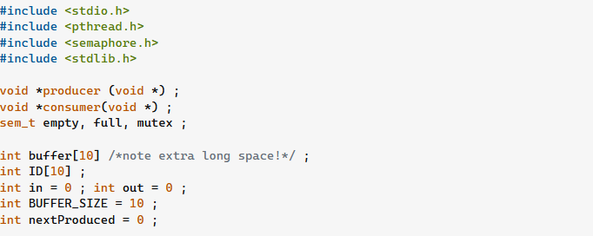
Producer Consumer

Slide 38
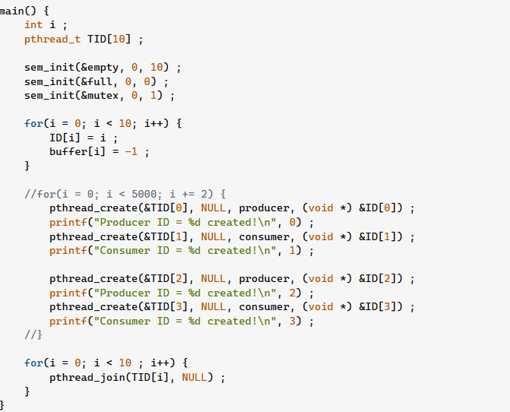

Slide 39
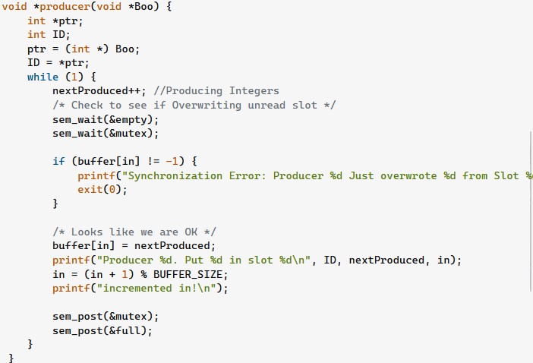

Slide 40
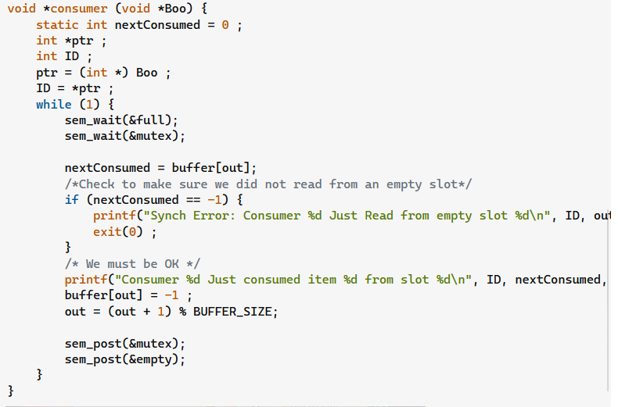

Slide 41
Dining philosophers problem
philosopher()
{ while(1) {
eat(); /* CS */
think();
}
}
philosopher()
{ while(1) {
entry();
eat(); /* CS */
exit();
think();
}
}
While either f_{(i-1)%n} or
f_{i} is in use, wait
Mark f_{(i-1)%n} and f_{i} in use
Mark both f_{(i-1)%n} and
f_{i} not in use
Only the nearest chopsticks can be used Only free chopsticks can be used Chopsticks must be acquired one by one

Slide 42
Dining philosophers problem
semaphore chopstick[5] = {1,1,1,1,1};
while (1) {
wait(chopstick[(i-1) % 5]);
wait(chopstick[i]);
eat();
signal(chopstick[i]);
signal(chopstick[(i-1) % 5]);
think();
}
Deadlock avoidance:
Odd philosophers pick up left chopstick first;
even philosophers pick up right chopstick first.
II) Philosophers can pick up chopsticks only if both are available,
Need a more general wait that waits on multiple
semaphores, and either succeeds when both are
available or does not block when one is available
wait(chopstick[(i-1) % 5], wait(chopstick[i]);
ME holds
Deadlock?

Slide 43
Readers-writers problem
Reference: Section 6.5.2
Shared object is accessed by several concurrent processes
Reader: processes that only read the shared object
Writer: processes that update (read + write) the shared object
Synchronization constraint: two or more readers can access shared data simultaneously; any writer must have exclusive access
Variants:
first readers-writers problem: readers have (non-preemptive) priority
second readers-writers problem: writers have (non-preemptive) priority

Slide 44
Readers-writers problem
semaphore mutex = 1, write access = 1, readcount = 0;
reader writer
wait(mutex); readcount++;
if (readcount == 1) wait(write_access);
signal(mutex);
wait(write_access); write(); signal(write_access);
read();
wait(mutex); readcount--;
if (readcount == 0) signal(write_access);
signal(mutex);

Slide 45
Summary
Manipulation of shared data ⇒ race conditions
Shared data should be accessed within critical sections Solutions to CSP:
Algorithm 3, Bakery algorithm
assume only atomic loads, stores, tests
Hardware solutions
assume atomic TestAndSet or Swap instructions
Semaphores
semaphores use one of the above solutions internally to ensure mutually exclusive access to semaphore variable
may be implemented as system calls which block if necessary
Example synchronization problems: producer-consumer, reader-writer, dining philosopher
abstractions of problems that occur in real systems

