Slide 1
What is Transients API? And Why We Need It
Phawin Khongkhasawan
www.prontotools.io

Slide 2


Phawin
Khongkhasawan
About me
Issue Hunter

Slide 3
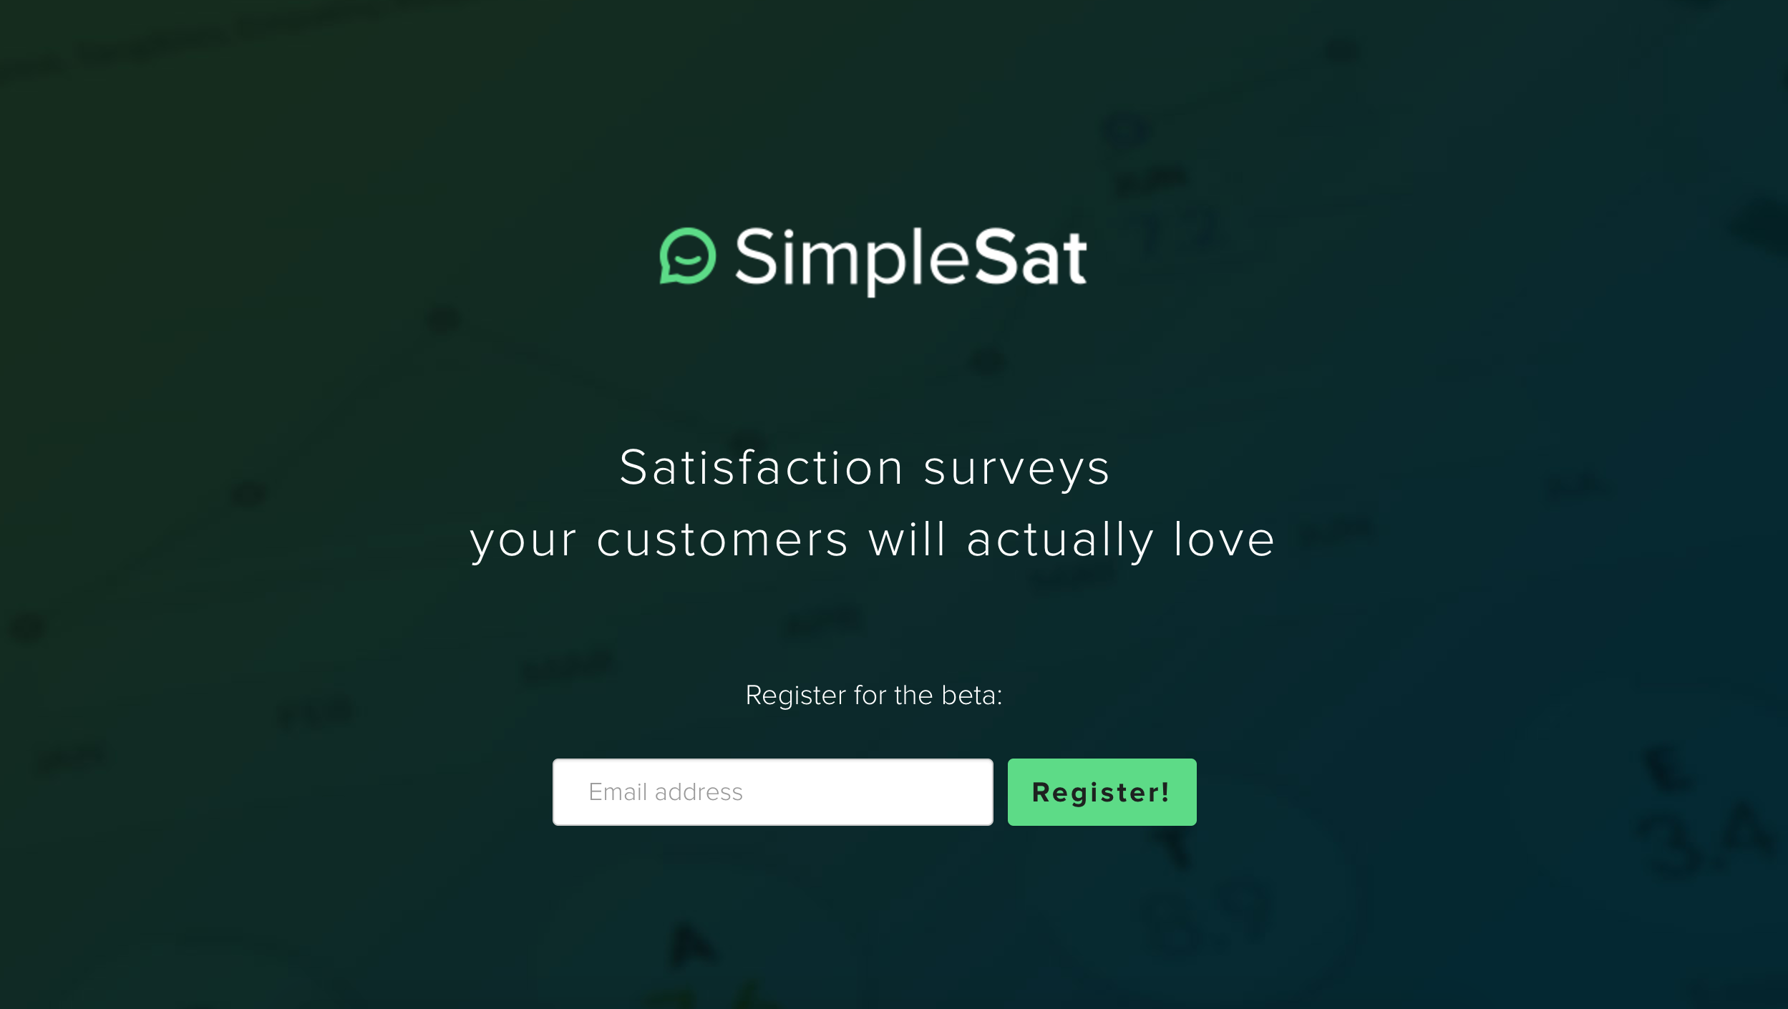


Slide 4

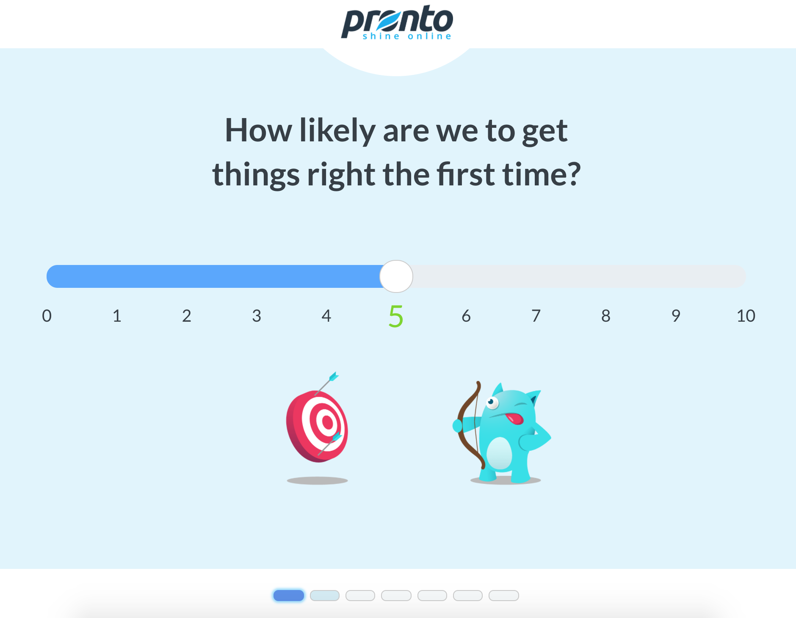


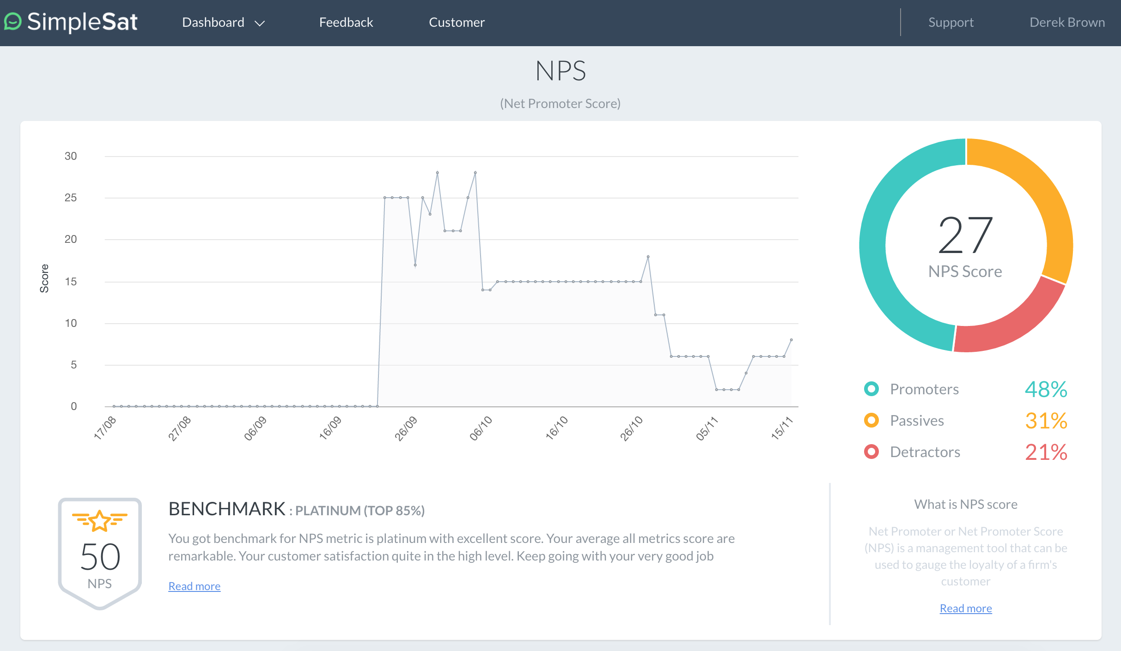

Slide 5


Slide 6


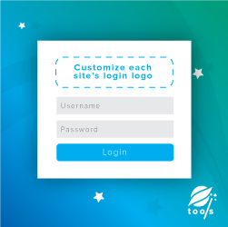

Our WordPress Plugins
ConnectWise Forms
Integration
Login Logout
Shortcode
Multisite Login Logos
WooCommerce Cart
Count Shortcode

Slide 7
What is Cache?

Slide 8
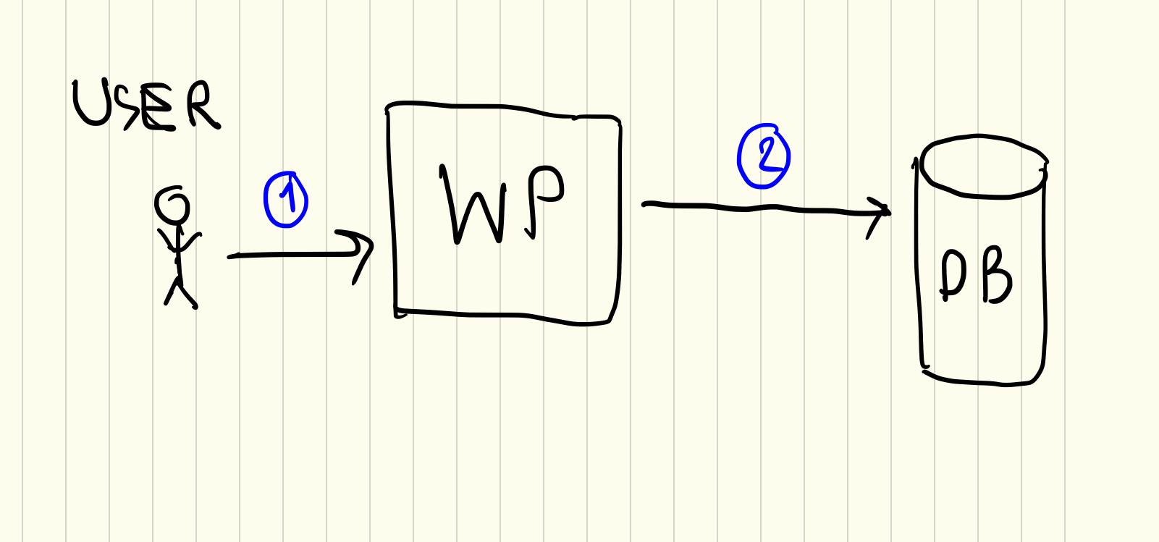

Slide 9
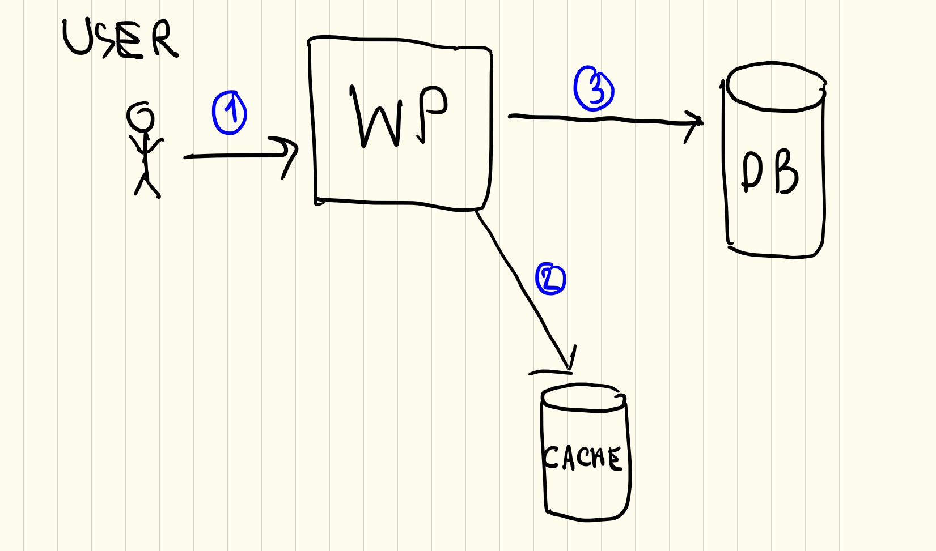

Slide 10
WHY WE NEED IT?

Slide 11

SPEED

Slide 12
Improve SEO

Slide 13
REDUCE COST

Slide 14
What is Transients?

Slide 15
get_transient( $transient );

Slide 16
set_transient( $transient, $value, $expiration );

Slide 17
USECASE

Slide 18

HEADER Menu

Slide 19
HomePAGE

Slide 20
DEMO

Slide 21
cautioN!!

Slide 22


We are hiring!
https://www.prontomarketing.com/company/careers/

