Slide 1
WEEK 12 / SLAM & BAYESIAN ESTIMATION
SLAM & Bayesian estimation
Week 12 · Where am I, and what surrounds me?
Estimate the robot
Estimate the map
Bayesian beliefs
Particles and Gaussian filters
Range-only landmarks
Joint uncertainty
30 min mathematics · 12 min integrated demo · 3 min recap
Robotics & Autonomous Systems · Localization and mapping under uncertainty
01
Notes:
TIMING: 0 minutes.
Students know coordinate transforms and Week10 beliefs. Explain the same physical scene first with a known map, then with unknown landmark positions. Both modes use range only. The simulator knows truth; the estimator never receives it. Heading is fixed in the demo. Thirty minutes of explanation, twelve minutes of visualization integrated at five points, and three minutes recap. The preserved teaching notes describe the older localization lesson; this plan and updated demo README define the revised session.
SOURCES
https://www-personal.acfr.usyd.edu.au/tbailey/papers/slamtute1.pdf

Slide 2
WEEK 12 / SLAM & BAYESIAN ESTIMATION
Why SLAM?
An unfamiliar environment gives us two unknowns.
Place data
Robot pose
Landmark map
Where was the sensor?
What generated the reading?
Match data
Estimate the robot and its surroundings together.
Robotics & Autonomous Systems · Localization and mapping under uncertainty
02
Notes:
TIMING: 1 minutes.
SLAM means simultaneous localization and mapping. A robot needs a map to interpret measurements, but needs its pose to place those measurements in the map. Examples include exploring a warehouse, inspecting an unfamiliar building, and autonomous navigation. SLAM estimates geometry and uncertainty; it is not motion planning, obstacle avoidance, or semantic scene understanding by itself. Start with this question before introducing particles so the main subject remains SLAM.
SOURCES
https://www-personal.acfr.usyd.edu.au/tbailey/papers/slamtute1.pdf

Slide 3
WEEK 12 / SLAM & BAYESIAN ESTIMATION
Localization, mapping, SLAM
The distinction is what is given and what is estimated.
Localization
Mapping
SLAM
Given: map
Estimate: robot
Given: poses
Estimate: map
Estimate both
Keep their coupling
Fixed landmarks can still have unknown positions.
Robotics & Autonomous Systems · Localization and mapping under uncertainty
03
Notes:
TIMING: 1 minutes.
Localization: given a map, infer robot state. Mapping: given robot poses, infer the map. SLAM: estimate both from controls and sensor evidence. The new selector changes whether map positions are known, not whether landmarks physically move. A static unknown map is standard SLAM. Both modes retain the same robot motion and range sensor. The teaching example supplies landmark identities and fixed heading; real SLAM can require association and orientation estimation.
SOURCES
https://www-personal.acfr.usyd.edu.au/tbailey/papers/slamtute1.pdf

Slide 4
WEEK 12 / SLAM & BAYESIAN ESTIMATION
Define the symbols
A pose is more than a position; a map contains many landmarks.
x_{t} = (x, y, θ); m = {m₁, …, m_{J}}
u_{t}: command; z_{t}: observation; c_{t}: landmark ID
t: time · j: landmark
i: particle · m: map
Demo state: p_t = (x,y); heading is fixed.
Robotics & Autonomous Systems · Localization and mapping under uncertainty
04
Notes:
TIMING: 1 minutes.
Define t as time, j as landmark index, i later as particle index. General planar pose x_t has position and heading. Each m_j is a two-dimensional static landmark position. Commands u_t produce uncertain motion; observations z_t provide noisy evidence. Correspondence c_t identifies the observed landmark. The existing demo instead estimates p_t=(x,y), holds heading fixed, and observes all three identified landmarks each cycle. Uppercase random quantities can be distinguished from concrete numerical samples; p(·) denotes a probability density, not the position vector p_t.
SOURCES
https://www-personal.acfr.usyd.edu.au/tbailey/papers/slamtute1.pdf

Slide 5
WEEK 12 / SLAM & BAYESIAN ESTIMATION
What does SLAM estimate?
A joint belief, rather than two independent guesses.
p(x_{0:t}, m | u_{1:t}, z_{1:t}, c_{1:t})
Online: p(x_{t}, m | u_{1:t}, z_{1:t}, c_{1:t})
Robot and map uncertainty are correlated.
Robotics & Autonomous Systems · Localization and mapping under uncertainty
05
Notes:
TIMING: 1 minutes.
Read every term: trajectory x_0 through x_t and map m conditioned on accumulated controls, observations, and associations. Full SLAM retains a trajectory posterior; online SLAM estimates the current pose and map after marginalizing past poses. They differ in representation and what can be revised. The demo stores current robot particles and maps conditional on their sampled histories, without retaining a global trajectory optimizer. Its known-map mode conditions on supplied m instead. Fix a reference frame through an initial pose prior; relative observations alone do not reveal a unique absolute world origin.
SOURCES
https://www-personal.acfr.usyd.edu.au/tbailey/papers/slamtute1.pdf

Slide 6
WEEK 12 / SLAM & BAYESIAN ESTIMATION
The SLAM process
Use motion and observations repeatedly, maintaining uncertainty.
Predict
Observe
Associate
Update
Joint estimate
Robot belief + landmark map + uncertainty
Move → predict → observe → associate → update.
Robotics & Autonomous Systems · Localization and mapping under uncertainty
06
Notes:
TIMING: 1 minutes.
Explain the cycle: move and predict, collect observations, associate them with landmarks, update the joint estimate, then continue. New landmarks need initialization; repeated landmarks refine existing estimates. A recognized revisit supplies a constraint between observations and previously estimated structure. Different algorithms store and process these constraints differently. Known IDs remove association search in the demo. Static landmark coordinates do not move during prediction; their estimated probabilities change when evidence arrives.
SOURCES
https://www-personal.acfr.usyd.edu.au/tbailey/papers/slamtute1.pdf

Slide 7
WEEK 12 / SLAM & BAYESIAN ESTIMATION
Bayesian prediction & correction
Week 10 beliefs, now over continuous robot states.
b̄_{t}(x) = ∫ p(x | x′,u_{t}) b_{t−1}(x′) dx′
b_{t}(x) = η p(z_{t} | x,m) b̄_{t}(x)
Prediction spreads possibilities; evidence changes plausibility.
Robotics & Autonomous Systems · Localization and mapping under uncertainty
07
Notes:
TIMING: 1.5 minutes.
These equations first describe known-map localization. The integral averages motion outcomes over every possible previous state x-prime. Prediction uses controls and the motion model, not the new measurement. Correction multiplies the predicted density by observation likelihood and normalizes with eta. The normalizer is the integral of numerator density over states. For SLAM the belief includes map variables too. Measurements affect robot and map jointly. This is estimation, unlike a POMDP planner choosing an action to optimize reward. State definitions and measurement timing must remain consistent.
SOURCES
https://www.cs.cmu.edu/~thrun/papers/fox.aaai99.pdf
https://www-personal.acfr.usyd.edu.au/tbailey/papers/slamtute1.pdf

Slide 8
WEEK 12 / SLAM & BAYESIAN ESTIMATION
Our range-only visualization
Same scene and sensor; different knowledge about the map.
y
L3
Model
500 robot particles
Three identified ranges
Fixed heading
Two noise presets
L1
L2
x
Localization knows coordinates; SLAM knows only IDs.
Robotics & Autonomous Systems · Localization and mapping under uncertainty
08
Notes:
TIMING: 1 minutes.
Exact model: 500 particles with Gaussian initial mean (2,2) and standard deviation .6 m per axis. Identified landmarks have true positions (0,0),(6,0),(0,6), known only in localization. Commands are eight .25 m translations along each of +x,+y,-x,-y. Motion standard deviation is .08 m per axis; range sigma is .15 or .60 m. The orange star is teaching-only truth; red X is weighted position estimate. Separate random streams drive true motion, sensor noise, and estimation. Gaussian ranges are an idealization and are not clipped. Display borders are not walls.
SOURCES
https://www-personal.acfr.usyd.edu.au/tbailey/papers/slamtute1.pdf

Slide 9
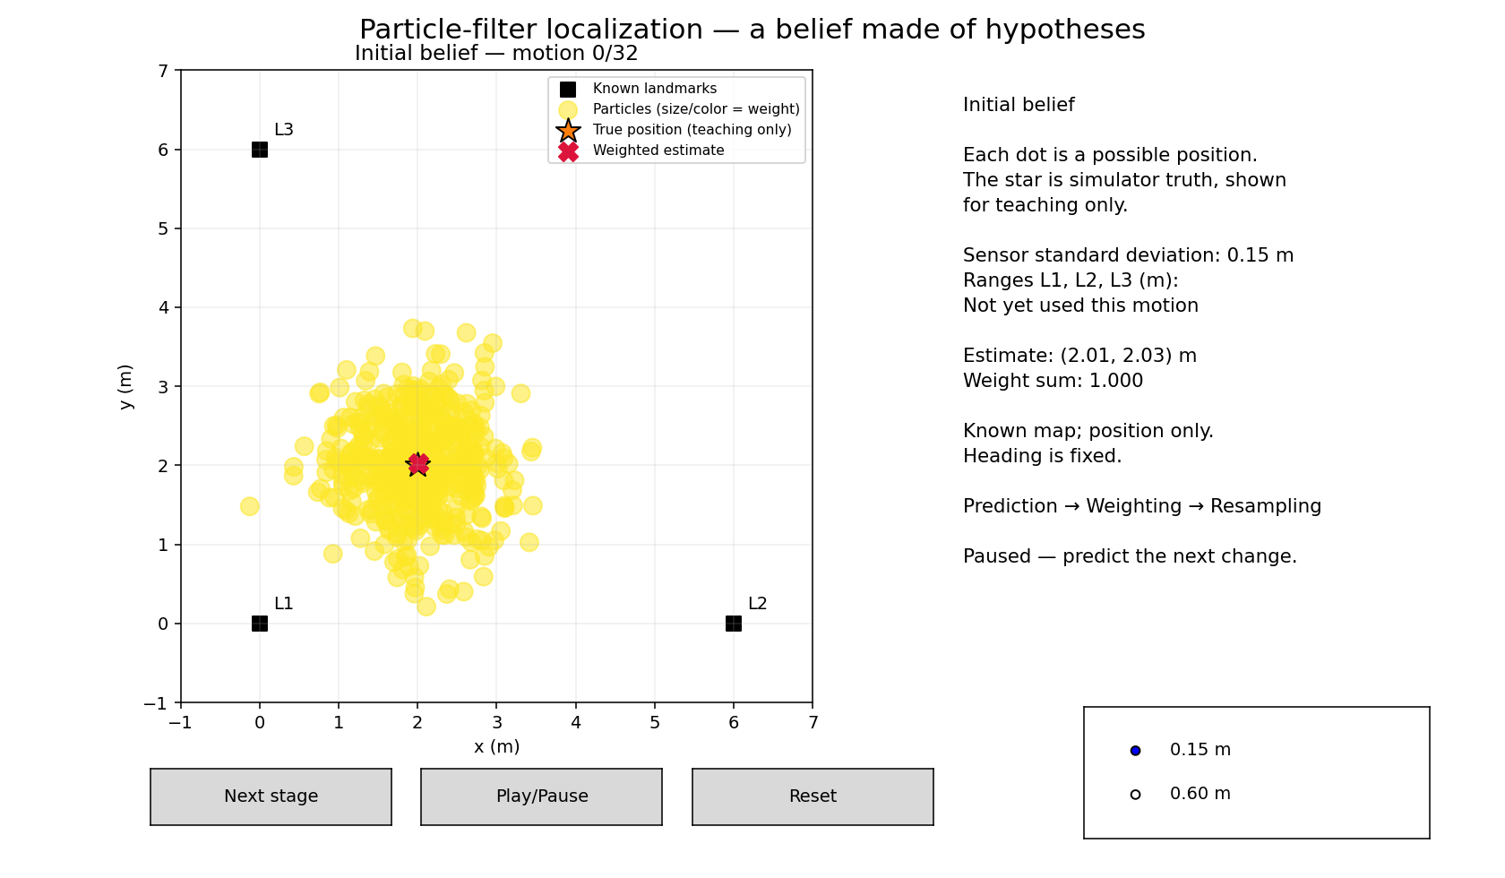
WEEK 12 / SLAM & BAYESIAN ESTIMATION
Live: inspect the initial belief
Localization mode · What would the real robot know?
Predict → reveal
Which information
is known?
Known landmarks + uncertain robot position.
Robotics & Autonomous Systems · Localization and mapping under uncertainty
09
Notes:
TIMING: 1 minutes.
One minute. Start in Localization: known map and .15 m noise. Identify black known landmark squares, orange truth star, red estimate, and weighted particles. Ask which is hidden from the estimator: the simulator truth star. A particle is a hypothetical position, not another robot. Show truth can be turned off without changing estimation. Keep the map selector in localization until the later unknown-map segment. If the window cannot open, use the included initial localization figure.
SOURCES
https://www.cs.cmu.edu/~thrun/papers/fox.aaai99.pdf

Slide 10
WEEK 12 / SLAM & BAYESIAN ESTIMATION
A belief made of particles
A weighted set of hypotheses approximates a distribution.
b_{t}(x) ≈ ∑_{i} w_{t}^{(i)} δ(x − x_{t}^{(i)})
∑_{i} w_{t}^{(i)} = 1; p̂_{t} = ∑_{i} w_{t}^{(i)}p_{t}^{(i)}
A mean is a summary, not the whole belief.
Robotics & Autonomous Systems · Localization and mapping under uncertainty
10
Notes:
TIMING: 1 minutes.
Each particle is a possible state. Delta denotes point mass at that hypothesis, not a tiny physical robot or a continuous Gaussian. Weights sum to one. The weighted mean summarizes the belief but can lie between two modes where little probability exists. A cloud can represent nonlinear or multimodal uncertainty, but finite sampling can miss a true region. Initial distributions and noise assumptions matter. The demo is roughly initialized tracking, not global localization or kidnapped-robot recovery.
SOURCES
https://www.cs.cmu.edu/~thrun/papers/fox.aaai99.pdf

Slide 11
WEEK 12 / SLAM & BAYESIAN ESTIMATION
Predict with the motion model
Move every robot hypothesis with its own sampled uncertainty.
p_{t}^{(i)} = p_{t−1}^{(i)} + u_{t} + ε_{t}^{(i)}
ε_{t}^{(i)} ∼ N(0, 0.08² I)
No new measurement is used yet.
Robotics & Autonomous Systems · Localization and mapping under uncertainty
11
Notes:
TIMING: 1 minutes.
The command is a .25 m axis-aligned translation in the next direction. Each hypothesis gets independent Gaussian motion noise. Simulator truth also moves noisily, using a separate stream. No sensor evidence has been consumed in Prediction. In SLAM the landmark grids remain fixed during this step because landmarks are static. Motion uncertainty broadens the predictive distribution in expectation; one finite realization need not visibly broaden. Do not promise the true square path closes perfectly.
SOURCES
https://www.cs.cmu.edu/~thrun/papers/fox.aaai99.pdf

Slide 12
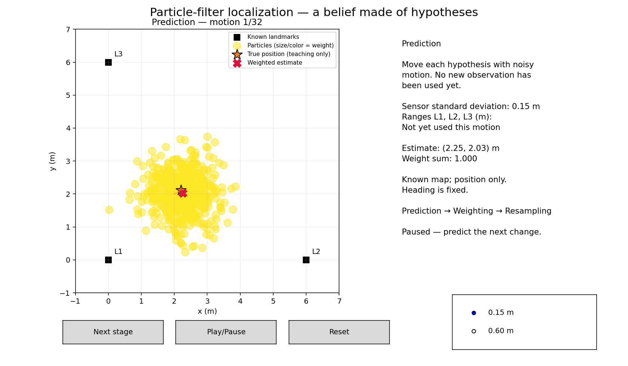
WEEK 12 / SLAM & BAYESIAN ESTIMATION
Live: predict before pressing
Next stage → Prediction
Predict → reveal
What moves?
What stays fixed?
What moves? What information is still missing?
Robotics & Autonomous Systems · Localization and mapping under uncertainty
12
Notes:
TIMING: 2 minutes.
Two minutes. Ask where the cloud will move and whether all dots should move identically. Press Next stage once. Compare with the prior and point out noisy displacement. The range panel says no new observation yet. The truth trajectory is only explanatory. Ask whether static map coordinates should also move: no. Use the saved prediction figure if needed.
SOURCES
https://www.cs.cmu.edu/~thrun/papers/fox.aaai99.pdf

Slide 13
WEEK 12 / SLAM & BAYESIAN ESTIMATION
Predict ranges; score agreement
Likelihood rewards hypotheses that explain the measurement.
h_{j}(p) = ‖m_{j} − p‖₂; z_{t,j} = h_{j}(p_{t}) + ν_{t,j}
ν_{t,j} ∼ N(0, σ_{z}²)
L_{i} ∝ exp[−½ ∑_{j} ((z_{t,j} − h_{j}(p_{t}^{(i)}))/σ_{z})²]
σ_z = 0.15 m or 0.60 m.
Robotics & Autonomous Systems · Localization and mapping under uncertainty
13
Notes:
TIMING: 1.5 minutes.
Range is Euclidean distance, not bearing. At p=(2,2), the three predicted ranges are sqrt8≈2.8284 and sqrt20≈4.4721 twice. Independent Gaussian range errors justify multiplying three likelihoods, or summing their log likelihoods. The squared residual is divided by sensor variance through the standardized residual. Larger sigma makes the same discrepancy less surprising. These are continuous probability densities, not probabilities of exact readings. Shared Gaussian normalization constants cancel when normalizing robot weights in localization.
SOURCES
https://www.cs.cmu.edu/~thrun/papers/fox.aaai99.pdf

Slide 14
WEEK 12 / SLAM & BAYESIAN ESTIMATION
Weight, then normalize
Keep particle positions; change their relative plausibility.
w̃_{i} = w_{t−1}^{(i)} L_{i}
w_{t}^{(i)} = w̃_{i} / ∑_{k} w̃_{k}
The estimate can move while the dots stay fixed.
Robotics & Autonomous Systems · Localization and mapping under uncertainty
14
Notes:
TIMING: 1 minutes.
The prior weight matters: evidence multiplies the previous belief, rather than discarding it. These equations use the demo bootstrap proposal, sampled from the motion model. More general importance-sampling proposals require a proposal correction. During correction robot coordinates remain unchanged. The weighted estimate may nevertheless move because its averaging weights changed. The demo computes log weights, subtracts the maximum, exponentiates and normalizes to avoid numerical underflow. Invalid likelihoods raise an error, not a fabricated uniform posterior.
SOURCES
https://www.cs.cmu.edu/~thrun/papers/fox.aaai99.pdf

Slide 15
WEEK 12 / SLAM & BAYESIAN ESTIMATION
Calculate three posterior weights
Equal priors · likelihoods 0.6, 0.3, 0.1
Particle
Prior × likelihood
Posterior
Copies / 10
A
(1/3) × 0.6 = 0.2
0.6
6
B
(1/3) × 0.3 = 0.1
0.3
3
C
(1/3) × 0.1 = 1/30
0.1
1
Normalizer = 1/3; posterior weights sum to 1.
Robotics & Autonomous Systems · Localization and mapping under uncertainty
15
Notes:
TIMING: 1.5 minutes.
Work before showing the answer. Multiply each likelihood by prior 1/3: .2,.1,1/30. The normalizer is 1/3. Division yields .6,.3,.1. Likelihoods need not sum to one across hypotheses; these chosen numbers happen to do so. Expected copies out of ten are 6,3,1. For general random resampling those are expectations, not fixed counts; the systematic method happens to give exactly these counts for this particular integer-count example. This table is a teaching calculation, not a trace from the 500-particle model.
SOURCES
https://www.cs.cmu.edu/~thrun/papers/fox.aaai99.pdf

Slide 16
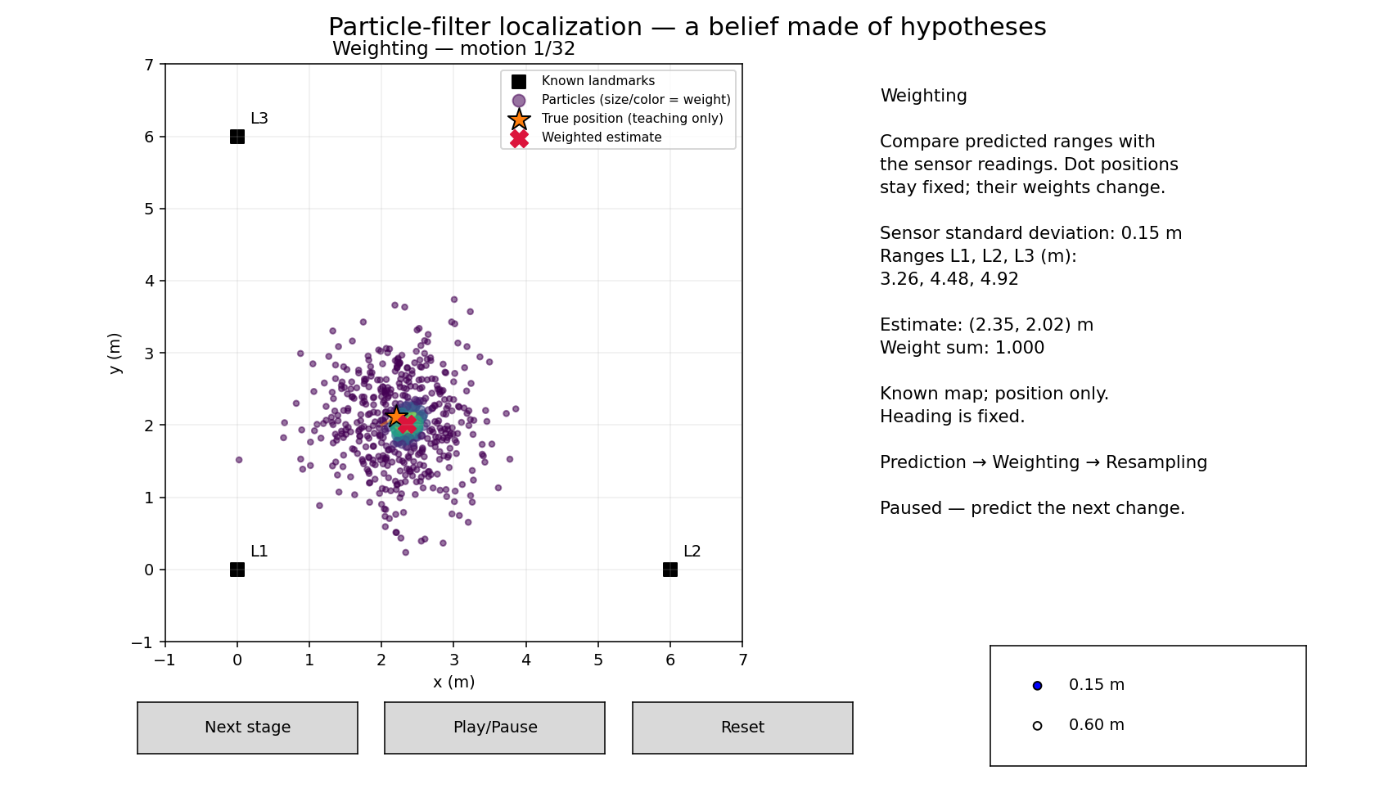
WEEK 12 / SLAM & BAYESIAN ESTIMATION
Live: reveal weighting
Next stage → Weighting
Predict → reveal
Dots or weights?
Why does the mean move?
Why does the red estimate move?
Robotics & Autonomous Systems · Localization and mapping under uncertainty
16
Notes:
TIMING: 2 minutes.
Two minutes. Ask students what should change. Press once and compare particle locations with the prediction state: positions did not move. Sizes/colors and red weighted estimate change. Read the three ranges and connect disagreement to likelihood. Ground truth is not used. The saved weighting image provides fallback. Keep one extra click for resampling, rather than allowing playback to skip the discussion.
SOURCES
https://www.cs.cmu.edu/~thrun/papers/fox.aaai99.pdf

Slide 17
WEEK 12 / SLAM & BAYESIAN ESTIMATION
Resample plausible hypotheses
Copy by probability; reset weights after selection.
Expected copies: 6 blue · 3 teal · 1 amber
P(select i) = w_{i}; new weights = 1/N
SLAM must copy the robot AND its conditional map.
Robotics & Autonomous Systems · Localization and mapping under uncertainty
17
Notes:
TIMING: 1 minutes.
The systematic algorithm takes one random offset and equally spaced thresholds on the cumulative weight distribution. It is not N independent random draws, although each ancestor has the correct expected copy count. Duplicates are allowed and can overlap. Selection frequency encodes the previous weights, so new particles receive equal weights. Resampling adds no evidence and does not guarantee improved accuracy; it can lose diversity. The demo resamples every measurement. Effective-sample-size adaptive schedules exist, but are not implemented.
SOURCES
https://www.cs.cmu.edu/~thrun/papers/fox.aaai99.pdf
https://www.cs.cmu.edu/~thrun/papers/montemerlo.fastslam-tr.pdf

Slide 18
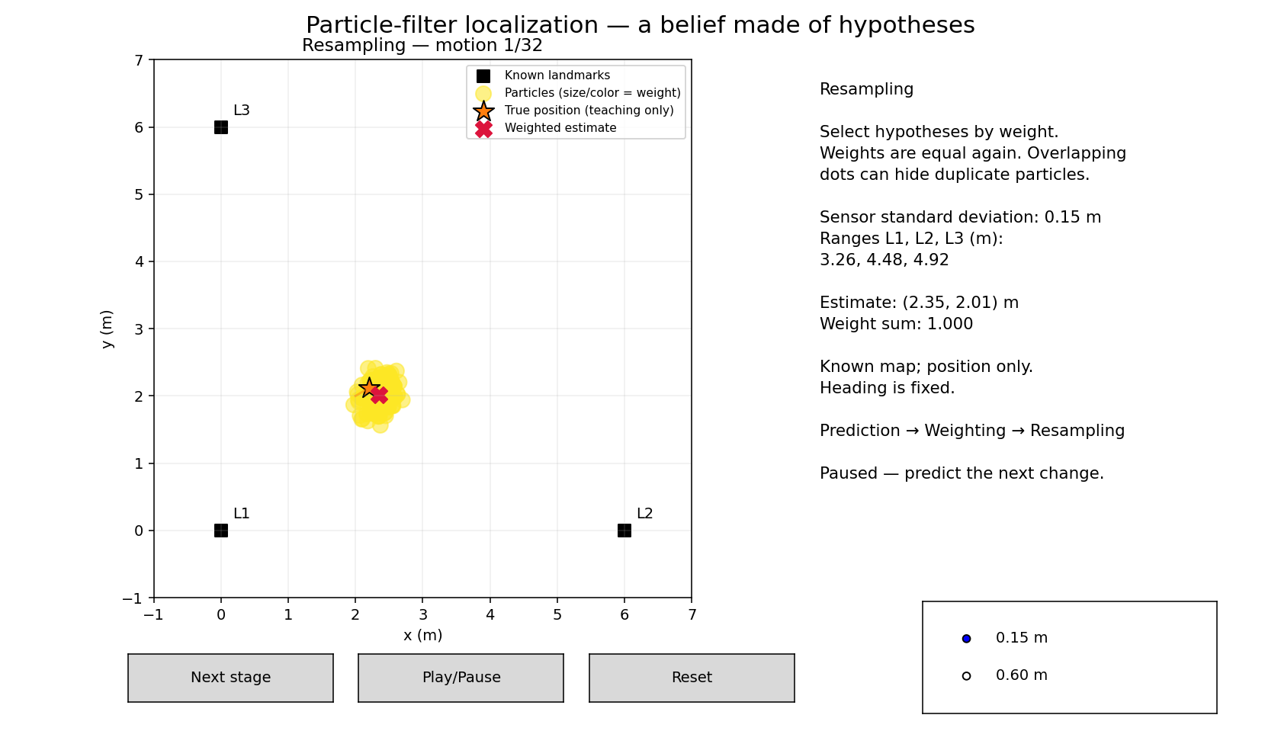
WEEK 12 / SLAM & BAYESIAN ESTIMATION
Live: reveal resampling
Next stage → Resampling
Predict → reveal
Another measurement?
What gets copied?
Uniform weights do not mean uniform spatial belief.
Robotics & Autonomous Systems · Localization and mapping under uncertainty
18
Notes:
TIMING: 2 minutes.
Two minutes. Ask whether another measurement is taken: no. Press once and show equal weights and overlapping copies. The estimate may shift due to finite resampling. If needed, play a few cycles then pause; do not consume the later SLAM comparison time. Reset retains selected noise and mode. Discuss what would go wrong if a SLAM particle kept a map from a different ancestor.
SOURCES
https://www.cs.cmu.edu/~thrun/papers/fox.aaai99.pdf
https://www.cs.cmu.edu/~thrun/papers/montemerlo.fastslam-tr.pdf

Slide 19
WEEK 12 / SLAM & BAYESIAN ESTIMATION
Uncertainty and failure
A tight cloud can still be wrong.
Evidence uncertainty
Approximation uncertainty
Noisy readings
Ambiguous geometry
Incorrect noise model
Finite robot hypotheses
Resampling diversity
Bounded landmark grids
Model mismatch · missing hypotheses · lost diversity
Robotics & Autonomous Systems · Localization and mapping under uncertainty
19
Notes:
TIMING: 1 minutes.
Noisier observations usually constrain belief less sharply, but individual outcomes vary and entropy is not guaranteed to fall at every update. Gaussian models can be wrong. Finite samples may miss correct hypotheses, and repeated resampling can eliminate useful paths. Means can lie between modes. Grid bounds and resolution affect the SLAM approximation. The same initial robot prior anchors the map imperfectly; no absolute truth recovery guarantee follows. The preset switch pauses and resets, so comparison is not a sudden noise change during the same trajectory.
SOURCES
https://www-personal.acfr.usyd.edu.au/tbailey/papers/slamtute1.pdf

Slide 20
WEEK 12 / SLAM & BAYESIAN ESTIMATION
When the map is unknown
The same range now constrains robot AND landmark locations.
Place data
Robot pose
Landmark map
Where was the sensor?
What generated the reading?
Match data
z_{t,j} ≈ ‖m_{j} − p_{t}‖₂
Static landmarks; unknown coordinates.
Robotics & Autonomous Systems · Localization and mapping under uncertainty
20
Notes:
TIMING: 1 minutes.
Localization interprets the observation against supplied m_j. In SLAM both terms are uncertain and must be inferred jointly. All landmarks remain static. Unknown map does not mean physically unstable objects. The SLAM estimator receives identified ranges, a generic bounded map prior, and a robot prior; no true coordinates. Both modes use exactly the same simulated range-only sensor and seeded physical motion. Mapping uncertainty is maintained per robot hypothesis, preserving coupling through a mixture of conditional maps.
SOURCES
https://www-personal.acfr.usyd.edu.au/tbailey/papers/slamtute1.pdf

Slide 21
WEEK 12 / SLAM & BAYESIAN ESTIMATION
Pose errors distort the map
Frame mathematics explains the coupling.
y
m_{j} = t_{t} + R(θ_{t}) z_{j}^{local}
(2,3): correct
Local point (1,0)
Robot (2,2), heading 90°
(3,2): wrong
x
R = rotation; t = translation. Example needs direction information.
Robotics & Autonomous Systems · Localization and mapping under uncertainty
21
Notes:
TIMING: 1.5 minutes.
Define R as rotation from the robot frame to world and t as world position of the robot origin. A local point observation (1,0), robot translation (2,2), and heading90 degrees yields landmark (2,3). Using heading0 incorrectly yields (3,2). This local point requires direction information; it is a conceptual alternative sensor example, NOT a measurement provided by the range-only demo. The demo instead constrains distance circles. Pose errors affect map placement, and map errors affect pose estimation. Relative sensing also leaves global reference-frame freedoms without an anchor.
SOURCES
https://www-personal.acfr.usyd.edu.au/tbailey/papers/slamtute1.pdf

Slide 22
WEEK 12 / SLAM & BAYESIAN ESTIMATION
Which landmark was observed?
Data association connects observations to map features.
Match
Initialize
Reject / defer
An existing landmark
Use its map belief
A new landmark
Keep uncertainty
Ambiguous match
Avoid false certainty
Demo IDs are supplied; real systems must often infer them.
Robotics & Autonomous Systems · Localization and mapping under uncertainty
22
Notes:
TIMING: 1 minutes.
Explain existing landmark match, new landmark initialization, and ambiguous or incorrect correspondence. The demo assumes exactly three landmarks with known IDs L1,L2,L3, so it avoids matching and discovery. This is a modeling simplification, not a solved real-world association problem. A mistaken association can create a false strong constraint and damage an estimate or loop closure. Matching may use geometry and appearance, uncertainty gates and consistency checks. Keep implementation detail in notes rather than turning this into a separate association lecture.
SOURCES
https://www-personal.acfr.usyd.edu.au/tbailey/papers/slamtute1.pdf

Slide 23
WEEK 12 / SLAM & BAYESIAN ESTIMATION
Range-only landmark estimation
One reading gives a circle; new viewpoints narrow the possibilities.
One range: a band
Two views: ambiguity
‖m_{j} − p_{t}‖₂ ≈ z_{t,j}
Mean ≠ most likely landmark location.
Robotics & Autonomous Systems · Localization and mapping under uncertainty
23
Notes:
TIMING: 1.5 minutes.
Conditional on one known robot hypothesis, a noisy distance produces an annular probability band around it. It does not uniquely initialize a point or narrow Gaussian. Two circles may intersect at two possibilities; collinear viewpoints can retain a reflection ambiguity. A third noncollinear viewpoint can distinguish them under suitable geometry. If robot position is uncertain, integrating its hypotheses adds further uncertainty. The demo uses full grid distributions to retain these modes. The shown coordinate mean can lie in the center of a ring where probability is low. Do not introduce bearings into the implemented sensor.
SOURCES
https://www-personal.acfr.usyd.edu.au/tbailey/papers/slamtute1.pdf

Slide 24
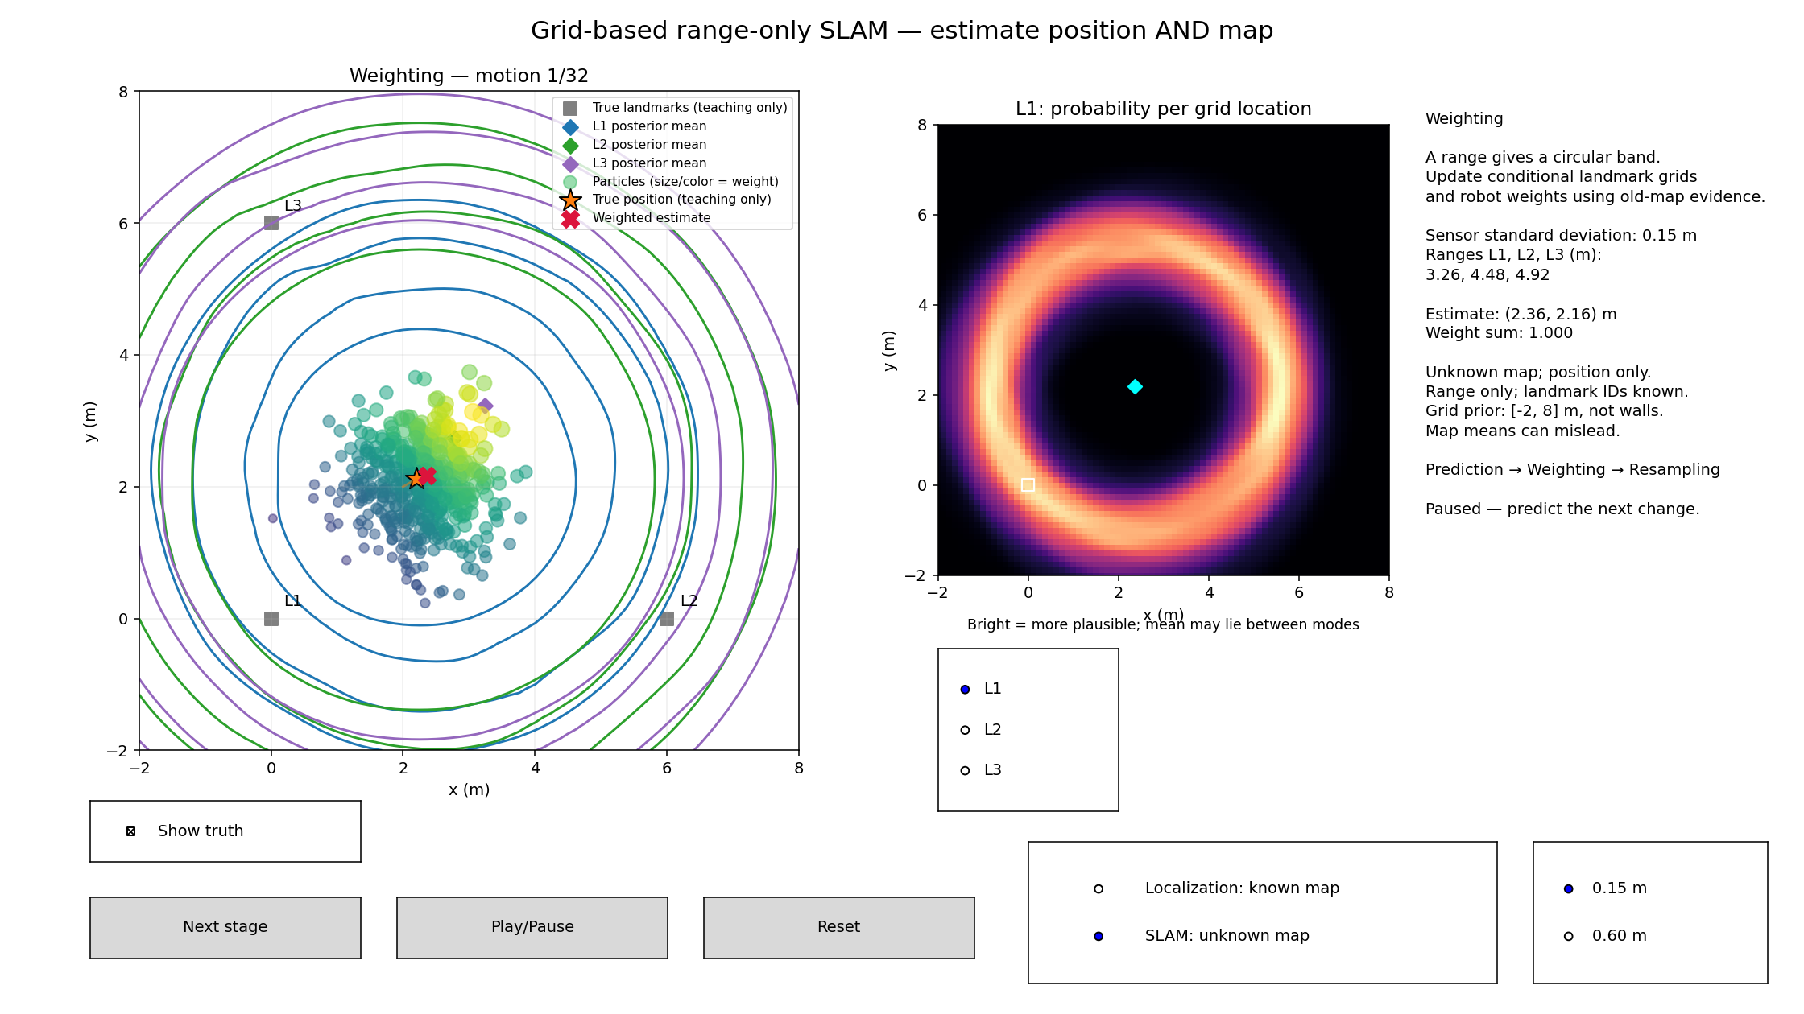
WEEK 12 / SLAM & BAYESIAN ESTIMATION
Live: switch to range-only SLAM
SLAM: unknown map · Same physical landmarks and sensor
Change modes
Unknown locations
Range-only bands
Multiple viewpoints
A circle → overlapping constraints → a more informative map.
Robotics & Autonomous Systems · Localization and mapping under uncertainty
24
Notes:
TIMING: 5 minutes.
Five minutes. Pause, select SLAM: unknown map; this resets while preserving noise and seed. Show initial uniform landmark grids and known IDs. Advance prediction then weighting: select L1,L2,L3 detail heatmaps and point out annular or ambiguous distributions. Resample: selected robot hypotheses bring their maps. Use prepared post-resampling snapshots at motions8,16,32 to show longer-term constraints without waiting for full playback. Show truth off and explain the mean marker is not a unique solution. Briefly switch sigma to .60m, noting the reset and generally less informative measurements. The grid is a bounded prior over landmark coordinates, not occupancy cells or walls. Repeated landmark IDs are observed; no explicit place-recognition/trajectory optimizer exists.
SOURCES
https://www-personal.acfr.usyd.edu.au/tbailey/papers/slamtute1.pdf

Slide 25
WEEK 12 / SLAM & BAYESIAN ESTIMATION
Drift and recognized revisits
Revisiting a place is useful only when the correspondence is recognized.
y
Recognized revisit
Adds a consistency constraint
Requires correct matching
Can inform correlated poses
x
Reobservation is implemented; global loop optimization is not.
Robotics & Autonomous Systems · Localization and mapping under uncertainty
25
Notes:
TIMING: 1.5 minutes.
Odometry errors accumulate and distort trajectories/maps. A valid revisit constraint can improve consistency by relating current observations to earlier structure. Merely returning near the start is not loop closure. The filter demo repeatedly reobserves supplied landmark IDs, refining joint estimates; it has no separate loop-closure detector, global trajectory optimizer, or past-pose correction display. Explain graph-based loop constraints conceptually with an editable original diagram. No guarantee that a false match helps, or that all map errors vanish. Static maps, sensible noise models, and correct association are assumptions.
SOURCES
https://www-personal.acfr.usyd.edu.au/tbailey/papers/slamtute1.pdf
https://www.roboticsbook.org/S64_driving_perception.html

Slide 26
WEEK 12 / SLAM & BAYESIAN ESTIMATION
Occupancy-grid mapping
A different map representation: free, occupied, or unknown.
ℓ_{t}(c) = ℓ_{t−1}(c) + logit P(c occupied | z_{t},x_{t}) − ℓ₀(c)
P(c occupied) = 1 / (1 + exp(−ℓ_{t}(c)))
HW6 connection; occupancy mapping is not implemented here.
Robotics & Autonomous Systems · Localization and mapping under uncertainty
26
Notes:
TIMING: 1.5 minutes.
Here c denotes a cell, distinct from association c_t. Logit(p)=log(p/(1-p)); .5 prior gives zero log odds. An inverse sensor model contributes free-space evidence before a hit and occupied evidence near a hit; untouched cells remain unknown. A toy occupied probability .7 adds log(7/3)≈.8473; two consistent updates with .5 prior produce probability49/58≈.8448. Conditional cell independence and supplied poses are mapping approximations. Handling uncertain trajectories jointly is SLAM. The demo landmark probability grids are NOT occupancy grids: each represents one landmark location and sums to one across locations. Occupancy cells each have their own Bernoulli probability.
SOURCES
https://www.cs.cmu.edu/~thrun/papers/thrun.iros01-occmap.pdf

Slide 27
WEEK 12 / SLAM & BAYESIAN ESTIMATION
Each robot hypothesis carries a map
Grid-based range-only SLAM uses conditional landmark distributions.
Particle i
e_{ij} = ∑_{g} L_{ij}(g) M_{t−1,ij}(g)
Robot position
L1 distribution
L2 distribution
L3 distribution
M_{t,ij}(g) ∝ L_{ij}(g) M_{t−1,ij}(g)
Evidence first; posterior map second; copy them together.
Robotics & Autonomous Systems · Localization and mapping under uncertainty
27
Notes:
TIMING: 1 minutes.
Read i as robot/path hypothesis, j as landmark ID, and g as candidate grid coordinate. Integrate the likelihood against the OLD map to score robot hypotheses. Then update each conditional map with that reading. Weight robot particles by the product of evidences for conditionally independent landmarks. Resampling copies whole hypotheses. Each landmark prior is uniform on an81x81 grid spanning -2 through8m at .125m spacing. This is a finite-grid Rao-Blackwellized method inspired by the FastSLAM decomposition, not the original landmark-EKF algorithm. Original FastSLAM combines particles with landmark Kalman filters; particles and Kalman methods are not mutually exclusive.
SOURCES
https://www.cs.cmu.edu/~thrun/papers/montemerlo.fastslam-tr.pdf

Slide 28
WEEK 12 / SLAM & BAYESIAN ESTIMATION
SLAM does not require particles
Choose a representation suited to the model and uncertainty.
Particles
EKF / UKF
Graph SLAM
Sampled hypotheses
Multiple modes
Sampling cost
Mean + covariance
Nonlinear approximations
Correlated state
Pose/map constraints
Optimize residuals
Different architecture
Particle filters · Gaussian filters · graph optimization
Robotics & Autonomous Systems · Localization and mapping under uncertainty
28
Notes:
TIMING: 1 minutes.
Particle methods can retain multiple modes but require adequate hypotheses and computation. KF is exact for linear Gaussian models with Gaussian initial belief. Nonlinear SLAM commonly uses EKF or UKF approximations; a single Gaussian can struggle with severe ambiguity. Graph-based methods optimize constraints and are not simply another filter. No method is universally best. Pose/map representation, association, sparsity, computation, and noise assumptions all matter. Our range-only ring distributions motivate the grid maps; a narrow Gaussian at first range would invent information.
SOURCES
https://www-personal.acfr.usyd.edu.au/tbailey/papers/slamtute1.pdf
https://www.cs.cmu.edu/~thrun/papers/montemerlo.fastslam-tr.pdf
https://www.roboticsbook.org/S64_driving_perception.html

Slide 29
WEEK 12 / SLAM & BAYESIAN ESTIMATION
The Kalman-filter idea
Represent uncertainty with a mean and covariance.
μ̄ = Fμ + Bu; Σ̄ = FΣF^{T} + Q
e = z − Hμ̄; S = HΣ̄H^{T} + C_{z}
K = Σ̄H^{T} S⁻¹; μ⁺ = μ̄ + Ke
Linear Gaussian assumptions make this update exact.
Robotics & Autonomous Systems · Localization and mapping under uncertainty
29
Notes:
TIMING: 1 minutes.
Define mu mean, Sigma covariance, F dynamics matrix, B command mapping, H measurement matrix, Q process covariance and C_z sensor covariance. Use C_z rather than R to avoid collision with rotation notation. Innovation e is measured minus predicted evidence; S is its covariance; K balances model uncertainty and measurement uncertainty. For scalar prior mean2 variance.36, command.25, Q=.0064, position observation2.4 with C_z=.0225: predicted2.25 variance.3664, gain.9421445, posterior mean2.3913217 and variance.0211983. This is a separate direct-position-sensor example, NOT the demo ranges. In code solve linear systems rather than explicitly invert S. More complete covariance equations appear in backup.
SOURCES
https://www-personal.acfr.usyd.edu.au/tbailey/papers/slamtute1.pdf

Slide 30
WEEK 12 / SLAM & BAYESIAN ESTIMATION
EKF-SLAM: linearize the models
One Gaussian estimates robot pose and every landmark together.
X = [x, y, θ, m_{1x}, m_{1y}, …]^{T}
μ̄ = f(μ,u); Σ̄ = FΣF^{T} + Q
e = z − h(μ̄); μ⁺ = μ̄ + Ke
Jacobians approximate nonlinear motion and sensing.
Robotics & Autonomous Systems · Localization and mapping under uncertainty
30
Notes:
TIMING: 1.5 minutes.
Joint state dimension is3+2J for planar pose and J landmarks. Static map portions of f leave landmarks unchanged, with zero map process noise. F and H are Jacobians of nonlinear f and h at the current prediction. Reuse S=H Sigma-bar H-transpose+C_z and K equations. Range h_j=sqrt((m_jx-x)^2+(m_jy-y)^2) is nonlinear. For nonzero range rho, its derivatives with respect to x,y are negative normalized displacement and with respect to landmark coordinates positive normalized displacement; derivative with respect to heading is zero for pure range. EKF approximates, rather than exactly representing ring ambiguity. Range-only landmark initialization needs suitable multi-view estimation, not an arbitrary point on the first circle.
SOURCES
https://www-personal.acfr.usyd.edu.au/tbailey/papers/slamtute1.pdf

Slide 31
WEEK 12 / SLAM & BAYESIAN ESTIMATION
Why cross-covariance matters
A landmark observation can inform the robot and the rest of the map.
Σ_{xx}
Σ_{xm}
Shared uncertainty
Robot ↔ landmarks
Landmark ↔ landmark
Use the full covariance
Σ_{mx}
Σ_{mm}
UKF uses sigma points; correlations still matter.
Robotics & Autonomous Systems · Localization and mapping under uncertainty
31
Notes:
TIMING: 1 minutes.
Robot-map covariance Sigma_xm captures shared uncertainty; landmark-landmark blocks reflect common robot errors. Because Kalman gain uses the full joint covariance, observing one feature can update other correlated state components. Dropping cross blocks changes the inference and may produce overconfidence. A frame anchor does not remove all uncertainty. UKF propagates sigma points through nonlinear functions and also maintains a joint Gaussian representation; it does not automatically resolve severe multimodality. In the demo dependencies are represented through the mixture of maps conditional on sampled robot histories.
SOURCES
https://www-personal.acfr.usyd.edu.au/tbailey/papers/slamtute1.pdf

Slide 32
WEEK 12 / SLAM & BAYESIAN ESTIMATION
Reconstruct the complete process
Different representations, the same estimation question.
Predict
Observe
Associate
Update
Joint estimate
Robot belief + landmark map + uncertainty
Predict → observe → associate → update robot AND map.
Robotics & Autonomous Systems · Localization and mapping under uncertainty
32
Notes:
TIMING: 1 minutes.
Have students narrate controls, prediction, observations, association, joint correction, and uncertainty representation. Ask what differs between selectors: known versus estimated landmark coordinates, not moving landmarks. Ask why robot resampling must carry the map and why one range cannot uniquely locate a feature. Conclude with selection of representation: particles/grids preserve ambiguity, EKF/UKF approximate Gaussian uncertainty, graph methods optimize constraints. SLAM is an estimation foundation used by planning but does not itself choose collision-free motions. Avoid universal accuracy or robustness claims.
SOURCES
https://www-personal.acfr.usyd.edu.au/tbailey/papers/slamtute1.pdf

Slide 33
WEEK 12 / SLAM & BAYESIAN ESTIMATION
Questions & recap
Explain the evidence, the uncertainty, and what each mode estimates.
Explain the updates
Explain SLAM
Prediction versus evidence
Likelihood versus weight
Resampling versus sensing
Known versus unknown map
Pose–map coupling
Particles versus Gaussian filters
Robotics & Autonomous Systems · Localization and mapping under uncertainty
33
Notes:
TIMING: 3 minutes.
Three minutes. Check localization versus SLAM, known/static versus moving landmarks, motion versus observation updates, likelihood versus normalized weight, resampling without new evidence, ring ambiguity, carrying maps during resampling, and EKF/UKF alternatives. Distinguish landmark-location probability grids from occupancy maps. Connect to HW6 motion/measurement updates and occupancy mapping without inventing assignment interfaces or solutions. A correct answer should identify robot-map coupling and the limits of fixed-heading, known-ID range-only simulation. The initial pose prior anchors the frame imperfectly; absolute accuracy is not guaranteed.
SOURCES
https://www-personal.acfr.usyd.edu.au/tbailey/papers/slamtute1.pdf

Slide 34
OPTIONAL / DEEPER DISCUSSION
Joint posterior and reference frame
Conditional independence requires explicit assumptions.
p(x_{0:t},m | u,z,c) ∝ p(x₀)p(m)
× ∏_{k} p(x_{k} | x_{k−1},u_{k}) ∏_{j} p(z_{k,j} | x_{k},m_{j})
p(m | x_{0:t},z,c) = ∏_{j} p(m_{j} | x_{0:t},z,c)
Online marginals differ from a stored full-trajectory posterior.
Robotics & Autonomous Systems · Localization and mapping under uncertainty
34
Notes:
TIMING: 0 minutes.
The posterior factorization assumes Markov motion, static landmarks, known associations, conditionally independent observations, and independent landmark priors given the trajectory. Terms involving data are understood over available observations at each step. Conditional independence is not unconditional independence: mixing uncertain trajectories couples map variables. Without an initial pose/frame anchor, jointly translated configurations remain equivalent under relative ranging; additional rotational ambiguities depend on motion/frame information. Demo commands are given in fixed world axes and heading is held fixed, while initial position has a Gaussian prior. No absolute truth coordinates enter the SLAM estimator.
SOURCES
https://www-personal.acfr.usyd.edu.au/tbailey/papers/slamtute1.pdf
https://www.cs.cmu.edu/~thrun/papers/montemerlo.fastslam-tr.pdf

Slide 35
OPTIONAL / DEEPER DISCUSSION
Likelihoods and systematic selection
Stable arithmetic and correct ancestry preserve the model.
log L_{i} = const − ½ ∑_{j} ((z_{j} − h_{j}(p_{i}))/σ_{z})²
u_{k} = (u₀ + k)/N; u₀ ∼ Uniform(0,1)
N_{eff} = 1 / ∑_{i} w_{i}²
Robotics & Autonomous Systems · Localization and mapping under uncertainty
35
Notes:
TIMING: 0 minutes.
Independent Gaussian densities share constants in localization. Log-space normalization subtracts maximum then exponentiates; this is numerical stabilization rather than a new filter. For systematic resampling take k=0..N-1, cumulative weights, and the first cumulative value beyond each u_k. Expected copies are Nw_i though sample counts are correlated. Effective sample size is a useful degeneracy diagnostic; this demo does not use an adaptive threshold. In SLAM copy each ancestor position and all its conditional maps, with independent mutable storage for descendants. All-zero or invalid mass is an error; numerical underflow and impossible evidence must not be hidden with a uniform fallback.
SOURCES
https://www.cs.cmu.edu/~thrun/papers/fox.aaai99.pdf
https://www.cs.cmu.edu/~thrun/papers/montemerlo.fastslam-tr.pdf

Slide 36
OPTIONAL / DEEPER DISCUSSION
Range-only conditional-map update
The evidence uses the previous map distribution.
e_{ij} = ∑_{g} L_{ij}(g) M_{old,ij}(g)
M_{new,ij}(g) = L_{ij}(g) M_{old,ij}(g) / e_{ij}
w_{i}⁺ ∝ w_{i} ∏_{j} e_{ij}
P(m_{j}=g | z,u) ≈ ∑_{i} w_{i} M_{ij}(g)
Robotics & Autonomous Systems · Localization and mapping under uncertainty
36
Notes:
TIMING: 0 minutes.
This finite-grid update exactly normalizes each conditional discrete landmark distribution, apart from floating point. Robot inference remains a finite particle approximation and map coordinates are quantized. Evidence must integrate against the OLD map: using the newly conditioned map would reuse the same observation incorrectly. Gaussian density constants are included in recorded evidence; shared constants cancel across particle weights. After all measurements, normalize robot weights. Resample the complete particle/map pair. Conditional maps use float64; 500x3x6561 entries require about75.1MiB for persistent probabilities, with additional temporary/copy memory. Chunk32 particle batches limit likelihood temporaries. Uniform bounded grid priors imply boundary and resolution assumptions. First-range rings can be clipped by the prior; full marginal heatmaps expose this.
SOURCES
https://www.cs.cmu.edu/~thrun/papers/montemerlo.fastslam-tr.pdf

Slide 37
OPTIONAL / DEEPER DISCUSSION
Kalman/EKF covariance and checks
Covariance correction must preserve the joint structure.
Σ⁺ = (I − KH) Σ̄ (I − KH)^{T} + K C_{z} K^{T}
F = ∂f/∂X; H = ∂h/∂X
ρ_{j} = ‖m_{j} − p‖; ∂ρ/∂p = −(m_{j} − p)^{T}/ρ_{j}
Robotics & Autonomous Systems · Localization and mapping under uncertainty
37
Notes:
TIMING: 0 minutes.
Joseph covariance form shown above is numerically robust; in exact arithmetic with the computed gain it agrees with (I-KH)Sigma-bar. At zero range the derivative is undefined. State and measurement dimensions must agree; full3+2J covariance includes all cross blocks. For scalar direct position example predicted variance.3664, gain.9421445102, posterior mean2.3913216765, variance.0211982515. Check Joseph and simplified forms numerically. This worked example is not the range-only demo. Range-only EKF initialization requires multiple observations or richer representations. UKF avoids explicit Jacobians but still approximates distributions with mean/covariance.
SOURCES
https://www-personal.acfr.usyd.edu.au/tbailey/papers/slamtute1.pdf

Slide 38
OPTIONAL / DEEPER DISCUSSION
Maps and graph-based SLAM
Landmark grids, occupancy cells, and factor graphs are different.
Occupancy: ℓ⁺ = ℓ + logit(p_{hit}) − ℓ₀
Graph: minimize ∑_{f} r_{f}(X)^{T} Ω_{f} r_{f}(X)
Robotics & Autonomous Systems · Localization and mapping under uncertainty
38
Notes:
TIMING: 0 minutes.
A landmark grid is a normalized distribution over one landmark location. Occupancy cells each carry a Bernoulli occupied/free variable; they are not normalized across the map. A graph objective sums weighted constraint residuals, with Omega information matrices. Pose anchors, robust losses, data association and sparsity are important; no graph optimizer is implemented here. For .5 occupancy prior and p_hit=.7, one update .7 and two updates49/58≈.8448276, subject to the inverse-model conditional assumptions. FastSLAM originally pairs trajectory particles with conditional landmark Kalman filters; our grid maps use the same decomposition idea without claiming identical implementation. Close with estimation versus planning and no universal best solver.
SOURCES
https://www.cs.cmu.edu/~thrun/papers/thrun.iros01-occmap.pdf
https://www.roboticsbook.org/S64_driving_perception.html
https://www.cs.cmu.edu/~thrun/papers/montemerlo.fastslam-tr.pdf

