Slide 1
WELCOME TO THE COURSE
Robotics &
Autonomous Systems
Week 1
Robotics & Autonomous Systems · ROS 2 Jazzy
01
Notes:
Final slide 1 — Robotics & Autonomous Systems
Timing: 0 minutes.
Week 1 — Robotics & Autonomous Systems
Display the course title while students settle.
Audience: Python familiarity; little networking knowledge.
The final deck has 15 main slides and five hidden backup slides (16–20).
The main session is 45 minutes: explanation/introduction 25; code 7; run/inspect 6; experiments 4; questions/recap 3.
ROS 2 Jazzy is the teaching baseline, not a claim about the newest distribution.

Slide 2
WEEK 01 / ROS BASICS
About me
Gilad Lifshitz
STUDIES
EXPERIENCE
Master’s student under Ronen.
Robots and drones
during army service.
YOUR FEEDBACK MATTERS
This is the first time we’re running this course.
All the tutorials are new. I’d love your feedback—
what works well and what needs improvement.
Robotics & Autonomous Systems · ROS 2 Jazzy
02
Notes:
Final slide 2 — About me
Timing: 1 minutes.
Introduce yourself as Gilad Lifshitz, a master’s student under Ronen. Describe your experience working with robots and drones during army service. Do not add an unconfirmed surname, degree specialization, or military role.
This is the first time we’re running this course, and all the tutorials are new. I’d love your feedback—what works well and what needs improvement. Invite both positive and critical feedback throughout the semester.

Slide 3
WEEK 01 / ROS BASICS
ROS basics
Today’s plan
01
Understand ROS at a high level
02
Watch a demonstration
03
Read the demonstration’s code
Robotics & Autonomous Systems · ROS 2 Jazzy
03
Notes:
Final slide 3 — ROS basics
Timing: 0.5 minutes.
Today we will learn what ROS provides at a high level, watch a live publisher/subscriber demonstration, and read the Python code that makes it work. The demonstration and code walkthrough share the dedicated Demo time block. Assume Python familiarity and little networking knowledge.

Slide 4
WEEK 01 / ROS BASICS
What is ROS, and why do we need it?
Despite its name, ROS is a software framework
that runs on an operating system.
Robot Operating System
Robot application
Connect software across
languages and machines.
Share common interfaces.
ROS libraries + tools + packages
Host OS + hardware
Reuse drivers and algorithms. Focus on your robot's behavior.
Robotics & Autonomous Systems · ROS 2 Jazzy
04
Notes:
Final slide 4 — What is ROS, and why do we need it?
Timing: 2 minutes.
Purpose: Establish what students are learning and why it exists.
- ROS means Robot Operating System: a software framework for building robotics
applications that runs on an operating system such as Linux.
- It supplies communication libraries, development/debugging tools, and an ecosystem
of reusable packages, including drivers and robotics algorithms.
- Robotics software combines components written by different people, often in different
languages and running on different computers. ROS supplies common interfaces to connect them.
Visual: Three layers: robot application; ROS libraries/tools/packages; host OS/hardware.
Speaker guidance: Start with “How do a camera, a planner, and a motor driver share
information?” Define middleware as software handling communication between application
components. Explain the purpose before introducing API names.
Demo connection: Python supplies the application logic; rclpy supplies ROS
interfaces; std_msgs supplies the message definition.
Reference: Official ROS 2 overview: https://github.com/ros2/ros2_documentation/blob/jazzy/source/index.rst.

Slide 5
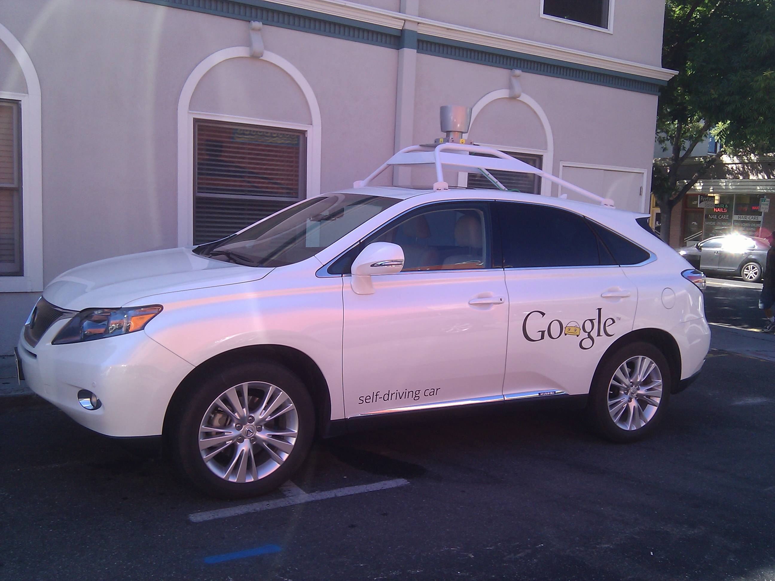
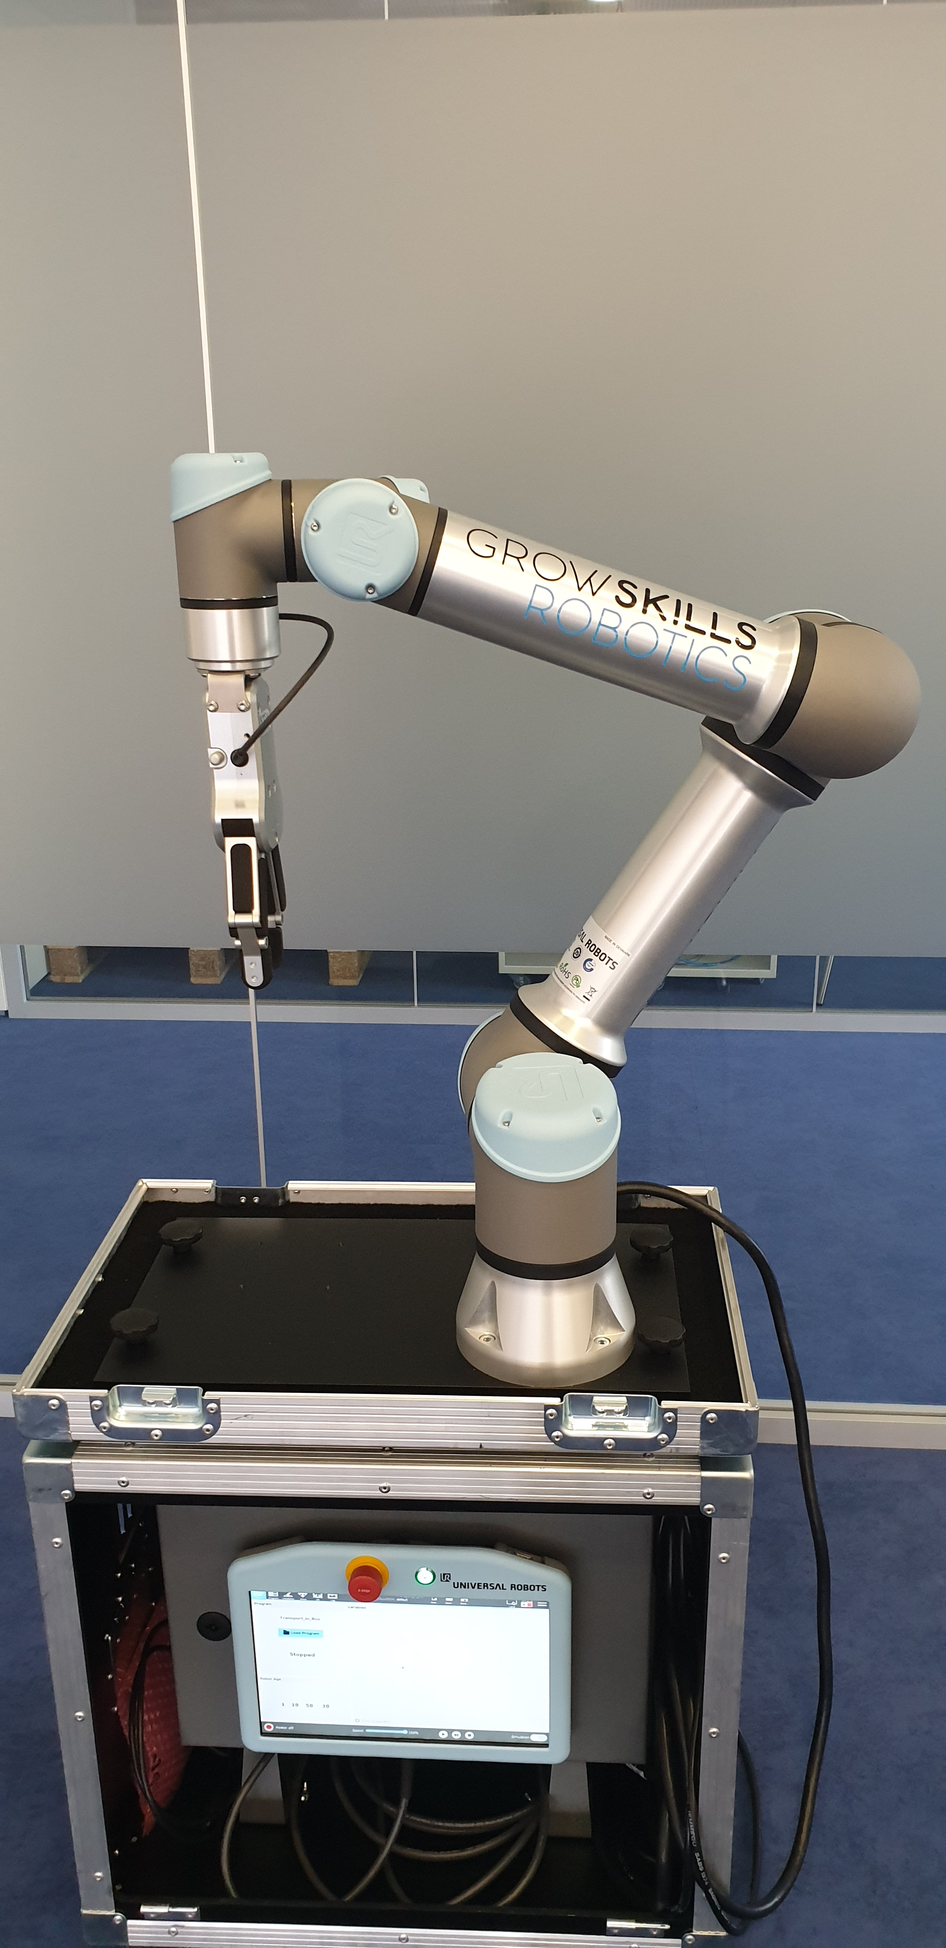
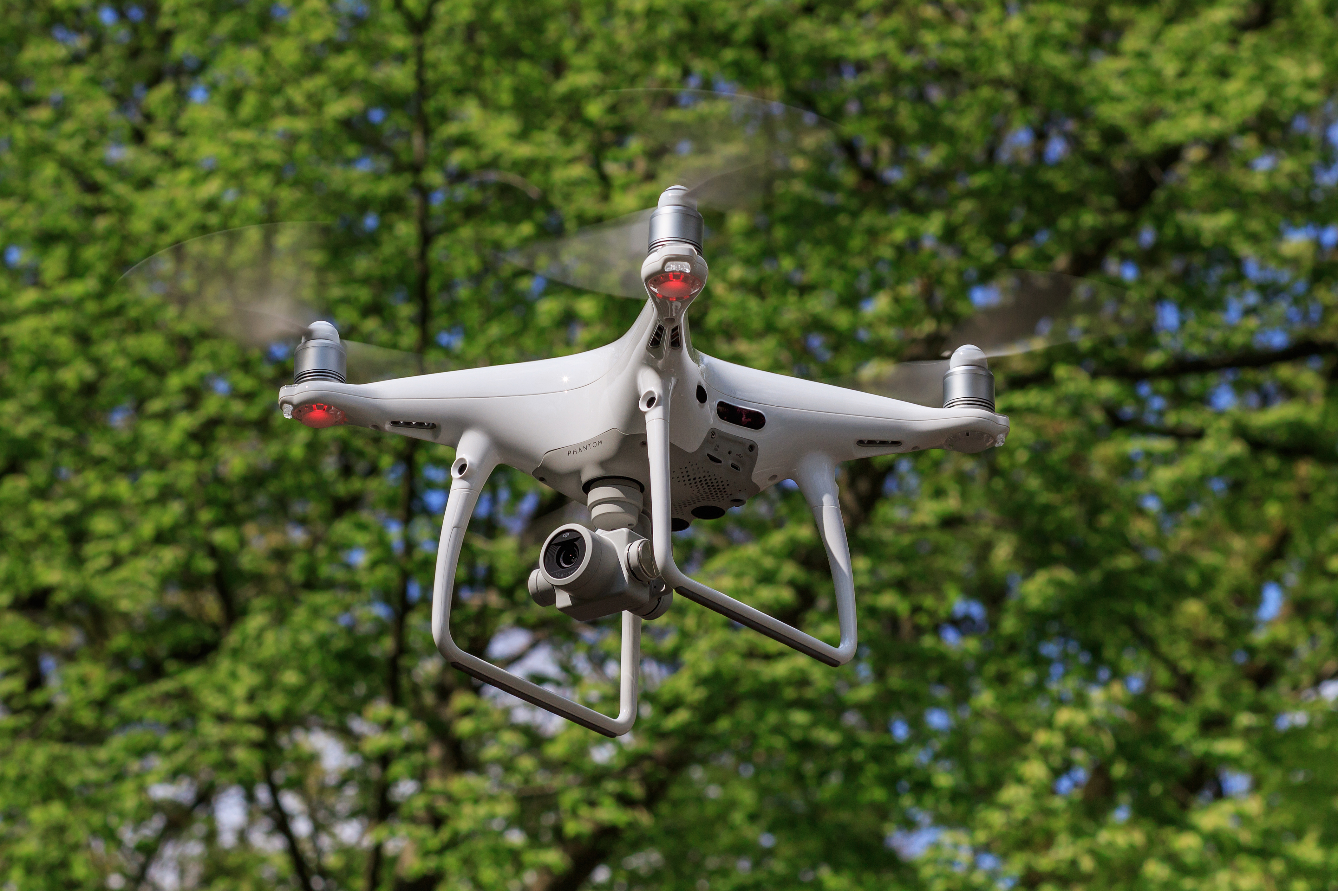
WEEK 01 / ROS BASICS
What is ROS used for?
One framework. Many kinds of autonomous systems.
Autonomous vehicles
Robotics
Drones
Robotics & Autonomous Systems · ROS 2 Jazzy
05
Notes:
Final slide 5 — What is ROS used for?
Timing: 1.5 minutes.
Purpose: Show three recognizable fields where ROS is used: autonomous vehicles, robotics, and drones. Explain the shared need to connect sensors, perception, planning, and control. These photographs illustrate application fields; they do not establish that a particular pictured product runs ROS.
Retained teaching context from the updated deck:
Timing: 2 minutes.
Purpose: Connect the framework to complete robots and industrial applications.
- Example robot: sensor drivers → perception/localization → planning → control →
actuator drivers. Localization also consumes motion feedback from the robot.
- Teams can integrate modules, inspect data, and reuse existing drivers and algorithms.
- Compatible interfaces allow simulated sensors/actuators to replace hardware during
development. Physical behavior and timing still need validation on the robot.
- Industry examples: ROS-Industrial's work with BMW and Microsoft on logistics
interoperability, and robotic blending/scan-and-plan work for foundries. These are
documented ROS ecosystem applications; do not assume all use the same ROS generation.
Visual: Robot software graph with sensor inputs, actuator outputs, and an alternative
simulation boundary. Place the industrial examples beside the graph.
Speaker guidance: Explain the benefit: interoperability for logistics; perception
linked to motion planning for manufacturing. ROS adoption alone does not make a system
safety certified or guarantee hard real-time control; these require system-level design.
Demo connection: The greeting producer and consumer represent two software modules;
a real sensor publishes structured measurements rather than greetings.
Reference: ROS-Industrial applications and project overview: https://rosindustrial.org/.
IMAGE CREDITS
Google self-driving car in Mountain View.jpg
Author: Mark Doliner
License: CC BY 2.0
License URL: https://creativecommons.org/licenses/by/2.0
Source: https://commons.wikimedia.org/wiki/File:Google_self-driving_car_in_Mountain_View.jpg
Changes: Displayed with a rectangular crop; original downloaded image retained.
Cobot.jpg
Author: GrowSkills Robotics
License: CC BY-SA 4.0
License URL: https://creativecommons.org/licenses/by-sa/4.0
Source: https://commons.wikimedia.org/wiki/File:Cobot.jpg
Changes: Displayed with a rectangular crop; original downloaded image retained.
DJI Phantom 4Pro 04-2017 img3 in flight.jpg
Author: A.Savin
License: FAL
License URL: http://artlibre.org/licence/lal/en
Source: https://commons.wikimedia.org/wiki/File:DJI_Phantom_4Pro_04-2017_img3_in_flight.jpg
Changes: Displayed with a rectangular crop; original downloaded image retained.

Slide 6
WEEK 01 / ROS BASICS
ROS 1 → ROS 2
Familiar concepts. A redesigned foundation.
2007
2017
2024
2025
ROS begins
ROS 2 Ardent
Jazzy
ROS 1 EOL
ROS 1
ROS 2
Master discovery · TCPROS
DDS discovery · QoS · lifecycle
ROS 2 = generation. Jazzy = distribution.
Robotics & Autonomous Systems · ROS 2 Jazzy
06
Notes:
Final slide 6 — ROS 1 → ROS 2
Timing: 2 minutes.
Keep the timeline brief to allow 2 minutes for the whole-network overview.
Purpose: Explain the redesign and establish which ROS students will use.
- ROS development began in 2007 around Willow Garage's PR2 research platform.
- ROS 2 addressed broader needs: multiple robots, embedded computers, unreliable
networks, production deployments, and more controlled execution.
- ROS 2's first non-beta distribution was Ardent Apalone in 2017.
- ROS 1's final official distribution, Noetic, reached end of life on May 31, 2025.
Existing ROS 1 systems remain, but this course uses ROS 2.
- ROS 1/ROS 2 are framework generations; Jazzy is a ROS 2 distribution bundling
compatible package versions. Jazzy is the demo baseline, not a claim about the newest release.
| Aspect | ROS 1 | ROS 2 |
| --- | --- | --- |
| Discovery | Nodes register with a ROS master | DDS-based discovery in the course setup; no ROS master |
| Topic transport | Custom protocols, commonly TCPROS | Replaceable RMW layer; DDS/RTPS in this explanation |
| Delivery policies | More limited options, including latching | Configurable QoS, including reliability/durability |
| Node management | Application-specific coordination | Standard managed lifecycle interface available |
| Application libraries | rospy, roscpp | rclpy, rclcpp |
Visual: Timeline and comparison table. In a ROS 1 sketch, distinguish master discovery
arrows from a direct data arrow between nodes.
Speaker guidance: The ROS 1 master helps endpoints find each other; it does not
relay every topic message. ROS 2 changes APIs/infrastructure while retaining concepts
such as nodes and topics. Real-time capability depends on the full system.
Demo connection: The scripts import rclpy; there is no roscore startup step.
References: Origins and redesign motivations: https://design.ros2.org/articles/why_ros2.html,
Ardent release: https://github.com/ros2/ros2_documentation/blob/jazzy/source/Releases/Release-Ardent-Apalone.rst,
distribution dates: https://github.com/ros2/ros2_documentation/blob/jazzy/source/Releases.rst,
official ROS 1 end-of-life announcement: https://discourse.ros.org/t/ros-noetic-end-of-life-may-31-2025/43160.

Slide 7
WEEK 01 / ROS BASICS
Nodes and the ROS graph
A node has a responsibility. A process hosts running code.
THIS DEMO: TWO PROCESSES
ALSO VALID: ONE PROCESS
/greeting_publisher
Node A
Node B
/greeting_subscriber
The graph describes nodes and their communication connections.
Robotics & Autonomous Systems · ROS 2 Jazzy
07
Notes:
Final slide 7 — Nodes and the ROS graph
Timing: 2 minutes.
Purpose: Explain how a robot application is decomposed.
- A node is a logical component with a responsibility: camera driver, localization,
planner, or motor interface. It creates communication endpoints and performs work.
- A process is a running OS program. One process can contain multiple ROS nodes;
this demo runs one node per Python process.
- The ROS graph describes nodes and communication connections. Names and namespaces
help identify components. Our nodes are /greeting_publisher and /greeting_subscriber.
Visual: Two process boxes containing the demo nodes; beside them, one process
containing two nodes to distinguish the concepts.
Speaker guidance: Point to super().__init__('greeting_publisher'). The class name,
script filename, and ROS node name are different identifiers.
Demo connection: ros2 node list reports graph names, not Python class names.
Reference: ROS 2 nodes: https://github.com/ros2/ros2_documentation/blob/jazzy/source/Concepts/Basic/About-Nodes.rst.

Slide 8
WEEK 01 / ROS BASICS
Topics carry typed messages
Publishers send. Subscribers receive. One topic can connect many.
/greeting_publisher
/chatter
/greeting_subscriber
std_msgs/msg/String
Another reader
String interface
message = String()
message.data = 'Hello, robotics!'
string data
Robotics & Autonomous Systems · ROS 2 Jazzy
08
Notes:
Final slide 8 — Topics carry typed messages
Timing: 2 minutes.
Save the detailed code explanation for the live walkthrough.
Purpose: Teach the communication pattern used in the demo.
- A topic names a channel carrying data of a defined message type.
- A publisher sends messages; a subscription receives them and registers a
callback. Multiple publishers and subscribers can use the same topic.
- Endpoints need the same resolved topic name, compatible type, and compatible QoS.
A shared name alone is insufficient.
- Message definitions describe fields; generated language bindings let Python and
C++ code use the same interface.
text
/greeting_publisher → /chatter (std_msgs/msg/String) → /greeting_subscriber
Definition: string data Python: message = String()
message.data = 'Hello, robotics! Message 0'
Visual: The diagram above with a second subscriber branch; show the field definition
beside the Python assignment.
Speaker guidance: A topic is a name and contract, not a separate broker process or
storage service. String keeps the example small; actual sensors use richer types.
Demo connection: Both constructors use String and /chatter. Show the definition
with ros2 interface show std_msgs/msg/String live.
Reference: Interface definitions: https://github.com/ros2/ros2_documentation/blob/jazzy/source/Concepts/Basic/About-Interfaces.rst.

Slide 9
WEEK 01 / ROS BASICS
Choose the right interface
Match the communication pattern to the task.
Topic
Service
data → data → data
request → response
Sensor readings
Reset odometry
Action
Parameter
goal → feedback → result
node configuration
Navigate + cancel
Exposure / frame name
Robotics & Autonomous Systems · ROS 2 Jazzy
09
Notes:
Final slide 9 — Choose the right interface
Timing: 2 minutes.
Purpose: Choose the right interface for a task.
| Concept | Interaction | Example |
| --- | --- | --- |
| Topic | Stream of typed messages | Sensor readings |
| Service | Client request → server response | Reset odometry and return success |
| Action | Goal → feedback → result; cancellation can be requested | Navigate to a waypoint |
| Parameter | Named, typed configuration belonging to a node | Sensor exposure or frame name |
- .srv defines request and response separated by ---; .action defines goal,
result, and feedback. Cancellation is handled by the server and need not be immediate.
- ROS 2 parameters belong to nodes, rather than a ROS 1-style global parameter server.
Whether a parameter can change at runtime depends on the node.
Visual: Three communication diagrams plus a configuration box attached to a node.
Speaker guidance: Ask which pattern fits camera frames, reset, and drive to a goal.
Demo connection: These scripts exercise topics. Their interval and greeting are
hardcoded; they have not been exposed as custom parameters.
References: Interfaces: https://github.com/ros2/ros2_documentation/blob/jazzy/source/Concepts/Basic/About-Interfaces.rst,
parameters: https://github.com/ros2/ros2_documentation/blob/jazzy/source/Concepts/Basic/About-Parameters.rst.

Slide 10
WEEK 01 / ROS BASICS
ROS domain
Nodes communicate locally or across computers in one ROS domain.
ROS_DOMAIN_ID = 42
Robot computer
Operator computer
Topic: images
Camera node
Perception node
Service: reset
Motor node
Diagnostics node
Action: navigate
Navigation node
Mission node
Same domain + reachable network + compatible interfaces.
Robotics & Autonomous Systems · ROS 2 Jazzy
10
Notes:
Final slide 10 — ROS domain
Timing: 2 minutes.
This is the high-level overview after introducing topics, services, actions, and parameters.
Explain the nesting from the outside inward: the outer boundary is one logical ROS domain (ROS_DOMAIN_ID=42); the two inner boxes are physical computers; the smaller boxes are ROS nodes. A computer can host several processes, and a process can contain several nodes, as the earlier node/process slide showed. The diagram does not assign one process per node.
Read the connections:
TOPIC: the Camera node on the robot publishes images; the Perception node on the operator computer subscribes. Topics support multiple publishers and readers; only one reader is drawn for clarity.
SERVICE: the Diagnostics node is a client requesting a reset from the Motor node's service server. The response travels back to Diagnostics. The double arrow represents request and response, not a continuously bidirectional stream.
ACTION: the Mission node sends a navigation goal to the Navigation node's action server. Feedback and the final result return to Mission; Mission can request cancellation. The double arrow summarizes these interactions.
LOCAL CONNECTION: Navigation publishes velocity commands to Motor on the robot computer. Point to the short upward arrow between those two nodes. The same graph supports communication within a computer and across computers.
Nodes can combine roles. Motor subscribes to commands and offers a reset service; Navigation offers an action and publishes commands. Nodes connect through named, typed interfaces rather than needing the consumer's physical location. A topic is not a separate broker process. Services and actions do not require a central ROS master. Parameters belong to individual nodes and are configuration, so they were introduced on the previous slide rather than drawn as another network-wide bus.
The ROS domain groups discoverable participants; it is neither a computer nor a subnet nor a security boundary. Several domains can coexist on the same physical network. In the ordinary DDS setup, different domain IDs do not communicate directly; bridging/routing is outside this overview. The same ID alone is insufficient: discovery must be allowed across machines, transport must be reachable (including firewall/network configuration), and endpoint names/types and topic QoS must be compatible. Nodes need not all connect to one another.
This diagram is a conceptual two-computer deployment. The existing demo stays on one machine because ROS_AUTOMATIC_DISCOVERY_RANGE=LOCALHOST. Do not change the demo or its README; briefly contrast that setup with this larger deployment.
Quick comprehension check: Can Mission stay on the laptop while Navigation runs on the robot? Yes, with the matching action interface and working middleware/network configuration. Does joining domain 42 mean every node exchanges data with every other node? No; interfaces and matching determine connections.
References:
ROS domain ID: https://github.com/ros2/ros2_documentation/blob/jazzy/source/Concepts/Intermediate/About-Domain-ID.rst
Discovery range: https://github.com/ros2/ros2_documentation/blob/jazzy/source/Tutorials/Advanced/Improved-Dynamic-Discovery.rst
Actions and client/server roles: https://github.com/ros2/ros2_documentation/blob/jazzy/source/Concepts/Basic/About-Actions.rst
Nodes: https://github.com/ros2/ros2_documentation/blob/jazzy/source/Concepts/Basic/About-Nodes.rst
Interfaces: https://github.com/ros2/ros2_documentation/blob/jazzy/source/Concepts/Basic/About-Interfaces.rst

Slide 11
WEEK 01 / ROS BASICS
ROS 2 communication behind the scenes
DDS = Data Distribution Service: discovery and message exchange.
Application
DataWriter
DataReader
rclpy / rclcpp
rcl: shared C core
Discover + match
rmw: adapter interface
DDS implementation
Serialize → deliver
Transport
Shared domain · type · compatible QoS
Middleware and communication settings can be configured when needed.
Robotics & Autonomous Systems · ROS 2 Jazzy
11
Notes:
Final slide 11 — ROS 2 communication behind the scenes
Timing: 3 minutes.
Purpose: Explain what sits underneath the ROS API.
text
Application: GreetingPublisher / GreetingSubscriber
↓
Client library: rclpy (Python) / rclcpp (C++)
↓
rcl: shared C client-library core
↓
rmw: ROS middleware interface and selected adapter
↓
DDS implementation: for example Fast DDS or Cyclone DDS
↓
Transport: for example UDP/IP; local delivery may use shared memory
- DDS (Data Distribution Service) is industry-standard middleware for typed
publish/subscribe exchange. ROS supplies robotics-facing APIs above it.
- A DomainParticipant joins a DDS domain. DataWriters and DataReaders are
sending/receiving endpoints underlying topic communication. ROS nodes do not
necessarily map one-to-one to DDS participants.
- Discovery: participants find one another and exchange endpoint information.
Compatible topic/type/QoS endpoints match, then exchange application data.
- Serialization: convert fields into bytes for transport; deserialize on receipt.
- RTPS is the interoperability wire protocol used by DDS implementations. DDS
describes middleware behavior/API; RTPS describes protocol-level communication.
- RMW allows different middleware implementations. Use DDS for this Jazzy explanation
without claiming every ROS 2 deployment must use DDS.
Visual: Layer stack plus two peers with dashed discovery and solid data arrows.
Label their writer/reader; do not insert a central topic broker.
Speaker guidance: Introduce terms one at a time. ROS_DOMAIN_ID=42 groups the demo's
participants; LOCALHOST restricts discovery to this machine. The same domain is
necessary here, but topic/type/QoS and network checks still matter. A domain ID does
not authenticate participants.
Demo connection: publish(message) enters the stack without application socket
code. Middleware receives data; the executor schedules the Python callback.
References: Middleware interface: https://design.ros2.org/articles/ros_middleware_interface.html,
client libraries: https://github.com/ros2/ros2_documentation/blob/jazzy/source/Concepts/Basic/About-Client-Libraries.rst,
DDS implementations and RTPS: https://github.com/ros2/ros2_documentation/blob/jazzy/source/Concepts/Intermediate/About-Different-Middleware-Vendors.rst.
Point to the dashed discovery arrow and solid data arrow. Serializing converts typed fields into bytes; the receiving side reconstructs the message. DomainParticipant joins a domain; it need not equal one ROS node. Discovery uses endpoint metadata before application data can flow.
CONFIGURATION (speaker reference; no live setup change required):
The course setup uses DDS through ROS 2's replaceable RMW interface. RMW_IMPLEMENTATION selects an installed middleware implementation, for example rmw_fastrtps_cpp or rmw_cyclonedds_cpp. Configure matching discovery/domain settings in each terminal and compatible QoS on endpoints. DDS vendor profiles can tune transports and discovery when needed; profile syntax is vendor-specific. Do not imply that every ROS 2 deployment must use DDS. DDS handles network discovery/data exchange; the executor schedules application callbacks.
Reference: https://github.com/ros2/ros2_documentation/blob/jazzy/source/How-To-Guides/Working-with-multiple-RMW-implementations.rst

Slide 12
WEEK 01 / ROS BASICS
QoS shapes delivery
Quality of Service sets the contract between endpoints.
More QoS policies are available, including deadline, lifespan, and liveliness.
Reliability
Durability
History
RELIABLE
VOLATILE
KEEP_LAST: 10
Retry lost samples
New data after joining
Keep 10 samples
10 = history depth
1.0 = timer interval (s)
A restarted subscriber does not replay missed greetings.
Robotics & Autonomous Systems · ROS 2 Jazzy
12
Notes:
Final slide 12 — QoS shapes delivery
Timing: 2 minutes.
Purpose: Explain why delivery behavior is configurable.
| Policy | Meaning | Demo setting |
| --- | --- | --- |
| Reliability | Best effort may lose samples; reliable delivery retries as needed | Reliable |
| Durability | Volatile serves current readers; transient local can retain samples for late joiners | Volatile |
| History/depth | KEEP_LAST retains up to a configured sample count per endpoint history | KEEP_LAST, depth 10 |
- Passing 10 to the rclpy constructors sets depth with other policies at their
defaults. create_timer(1.0, ...) sets a one-second interval.
- Restarting the subscriber gives new greetings after matching, not replay of all
missed greetings. Depth 10 does not change volatile durability.
- QoS must be compatible: a best-effort publisher cannot satisfy a reader requesting reliable delivery.
Visual: Bounded history beside a timeline marking subscriber stop/restart.
Speaker guidance: Distinguish history, late joining, and reliability. Reliable
transport does not guarantee callback processing by a deadline.
Demo connection: Inspect QoS with ros2 topic info /chatter --verbose.
References: QoS policies: https://github.com/ros2/ros2_documentation/blob/jazzy/source/Concepts/Intermediate/About-Quality-of-Service-Settings.rst,
rclpy endpoint depth handling: https://github.com/ros2/rclpy/blob/jazzy/rclpy/rclpy/node.py.
ADDITIONAL POLICIES: Deadline describes the expected interval between messages; lifespan limits how long a sample remains valid; liveliness helps detect whether publishers are still alive. Mention that these exist without expanding the three-policy overview. Official Jazzy reference: https://github.com/ros2/ros2_documentation/blob/jazzy/source/Concepts/Intermediate/About-Quality-of-Service-Settings.rst

Slide 13
WEEK 01 / ROS BASICS
Lifecycle of a node
DDS delivers data. The executor runs your callbacks.
ORDINARY NODE: OUR DEMO
init → construct node
spin → ready callbacks
Ctrl+C → cleanup
Robotics & Autonomous Systems · ROS 2 Jazzy
13
Notes:
Final slide 13 — Lifecycle of a node
Timing: 3 minutes.
Purpose: Explain the lifecycle of the ordinary Node used in this demo.
rclpy.init() → construct node/endpoints/timer → rclpy.spin(node)
The executor waits for ready work and runs timer/subscription callbacks.
Ctrl+C ends spinning; finally destroys the node and shuts down the context.
DDS delivers data; the executor runs your callbacks.
These are application startup/runtime/cleanup steps, rather than managed lifecycle states. The optional managed lifecycle diagram is backup slide 19.
Retained ordinary-node teaching notes:
Timing: 3 minutes.
Purpose: Connect ROS concepts to execution and lifecycle management.
text
rclpy.init() → construct node/endpoints/timer → rclpy.spin(node)
↓
Ctrl+C / context shutdown
↓
destroy_node() → try_shutdown()
- An executor waits for ready work and runs callbacks. These scripts use the
default single-threaded executor through rclpy.spin(node).
- Publisher: timer ready → publish_greeting → construct/fill String → publish.
Subscriber: data available → executor takes message → receive_greeting → log.
- The timer sets an intended period, not a hard deadline. A long callback delays
other work on that single-threaded executor. Middleware receipt and callback
execution are separate stages.
- The scripts catch keyboard/external shutdown and clean up in finally, releasing
node resources and shutting down the context if needed.

Slide 14
WEEK 01 / ROS BASICS
Inspect before debugging
Source Jazzy in every terminal. Run these scripts directly.
ros2 node list
Find nodes
ros2 topic list
Find topics
ros2 topic info /chatter --verbose
Type + QoS
ros2 interface show std_msgs/msg/String
Read fields
ros2 topic echo /chatter
Observe data
topic echo becomes another subscriber.
Robotics & Autonomous Systems · ROS 2 Jazzy
14
Notes:
Final slide 14 — Inspect before debugging
Timing: 2 minutes.
Purpose: Give students a practical starting point for inspecting ROS.
| Command | What to look for |
| --- | --- |
| ros2 node list | The two node names |
| ros2 topic list | /chatter and infrastructure topics |
| ros2 topic info /chatter --verbose | Type, endpoint counts, and QoS |
| ros2 interface show std_msgs/msg/String | string data |
| ros2 topic echo /chatter | Live data; echo adds another subscription |
- A package groups code/resources and declares dependencies. A workspace
groups packages for building; ROS 2 commonly uses ament and colcon.
- Sourcing a setup script makes an installation available in that shell; a built
workspace can overlay that installation.
- This demo uses installed rclpy and std_msgs. Run directly without creating or
building a package; source Jazzy in every terminal.
Visual: Three terminal panes plus the publisher/topic/subscriber diagram.
Speaker guidance: Ask students to find the names, type, depth, and interval in
code before running it. Predict what an extra subscriber changes.
Demo connection: Open both scripts, then use the prepared terminals to connect
each inspection command to the running greeting graph.
References: Topic tutorial: https://github.com/ros2/ros2_documentation/blob/jazzy/source/Tutorials/Beginner-CLI-Tools/Understanding-ROS2-Topics/Understanding-ROS2-Topics.rst,
workspace tutorial: https://github.com/ros2/ros2_documentation/blob/jazzy/source/Tutorials/Beginner-Client-Libraries/Creating-A-Workspace/Creating-A-Workspace.rst,
verbose topic-info implementation: https://github.com/ros2/ros2cli/blob/jazzy/ros2topic/ros2topic/verb/info.py.

Slide 15
WEEK 01 / ROS BASICS
Demo time
Predict the behavior before changing the running system.
/greeting_publisher
/chatter
/greeting_subscriber
std_msgs/msg/String
01
02
03
Subscriber stops?
Subscriber restarts?
Publisher restarts?
Robotics & Autonomous Systems · ROS 2 Jazzy
15
Notes:
Final slide 15 — Demo time
Timing: 20 minutes.
Demo block: code 7; run/inspect 6; experiments 4; recap 3.
Follow the demo instructions: demo/README.md; keep the greeting graph visible.
- 7 minutes — code: Imports/inheritance, node names, matching topic/type, depth,
timer, message construction/publication, subscriber callback/logging, init,
executor spin, and cleanup. Read both scripts before running them.
- 6 minutes — run and inspect: Start nodes; identify names, type, endpoint counts,
QoS, field definition, and data. Explain echo's subscription; stop it before
interpreting endpoint counts again.
- 4 minutes — experiments: Predict, then stop/restart the subscriber (publisher
continues; no replay) and publisher (reception stops; counter resets). The subscriber
may miss early restarted messages while discovery completes.
- 3 minutes — recap: Identify components; choose topic/service/action; distinguish
10 from 1.0; explain DDS versus executor roles and ordinary versus managed nodes.
CODE: Identify imports, class/base class, super().__init__ names, String and /chatter, queue depth, count initialization, create_timer, publish_greeting, receive_greeting, rclpy.init, spin, and finally cleanup. Read actual publisher.py and subscriber.py outside the deck.
RUN: Use three terminals sourced with /opt/ros/jazzy/setup.bash, ROS_DOMAIN_ID=42, and ROS_AUTOMATIC_DISCOVERY_RANGE=LOCALHOST. Run both scripts and inspect before echo. Echo adds a reader; stop it before rechecking counts.
PREDICTIONS: Subscriber stops: publisher continues. Subscriber restarts: new messages, no replay, possible discovery delay. Publisher restarts: publisher counter resets to zero; reader may first see a later number.
RECAP: Ask which patterns fit sensor data, reset, and navigation; identify DDS versus executor responsibilities; distinguish 10 from 1.0 and ordinary runtime from managed lifecycle. Stop scripts with Ctrl+C.

Slide 16
OPTIONAL / DEEPER DISCUSSION
DDS discovery and RTPS
Find participants. Match endpoints. Exchange application data.
Participants
Endpoint discovery
Application data
SPDP → SEDP → matching writers and readers
Reliable delivery can recover missing samples.
Sequence → heartbeat → ACK/NACK → retransmission
Robotics & Autonomous Systems · ROS 2 Jazzy
16
Notes:
Final slide 16 — DDS discovery and RTPS
Optional backup — hidden during normal slideshow playback.
Optional backup — outside the timed core.
Expand participant discovery followed by endpoint discovery (SPDP/SEDP in standard
RTPS discovery). Explain sequence numbers, heartbeats, acknowledgments/negative
acknowledgments, and retransmission for reliability; reliable DDS does not imply TCP.
UDP multicast is commonly used for discovery, but discovery servers and transport
configurations vary. Local delivery can use implementation-specific optimizations.
Visual: Discovery sequence beside a missing-sample/retransmission sequence.
Reference: Fast DDS discovery: https://fast-dds.docs.eprosima.com/en/stable/fastdds/discovery/discovery.html
and RTPS writer behavior: https://fast-dds.docs.eprosima.com/en/stable/fastdds/rtps_layer/rtps_layer.html.

Slide 17
OPTIONAL / DEEPER DISCUSSION
QoS compatibility
The publisher must satisfy the subscriber's requested policy.
Publisher offers
Reader requests
Compatible?
Best effort
Best effort
Yes
Best effort
Reliable
No
Reliable
Best effort
Yes
Reliable
Reliable
Yes
Reliability shown here; other policies must also be compatible.
Robotics & Autonomous Systems · ROS 2 Jazzy
17
Notes:
Final slide 17 — QoS compatibility
Optional backup — hidden during normal slideshow playback.
Optional backup — outside the timed core.
| Publisher offers | Subscriber requests | Reliability compatible? |
| --- | --- | --- |
| Best effort | Best effort | Yes |
| Best effort | Reliable | No |
| Reliable | Best effort | Yes |
| Reliable | Reliable | Yes |
Assume other policies are compatible. Transient-local retention needs a live writer
and compatible late-joining reader; it is not an indefinite archive. Deadline and
liveliness policies expose timing/availability expectations and events, not hard
callback timing guarantees.
Visual: Compatibility table and retained-data timeline.
Reference: QoS documentation: https://github.com/ros2/ros2_documentation/blob/jazzy/source/Concepts/Intermediate/About-Quality-of-Service-Settings.rst.

Slide 18
OPTIONAL / DEEPER DISCUSSION
Executors and concurrency
Threads help only when callback groups allow work to overlap.
Single-threaded: one callback at a time
Slow callback
Next callback
Multithreaded: eligible callbacks can overlap
Worker 1
Callback A
Worker 2
Callback B
Robotics & Autonomous Systems · ROS 2 Jazzy
18
Notes:
Final slide 18 — Executors and concurrency
Optional backup — hidden during normal slideshow playback.
Optional backup — outside the timed core.
Compare one execution thread with a multithreaded worker pool. Callback groups control
which callbacks may overlap; additional threads alone do not make callbacks in the
default mutually exclusive group concurrent. Discuss slow callbacks and blocking
service calls as sources of delay/deadlock; favor short callbacks and asynchronous interactions.
Visual: Single-worker versus multiple-worker callback timelines.
Reference: Callback-group guide: https://github.com/ros2/ros2_documentation/blob/jazzy/source/How-To-Guides/Using-callback-groups.rst.

Slide 19
OPTIONAL / DEEPER DISCUSSION
Managed lifecycle transitions
A supervisor requests transitions; callbacks manage resources.
configure
activate
Unconfigured
Inactive
Active
cleanup
deactivate
Finalized
shutdown
Callbacks: success / failure; errors → ErrorProcessing
Robotics & Autonomous Systems · ROS 2 Jazzy
19
Notes:
Final slide 19 — Managed lifecycle transitions
Optional backup — hidden during normal slideshow playback.
Optional backup — outside the timed core.
Expand the diagram with Configuring, Activating, Deactivating, CleaningUp, ShuttingDown,
and ErrorProcessing. Lifecycle callbacks report success/failure/error; resulting
states depend on the transition and error handling. Supervisors inspect states and
request transitions. Lifecycle publishers gate managed publication when inactive;
application code must still implement suitable behavior for other callbacks/resources.
Use a sensor-startup example separate from the ordinary-node demo.
Visual: Full state machine with success, failure, and error paths distinguished.
Reference: Managed-node design: https://design.ros2.org/articles/node_lifecycle.html.
Diagram shows the normal path and reversals. Shutdown is possible from primary operational states. Transition callbacks can return success, failure, or error; failure normally returns to the previous primary state, while error handling uses ErrorProcessing with transition-specific results. Finalized retains the node for introspection until destruction. Managed lifecycle requires appropriate application behavior; arbitrary subscribers/services are not automatically disabled.

Slide 20
OPTIONAL / DEEPER DISCUSSION
Migrating from ROS 1
Keep the architectural ideas. Port the implementation.
ROS 1 graph
Bridge
ROS 2 graph
APIs · build · parameters · launch · QoS
Bridge support depends on interfaces, distributions, and operating systems.
Robotics & Autonomous Systems · ROS 2 Jazzy
20
Notes:
Final slide 20 — Migrating from ROS 1
Optional backup — hidden during normal slideshow playback.
Optional backup — outside the timed core.
Port APIs, package/build configuration, parameters, launch files, and delivery policies;
rospy code does not run unchanged as rclpy. A ROS 1/ROS 2 bridge can connect supported
topic/service interfaces when built with required types. Check distribution/OS support
before planning a mixed deployment. The course demo needs no bridge.
Visual: ROS 1 graph → interface bridge → ROS 2 graph.
Reference: Official ROS 1 bridge documentation: https://github.com/ros2/ros1_bridge.

