Slide 1
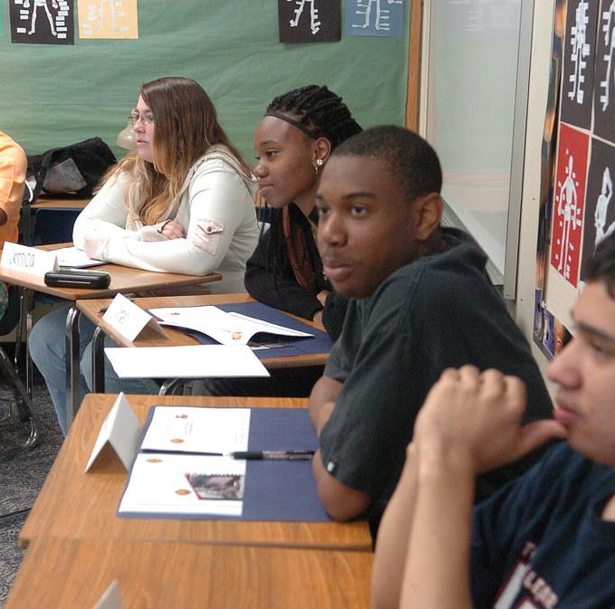
Choice & Voice: Motivating SLIFE students through critical literacy
AKA: Motivation through critical literacy for authentic purposes & authentic audiences

Slide 2
—Paulo Freire
“Literacy is an active phenomenon. Its power lies not in a perceived ability to read and write, but rather in an individual’s capacity to put those skills to work in shaping the course of his or her own life..”

Slide 3
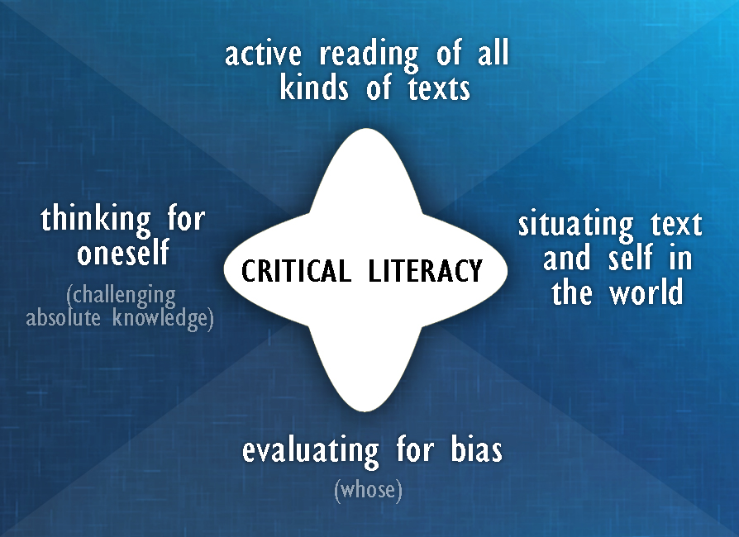
https://ml2secondlanguageliteracies.files.wordpress.com/2016/09/rebecca-zak-slide-5-critical-literacy-chart.jpg

Slide 4
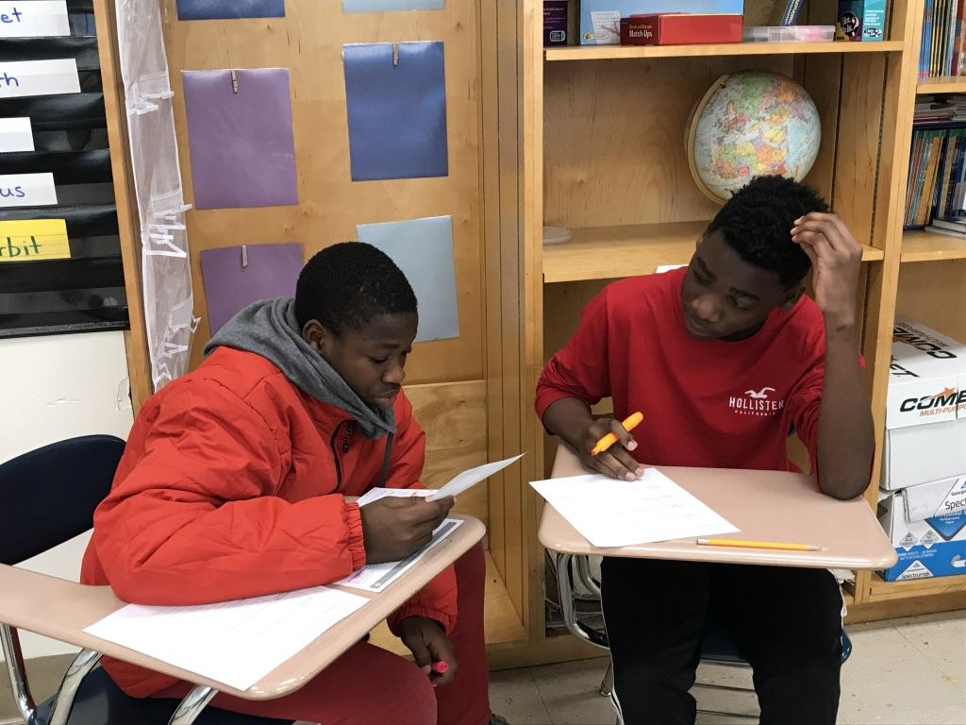
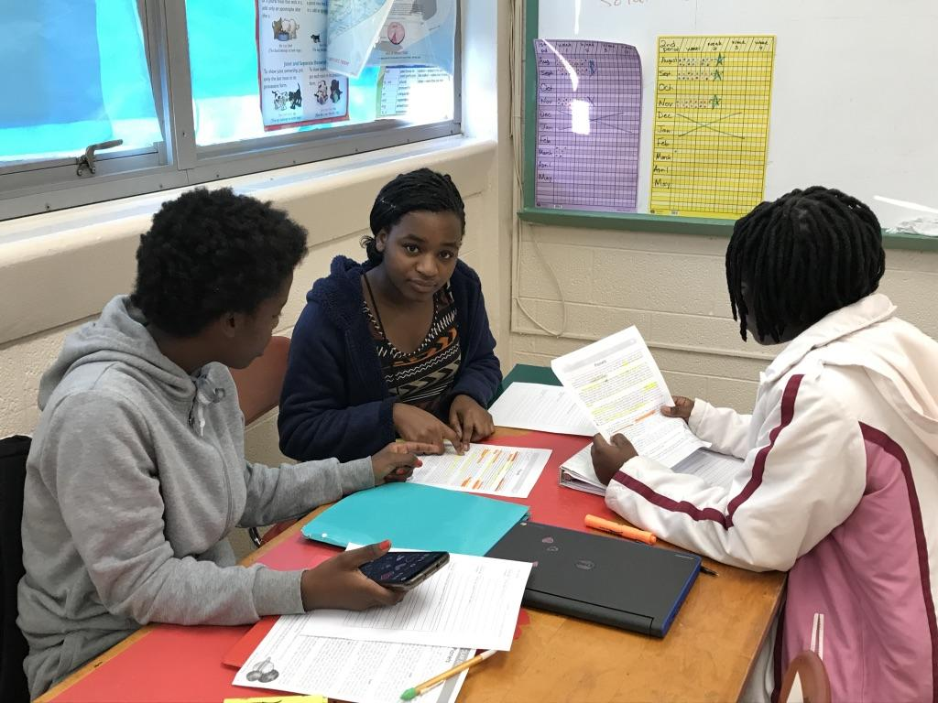
Our story
Notes:
inner-city school challenged by de facto racial segregation
predominantly African American population,
About 10% of the students are refugee and
migrant ELs from Central Africa, the Middle East, & Central America, and the Middle East
Nearly 90% of the school population receives free or reduced-price meals.

Slide 5
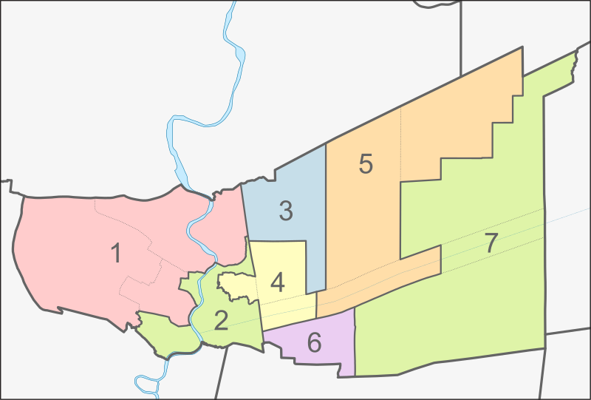
Relevant topic: New schools & rezoning
Notes:
The construction of two new middle schools will require some enrollment redistricting from existing schools, according to an email sent to parents by the Superintendent.
Hearings were to be held at several of the affected schools, including ours.
NAACP got involved because the two schools were in predominantly White neighborhoods while our students would possibly lose the only middle school in their community.

Slide 6
Existing Knowledge - Hearsay & Rumors
Sam: My mother say we ain’t going nowhere. We still going here.
Waseme: That ain’t right. They gonna make us go to Riverbend, gonna take an hour to get there.
Rashida: How you know? Your momma don’t know.
Notes:
Perfect for persuasive and argumentative writing - a TN standard

Slide 7
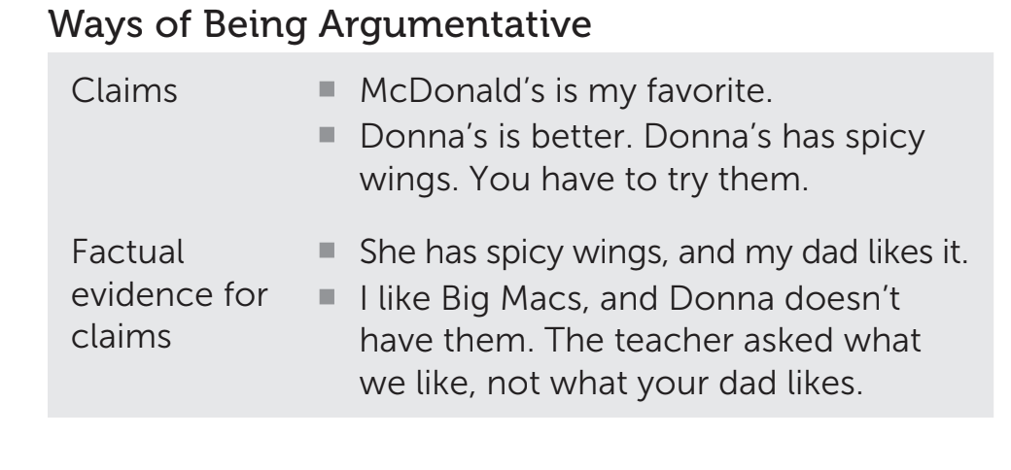
Existing Knowledge - argumentation

Slide 8
Interest Driven Literacy Practices
Class watched and listened to news reports and clips of town hall meetings.
Class analyzed these multimodal texts for claims and evidence together in discussion.
Finally, the class read and analyzed local newspaper articles about the rezoning proposal for claims and evidence.
Notes:
Although the articles were written above their reading levels, students persevered
and read the entire texts because of their own intense interest in the outcome and scaffolding that was provided.

Slide 9
Evidence of critical reading & thinking
Conversations became more fact based and less opinion based.
Rashida: Do you know, if we do go to that school, we’ll have to get up at 6:00 to ride the bus and it’s gonna take 40 minutes to get there?
Waseme: Look at this! They built those new schools over there on the North Side and the last time the South Side got a new middle school or high school was in 1950. That’s older than my grandma!

Slide 10
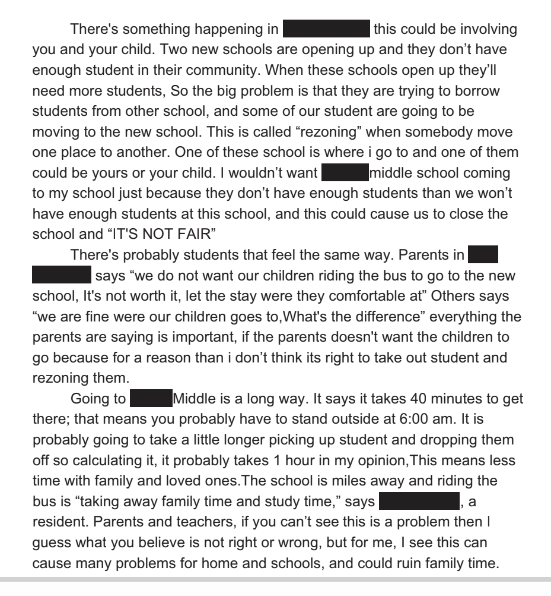
Final Project:
An appeal to parents & teachers who would attend the hearings

Slide 11
Relevant
Student-generated topic
Student-generated topic.
Existing
Uncover students’ existing knowledge.
Authentic
Read authentic texts. Write for an authentic audience.
Critical
Question what you hear and read, find evidence.
Honoring
Co-create to honor their worlds and words (Paulo Freire).

