Slide 1
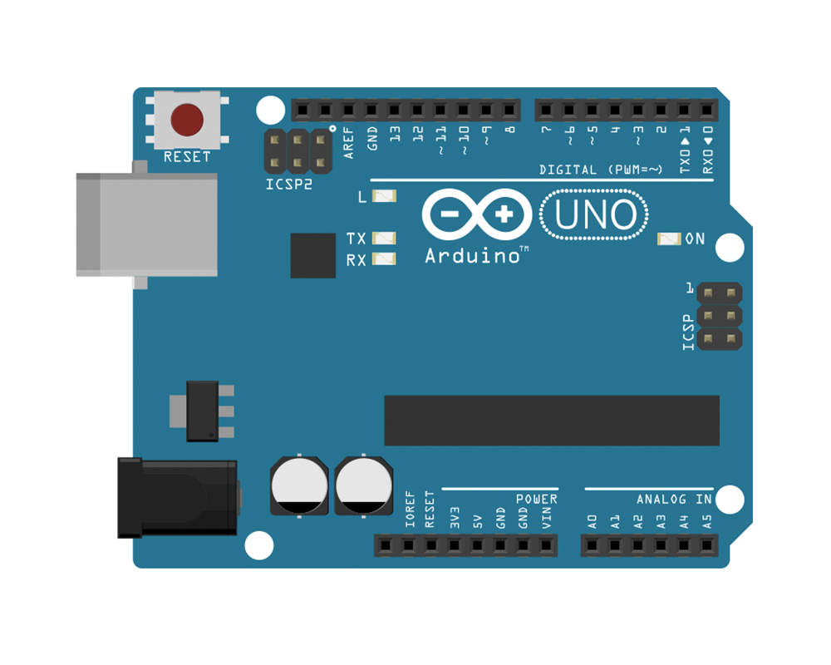
10
2
VCC
INT1
MISO
GND
SCK
SCX
VCC
SDX
MOSI
SDO
BMI160
CSB
GND

Slide 2
SDA
SCL
2
VCC
INT1
GND
SCX
SDX
SDO
BMI160
CSB
5V
GND

Slide 3
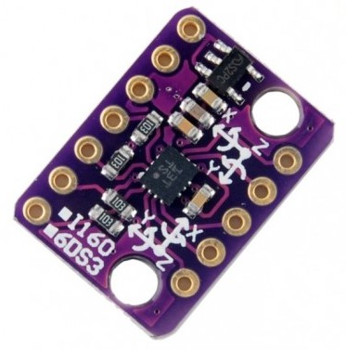
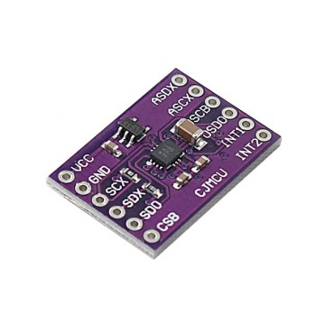
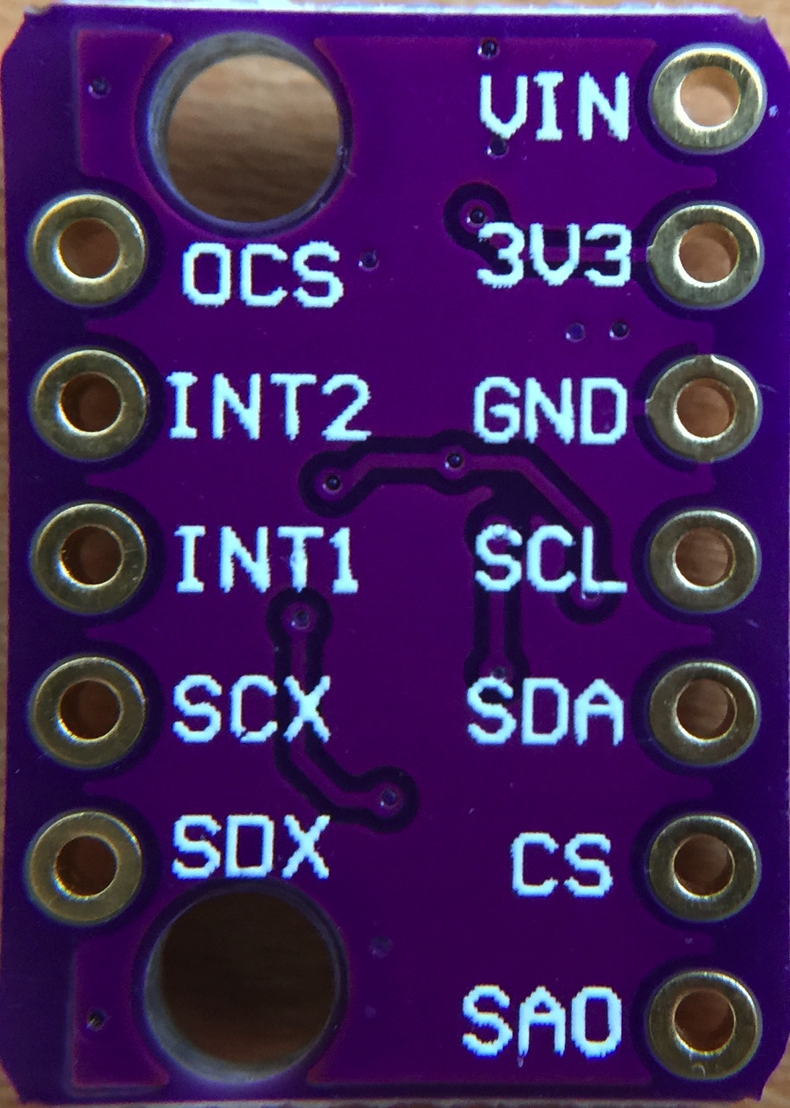
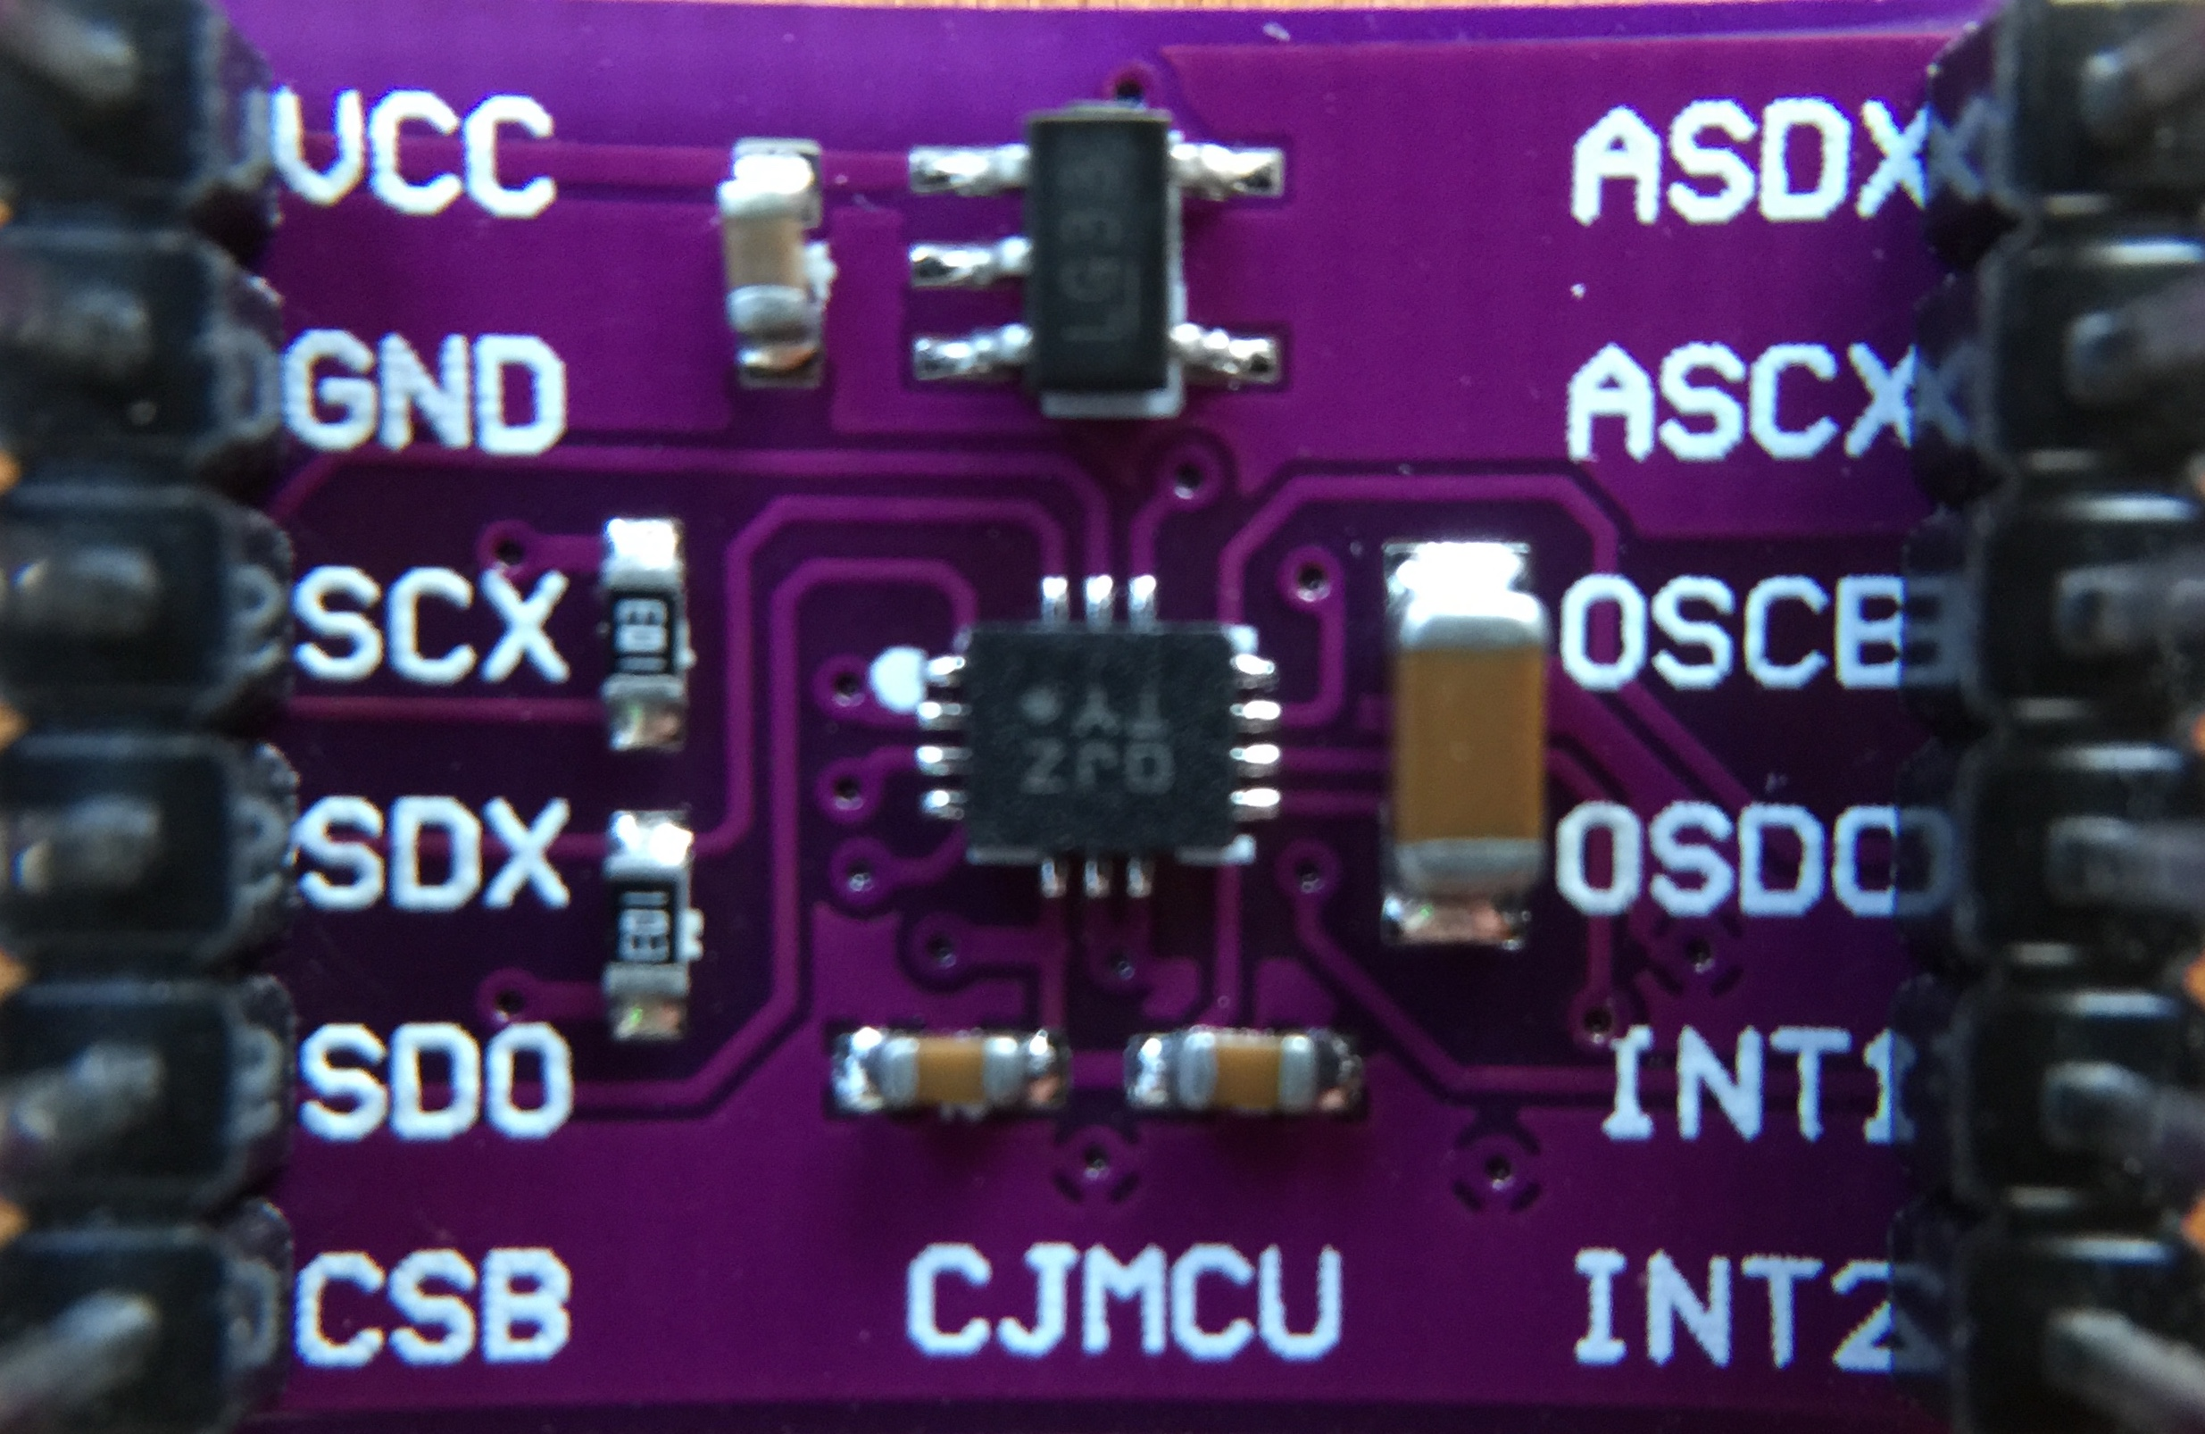
SPI
I2C
VCC
VCC
GND
GND
SCK
SCL
MOSI
SDA
MISO
Address select *1
SS
-
INT
INT
*1 GND for default address 0x68

Slide 4
VCC
GND
SCX
SDX
SDO
CSB

