Slide 1


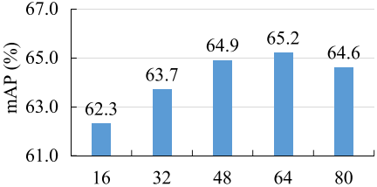
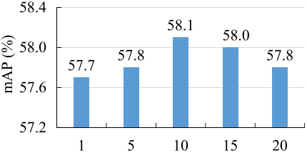
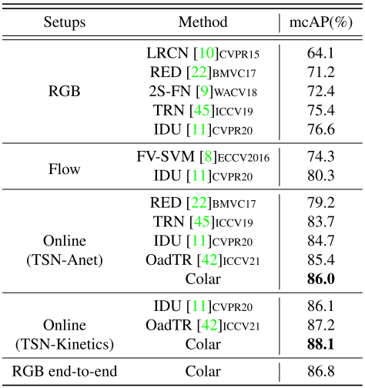








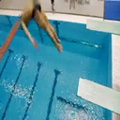
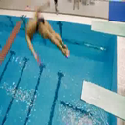
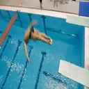

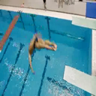
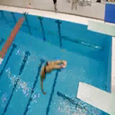
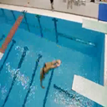
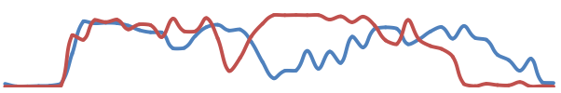

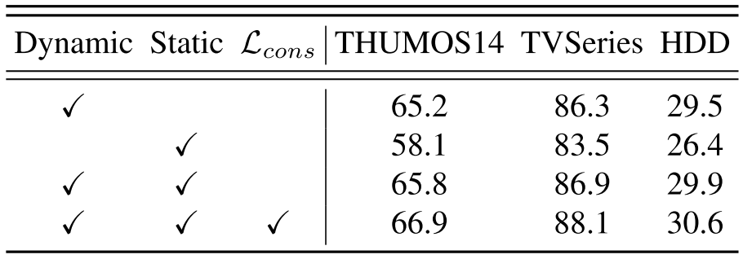
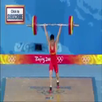
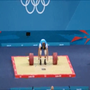
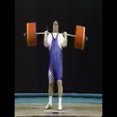
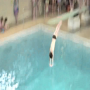
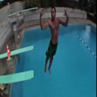
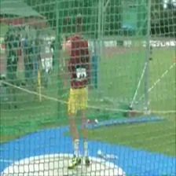
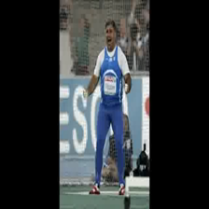
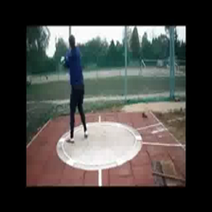
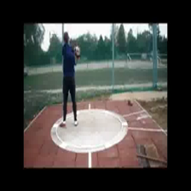
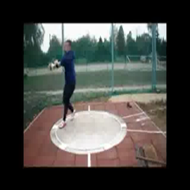
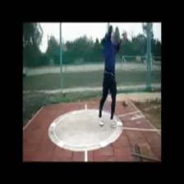
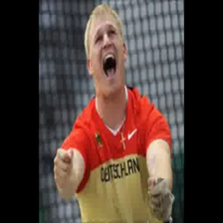
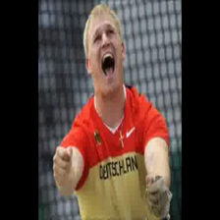
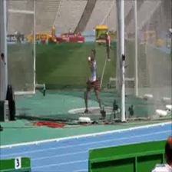
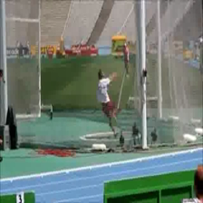
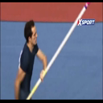
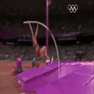
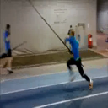





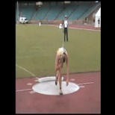



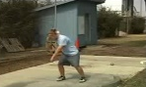














Colar: Effective and Efficient Online Action Detection by Consulting Exemplars Le Yang, Junwei Han, Dingwen Zhang School of Automation, Northwestern Polytechnical University, China
GitHub
Motivation
Existing works strive to learn a coherent representation for all frames belonging to the same category.
Even frames from the same category can exhibit large varieties.
We propose to select representative frames, form category exemplars, and guide online action detection.
Experiments
easy to follow.
Comparison experiments
Using both RGB features and flow features, Colar achieves state-of-the-art performance on three benchmarks, THUMOS14, TVSeries and HDD.
Using only video frames, Colar runs much faster and achieves competitive results.
Ablation experiments
The dynamic branch and the static branch are complementary to each other.
Figure 3. Ablation studies and temporal length (left) and exemplar number (right).
OadTR
Background
Volleyball Spiking
Background
Static score
1
Dynamic score
Self-attention at each frame
Anticipating future
0.5
0
Colar
(a) Detection scores from intra-segment branch and intra-category branch.
······
Historical exemplars
1
Background
Hammer Throw
Background
Hammer Throw
Category exemplars
0
Score
-1
Figure 1. Superiority of our proposed Colar method.
Similarity
…
(b) Attention weights in intra-segment branch.
Method
Figure 4. Qualitative analysis of the proposed Colar method.
Classifier
Conclusion
The category exemplar makes Colar effective and efficient.
Category exemplars can capture disverse distributions within actions.
Diverse distributions are easier to learn than previous coherent distributions.
Category exemplars are extensively trained, thus, more discriminative.
Ordinary sample only influences one iteration for a training epoch.
Dynamic branch, along with the consistency loss, alleviates the optimization process.
Similar efficiency as mutual learning.
$$μ1$$
$$μ2$$
$$μ3$$
$$μ4$$
Historical feature f
Dynamic Branch
Transform to the key space and the value space.
Measure pair-wise similarity
Aggregate value features
OAD based on historical features.
Static Branch
Transform to the key space and the value space.
Measure pair-wise similarity
Aggregate category feature
OAD based on exemplar features.
Dynamic Branch
…
Network
Static Branch
$$e_{0}$$
$$e_{1}$$
$$e_{c}$$
Category feature e
$$ν_{0,1}$$
$$ν_{0,2}$$
$$ν_{c,1}$$
$$ν_{c,2}$$
…
key
…
Classifier
value
Similarity
Similarity
Score
weight
Shot Put
Shot Put
Golf Swing
Golf Swing
Shot Put
Figure 2. Framework of the proposed Colar method for online action detection.

