Slide 1
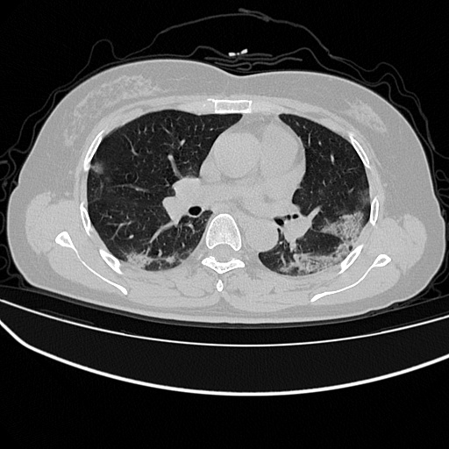







Img
GT
$$loss_{overall}$$
74.57%
$$loss_{BCE}$$
$$loss_{BCE+Dice}$$
68.74%
72.82%

