Slide 1
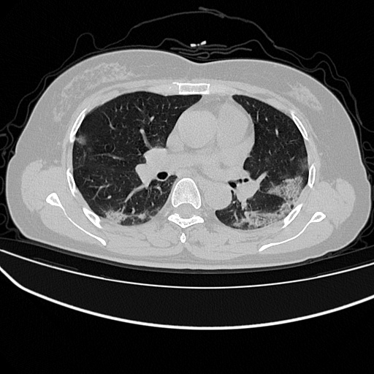


SAR Attention
SAR Attention
Residual blocks 3x3
SAR Attention
Conv 3x3
Max Pooling 2x2
De-Conv 3x3
Residual Blocks
Decoder Blocks
SAR Attention
MRC Block
RMP Block
1x1 Conv
3x3
De-Conv
1x1 Conv
3x3 Conv
3x3 Conv
Pretrained Feature Encoder
Context Extractor
Feature Decoder

