Slide 1
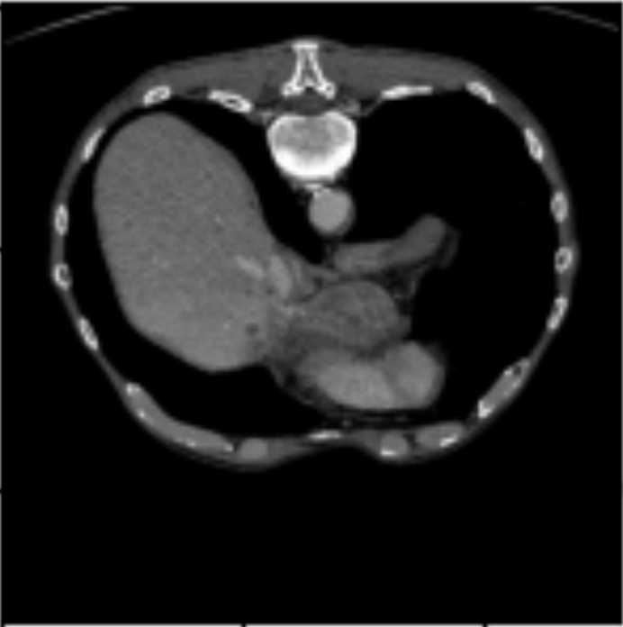





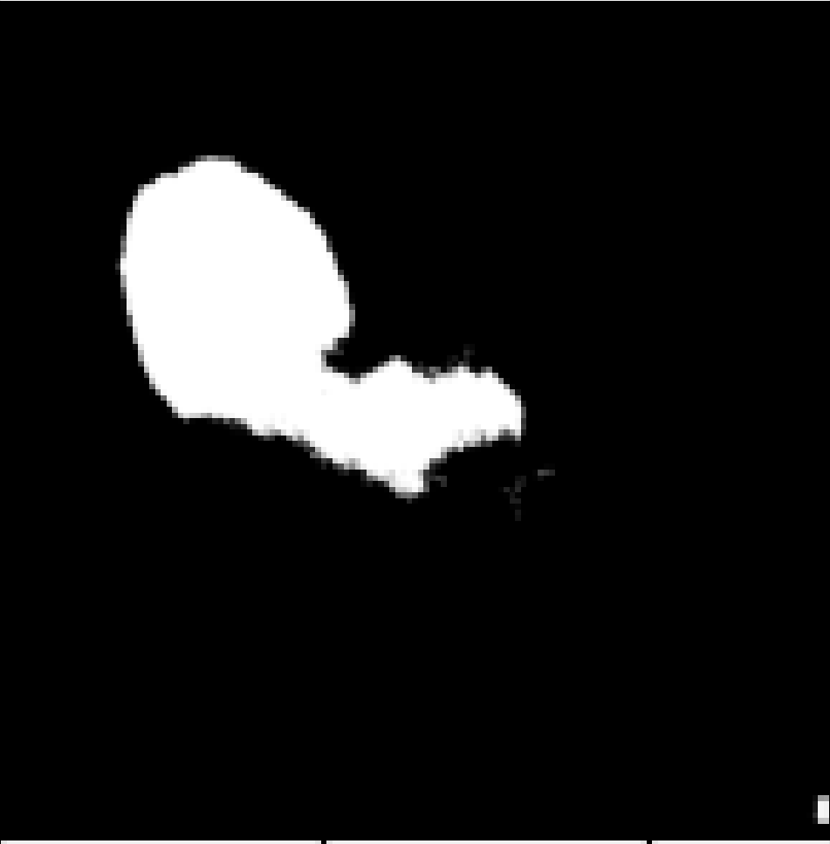
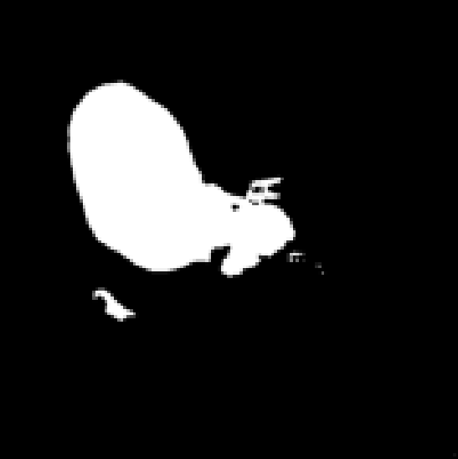
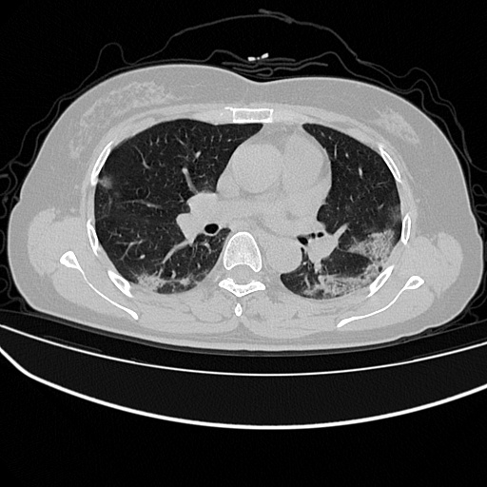







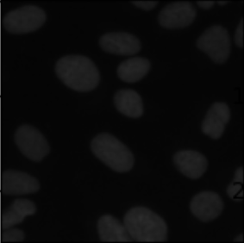


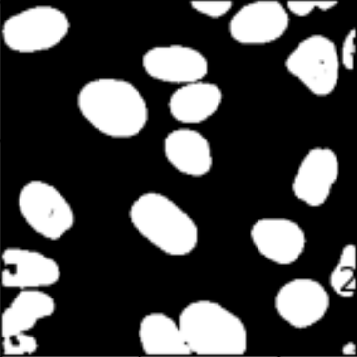
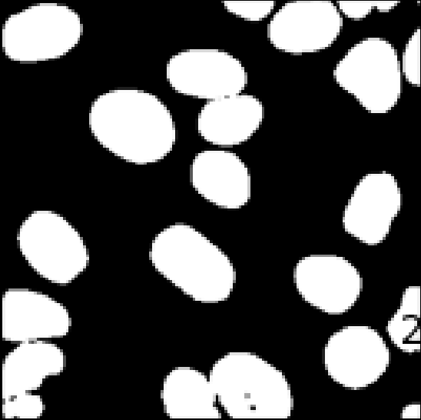
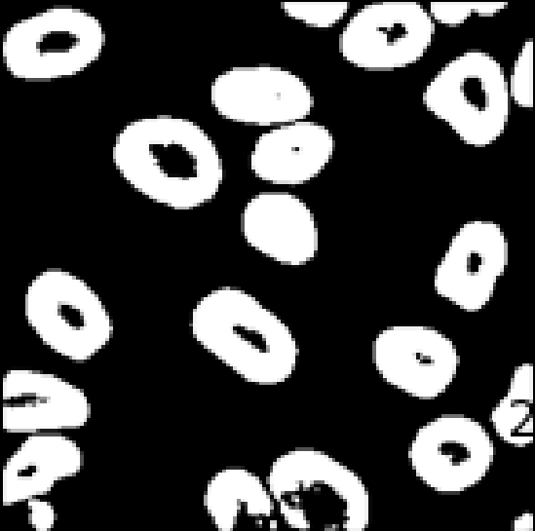
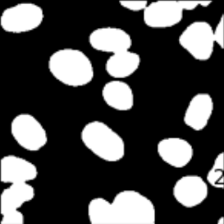
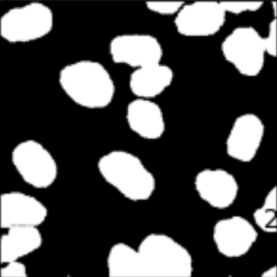
Img
GT
Our Method
Att U-Net
U-Net++
U-Net
CE-Net
FCN32s
Liver
91.65%
87.76%
87.81%
86.15%
87.21%
83.00%
COVID19
74.57%
70.73%
67.99%
66.17%
72.69%
60.45%
DSB Cell
89.65%
87.76%
87.81%
86.15%
87.21%
83.00%

