Slide 1


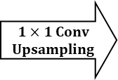



RMP Block
Input
1024 channels
Concatenate
5120 channels
Output
1024 channels
$2×2$ pooling
$1×1$ Conv
Upsampling
$3×$3 pooling
$1×1$ Conv
$5×5$ pooling
$6×6$ pooling

